Slide 1
How do I create a worksheet?
03/02/2021

Slide 2

Objectives
Creating resources for learning – what needs to be considered? (Purpose, learning intent, curriculum/qualifications, pupils …)
What’s good practice? A review of guidance for resource production and teaching.
Resource type and learning need – what should be used?
The basics – construction, type, use, language and images.
Writing questions – watch out for the pitfalls!
Progression – how much depth?
Considering assessment (low stakes testing > examinations)

Slide 3

Where do I start?
How do I create a worksheet?
What’s best to support learning?
What depth of content do I cover?
How do I write questions?

Slide 4

Considerations …
Rationale for the resource (purpose, learning intent)
Curriculum/qualification requirements
Teaching strategies (pedagogy)
Pupil needs
Construction – type … use … language …
Use of command words
Sentence length / use of illustrations, charts and photos
Being able to answer the questions!
Assessment (learning impact)

Slide 5


Effective pedagogy approaches?
Effective pedagogies give serious consideration to pupil voice.
Effective pedagogies depend on behaviour (what teachers do), knowledge and understanding (what teachers know) and beliefs (why teachers act as they do).
Effective pedagogies involve clear thinking about longer term learning outcomes, as well as short-term goals.
Effective pedagogies build on pupils’ prior learning and experience.
Effective pedagogies involve scaffolding pupil learning.
https://assets.publishing.service.gov.uk/government/uploads/system/uploads/attachment_data/file/329746/what-makes-great-pedagogy-nine-claims-from-research.pdf

Slide 6


Effective pedagogy approaches?
6. Effective pedagogies involve a range of techniques, including whole-class and structured group work, guided learning and individual activity.
7. Effective pedagogies focus on developing higher order thinking and metacognition, and make good use of dialogue and questioning in order to do so.
8. Effective pedagogies embed assessment for learning.
9. Effective pedagogies are inclusive and take the diverse needs of a range of learners, as well as matters of student equity, into account.
https://assets.publishing.service.gov.uk/government/uploads/system/uploads/attachment_data/file/329746/what-makes-great-pedagogy-nine-claims-from-research.pdf

Slide 7
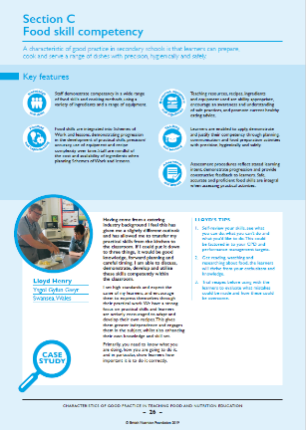
Characteristics of good practice
Secondary
Developing professional competence
Being an accomplished food teacher
Taking a whole school approach
Teaching the curriculum
Managing the subject
Good food hygiene and safety practices
Food skill competency
Food provenance know-how
Nutrition proficiency
Consumer awareness
Food science aptitude
Define good practice (as a teacher, whole school, lesson planning, practical classes, food skills, theory content)
Case studies
Top tip
Be secure in your own knowledge and skills
https://www.foodafactoflife.org.uk/professional-development/ppd-toolkit/primary/characteristics-of-good-practice-in-teaching-food-and-nutrition-education-in-primary-schools/
https://www.foodafactoflife.org.uk/professional-development/ppd-toolkit/secondary/characteristics-of-good-practice-in-teaching-food-and-nutrition-education-in-secondary-schools/

Slide 8

Guidelines for producers and users of school education resources about food
Voluntary guidelines which can be adopted as part of a good practice approach by those that produce and use education resources for schools about food throughout the UK.
Further support the work of food education in schools, ensuring that children and young people use up-to-date, evidence-based and high-quality resources to support their learning about food.

Slide 9

Guidelines for producers and users of school education resources about food
The guidelines aim to:
set and promote high standards, expectations and requirements for the production of resources in relation to food education for schools;
promote consistency of information;
ensure resources support the curriculum and qualifications (England, Northern Ireland, Scotland and/or Wales), as well as the Core competences for children and young people;
promote best practice, supporting teachers and enabling children and young people to learn.

Slide 10
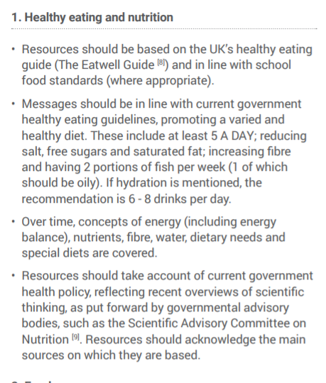
Guidelines
There are 14 guidelines:
five covering key content …
Healthy eating and nutrition
Food provenance
Food preparation
Food choice
Healthy lifestyles

Slide 11
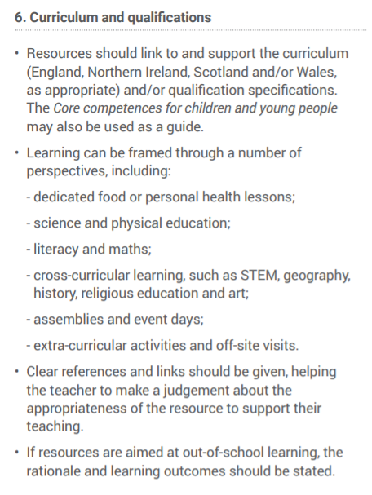
Guidelines
nine focusing on …
Curriculum and qualifications
Supporting teaching and learning
Evidenced based
Campaigning, fundraising and marketing
Original works and adaptations
Design and production
Consultation, testing and feedback
Society, culture and religion
Contact details

Slide 12
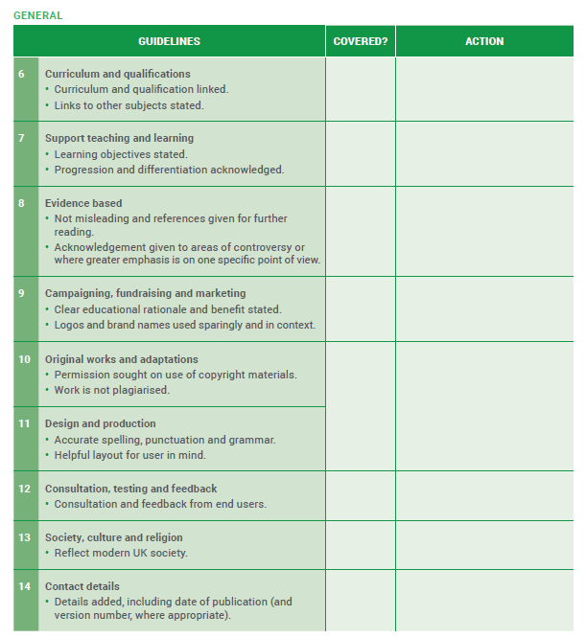
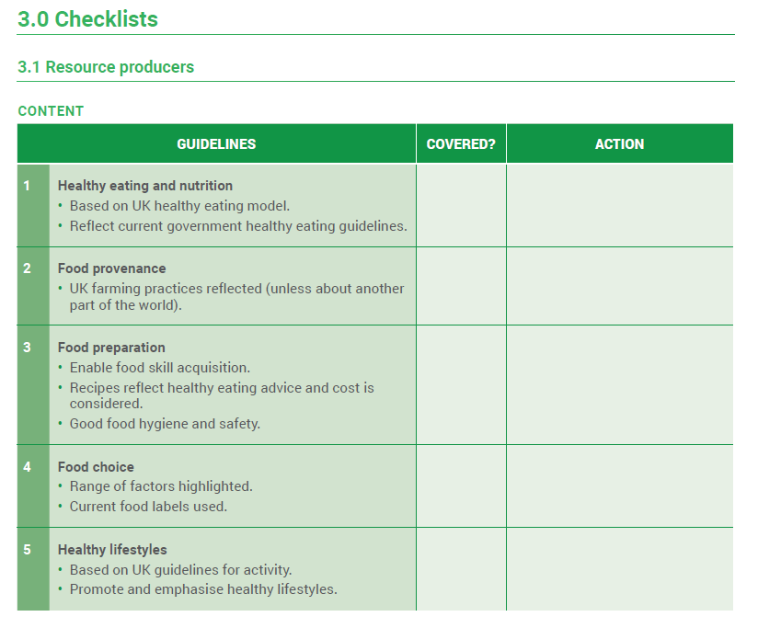
Guidelines
Top tip
Use guidelines as a useful reference to check your work (sometime the most obvious)

Slide 13
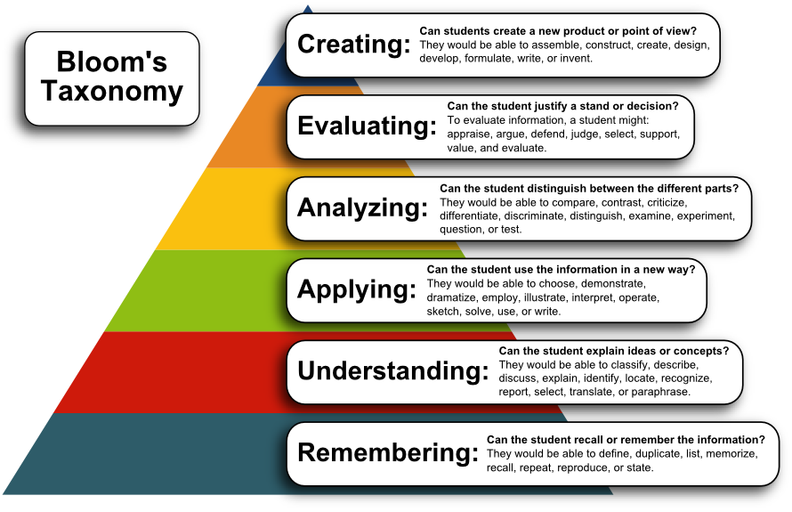
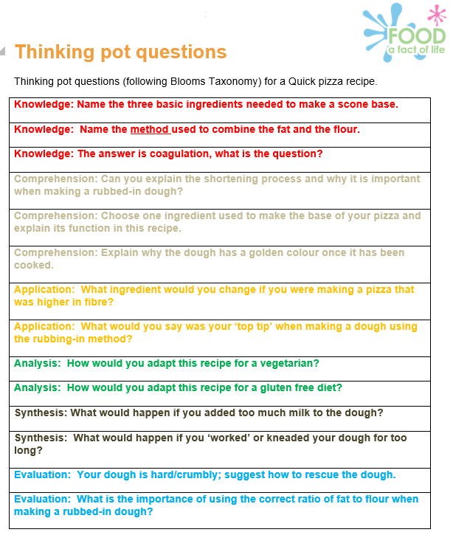
The questions are cut up and put into a ‘pot’.
When pupils have finished an activity (in this case finished making a scone based pizza), they take a question from the pot and answer it.

Slide 14
Content: An example
SOW webinar 2019 – building block – look at each and consider resources/approach needed
Pupils should be taught to:
use the basic principles of a healthy and varied diet to prepare dishes.
apply the basic principles of a healthy and varied diet.
apply the principles of nutrition and health.
Evaluate
Dietary needs and health (ages and stages, special diets)
Apply
Energy and nutrients (source, function and amount)
Name and list
The eatwell guide and 8 top tips for healthy eating
5 A DAY
Food and drinks

Slide 15
Learning objectives (intent)
Know
Understand
Be familiar with
Appreciate
Be aware of
Learn the basics of
Believe
Obtain a working knowledge of
Realise the significance of
Be interested in
List
Give X examples of
State / Name
Describe /Explain
Compare
Outline
Evaluate
Identify
Analyse
Summarise
What the learner is able demonstrate to others
These help to create a resource, especially activities, tasks and questions
AVOID

Slide 16

Teaching styles and approaches
Lecturing and presenting
Demonstrating
Experiments and investigations
Cooking and food preparation
Active learning – actively doing, not listening (more engaged in the activity/learning)
Group work
Peer instruction

Slide 17

What type of resource? Why?
Worksheets – capture learning
Presentations – provide information
Cards, e.g. flash cards – active learning
Displays and posters (visual) – provide info
Videos – provide info (interactive video?)
Interactive tools, e.g. nutritional analysis
Recipes and menus – instruction, case study
Investigations and experiments – enquiry
Tasting – active, sensory, analysis …
Stories – context, real life or not!
Books, magazines, internet searches – context, analysis

Slide 18

Provision of information - what format?
Note taking (from a presentation/talk)
Writing frames / charts / tables
Questions – closed (multiple choice) and open
Comprehension exercise, based on text/case study
Data charts and graphs (create and/or read/use)
Menus and food packaging
Counting
Sequencing
Matching and missing items/words
Sorting, e.g. groups, odd one out
Text and illustrations/photographs

Slide 19
Do you know the question?
Top tips
Start with the answer, then write the question.
Can you answer the question?
Can you name the groups of the Eatwell Guide?
Yes
No
Think about the different foods that provide fibre.
No answer needed, as it says to think only.
Name as many vegetables as you can.
Verbal or written? List, group? Same marks for 5, as for 100?

Slide 20
Command words (similar to objectives)
Top tips
Command words give direction to pupils.
They support learning objectives.
They guide your assessment, e.g. list 5, calculate, describe …
Analyse
Argue
Assess
Calculate
Comment
Compare
Consider
Contrast
Define
Describe
Develop
Discuss
Estimate
Evaluate
Examine
Explain
Give
Identify
Illustrate
Interpret
Justify
List
Name
Outline
Prove
Review
State
Suggest
Which
https://www.aqa.org.uk/resources/food/gcse/food-preparation-and-nutrition/teach/command-words

Slide 21
Bloom’s - Questions
Knowledge – List, Name, State
Understanding (comprehension) – Explain, Compare and contrast, Outline, Summarise
Application – Interpret, Apply, Explain, Illustrate how, Based on chart, suggest ways to solve
Analysis – Analyse, effects, compare
Synthesis – Design, Create, Recommend, Support with evidence
Evaluate – Evaluate, Decide, Assess, Test

Slide 22
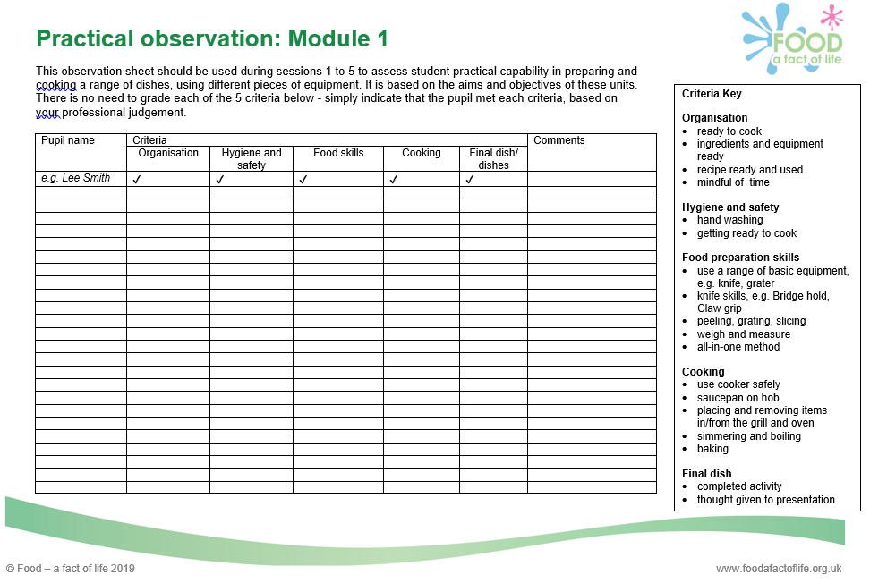
Assessment
Low stakes – evaluation that has little impact on course marks, e.g. hand-ups, Kahoot!, online quizzes
Worksheets – marks known for each question? (Closed/open)
Practical work – how is success rewarded? What criteria is used?
Role of self assessment
Homework
Start and end of module/term tests (written/practical)
Formal examinations

Slide 23
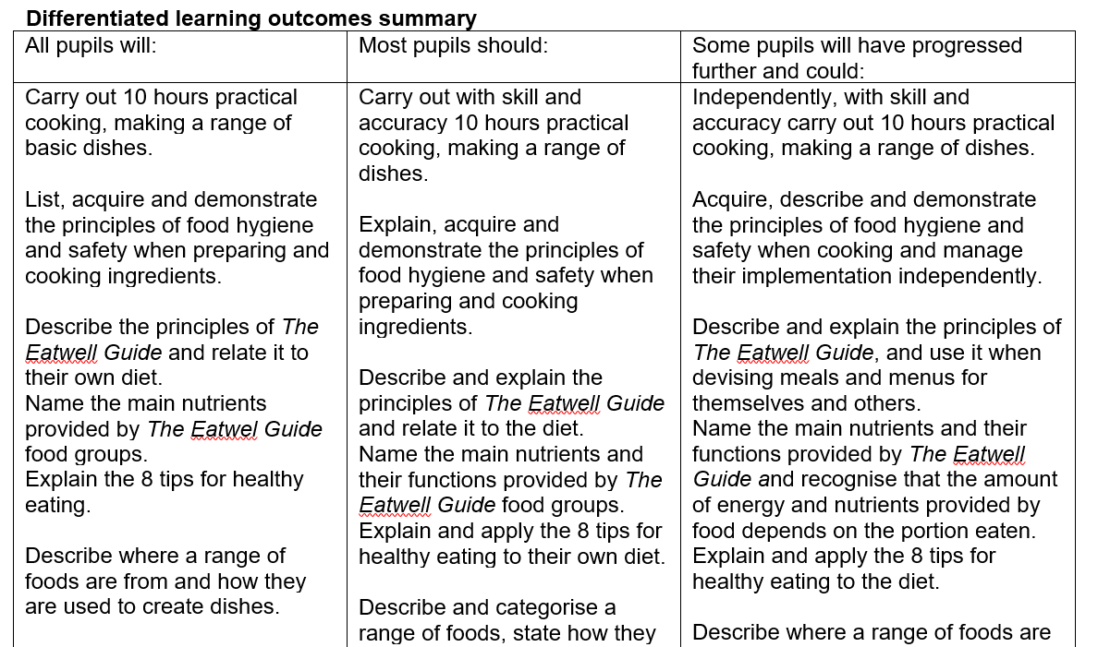
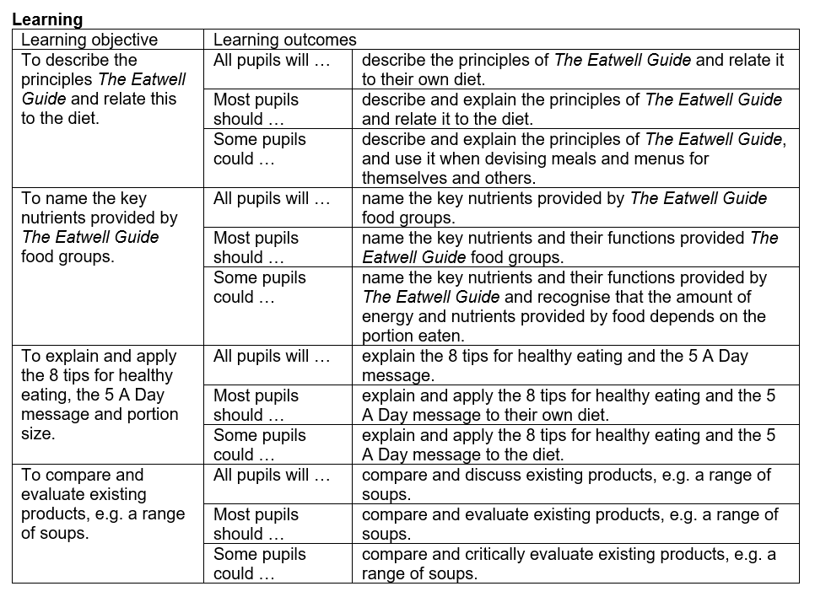
Differentiation
You may not need lots of different resources (e.g. worksheets)
Review your Schemes and lesson plans – what have you already stated?
Can learning be extended? Do additional resources need to be created, or can questions/tasks be differentiated?
Consider ‘Blooms’ (remembering > applying > creating)

Slide 24
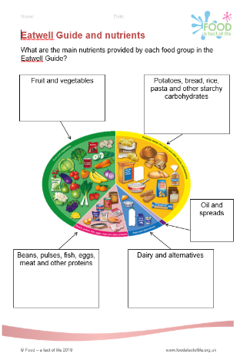
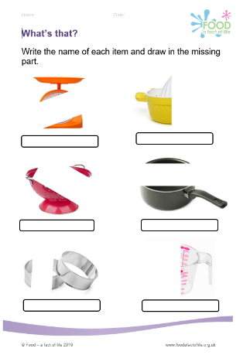
Ok, so what about a worksheet?
Name, date, group …
Font size (readability)
What’s it for? Is it needed?
Can it be answered based on previous learning? If not, else is needed? Other info needed? Calculator?
Consider different command words and question types, e.g. sorting, matching, missing word.
Use real life examples (menus/labels) and/or data charts.
Is the assessment (marking) clear?
Have you proof read it?
Can you answer it?

Slide 25


Take home tips …
Be secure in your knowledge and skills
Always remember the intent (objectives) and impact (assessment)
Focus on the pupils you teach – you will know them and their learning needs
Focus on language (grammar, spelling and get to the point …)
Be creative
Use existing materials and resources as a ‘starter’ – you can always adapt
Don’t forget … name, date, group … (sometimes it’s the simple things that trip us up!)
Be secure in your knowledge and skills
Always remember the intent (objectives) and impact (assessment)
Focus on the pupils you teach – you will know them and their learning needs
Focus on language (grammar, spelling and get to the point …)
Be creative
Use existing materials and resources as a ‘starter’ – you can always adapt
Don’t forget … name, date, group …

Slide 26
How do I create a worksheet?
For further information, go to:
www.foodafactoflife.org.uk

