Slide 1
Watercress

Slide 2
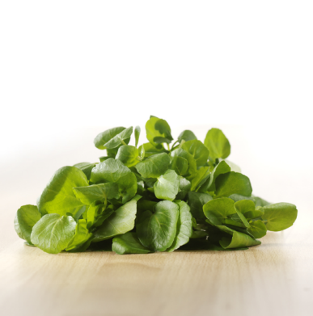
What is this?
This is watercress.
Watercress is a vegetable.

Slide 3
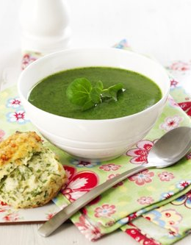
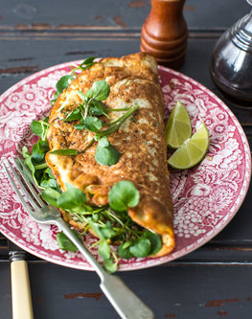
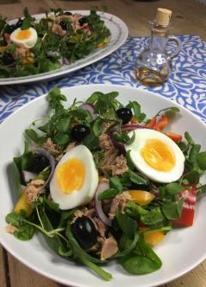
What’s in these?
They all use watercress.

Slide 4
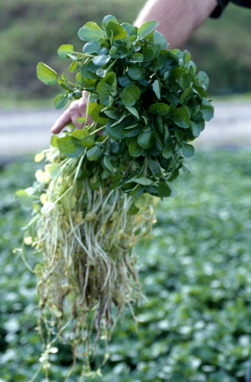
Where does watercress come from?
Watercress is grown in flowing water.
The seed is grown in watercress beds that are supplied by flowing spring water on the farm.
Watercress grows in the UK, between March and November.

Slide 5
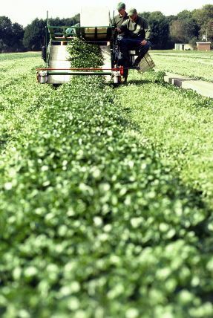
Where does watercress come from?
Watercress is the leaves and the stem (stalk) of the plant.
Watercress is picked when ready.
Have you seen watercress growing before?

Slide 6
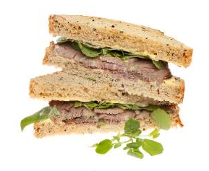
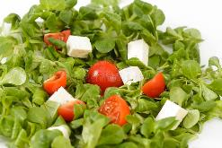
Dishes
Watercress can be eaten raw - just wash first.
Watercress can be used in lots of dishes.

Slide 7
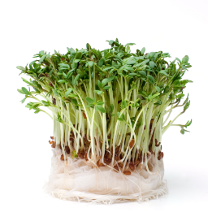
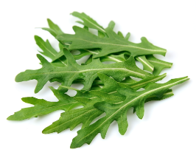
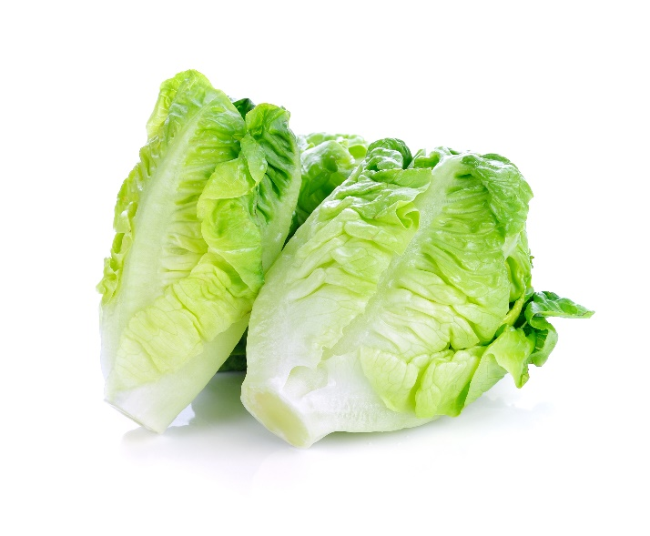
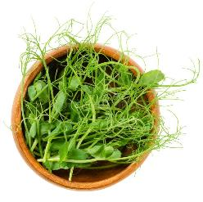
Similar
Salad cress, wild rocket, lettuce and pea shoots are similar to watercress.
They are all leaves of a plant.

Slide 8


Summary
Watercress is grown for our food.
Watercress
Lots of dishes use watercress.

Slide 9
Do you like watercress?

Slide 10
Watercress
For further information, go to:
www.foodafactoflife.org.uk
This resource meets the Guidelines for producers and users of school education resources about food.

