Slide 1
Watercress

Slide 2
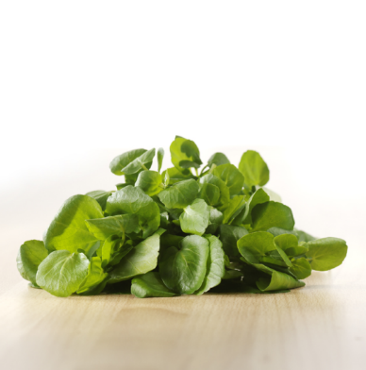
What is this?
This is watercress.
Watercress is a leafy green vegetable.

Slide 3
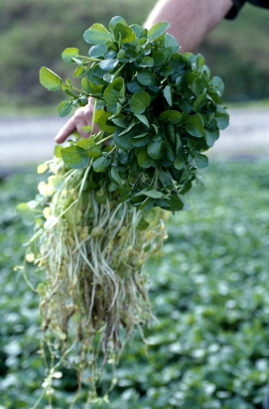
Where does watercress come from?
Watercress is grown in flowing water.
The seed is grown in watercress beds that are supplied by flowing spring water on the farm.
Watercress grows in the UK, between March and November.

Slide 4
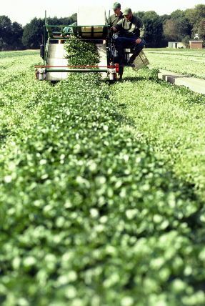
Harvesting
Watercress is the leaves and the stem (stalk) of the plant.
Watercress is picked when ready from the watercress beds.

Slide 5
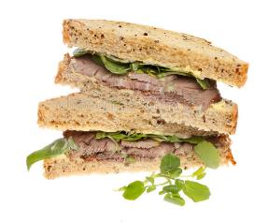
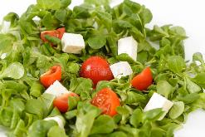
Dishes
Watercress can be eaten raw - just wash first.
Watercress can be used in lots of dishes.

Slide 6
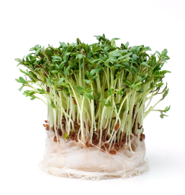
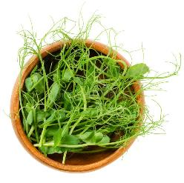
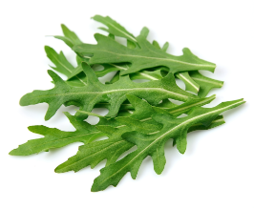
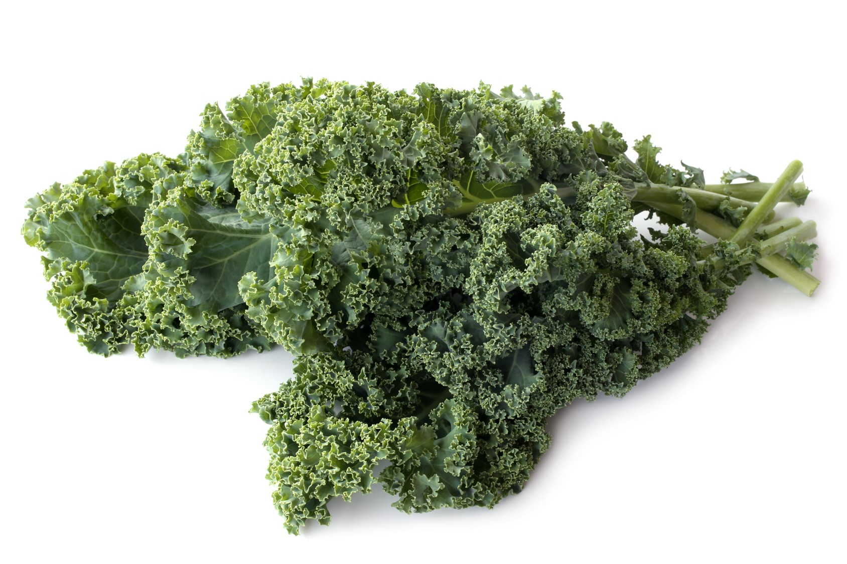
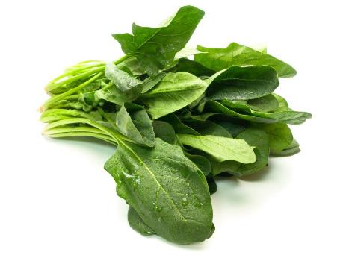
Similar
Salad cress, pea shoots, kale, spinach and wild rocket are similar to watercress.
They are all leaves of a plant.
Pea shoots
Salad cress
Wild rocket
Kale
Spinach

Slide 7


Summary
Watercress is grown for our food.
Watercress
Lots of dishes use watercress.

Slide 8
Watercress
For further information, go to:
www.foodafactoflife.org.uk
This resource meets the Guidelines for producers and users of school education resources about food.

