Slide 1
Oats

Slide 2
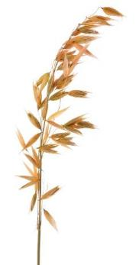
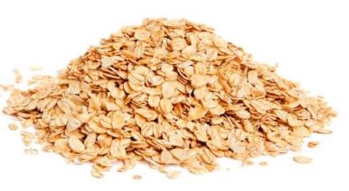
Overview
This presentation gives an overview and explanation of:
farming oats in the UK;
the processing of oats;
oat-based products.

Slide 3
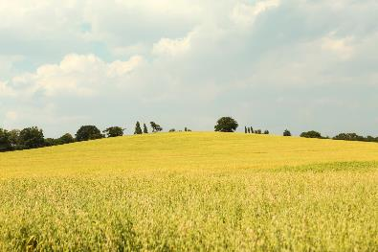
Farming oats
Oats are grown on about 170,00 hectares of land in the UK.
Oats are the third main crop grown in the UK and farmers produce on average around one million tonnes per year.
In the UK, oats are planted in September and harvested the following August.
The harvesting process removes the grains from the plant.

Slide 4
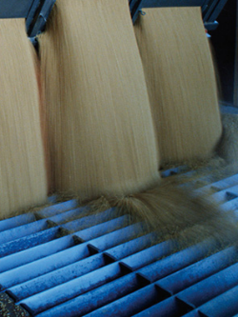
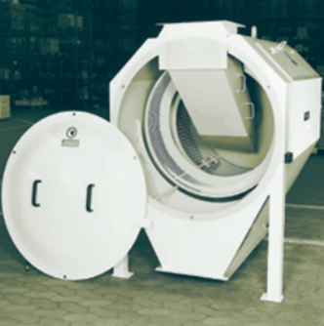
Processing oats
Grains of oats from the farm are processed into food and drink products.
At the mill the incoming oats are sampled and tested for moisture content, specific weight and foreign matter.
The grain is cleaned and then stored in large grain silos.

Slide 5
The different stages at the mill

Slide 6
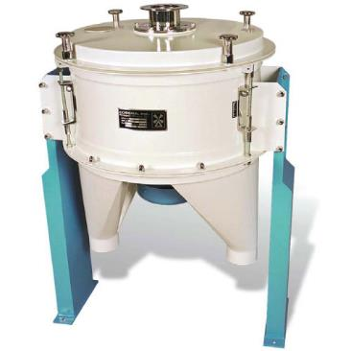
Processing oats
The oats need to be separated from the hull or husk and are fed into a high speed drum, where they separate on impact.
The hull or husks are ground and used for cattle and poultry feed.
To prevent spoiling, the oats pass through a heat and moisture radiator which removes all the moisture content and prevents the oat from sprouting.
The last stage of the milling process, shelled oats are rolled to produce oat flakes.

Slide 7
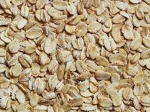
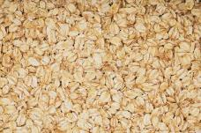
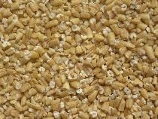
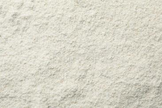
Types of oats
Oats are milled, steamed, heated and cooled in a kiln, which brings out the flavour. The oats are then rolled, cut or ground to produce flakes, oatmeal or flour.
Rolled oats - known as oat flakes.
Oatmeal - the tough bran has been removed and light baked, this can be coarse, medium or fine.
Pinhead oats - known as coarse oatmeal or steel cut oats.
Oat flour - finer than oatmeal, this is made by grinding and sieving oats.

Slide 8
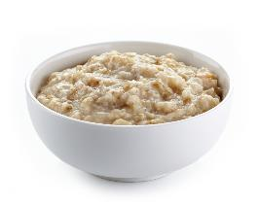
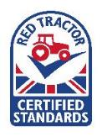
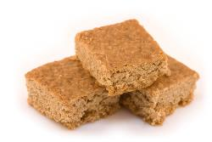
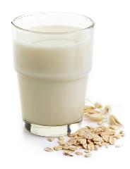
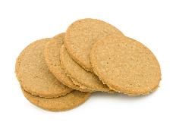
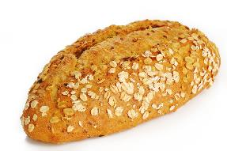
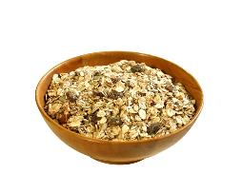
Oat based products
Food products may display The Red Tractor mark. This shows that it has been produced to a high set of quality standards.

Slide 9
Oats
For further information, go to:
www.foodafactoflife.org.uk
This resource meets the Guidelines for producers and users of school education resources about food.

