Slide 1
Oats

Slide 2
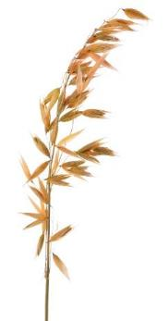
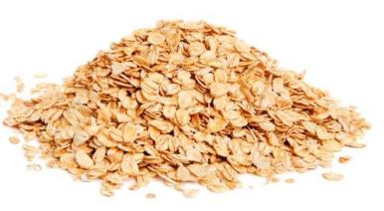
Overview
This presentation gives an overview and explanation of:
farming oats in the UK;
the processing of oats;
oat-based products.

Slide 3
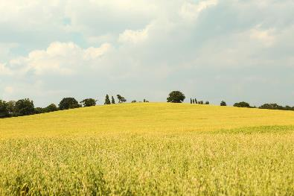
Farming oats
Oats are grown on about 170,00 hectares of land in the UK.
Oats are the third main crop grown in the UK and farmers produce on average around one million tonnes per year.
In the UK, oats are planted in September and harvested the following August.
The harvesting process removes the grains from the plant.

Slide 4
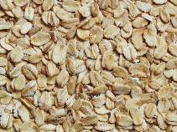
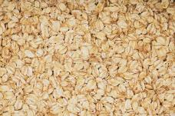
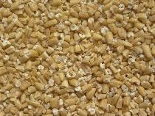

Types of oats
Oats are milled, steamed, heated and cooled in a kiln, which brings out the flavour. The oats are then rolled, cut or ground to produce flakes, oatmeal or flour.
Rolled oats - known as oat flakes.
Oatmeal - the tough bran has been removed and light baked, this can be coarse, medium or fine.
Pinhead oats - known as coarse oatmeal or steel cut oats.
Oat flour - finer than oatmeal, this is made by grinding and sieving oats.

Slide 5
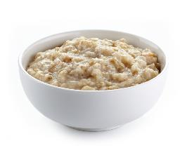

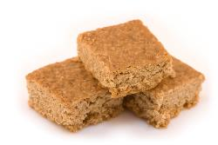
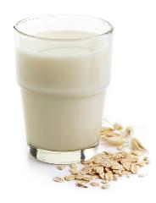
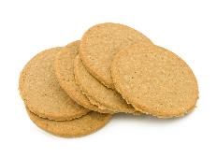
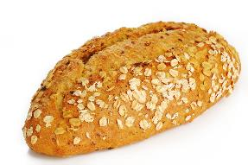
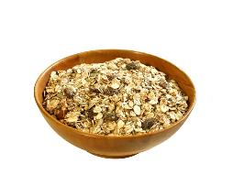
Oat based products
Food products may display The Red Tractor mark. This shows that it has been produced to a high set of quality standards.

Slide 6
Oats
For further information, go to:
www.foodafactoflife.org.uk
This resource meets the Guidelines for producers and users of school education resources about food.

