Slide 1
Barley

Slide 2
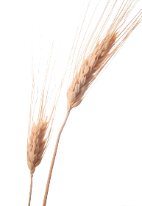
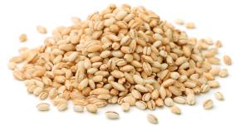
Overview
This presentation gives an overview and explanation of:
farming barley in the UK;
the process of malting;
barley in our diet;
food and drink made from barley and malt.

Slide 3
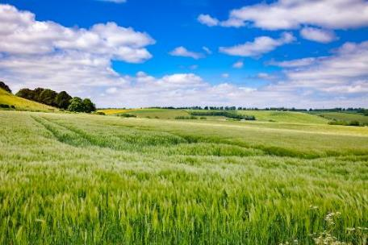
Farming barley
Barley is grown on about 1.2 million hectares of land in the UK.
Barley is the second biggest crop grown in the UK and our farmers produce on average around 6-8million tonnes per year.
Two thirds of the barley crop is planted with varieties that have malting potential.
In the UK, barley is planted in September and harvested the following August. The harvesting process removes the grains from the plant.
Nearly 20% of the UK barley crop is exported.

Slide 4
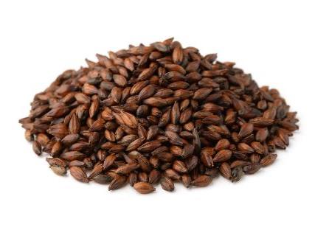

Malting barley
Malting is the process that turns grains of harvested barley from the farm into malted barley for food and drink.
The UK malting industry is the 4th largest in the world.
British malt is exported to more than 80 countries around the world. The important growth markets are in the Far East, South America and Eastern Europe.
Assurance and traceability schemes include – Red Tractor and Assured UK Malt.
Food and drink made from barley that has been through the scheme may display the Red Tractor mark. This shows that it has been produced to a high set of quality standards.

Slide 5
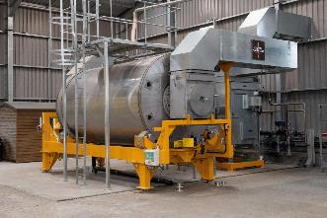
The different stages in malting barley
To make malt, cleaned barley, water, air and heat are needed. The simplified diagram below shows the different stages.
Steeping (soaking in water)
Germination (growing)
Kilning (drying)

Slide 6


Barley in our diet
Barley is part of the starchy carbohydrate group of the Eatwell Guide.
This group also includes potatoes, bread, rice, pasta and other starchy carbohydrates, and around a third of what we eat should come from this group.
The recommendations from the Eatwell Guide is to base meals on starchy carbohydrates, choosing wholegrain versions where possible.
Whole barley, which is uncommon in supermarkets but can be purchased online, is a wholegrain. We should be trying to eat more wholegrains in our diets.

Slide 7
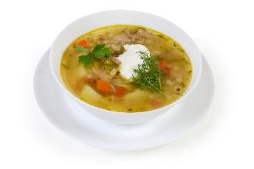
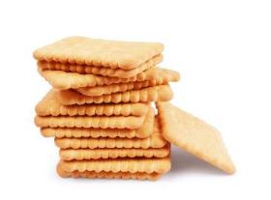
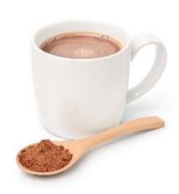
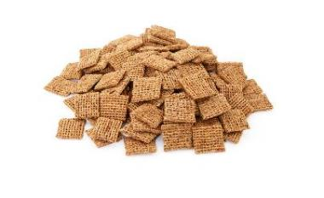
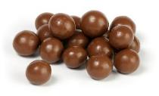
Food and drink made from barley and malt

Slide 8
Barley
For further information, go to:
www.foodafactoflife.org.uk
This resource meets the Guidelines for producers and users of school education resources about food.

