Slide 1
Barley

Slide 2
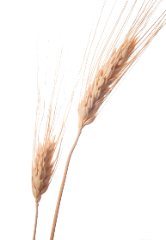
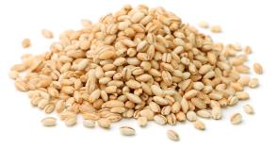
Overview
This presentation gives an overview and explanation of:
farming barley in the UK;
the process of malting;
barley in our diet;
food and drink made from barley and malt.

Slide 3
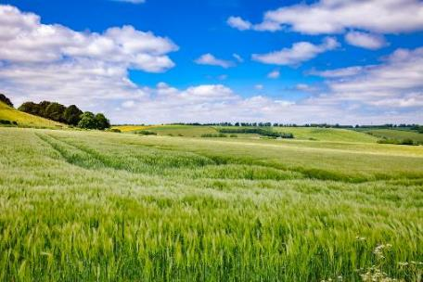
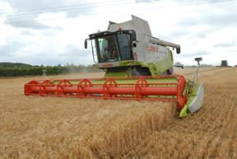
Farming barley
Barley is grown on about 1.2 million hectares of land in the UK.
Barley is the second biggest crop grown in the UK and our farmers produce on average around 6-8million tonnes per year.
Two thirds of the barley crop is planted with varieties that have malting potential.
In the UK, barley is planted in September and harvested the following August. The harvesting process removes the grains from the plant.
Nearly 20% of the UK barley crop is exported.

Slide 4
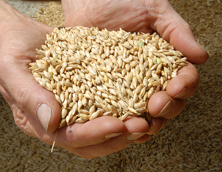

Malting barley
Malting is the process that turns grains of harvested barley from the farm into malted barley for food and drink.
The UK malting industry is the 4th largest in the world.
British malt is exported to more than 80 countries around the world. The important growth markets are in the Far East, South America and Eastern Europe.
Assurance and traceability schemes include – Red Tractor and Assured UK Malt.
Food and drink made from barley that has been through the scheme may display the Red Tractor mark. This shows that it has been produced to a high set of quality standards.

Slide 5
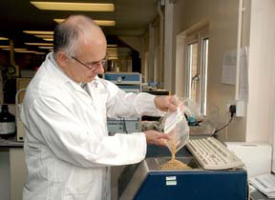
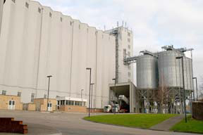
Stage 1: Malting
Malting is the process that turns grains of harvested barley from the farm into malted barley for food and drink.
To make malt you need barley, water, air and heat.
The incoming grain is sampled, tested and inspected.
The grain is cleaned to remove stones, foreign objects, dust and straw and is then dried.
This ensures all grain will germinate evenly and prevent mould development.
The grain is then stored in silos.

Slide 6
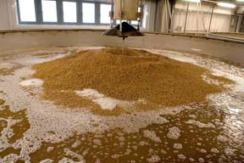
Stage 2: Steeping
Steeping or soaking in water is the first stage in malt production.
Steeping typically takes 48 hours and is covered in water 2 to 3 times.
Periods without water are called air rests and allow the grain to hydrate evenly.
At the end of the steeping period the grain will contain 45% moisture.

Slide 7
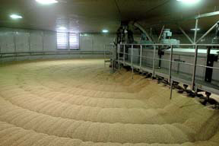
Stage 3: Germination
The grain is transferred to a germination vessel
Over the next 4-5 days the grain is encouraged to grow under controlled conditions.
During this time grains natural enzymes remove the cell walls and make the grain softer and easier to grind.
At this stage the germinating grain is know as ‘green malt’.

Slide 8
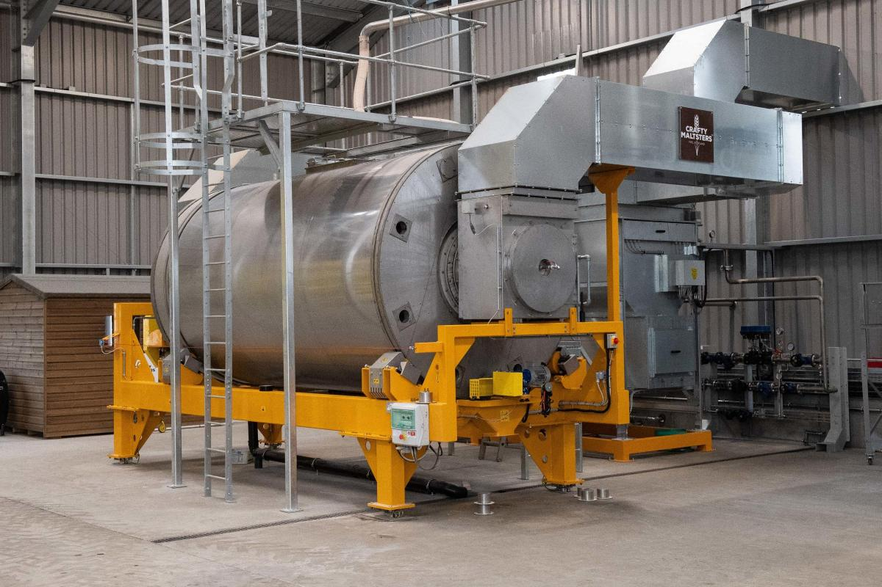
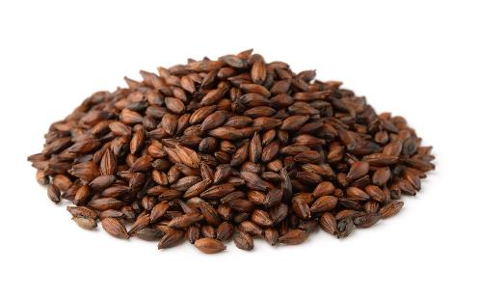
Stage 4: Kilning
Green malt is transferred to kilns for warm air drying to stop the germination process and reduce the moisture content of the grain by 43%.
Kilning generates both flavour and colour in the malt.
The kilning process takes around 20-28 hours.
At this stage the malt takes on its own distinctive flavour and colour.
Drying also make the malt easier to grind.

Slide 9


Barley in our diet
Barley is part of the starchy carbohydrate group of the Eatwell Guide.
This group also includes potatoes, bread, rice, pasta and other starchy carbohydrates, and around a third of what we eat should come from this group.
The recommendations from the Eatwell Guide is to base meals on starchy carbohydrates, choosing wholegrain versions where possible.
Whole barley, which is uncommon in supermarkets but can be purchased online, is a wholegrain. We should be trying to eat more wholegrains in our diets.

Slide 10
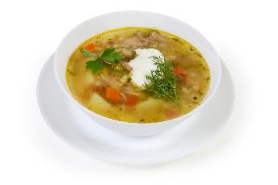
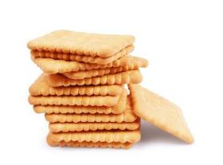
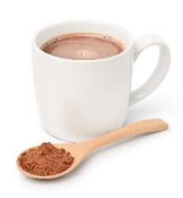
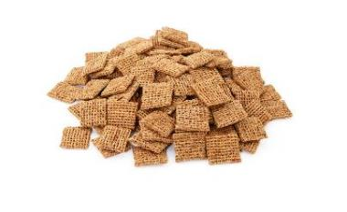
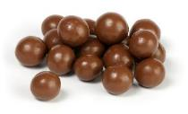
Food and drink made from barley and malt

Slide 11
Barley
For further information, go to:
www.foodafactoflife.org.uk
This resource meets the Guidelines for producers and users of school education resources about food.

