Slide 1
Eggs

Slide 2
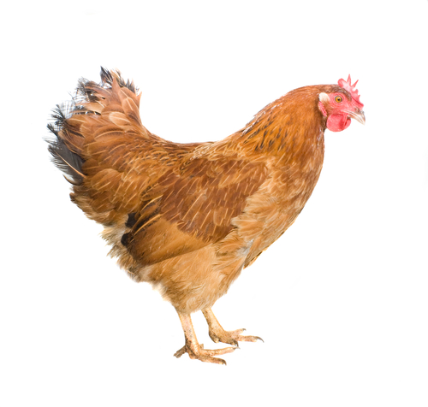
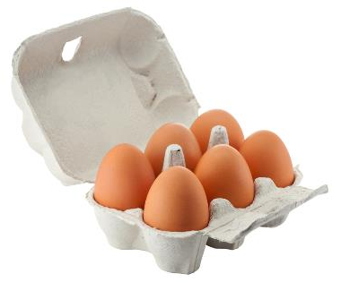
Where do eggs come from?
Eggs are laid by hens.
During 2019, in the UK:
13,093 million eggs were eaten;
11,388 million eggs were produced;
1,676 million eggs were imported and 271 million eggs were exported.
Hens are reared in three different ways to provide eggs in the UK.
Source: www.egginfo.co.uk

Slide 3
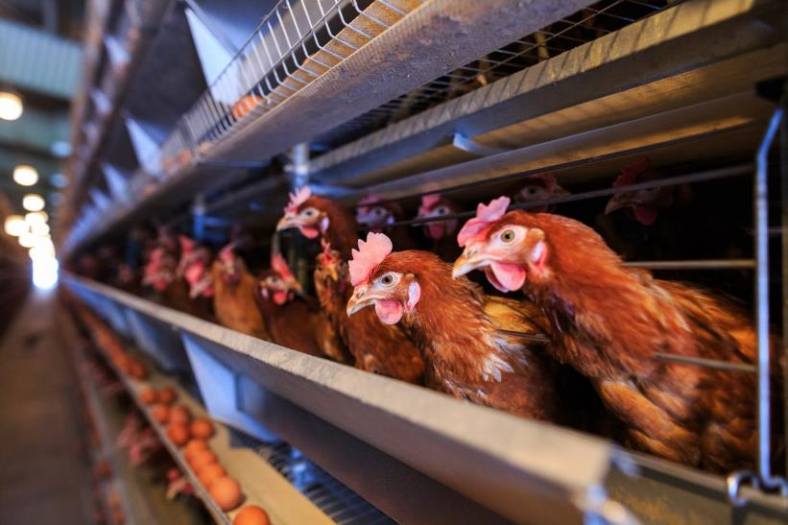
Enriched colony cage egg production
Between 40-80 hens share an enriched colony cage.
Bird space in enriched colony cages is 750cm² per hen.
The space allows the bird to perch, lay their eggs and scratch.
Manure is removed two or three times a week from revolving belts underneath the colony.
Food and water is provided, and the temperate and light is controlled.
Source: NFU

Slide 4
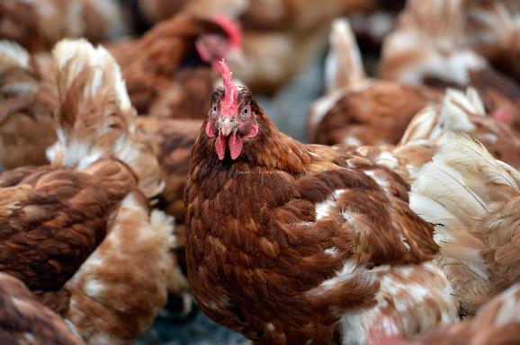
Barn egg production
Hens are able to move freely around the barn.
Current legislation stipulates that there is a maximum of 9 hens per square metre of useable space.
Nest boxes are provided, one per five hens. Alternatively, communal nests are provided.
Perches allow for 15 centimeters of space per hen.
Food and water is provided, and the temperate and light is controlled.

Slide 5
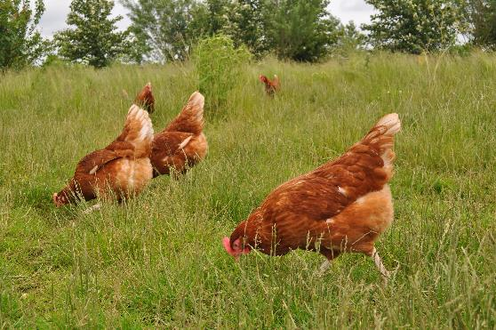
Free range egg production
Hens have access to the outside at all times.
Legislation stipulates that, to be ‘free range’, there must be no more than 2,500 hens per hectare.
There are nest boxes and perches for the hens.
Around one-third of the ground is used for scratching and dust bathing.
Many farmers plant trees to provide hens with shelter and a feeling of security outdoors.
Hens are fed automatically ensuring a constant supply of fresh food. Food consists mainly of grain, such as wheat, along with soya mea, and vitamins and minerals.
www.lovefreerangeeggs.co.uk

Slide 6
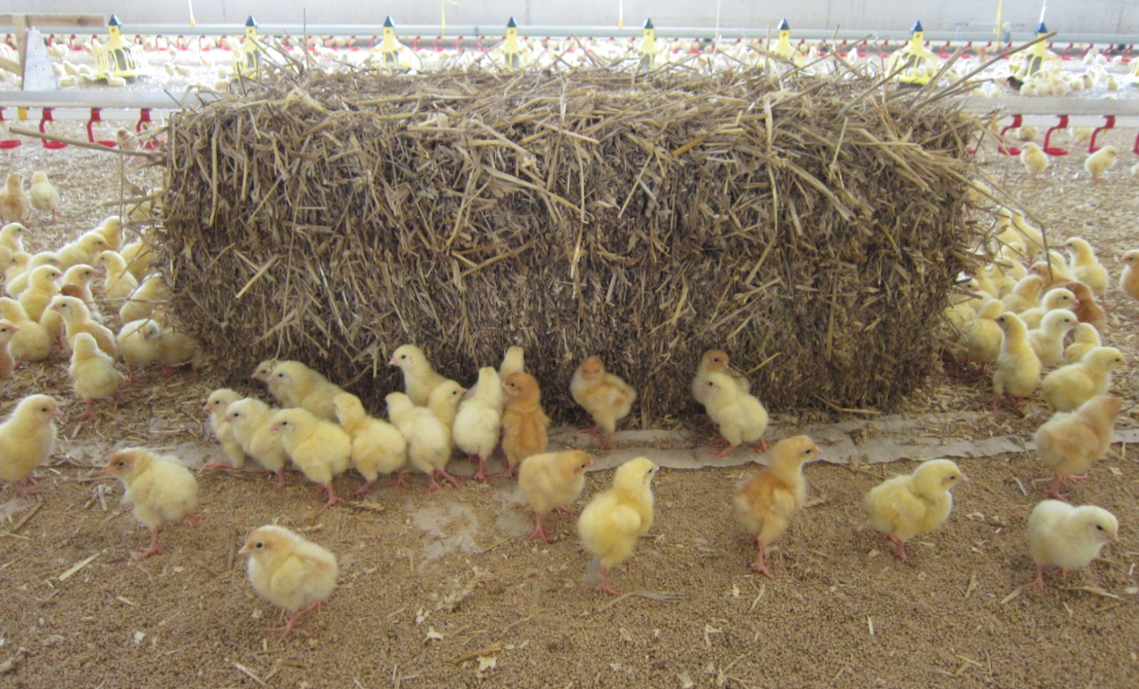
Hatching and rearing chicks
Chicks are bred at hatcheries.
Only females can lay eggs so a process to assess a chick’s gender takes place immediately after birth.
Chicks will be sexed and transported to a pullet rearing farm within 48 hours of hatching.
The pullets, as they are now known, will remain on the pullet rearing farm for around 16 weeks. They will then be transported to the laying farm.

Slide 7
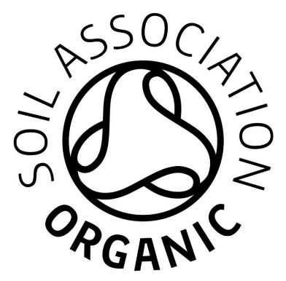
Organic egg production
Hens that produce organic eggs are always free range.
The land and feed must be organic.
Regulations stipulate a maximum of six hens per square metre and a maximum flock size of 3,000 birds.
Hens must be provided with nesting boxes and perches.
The perches must provide 18 centimeters of space per hen.
Soil Association organic standards specify a maximum flock size of 2,000 hens and that each hen must have a minimum of 10 square metres of space outside. Hens must also have access to the outside from 12 weeks of age.
logo© Soil Association
Source: www.egginfo.co.uk

Slide 8
Beak tipping
Beak tipping is carried out to prevent dominant hens from harming other hens in the flock.
Most egg-laying hens have the sharpest point of their beaks passed under an infra-red beam when they are a day old.
This allows normal beak growth but rounds off the sharpest point when the hen is fully grown.
Beak tipping is not carried out on hens that lay Soil Association organic eggs.

Slide 9
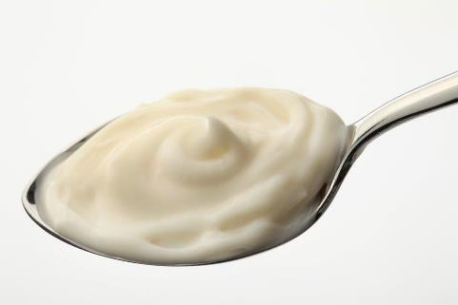
Cage-Free 2025
Britain’s major retailers and food-service companies have made a commitment to no longer sell whole eggs (in their shells) from hens housed in enriched colony cages by 2025.
Currently, this commitment only applies to whole eggs and not those used in processed foods.
Cage-Free 2025

Slide 10
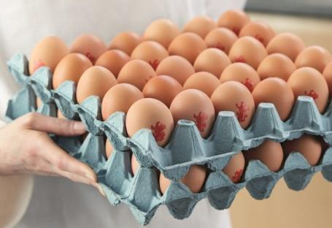
Eggs in the UK
Over 90% of UK eggs are stamped with the ‘lion’ mark – showing that they are safe to eat.
The Lion Code of Practice sets stringent requirements throughout the production chain to ensure quality, freshness and the highest standards of food safety.
Hens are vaccinated against Salmonella Enteritidis and Salmonella Typhimurium.
Raw, partially cooked and fully cooked British Lion eggs are safe to eat by pregnant women.*
* Source: NHS

Slide 11
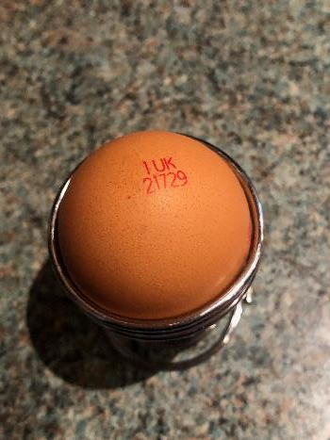
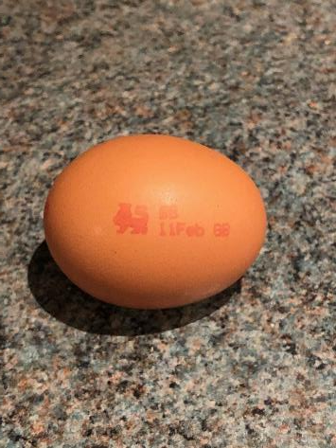
British Lion Mark egg labelling
Method of production
0 = Organic
1 = Free Range
2 = Barn
3 = Caged
British Lion Mark
Producer identity -
a unique code denoting where the egg was produced
Best before date

Slide 12
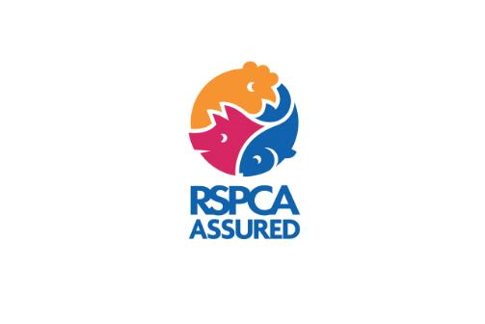
RSPCA Assured egg-laying hen standards
RSPCA higher welfare standards ensure that all hens have:
more space to roam around;
natural daylight for indoor birds;
raised perches to perch on;
more daily inspections;
straw bales and other objects to peck at;
welfare assured from birth to slaughter.
logo© RSPCA Assured

Slide 13

Laid in Britain assurance scheme
Laid in Britain is a food safety and hen welfare assurance scheme.
The Scheme is specifically for independent egg producers and retailers who supply locally.
Hens are vaccinated against salmonella, all eggs are fully traceable back to the farm and there are best before dates on egg boxes and packs.
logo© Laid in Britain

Slide 14
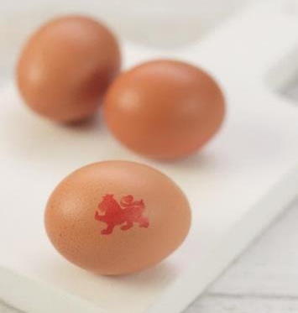
Eggs sizes
Eggs are now sold in four different sizes: small, medium, large and very large. Mixed weight boxes are also now available which contain different sized eggs.
Some older recipes ask for an egg in size 0 – 7. The chart below shows the equivalent sizes.
Weight | New size | Old size
73g and over | Very large | Size 0 Size 1
63 – 73g | Large | Size 1 Size 2 Size 3
53 – 63g | Medium | Size 3 Size 4 Size 5
53g and under | Small | Size 5 Size 6 Size 7

Slide 15
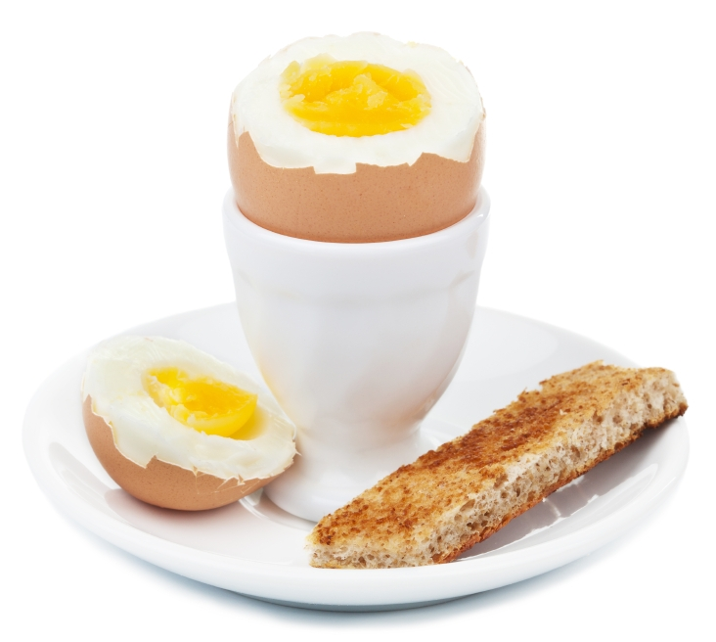
Parts of an egg
Yolk
Eggs have three main parts:
White
Shell

Slide 16
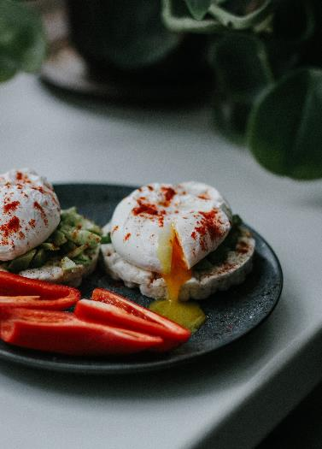

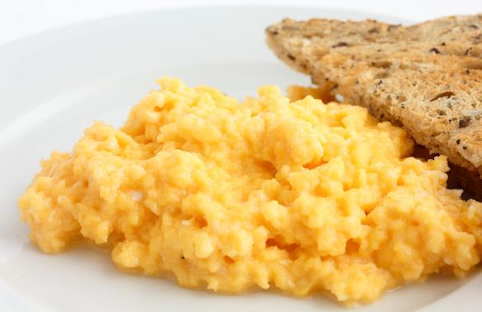
Uses of eggs
Eggs can be boiled, poached, fried or scrambled.

Slide 17
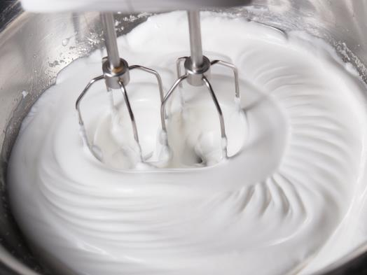
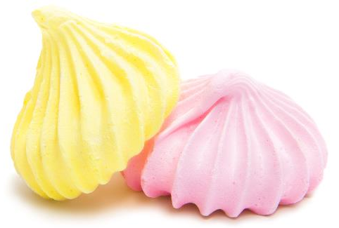
Uses of eggs
The white of an egg can be whisked to make a foam.
The mechanical action of whisking causes denaturation, a change in the structure of the protein, and incorporates air to form a foam.
Denaturation is a partially reversible change. If the foam is left to stand, it will collapse back to form liquid egg white.
However, as the change is only partially reversed, trying to make a new foam from the previously collapsed one will not work well.

Slide 18
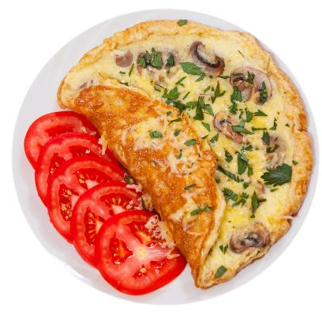
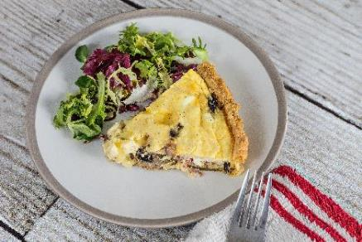
Uses of eggs
Eggs are used to make omelettes and quiche.
When egg is cooked it changes colour and becomes firmer (sets). This is known as coagulation.
Coagulation follows denaturation.
The heat causes egg proteins to unfold from their coiled state and form a solid, stable network.
This change is irreversible.

Slide 19
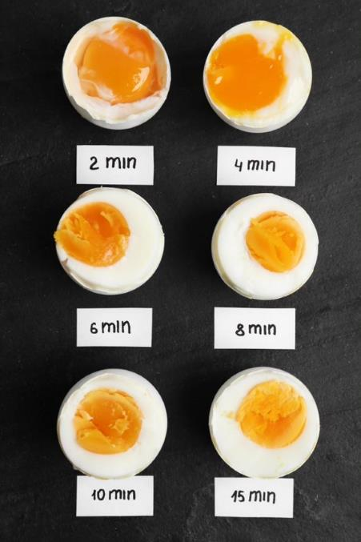
Uses of eggs
Coagulation continued.
Egg whites coagulate at 60°C, egg yolks at 65°C, with full coagulation occurring at 70°C.

Slide 20
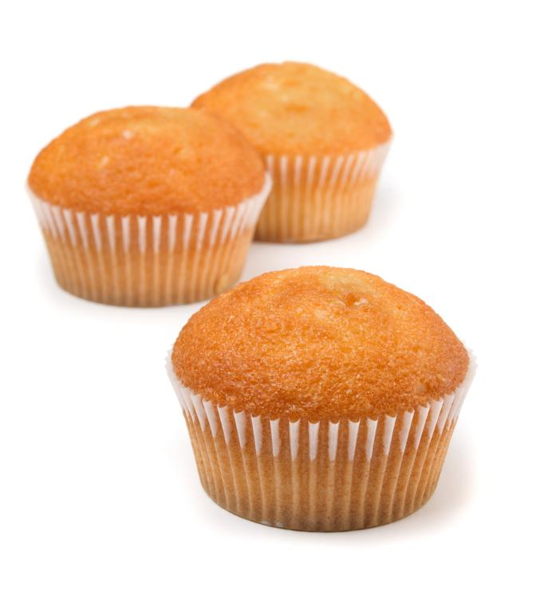
Uses of eggs
Eggs are used in cakes. They:
trap air (aerate) when whisked into a foam;
coagulate (set) on heating;
emulsify holding the fat in an emulsion which keeps it stable;
add colour, flavour and nutritional value.

Slide 21
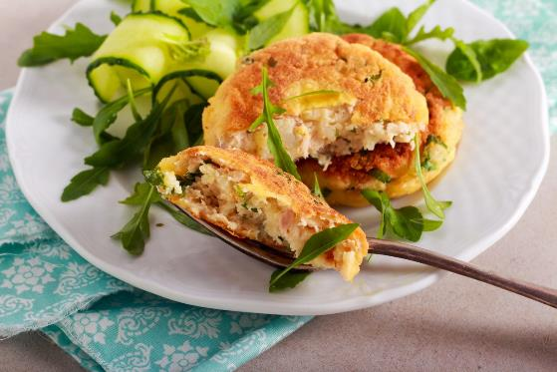
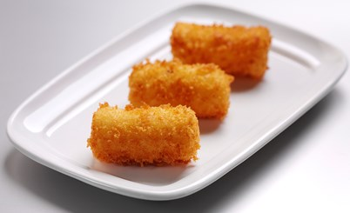
Uses of eggs
Eggs are used to bind ingredients together, e.g. fish cakes and croquette potatoes.
Raw egg combines the other ingredients and during cooking the protein in the egg coagulates, keeping the fishcake, or croquettes, together.
Egg also helps ‘stick’ the breadcrumbs to the outside of the fishcake or croquettes.

Slide 22
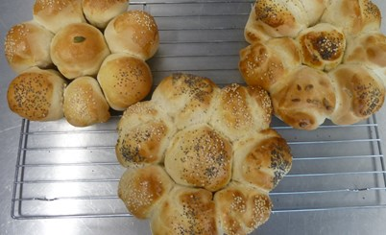
Uses of eggs
Eggs can be used as a glaze, e.g. bread.
Beaten egg is brushed over the surface before cooking. The surface of the food takes on a shiny, golden-brown appearance due to coagulation of egg proteins and the Maillard browning reaction.

Slide 23
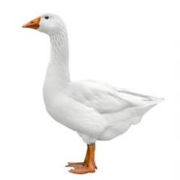
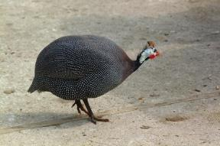
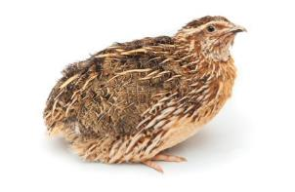
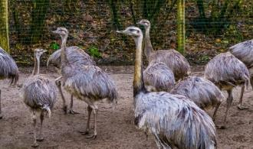
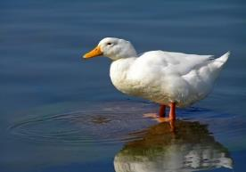
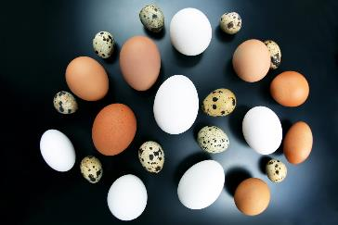
Eggs from other types of poultry
Eggs from other poultry can also be eaten:
duck;
emu;
goose;
guinea fowl;
pheasant;
rhea;
turkey;
ostrich;
quail.
Goose
Guinea fowl
Quail
Rhea
Duck

Slide 24
Eggs
For further information, go to:
www.foodafactoflife.org.uk
This resource meets the Guidelines for producers and users of school education resources about food.

