Slide 1
Peas

Slide 2
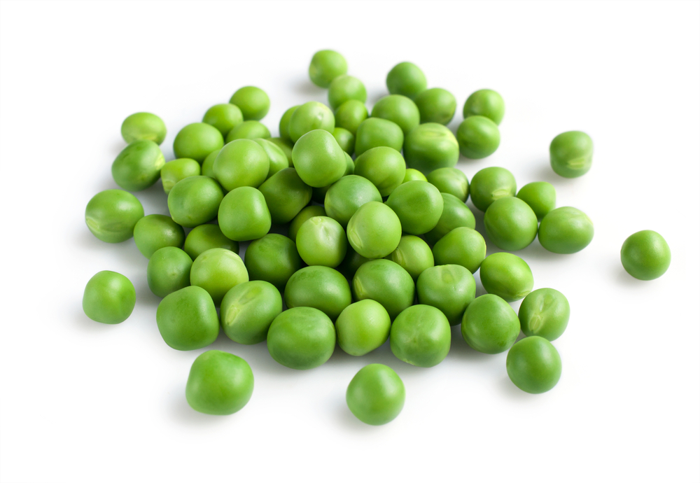
What are these?
These are peas.
Peas are a vegetable.

Slide 3
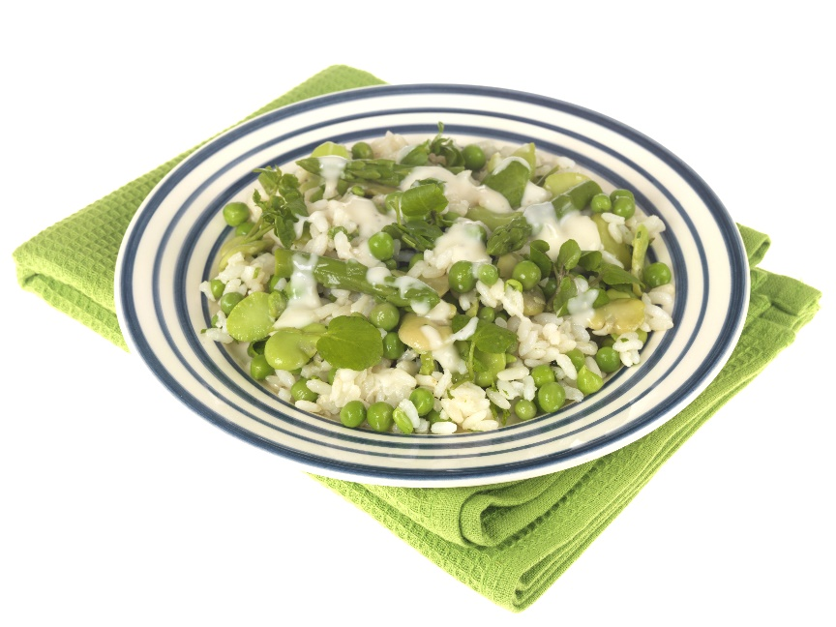
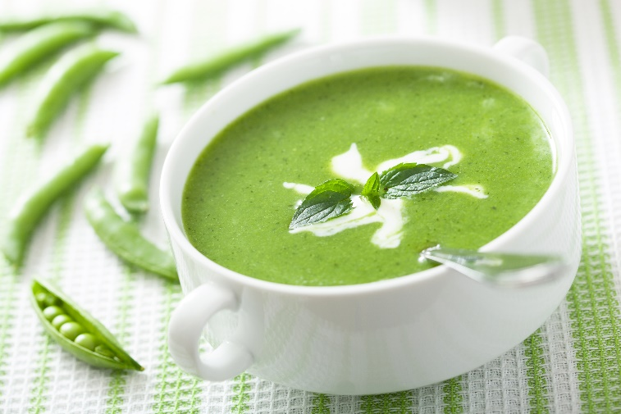
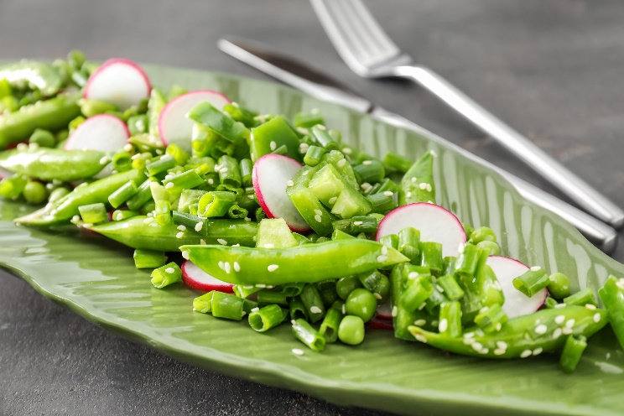
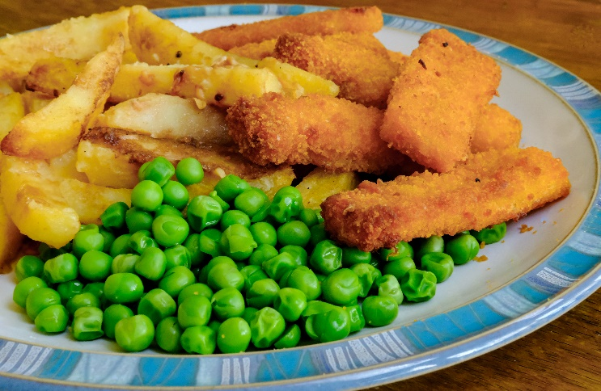
What are these?
What are they made from?
They are all made using peas.

Slide 4
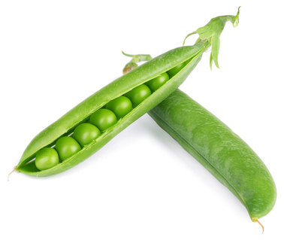
Where do peas come from?
Peas grow in the UK.
Peas are a plant.
They grow above the ground – they are found in pods.

Slide 5
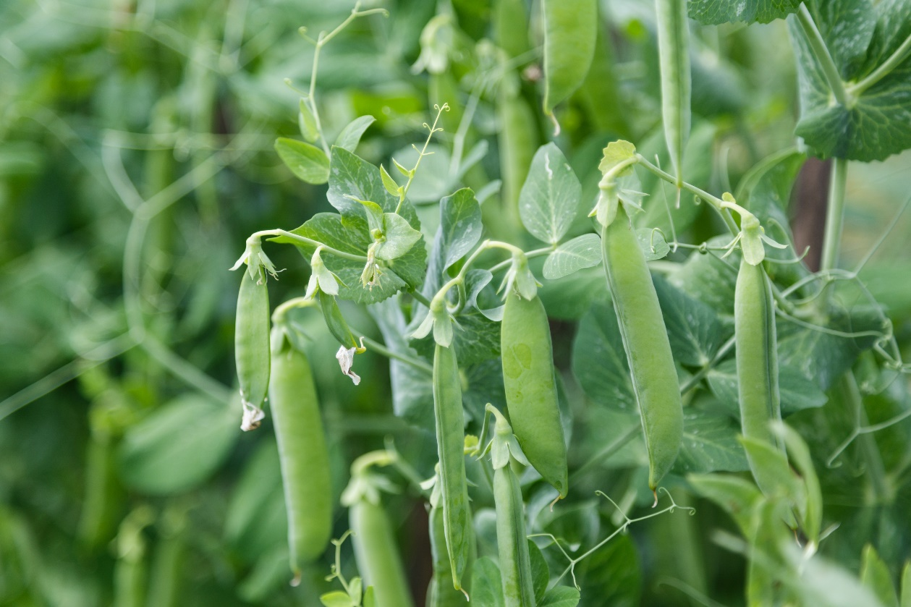
Where do peas come from?
The pods are picked when ready and the peas are removed.
Have you seen peas growing before?

Slide 6
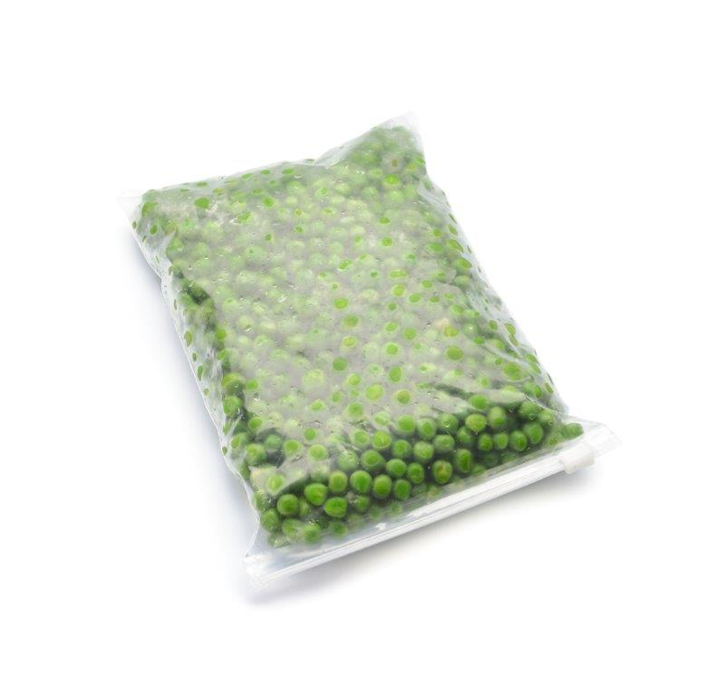

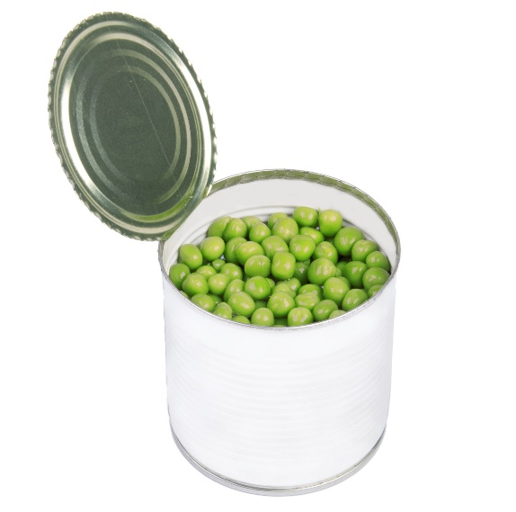
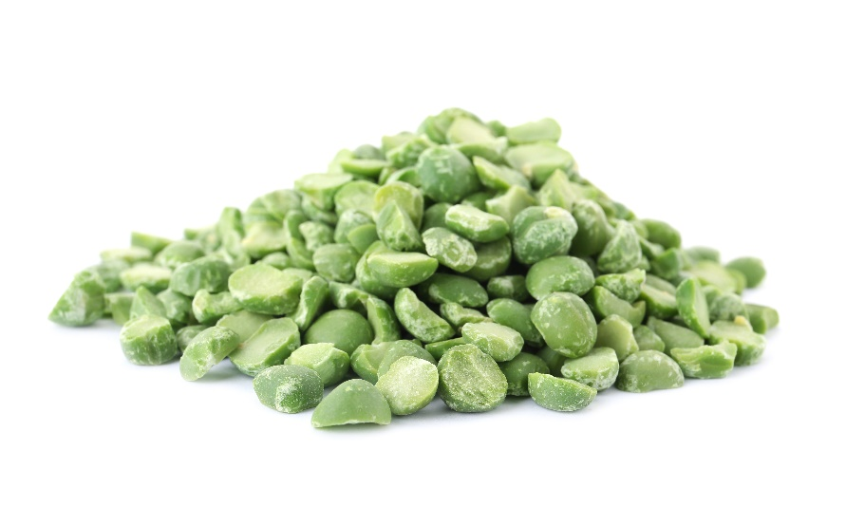
Peas
Peas can be purchased as:
fresh;
frozen;
dried;
canned.

Slide 7



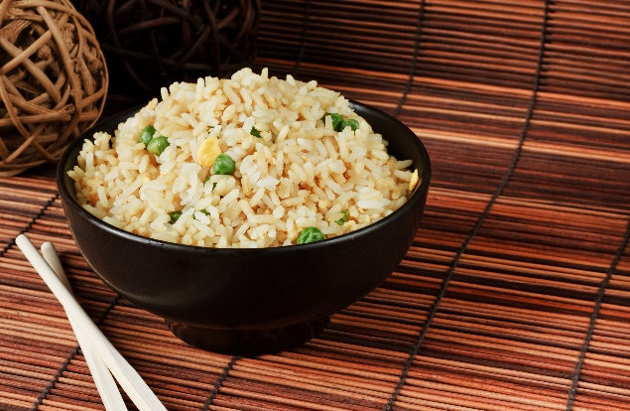
Dishes
Peas can be eaten raw – remove from the pod first.
Peas can be used in lots of dishes.

Slide 8
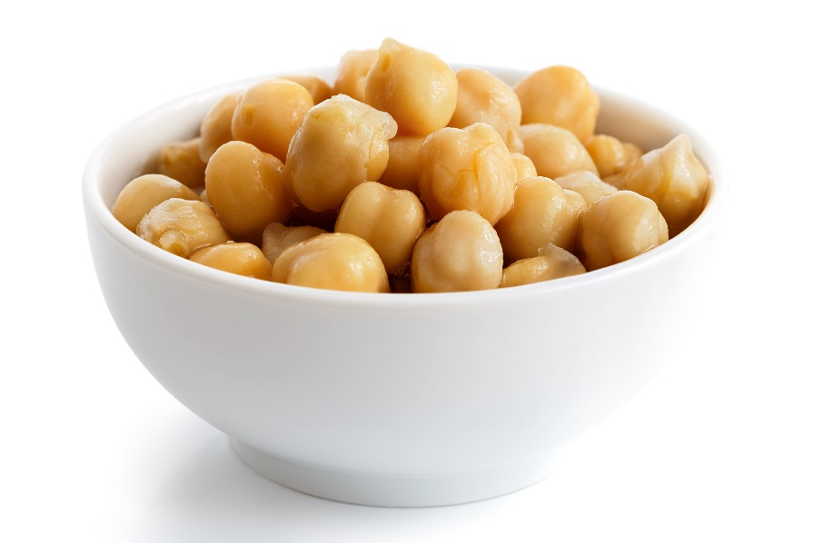
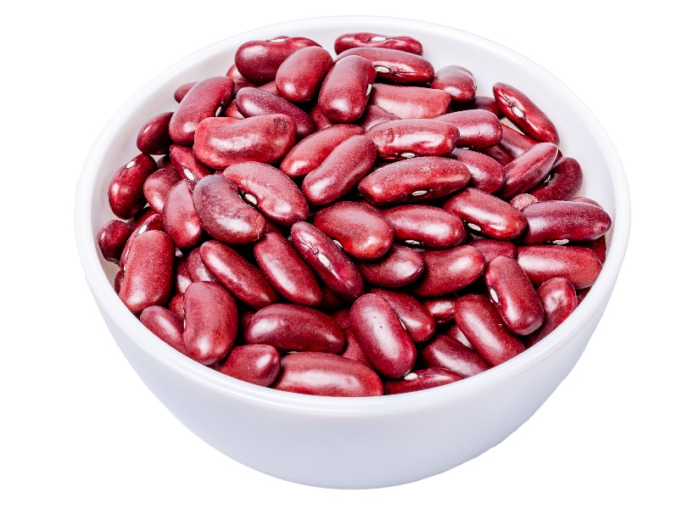
Similar
Chickpeas and Red kidney beans are similar to peas.
They all belong to a family called legumes.

Slide 9



Summary
Peas are grown for our food.
Peas
Lots of dishes use peas.

Slide 10
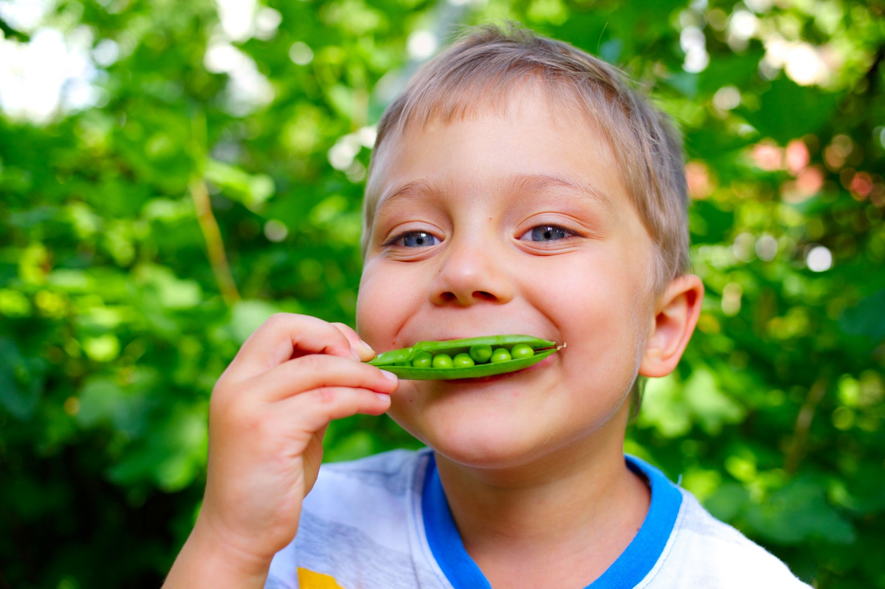
Do you like peas?

Slide 11
Peas
For further information, go to:
www.foodafactoflife.org.uk

