Slide 1
Poultry

Slide 2
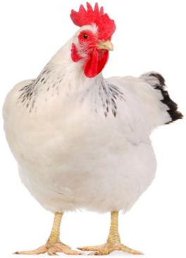
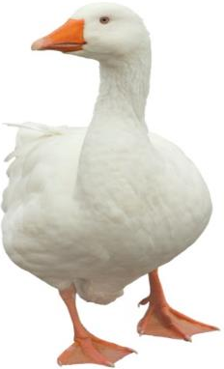
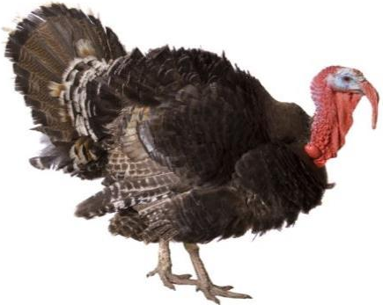
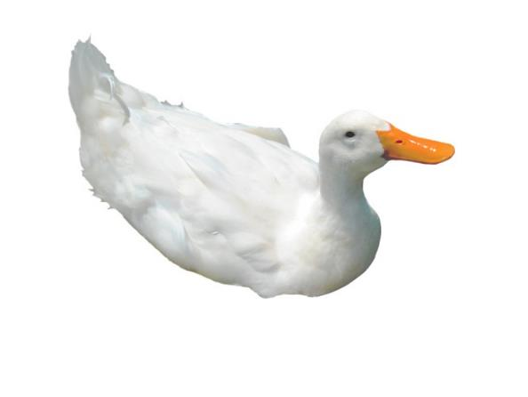
Introduction
Chicken, turkey, duck and goose are all types of poultry.
They are reared for meat.

Slide 3
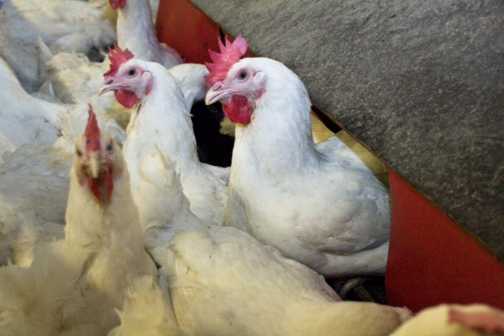
Introduction
Chickens farmed for meat are called broiler chickens and can be male or female. Broilers typically have white feathers, whereas egg laying hens usually have brown feathers.
Poultry | Male | Female
Chickens | Cockerel or rooster | Hen or pullet
Ducks | Drake | Hen or duck
Geese | Gander | Goose
Turkeys | Stag | Hen

Slide 4
Poultry in the UK
In 2019 the value of poultry meat in the UK was £2.65 billion.
On average each year in the UK, people consume 35kg of poultry meat.
The poultry meat industry supports over 37,000 jobs. 13,000 additional workers are employed for seasonal, Christmas poultry production.
Type of poultry | Number in 2019 (million)
Table chickens | 121.5
Laying flock (including pullets) | 41.5
Breeding flock | 13
Turkeys, ducks, geese and all other poultry | 10.75
Total | 186.76
Agriculture in the UK 2019
National Farmers Union
British Poultry Council

Slide 5
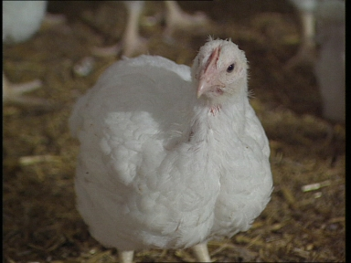
Breeder farm
Eggs are laid by broiler hens (parent flock).
In October 2020 109.8 million eggs were laid by broiler hens.
Once laid, or set, the eggs are collected and sent to a hatchery.
UK poultry and poultry meat statistics

Slide 6
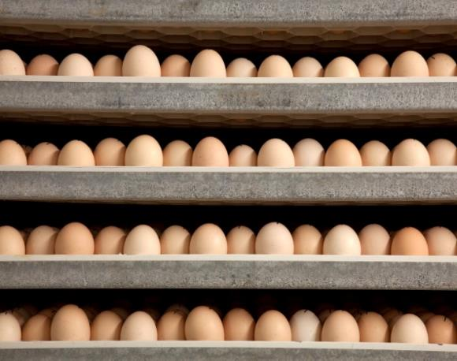
Hatchery
The eggs are incubated at the hatchery. They are kept warm, until the chicks start to hatch out of their shells.
Hen eggs take around 21 days to hatch and turkey eggs around 28 days.
The hatched birds are then sorted and transported to rearing farms.

Slide 7
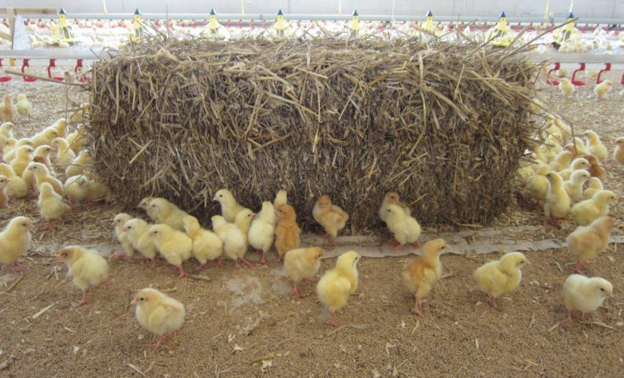
Hatchery
When a chick hatches it can live healthily for up to two days without being given any food or water. This is because it still has nutrients in its stomach from when it was inside the egg.
Therefore, chicks not need food or water when they are being moved to the rearing farm.
A group of chicks is called a clutch or peep.

Slide 8
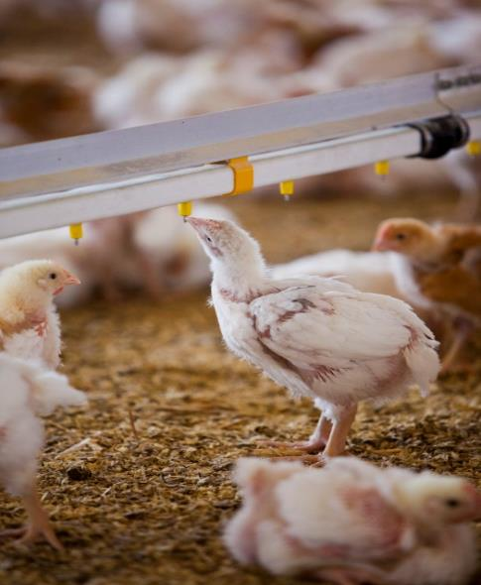
Rearing farms - chickens
There are three main types of chicken rearing farms, or chicken production, in the UK:
standard indoor;
free range;
organic.

Slide 9
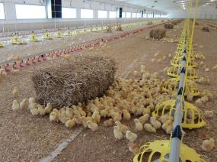
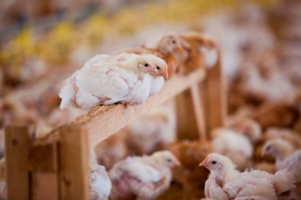
Chicken production – standard indoor
The chickens raised in large open ‘houses’ and are provided with space and dirt to scratch and dust bathe.
There are also places for chickens to perch when they are bigger.
Their food travels down pipes into feeders and freshwater is always available.
Keeping the chickens indoors can protect them from predators.
Some houses have curtain walls that can be lifted in good weather to provide natural daylight and fresh air.

Slide 10
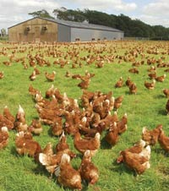
Chicken production – free range
Chickens have access to the outdoors during the daytime for at least half of their lifetime and the birds used are often slower growing breeds.
The minimum space allowed is 1 square foot per bird.
Pop-holes allow access to the outside.
At night the hens come inside for protection from predators.

Slide 11
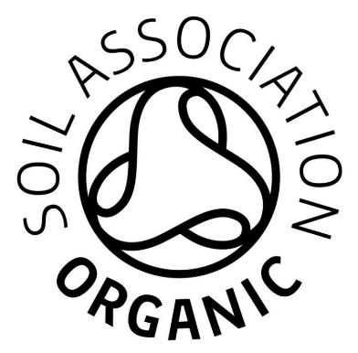
Chicken production - organic
Organic standards require that chickens:
live in smaller flocks – eight times smaller than in free range production;
must have continuous access to the outside and have more pop-holes than free range to encourage them to explore their surroundings;
must not have their beaks trimmed – this is often done in other production systems to stop the chickens from harming themselves or each other;
are fed organic feed;
are often breeds that are slower growing.
Logo© Soil Association

Slide 12
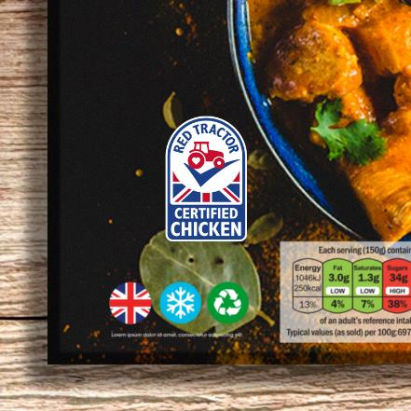
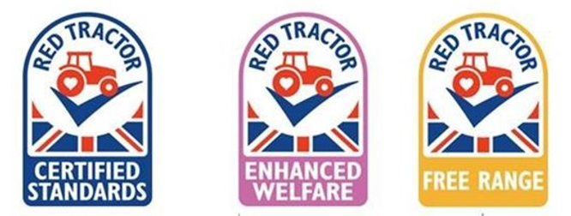
Red Tractor poultry standards
The Red Tractor standards require that birds are:
fed with safe animal feed that is from certified sources and have access to fresh, clean drinking water at all times;
inspected twice daily and have strict procedures in place to prevent spread of disease.
‘Named ingredient’ logo - for products where the Red Tractor certified ingredient(s) makes up 94% or less of the finished product.
Logo© Red Tractor

Slide 13
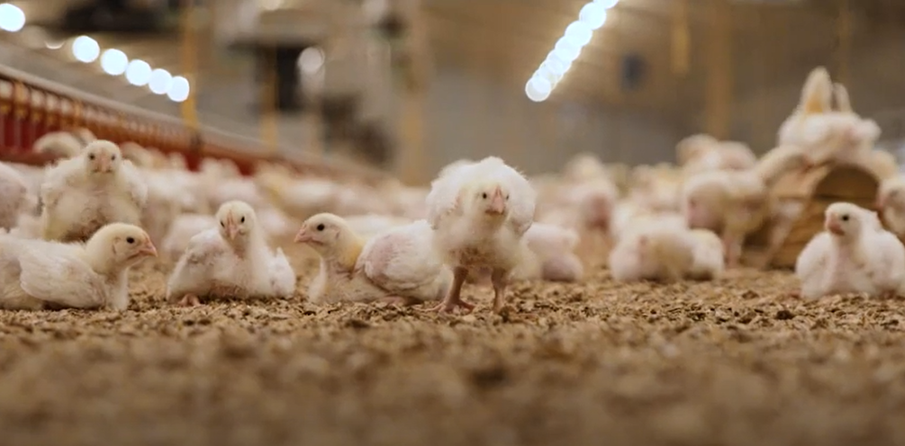
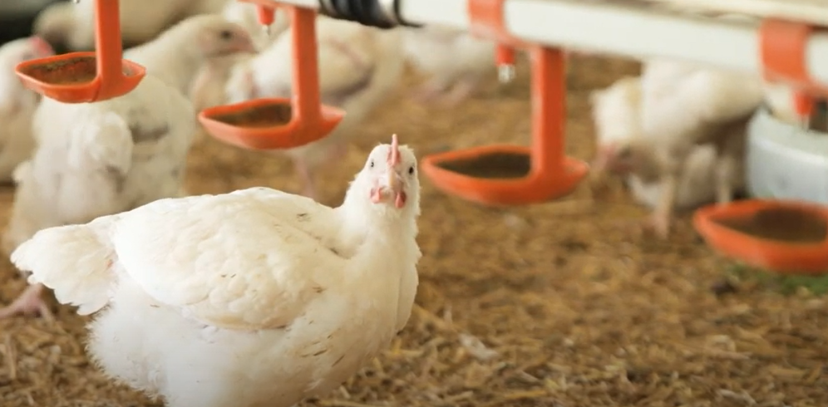
Red Tractor standards
Watch these videos to find out more about the Red Tractor standards for chicken.
Chicken farming
Chicken farming and food safety
Click on the images above to play the videos

Slide 14
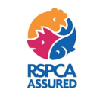
RSPCA Assured chickens
The RSPCA Assured standards require that:
chickens have easy access to fresh water and a diet to maintain full health and promote a positive state of well-being;
the environment in which chickens are kept needs to be designed to protect them from physical and thermal discomfort, fear and distress, and allow them to behave naturally;
flock sizes should not exceed 30,000 birds for indoor systems and 15,000 for free range systems;
there is environmental enrichment such as straw bales, perches, pecking objects.
logo© RSPCA Assured
RSPCA standards for meat chickens

Slide 15
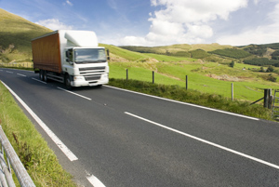
Catching
Once the birds reach their required weight they are transported from the rearing farm to the processing plant.
Trained staff called ‘catchers’ catch the birds and put them in containers called modules.
Catching is carried out quietly and with care to avoid unnecessary stress and to prevent injury to the birds.
The modules are then loaded into lorries and taken to the processing plant.

Slide 16
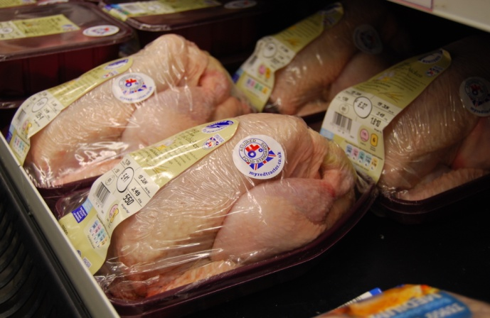
Processing plant
The birds are processed and packaged at the processing plant.
After the birds have been processed they are weighed, and then either left whole or portioned.
The meat is then packaged and labelled ready to be delivered to restaurants, shops and supermarkets.

Slide 17
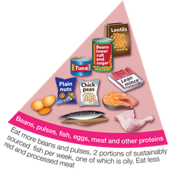
The nutrition of poultry
Poultry includes chicken, turkey, duck and goose.
Poultry can be part of a healthy, balanced diet, and is a source of protein and some vitamins and minerals.
This food fits into the ‘beans, pulses, fish, eggs, meat and other proteins’ Eatwell Guide food group.
When choosing this food, we should be choosing options with less saturated fat.
Too much saturated fat in the diet can raise blood cholesterol levels and increase the risk of developing heart disease.
British Nutrition Foundation

Slide 18
Making healthier choices with poultry
To make healthier choices when choosing poultry, we can:
choose poultry without the skin, or remove the skin before cooking;
limit poultry products in pastry, batter or breadcrumbs as they can be high in fat and/or salt;
grill or bake instead of frying;
if roasting, place on a metal rack over a roasting tin to allow the fat to run off.
NHS Live well/Eat well

Slide 19
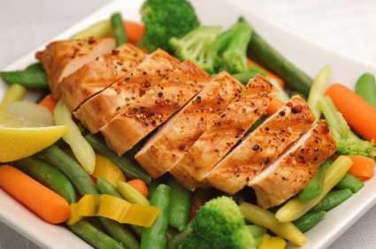
Storing and cooking poultry safely
Store raw poultry in clean sealed containers on the bottom shelf of the fridge, so the meat cannot touch or drip onto other food.
Do not wash raw chicken before cooking, as this can increase the risk of food poisoning from campylobacter bacteria. Splashing water from washing chicken can spread bacteria to hands and around the kitchen.
When cooking portions of chicken and poultry, there should be no pink meat. They should also be steaming hot inside. The juices should run clear when cooked.
To check a whole chicken or other bird, pierce the thickest part of the leg with a clean knife or skewer until the juices run out. The juices should not have any pink or red in them.
FSA campylobacter

Slide 20
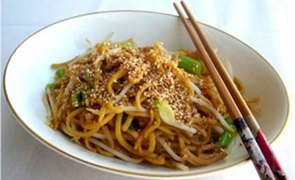
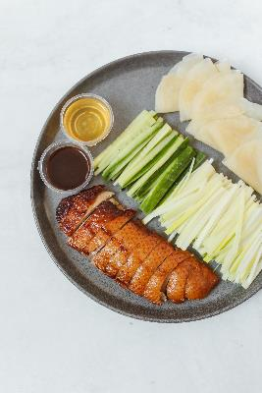
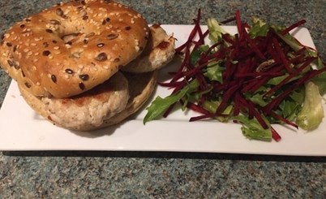
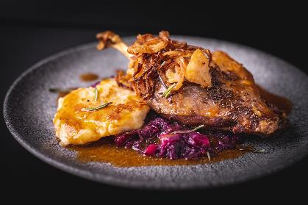
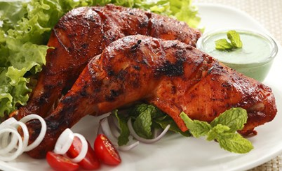
Dishes made with poultry
Chicken stir fry
Turkey burgers
Crispy duck and pancakes
Roast goose
Tandoori chicken

Slide 21
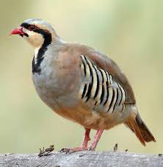
Similar – feathered game or game birds
In Britain today there are around 300 game farms, mostly rearing pheasants and partridges.
Eggs are collected daily from April onwards and are hatched in electronic incubators. The chicks are then reared on in purpose-built shelters, where they are provided with food, water, grit and all their other needs.
As they grow, the chicks are given access to outdoor runs where they can get used to the natural environment.
In about August, they are sold to shoots, where gamekeepers will take over their care, releasing them into the countryside.

Slide 22
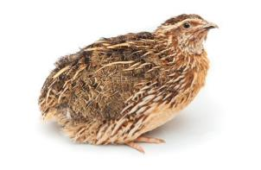
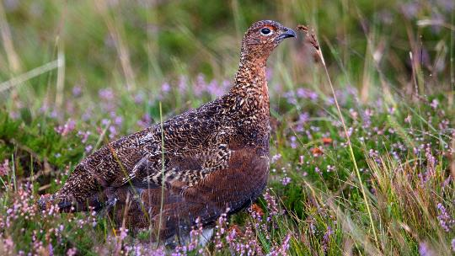
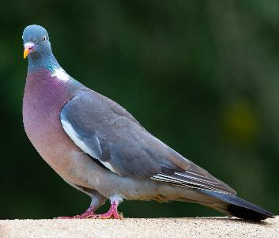
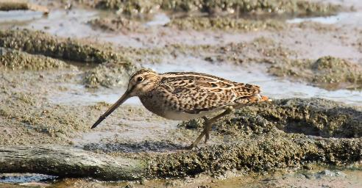
Feathered game or game birds
Game birds also include:
grouse;
quail;
snipe;
wild duck;
woodcock;
wood pigeon.
Quail
Grouse
Wood pigeon
Snipe

Slide 23
Poultry
For further information, go to:
www.foodafactoflife.org.uk
This resource meets the Guidelines for producers and users of school education resources about food.

