Slide 1
Fruit

Slide 2
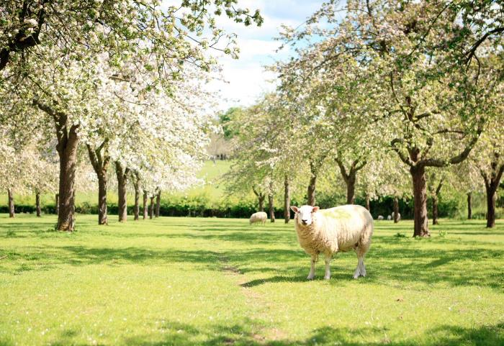
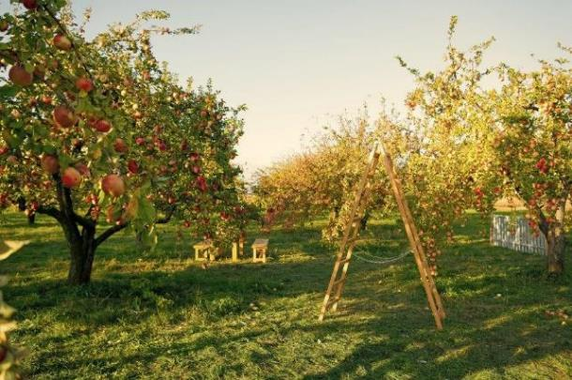
Fruit
Fruit are the mature ripened ovaries of flowers.
One of the main purposes of fruit is to spread the seeds of the plant.
Fruit can be classified as:
berries;
citrus fruit;
fleshy fruit;
pomes;
stone fruit.
Apples trees in flower
Apples trees in fruit

Slide 3
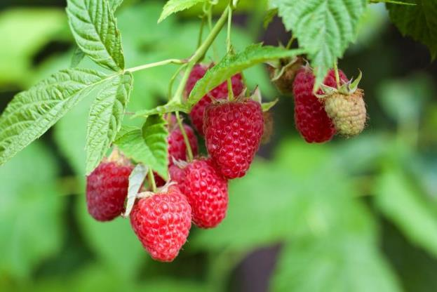
Berries
A berry is a small, sweet fruit.
They are often coloured red, blue or black.
They contain small seeds, which are usually edible and do not have a large stone.

Slide 4
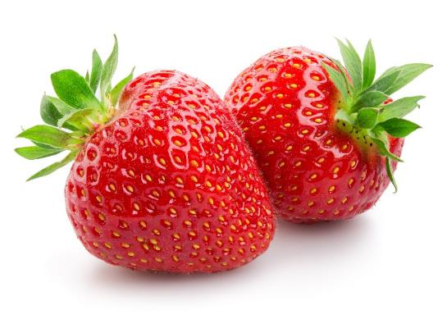
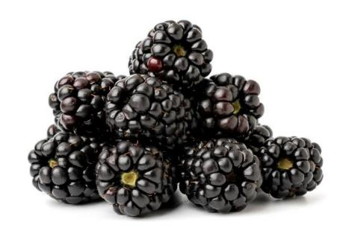
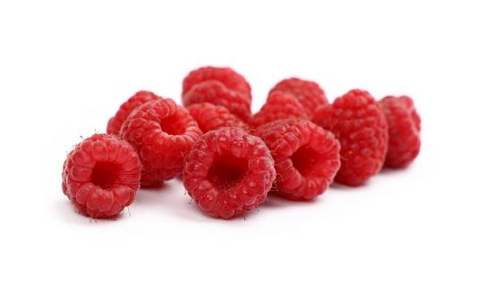
Berries
Berries include:
blackberries;
blackcurrants;
blueberries;
grapes;
raspberries*;
strawberries.
Strawberries
Blackberries
*Botanically, raspberries are not a true berry (a fruit with many seeds scattered throughout the pulp) but an etaerio (or aggregate fruit) made up of drupelets (individual sections of fruit each with its own seed).
Raspberries

Slide 5
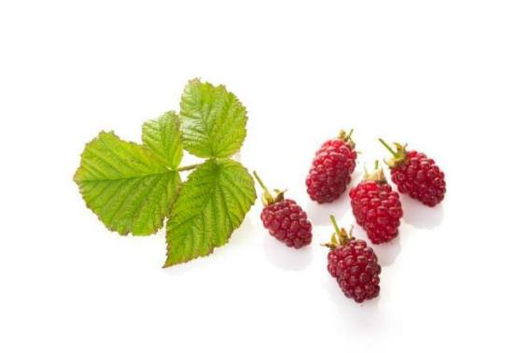
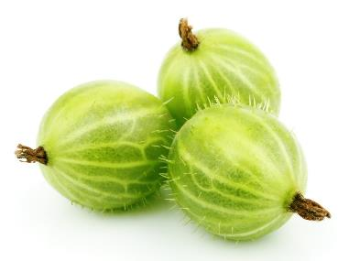
Berries
Lesson common examples of berries include:
elderberries;
goji berries;
gooseberries;
loganberries.
Loganberries
Gooseberries

Slide 6
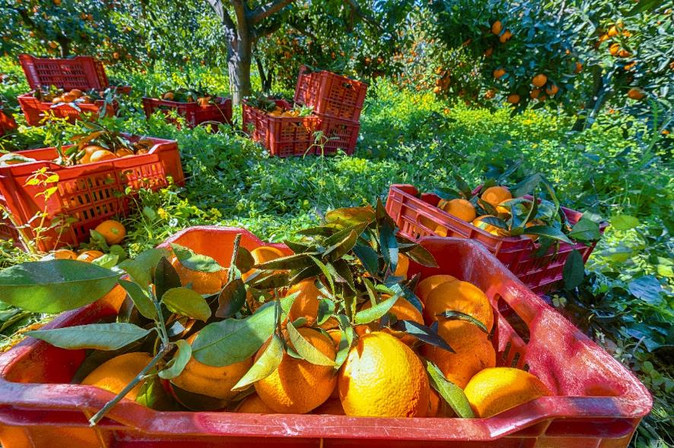
Citrus fruit
Citrus fruits are usually quite large and round.
They have a waxy outer layer that needs to be peeled off before they can be eaten.
They also tend to have a sour taste.
Oranges

Slide 7
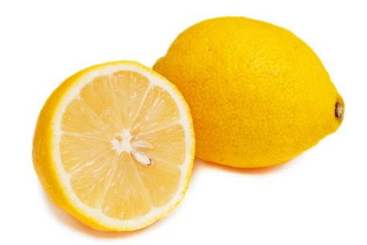
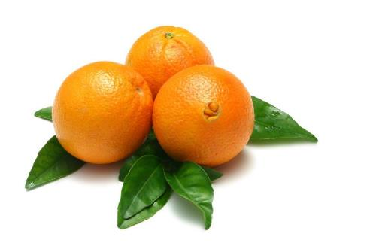
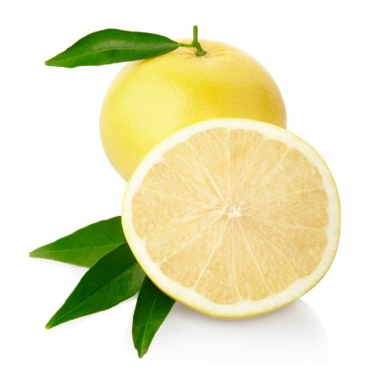
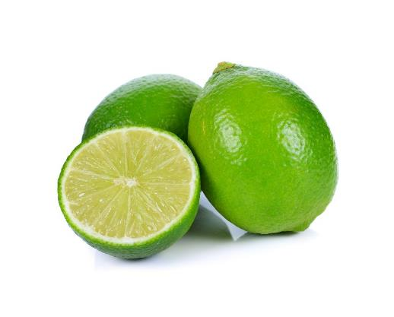
Citrus fruit
Citrus fruit include:
grapefruits;
lemons;
limes;
oranges.
Lemons
Navel oranges
Grapefruits
Limes

Slide 8
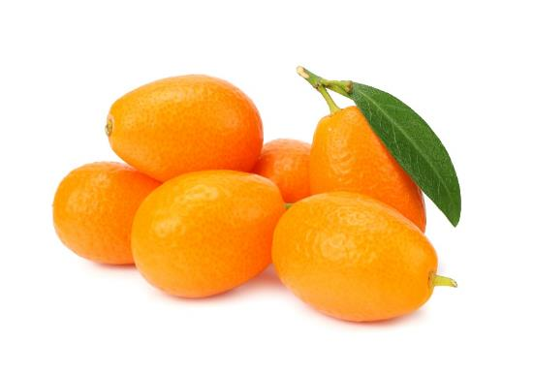
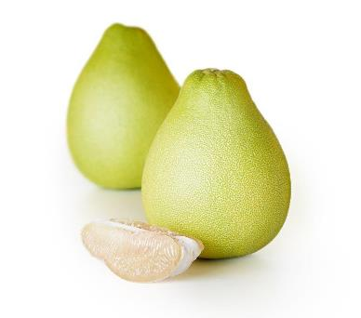
Citrus fruit
Lesson common examples of citrus fruit include:
bergamot;
kumquat;
pomelo.
Kumquats
Pomelo

Slide 9
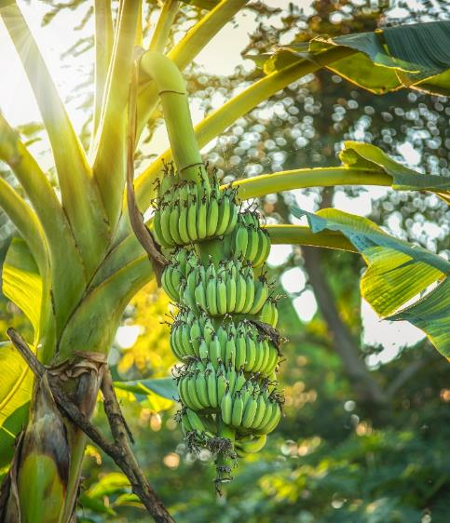
Fleshy fruit
These fruits are usually fairly large and do not have a central stone.
Often, the seeds in the fruit are eaten along with the flesh as they are small and soft, but this is not true with melons.
Bananas

Slide 10
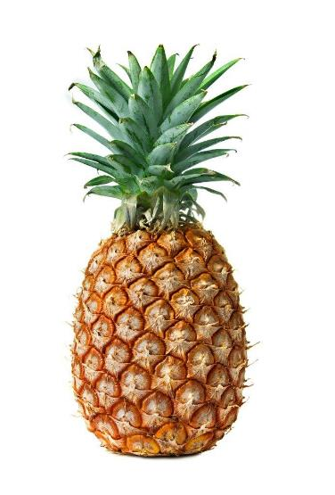
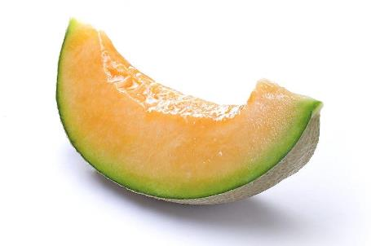
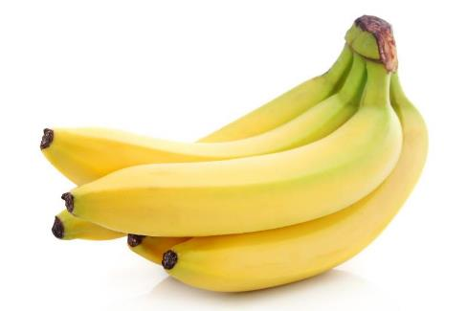
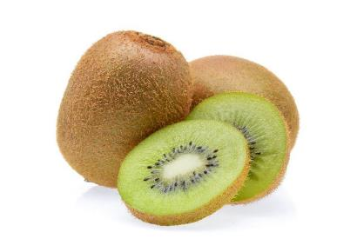
Fleshy fruit
Fleshy fruit include:
bananas;
kiwi fruit;
melons;
pineapples.
Melon
Pineapple
Bananas
Kiwi fruit

Slide 11
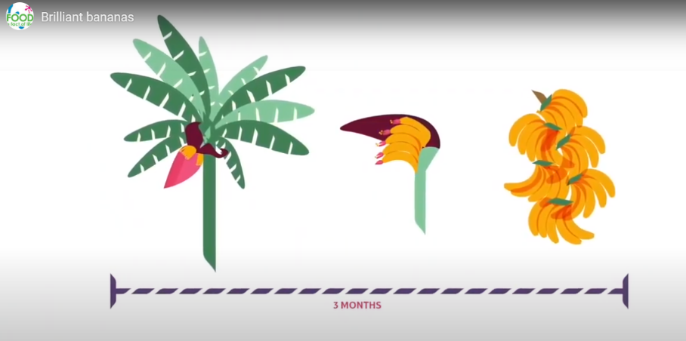
Growing and harvesting bananas
To find out more about growing and harvesting bananas, watch this Brilliant bananas – from field to fork video.
Click on the image to play the video

Slide 12
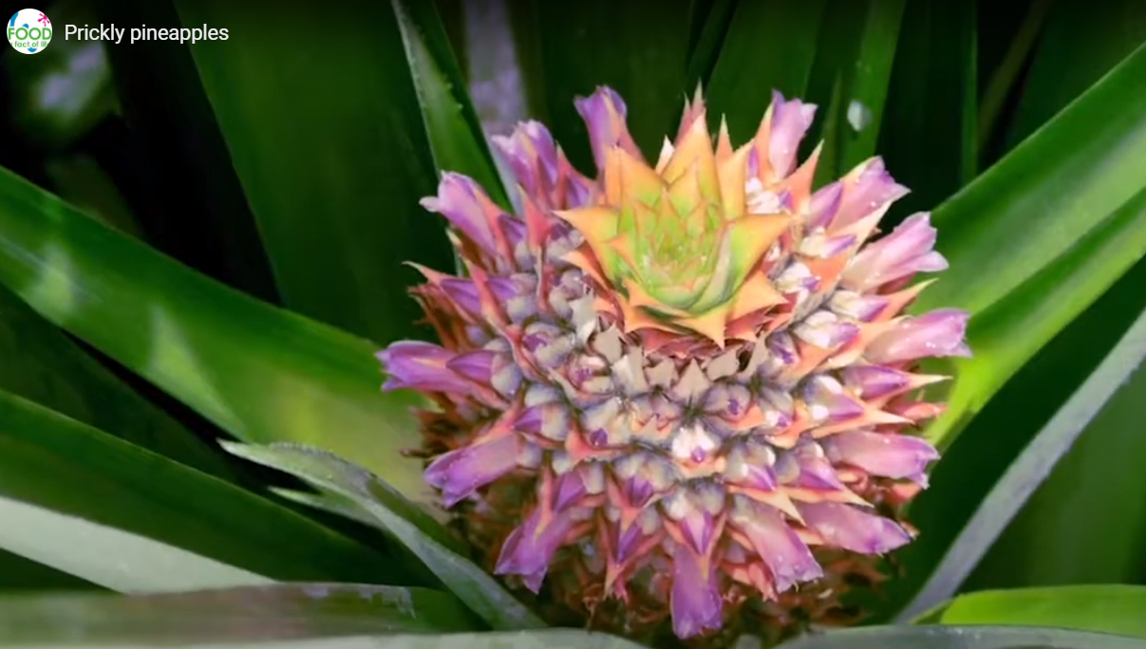
Growing and harvesting pineapples
To find out more about growing and harvesting pineapples, watch this Prickly pineapples – from field to fork video.
Click on the image to play the video

Slide 13
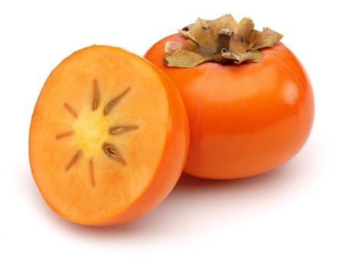
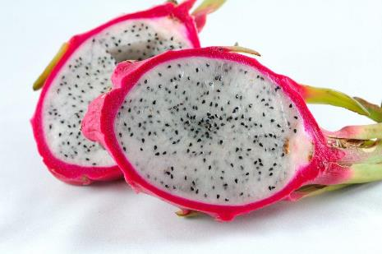
Fleshy fruit
Less common examples of fleshy fruit include:
dragon fruit;
mangosteen;
persimmon;
guava.
Dragon fruit
Persimmon

Slide 14
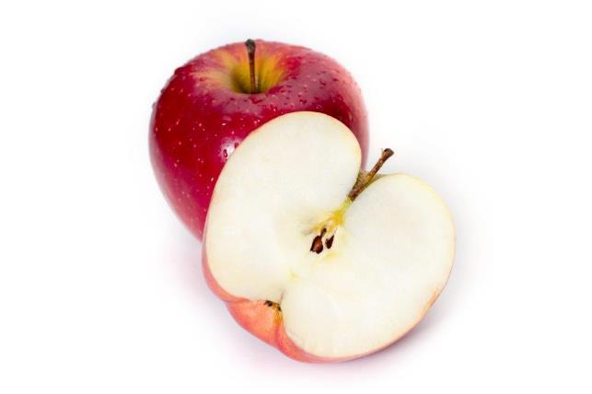
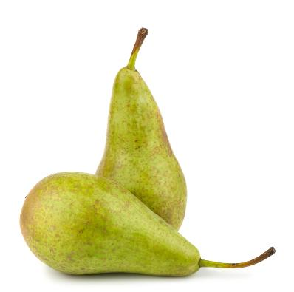
Pomes
Apples and pears are a special type of fruit called a ‘pome’.
These fruits have a core which is usually not eaten and contain several ‘pips’.
Apples
Pears

Slide 15
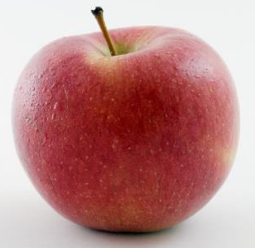
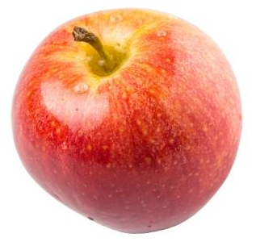
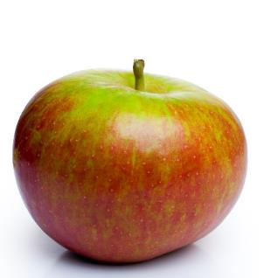
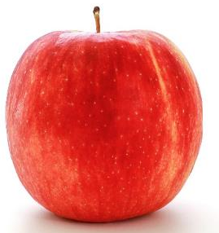
Apple varieties
There are lots of different types apple – 3,000 varieties in the UK.
They have different names, such as:
Braeburn;
Cox;
Jazz;
Royal gala.

Slide 16
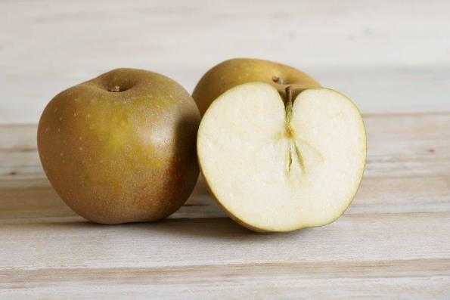
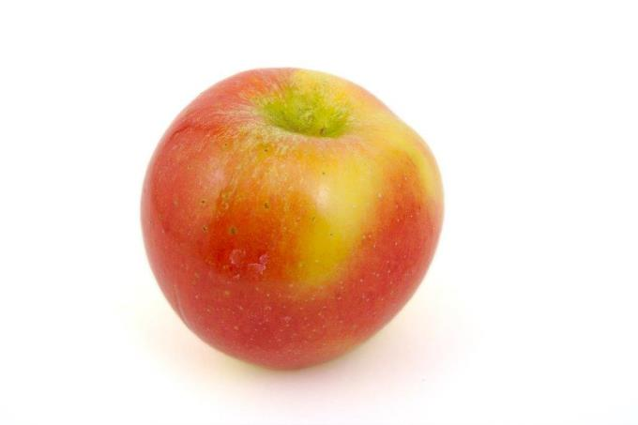
Apple varieties
Less well known apple varieties include:
Cameo;
Egremont Russet;
Kanzi;
Ruebens;
Worcester Pearmain.
Egremont Russet
Red Kanzi

Slide 17
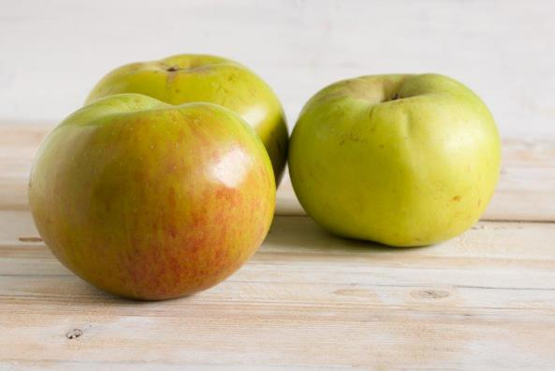
Cooking apples
Bramley apples are traditionally used for cooking.
The first Bramley tree grew from pips planted by a young girl, Mary Ann Brailsford, in her garden in England in 1809.

Slide 18
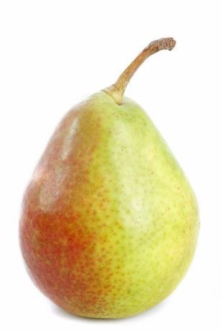
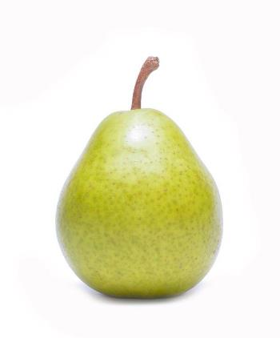
Pears
Pear varieties include:
Conference;
Comice;
Williams.
Conference
Comice
Williams

Slide 19
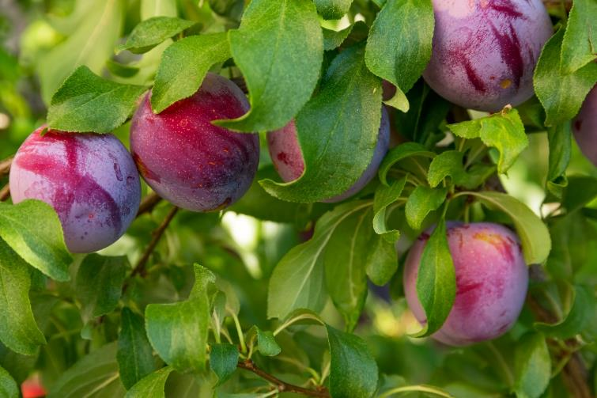
Stone fruit
Stone fruits are those that have a large, hard ‘stone’ in the middle of them that is not eaten.
Plums

Slide 20
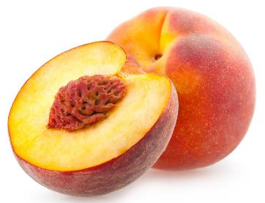
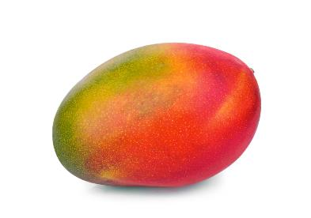
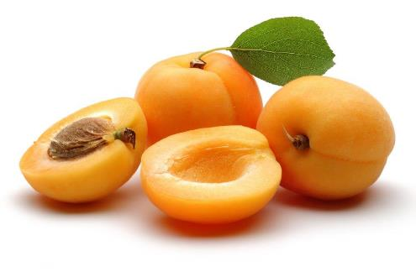
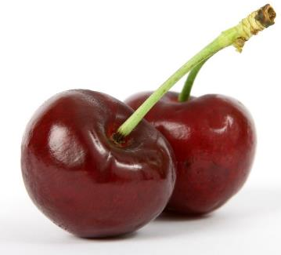
Stone fruit
Stone fruit include:
apricots;
cherries;
mangoes
peaches;
plums.
Mango
Peaches
Apricots
Cherries

Slide 21
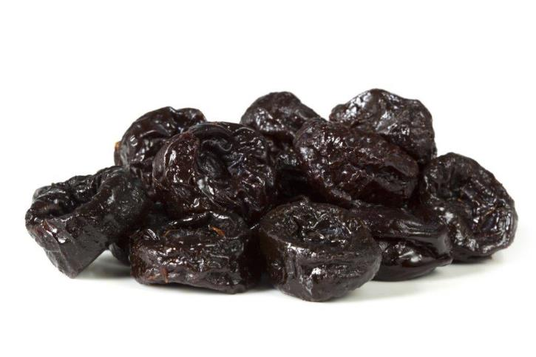
Prunes
Sweet black plums are often dried to make prunes.

Slide 22
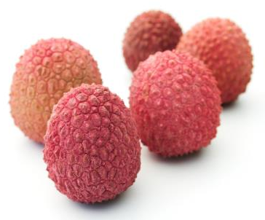
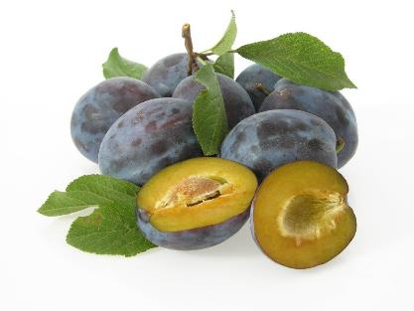
Stone fruit
Less common examples of stone fruit include:
damsons;
lychees.
Lychees
Damsons

Slide 23
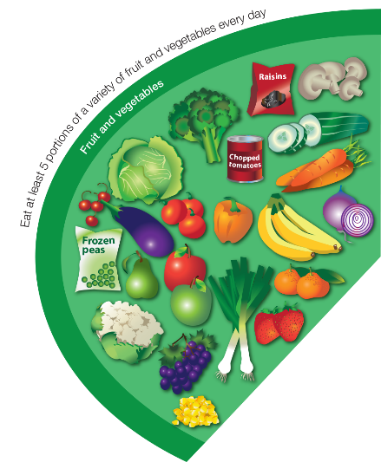
The importance of fruit and vegetables
We should all aim to have at least 5 portions of a variety of fruit and vegetables each day.
Fruit and vegetables should make up around one third of what we eat each day.
Fruit and vegetables are an important part of a healthy, balanced diet, as some types are good sources of fibre, as well as providing lots of essential vitamins and minerals.
Eating lots of fruit and vegetables can help you maintain a healthy weight (as they are naturally low in calories) and having your 5 A DAY could reduce your risk of some diseases.

Slide 24
Fruit – what counts towards your 5 A DAY?
All fruit counts, including fresh, frozen, canned, dried and juiced varieties.
A portion of fruit is 80g, or for children, around the amount that fits into the palm of their hands.
A 150ml smoothie or a glass of unsweetened 100% fruit juice counts as a maximum of one portion of your 5 A DAY (because when a fruit is juiced or blended, sugars are released which can cause damage to teeth).
One portion of dried fruit is 30g, and this counts one a portion of your 5 A DAY.

Slide 25
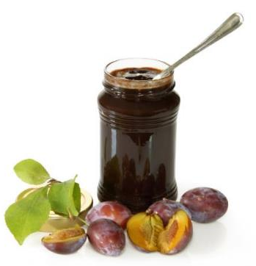
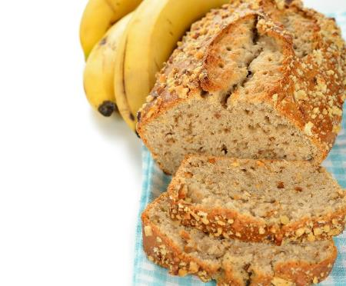
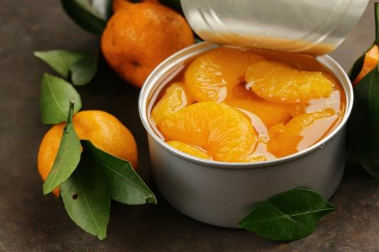
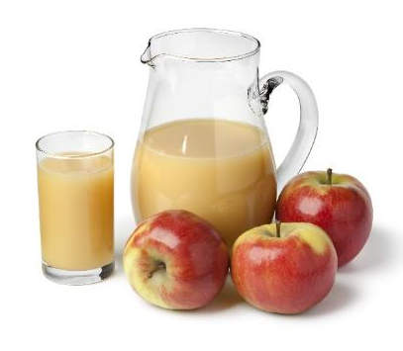
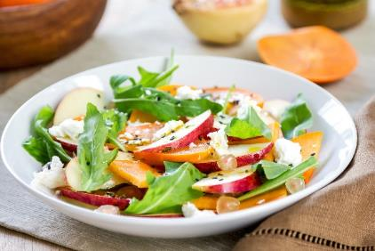
Cooking and eating fruit
Fruit can be eaten raw, just wash first and remove any large stones or peel.
Fruit can also be canned, dried, frozen, juiced or cooked and made into dishes.

Slide 26
Fruit
For further information, go to:
www.foodafactoflife.org.uk
This resource meets the Guidelines for producers and users of school education resources about food.

