Slide 1
Fruit

Slide 2
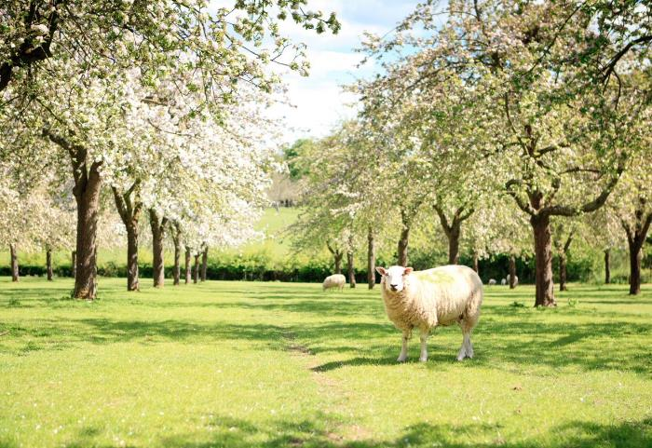
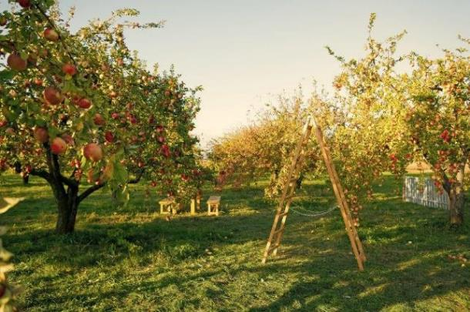
Fruit
Fruit are the mature ripened ovaries of flowers.
One of the main purposes of fruit is to spread the seeds of the plant.
Fruit can be classified as:
berries;
citrus fruit;
fleshy fruit;
pomes;
stone fruit.
Apples trees in flower
Apples trees in fruit

Slide 3
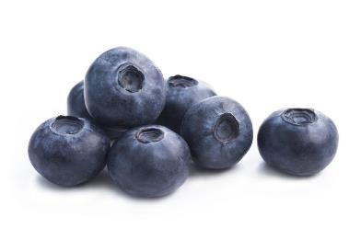
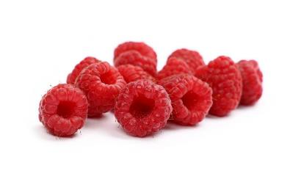
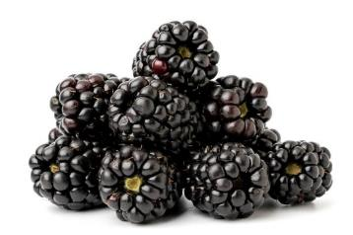
Berries
A berry is a small, sweet fruit. They are often coloured red, blue or black.
True berries are defined as a fleshy fruit where the entire ovary wall (in a single flower) ripens into a fruit.
Cranberries and blueberries, are formed from both the ovary and other parts of the flower and are known as ‘false berries’.
Blackberries and raspberries are known as aggregate fruits, and have lots of individual ‘drupelets’. They are formed from a single flower, but from a number of separate carpels (female reproductive parts) within that flower.
Blueberries
Raspberries
Blackberries

Slide 4
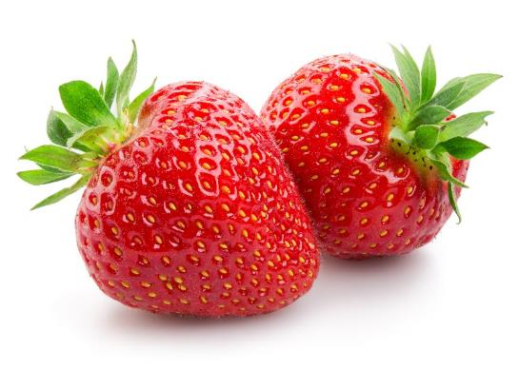
Berries
Berries also include:
blackcurrants;
grapes;
strawberries.
Strawberries are also known as an accessory fruit as the flesh has resulted from the receptacle of the flower.
Strawberries

Slide 5
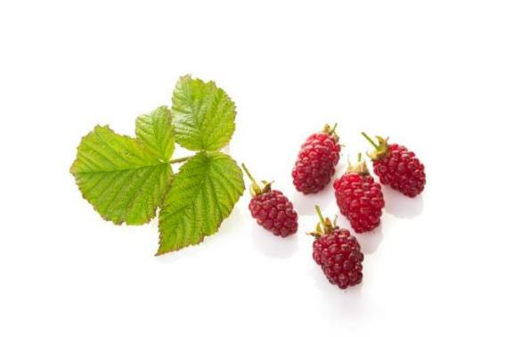
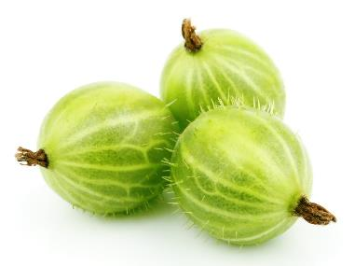
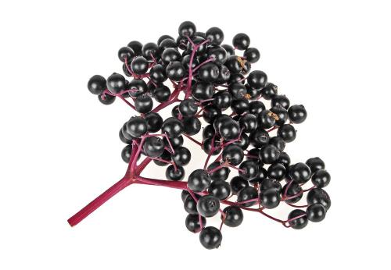
Berries
Lesson common examples of berries include:
elderberries;
goji berries;
gooseberries;
loganberries.
Loganberries
Gooseberries
Elderberries

Slide 6
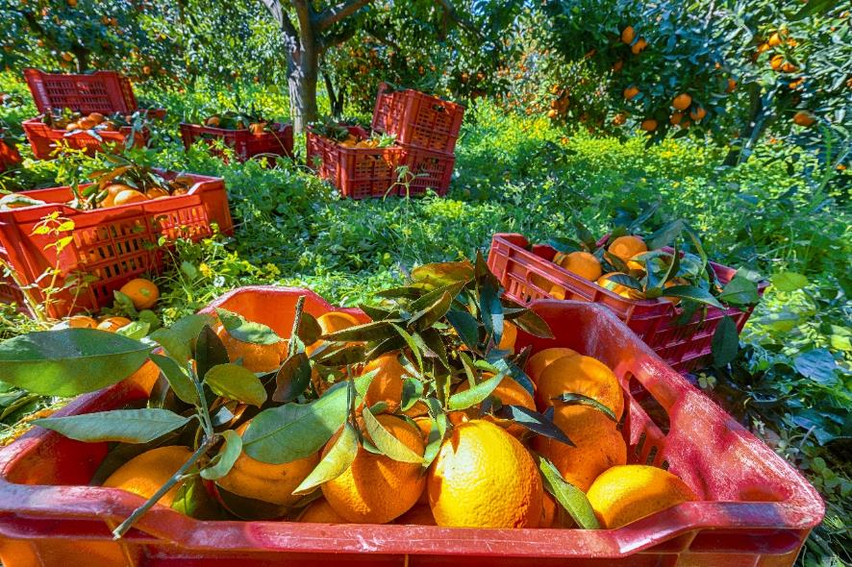
Citrus fruit
Citrus fruits are also berries, and are a type of berry known as hespiridiums (a berry with sections of pulp inside a peelable rind).
Oranges

Slide 7
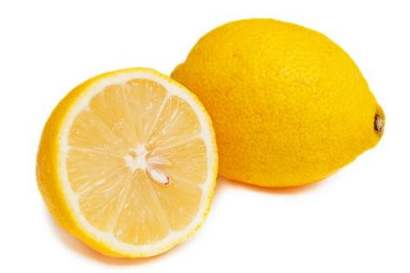
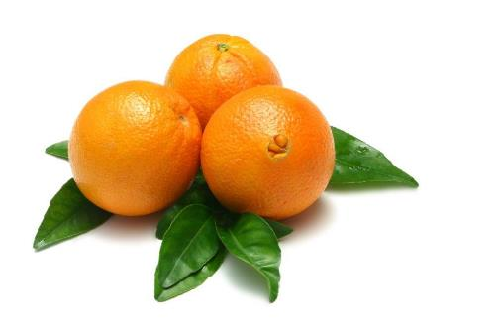
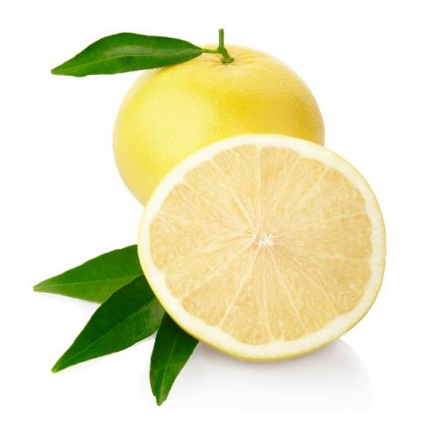
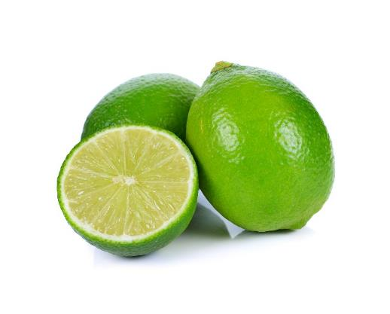
Citrus fruit
Citrus fruit include:
grapefruits;
lemons;
limes;
oranges.
Lemons
Navel oranges
Grapefruits
Limes

Slide 8
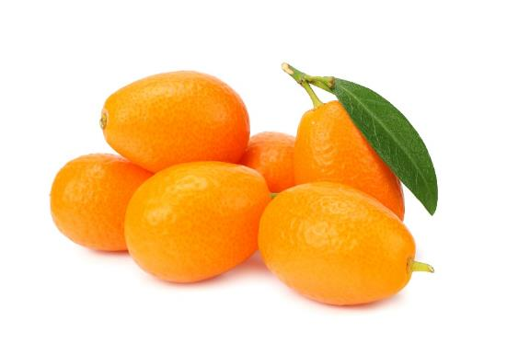
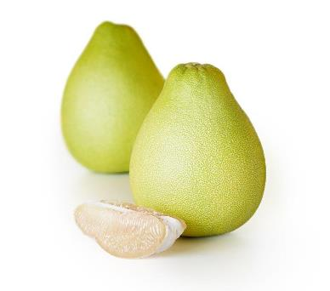
Citrus fruit
Lesson common examples of citrus fruit include:
bergamot;
kumquat;
pomelo.
Kumquats
Pomelo

Slide 9
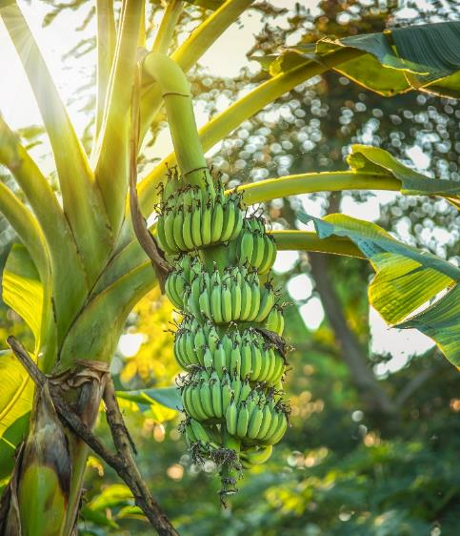
Fleshy fruit
These fruits are usually fairly large and do not have a central stone.
Often, the seeds in the fruit are eaten along with the flesh as they are small and soft, but this is not true with melons.
Bananas

Slide 10
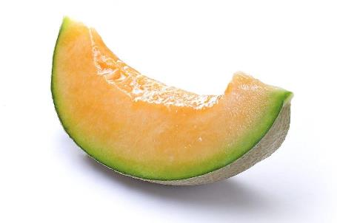
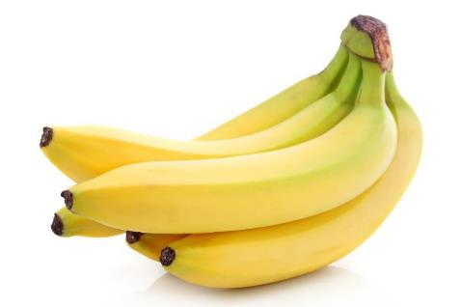
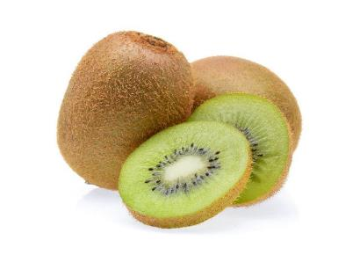
Fleshy fruit
Fleshy fruit include:
bananas;
kiwi fruit;
melons.
Melon
Bananas
Kiwi fruit
Melons are, botanically speaking, berries and are part of a particular group of berries known as pepoes (a type of berry with a hard rind).

Slide 11
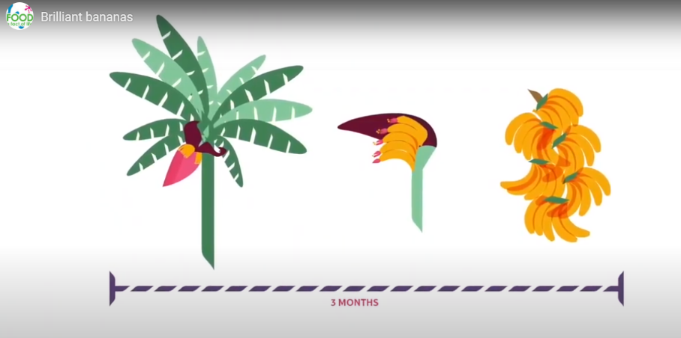
Growing and harvesting bananas
To find out more about growing and harvesting bananas, watch this Brilliant bananas – from field to fork video.
Click on the image to play the video

Slide 12
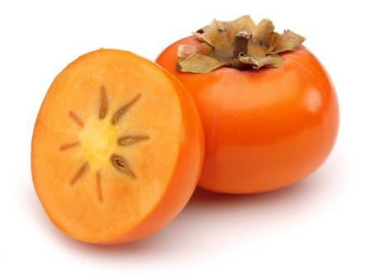
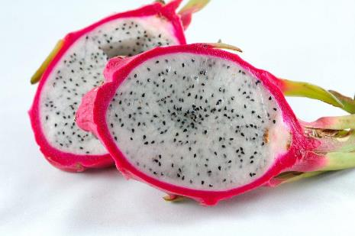
Fleshy fruit
Less common examples of fleshy fruit include:
dragon fruit;
mangosteen;
persimmon;
guava.
Persimmon
Dragon fruit

Slide 13
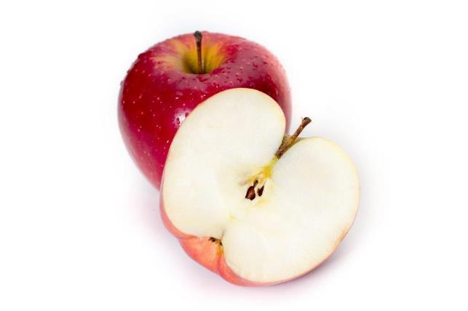
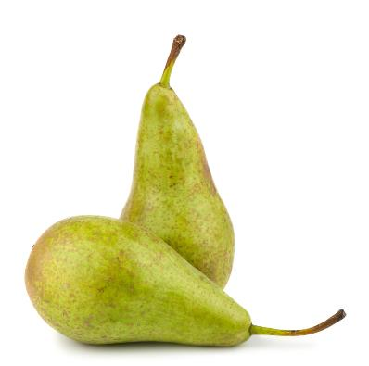
Pomes
Apples and pears are a special type of fruit called a ‘pome’.
Pomes are berry-like fruits, with a large portion of outer flesh and a tough ‘core’ which contains the seeds (usually five.)
Apples
Pears

Slide 14
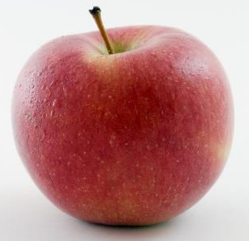
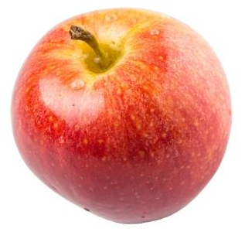
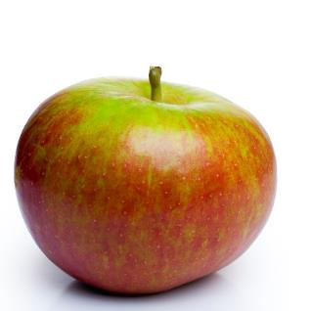
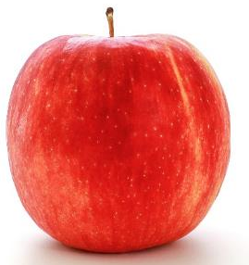
Apple varieties
There are lots of different types apple – 3,000 varieties in the UK!
They have different names, such as:
Braeburn;
Cox;
Jazz;
Royal gala.

Slide 15
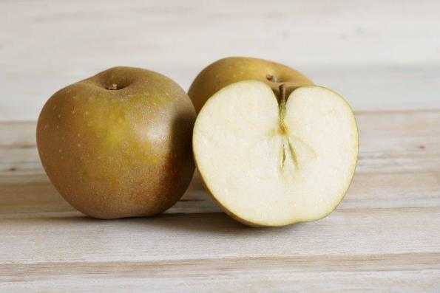
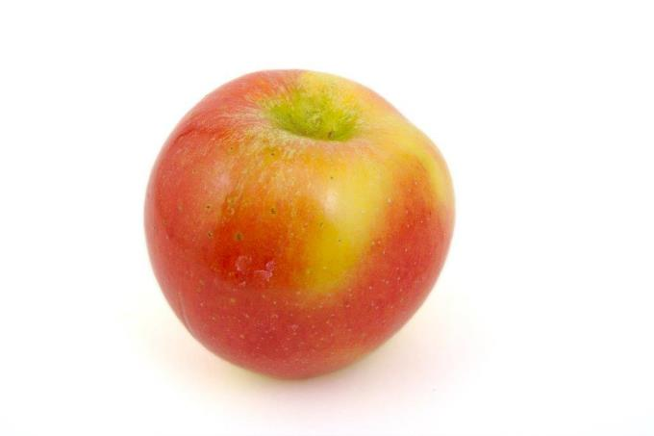
Apple varieties
Less well known apple varieties include:
Cameo;
Egremont Russet;
Kanzi;
Ruebens;
Worcester Pearmain.
Egremont Russet
Red Kanzi

Slide 16
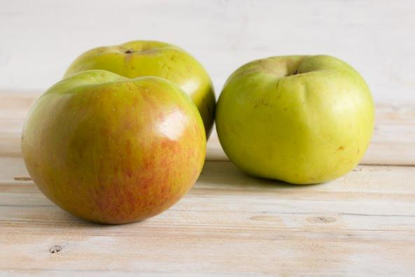
Cooking apples
Bramley apples are traditionally used for cooking.
The first Bramley tree grew from pips planted by a young girl, Mary Ann Brailsford, in her garden in England in 1809.

Slide 17
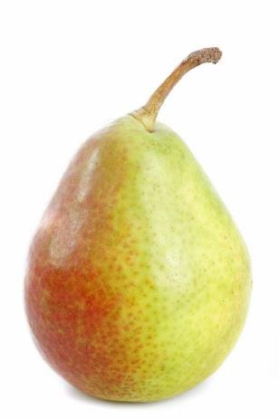
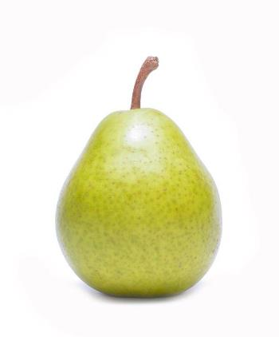
Pears
Pear varieties include:
Conference;
Comice;
Williams.
Conference
Comice
Williams

Slide 18
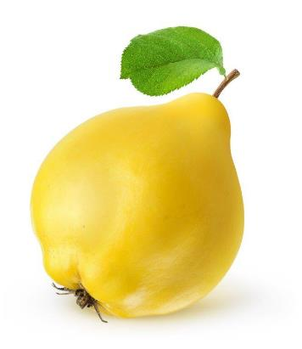
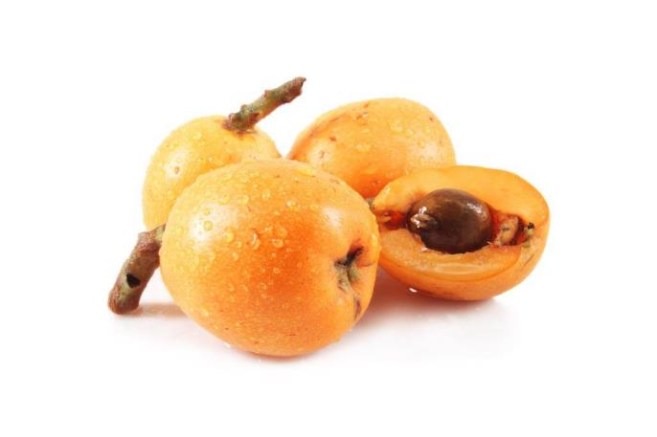
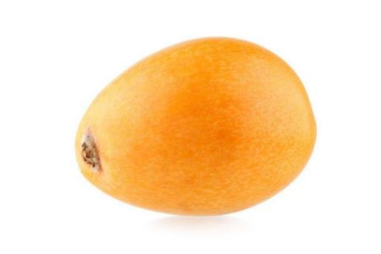
Pomes
Less common examples of pomes are:
loquat;
medlar;
quince.
Quince
Medlar
Loquat

Slide 19
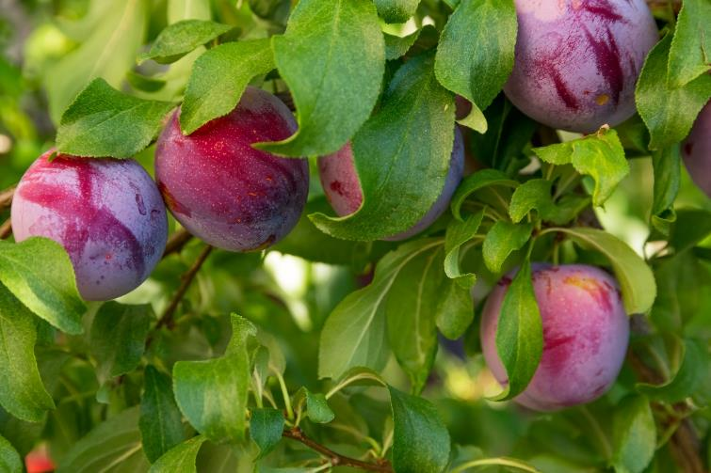
Stone fruit
Stone fruits are also known as drupes. A drupe is defined as a fleshy fruit containing a single seed (also known as a pit or stone), which is not eaten.
Plums

Slide 20
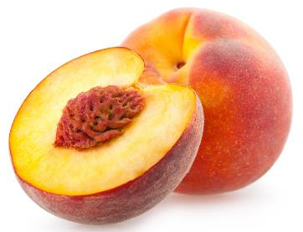
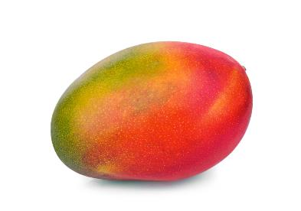
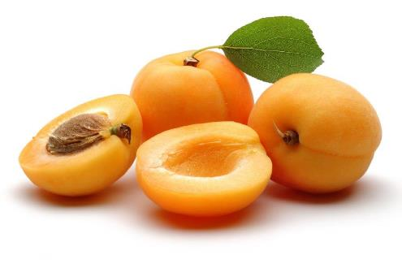
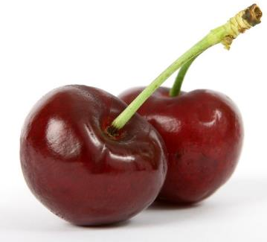
Stone fruit
Stone fruit include:
apricots;
cherries;
mangoes
peaches;
plums.
Mango
Peaches
Apricots
Cherries

Slide 21
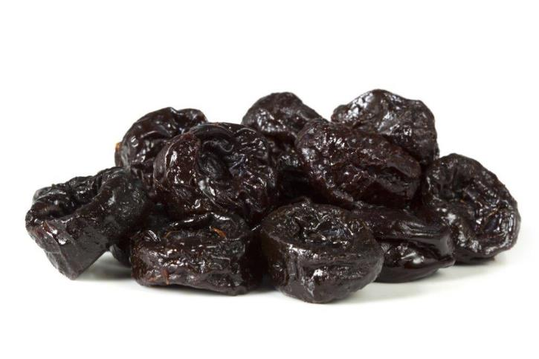
Prunes
Sweet black plums are dried to make prunes.

Slide 22
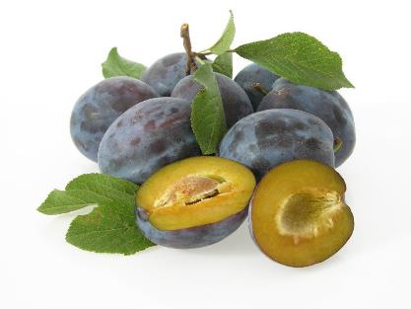
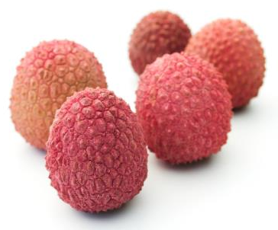
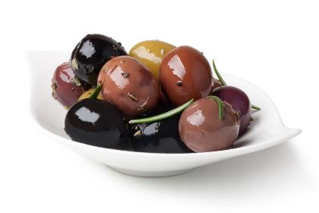
Stone fruit
Less common examples of stone fruit include:
damsons;
lychees.
Lychees
Damsons
The more savoury olive, is also a drupe.
Olives

Slide 23
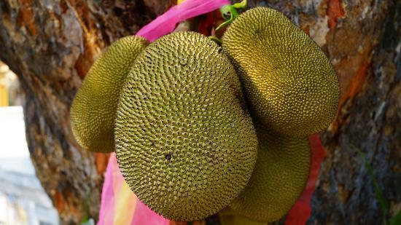
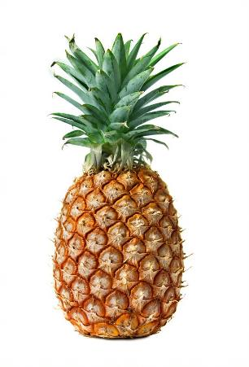
Multiple fruit
Multiple fruits are fruits that are formed from separate flowers, but that fuse together into a single mass.
Examples of multiple fruits include:
breadfruit;
figs;
jackfruit (often eaten in savoury dishes);
mulberries;
pineapples.
Jackfruit
Pineapples

Slide 24
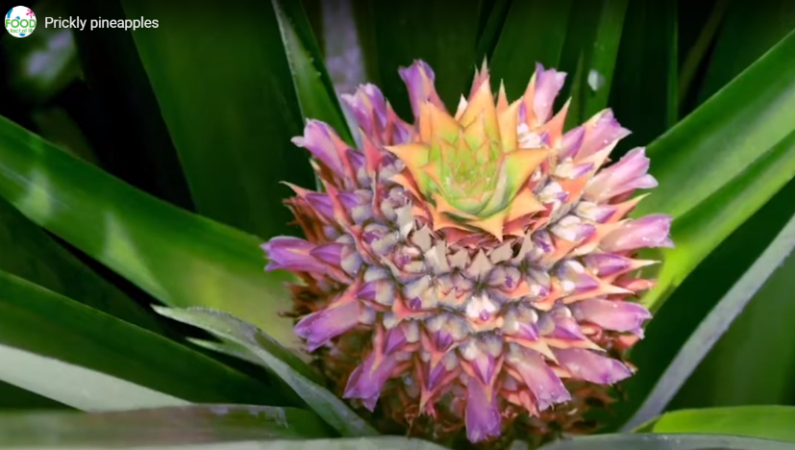
Growing and harvesting pineapples
To find out more about growing and harvesting pineapples, watch this Prickly pineapples – from field to fork video.
Click on the image to play the video

Slide 25
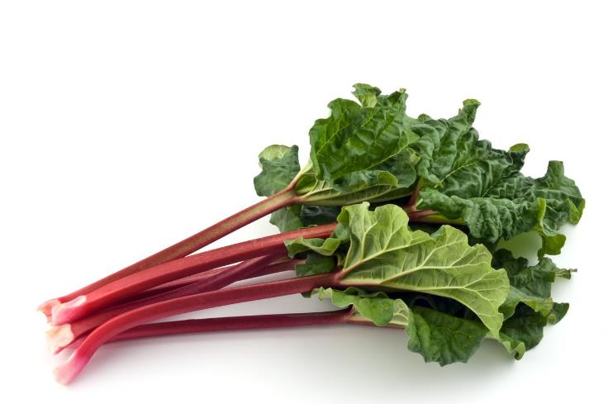
Rhubarb
Rhubarb was originally grown as a vegetable crop in England and Scandinavia in the 18th Century.
It is now more commonly known as a fruit and cooked in both sweet and savoury dishes.
The pink fleshy stalk of the plant is edible but the leaves are poisonous so should not be eaten. Hands should be washed after touching the leaves.
Rhubarb

Slide 26

The importance of fruit and vegetables
We should all aim to have at least 5 portions of a variety of fruit and vegetables each day.
Fruit and vegetables should make up around one third of what we eat each day.
Fruit and vegetables are an important part of a healthy, balanced diet, as some types are good sources of fibre, as well as providing lots of essential vitamins and minerals.
Eating lots of fruit and vegetables can help you maintain a healthy weight (as they are naturally low in calories) and having your 5 A DAY could reduce your risk of some diseases.

Slide 27
Fruit – what counts towards your 5 A DAY?
All fruit counts, including fresh, frozen, canned, dried and juiced varieties.
A portion of fruit is 80g, or for children, around the amount that fits into the palm of their hands.
A 150ml smoothie or a glass of unsweetened 100% fruit juice counts as a maximum of one portion of your 5 A DAY (because when a fruit is juiced or blended, sugars are released which can cause damage to teeth).
One portion of dried fruit is 30g, and this counts one a portion of your 5 A DAY.

Slide 28





Cooking and eating fruit
Fruit can be eaten raw, just wash first and remove any large stones or peel.
Fruit can also be canned, dried, frozen, juiced or cooked and made into dishes.

Slide 29
Fruit
For further information, go to:
www.foodafactoflife.org.uk
This resource meets the Guidelines for producers and users of school education resources about food.

