Slide 1
A thematic approach to teaching food and nutrition in primary schools
24/3/2021

Slide 2
Covered in today’s webinar
Thematic learning in primary schools and using food as a context.
A look at the types of thematic packs available on Food – a fact of life.
An introduction to two new thematic packs, Victorians and Space, and what they include.
An introduction to the resources available, and how these support learning.
Get inspiration on how the packs can be used in primary schools throughout the UK.
Links to Food – a fact of life resources.
Suggestions for further reading and sources of information.

Slide 3

Why take a themed approach?
A thematic pack is a series of lessons and activities with a ‘theme’.
Many areas of the curriculum can be linked together under a theme.
Gives context to learning – helping pupils to grasp concepts, makes learning more connected, less fragmented.
Help to motivated pupils - get them curious.
Provide a meaningful way to explore food and nutrition concepts through other learning, such as history, families, technology.
Unifies everything you teach – skills, concepts, lessons, and more – under a single topic, theme or an overarching question or ‘big idea’.
Packs are created to advance understanding of the theme.

Slide 4
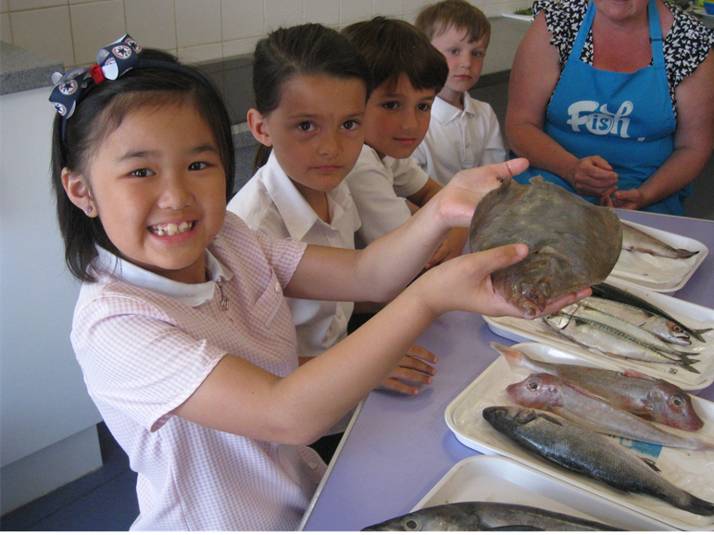
Two ways to take a thematic approach to teaching using Food – a fact of life resources
Build your own!
Fish
Potatoes
Ready to use!
Vegetables
Fibre
Harvest
Victorians
Space

Slide 5
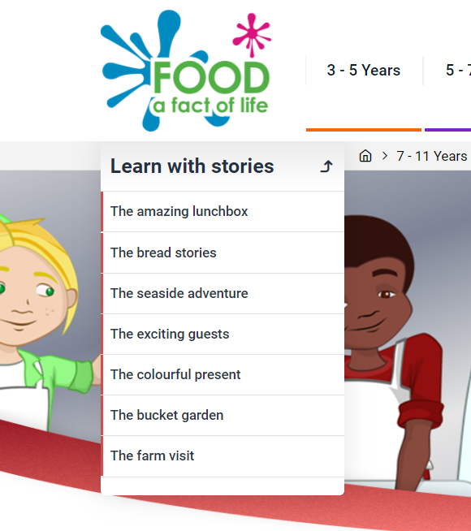
Build your own thematic pack
Build your own!
Decide on your food theme… you could start with the use the Learn with stories themes
Search your food theme on Food – a fact of life for more resources and recipes suitable for the age of your pupils
Create a collection using the Food – a fact of life Dashboard

Slide 6
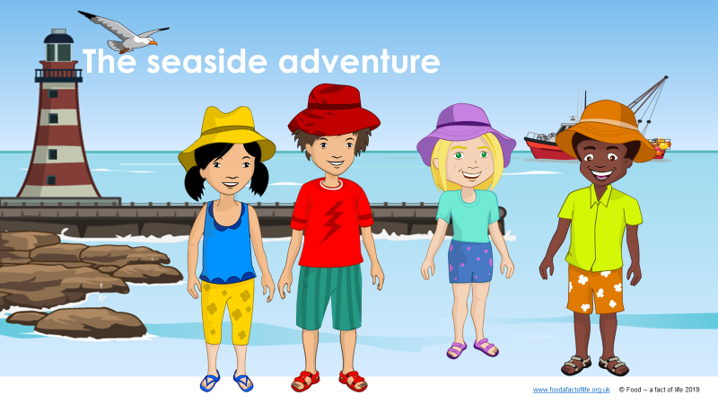
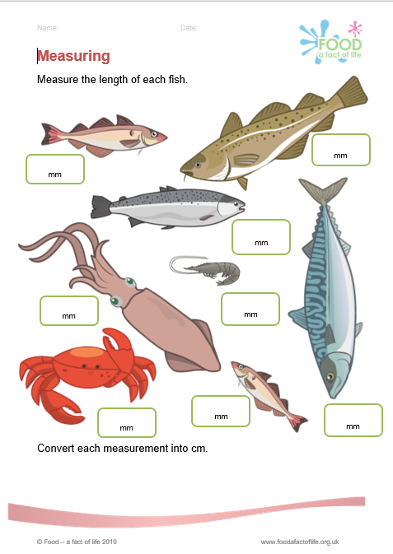
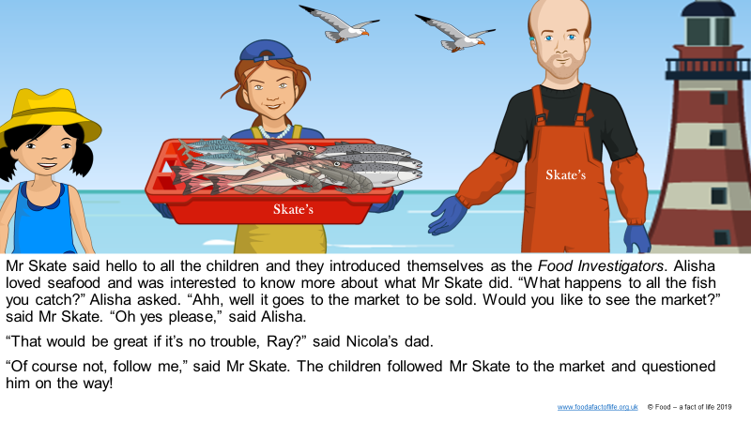
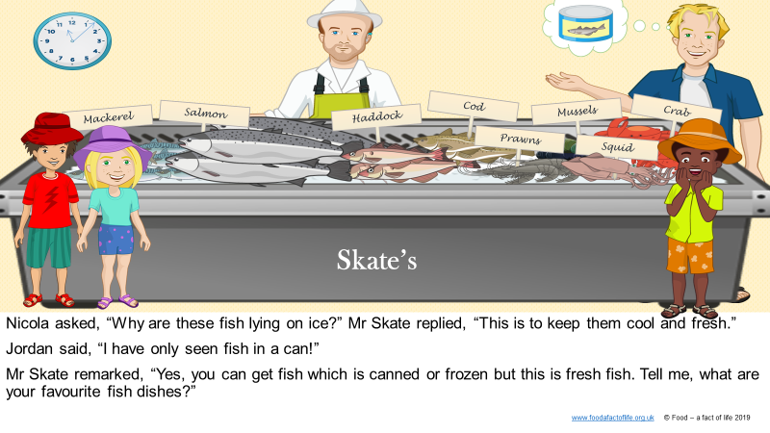
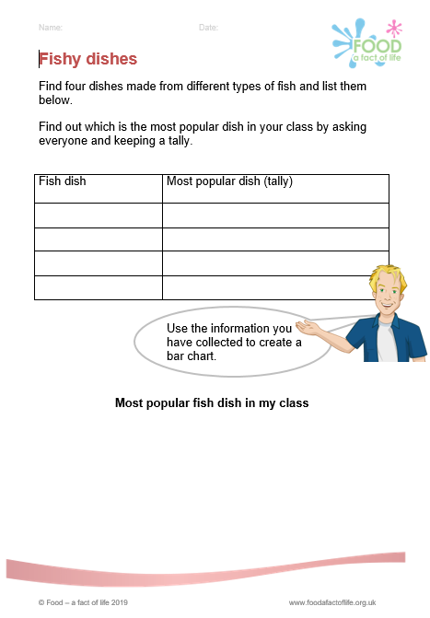
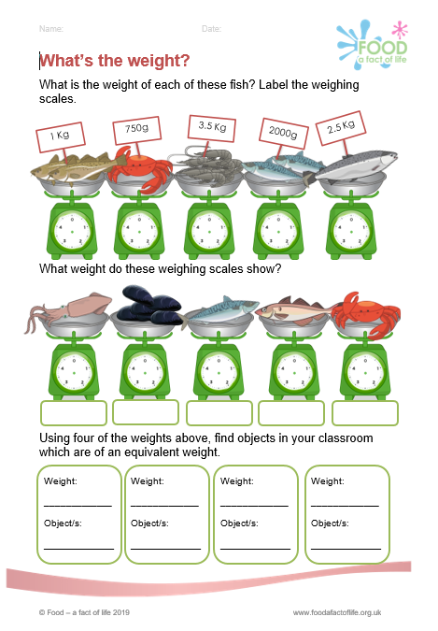
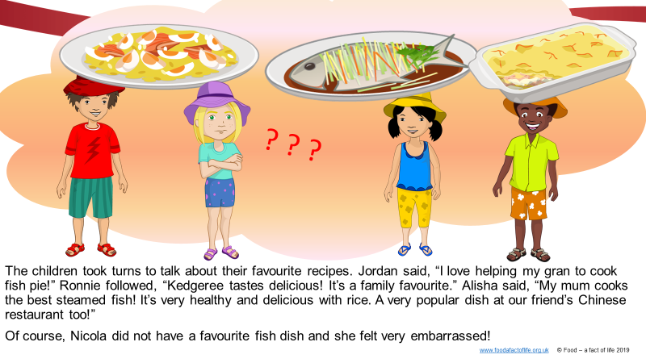
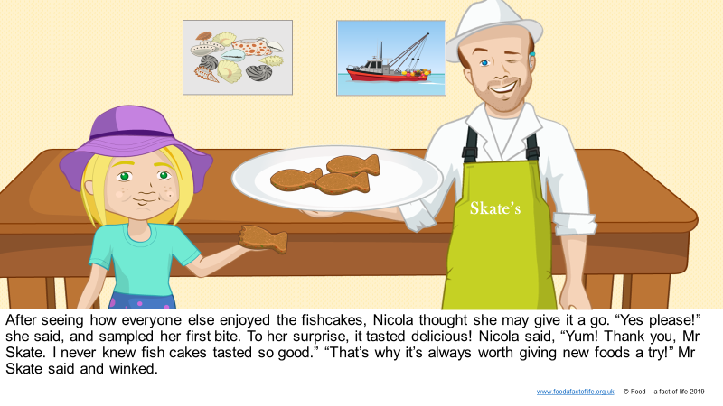
Build your own thematic pack – fish
1. Start with… Learn with stories –
The seaside adventure, about:
Catching fish - fishing
Fish available – varieties
Fish dishes
Tasting fish
Fish themed literacy and numeracy
activity sheets
To find these resources:
7 - 11 Years > Activity packs > Learn with stories

Slide 7
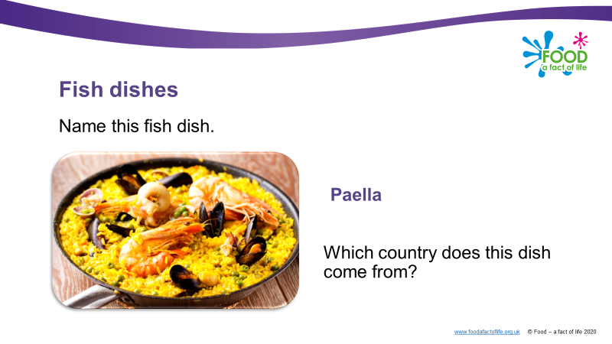
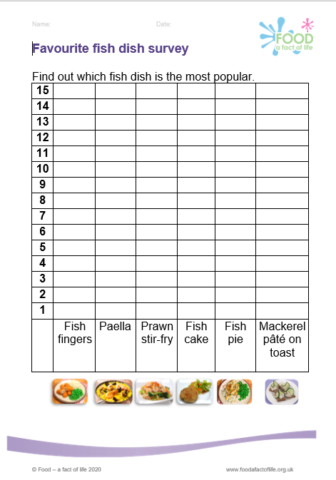
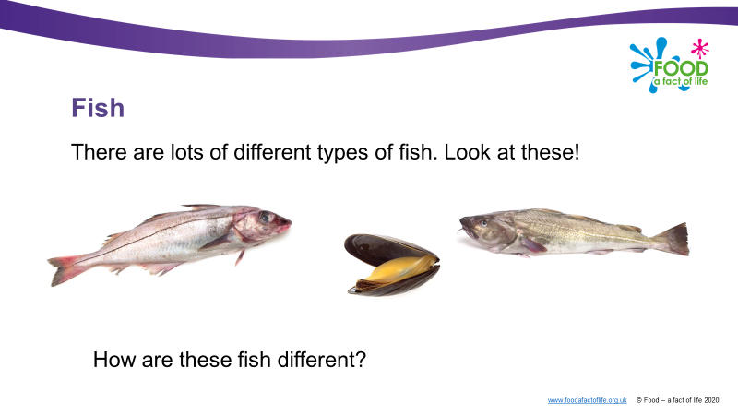
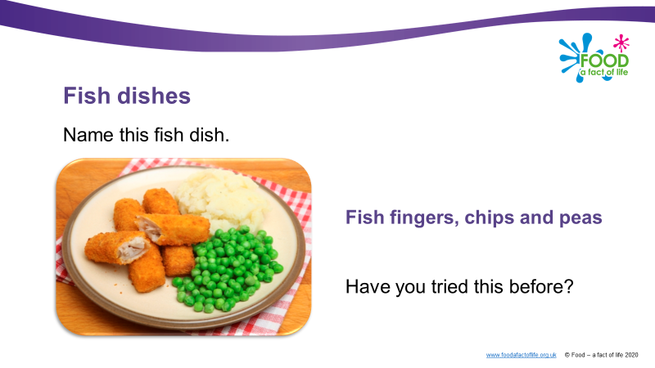
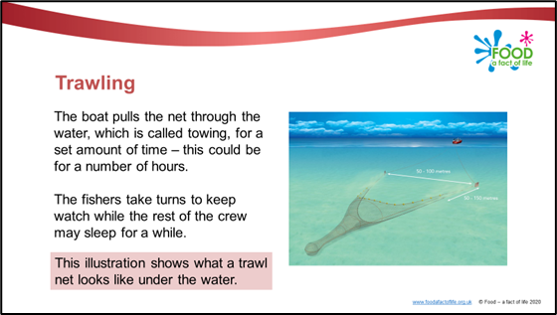
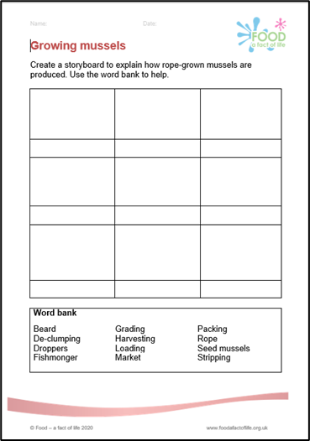
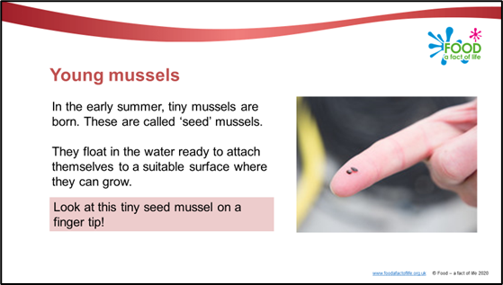
Build your own thematic pack – fish
2. Search Food –a fact of life for further fish resources
5-7 Years (Food commodities)
Presentations - Types of fish, Fish dishes
Activity sheets – investigations and surveys
7-11 Years (Food commodities)
Presentations - Being a fisher, Growing mussels, The fish and chip shop
Activity sheets – retelling how mussels are grown, and drawing and labelling a fish counter
To find these resources:
5-7 Years > Food commodities > Fish and shellfish / 7 - 11 Years > Food commodities > Fish and shellfish

Slide 8
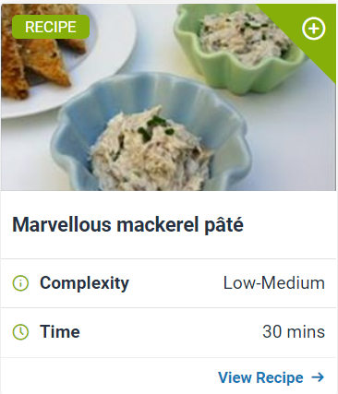
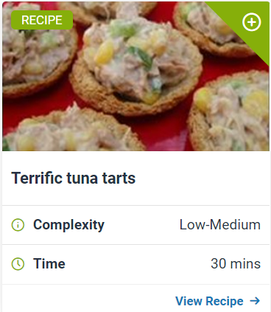
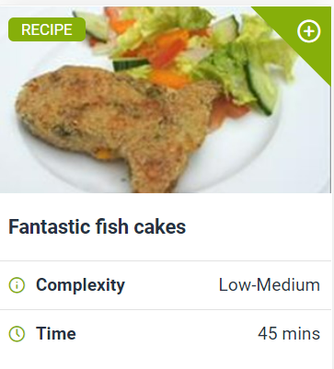
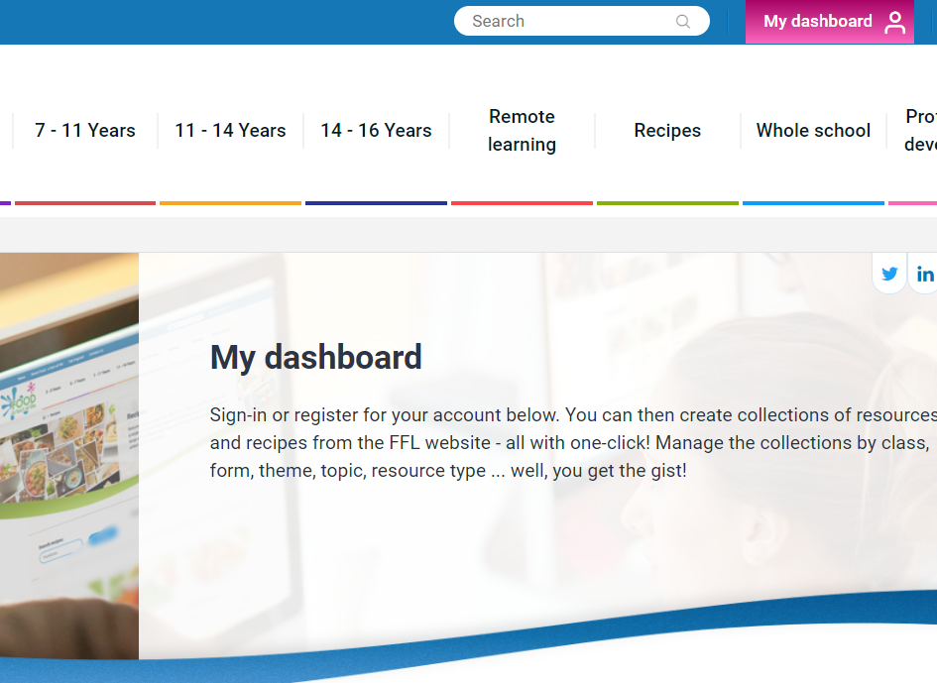
Build your own thematic pack – fish
3. Search Food – a fact of life for supporting recipes
For example, Terrific tuna tarts, Fantastic fish cakes, Marvelous mackerel pâté
4. Use the Food – a fact of life Dashboard facility to keep your resources together in a ‘collection’
To find these resources:
5-7 Years > Food commodities > Fish and shellfish / 7 - 11 Years > Food commodities > Fish and shellfish

Slide 9
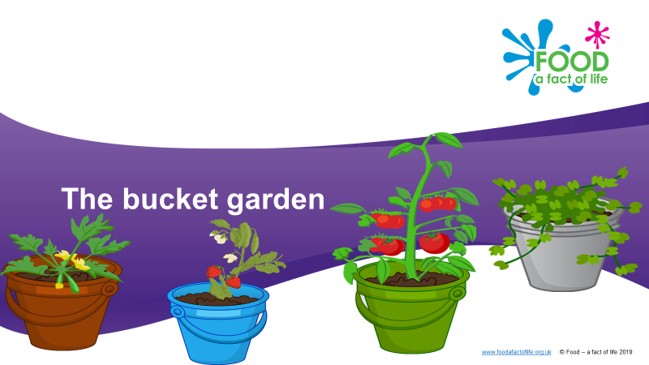
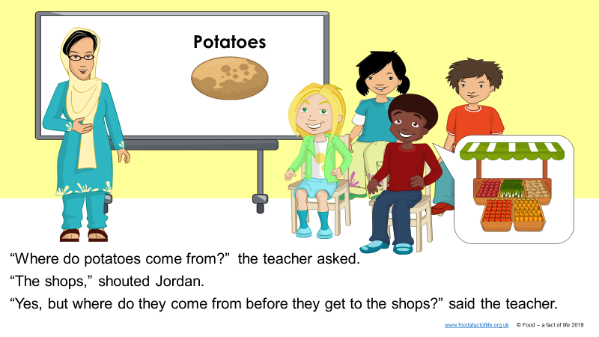
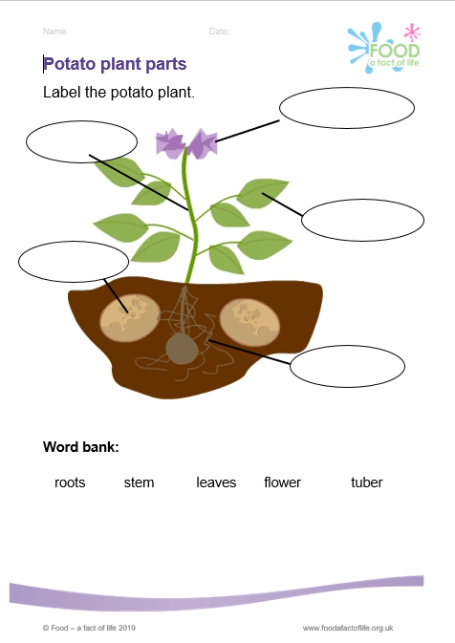
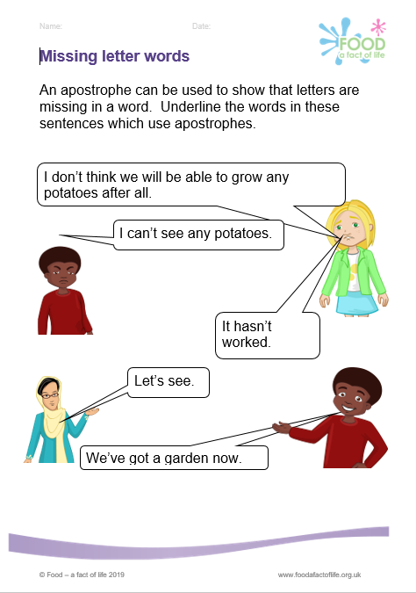
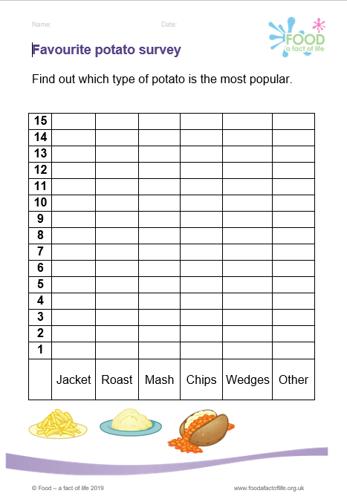
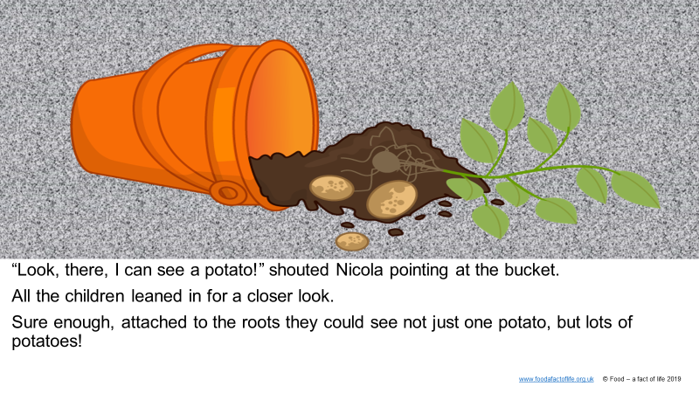
Build your own thematic pack – potatoes
1. Start with… Learn with stories –
The bucket garden, about:
Growing potatoes
Potato themed literacy and numeracy activity sheets
To find these resources:
5-7 Years > Activity packs > Learn with stories Visit www.growyourownpotatoes.org.uk for potato growing kits

Slide 10
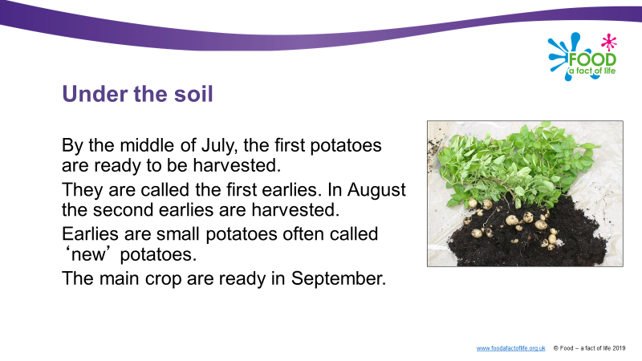
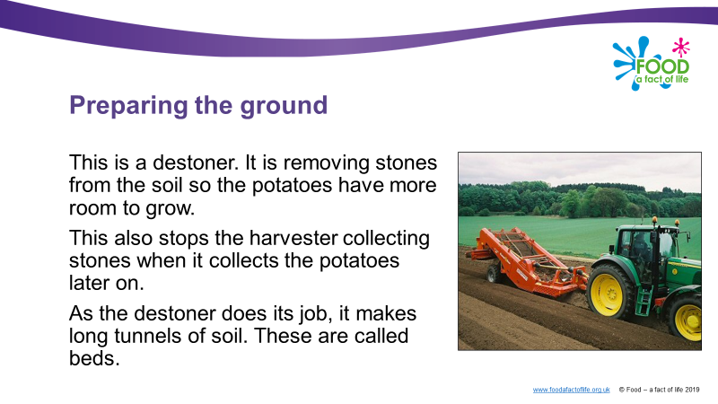
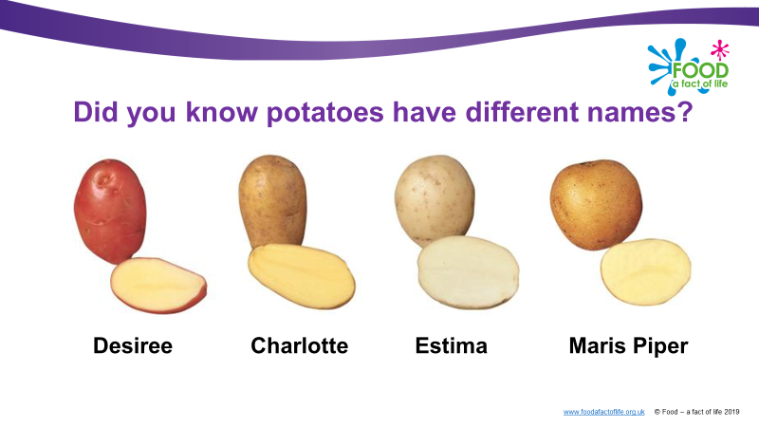
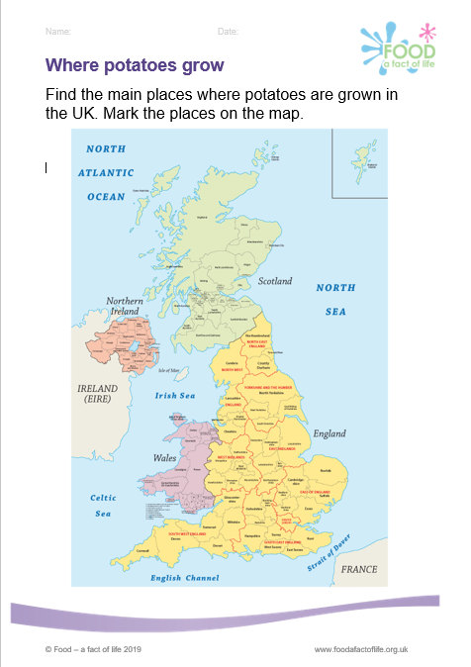
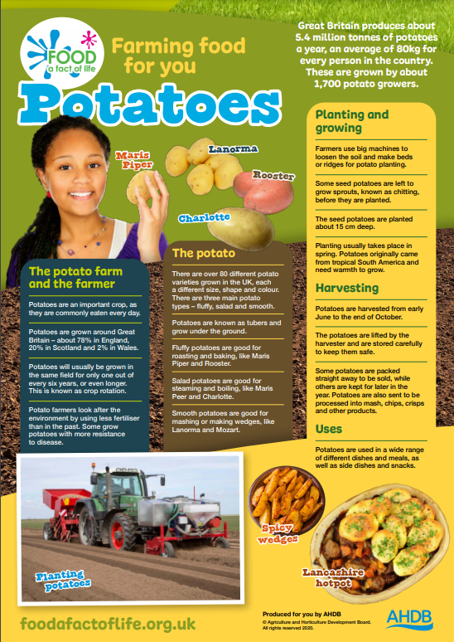
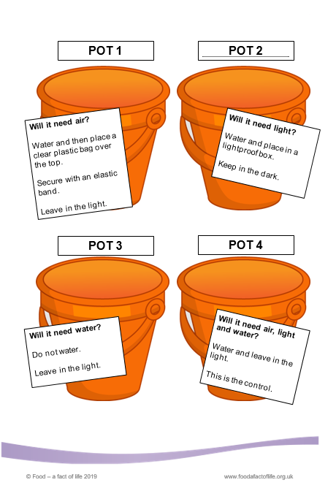
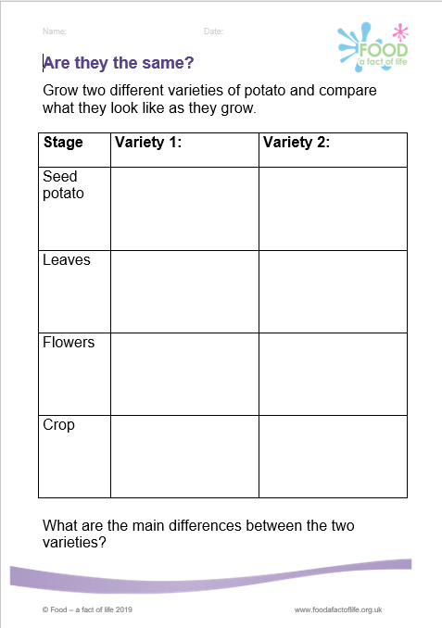
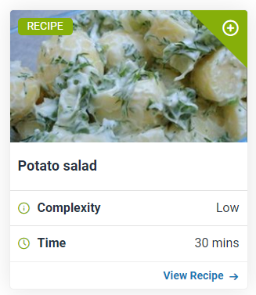
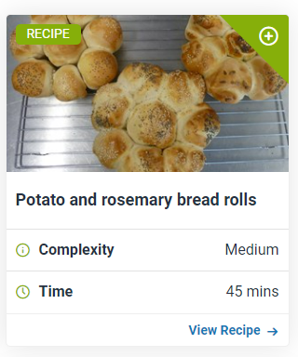
Build your own thematic pack – potatoes
2. Search Food –a fact of life for further potato resources and recipes
For example:
presentations about potato varieties, how they are farmed, potato dishes;
activity sheets about locating where potatoes grow in the UK, investigating the best conditions for growing potatoes.
3. Use the Food – a fact of life Dashboard facility to keep your resources together in a ‘collection’
To find these resources:
5-7 Years > Food commodities > Potatoes
7 - 11 Years > Food commodities > Potatoes

Slide 11
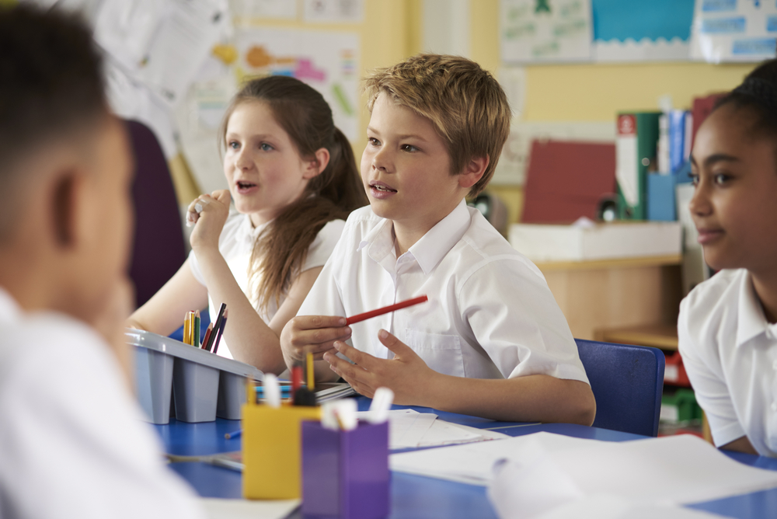
Ready to use thematic packs
Vegetables
Fibre
Harvest
Victorians
Space

Slide 12
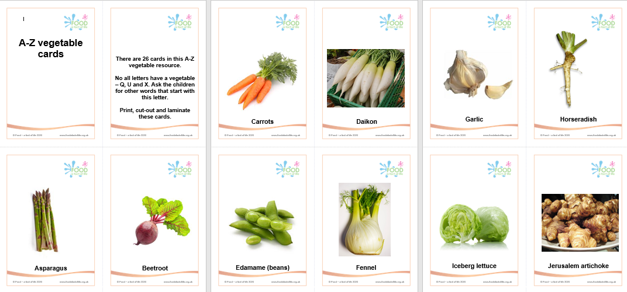
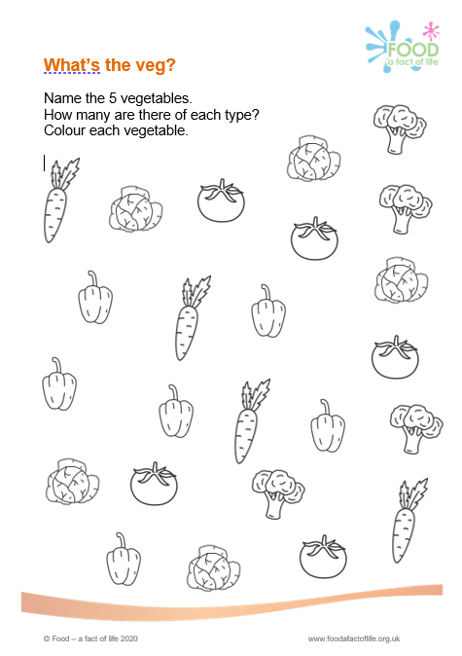
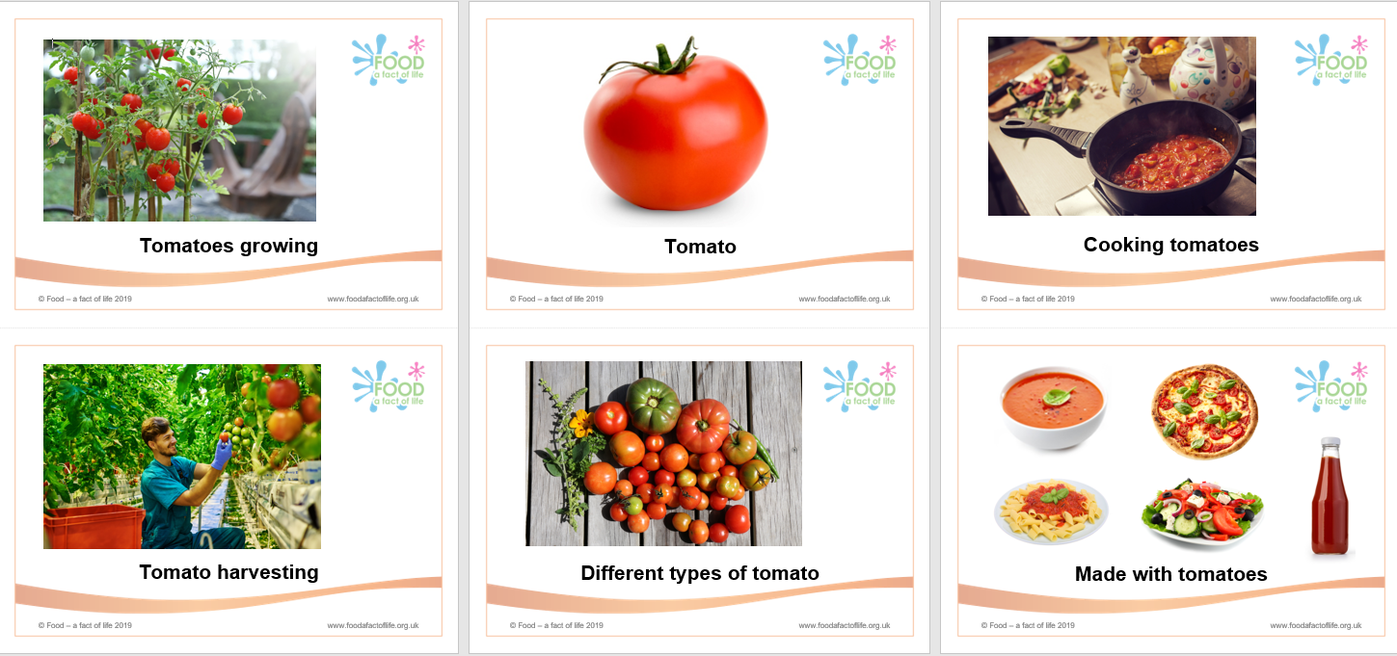
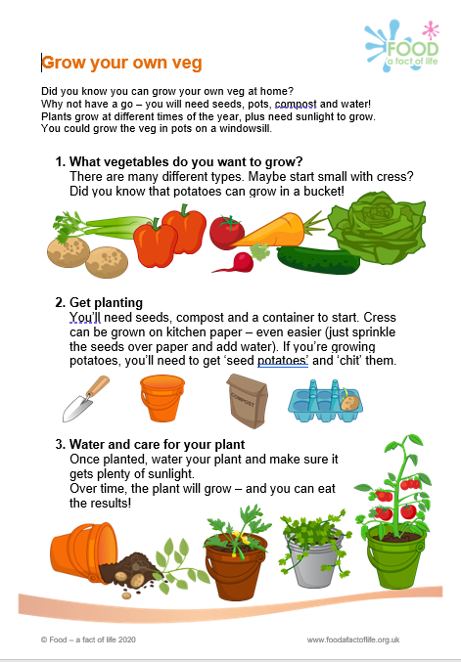
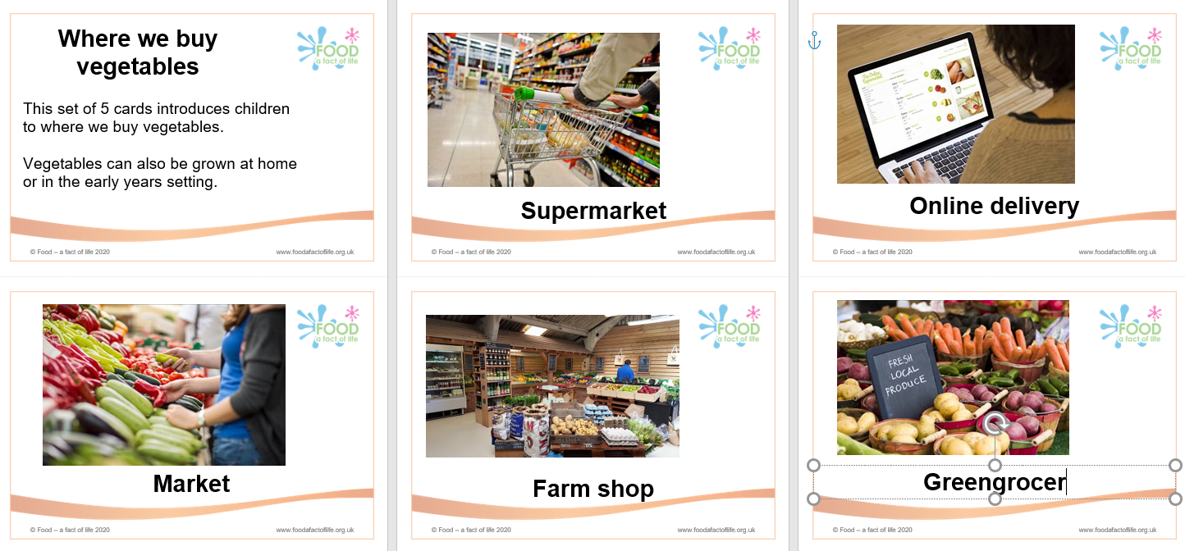
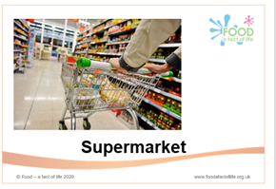
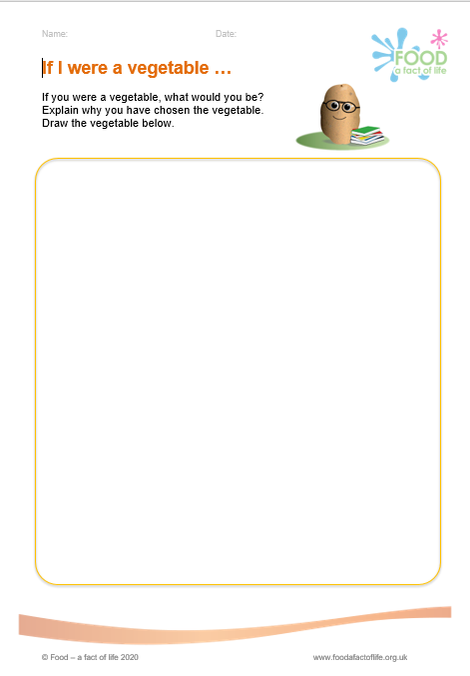
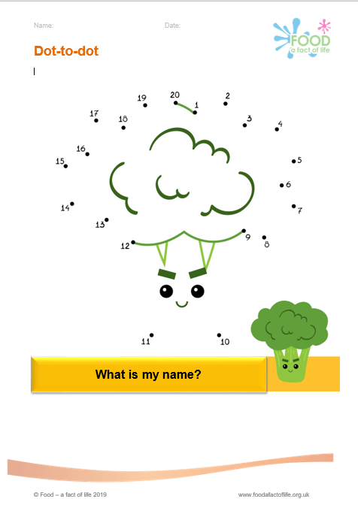
Theme: Vegetables (3-5 years)
Supports
Learning about healthy eating – vegetables (5 A DAY)
Encourages vegetable consumption (Reading University research)
Where food come from (vegetables)
Includes
Image cards – A-Z, where vegetables can be bought, farm to fork (sequencing)
Activity sheets
To find these resources: 3-5 Years > Activity packs > Vegetable activity pack Vegetable ebooks: https://www.seeandeat.org/

Slide 13
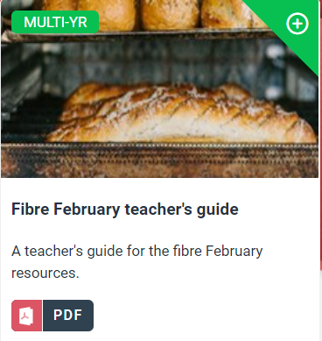
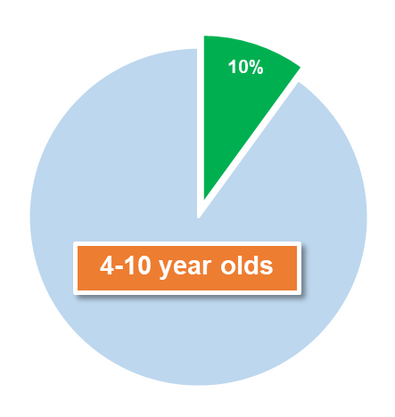
Theme: Fibre
Supports
Learning about healthy eating – fibre (fibre recommendations, amount of fibre in different food)
Numeracy (decimals)
Includes
Teachers’ guide, games, activity sheets, fibre cards
Age | Recommended intake per day | Average intake per day | % meeting recommendation
1.5-3 years | 15g* | 10.3g | 10%
4-10 years | 20g* | 14.0g | 10%
11-18 years | 25g* | 15.3g | 4%
19-64 years | 30g | 19.0g | 9%
65+ years | 30g | 17.5g | 7%
To find these resources: 7 - 11 Years > Activity pack > Fibre activity pack

Slide 14
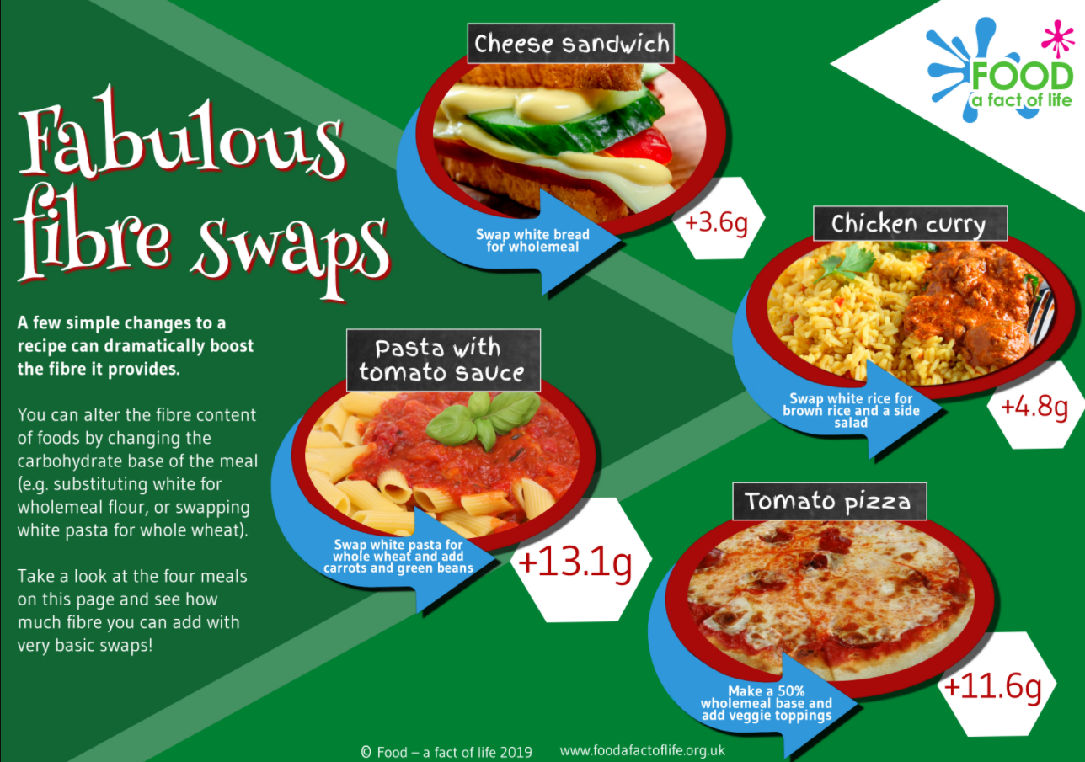
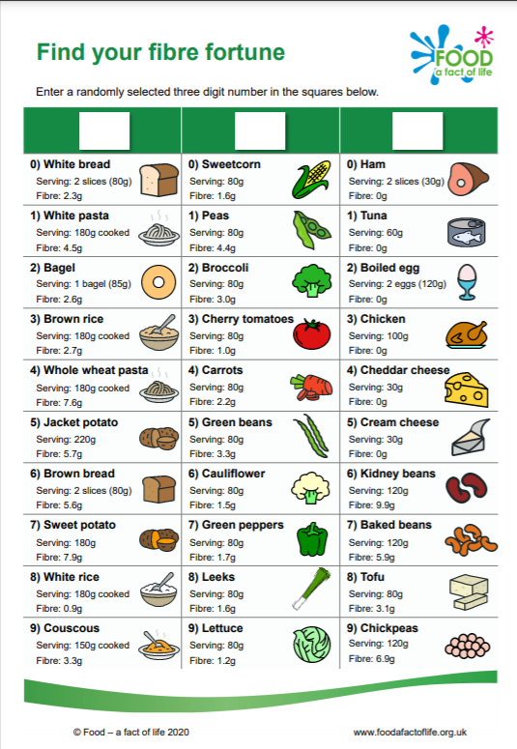
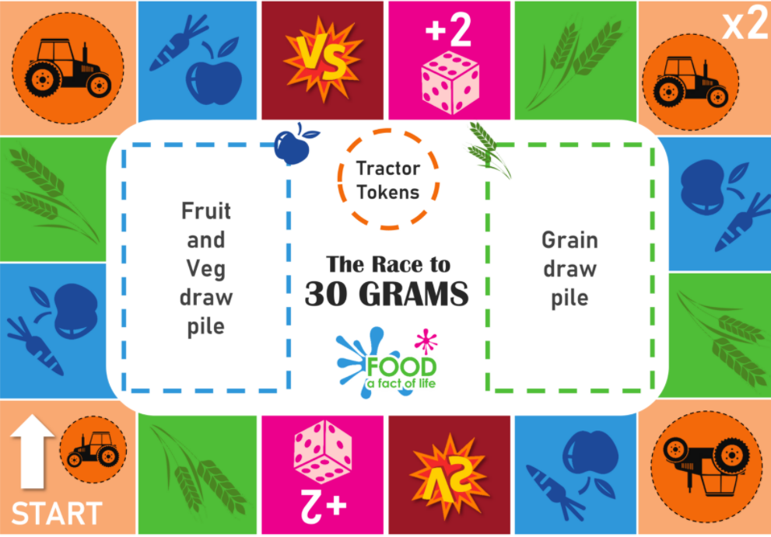





Theme: Fibre
To find these resources: 7 - 11 Years > Activity pack > Fibre activity pack
Simple nutritional analysis tool (on Food – a fact of life), Explore Food

Slide 15







Theme: Harvest festival
Supports
Introducing the context of harvest festival
History and social dimensions
Harvesting today (and the grain chain)
Practical aspects of harvest
Includes
Presentations, quizzes, games, sequencing cards
To find these resources: 7 - 11 Years > Activity packs > Harvest festival activity pack

Slide 16








Theme: Victorians (new!)
Supports
Learning about food in Victorian times – eating, shopping cooking
Seasonal food
Preserving food
Comparing Victorian and modern-day diets
Includes
Teachers guide, presentation, activity sheets and a recipe
To find these resources: 7-11 Years > Activity packs > Victorians (coming soon)

Slide 17








Theme: Space (new!)
Supports
Nutrition and human health
Comparing food on earth to food in space (requirements)
Physical activity
Preserving food, e.g. dehydrating
Includes
Teachers guide, presentation, activity sheets, game
To find these resources: 7-11 Years > Activity packs > Space (coming soon)

Slide 18
Wrap up!
To find out more and to book, go to: https://www.foodafactoflife.org.uk/training/
Feedback
We are planning to develop more thematic packs. We'd really like your feedback on what we've done, as well as ideas for the future. Let us know on the evaluation form.
More PPD information, support and newsletter sign-up: https://www.foodafactoflife.org.uk/professional-development/
More training
Webinar and conference recordings.
Online training including:
- Food teaching in primary – the why, what and how;
- Characteristics of good practice in teaching food and nutrition education in primary schools.

Slide 19
A thematic approach to teaching food and nutrition in primary schools
For further information, go to:
www.foodafactoflife.org.uk

