Slide 1
Cauliflower

Slide 2
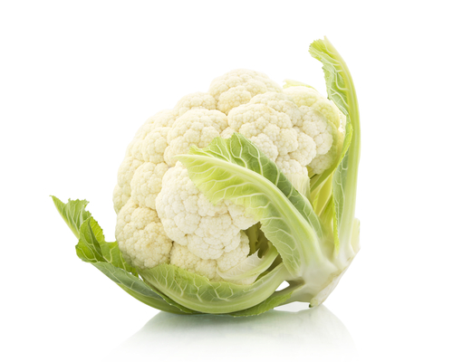
What is this?
This is a cauliflower, it is the flower of a plant (vegetable).
The flowers of the plant are used to help them be pollinated.
Some flowers are edible, but many others are not.

Slide 3
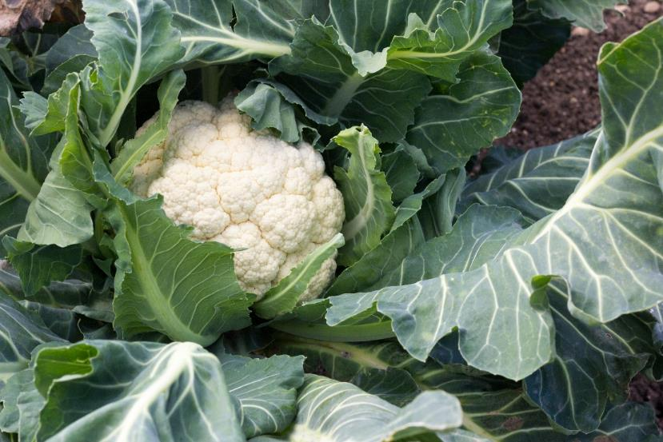
Where does cauliflower come from?
Cauliflowers grow in the UK.
Cauliflower is a plant.
They grow above the ground.
Cauliflower is the flower of a plant.

Slide 4
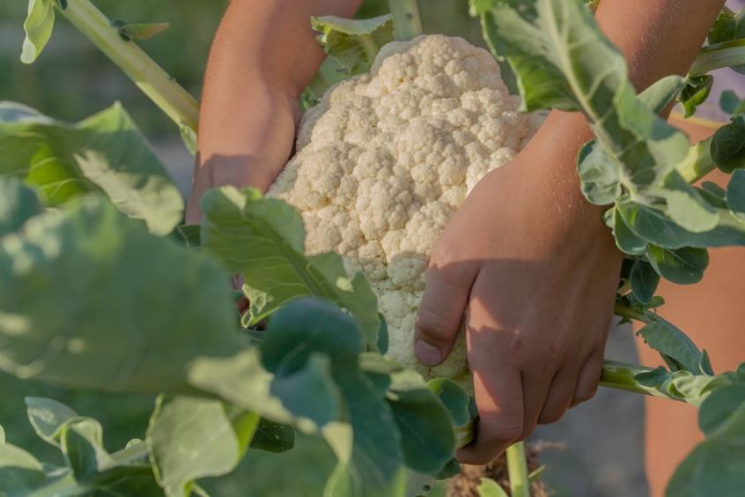
Harvesting
Cauliflowers are picked when ready from a garden or field.
Cauliflower from the UK is harvested throughout the year.

Slide 5
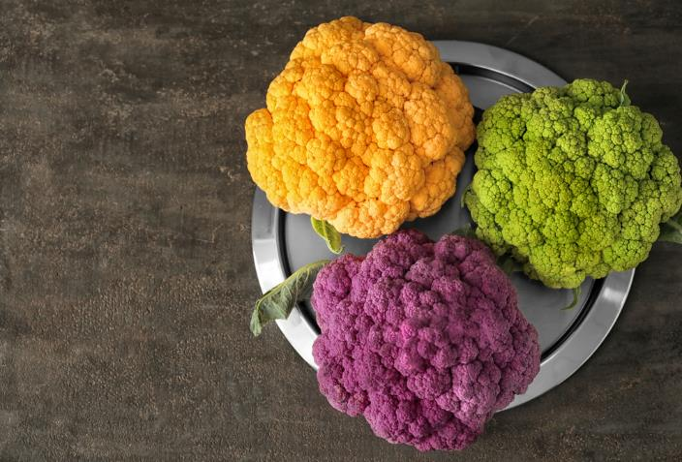
Cauliflower varieties
There are different types cauliflower.
They have different names, such as:
All year round;
Alpha;
Red lion.

Slide 6
Cauliflower
Cauliflower can be purchased:
fresh;
frozen.

Slide 7

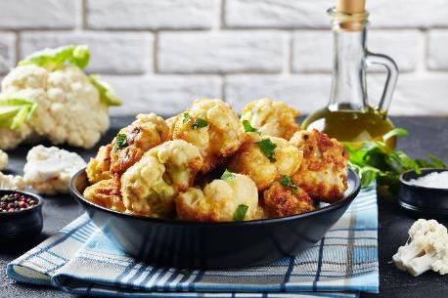
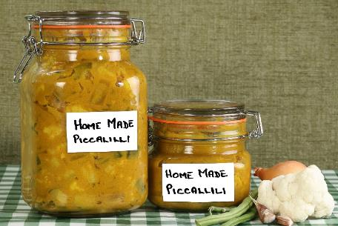
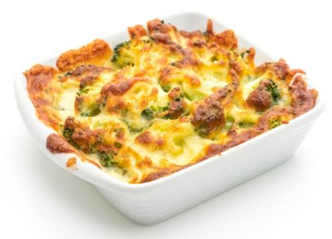
Dishes
Cauliflower can be eaten raw – just wash first.
Cauliflower can be used in lots of dishes.

Slide 8
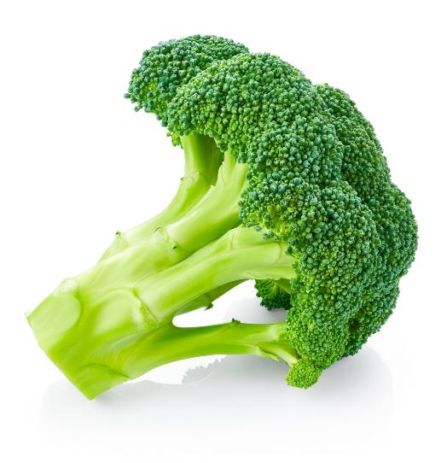
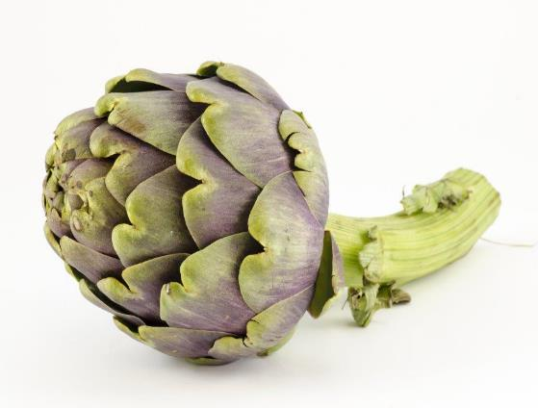
Similar
Broccoli and artichoke are similar to cauliflower.
They are the flowers of a plant.
Broccoli
Artichoke

Slide 9

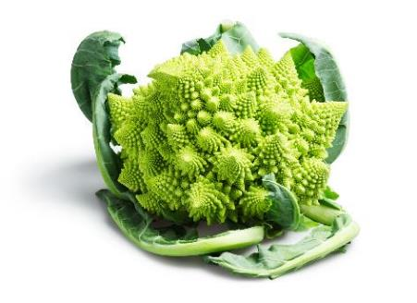
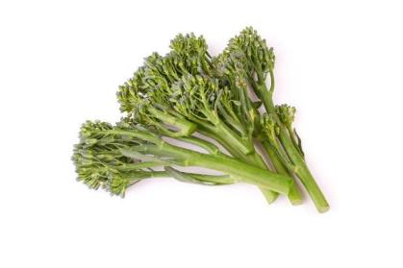
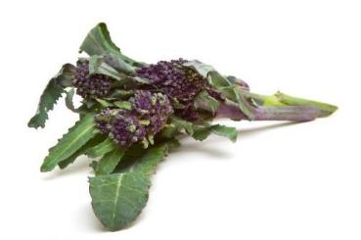
Similar
There are different varieties of broccoli including:
Calabrese;
Sprouting;
Romanesco.
Calabrese
Romanesco
Sprouting
Purple sprouting

Slide 10
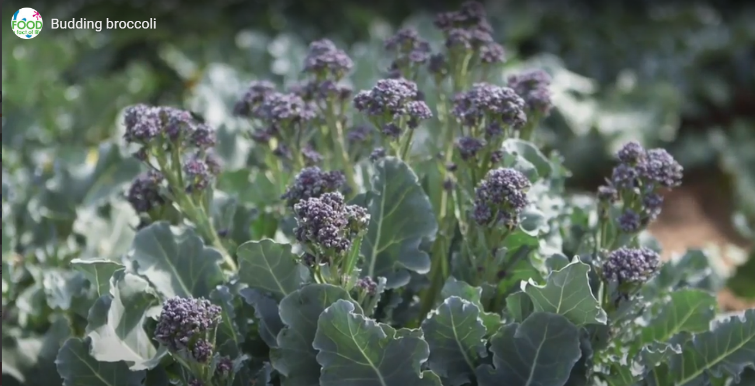
Harvesting broccoli
Watch the video about broccoli being harvested.
Then answer the Budding broccoli quiz.
Click on the picture above to watch the video.

Slide 11

Summary
Cauliflower are grown for our food.
Cauliflower
Lots of dishes use cauliflower.

Slide 12
Cauliflower
For further information, go to:
www.foodafactoflife.org.uk

