Slide 1
Vegetables

Slide 2
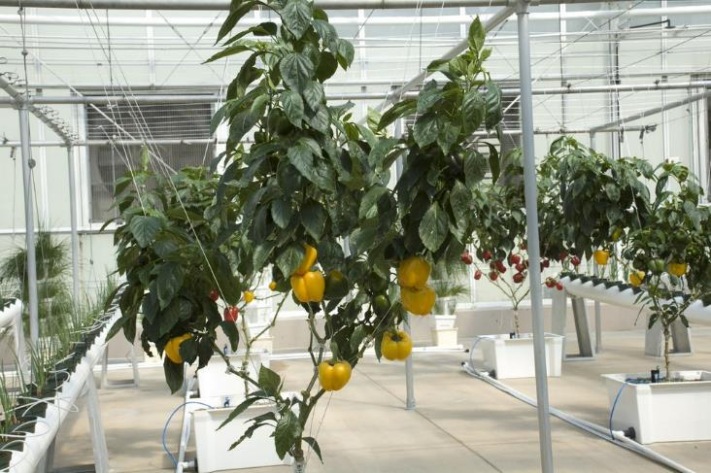
Vegetables
Vegetables are the edible part of a plant.
They are often grouped according to the part of the plant that is eaten:
bulbs;
flowers;
fruit;
leaves;
roots;
seeds;
stem (stalk).
Peppers are the edible fruit of a plant.

Slide 3
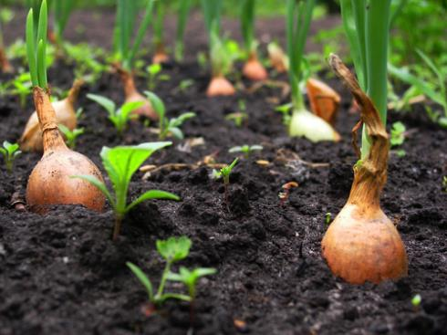
Bulbs
Some plants have bulbs which stay underground to store food for the plant when it is not growing.
When the time is right, the bulb produces shoots which grow up through the soil.
Onions are the edible bulb of a plant

Slide 4
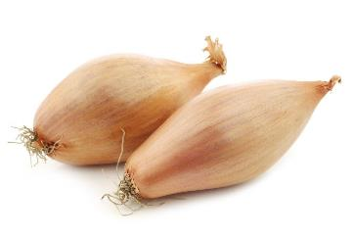
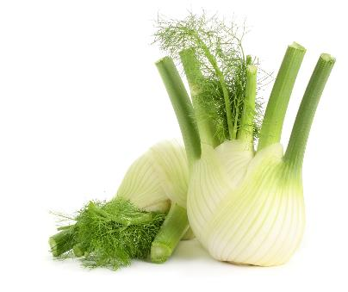
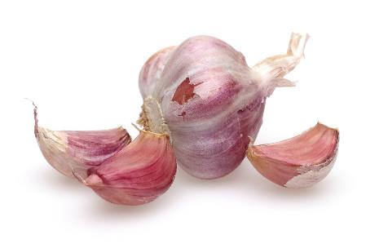
Bulbs
Bulbs include:
garlic;
fennel;
onions;
shallots.
Shallots
Fennel
Garlic

Slide 5
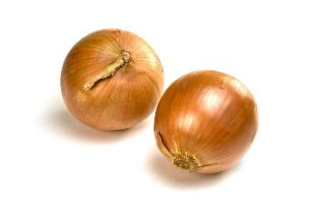
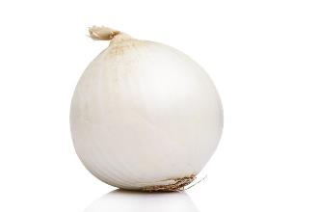
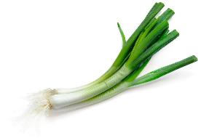
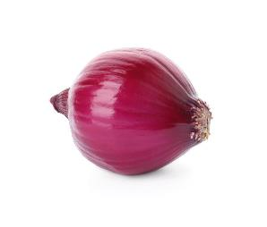
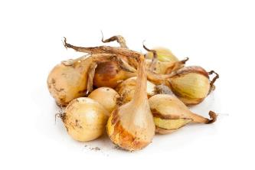
Bulbs - onions
There are different types of onion, including:
cooking;
white;
pickling;
green;
salad;
red.
Cooking
White
Green
Red
Pickling

Slide 6
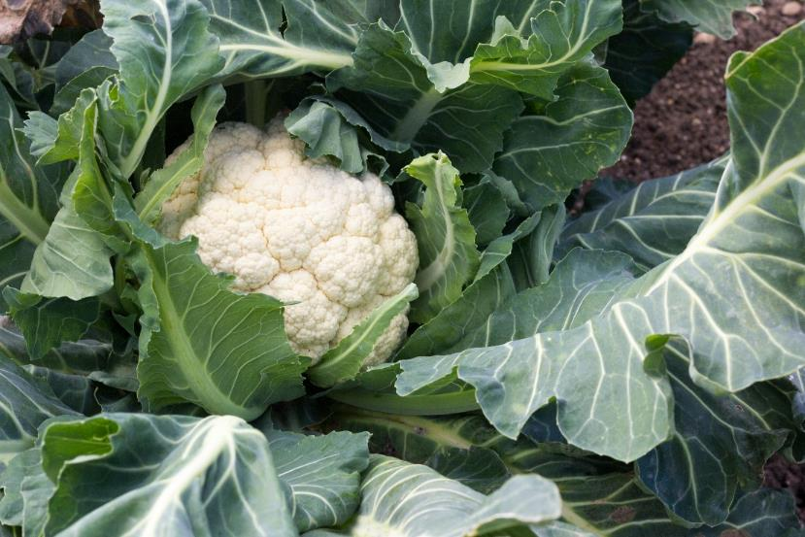
Flowers
Flowers are part of the plant that allow it to reproduce.
Pollination is required for the plant to reproduce. Pollination happens when the plant's male part (the stamen) creates pollen, which is moved to the female part (the stigma). The transfer of pollen can be by wind, birds, bats, mammals and insects, including butterflies and bees.
Bees are a particularly important pollinator and there are around 70 crops in the UK that depend on, or benefit from, bee pollination.
Cauliflower is the edible flower of a plant. Some flowers are edible, but many others are not
Soil Association

Slide 7
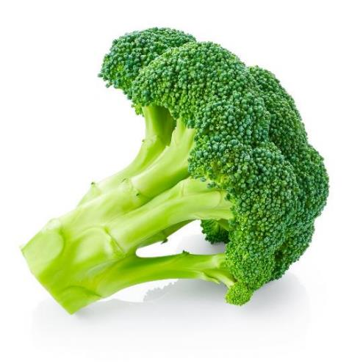
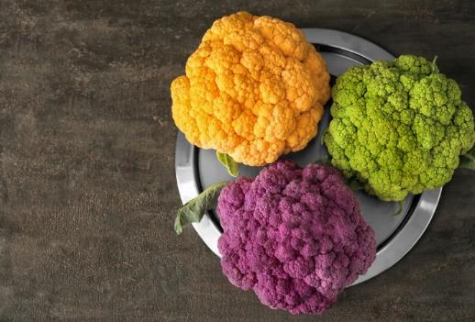
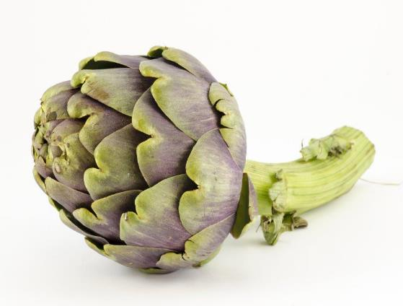
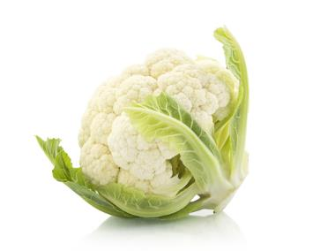
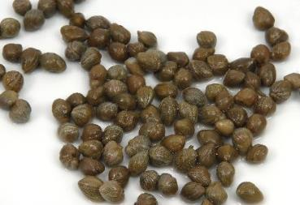
Flowers
Flowers include:
artichoke;
broccoli;
capers;
cauliflower.
Broccoli
Cauliflower
Artichoke
Cauliflower
Capers

Slide 8
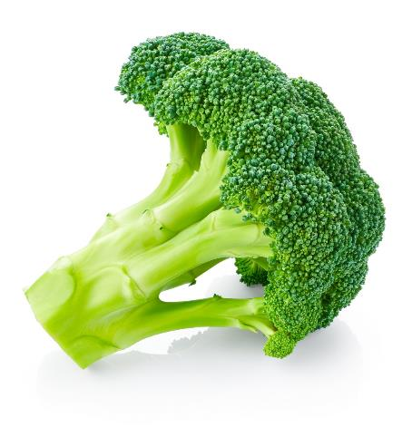
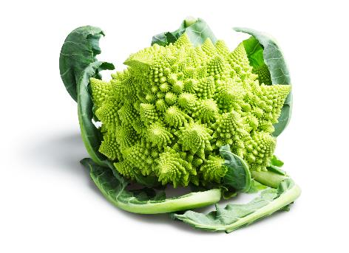
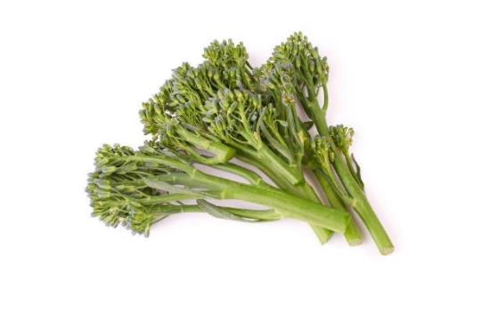
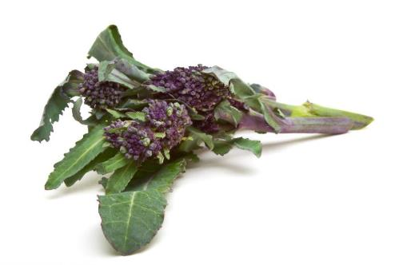
Flowers - broccoli
There are different varieties of broccoli including:
Calabrese;
Sprouting;
Romanesco.
Calabrese
Romanesco
Sprouting
Purple sprouting

Slide 9
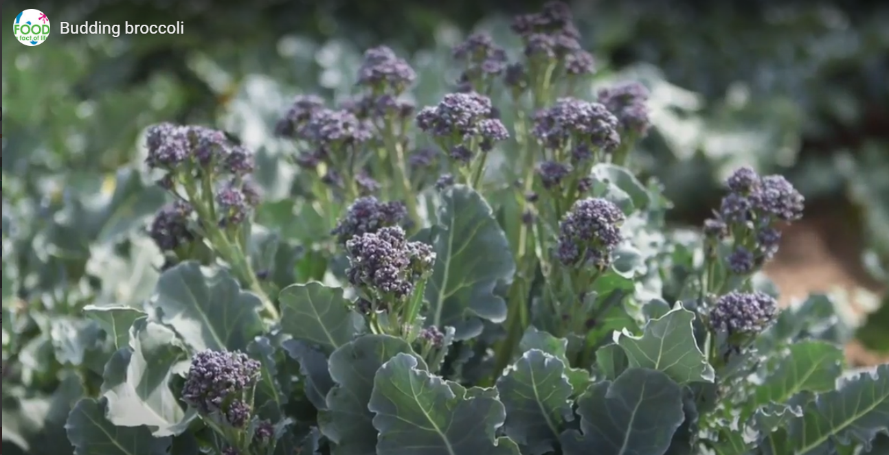
Flowers - harvesting broccoli
Watch the video about broccoli being harvested.
Then answer the Budding broccoli quiz.
Click on the picture above to watch the video.

Slide 10
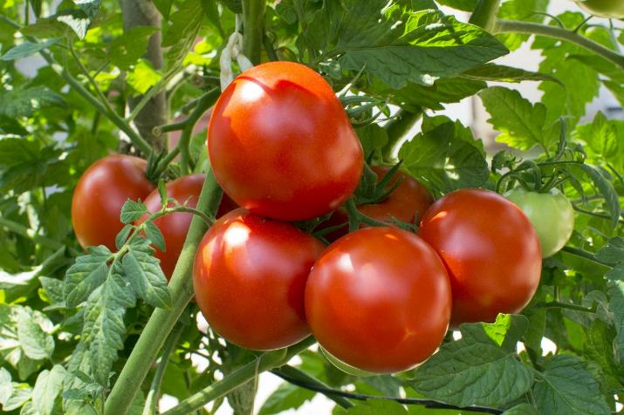
Fruit
The fruit of a plant is created after its flowers have been pollinated.
Many fruits are sweet, but some fruits are not and are usually used like a vegetable in food, e.g. tomatoes, cucumber and aubergine.
Tomatoes are the edible fruit of a plant.

Slide 11
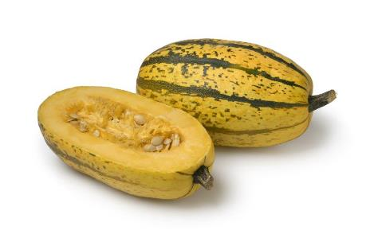
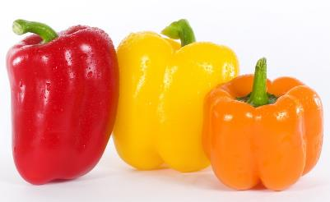
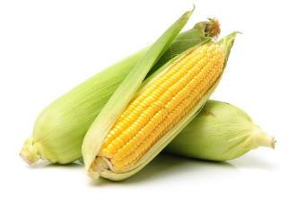
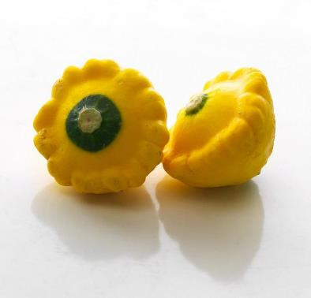
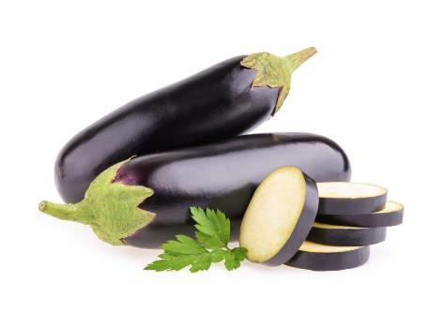
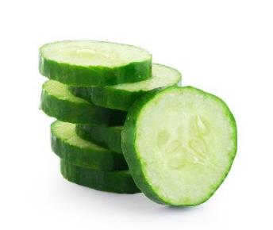
Fruit
‘Savoury’ fruit includes:
aubergine;
cucumber;
pepper;
squash;
sweetcorn;
tomatoes.
Spaghetti squash
Peppers
Sweetcorn
Yellow scallop squash
Aubergine
Cucumber

Slide 12
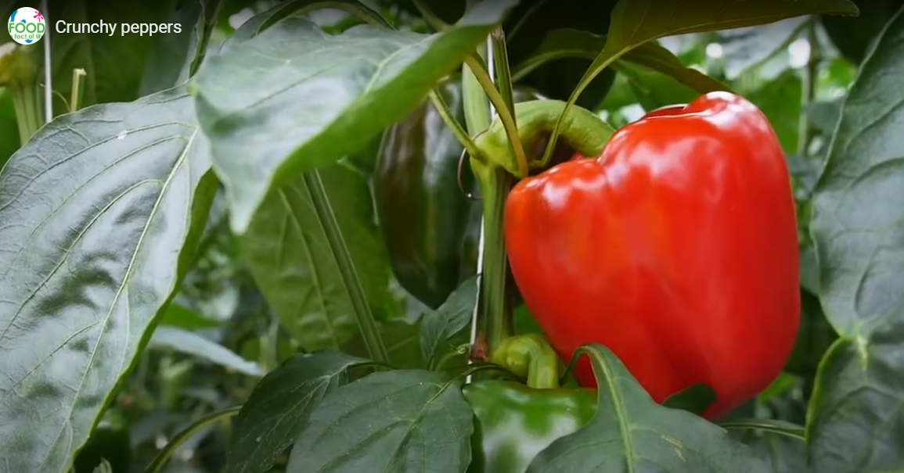
Fruit - growing peppers
Watch this video about peppers.
Click on the picture above to watch the video.

Slide 13
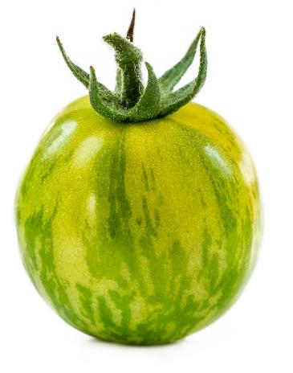
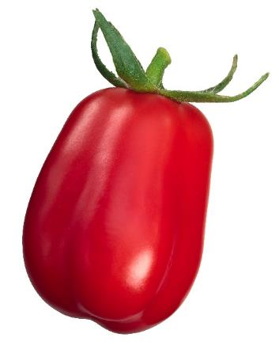
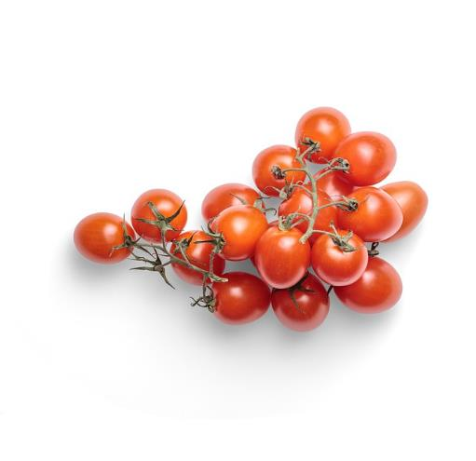
Fruit - tomatoes
There are many different types of tomato.
They have different names, such as:
Cherry;
San marzano;
Green zebra.
Green zebra
San Marzano
Cherry

Slide 14
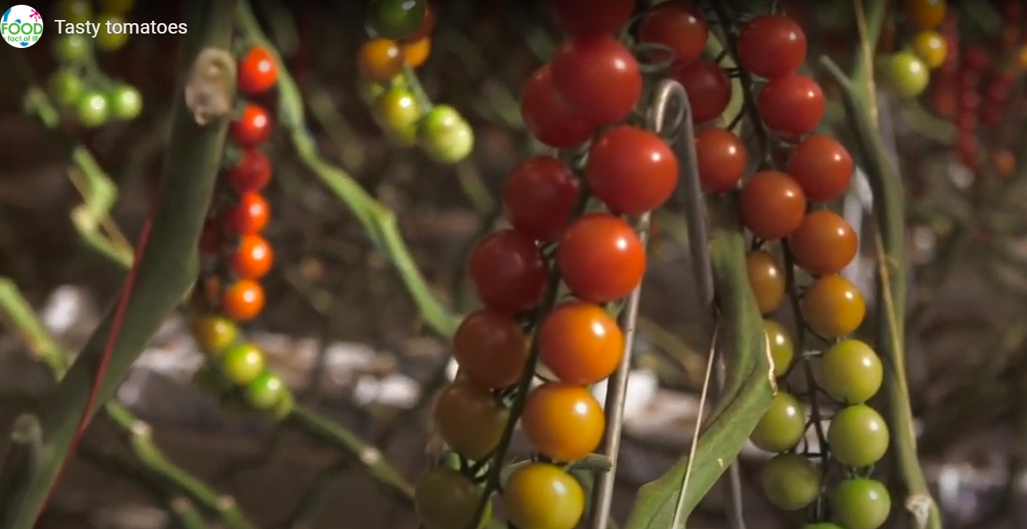
Fruit - harvesting tomatoes
Watch this video about tomatoes.
Then answer the Tasty tomatoes quiz.
Click on the picture above to watch the video.

Slide 15
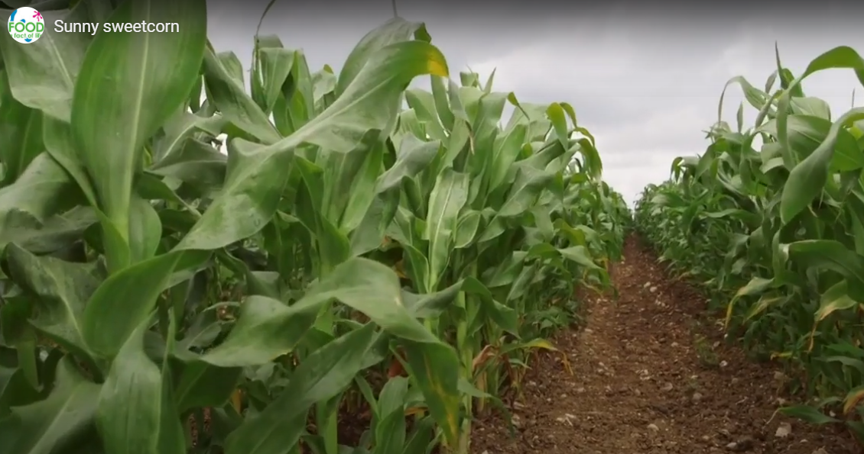

Fruit - sweetcorn
Sweetcorn is the fruit of the maize plant and, when fresh, is considered a vegetable. The kernels when dried, are considered a grain and are used to make flour or popcorn.
Watch this video to find out more about sweetcorn.
Click on the picture above to watch the video.

Slide 16
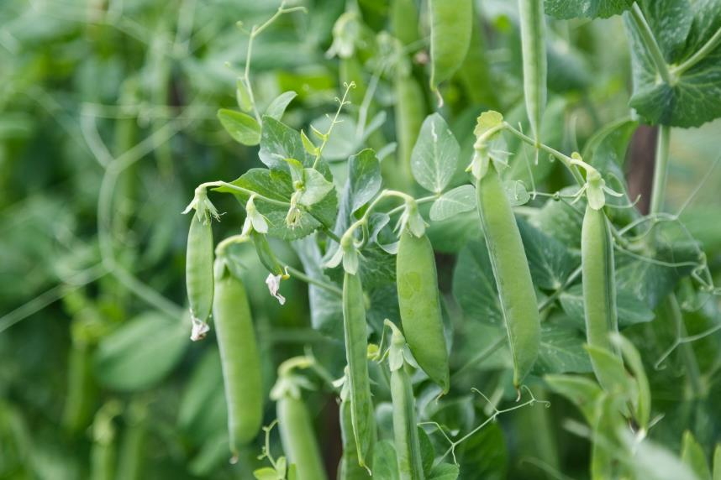
Legumes
Legumes are grown for their edible seeds, known as beans and peas. They are the fruit (seed) of a plant.
Peas are the edible seeds of plants

Slide 17
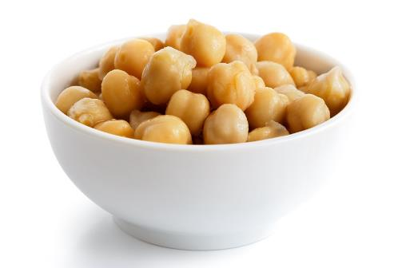
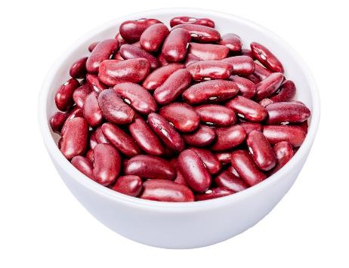
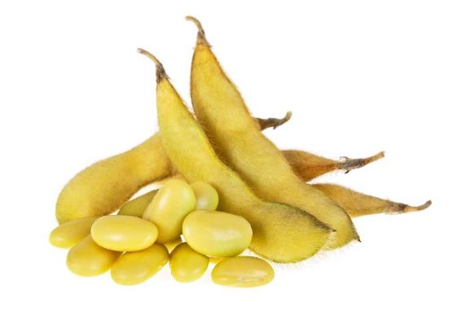
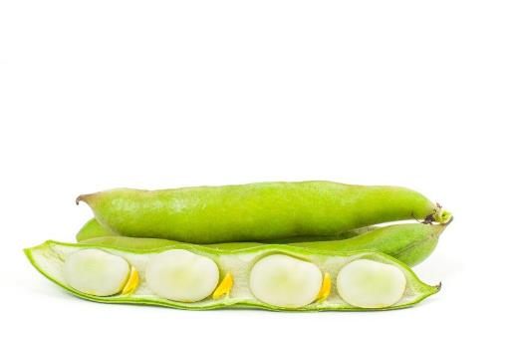
Legumes
Legumes include:
adzuki beans;
chickpeas;
garden peas;
kidney beans;
lima beans;
soy beans.
Chickpeas
Kidney beans
Soy beans
Lima beans

Slide 18
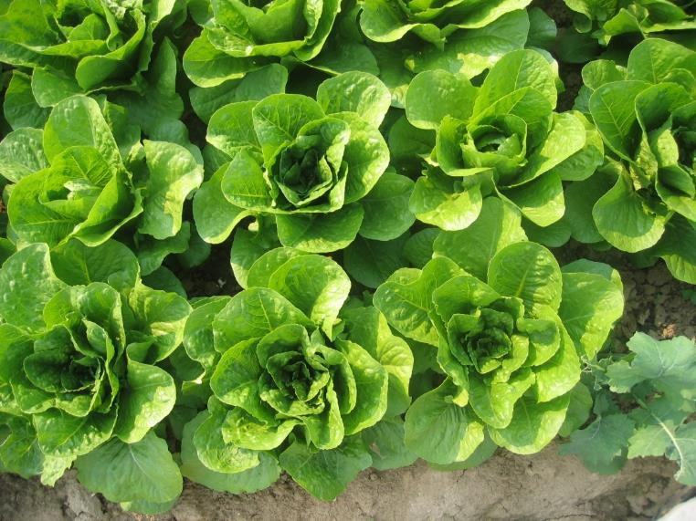
Leaves
Plant leaves capture sunlight and use the energy from it to make food. This process is known as photosynthesis.
Carbon dioxide (from the air), water (from the soil)* and light (usually sunlight) are needed for photosynthesis to take place.
Plant’s leaves are usually flat and green, which helps them to capture lots of sunlight.
*Some plants are grown hydroponically. This means that they get their water from a nutrient solution, rather than the soil.
Lettuce is the edible leaves of a plant

Slide 19
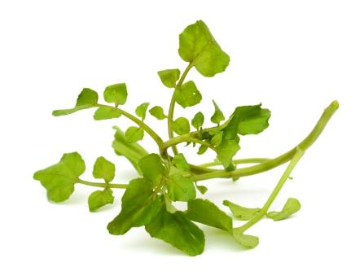
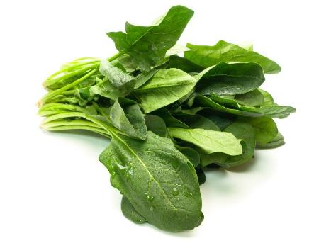
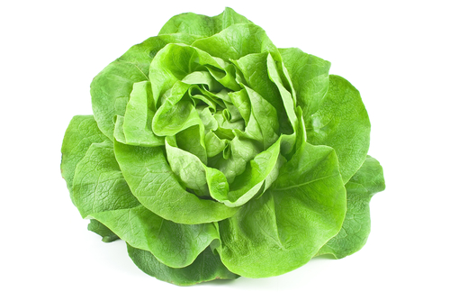
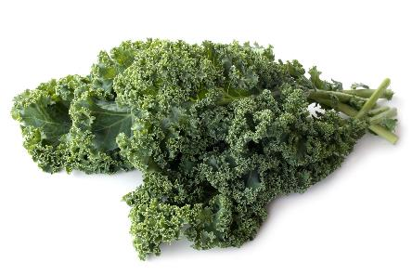
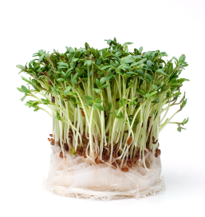
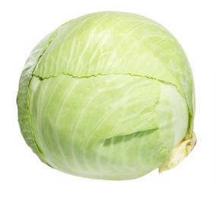
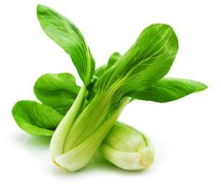
Leaves
Leaves include:
cabbage;
kale;
pak choi;
salad cress;
spinach;
watercress.
Watercress
Spinach
Lettuce
Kale
Cabbage
Salad cress
Pak choi

Slide 20
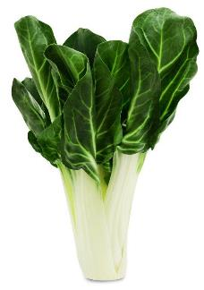
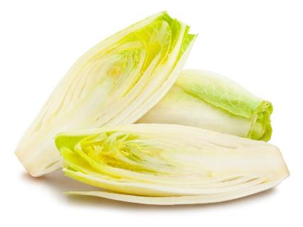
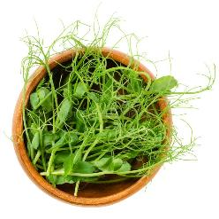

Leaves
Less common examples of leaves include:
chard;
chicory;
choi sum:
pea shoots.
Chard
Chicory
Choi sum
Pea shoots

Slide 21



Leaves – lettuce
There are many different types of lettuce.
They have different names, such as:
Iceberg;
Cos;
Rocket.
Round
Rocket
Cos

Slide 22




Leaves - lettuce
More unusual varieties of lettuce include:
Lollo rosso;
Oak leaf;
Batavia;
Lollo verde.
Batavia
Lollo verde
Lollo rosso
Oak leaf

Slide 23

Roots
The roots of the plant take up water and nutrients from the soil for growth.
They also anchor the plant to the ground.
'Carrots' are the edible root of this plant

Slide 24




Roots
Roots include:
beetroot;
carrot;
celeriac;
parsnip;
radish;
turnip.
Parsnips
Radishes
Celeriac
Beetroot

Slide 25

Roots - carrots
There are 44 varieties around the world.
They have different names, such as:
Chanteray;
Danvers;
Nantes.

Slide 26


Roots - tubers
Tubers store nutrients for the plant and also propagate new plants by forming stems and leaves. Tubers are often high in carbohydrates.
Potatoes
Potatoes are tubers

Slide 27





Roots - tubers
Tubers include:
cassava;
Jerusalem artichokes;
potatoes;
sweet potatoes;
yams.
Cassava
Jerusalem artichokes
Yam
Sweet potatoes
Potatoes

Slide 28

Stem (stalk)
The stalk of the plant helps to keep it standing up, provide support and carry water and nutrients to different parts of the plant.
Celery is the edible stem (stalk) of a plant

Slide 29



Stem (stalk)
Stems or stalks include:
asparagus;
celery;
kohlrabi.
Kohlrabi
Celery
Asparagus

Slide 30

Mushrooms
Mushrooms are different kinds of fungi, rather than plants.
Many types of mushroom are dangerous to eat.
Mushrooms available for consumers to buy are carefully selected to be safe.

Slide 31



Mushrooms
There are many different types of mushroom.
They have different names, such as:
Button;
Chestnut;
Portobello.
Button
Chestnut
Portobello

Slide 32





Mushrooms
More unusual mushroom varieties include:
Oyster;
Shiitake;
Maitake (hen of the woods);
Enoki;
Wood ear.
Shitake
Maitake
Oyster
Wood ear
Enoki

Slide 33

Mushrooms
Watch this video about mushrooms.
Click on the picture above to watch the video.

Slide 34

The importance of fruit and vegetables
We should all aim to have at least 5 portions of a variety of fruit and vegetables each day.
Fruit and vegetables should make up around one third of what we eat each day.
Fruit and vegetables are a very important part of a healthy, balanced diet, as they are good sources of fibre, as well as providing essential vitamins and minerals.
Eating lots of fruit and vegetables can help maintain a healthy weight (as they are naturally low in energy) and having your 5 A DAY could reduce your risk of some diseases.

Slide 35



What counts towards your 5 A DAY?
All fruit and vegetables count, including fresh, frozen, canned, dried and juiced varieties. A portion of fruit or vegetables is 80g or, for children, around the amount that fits into the palm of their hands.
For example, a portion of vegetables could include:
three heaped tablespoons of cooked vegetables like broccoli, peas, cabbage or carrots;
a dessert bowl of salad or seven cherry tomatoes;
three heaped tablespoons of beans, chickpeas or lentils can count as one of your 5 A DAY (but only once each day);
a 150ml smoothie or a glass of unsweetened 100% vegetable juice (as a maximum of 1 of your 5 A DAY).

Slide 36







Cooking and eating vegetables
Some vegetables can be eaten raw, just wash first and scrub or peel, if required.
Vegetables can also be canned, dried, frozen, juiced, pickled or cooked and made into dishes.

Slide 37
Vegetables
For further information, go to:
www.foodafactoflife.org.uk
This resource meets the Guidelines for producers and users of school education resources about food.

