Slide 1
Vegetables

Slide 2
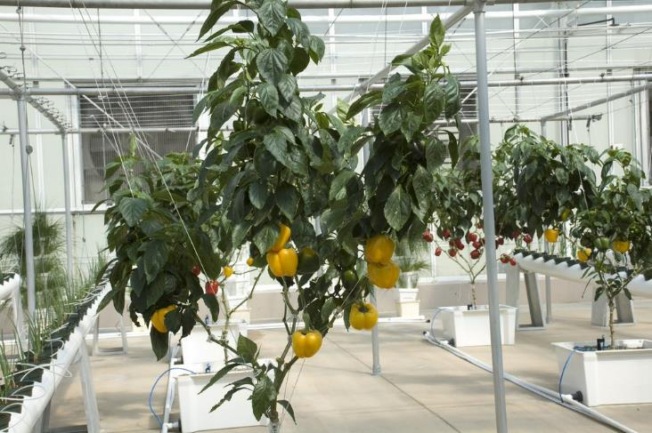
Vegetables
Vegetables are the edible part of a plant.
They are often grouped according to the part of the plant that is eaten:
bulbs;
flowers;
fruit;
leaves;
roots;
seeds;
stem (stalk).
Peppers are the edible fruit of a plant

Slide 3
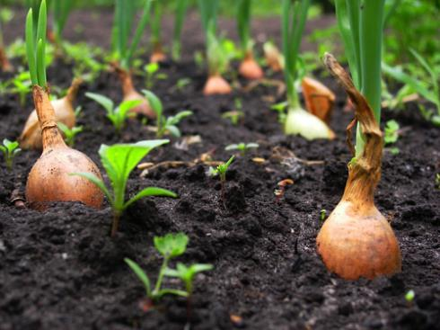
Bulbs
Some plants have bulbs which stay underground to store food for the plant when it is not growing. When the time is right, the bulb produces shoots which grow up through the soil.
Onions are the edible bulb of a plant

Slide 4
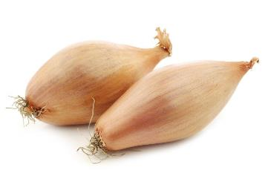
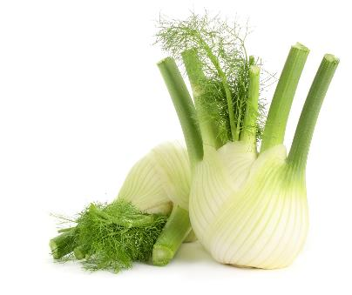
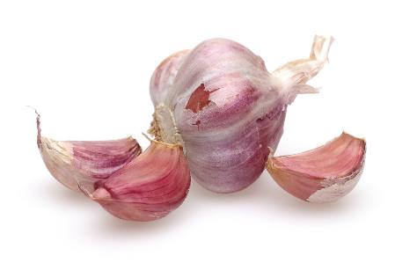
Bulbs
Bulbs include:
garlic;
fennel;
onions;
shallots.
Shallots
Fennel
Garlic

Slide 5
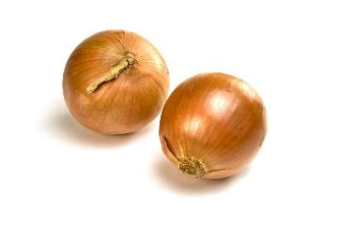
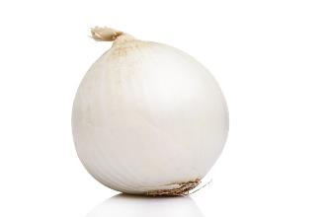
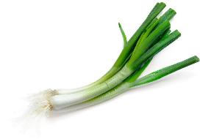
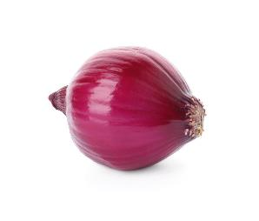
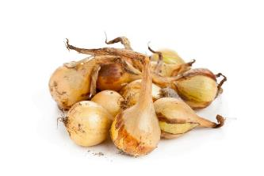
Bulbs - onions
There are different types of onion, including:
cooking;
white;
pickling;
green;
salad;
red.
Cooking
White
Green
Red
Pickling

Slide 6
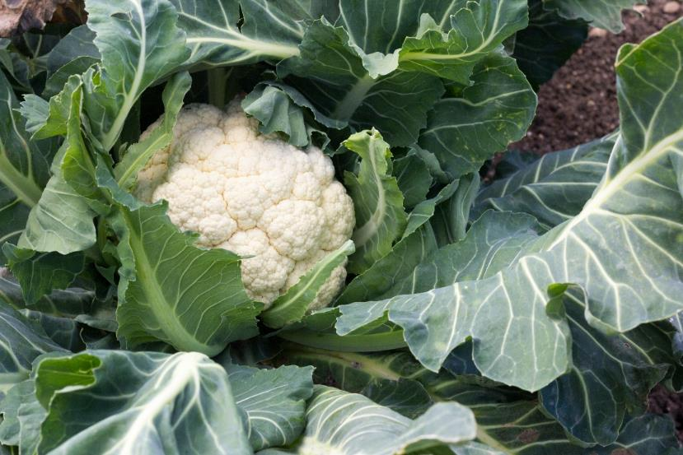
Flowers
Flowers are part of the plant that allow it to reproduce.
Pollination is required for the plant to reproduce. Pollination happens when the plant's male part (the stamen) creates pollen, which is moved to the female part (the stigma). The transfer of pollen can be by wind, birds, bats, mammals and insects, including butterflies and bees.
Bees are a particularly important pollinator and there are around 70 crops in the UK that depend on, or benefit from, bee pollination.
Cauliflower is the edible flower of a plant. Some flowers are edible, but many others are not
Soil Association

Slide 7
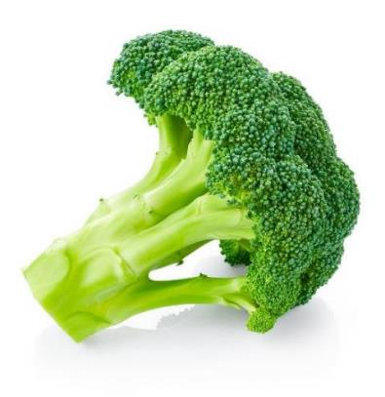
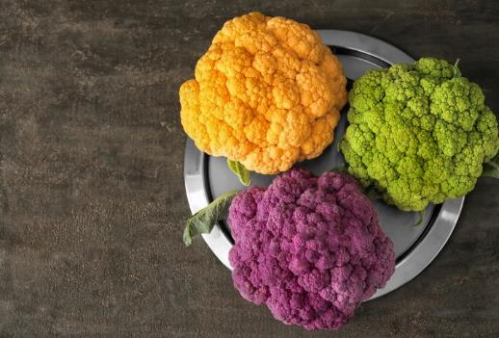
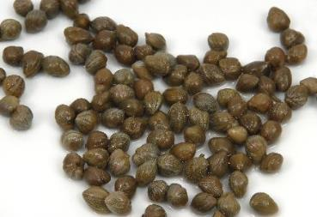
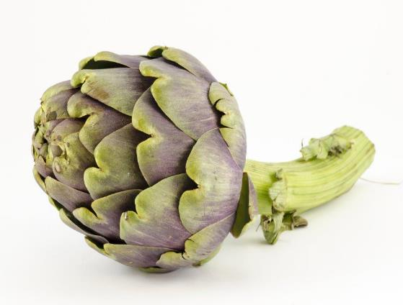
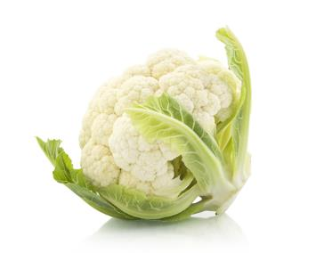
Flowers
Flowers include:
artichoke;
broccoli;
capers;
cauliflower.
Broccoli
Cauliflower
Capers
Cauliflower and broccoli are from the family of vegetables known as brassica.
Artichoke
Cauliflower

Slide 8
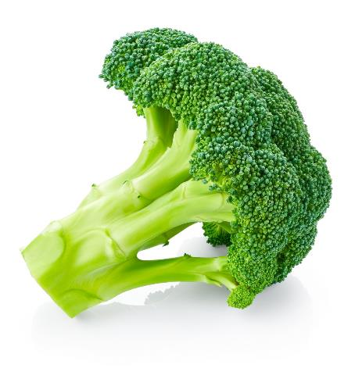
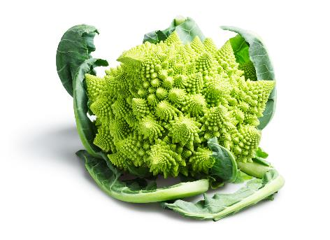
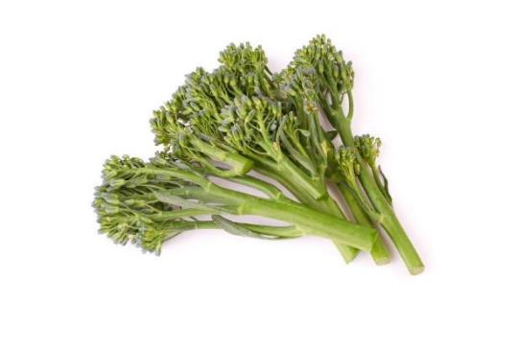
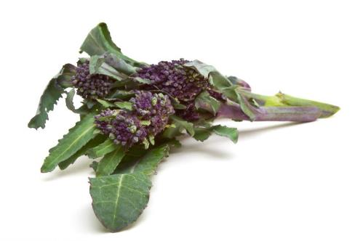
Flowers - broccoli
There are different varieties of broccoli including:
Calabrese;
Sprouting;
Romanesco.
Calabrese
Romanesco
Sprouting
Purple sprouting

Slide 9
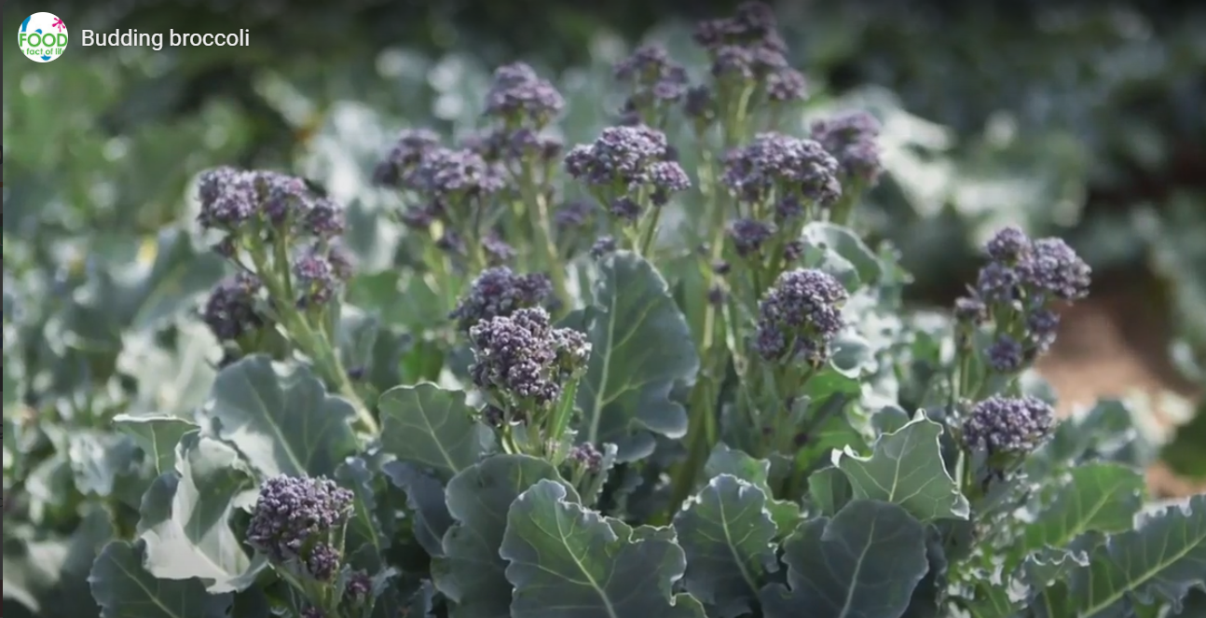
Flowers - harvesting broccoli
Watch the video about broccoli being harvested.
Then answer the Budding broccoli quiz.
Click on the picture above to watch the video.

Slide 10
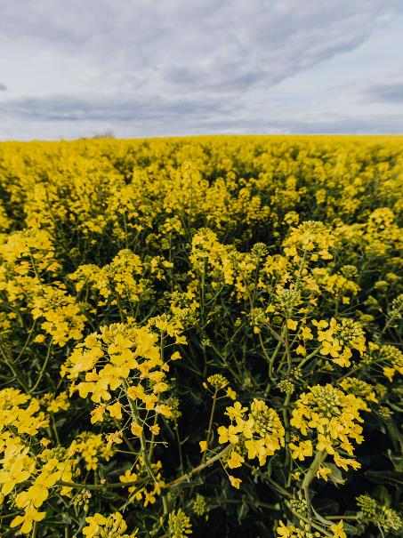
Rapeseed
Rapeseed, or oilseed rape, is a bright yellow flowering member of the brassica family, along with broccoli, cabbage and cauliflower.
Rapeseed is grown for its oil-rich seeds, which are dried and pressed to produce a golden coloured oil.
The seeds of the rapeseed plant are used to make oil

Slide 11
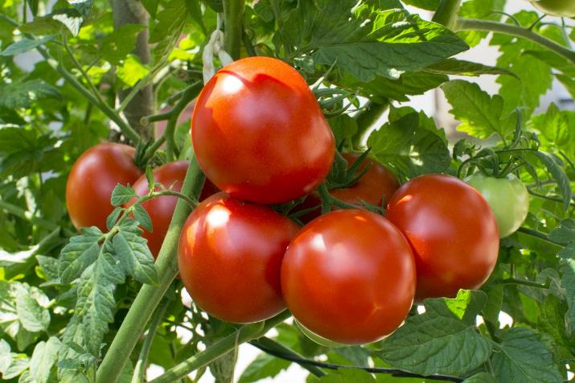
Fruit
The fruit of a plant is created after its flowers have been pollinated.
Many fruits are sweet, but some fruits are not and are usually used like a vegetable in food, e.g. tomatoes, cucumber and aubergine.
Tomatoes are the edible fruit of a plant.

Slide 12
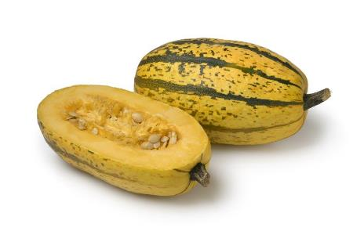
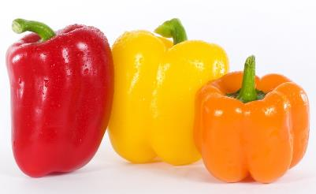
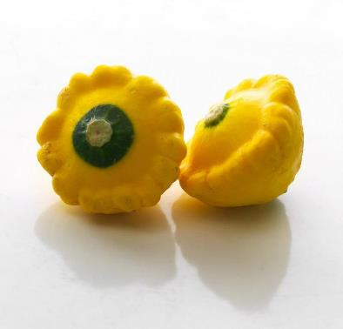
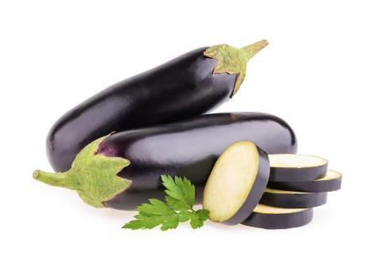
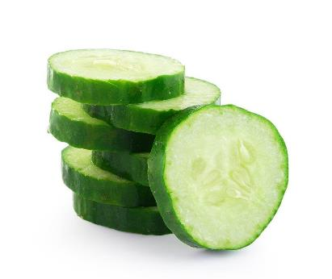
Fruit
‘Savoury’ fruit includes:
aubergine;
cucumber;
pepper;
squash;
tomatoes.
Spaghetti squash
Peppers
Yellow scallop squash
Aubergine
Cucumber

Slide 13
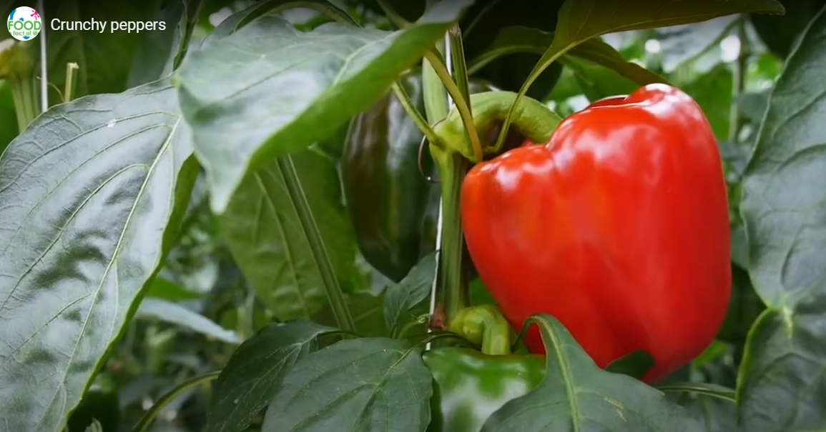
Fruit - growing peppers
Watch this video about peppers.
Click on the picture above to watch the video.

Slide 14
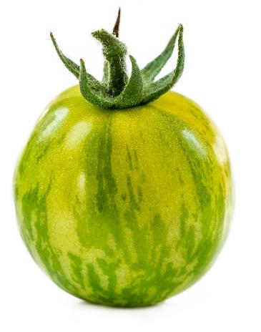
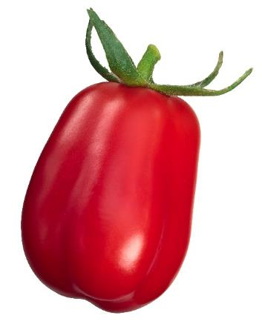
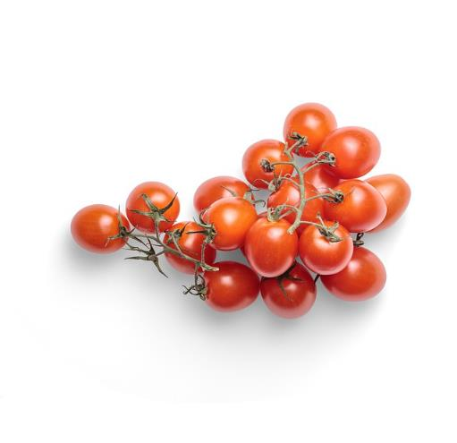
Fruit - tomatoes
There are lots of different types tomatoes.
They have different names, such as:
Cherry;
San marzano;
Green zebra.
Green zebra
San Marzano
Cherry

Slide 15
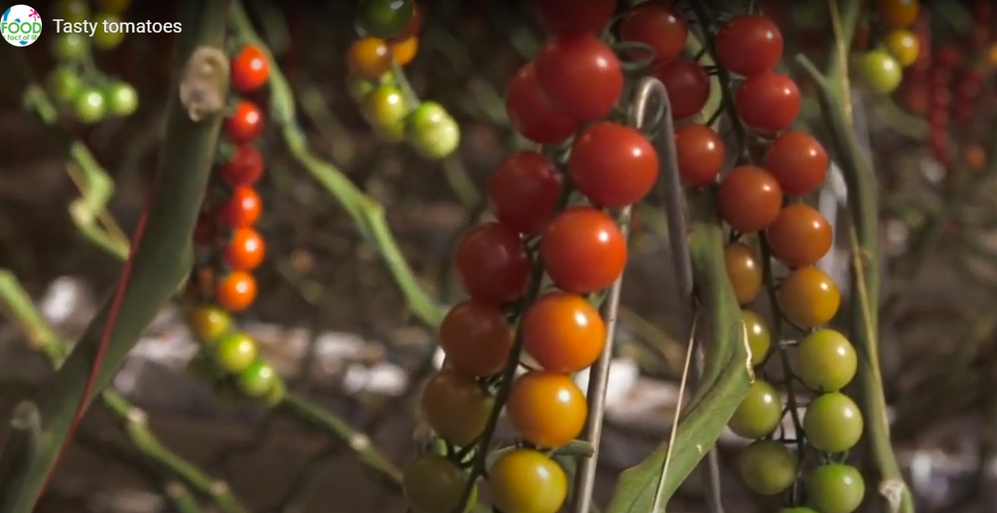
Fruit - harvesting tomatoes
Watch this video about tomatoes.
Then answer the Tasty tomatoes quiz.
Click on the picture above to watch the video.

Slide 16
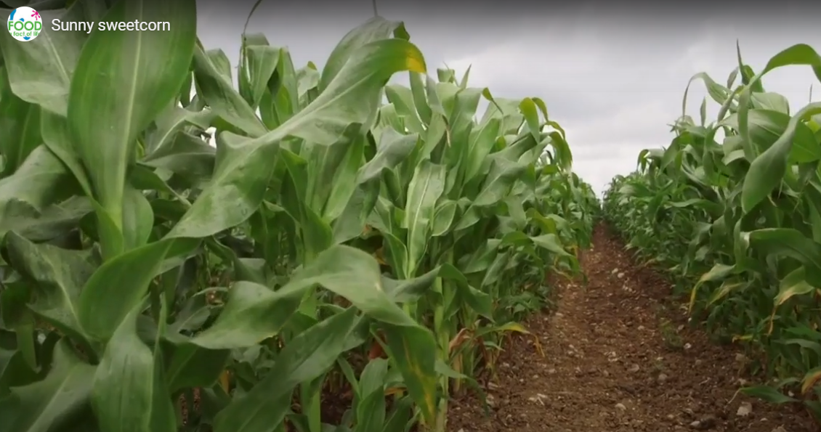
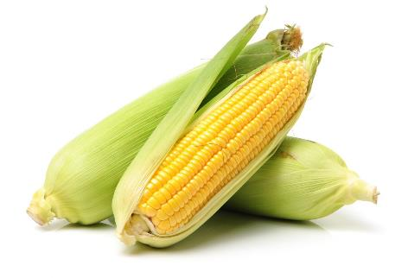
Fruit - sweetcorn
Sweetcorn is the fruit of the maize plant and, when fresh, is considered a vegetable. The kernels when dried, are considered a grain and are used to make flour or popcorn.
Watch this video to find out more about sweetcorn.
Click on the picture above to watch the video.

Slide 17
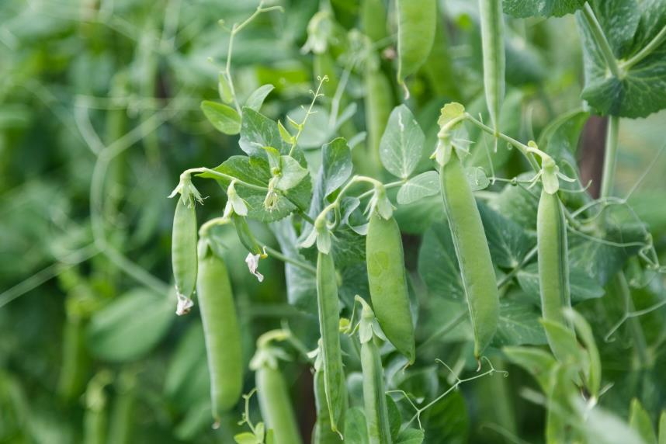
Legumes
Legumes are grown for their edible seeds, known as beans and peas. They are the fruit (seed) of a plant.
Peas are the edible seeds of plants

Slide 18
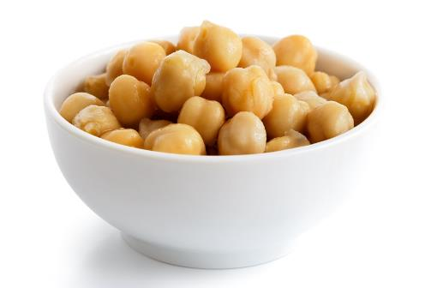
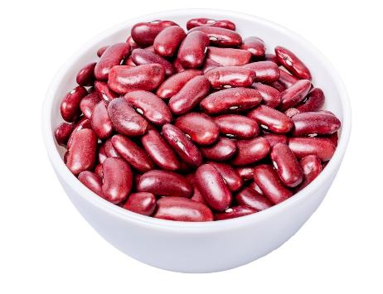
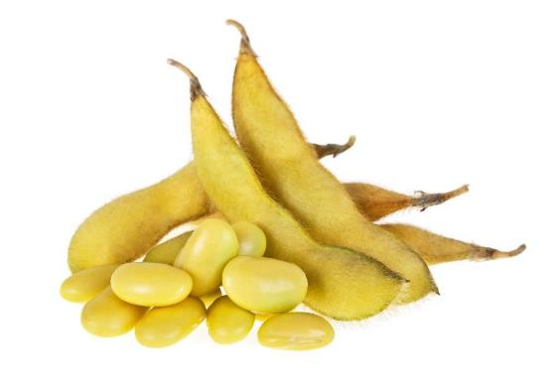
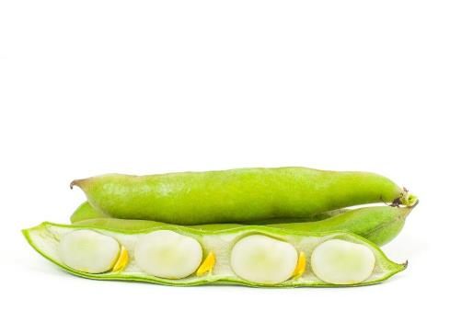
Legumes
Legumes include:
adzuki beans;
chickpeas;
garden peas;
kidney beans;
lima beans;
soy beans.
Chickpeas
Kidney beans
Soy beans
Lima beans

Slide 19
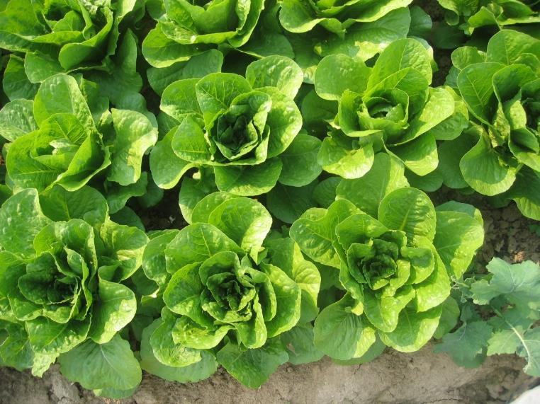
Leaves
Plant leaves capture sunlight and use the energy from it to make food. This process is known as photosynthesis.
Carbon dioxide (from the air), water (from the soil)* and light (usually sunlight) are needed for photosynthesis to take place.
Plant’s leaves are usually flat and green, which helps them to capture lots of sunlight.
*Some plants are grown hydroponically. This means that they get their water from a nutrient solution, rather than the soil.
Lettuce is the edible leaves of a plant

Slide 20
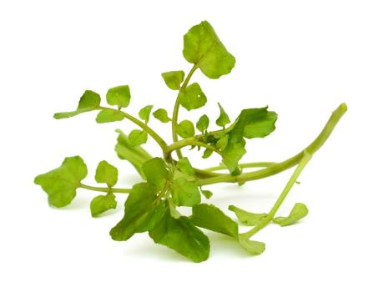
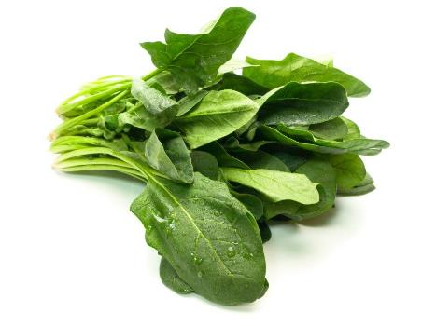
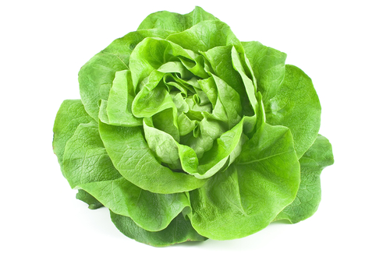
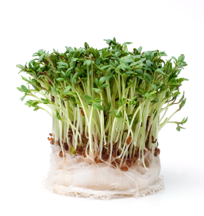
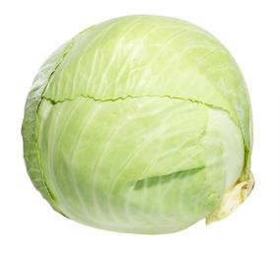
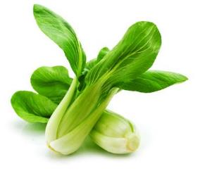
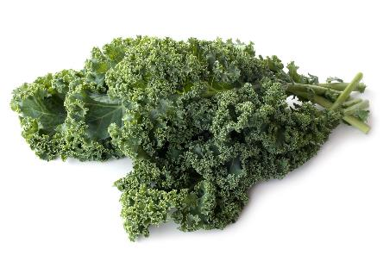
Leaves
Leaves include:
cabbage;
kale;
pak choi;
salad cress;
spinach;
watercress.
Watercress
Spinach
Lettuce
Cabbage
Pak choi
Salad cress
Kale

Slide 21
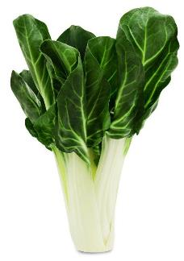
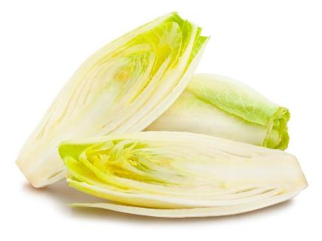


Leaves
Less common examples of leaves include:
chard;
chicory;
choi sum;
pea shoots.
Chard
Chicory
Choi sum
Pea shoots

Slide 22



Leaves – lettuce
There are lots of different types lettuce.
They have different names, such as:
Iceberg;
Cos;
Rocket.
Round
Rocket
Cos

Slide 23




Leaves - lettuce
More unusual varieties of lettuce include:
Lollo rosso;
Oak leaf;
Batavia;
Lollo verde.
Batavia
Lollo verde
Lollo rosso
Oak leaf

Slide 24

Roots
The roots of the plant suck up water and useful nutrients from the soil to help the plant stay healthy.
They also anchor the plant to the ground.
Carrots are the edible root of a plant

Slide 25




Roots
Roots include:
beetroot;
carrot;
celeriac;
parsnip;
radish;
turnip.
Parsnips
Radishes
Celeriac
Beetroot

Slide 26

Roots - carrots
There are 44 varieties around the world.
They have different names, such as:
Chanteray;
Danvers;
Nantes.

Slide 27


Roots - tubers
Tubers store nutrients for the plant and also propagate new plants by forming new stems and leaves. Tubers are often high in carbohydrates.
Potatoes
Potatoes are tubers

Slide 28





Roots - tubers
Tubers include:
cassava;
Jerusalem artichokes;
potatoes;
sweet potatoes;
yams.
Cassava
Jerusalem artichokes
Yam
Sweet potatoes
Potatoes

Slide 29

Stem (stalk)
The stalk of the plant helps to keep it standing up and also helps to move water and nutrients to other parts of the plant.
Celery is the edible stem (stalk) of a plant

Slide 30



Stem (stalk)
Stems or stalks include:
asparagus;
celery;
kohlrabi.
Kohlrabi
Celery
Asparagus

Slide 31

Stem (stalk) - samphire
Samphire is a plant that grows near salt water.
There are two types of samphire, marsh and rock. Marsh samphire is more widely available.
Marsh samphire is also known as common glasswort.
In north Wales, samphire is known as sampkin.
Samphire

Slide 32

Mushrooms
Mushrooms are different kinds of fungi, rather than plants.
Many types of mushroom are dangerous to eat. Mushrooms available for consumers to buy are carefully selected to be safe.

Slide 33



Mushrooms
There are lots of different types of mushrooms.
They have different names, such as:
Button;
Chestnut;
Portobello.
Button
Chestnut
Portobello

Slide 34





Mushrooms
More unusual mushroom varieties include:
Oyster;
Shiitake;
Maitake (hen of the woods);
Enoki;
Wood ear.
Shitake
Maitake
Oyster
Wood ear
Enoki

Slide 35

Mushrooms
Watch this video about mushrooms.
Click on the picture above to watch the video.

Slide 36

The importance of fruit and vegetables
We should all aim to have at least 5 portions of a variety of fruit and vegetables each day.
Fruit and vegetables should make up around one third of what we eat each day.
Fruit and vegetables are a very important part of a healthy, balanced diet, as they are good sources of fibre, as well as providing lots of essential vitamins and minerals.
Eating lots of fruit and vegetables can help maintain a healthy weight (as they are naturally low in calories) and having your 5 A DAY could reduce your risk of some diseases.

Slide 37



Fruit and vegetables – what counts towards your 5 A DAY?
All fruit and vegetables count, including fresh, frozen, canned, dried and juiced varieties.
A portion of fruit or vegetables is 80g or, for children, around the amount that fits into the palm of their hands.
For example, a portion of vegetables could include:
three heaped tablespoons of cooked vegetables like broccoli, peas, cabbage or carrots;
a dessert bowl of salad or seven cherry tomatoes;
three heaped tablespoons of beans, chickpeas or lentils can count as one of your 5 A DAY (but only once each day);
a 150ml smoothie or a glass of unsweetened 100% vegetable juice (as a maximum of 1 of your 5 A DAY).

Slide 38


Cooking for health - increasing the vegetable content in dishes
Add vegetables into rice, pasta or couscous, e.g. mushrooms, peas, sweetcorn, peppers.
Experiment with colourful and interesting salads, salsas, vegetable-based dips, such as guacamole, and vegetable side dishes.
Vegetables like carrot, parsnip and beetroot can also be added to sweet foods, such as cakes.
Incorporate vegetables into sauces or with other foods, such as:
  blended into pasta sauces and soups;
  grated into fish cakes;
  mashed with potatoes.

Slide 39







Cooking and eating vegetables
Some vegetables can be eaten raw, just wash first and scrub or peel, if required.
Vegetables can also be canned, dried, frozen, juiced, pickled or cooked and made into dishes.

Slide 40
Vegetables
For further information, go to:
www.foodafactoflife.org.uk
This resource meets the Guidelines for producers and users of school education resources about food.

