Slide 1

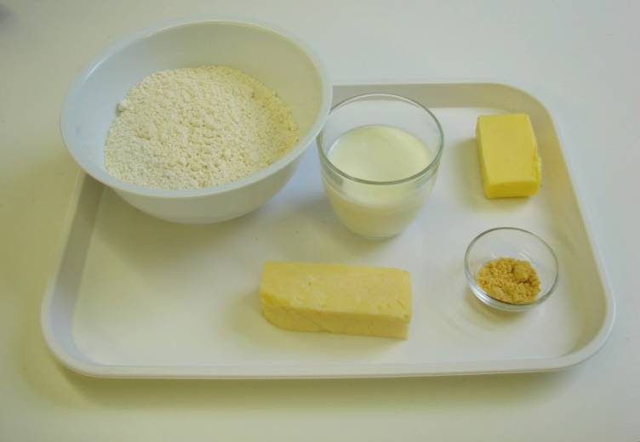
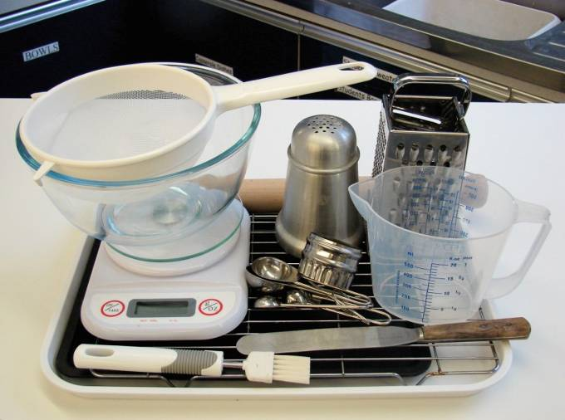
This recipe is from the original Licence to Cook programme and is provided under the Open Government Licence.
Cheesy scones
Ingredients
250g self raising flour
1 x 5ml spoon mustard powder
40g butter or baking fat/block
75g hard cheese
125ml semi-skimmed milk
Equipment
Non-stick baking tray
Pastry brush
Weighing scales
Sieve
Mixing bowl
Measuring spoons
Grater
Chopping board
Measuring jug
Flour dredger
Rolling pin
Scone cutter
Cooling rack
© Food – a fact of life 2019
www.foodafactoflife.org.uk

Slide 2
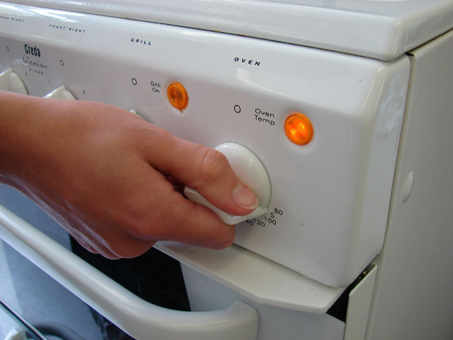
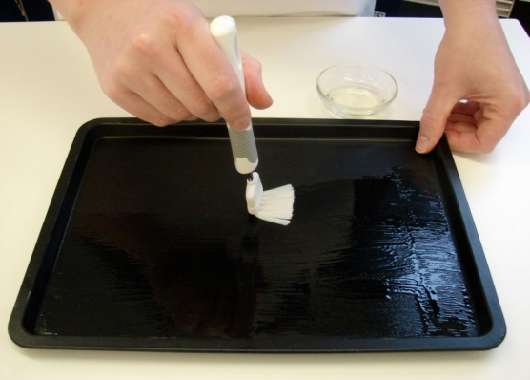
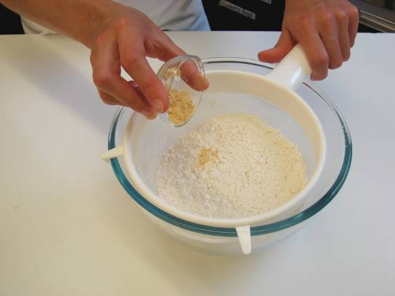
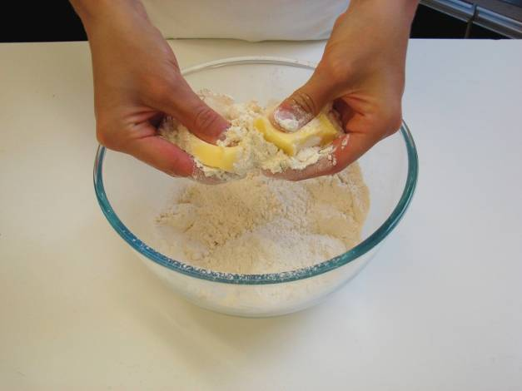
This recipe is from the original Licence to Cook programme and is provided under the Open Government Licence.
Method
Preheat the oven to 220°C or gas mark 7.
Prepare a baking tray, e.g. greased.
Sieve the flour and mustard into the bowl.
Rub in the fat into the flour until it resembles breadcrumbs.
© Food – a fact of life 2019
www.foodafactoflife.org.uk

Slide 3
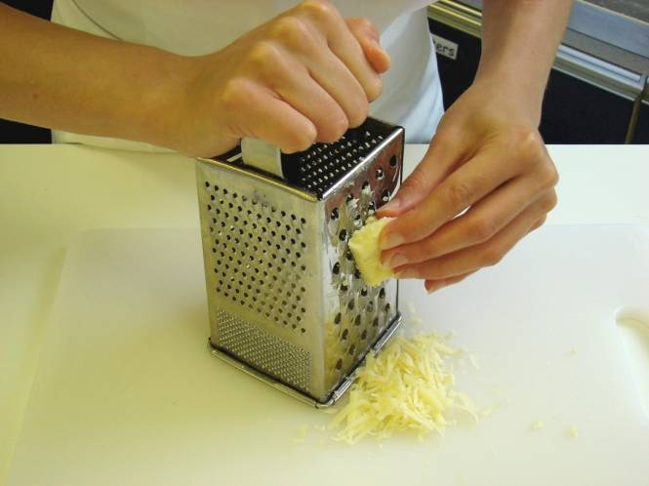
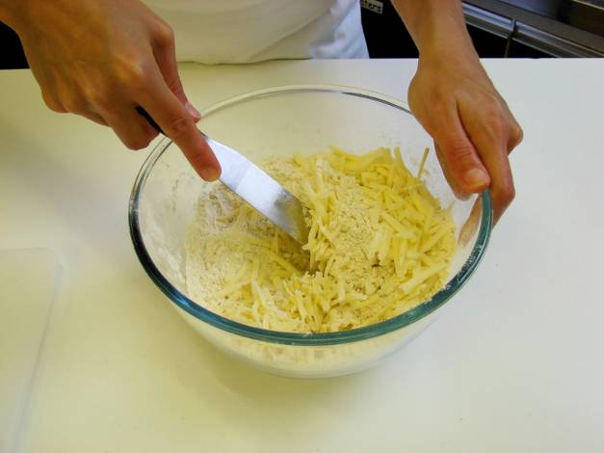
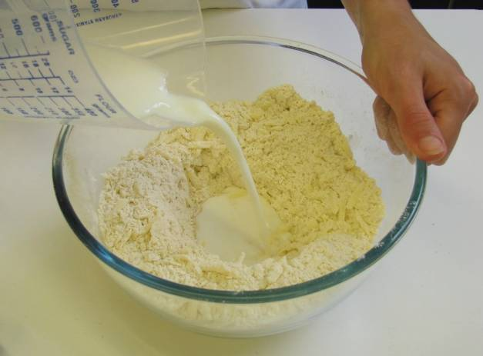
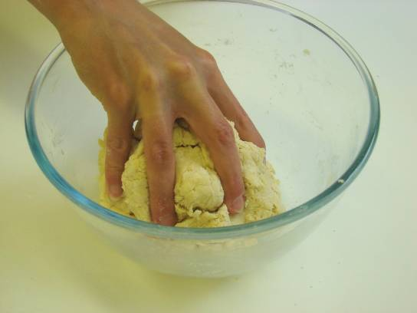
This recipe is from the original Licence to Cook programme and is provided under the Open Government Licence.
Method
Grate the cheese.
Stir in the cheese.
Make a well in the middle of the flour and carefully pour in the milk (save just a little of the milk).
Mix to form a soft dough.
© Food – a fact of life 2019
www.foodafactoflife.org.uk

Slide 4
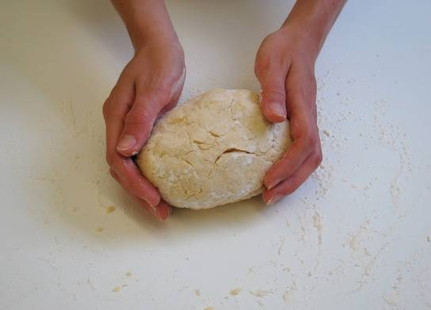
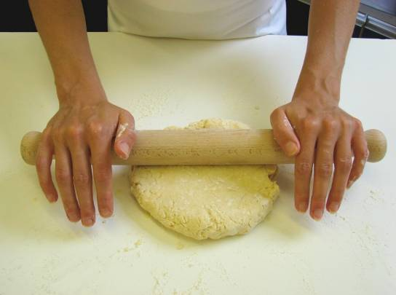
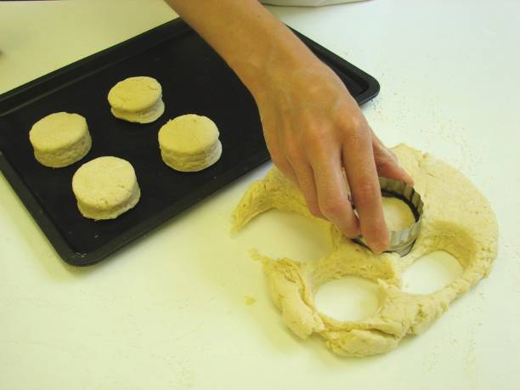
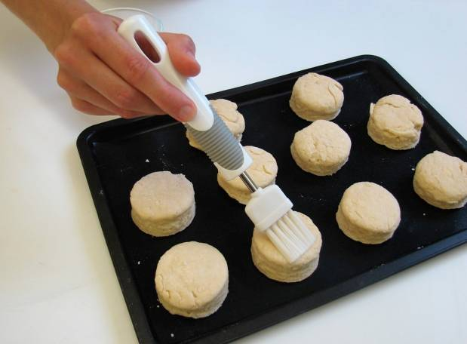
This recipe is from the original Licence to Cook programme and is provided under the Open Government Licence.
Method
Place the dough on a lightly floured work surface.
Roll out the dough to about 1½ cm thick.
Shape the scones using a cutter.
Place the scones on the baking tray and brush each top with a little milk.
© Food – a fact of life 2019
www.foodafactoflife.org.uk

Slide 5
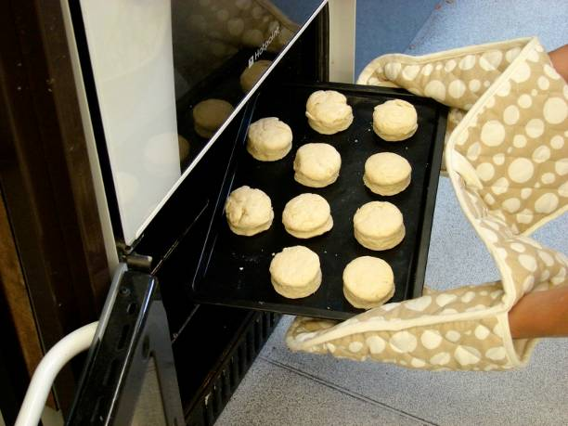
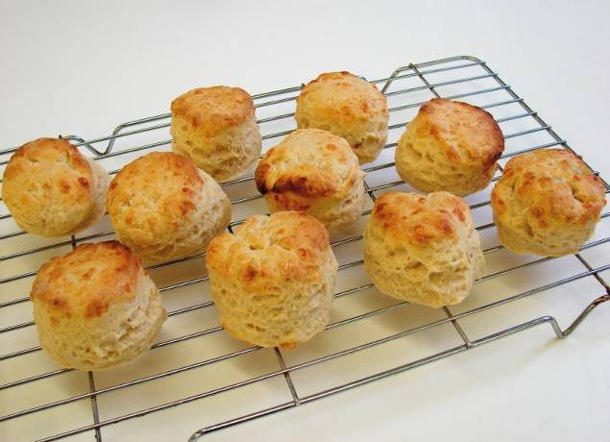
This recipe is from the original Licence to Cook programme and is provided under the Open Government Licence.
Method
Bake for 12-15 minutes, until golden brown.
Allow to cool on a cooling rack.
© Food – a fact of life 2019
www.foodafactoflife.org.uk

