Slide 1
Food in space

Slide 2
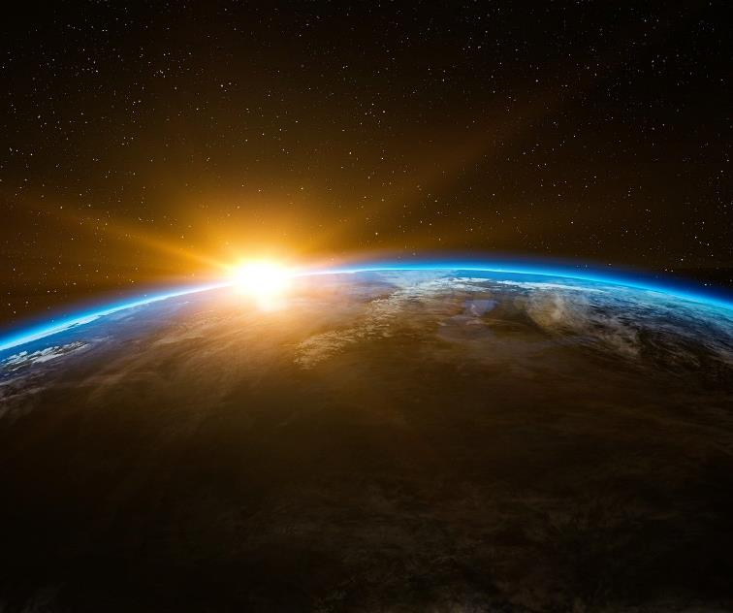
Living in space
The people who live and work in space are called astronauts.
Astronauts live on an artificial satellite in space, called the International Space Station.
The International Space Station is 240 miles above the surface of the Earth.

Slide 3
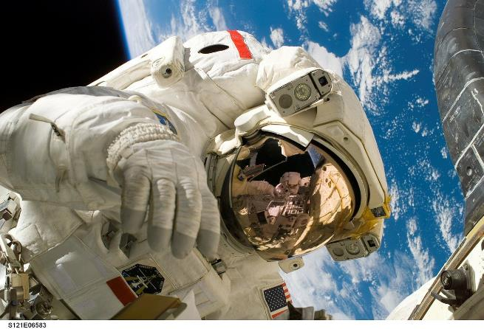
Living in space
In space, there is less gravity, so everything floats.
This makes living in space very different because the astronauts, and the equipment and food, float around.
Write down five everyday items that might be more difficult to use because they are floating.

Slide 4
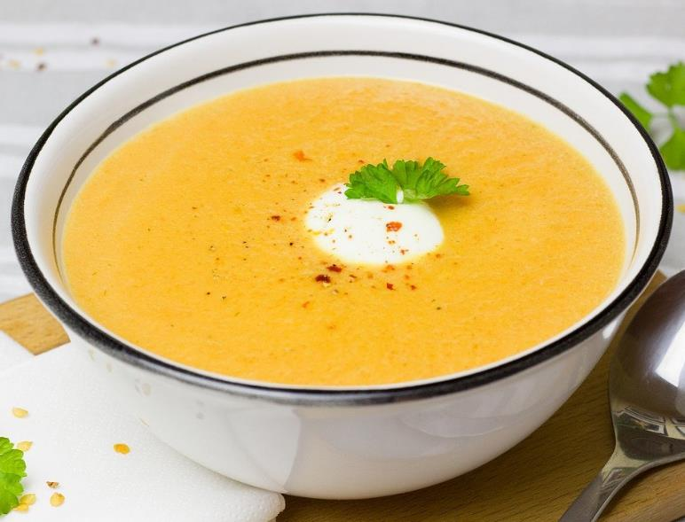
Space food changing over time
The food that astronauts eat has changed since the early space missions.
At first, the food available for astronauts was limited and unappetising.
One of the first types of food eaten was vegetable soup that was served in a metallic tube.
Now astronauts can choose from a wide range of different food.

Slide 5
Space food changing over time
Let’s see how space food has changed over time…
1960s
Space food was based on Army survival rations, and consisted of pureed food packed.
1961-1975
Dehydrated milk, coffee, grapefruit juice and soups could be eaten with just some added water.
1973/74
On the Skylab mission, space was available for a dining room and table.
Now
Astronauts now get taste-testing sessions so they can recommend dishes for their upcoming missions.
1962
Scientists tested whether an astronaut could eat food in space.
1969
The spoon-bowl pack was invented, so food could have hot water added.
1970s and 80s
Space menus include more than 70 food items.

Slide 6
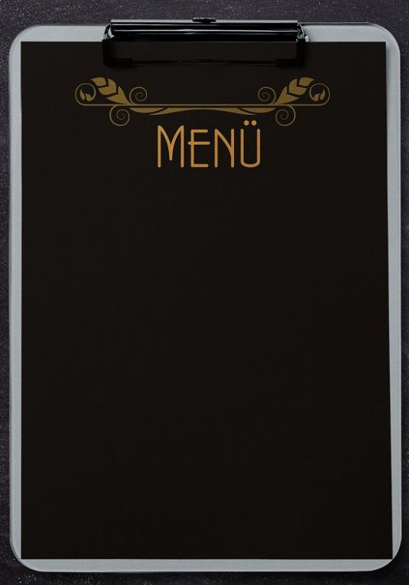
Food in space
Astronauts have three healthy, balanced meals during the day (breakfast, lunch, dinner) and some snacks.
Astronaut usually choose their own menu, but nutritionists help to make sure it is healthy.
There are lots of different things to think about when planning meals for in space.
List three things the nutritionists and astronauts might need to consider.

Slide 7

What astronauts need
When astronauts go into space, food scientists and nutritionists ensure that they have:
Food provides the right amounts of energy and nutrients for their needs.
Food that is lightweight and compact.
Food that the astronauts enjoy eating.
Food that is either ready to eat or can be prepared easily and quickly.
Enough food that will last throughout their mission.

Slide 8
Processing food ready for space
Astronauts can still have some of your favourite food in space, but they have to be prepared differently.
Potatoes and prawns are heat processed and canned, allowing them to be stored at room temperature.
Drinks are dehydrated for transport, and usually come in powdered form.
Meat is heat processed so it can be stored at room temperature, so it lasts longer and to remove harmful bacteria.

Slide 9
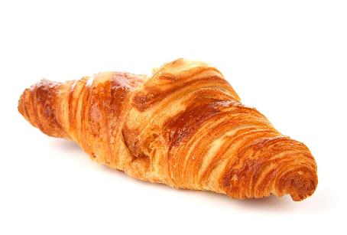
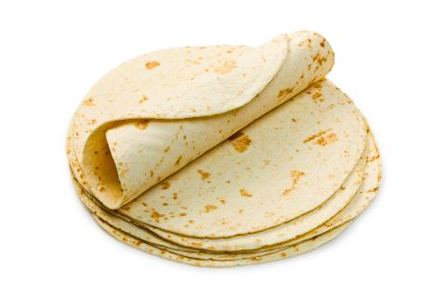
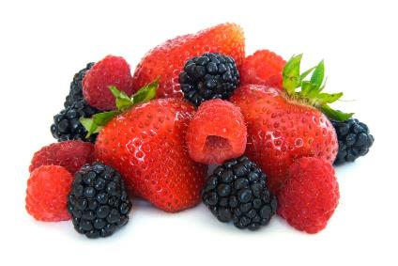
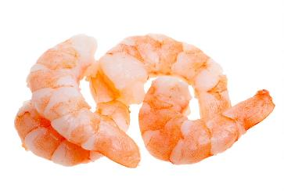
Am I suitable for space?
Take a look at these food. Are they suitable for space?
Croissant
Tortilla
Berries
Prawns
Notes:
Ready to eat foods such as peanuts are suitable for space.
Biscuits are also ready to eat; therefore, can be taken in space.
Tortillas are suitable for space travel and are astronauts favourite food.
Salt has to be dissolved in water to be taken in space.
Black berries do not last. Dried berries could be taken in space.
Prawns have to be cooked or dehydrated before taking in to space.

Slide 10


Am I suitable for space?
Take a look at these food. Are they suitable for space?
I have too many crumbs to go into space!
I am suitable for space!
I can only go into space if I am dried.
I can only go into space if I am cooked or dehydrated.

Slide 11
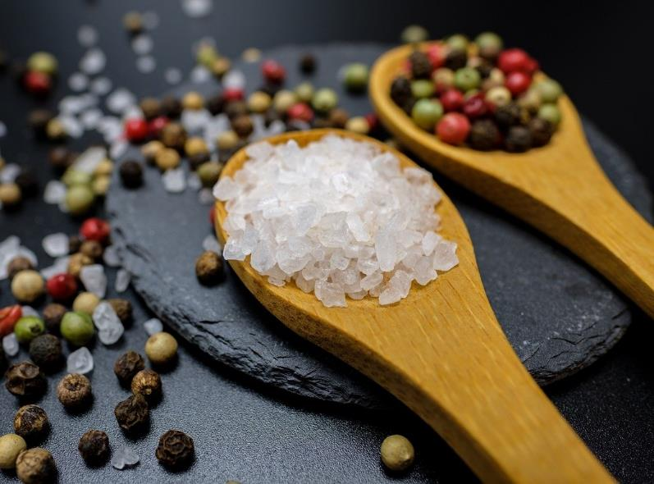
Eating in space
There are even things the astronauts have to consider about how they eat in space.
The dinner tray needs to be attached to the astronaut so it does not float away.
Even cutlery is different. In space, astronauts need scissors to cut the food pouches.
Salt and pepper needs to be added to water or oil, so it does not float away.

Slide 12



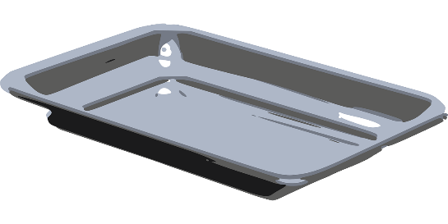
Cutlery in space
Astronauts use knives and forks to eat, just the same as you at home!
Astronauts need scissors when they are eating to cut into the food pouches.
Rather than a plate, astronauts have a meal tray. This needs to be attached to an astronaut’s lap or to a wall, so it doesn’t float away.

Slide 13
Preparing food in space
How you prepare food is also different in space, because you do not have the same equipment as on earth.
A meal for four astronauts can be set up in about five minutes, but heating or rehydrating the food takes an extra 20 to 30 minutes.
Let’s have a look at a kitchen on Earth, and think of some of the things we don’t have in space.

Slide 14
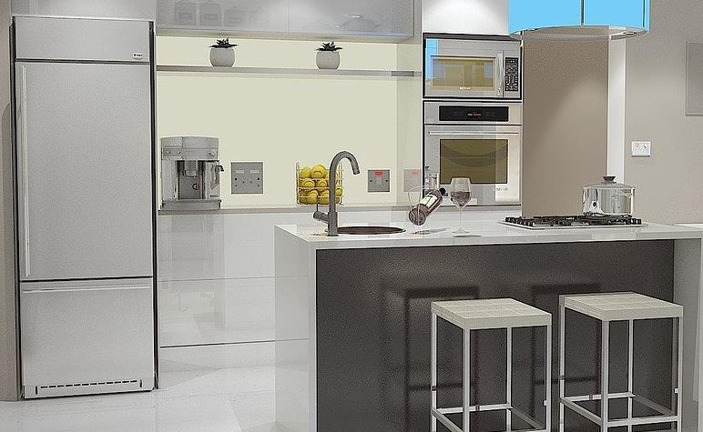
Space kitchen and a normal kitchen
There is no hob at the ISS, so astronauts have to use a food warmer or galley oven, which is similar to an oven at home.
The ISS does not have a fridge or a freezer.
So, all food needs to be able to be stored at room temperature.
There is no sink on the ISS, but astronauts have to add water to food.
They can use a specially designed tap or a water gun.
There is no dishwasher for washing up in space, so food is packed in a disposable container.

Slide 15
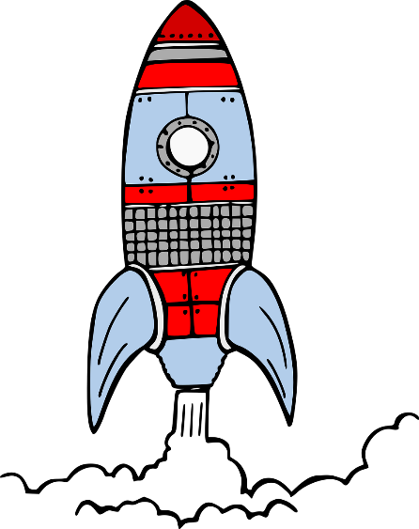
Preparing space food – the countdown!
18 months to go
Astronauts undergo taste-testing sessions to help pick food for in space.
3 months to go
The menus are then finalised and given to the shut­tle food contractor.
2/3 days to go
The food is loaded onto the spacecraft.
5 months to go
Astronauts, along with nutritionists, choose what will be on the menu.
1 month to go
The food is cooked and packed.
0 days to go
Lift-off! The astronauts and the food go into space.

Slide 16
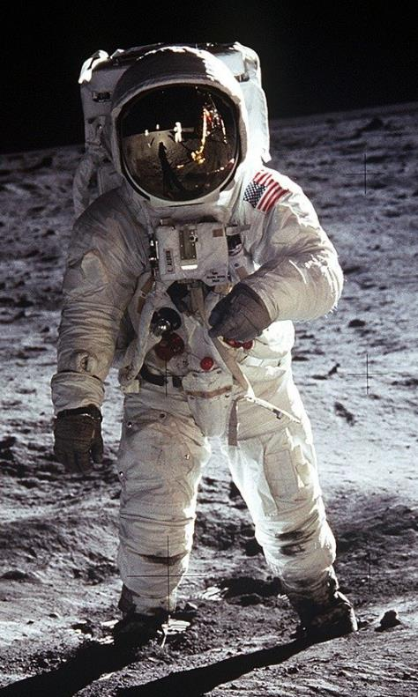
Exercise in space
Gravity is less strong on the international space station as it is on Earth, astronaut’s bones and muscles can weaken as they are not working as hard, because there is less gravity.
Astronauts exercise for at least two hours each day.
The ISS has its own gym which has special exercise equipment to allow astronauts to exercise.
List three difficulties with exercising without any gravity.

Slide 17
What do we know about food in space?
Remember SPACE!
S – Strap it down. Strap the tray and cutlery down so it doesn’t float away.
P – Processed. Process food so it can be stored for longer periods.
A – Appetising. Food is now much more appetising for astronauts.
C – Crumbs! Make sure the food doesn’t have crumbs, as these can be dangerous.
E – Easy to prepare. Make sure the food is easy to prepare, e.g. just add water!

Slide 18
Food in space
For further information, go to:
www.foodafactoflife.org.uk

