Slide 1
What can you eat in space?

Slide 2
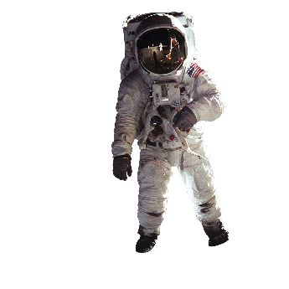
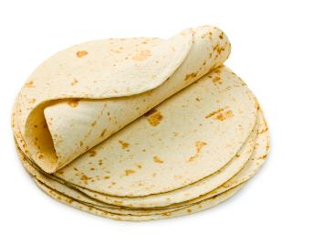
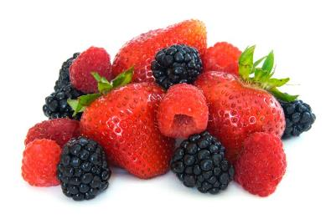
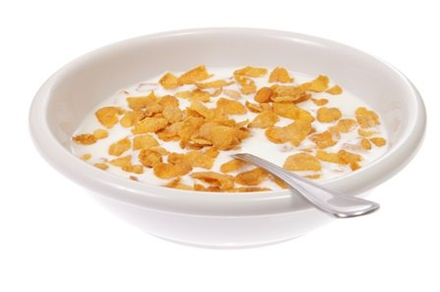
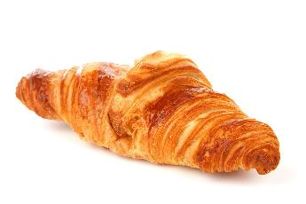
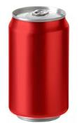
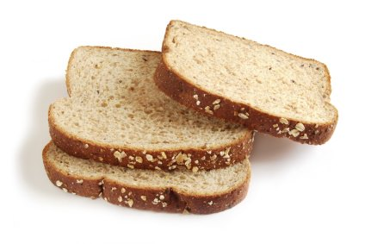
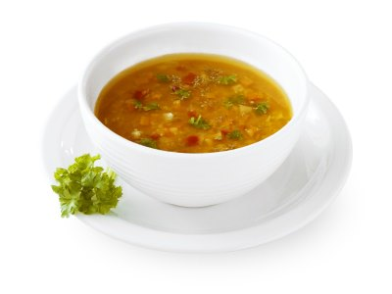
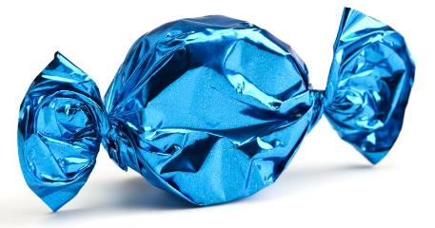
Click on the foods you want to have in space

Slide 3
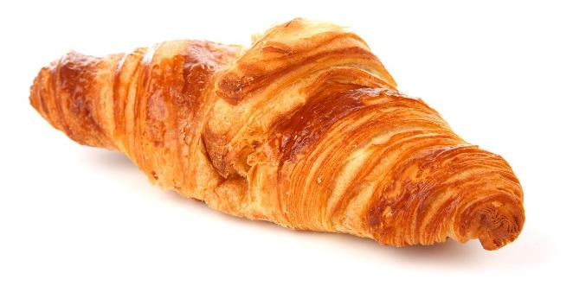


Croissant
A croissant produces a lot of crumbs, so is not suitable to have in space.
Astronauts are not allowed food that leaves crumbs, as the small food particles could clog air vents, damage space equipment or get stuck in an astronaut's eyes, mouth or nose.
Some food is coated with gelatine or oil to prevent it crumbling!
Off the menu!
Click on the Astronaut to go back to the food!

Slide 4
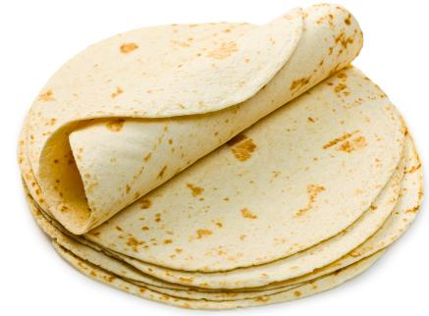
Tortilla
A tortilla is suitable to have in space, as it does not produce many crumbs and is easily stored.
These are often astronauts' favourite food when they are on a mission, and they a great replacement for other food that may make more crumbs.
They have been eaten in space since 1985.
On the menu
Click on the Astronaut to go back to the food!

Slide 5
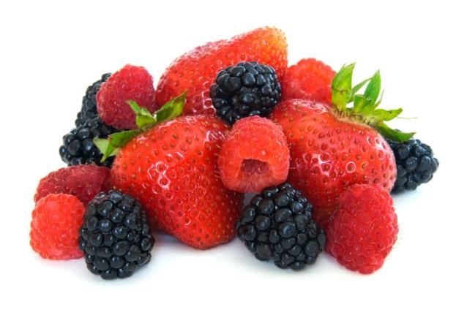
Berries
Whilst some fresh fruit is able to be taken to the ISS, and eaten in the first few days, berries are usually modified.
Berries are freeze dried, so they store for longer periods of time.
You can buy freeze dried berries on Earth, they aren’t just for space travel!
Need to be modified
Click on the Astronaut to go back to the food!

Slide 6
Breakfast cereal
Breakfast cereals are an example of food packaged in rehy­dratable containers.
Breakfast cereals are stored with the cereal in a rehydratable package with non-fat dry milk and sugar, if needed.
Water can then be added to the package just before the cereal is eaten.
On the menu
Click on the Astronaut to go back to the food!

Slide 7
Bread
Some fresh bread may be able to be taken to eat for the first few days.
But, bread is rarely eaten - astronauts often have tortillas instead.
Bread does not stay fresh long enough to be a good food for life in space.
Off the menu!
Click on the Astronaut to go back to the food!

Slide 8
Cola drink
You can actually have cola at the ISS.
Cola companies have produced special drinking nozzles so the astronauts can drink cola without it going everywhere.
These drinks are usually kept in pouches, with a built in straw.
Drinks usually come in powdered form.
On the menu
Click on the Astronaut to go back to the food!
Notes:
https://www.spacekids.co.uk/spacefood/

Slide 9
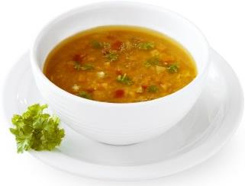
Vegetable soup
Vegetable soup was one of the first types of food eaten in space.
The first Russians in space ate a type of Russian vegetable soup called Borscht.
This was stored in a metallic tube and astronauts had to squeeze the soup out, a bit like toothpaste!
On the menu
Click on the Astronaut to go back to the food!
Notes:
https://www.spacekids.co.uk/spacefood/

Slide 10

Sweets
Astronauts are able to have sweets on the international space station.
However, they work hard with nutritionists to make sure they have a healthy diet.
Sweets should be had less often and in small amounts, even in space!
On the menu – but in small amounts!
Click on the Astronaut to go back to the food!

Slide 11
What can you eat in space?
For further information, go to:
www.foodafactoflife.org.uk

