Slide 1
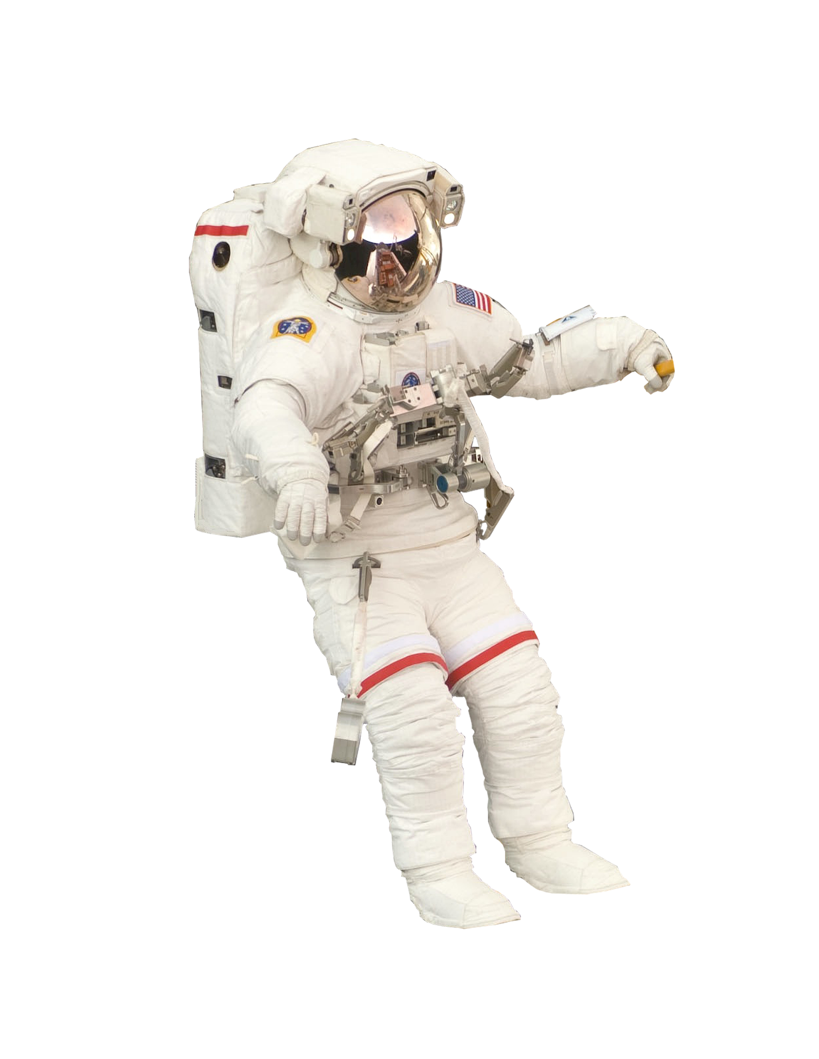









20
21
22
23
24
25
Start
19
18
17
16
15
14
13
12
4
5
6
7
8
9
10
11
Race
3
2
1
Lift off
Space
1
2
3
11
10
9
8
7
6
5
4
12
13
14
15
16
17
18
19
Start
25
24
23
22
21
20

