Slide 1
Farming food

Slide 2
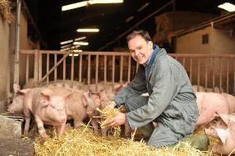
Farming systems
Agriculture in the UK can be grouped into five main types:
subsistence: grown just for the farmer/producer and their family;
commercial: grown to sell – this could be small or large scale;
organic farming: artificial fertilisers are not allowed to be used and pesticide use is severely restricted;
free-range: animals, for a least part of the day, can roam freely outdoors;
intensive farming: a large number of the same crop or animal are grown together.

Slide 3
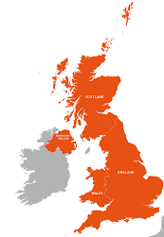
Farming in the UK
Some parts of the United Kingdom have excellent soil for crops, while others are used for cattle, sheep, pigs and poultry.
In the north-west of England, Wales and Scotland, farmers keep cattle and sheep. Sheep can survive the cold winters on the hills and moors.
In the east of England (East Anglia), wheat, barley and vegetables grow in large fields.
Cattle, sheep, pigs and dairy are the largest commodity sectors in Northern Ireland.
In the south-east of England and the lowlands of Scotland, grain, potatoes and sugar beet are grown. Most UK cauliflowers are grown in the south-east.
In the south-west of England, the rich grass is ideal for feeding dairy cows.

Slide 4
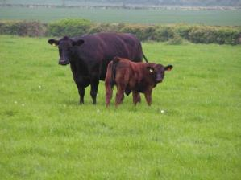
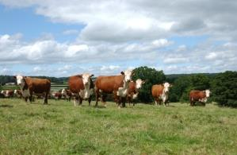
Cattle farming
British beef breeds include:
Hereford;
Galloway;
Beef Shorthorn;
Aberdeen Angus;
South Devon.
Some cattle are dual purpose and are farmed for both dairy and beef production.

Slide 5
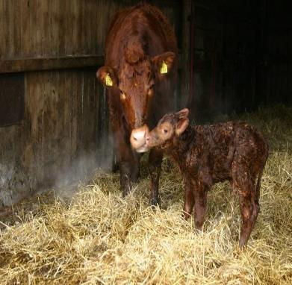
Cattle farming
Calves reared on beef cows remain with their mothers 6-9 months before being weaned.
Dairy calves are separated from their mother shortly after birth.
Milk is the main source of nutrition for young calves.
As they grow older they predominantly have a grass based diet.
Diets will often be supplemented using cereals or pulses to supply energy or protein.
This calf has just been born and weighs about 35 kg.

Slide 6
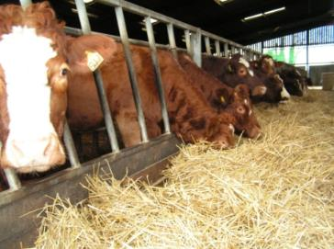
Cattle farming
Most animals spend the summer months in fields grazing and many are housed in large barns in the winter when the grass has stopped growing. Maize silage is also sometimes used as feed.
The diets can be supplemented with other ingredients, for example cereals like barely or protein feeds such as beans.
Cattle diets ustilise feed which humans cannot consume, for example by-products of flour manufacture or margarine production.

Slide 7
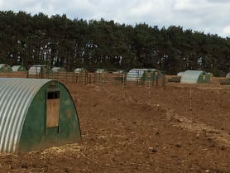
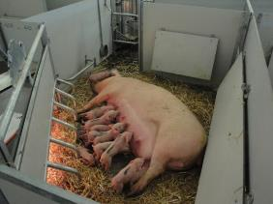
Pig farming
Pigs are generally reared indoors in barns with open sides, natural ventilation and straw or slats which allow drainage of excrement.
Approximately 40% of UK pig production is outside, with huts for shade and protection from the elements. In the summer water is used to create an area for the pigs to wallow and remain cool in the heat. Pigs are like dogs and are not able to sweat to regulate their body temperature.
Once a sow (female pig) has been serviced by the boar (male pig) or artificially inseminated the gestation period will last 3 months, 3 weeks and 3 days. A sow can give birth to two litters a year.

Slide 8
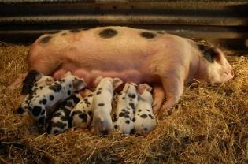
Pig farming
Piglets are born with teeth and may have these clipped or ground to protect the sow’s teats and udder. This also reduces the injury of piglets when they are playing with each other.
After about 4 weeks, once weaned, the piglets leave the sow to be reared in separate accommodation.
Pigs are normally sent to the abattoir at 6-7 months. The farmer will decide if the sow will be taken to be served by a boar (or more commonly artificially inseminated) or to sent to the abattoir (typically after 6 litters).
Adult pigs will feed on cereals such as corn and soya for carbohydrate and protein. Their diet can be supplemented with vitamins and minerals.

Slide 9
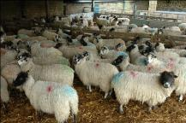
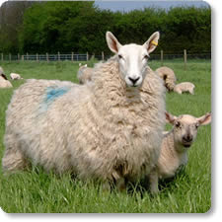
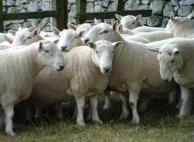
Sheep farming
Three main groups of sheep breeds:
Mountain and Moorland/Upland - these are hardy sheep which can cope with rugged terrain, such as Welsh Mountain and Swaledale;
Longwool - these are originally bred for their wool, but now used in cross breeding, such as Border Leicester and Bluefaced Leicester;
Terminal Sire Breeds - these are compact muscular type of sheep suitable for grassland and less harsh environments, such as Suffolk, Charollais and Texel

Slide 10
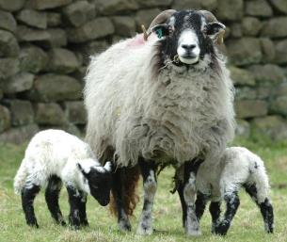
Sheep farming
In late summer, the sheep are prepared for mating. Feed intake is increased just before ovulation - this is called flushing. The sheep need to be healthy and in good physical condition. Mating, or tupping, by rams or artificial insemination occurs during the autumn.
The busiest time of the year for a sheep farmer is during lambing, from January to May. A farmer will plan for lambing to take place when the weather conditions improve and the grass begins to grow.
The lambs are weaned normally between 12 and 16 weeks of age.
Farmers will select some females for breeding based on their physical condition and finish the rest for market.

Slide 11
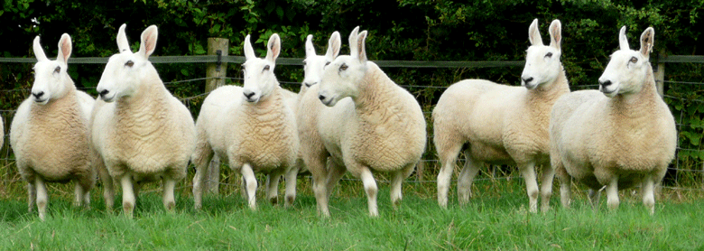
Sheep farming
Sheep enjoy a diet of grass. This diet can be supplemented with hay, silage and root crops, such as turnips, when grass is not readily available.
Shearing takes place when the weather is warm and dry. This does not hurt the sheep. It is effectively a hair cut. Lambs do not need shearing.
Sheep are checked by the shepherd daily, to make sure they are healthy and free from disease.

Slide 12
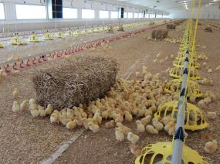
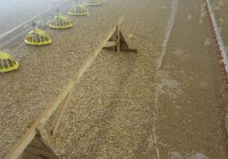
Chicken farming – higher welfare
Chickens reared for meat are called broilers or broiler chickens.
Chickens are born in a hatchery and are then transferred to a rearing farm at one day old.
The chickens are provided with space and dirt to scratch and dust bathe. There are also places for chickens to perch when they are bigger.

Slide 13
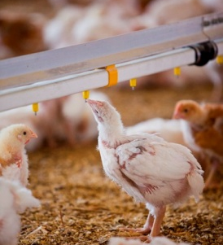
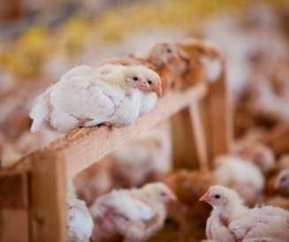
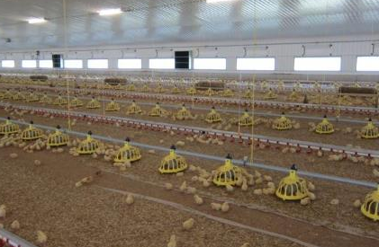
Chicken farming – higher welfare
Their food travels down pipes into feeders and freshwater is always available.

Slide 14
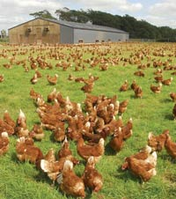
Chicken farming – free range
Chickens have access to the outdoors during the daytime for at least half of their lifetime and the birds used are often slower growing breeds.
Pop-holes allow access to the outside.
At night the hens come inside for protection from predators.

Slide 15
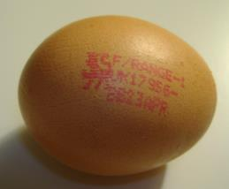
Egg production
In the UK, there are three systems for producing eggs:
  laying cage - across the European Union conventional 'battery' cages have been banned. In the UK, they have been replaced by larger, ‘enriched’ colony cages;
  barn– hens are able to move freely around the barn. The number of hens is limited and they are given space to perch, scratch and dust bathe;
  free-range - hens must have continuous daytime access to runs which are mainly covered with vegetation and there is maximum number of hens in a flock;
  organic - hens producing organic eggs are always free range. In addition, hens must be fed an organically produced diet and ranged on organic land.

Slide 16
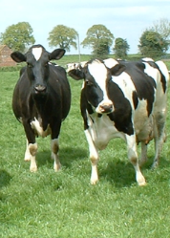
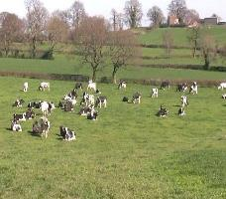
Dairy farming
Cows are reared on dairy farms to produce milk.
Currently, 14.5 billion litres of milk each year are produced on dairy farms in the UK. Around 6.5 billion litres of these are sold for drinking and some goes to the production of dairy products such as cheese or butter.
A dairy cow needs to give birth to a calf in order to produce milk.
Most British dairy cows eat grass during the summer and silage (dried grass or maize) in the winter.

Slide 17
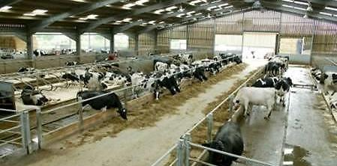
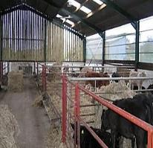
Dairy farming
Dairy cows mostly graze outdoors during the summer, moving from indoor housing. Outside they can easily graze at their own leisure, exercise, get fresh air and natural light.
Most dairy cows are housed during the winter and bad weather.
Sheds are designed to be extremely spacious and airy, allowing the cows to rest, stand and move around freely to exercise and socialise.

Slide 18
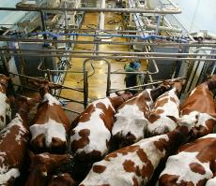
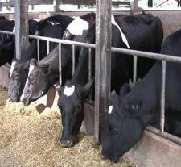
Dairy farming
The cows come in from the fields or the barn into the collecting yard twice a day.
Once the cows have been milked, they are let out of the parlour. The cows are free to move around, sit down, eat and drink.
They are then returned to the field or barn until the next time they are due to be milked.

Slide 19
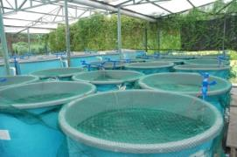
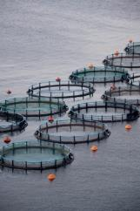
Fish farming
Fish farming is the principle form of aquaculture. Fish are farmed in both fresh water and seawater.
Around the world, fish and shellfish species which are commonly farmed include: salmon, trout, sea bass, turbot, halibut, sea bream, kingfish, barramundi, grouper, prawns and carp.
Atlantic salmon is one of the most commonly farmed fish species in the UK, with farms mainly located in the Scottish highlands.
Farmed fish are bred in special tanks on land, or pens in the sea.

Slide 20
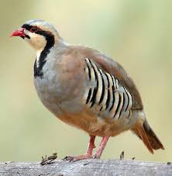
Game farming – game birds
In Britain today there are around 300 game farms, mostly rearing pheasants and partridges.
Eggs are collected daily from April onwards and are hatched in electronic incubators. The chicks are then reared on in purpose-built shelters, where they are provided with food, water, grit and all their other needs.
As they grow, the chicks are given access to outdoor runs where they can get used to the natural environment.
In about August, they are sold to shoots, where gamekeepers will take over their care, releasing them into the countryside.

Slide 21
Farming food
For further information, go to:
www.foodafactoflife.org.uk

