Slide 1
Growing food

Slide 2
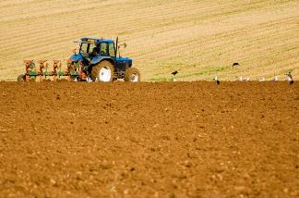
Farming in the UK
Types of farming:
arable (growing of crops and cereals);
pastoral (rearing and production of animals including pigs, chickens, hill farming sheep, beef and dairy cattle);
mixed farming (combination of arable and pastoral);
horticulture (production of flowers, fruit, vegetables or ornamental plants);
market gardening (small scale production of fruit and vegetables);
viticulture (grapes).

Slide 3
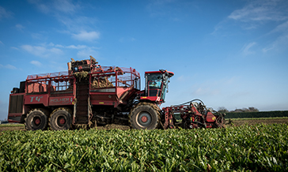
Principal crops
Wheat.
Barley.
Oats.
Potatoes.
Sugar beet.
Vegetables.
Oil seed rape.
Fruits.

Slide 4
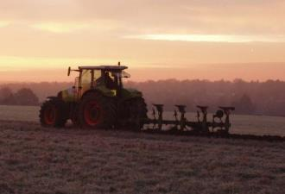
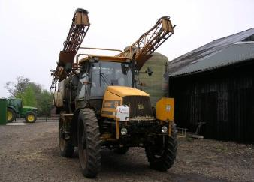
Wheat farming
In the late autumn to early winter, the fields are ploughed and seeds are sown.
In the spring, the seeds begin to grow into plants. They are sprayed with fertiliser to help them grow. Sometimes they are sprayed to get rid of weeds and pests as well.

Slide 5
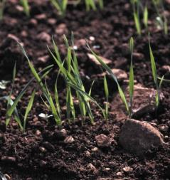
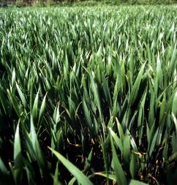
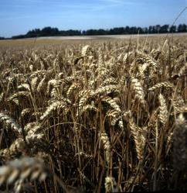
Wheat farming
To grow plants need light from the sun and water from the rain.
This is what wheat looks like when it is growing. Soil gives plants the food they need to grow and stay healthy.

Slide 6
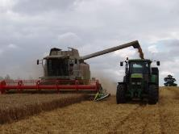

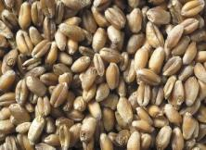
Wheat farming
In the late summer the wheat is harvested.
A combine harvester cuts the wheat and separates the grain,
the straw and the chaff.
The chaff is what is left when the grain has been separated from
the ear.

Slide 7
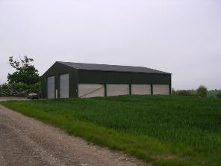
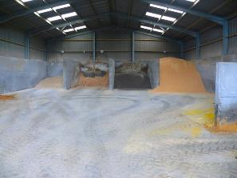
Wheat farming
The grain is kept in a store before it goes to be milled
or used to make breakfast cereal.

Slide 8
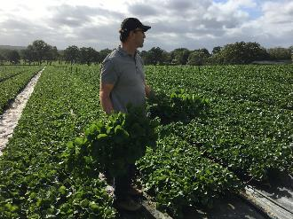
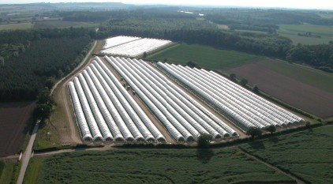
Fruit farming - strawberries
A few UK farmers grow strawberries outside in the fields.
However, most strawberries in the UK are now grown in poly tunnels or glass houses.

Slide 9
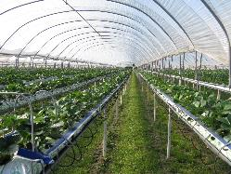
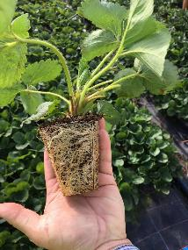
Fruit farming - strawberries
UK strawberries are mostly grown on table tops under cover and the plants are watered and fed via a system of pipes.
The plants are first grown in trays and when they are big enough, they are planted into compost on the table tops. The compost can be in bags, pots or troughs.

Slide 10
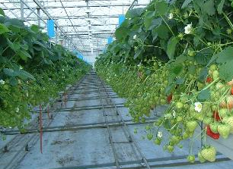
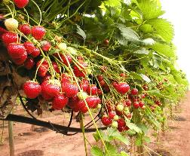
Fruit farming - strawberries
When the strawberries turn red they are ready to be picked. This is done by hand as they are too soft to be picked by machine.
Soft fruit production in the UK has increased dramatically over the last ten years.
166,055 portions of strawberries and cream were served at Wimbledon in 2018!

Slide 11
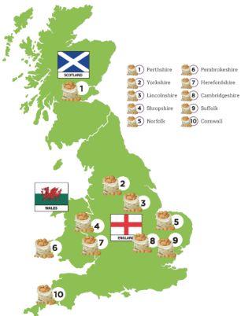
Vegetable farming - potatoes
More than 5.4 million tones of potatoes are produced in the UK annually and there are around 2,500 specialist potato farms within the UK.
Potatoes will usually be grown in the same field for only one out of every six years, or even longer. This is known as a rotation.
Grass, cereals and other crops are grown during the other years to replenish the nutrients and improve soil health.

Slide 12
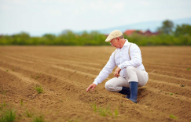
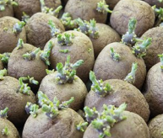
Vegetable farming - potatoes
Firstly, the soil is tested for nutrients and moisture and to decide which varieties to grow. Then the farmers plough the ground and turn the soil.
Later in the spring, the farmer spreads fertiliser and often uses a stone separator to remove stones from the soil where the potatoes are growing.
Seed potatoes are planted in rows and covered with soil, about 15-17cm deep. Planting usually takes place in spring, but depends on the climate.

Slide 13
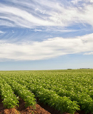
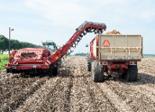
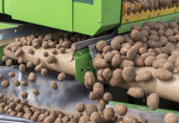
Vegetable farming - potatoes
Farmers care for their potato crops as they grow, using plant protection products to guard against insects and disease.
Potatoes are grown for around 5 months before they are ready for harvesting. Harvesting can start as early as June and finish at the end of October.
To see if the crops are ready, farmers test the crops by digging up, weighing and measuring sample potatoes.
The potatoes are then lifted by the harvester. Small and damaged potatoes are removed.

Slide 14
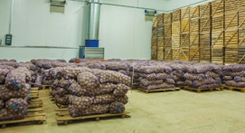
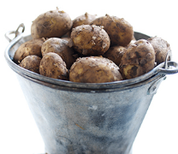
Vegetable farming - potatoes
Potatoes are placed in bulk storage or weighed and bagged ready for distribution.
Potatoes can also be stored in boxes in an insulated potato store.
Farmers will check the potatoes regularly throughout the storage season.

Slide 15
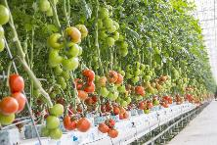
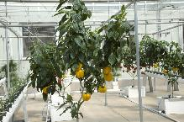
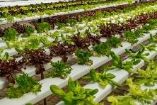
Vegetable farming - hydroponics
Hydroponic vegetables are grown in a nutrient solution rather than soil. Tomatoes, peppers and lettuce are increasingly grown this way.
Growing vegetables hydroponically enables them to be grown in a controlled environment with less chance of disease, faster growth, and greater yield.

Slide 16
Growing food
For further information, go to:
www.foodafactoflife.org.uk

