Slide 1
Practical food skills and recipes masterclass – sausage making
19/05/2021

Slide 2
Covered in today’s webinar
Food skills and ingredients for producing sausages from scratch.
The versatility of pork meat and use of sausages in different dishes for the classroom.
Labelling of sausage products and quality standards in the UK.
Good food hygiene and safety practices – handling meat safely.
Links to Food – a fact of life resources.
Ingredients and equipment.

Slide 3
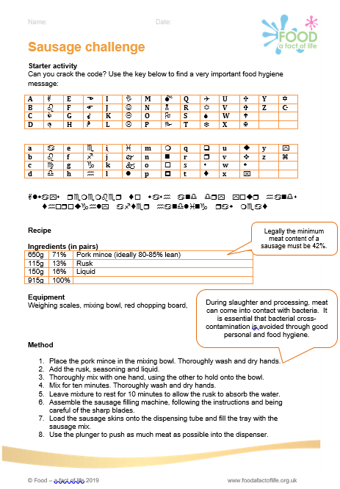
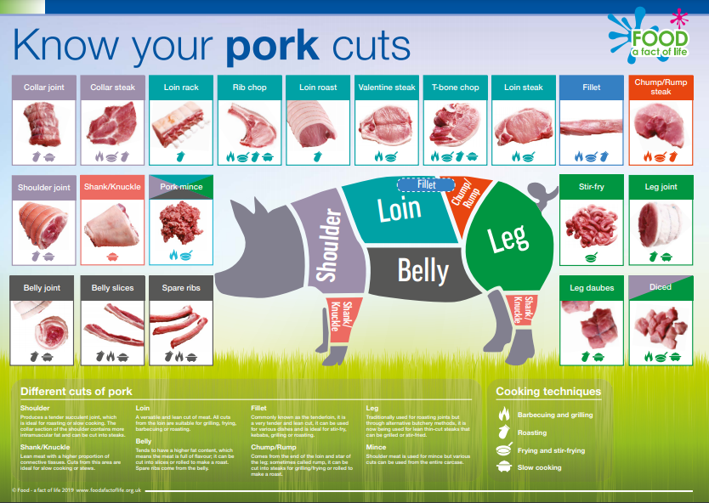
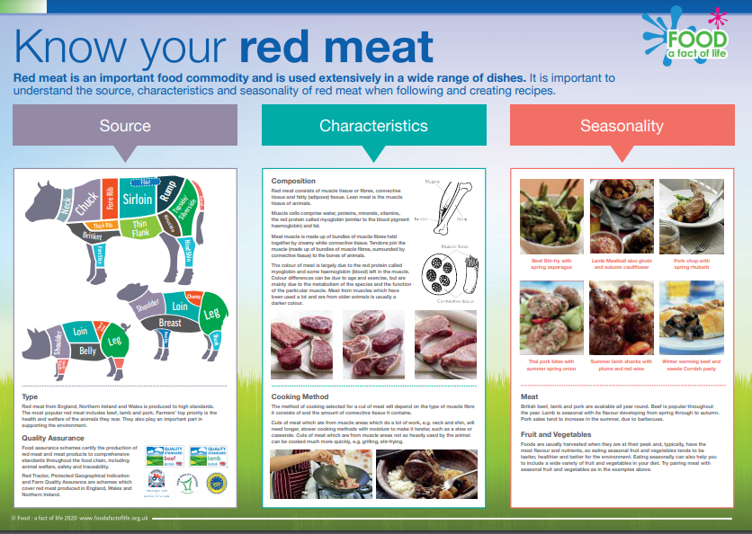
Resources
Sausage challenge (plus burger and kofta challenges).
Red meat activities and resources 11-14 Years and 14-16 Years.
Food hygiene and safety resources 11-14 Years and 14-16 Years.
Where food comes from resources.
Posters.

Slide 4
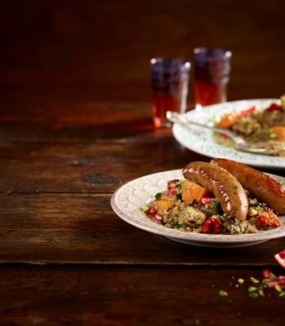
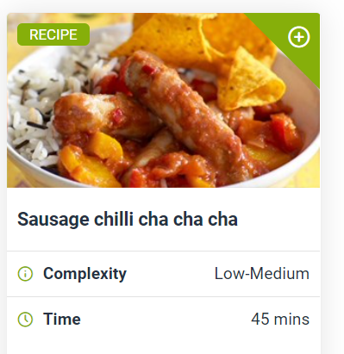
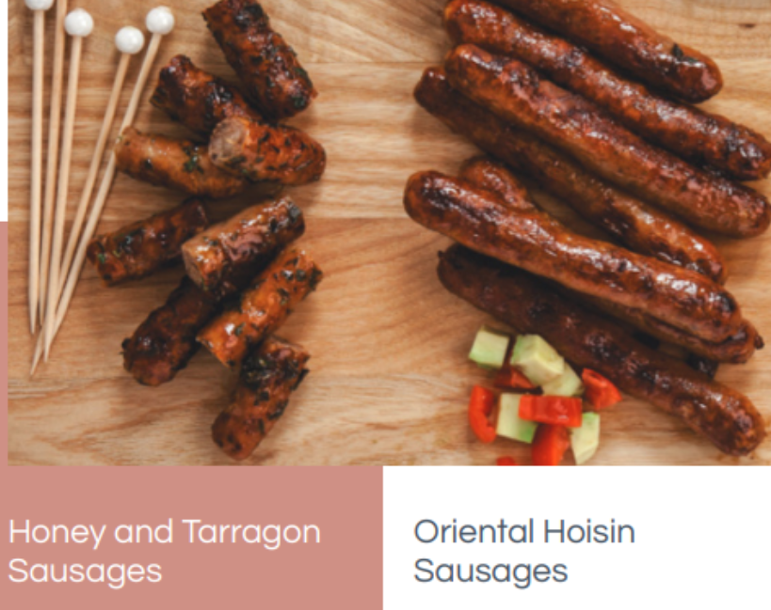


Recipes
Food – a fact of life
Love Pork
Ladies in Pigs recipe booklet

Slide 5
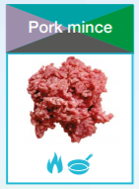
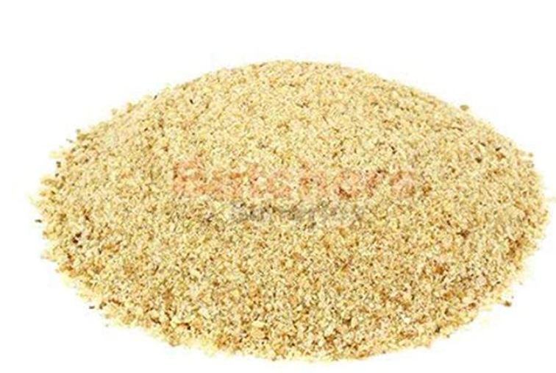
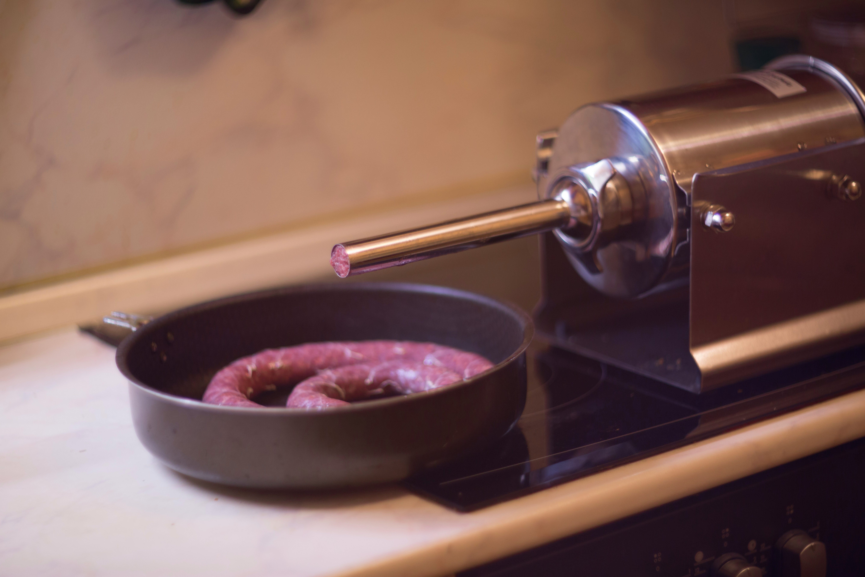

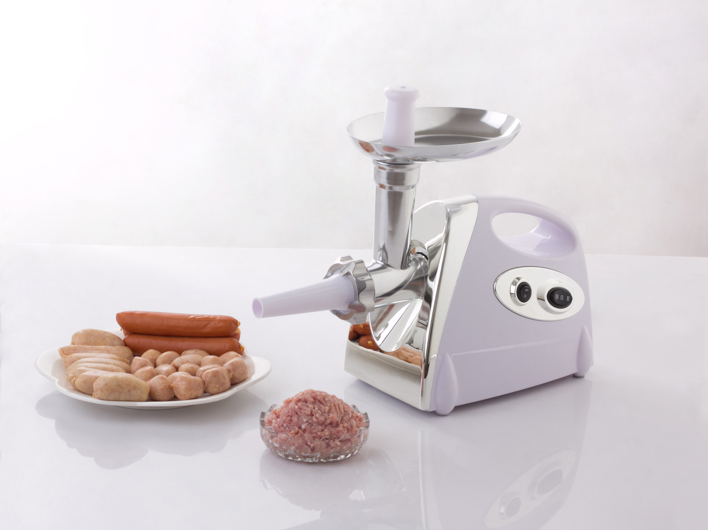
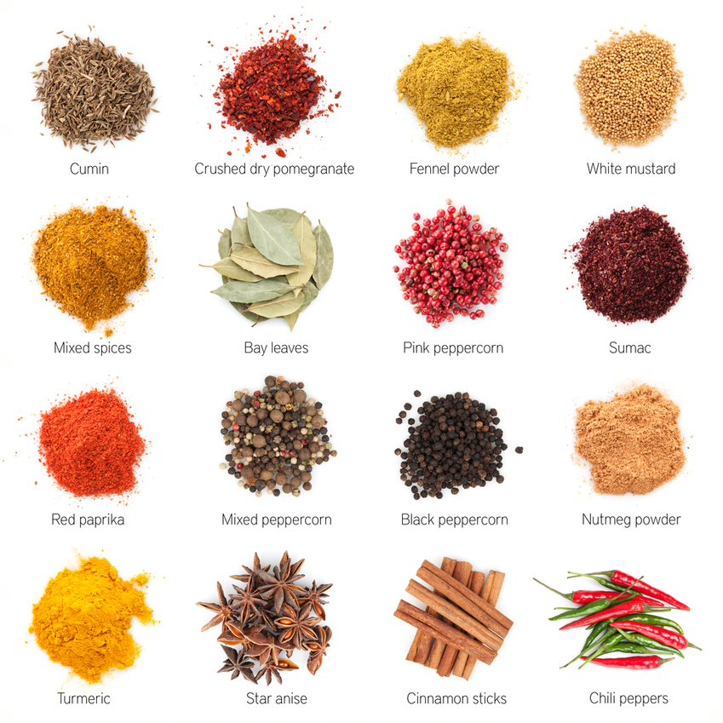
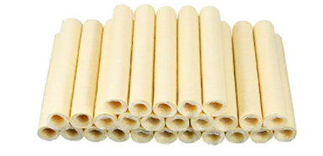
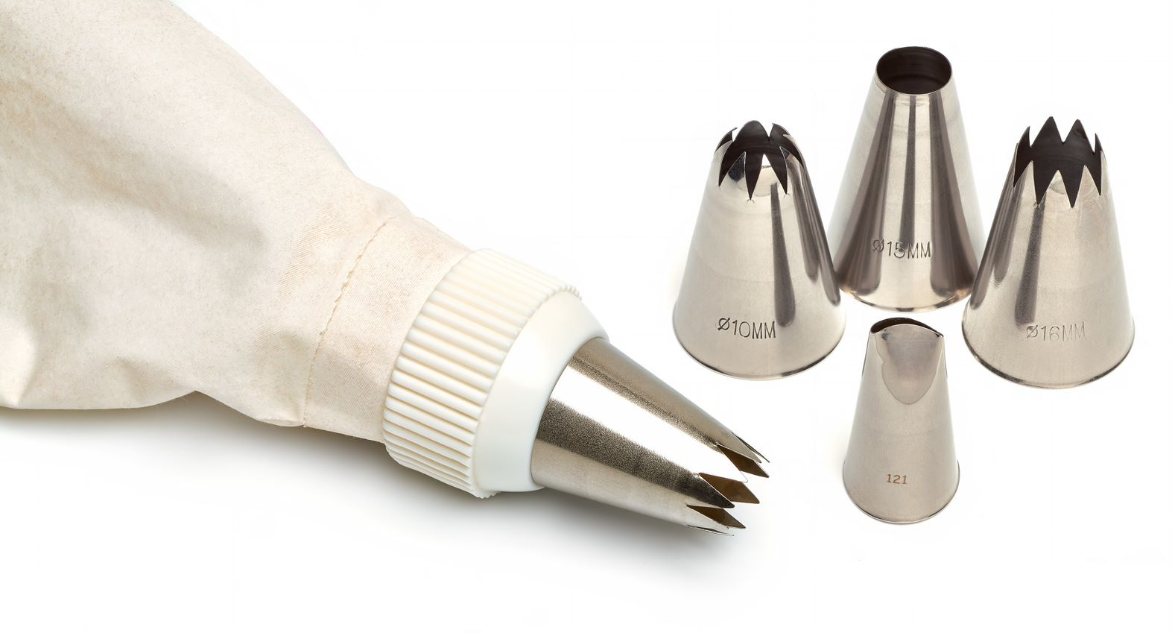
What will you need?
Water
Ideally 80-85% lean
Rusk
Hand-held/table top sausage maker
Electric meat grinder/sausage maker
Sausage skins
Piping bag
Spices

Slide 6
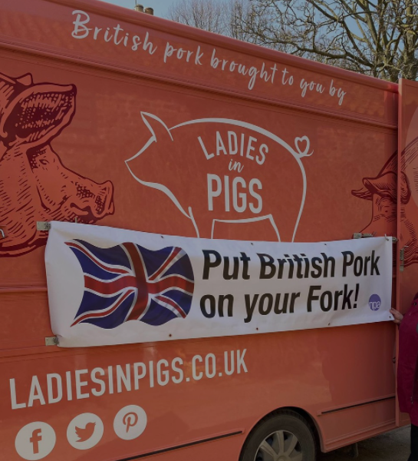
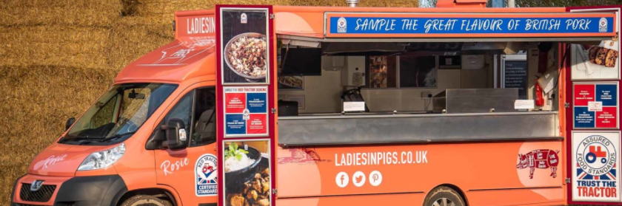

Ladies in Pigs
Face-to-face and virtual visits to schools
www.ladiesinpigs.co.uk
www.instagram.com/ladies_in_pigs

Slide 7
Practical food skills and recipes masterclass – sausage making
For further information, go to:
www.foodafactoflife.org.uk

