Slide 1
Fish in the diet

Slide 2
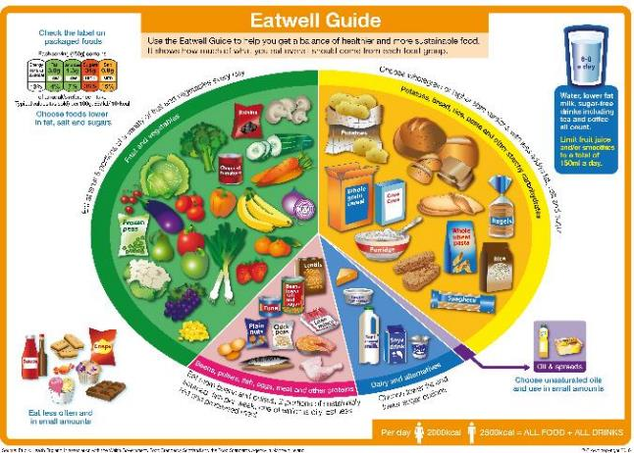
Fish in the diet
Fish is a popular food in many cultures, although many people in the UK do not consume as much fish as is recommended.
Eating a wide variety of fish and buying fish from sustainable sources ensures there are enough fish to eat now and in the future.
‘Sustainable’ fish or shellfish are those that do not cause damage to other animals and plants and are caught or produced in a way that will allow fish stocks to be replenished.

Slide 3
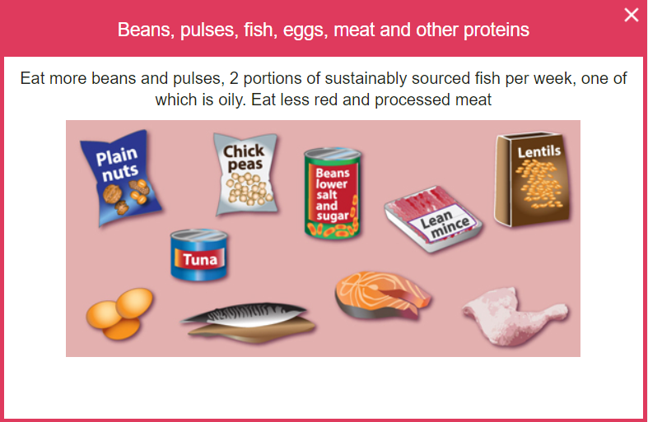
The Eatwell Guide
Fish is in the Beans, pulses, fish, eggs, meat and other proteins food group in the Eatwell Guide.
Around one-sixth of the food that people consume should come from this group in the diet.
It is recommended to consume two portions (one portion is 140g) of sustainably sourced fish per week.
One of these portions should be ‘oily’, because these fish contain healthy fats known as Omega-3.

Slide 4
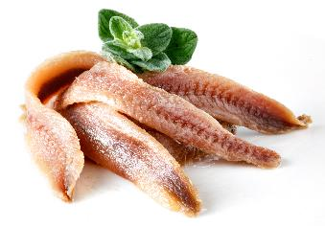
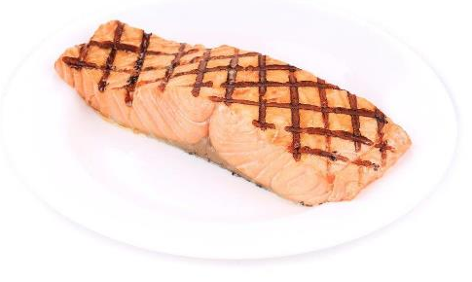
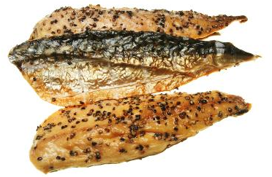
How much fish is eaten in the UK?
No age group in the UK currently meets the recommended intake for fish – low intakes of oily fish is a particular concern.
On average, UK adults eat 56g of oily fish per week and children (under 18 years of age) eat less than 20g per week¹.
¹ NDNS Year 9-11

Slide 5
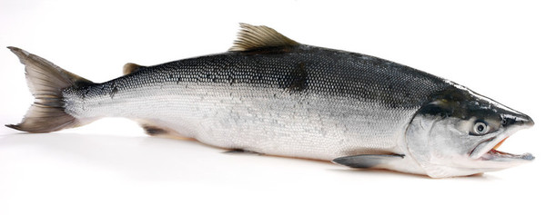
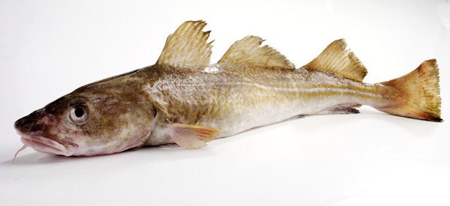
Nutrients provided by fish
Fish provides a range of nutrients, including:
Omega-3 fats (in some fish);
protein;
vitamin D (in some fish);
B vitamins;
iodine.
This salmon is high in Omega-3 fats and vitamin D, as well as protein and B vitamins
Cod is lower in Omega-3 and vitamin D than salmon, but still contains other nutrients and is also high in iodine

Slide 6
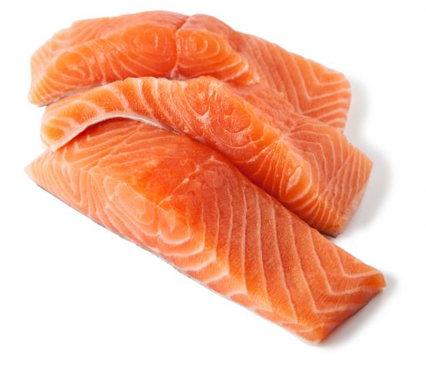
Omega-3 fats
Oily fish, such as salmon or sardines, is high in healthy fats called Omega-3, which can help to maintain good heart health.
Most people need to eat more oily fish than they are currently consuming.
However, there is some different advice for pregnant and breastfeeding women, as well as babies and young children.
Salmon is an example of an oily fish, meaning it contains Omega-3
NHS Fish and shellfish nutrition

Slide 7
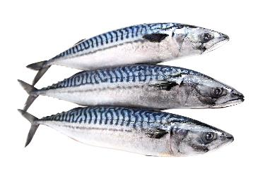
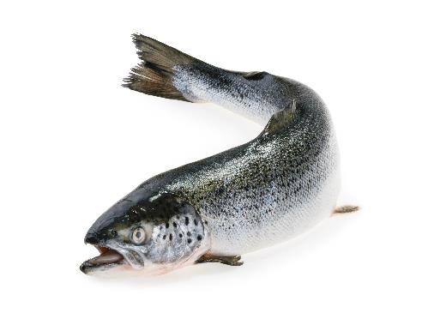
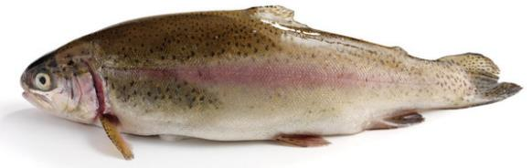
Fish high in Omega-3
Oily fish (high in Omega-3)
Herring
Mackerel
Salmon
Sardines
Sprats
Trout
Mackerel
Salmon
Rainbow Trout

Slide 8
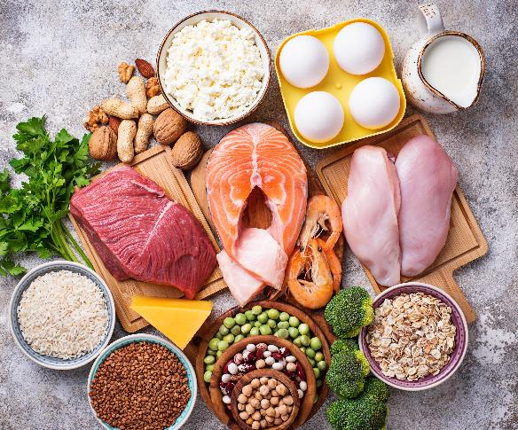
Protein
Protein is essential for growth and repair of the body and maintenance of good health. It also provides energy.
The amount of protein we need changes during a lifetime.
Animal proteins (including fish) contain ‘complete proteins’ with the full range of amino acids (the building blocks of proteins) that the body needs.
However, vegans and vegetarians can get all the amino acids they need by combining different plant sources of protein.
Fish is a source of protein. Protein is provided by plant and animal sources.
British Nutrition Foundation - protein

Slide 9
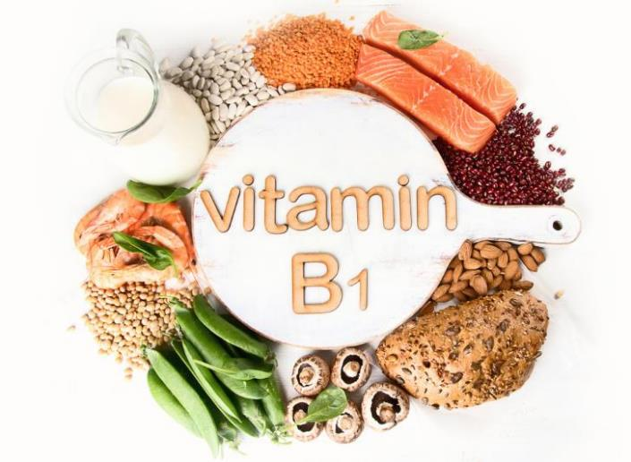
Vitamins and minerals
Fish contains many vitamins and minerals.
Oily fish contain vitamin D, which helps maintain a healthy immune system, strong bones, muscles and teeth.
They also contain a mixture of B vitamins, which perform a number of important roles in the body. For example, vitamin B1 (thiamin) helps keep the brain and heart working normally.
Minerals in fish include iodine and selenium, which are rare elsewhere in the diet. Iodine helps with normal growth in children, while selenium helps to maintain hair and nails.
Fish provides B vitamins, such as vitamin B1 (thiamin).
British Nutrition Foundation – What is in the fish in your dish?
EU Register of Health Claims

Slide 10
Fish in the diet
For further information, go to:
www.foodafactoflife.org.uk
This resource meets the Guidelines for producers and users of school education resources about food.

