Slide 1
Rice

Slide 2
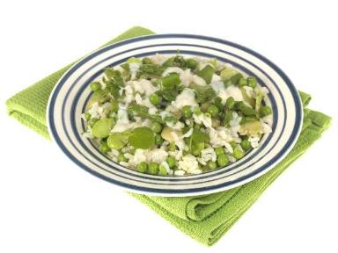
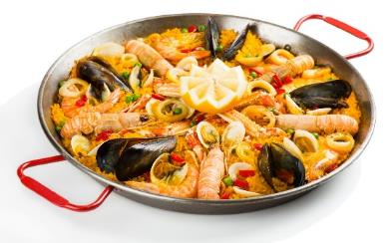
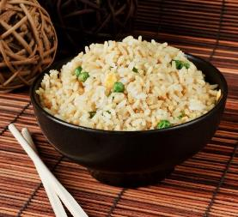
What do these have in common?
They all contain rice.

Slide 3
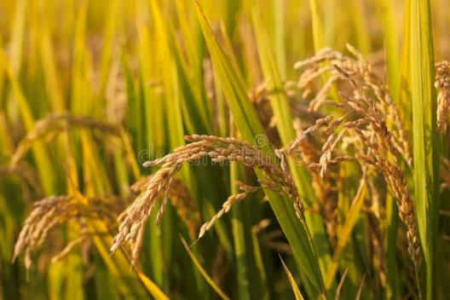
Where does rice come from?
Rice comes from a plant.

Slide 4
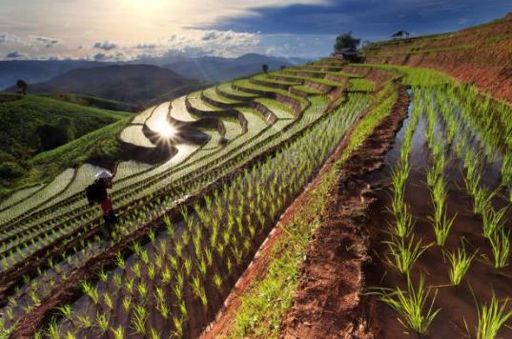
Where is rice grown?
Rice is grown in fields that have been flooded with water.

Slide 5
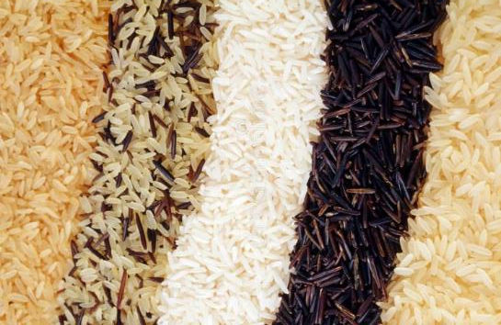
Rice varieties
There are three main types of rice:
long grain;
medium grain;
short grain.

Slide 6
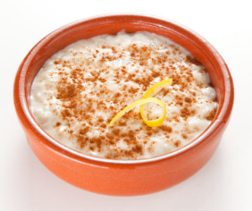
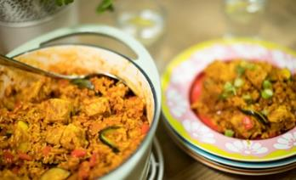
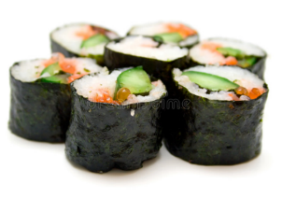
Meals
Rice can be used in lots of meals and dishes.

Slide 7

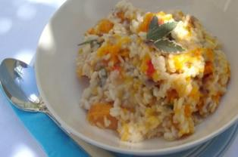
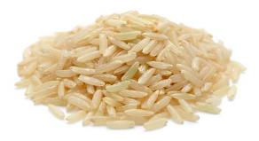
Summary
Rice is from plants.
Rice
Lots of meals are made with rice.

Slide 8
Rice
For further information, go to:
www.foodafactoflife.org.uk
This resource meets the Guidelines for producers and users of school education resources about food.

