Slide 1
A hands-on approach to teaching food and nutrition education to pupils with additional needs
9/06/2021

Slide 2
Covered in today’s webinar
Using food and nutrition education to develop the skills, knowledge and life-experiences of pupils with additional needs.
Practical examples of meeting pupils’ needs and ensuring inclusion.
Supporting pupils to develop skills for independent living and meaningful employment, particularly in catering and hospitality.
Resources for use with pupils with additional needs and professional development support available from Food – a fact of life.
Suggestions for further reading and sources of information.

Slide 3
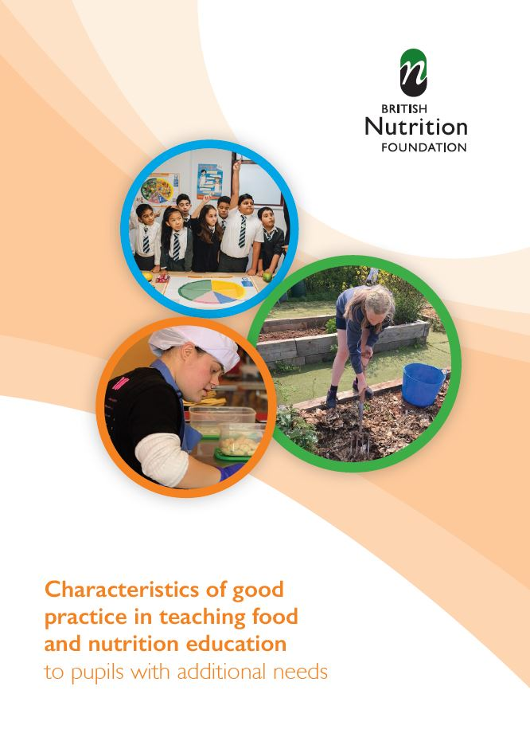
Characteristics of good practice in teaching food and nutrition education to pupils with additional needs
Defines the key characteristics of good practice that are specific to teaching food and nutrition to pupils with additional needs.
• Exemplifies these characteristics of good practice in UK schools, both special and mainstream.
The British Nutrition Foundation would like to gratefully acknowledge the financial support provided by the Savoy Educational Trust for the production of this Guide.
Guide and supporting resources

Slide 4
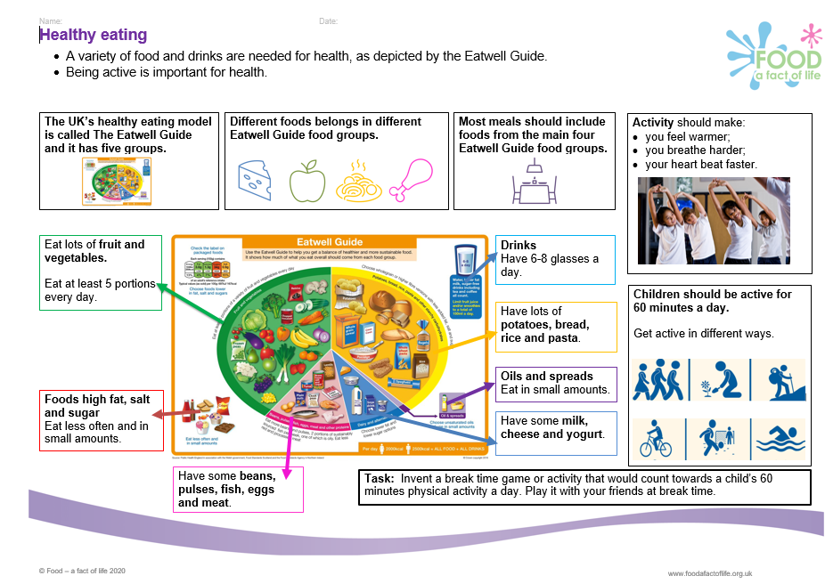
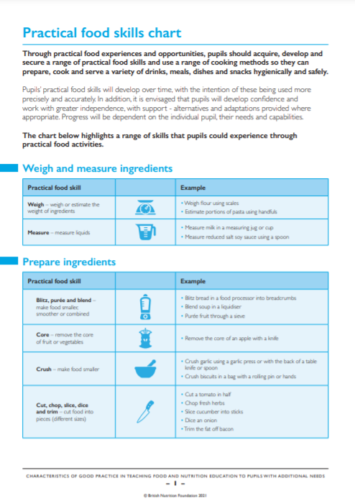
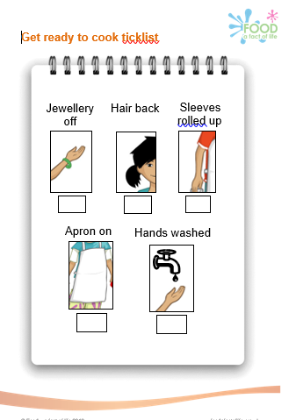
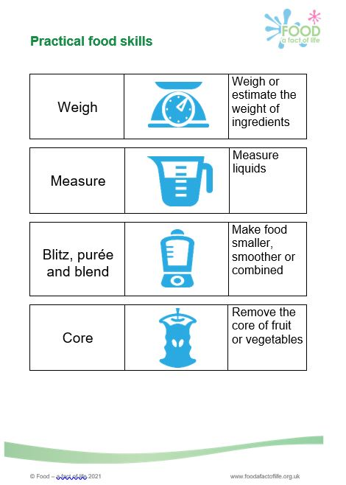
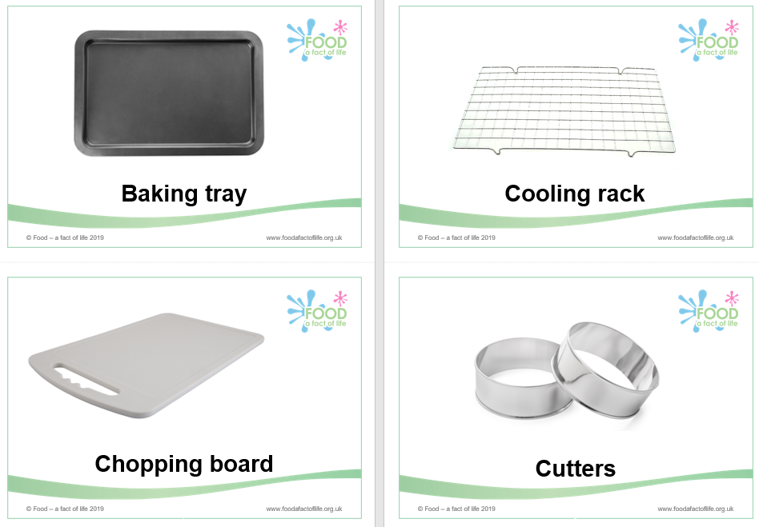
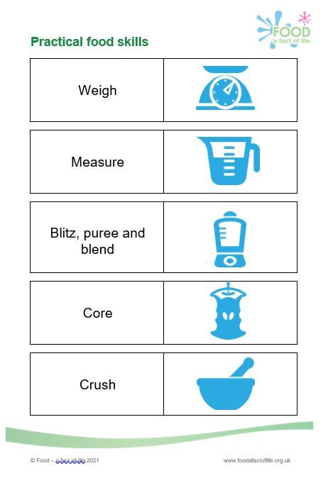
Food – a fact of life resources
All Food – a fact of life resources are editable!
Resources cover healthy eating, cooking and where food comes from, for ages 3-5 years to 14-16 years – you choose the resources to suit your pupils’ needs.
Knowledge organisers.
Activity packs.
Learn with stories.
Videos and interactive games.
BTEC Home Cooking skills Level 1 and 2 resources mapping document.
Practical food skills chart – teacher and pupil versions.

Slide 5
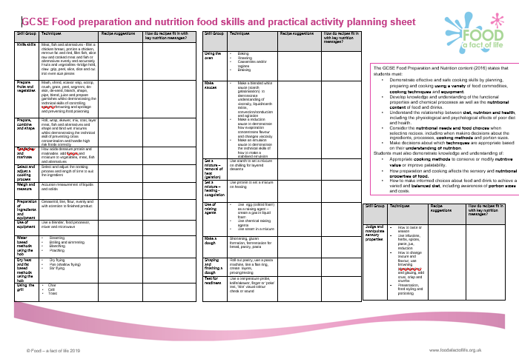
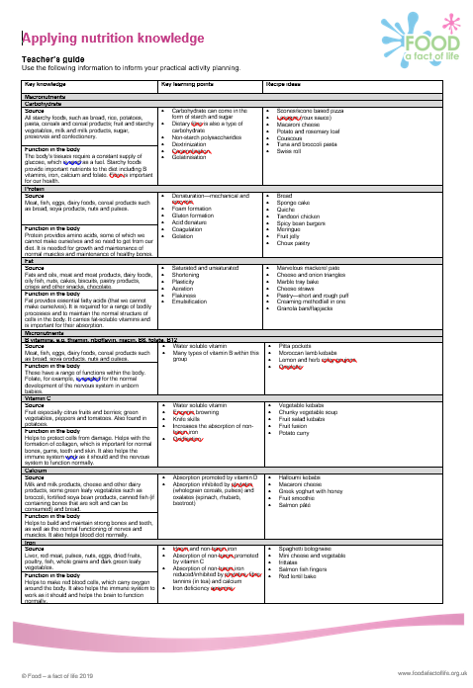
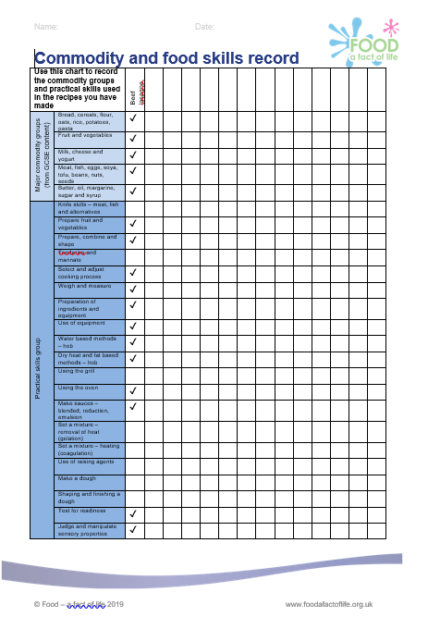
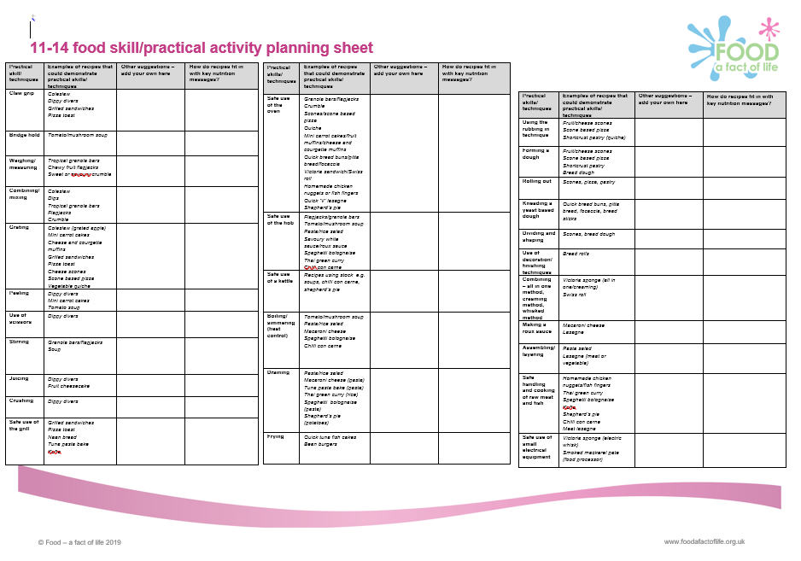
Resources to support planning and evidencing
Planning and evidencing sheets

Slide 6
Sources of support and further information
Videos
The Triune Brain - a short video about the triune brain from a child perspective
Experiences build Brain architecture
Serve & Return Interaction Shapes Brain Circuitry
Toxic Stress Derails Healthy Development
What is educational neuroscience - Learnus Interview
The Adolescent Brain
Books
Cozolino, L, 2014. Attachment-Based Teaching: Creating a Tribal Classroom, The Norton Series on the Social Neuroscience of Education. W. W. Norton & Company.
Cozolino, L, 2013. The Social Neuroscience of Education: Optimising Attachment and Learning in the Classroom, The Norton Series on the Social Neuroscience of Education. W. W. Norton & Company.
Rosenthal, R., Jacobson, L. 1968. Pygmalion in the classroom. Crown House Publishing.

Slide 7
Sources of support and information
Articles
Frontiers in Systems Neuroscience, Yamamoto, T, Ueji, K, 2011, Brain Mechanisms on Flavour Learning.
Boyce, P, 2020, Pygmalion Effect Definition.
Queens University, 2003, Brain Patterns Same Whether Doing or Just Watching.
Neuroscience News, Kaisa Kähkönen, University of Eastern Finland. 2018, Sensory Based Food Education Encourages Children to Eat Fruit and Veg.
Options Autism, 2017, Facing food challenges for those with autism and sensory processing differences.
Mustafa Mirreh, 2021, Independent Newspaper, OnePoll study of 2000 parents on their children's fussy eating behaviours.

Slide 8
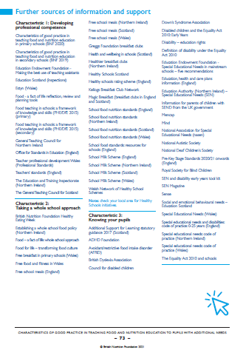
Sources of support and further information
Three pages of websites and useful information/ documents that support each of the characteristics can be found at the end of the Characteristics of good practice in teaching food and nutrition to pupils with additional needs guide.

Slide 9
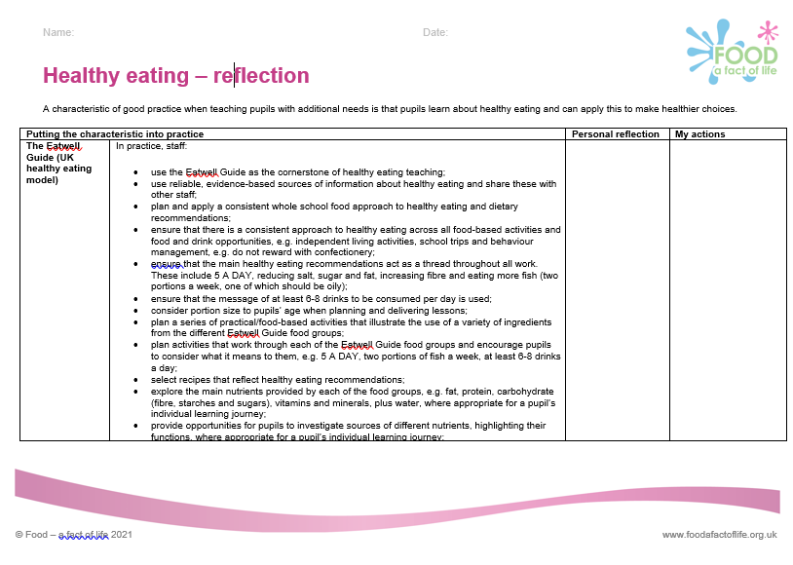
Support for your professional development
Reflection documents
Help develop reflective practice.
Ideal for staff at all career stages.
Provide an opportunity to reflect on personal practice and identify future actions.
There are also resources to support needs analysis and planning your own professional journey based on the Teaching food in primary/secondary schools: A framework of knowledge and skills.
Reflection documents

Slide 10
Further training
To find out more and to book, go to: https://www.foodafactoflife.org.uk/training/
Webinars
Careers in catering and hospitality – opportunities for young people with additional needs - 30 June at 4.30pm
Online
Characteristics of good practice in teaching food and nutrition education to pupils with additional needs
Also, FFL masterclasses, webinars, practical food skills workshops and online training. Read this article to find out more.
More PPD information, support and newsletter sign-up: https://www.foodafactoflife.org.uk/professional-development/

Slide 11
A hands-on approach to teaching food and nutrition education to pupils with additional needs
For further information, go to:
www.foodafactoflife.org.uk
The British Nutrition Foundation gratefully acknowledges the support from the Savoy Educational Trust, which has enabled us to develop and produce the Characteristics of good practice in teaching food and nutrition education to pupils with additional needs guide, as well as host training events for teachers.

