Slide 1
Using school gardens to explore where food comes from
22/06/2021

Slide 2
Covered in today’s webinar
The benefits of establishing and using a school garden.
Establishing a school garden for growing food in your school.
Planning your gardening activities around the growing seasons and school year.
Encouraging wildlife to your school garden.
Using what you grow in seasonal recipes.
Getting the whole school community involved.
Links to Food – a fact of life resources.
Suggestions for further sources of information.

Slide 3
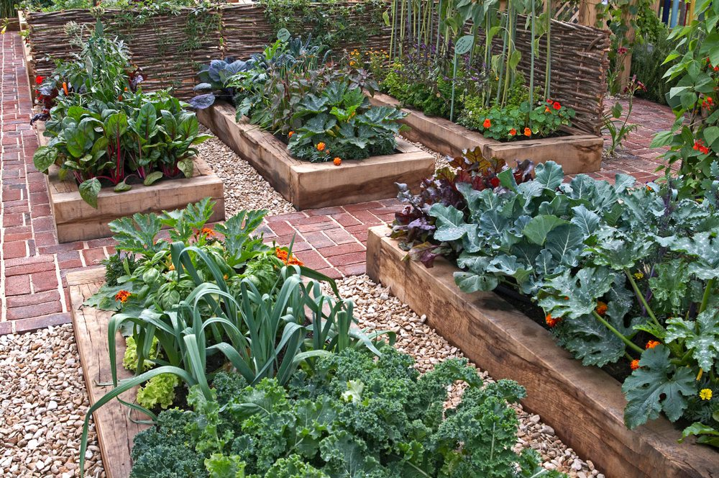
Food – a fact of life resources
New!
Resources to support planning and setting up a growing club in your school, including:
a guide to growing clubs;
case studies
planning sheets;
suggested tools and resources list;
parent/carer letter template.
Growing club resources

Slide 4
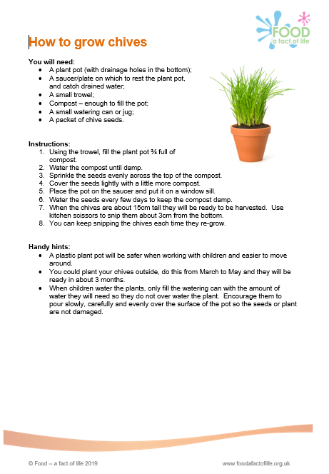
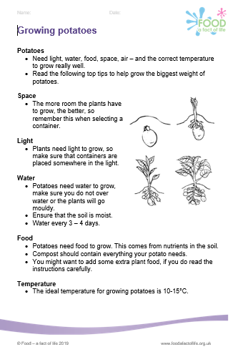
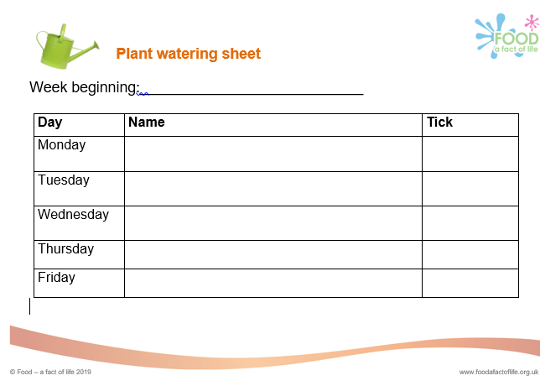
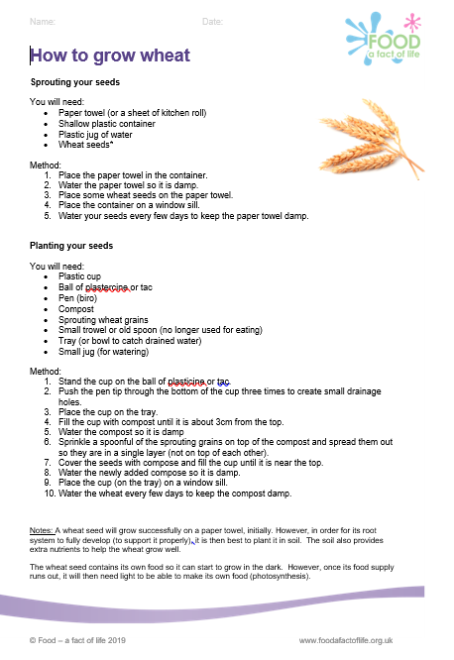
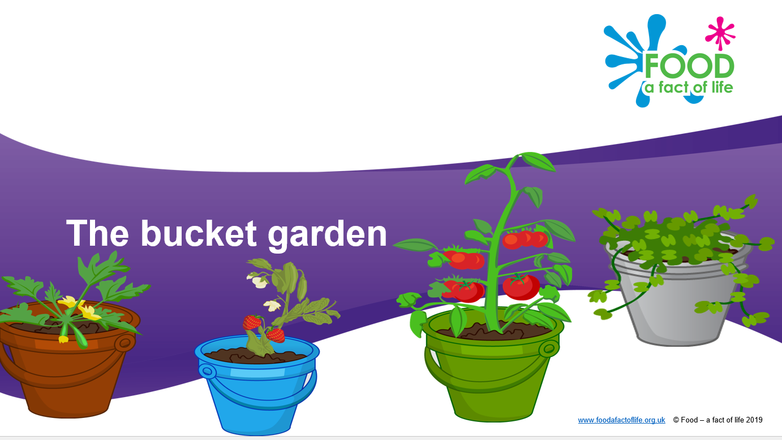
Food – a fact of life pupil resources
Plant watering sheet
Learn with stories
How to grow chives
Grow your own potatoes
How to grow wheat

Slide 5
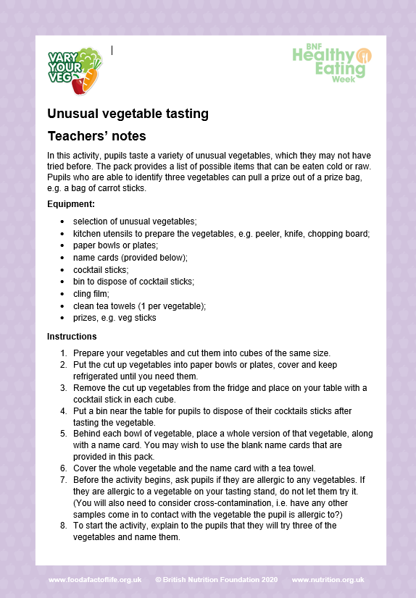
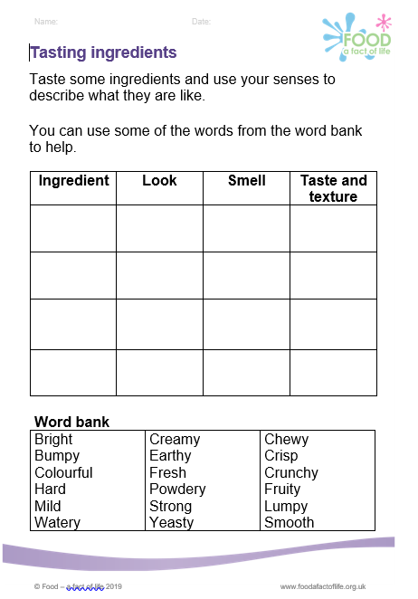
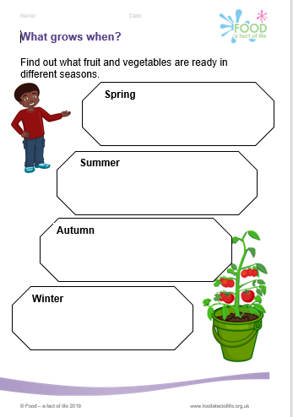
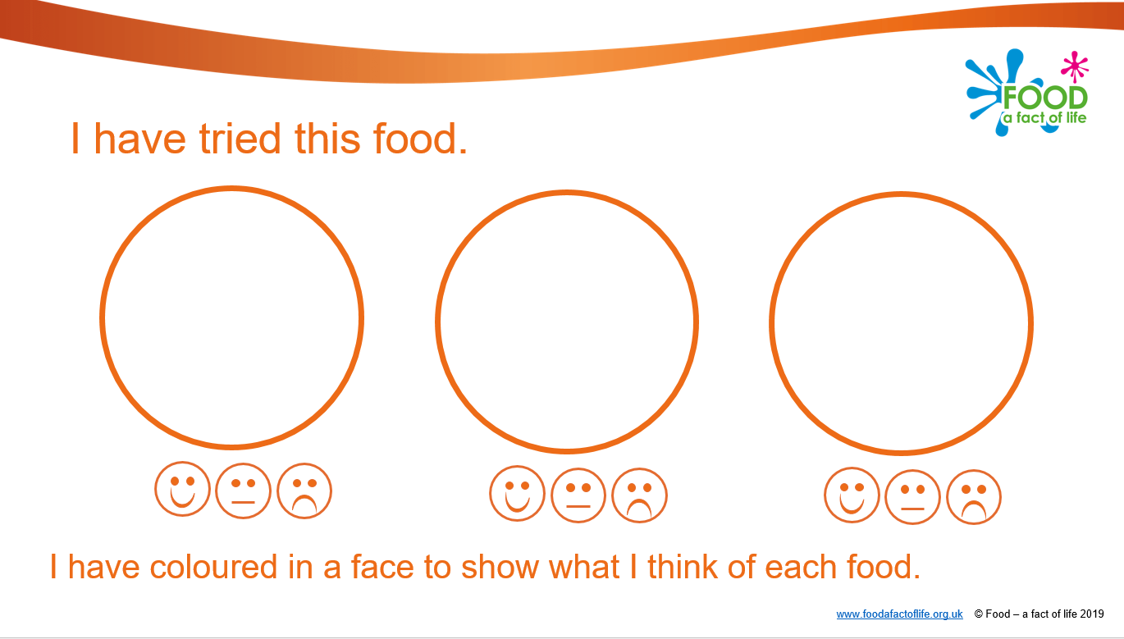

Food – a fact of life resources
Rainy day activities – be prepared!
Tasting guide
Where food comes from
Food commodities
Recipes
My food book
What grows when?
Tasting ingredients
Unusual vegetable tasting
Learn with stories

Slide 6
Further sources of information
Botanic Gardens Education Network
British Hen Welfare Trust
Countryside Classroom
Food growing schools
Garden Organic
Grow to School
LEAF Education
NFU Education
Royal Highland Education Trust
RHS School Gardening
School food matters – growing links
Sustainable learning – keeping chickens in school

Slide 7
Using school gardens to explore where food
comes from
For further information, go to:
www.foodafactoflife.org.uk

