Slide 1
Assessing recipe complexity – activity

Slide 2
How complex are the recipes that your pupils make?
A practical activity to get you, your colleagues and pupils thinking objectively:
Working in pairs prepare three similar dishes, e.g. scrambled eggs, omelette, frittata
Identify the learning intent – teacher.
Role model good practice (hygiene, safety, skills) – teacher.
Consider how the recipes could be made in school (age/phase; individually, pairs or in a group) – teacher.
Identify practical food skills used – teacher and pupils.
Discuss key nutrition messages and functions of ingredients – teacher and pupils.
Suggest further developments (stretch and challenge/extend complexity) – teacher and pupils.
Suggest recipe complexity.
Remember: It is not about the recipe title, but what goes into the recipe, e.g. ingredients, skills, processes.
A selection of recipes for this activity can be found here.

Slide 3
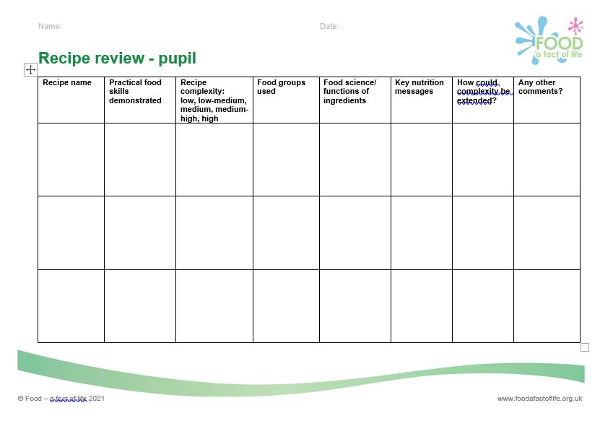
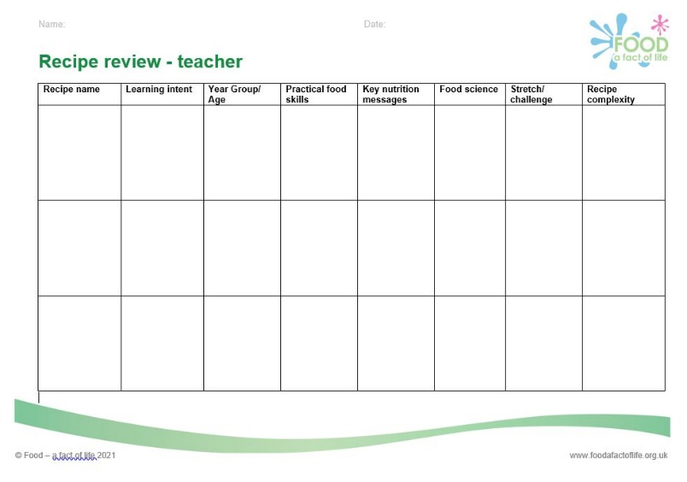
Using complexity rating activities for planning
Use this type of activity:
When planning Schemes of Work and lessons - either make the dishes or use recipes.
With pupils to help them research, plan and trial in preparation for practical examinations.
Recipe review sheets

Slide 4
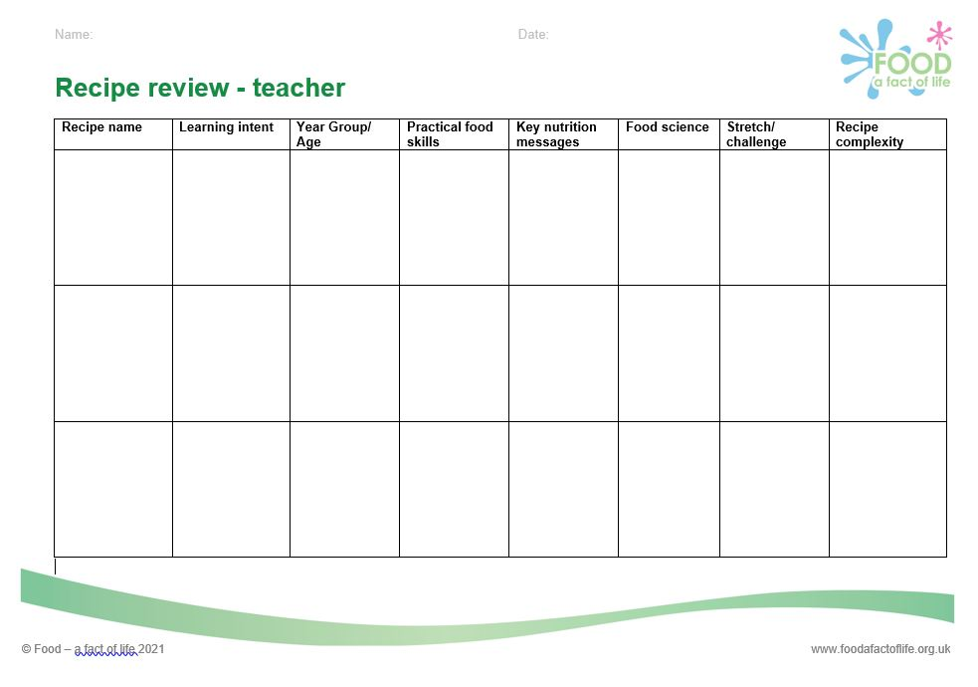
What did you/your pupils record?

Slide 5
Recipe complexity – were you correct?
Recipe | Complexity
Bread rolls | Low-medium
Fruit plait | Medium
Pizza (yeast dough) | Medium-high
Savoury filled choux buns | Low-medium
Savoury filled choux buns with tomato and ham | Medium
Savoury choux buns with a roux sauce filling | Medium-high
Apple and sultana crumble with canned custard | Low-medium
Apple and sultana crumble with homemade custard | Medium
Apple and sultana crumble with homemade egg custard | Medium-high
Recipe | Complexity
Scrambled eggs | Low
Mini vegetable frittata | Low-medium
Omelette | Medium
Lamb and pepper kebabs | Low-medium
Marinated lamb and vegetable kebabs | Medium
Kofta kebabs | High
Boiled new potatoes | Low
Mashed potatoes | Low-medium
Duchess potatoes | Medium

Slide 6
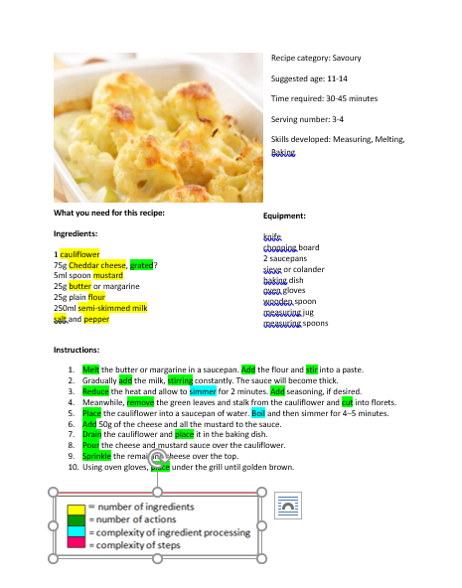
Complexity (objective rating)
Criteria:
Number of ingredients
Number of actions (verbs/steps)
Complexity of ingredient processing (the fact that a number of steps are required, e.g. divide, shape, debone, fillet, pipe, boil, simmer), including high risk ingredients)
Complexity of steps, e.g. finely cut or a julienne
Duration of preparation (same as the number of steps)
Cauliflower cheese: low-medium complexity

Slide 7
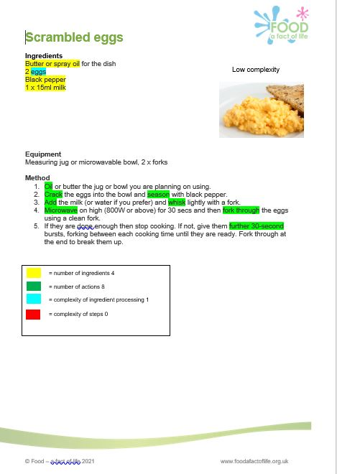
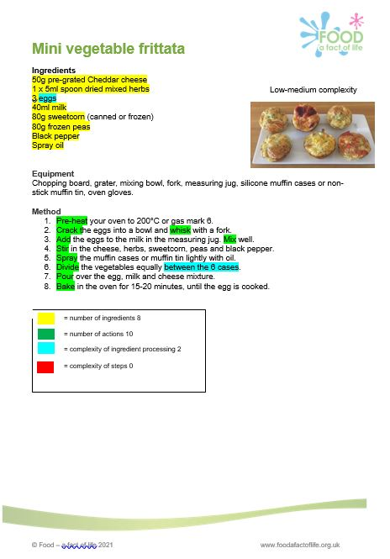
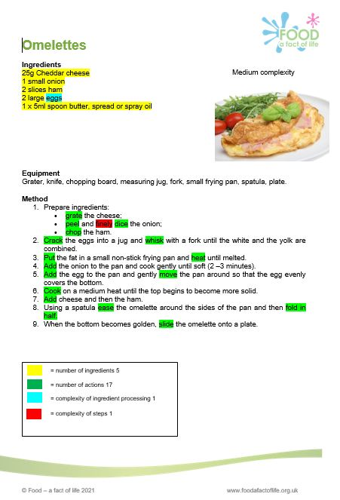
Complexity (objective rating)
These recipes can be found here.

Slide 8
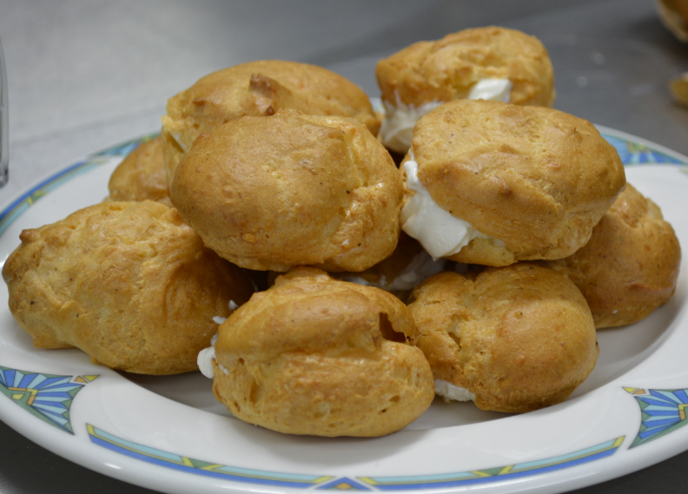
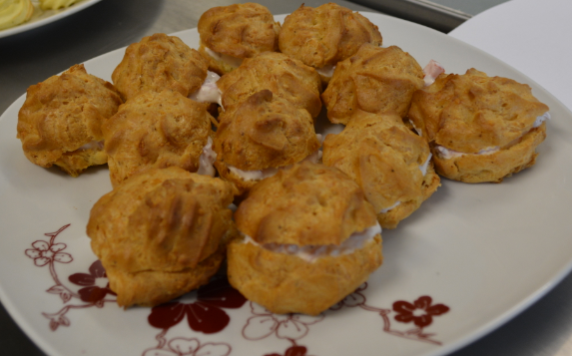
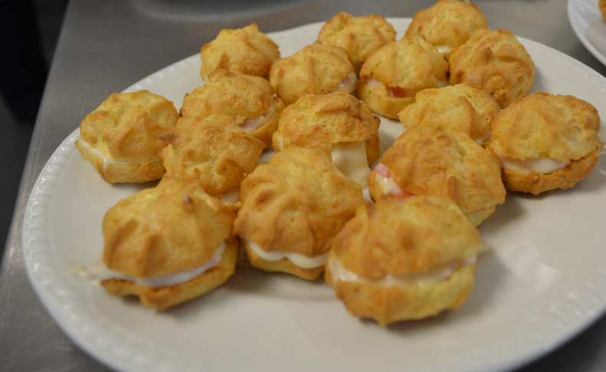
Savoury filled choux buns
Low-medium
Medium
Medium-high
Spooned and filled with cream cheese
Piped and filled with cream cheese, ham and tomato
Piped and filled with a homemade roux sauce, ham and tomato
= number of ingredients 9
= number of actions 14
= complexity of ingredient processing 2
= complexity of steps 0
= number of ingredients 11
= number of actions 20
= complexity of ingredient processing 2
= complexity of steps 1
= number of ingredients 15
= number of actions 33
= complexity of ingredient processing 2
= complexity of steps 1

Slide 9
Recipe complexity activity
For further information, go to:
www.foodafactoflife.org.uk

