Slide 1
Meat types and cuts

Slide 2
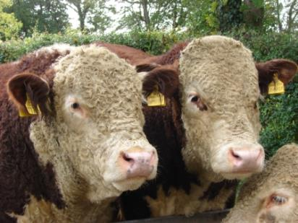
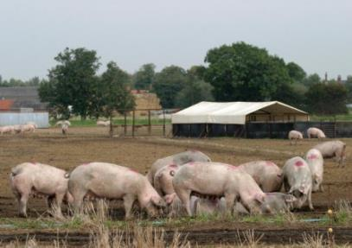
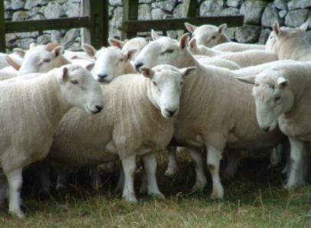
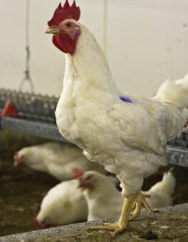
Meat
Animals are reared by farmers across the UK for our food.
Popular animals include cattle, sheep, pigs and chicken.

Slide 3
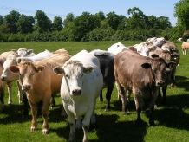
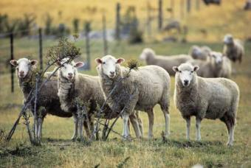
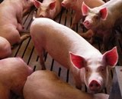
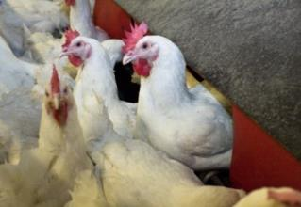
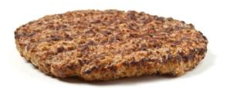
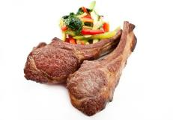
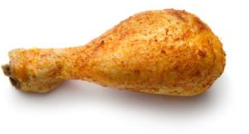
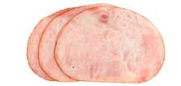
Meat is from different animals
Cattle
Sheep
Pigs
Chicken
Beef burger
Lamb chop
Ham
Chicken drumstick

Slide 4
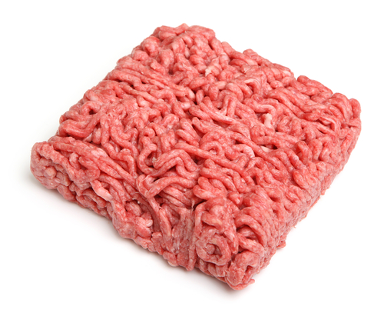
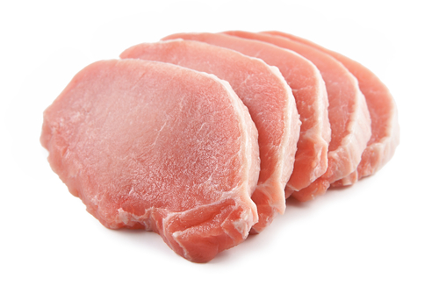
Introduction
Most people buy meat in the form of cuts, joints or mince. Meat is also bought ready prepared, e.g. sausages, ham, burgers, kebabs.
A wide range of different cuts are available, giving greater choice and variety.
Knowing where meat comes helps you know how to prepare, cook and serve it.

Slide 5
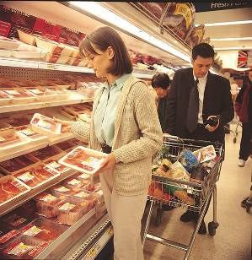
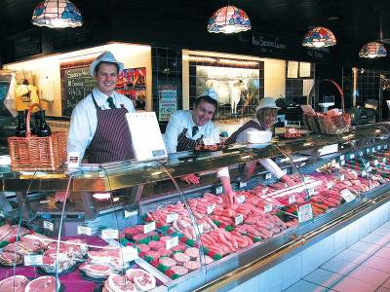
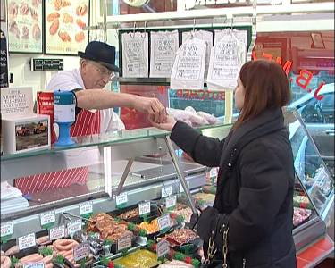
Where we buy meat
Cuts of meat are prepared by butchers in shops or supermarkets.

Slide 6
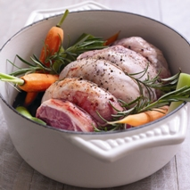
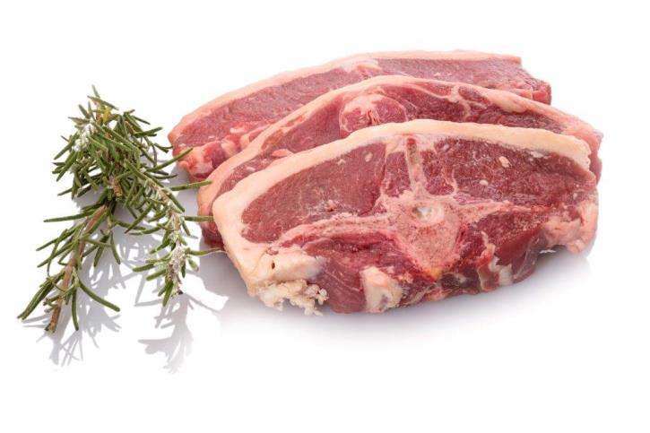
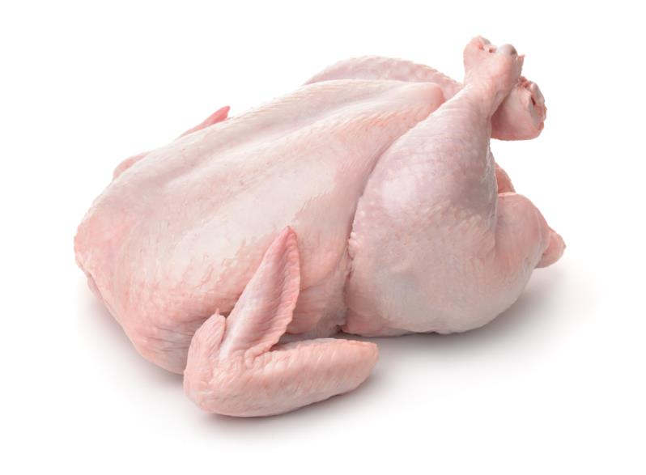
Cuts of meat
Legs – lamb or chicken leg, roasted
Chops – lamb or pork chops (with a bone)
Steaks – suitable for quick and easy methods of cooking, e.g. grilling
Whole– roast chicken

Slide 7
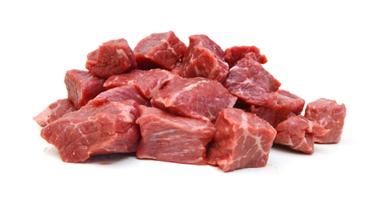
Cuts of meat
Cubes of meat – sold cut into cubes, ready for making stews, kebabs and casseroles.
Minced meat – the meat is minced.
Thin strips – meat is pre-cut into strips, suitable for quick cooking methods, e.g. stir-frying.

Slide 8
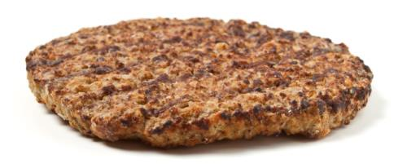
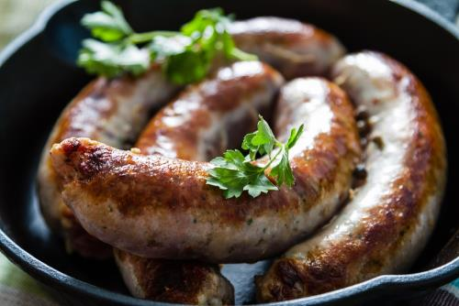
Types of meat
Ham and gammon: pork which has been treated
Burgers: usually made from minced beef or lamb, formed into a circle (sometimes other ingredients are added, such as onion, pepper or herbs)
Sausages: usually made from minced pork, sometimes with herbs and spices, in a skin

Slide 9
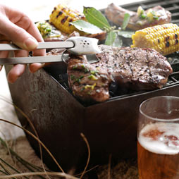
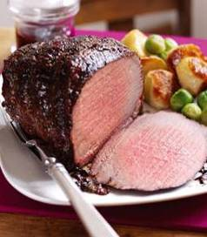
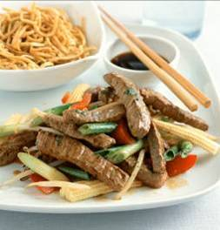
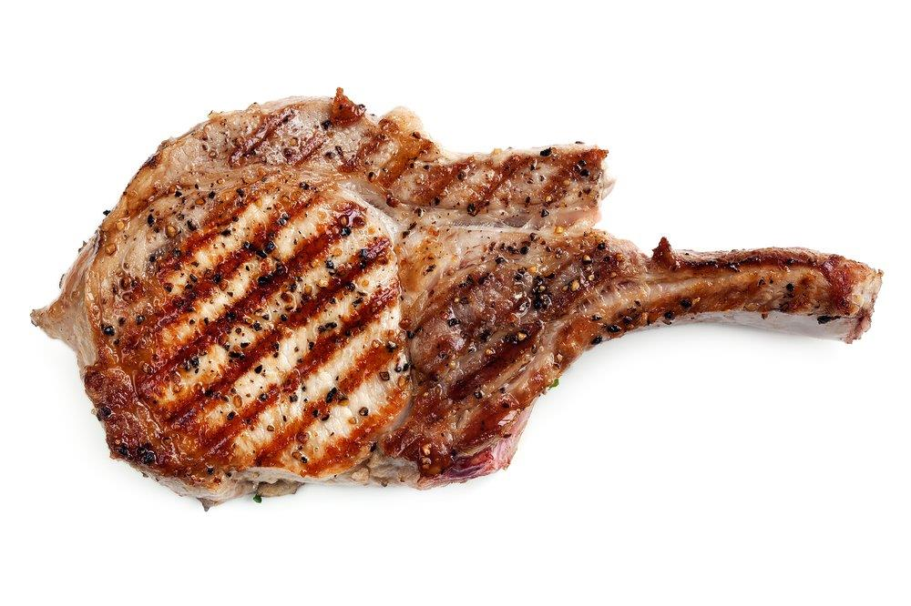
Cooking meat
Meat can be cooked in a different ways, such as:
Barbecuing
Grilling
Stir-frying
Roasting

Slide 10
For further information, go to:
www.foodafactoflife.org.uk

