Slide 1
Cattle farming

Slide 2
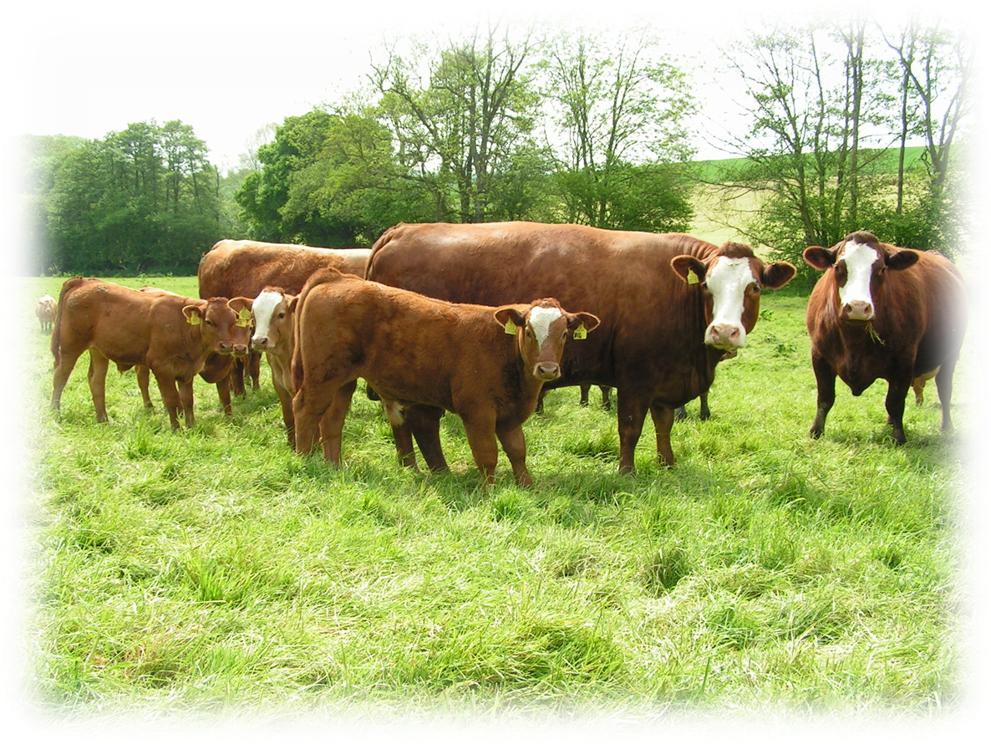
Agriculture in the UK
Livestock farming for meat production has been an established industry in the UK for centuries.
Diverse range of commodities are produced – beef, lamb, pork, dairy, chicken, potatoes, fruit and vegetables.
Significant contributor to the UK economy - £8.5 billion.
We consume just under 50% of the unprocessed food which is produced in the UK.
Agriculture provides 475,000 jobs directly, and an extra 30,000 through goods and services.

Slide 3
Glossary
Suckler cow - female beef cow
Bull - Male cow
Heifer - young female cow
In calf - pregnant cow
Replacements - cows bred or bought-in to replace the old cows in the breeding herd
Weaning - the calves no longer require milk and can survive without their mothers
Finished cattle - cattle which are ready to be sold for meat
Herd - a group of cows

Slide 4
Introduction to cattle farming
There are 9.8 million cattle and calves (including the dairy herd) in the UK.
The UK exported 90,370 tonnes of beef and veal in 2018- most of this is sent to EU countries.
The UK imported 237,691 tonnes of beef and veal in 2018- most of this came from EU countries.
UK farm assurance standards for cattle are different to those in the EU and other countries.
Cattle can graze steep hills and poor quality land such as moorland which is unsuitable for growing any other food sources.

Slide 5
Cattle breeding systems
Farmers may keep purebred cattle or crossbred cattle, or a mixture of both.
This decision depends on:
land type such as moorland or high quality grass;
location such as in the north of the country where the weather is colder;
market- whether the farmer is producing cattle for breeding or for meat or both.
Crossbreeding can be used to get the best attributes of different breeds to improve animal performance such as milk quality and calf survival.

Slide 6
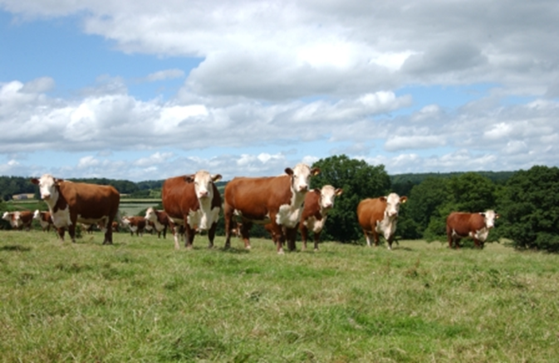
Breeds of cattle
There are 33 breeds of cattle which are native to the UK, these include:
Hereford
Galloway
Beef Shorthorn
Aberdeen Angus
South Devon
Native breeds have been farmed for centuries in the UK. They are hardy, easy calving and can utilise poor quality grazing well. These are slower growing than continental breeds.

Slide 7
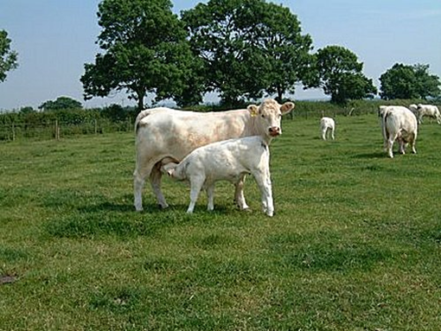
Breeds of cattle
There are also breeds in the UK which originate from Europe, these are known as continental:
Charolais
Limousin
Simmental
Belgium blue
Blonde de Aquitaine
Continental breeds are fast growing and well muscled animals which maximise meat production.
Continentals breeds and native breeds are used together in crossbreeding systems.

Slide 8
The lifecycle of cattle
Suckler cows have one calf per year. They must be healthy and in good physical condition to have a calf every year.
A cow gets in calf (pregnant) by a bull or artificial insemination
Gestation, or the pregnancy, will last for 9 months
The cow prepares for pregnancy throughout this time, known as the ‘dry period’

Slide 9
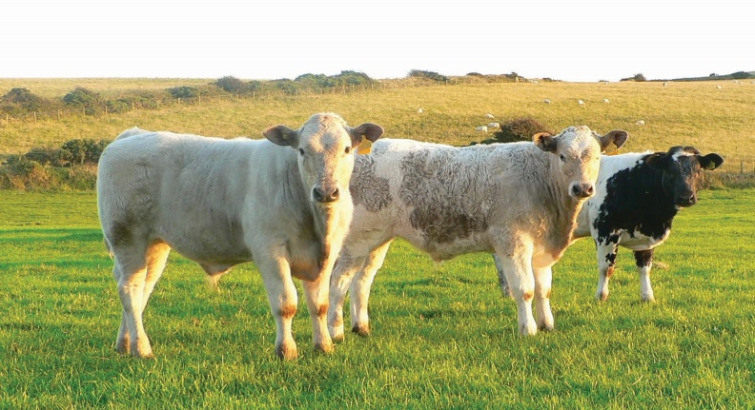
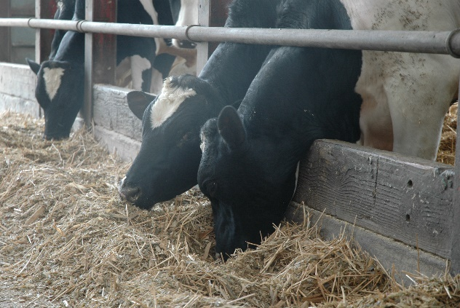
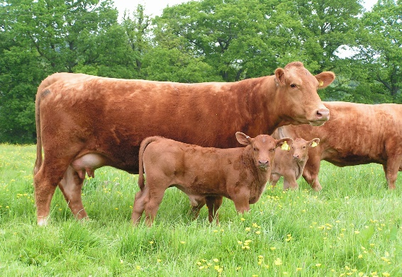
The lifecycle of cattle
Milk is the main source of nutrition for young calves. The cow produces colostrum first then milk. Colostrum is thicker than normal milk and is rich in antibodies.
After birth (calving) the calf will stay with its mother for 6 – 9 months
The calves no longer require milk and can survive without their mothers. This is called weaning
The weaned calves are fed a different diet to the cows

Slide 10
The lifecycle of cattle
Depending on the breed and feed available, the cattle will be sold for beef aged 12 – 22 months old.
The calves are now adults, fully grown and ready for sale
Some females are kept for breeding or sold at market in breeding sales
Their mothers will be ready to calve again soon

Slide 11
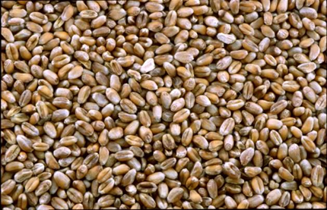
Diet of cattle
Cattle spend the spring and summer months grazing. In winter, some cattle are housed which keeps them dry and comfortable. They are fed hay or silage inside and this may be supplemented with other feeds.
Cattle can utilise lots of different feeds such as:
grass and clover;
preserved feed such as grass silage, maize silage and hay;
turnips and swedes;
kale;
straw;
grains such as barely, wheat and oats;
by-products of food manufacture such as biscuit meal, citrus pulp and distillers grains;
beans.

Slide 12
Silage and hay making
When the grass stops growing in winter, sheep and cattle are fed silage or hay. This is preserved grass.
Silage is fermented to maintain the nutrients (sugar and protein). Hay is drier than silage and doesn’t need to be wrapped if it is stored in a weather proof barn.
Grass is cut in spring and summer
The grass is left in the field to wilt (can take up to 5 days for hay)
Silage is baled and wrapped to preserve it

Slide 13
Cattle farming
For further information, go to:
www.foodafactoflife.org.uk

