Slide 1
Rice

Slide 2
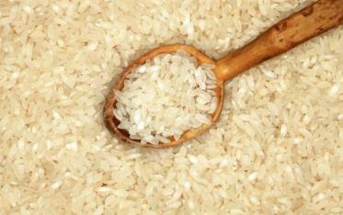
Overview
This presentation covers:
how rice is grown and processed;
different types of rice and their use in dishes;
rice in the diet;
cooking with rice;
food and drink made from rice.

Slide 3
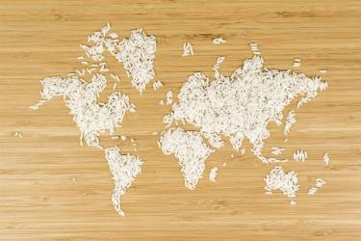
Rice around the world
Rice is grown in every continent of the world except Antarctica and each country has developed its own recipes.
For example:
paella in Spain;
risotto in Italy;
cajun and creole dishes from the US;
sushi in Japan.
The Rice Association

Slide 4
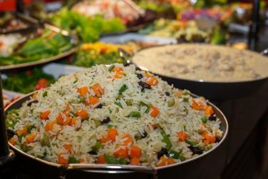
Rice in the UK
The rice industry in the UK is worth around £750m annually to the economy and £400m for retail.
In 2017 there were 78 new rice products launched, which included microwavable rice which is useful for today's smaller households and people with less time to spend in the kitchen. Rice pouches now make up over half retail sales.
Rice eaten per person per week has grown 450% since the 1970s, with 90% of UK households buying rice.
There are 11 rice mills in the UK.
The Rice Association

Slide 5
What is rice?
When rice is harvested it is called ‘paddy'. A paddy is a complete seed of rice and one grain of paddy contains one rice kernel.
Each paddy grain has many layers, the outermost layer is the husk.
Inside the husk is the grain kernel itself. This is made up of outer bran layers and the internal white starchy endosperm.
The inner part of the grain is the endosperm, which is composed of mainly starch. This is what forms milled (white) rice.

Slide 6
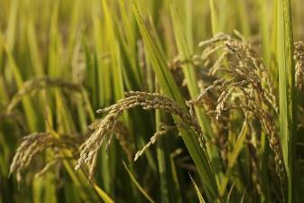
Rice - the plant
The plant has many different variations, but is generally a short living plant, with an average life span of 3-7 months, depending on the climate and the variety.
Substantial amounts of water are required for the planting of rice.
The height of the plant can range from 0.4m to over 5m in some floating rice.

Slide 7
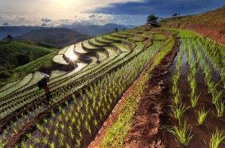
Farming rice
In many Asian countries the ancient methods for cultivating and harvesting are still practised.
The fields are prepared by:
Ploughing - often with a simple plough drawn by water buffalo, ploughing breaks up the soil.
Fertilising - naturally fertilised.
Smoothing - where a roller (e.g. a large log) is dragged over the field to smooth the earth, giving a smooth bed for the seedlings to be planted on and ensures the water depth is equal.

Slide 8
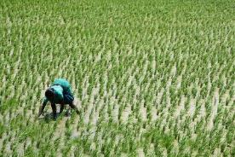
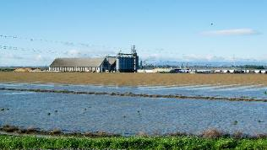
Farming rice
Seedlings are started in beds and, after a period of 30-50 days, are transplanted by hand to fields which have been flooded by rain or river water.
During the growing season, irrigation is maintained by dyke-controlled channels or by hand watering.
The fields are drained before cutting of the crop commences.
In the USA rice is mainly grown in the southern states and in California.
Fields are flooded in April and May and are then seeded by aeroplane. By September the crop is mature and ready to be harvested.

Slide 9
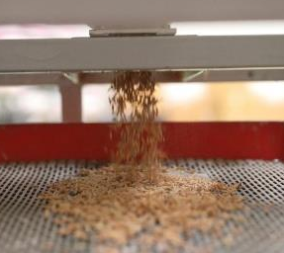
Processing rice
After harvest, the rice is threshed to loosen the hulls.
Once sold by the farmer, the rice, known as paddy or rough rice, is screened to remove stones, loose chaff and paddy stalks (part of the plant).
The rice is then slowly dried by warm air to reduce any moisture and then it is screened to remove dust particles.
The outer husk is removed next, but the bran layer is left intact, this forms brown rice. The rice is then cleaned and graded.
If the brown rice is to be sold as white rice, it then goes to the mill where it undergoes milling, an abrasive action which removes the bran layer surrounding the rice grain.

Slide 10
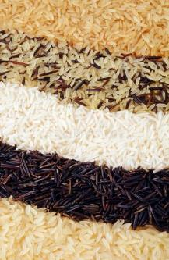
Different types of rice and their use in dishes
Rice is very versatile. It can be served as an accompaniment to a meal, be the basis of a main dish, or served in starters and as a pudding.
Many countries start the day with a rice breakfast, such as congee in China and rice porridge in Japan.
The rice varieties can be divided into three basic groups, long grain, short grain and medium grain. Within the groups there are also speciality and aromatic rice.

Slide 11
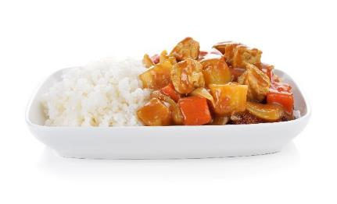
Different types of rice and their use in dishes
Long grain rice
Regular long grain rice is one of the most popular types of rice because it works well with rich and delicate sauces.
On cooking, the grains separate to give a fluffy effect.
Types include - all purpose, easy cook, brown (or wholegrain), basmati and jasmine.

Slide 12
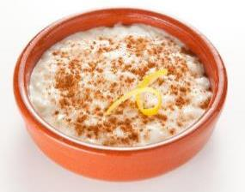
Different types of rice and their use in dishes
Medium grain rice
In Europe, medium grain rice is typically associated with risotto, as it is creamy when cooked.
Medium grain rice is also particularly suitable for puddings and other dishes that use liquid in the cooking method.
Types include - arborio, carnaroli, roma and ribe.

Slide 13
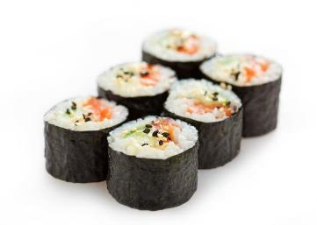
Different types of rice and their use in dishes
Short grain rice
Tends to be almost round and is typically moist when cooked, giving sticky rice, which is perfect for puddings, and is also used in sushi.
Types include – bomba and originario.

Slide 14
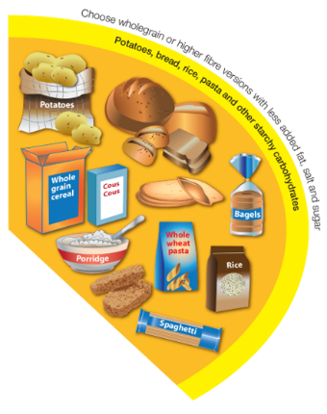
Rice in our diet
The recommendations from the Eatwell Guide is to base meals on starchy carbohydrates.
Around a third of what people eat should be potatoes, bread, rice, pasta and other starchy carbohydrates.
People should be choosing wholegrain versions of starchy carbohydrates where possible, and brown rice is a wholegrain.
Having more wholegrains is a good way to increase fibre intake, which is important for health.
Wholegrains also provide some essential vitamins and minerals that have a wide range of important functions in our body.

Slide 15
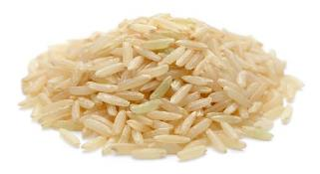
Rice - food safety
Dried rice can be contaminated with Bacillus cereous bacteria, which produces spores. Spores produce toxins which can lead to digestive upset.
Spores are not destroyed by cooking. If left at room temperature, the bacteria could start multiplying. If not eaten straight away, rice should be cooled quickly and stored in a fridge below 5°C, to prevent multiplication.
Reheating will not kill the spores.
FSA Fact checker

Slide 16
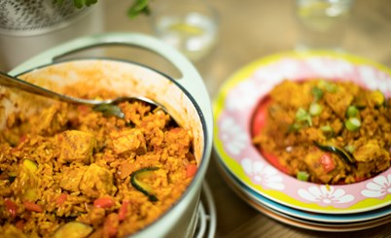
Leftovers using rice
Leftovers should be cooled as quickly as possible within two hours, and then stored in the fridge below 5ºC. Separating the food into smaller containers can help.
When leftovers are reheated they need to be steaming hot. If using a digital probe, food should be reheated to a minimum of 75°C. In Scotland food must be reheated to a core temperature of 82°C.
Leftovers should not be reheated more than once and should be used within 48 hours from when it was made.
Leftover rice dishes should be used within 24 hours from when it was made.

Slide 17
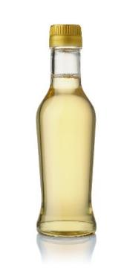
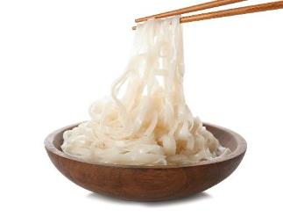
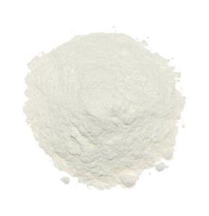
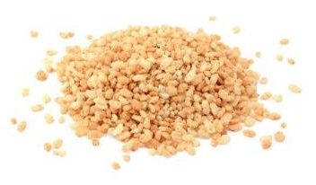
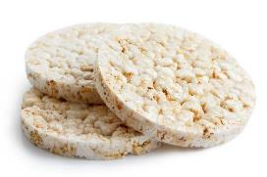
Food and drink made from rice

Slide 18
Rice
For further information, go to:
www.foodafactoflife.org.uk
This resource meets the Guidelines for producers and users of school education resources about food.

