Slide 1
Practical food skills and recipes masterclass – artisan bread making
14/07/2021

Slide 2
Covered in today’s webinar
A day in the life of a bakery.
Artisan baking.
The science of bread making.
How to make three artisan breads, with hints and tips for the classroom
Links to Food – a fact of life.
Suggestions for sources of information.

Slide 3
Lewis’ bread recipes
Sourdough starter | Equal parts flour and water
Bloomer | kg
Strong white flour | 1.000
White sponge dough | 0.616
Water | 0.518
Sourdough dough | 0.103
Bread fat | 0.028
Yeast | 0.013
Salt | 0.017
 | 2.293
Sourdough | kg
Strong white flour | 1.000
Water | 0.760
White starter | 0.500
Salt | 0.025
 | 2.285
Focaccia | kg
Biga | 0.800
Strong white flour | 0.600
Water | 0.540
Extra virgin olive oil | 0.060
Salt | 0.025
Yeast | 0.009
 | 2.034
Sponge dough | kg
Flour | 2.000
Water | 3.000
Yeast | 0.003
Biga | kg
Flour | 2.000
Water | 1.100
Yeast | 0.003

Slide 4
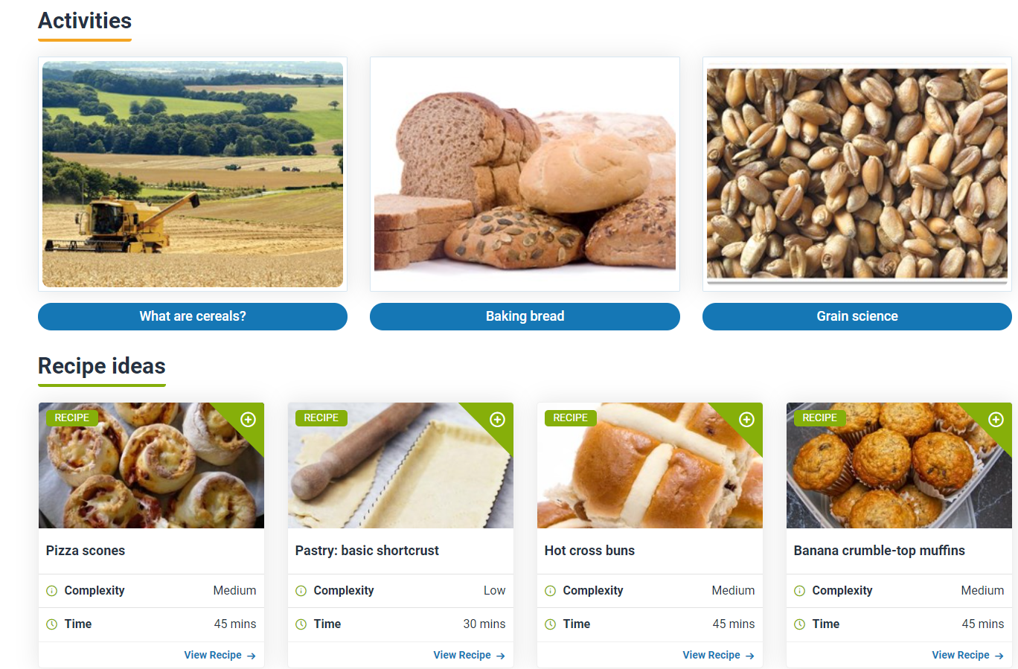
Resources
11-14 and 14-16 cereals resources
Types of bread presentation
Bread making listening activity and supporting notes
Gluten content investigation
The science of bread making presentation
The science of bread making teachers’ notes
Bread science lesson plan
Exploring flatbread lesson plan
Bread making experiment
Bread making – yeast experiment

Slide 5
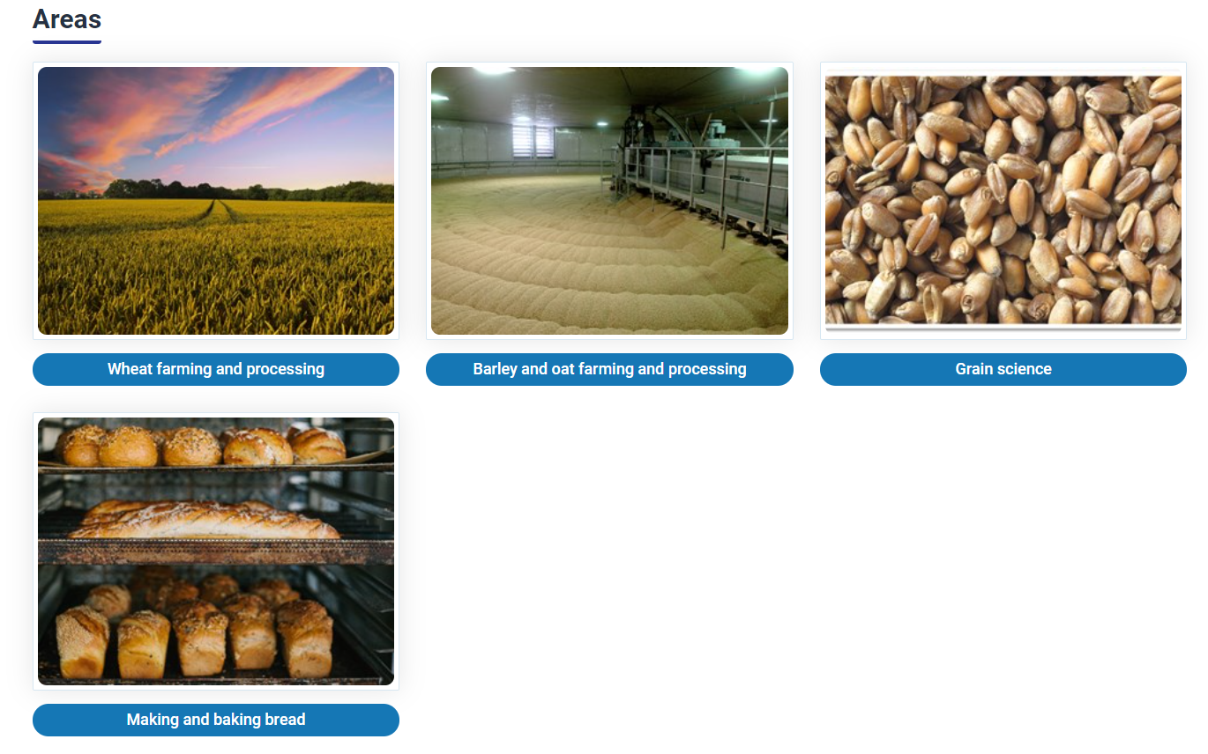
Resources
Wheat to bread production videos
Knowledge organisers – cereals coming soon
Bread activity pack
Fibre activity pack
Harvest festival activity pack

Slide 6
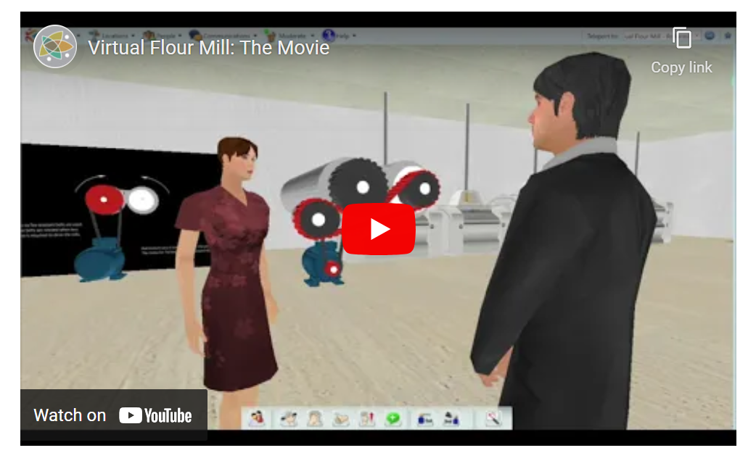
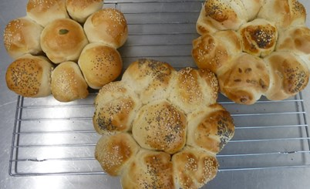
Other resources and sources of information
Primary processing of wheat
UK Flour Millers
Recipes
Quick bread buns – cold oven method
Food – a fact of life
FabFlour - Flour Advisory Bureau
Support for primary colleagues
Skill-a-long webinar recording
5-7 and 7-11 cereals resources
Learn with stories – The bread stories

Slide 7
Further training
To find out more and to book, go to: https://www.foodafactoflife.org.uk/training/
Cheese making masterclass - Wednesday 15 September at 4.30pm
FFL 30th anniversary conference – Saturday 9 October at 9am
More masterclasses, webinars and practical food skills workshops coming soon and don’t forget our online training! Read this article to find out more.
More PPD information, support and newsletter sign-up: https://www.foodafactoflife.org.uk/professional-development/

Slide 8
Practical food skills and recipes masterclass – artisan bread making
For further information, go to:
www.foodafactoflife.org.uk

