Slide 1
Pig farming

Slide 2
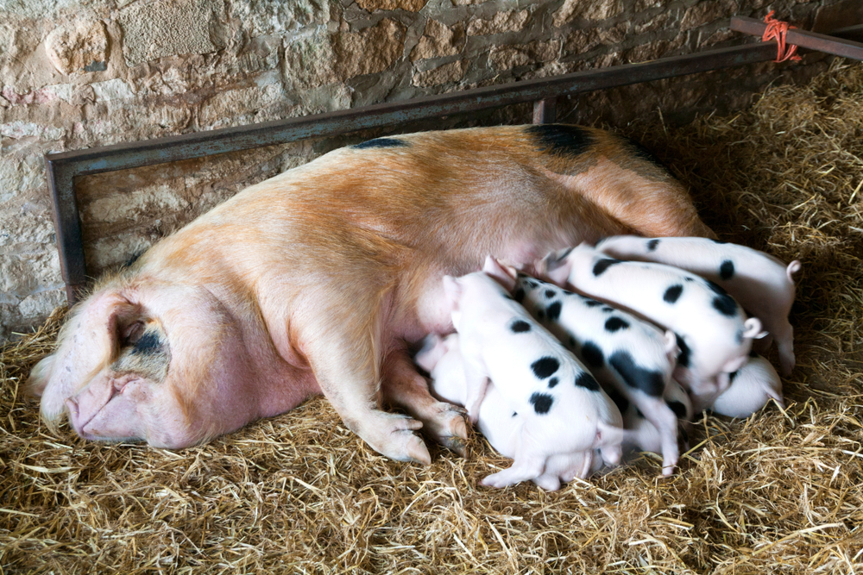
Agriculture in the UK
Livestock farming for meat production has been an established industry in the UK for centuries.
Diverse range of commodities are produced – beef, lamb, pork, dairy, chicken, potatoes, fruit and vegetables.
Significant contributor to the UK economy - £8.5 billion.
We consume just under 50% of the unprocessed food which is produced in the UK.
Agriculture provides 475,000 jobs directly, and an extra 30,000 through goods and services.

Slide 3
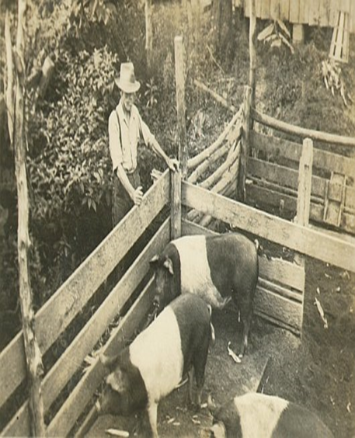
Introduction to pig farming
Today's pig industry has been influenced by 6000 years of history.
From the start pigs were bred to consume waste products, fertilise the land and obviously provide essential meat.
Farming has progressed; everyone used to have backyard pigs however this is very rare now and pigs are generally reared on specialist pig farms.

Slide 4
Glossary
Sow - Female pig
Boar - Male pig
Gilt - Female pig which has never had any piglets
Weaner - Piglet after being taken off its mother at 28 days
Finisher - Pig which is getting fattened ready for slaughter
Farrowing - When a sow or gilt gives birth
Serve -To get the female pregnant
AI - Artificial insemination
Wean - Take the piglets off the mum

Slide 5
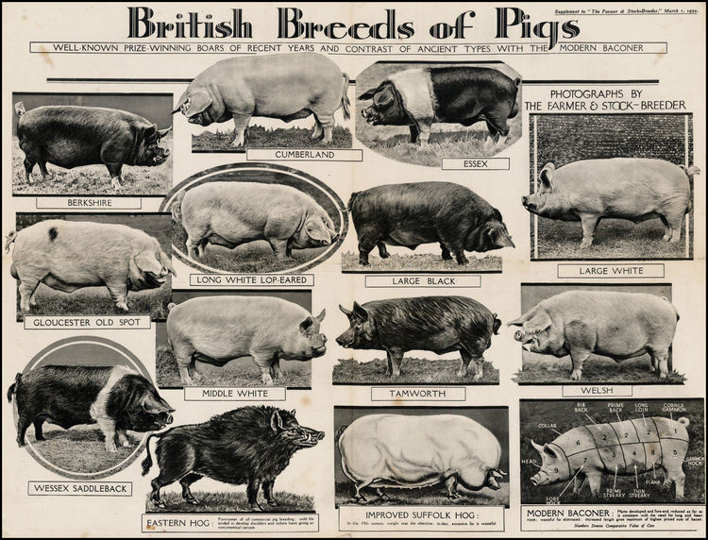
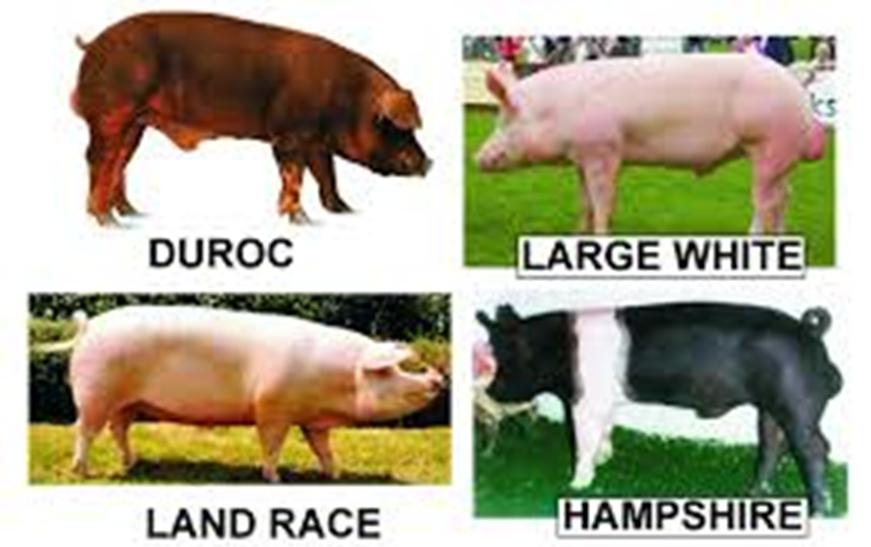
Pig breeds over the years & today

Slide 6
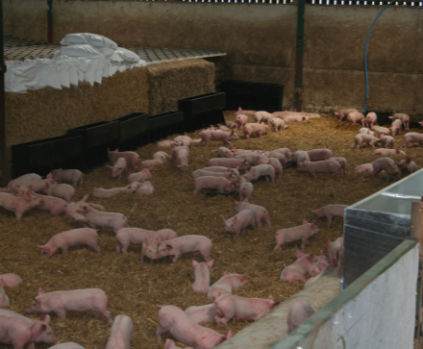
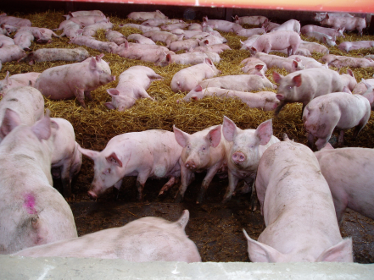
The lifecycle of a piglet
Piglets stay on their mums for 28 days.
They are then weaned off and moved into different accommodation.
Some finishers stay in the same accommodation until they are ready for slaughter. Others will move houses part way through. Finishers will have seven different diets throughout their life.
Generally finishers reach slaughter weight in 6 months and will be 110Kg.

Slide 7
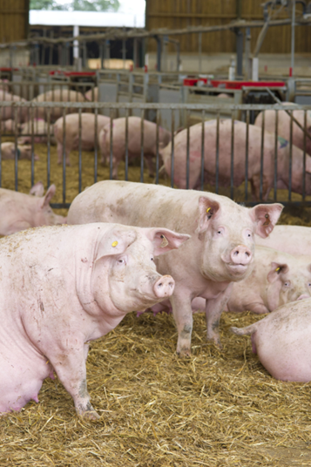
The lifecycle of a gilt into a sow
A gilt arrives onto our farm at 180 days.
At 230 days she is served with AI.
At 21 days post service she is scanned.
At 3 months, 3 weeks and 3 days she will farrow.
She is now a sow.
She looks after her piglets for 28 days.
Her piglets are then weaned off her
She is re-served 5 days later and the cycle starts again.
On average each sow will have six litters in her lifetime

Slide 8
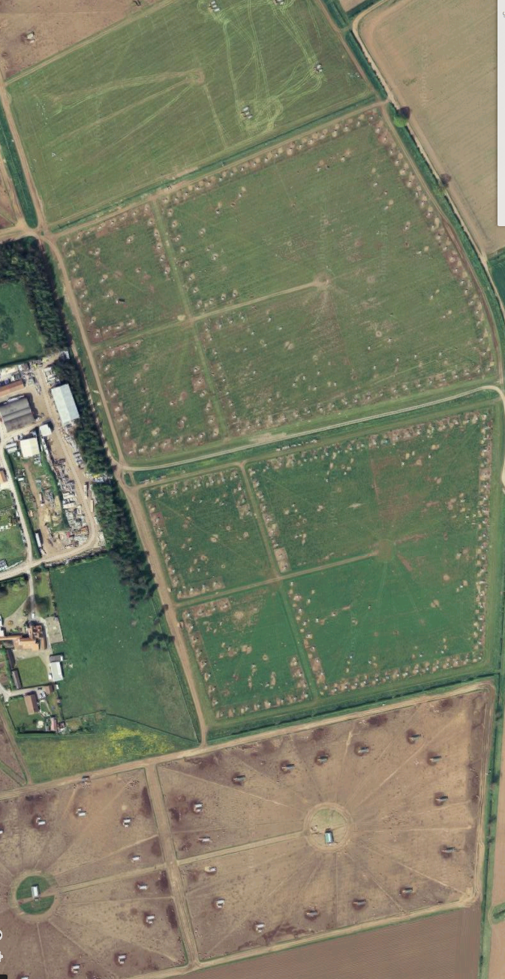
Outdoor breeding unit
England is the only country to have pigs like this on a large scale – this is perceived as the highest welfare system to house pigs in as they are in their natural environment.
40% of the UK’s pig farms are outdoors.
There are 1,200 breeding sows in this unit and the sows look after their piglets until they are 28 days old.

Slide 9
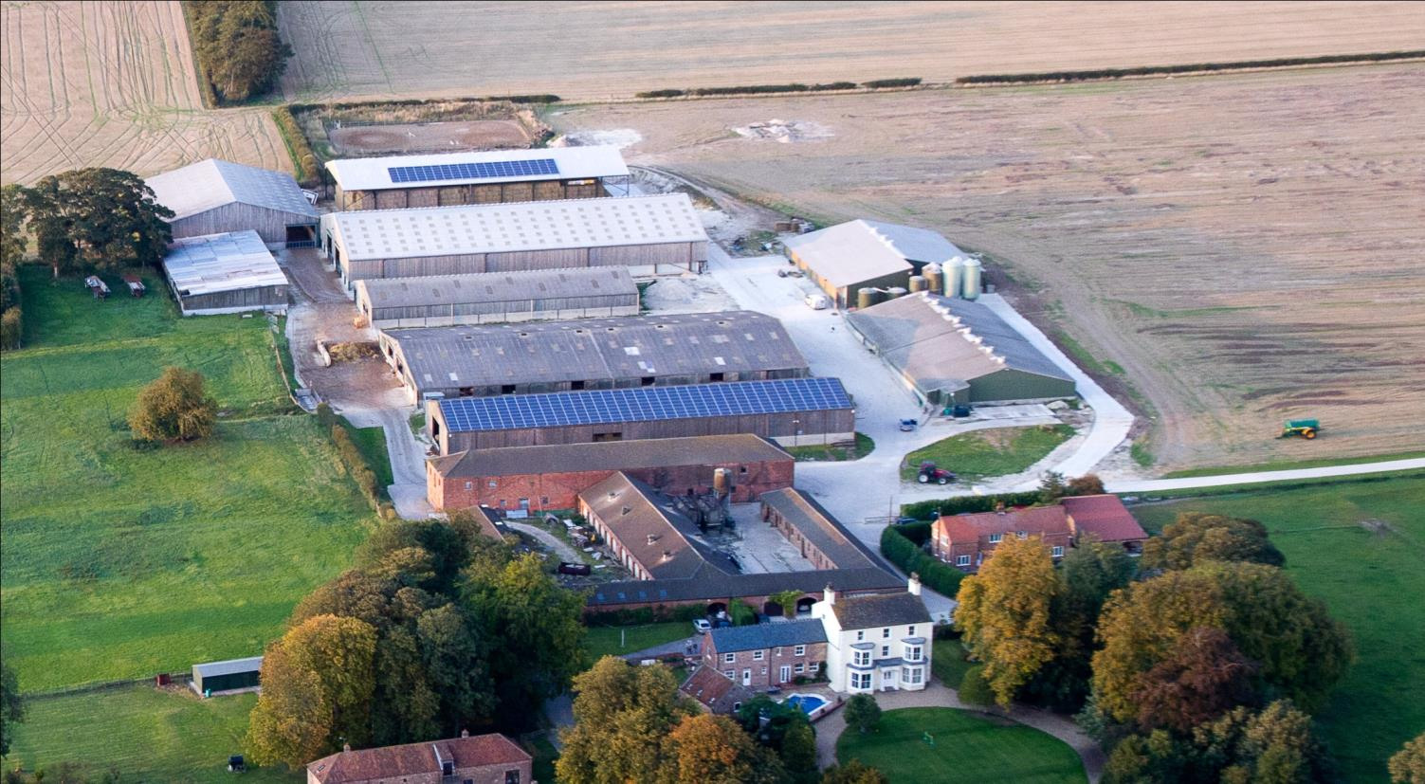
Indoor breeding unit
1,700 breeding sows in this unit.
Every week 72 sows are farrowed.
The sows look after their piglets until they are 28 days old.
All the animals in this unit are kept inside in straw yards until they give birth.

Slide 10
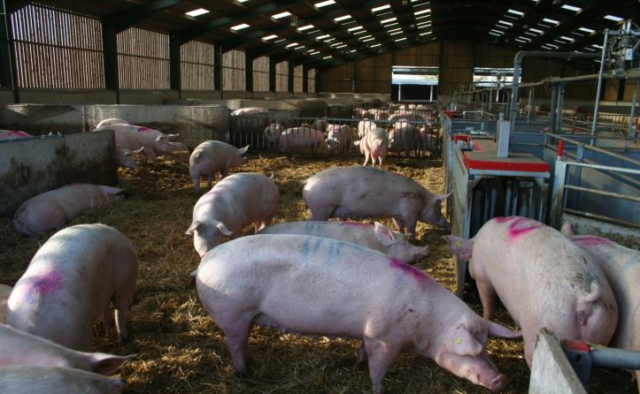
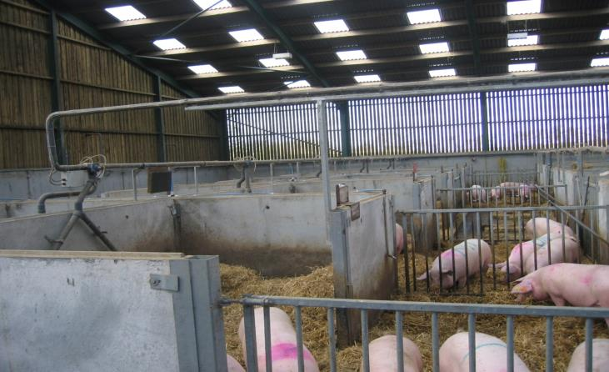
Housing systems
The computerised system picks up which sow is in the feeder and feeds it a particular amount of food depending on how far on in her pregnancy she is.

Slide 11
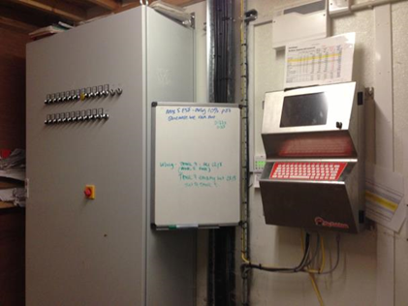
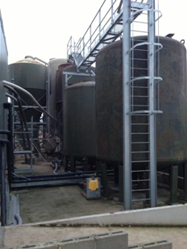
Diet of pigs
Good nutrition is vital and the feeding system on the farm is computerised. There is a liquid feeding system in the indoor unit using the waste products from milk, distilleries and bakers. It is essential that there is no meat in the waste products to prevent harm to pigs and the possible spread of disease.
Wheat, barley and soya are also used for protein and fibre.
The outdoor sows are fed with similar ingredients but as a dry pellet.

Slide 12
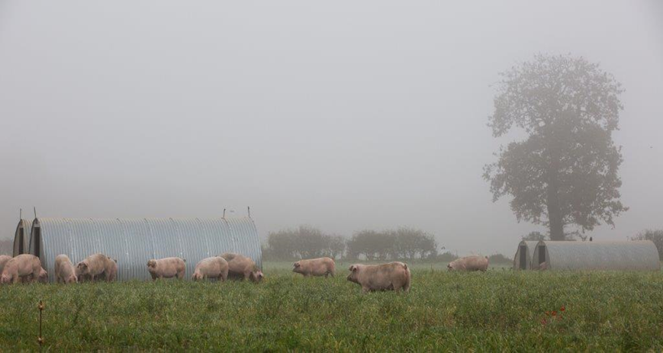
Health & welfare of livestock
Farmers check their animals every day and provide quality feed with clean fresh water.
Vets and nutritionists work with farmers to provide expert advice on health and welfare.
When animals are housed, the building is kept clean and fresh bedding is provided to keep animals comfortable and free from disease.
If an animal is sick they must be treated immediately, which may require a visit from the vet.

Slide 13
Pig farming
For further information, go to:
www.foodafactoflife.org.uk

