Slide 1
Rice

Slide 2
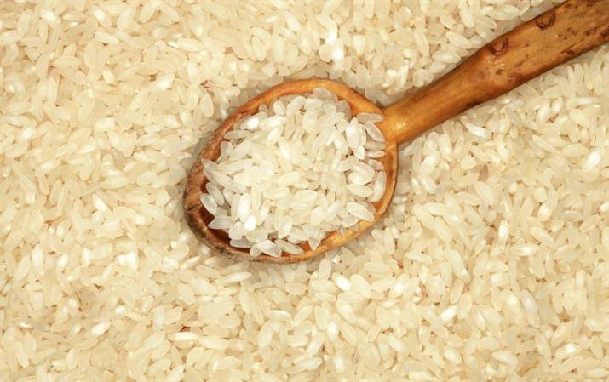
Overview
This presentation covers:
how rice is grown and processed;
different types of rice and their use in dishes;
rice in our diet;
cooking with rice;
food and drink made from rice.

Slide 3
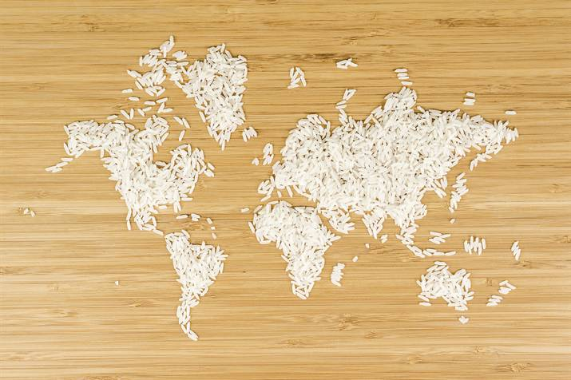
Rice around the world
There are more than 40,000 varieties of cultivated rice (the grass species Oryza sativa) said to exist. But the exact figure is uncertain. Over 90,000 samples of cultivated rice and wild species are stored at the International Rice Gene Bank and these are used by researchers all over the world.
Rice is grown in every continent of the world except Antarctica and each country has developed its own recipes, e.g. paella in Spain, risotto in Italy, fiery cajun and creole dishes from the US, and the precisely prepared delicacies of sushi in Japan.
The Rice Association

Slide 4
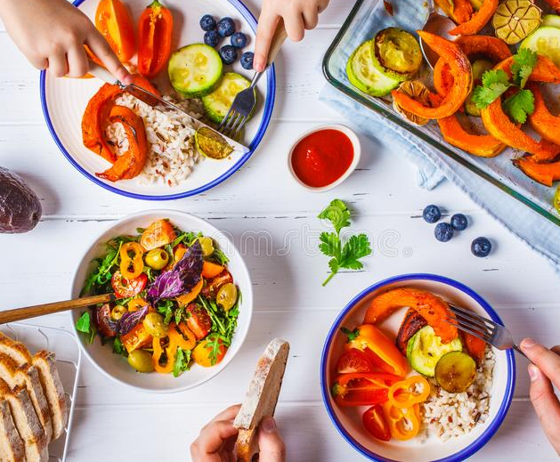
Rice in the UK
The rice industry in the UK is worth around £750m annually to the economy and £400m for retail.
In 2017 there was 78 new rice products launched, including microwavable rice which is useful to today's smaller households and people with less time to spend in the kitchen. Rice pouches now make up over half retail sales.
Rice eaten per person per week has grown 450% since the 1970s, with 90% of UK households buying rice.
There are 11 rice mills in the UK.
The Rice Association

Slide 5
What is rice?
When rice is harvested it is called ‘paddy'. A paddy is a complete seed of rice and one grain of paddy contains one rice kernel. Each paddy grain has many layers, the outermost layer is the husk. The husk consists of two interlocked half shells. Each protects one half of the paddy grain. The husk is composed of silica and cellulose.
Inside the husk is the grain kernel itself. This is made up of outer bran layers and the internal white starchy endosperm. The bran consists of several very fine layers. Bran is mainly composed of fibre, Vitamin B complexes, protein and fat. At the base of each grain is an embryo, which will grow into a new plant if planted.
The inner part of the grain is the endosperm, which is composed of mainly starch. This is what forms milled (white) rice. Rice starch is composed of mainly two types of starches, amylose and amylopectin. The exact mixture of these determines the cooking texture of the rice.

Slide 6
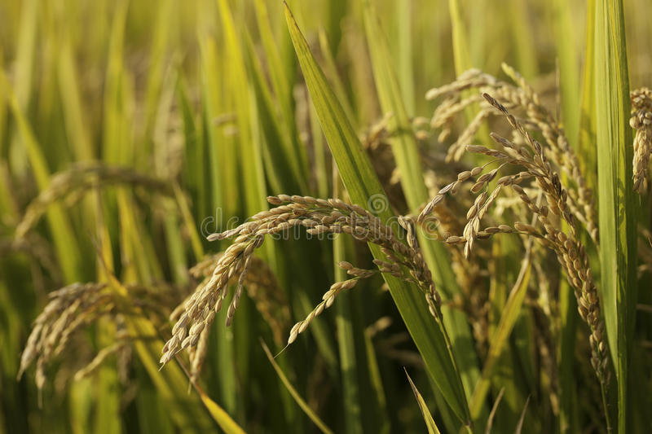
Rice - the plant
The plant has many different variations, but is generally a short living plant, with an average life span of 3-7 months, depending on the climate and the variety.
Substantial amounts of water are required for the planting of rice.
The height of the plant can range from 0.4m to over 5m in some floating rice.

Slide 7
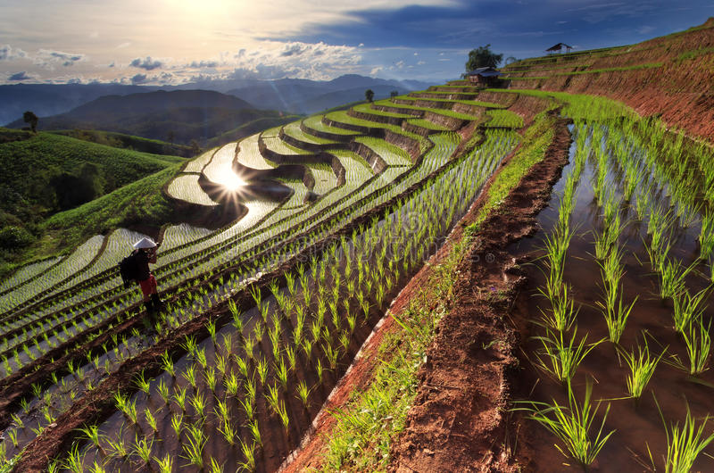
Farming rice
In many Asian countries the ancient methods for cultivating and harvesting are still practised.
The fields are prepared by:
Ploughing - often with a simple plough drawn by water buffalo, ploughing breaks up the soil.
Fertilising - naturally fertilised.
Smoothing - where a roller (e.g. a large log) is dragged over the field to smooth the earth, giving a smooth bed for the seedlings to be planted on and ensures the water depth is equal.

Slide 8
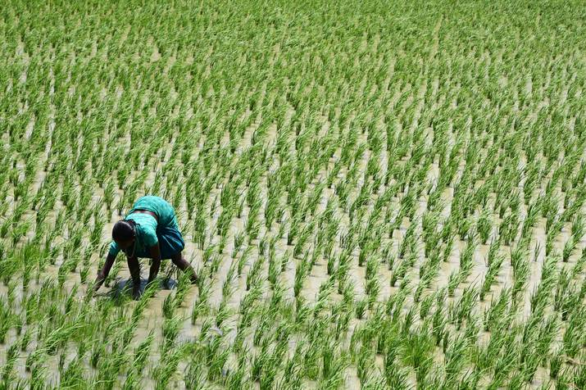
Farming rice
Seedlings are started in beds and a after a period of 30-50 days are transplanted by hand to fields which have been flooded by rain or river water.
During the growing season, irrigation is maintained by dyke-controlled channels or by hand watering.
The fields are drained before cutting of the crop commences.

Slide 9
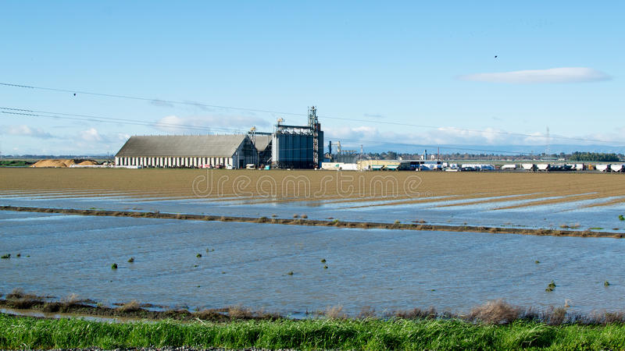
Farming rice
In the USA rice is mainly grown in the southern states and in California.
Computerised laser guided land levelling and re-circulating irrigation systems help farmers to increase yield and reduce the amounts of water required.
Fields are flooded in April and May and are then seeded by aeroplane.
By September the crop is mature and ready to be harvested.
The rice is transported to dryers to remove moisture and then sent to mills for processing.

Slide 10
Processing rice
After the rice has been harvested, it is threshed to loosen the hulls, normally by flailing, treading or working in a mortar and winnowed free of chaff by tossing it in the air above a sheet or mat.
Once sold by the farmer the rice, known as paddy or rough rice is screened to remove stones, loose chaff and paddy stalks (part of the plant).
The rice is then slowly dried by warm air to reduce any moisture and then the it is screened to remove dust particles.
The outer husk is removed next, but the bran layer is left intact, this forms brown rice. The rice is then cleaned and graded.
If the brown rice is to be sold as white rice it then goes to the mill where it undergoes milling, an abrasive action which removes the bran layer surrounding the rice grain.

Slide 11
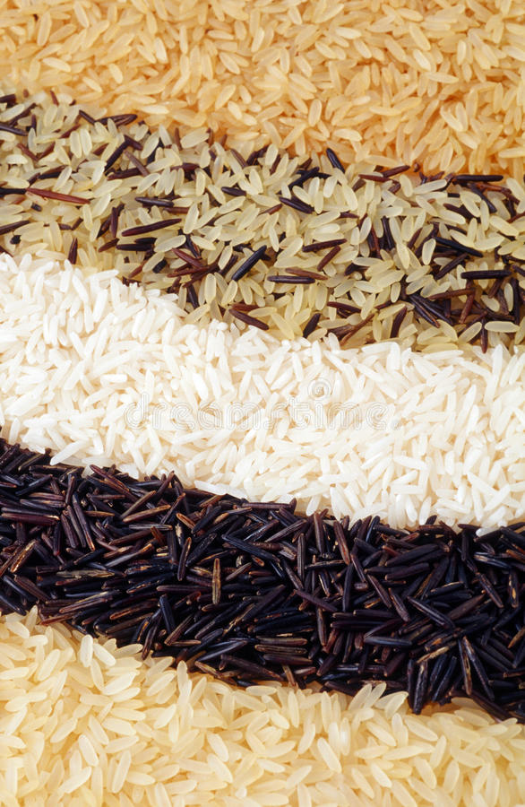
Different types of rice and their use in dishes
Rice is very versatile. It can be served as an accompaniment to a meal, be the basis of a main dish, or served in soups and starters and as a pudding.
Many countries start the day with a rice breakfast such as congee in China and rice porridge in Japan. One of the most popular form of rice is eaten as breakfast cereals.
The rice varieties can be divided into three basic groups, long grain, short grain and medium grain. Within the groups there are also speciality and aromatic rice.

Slide 12
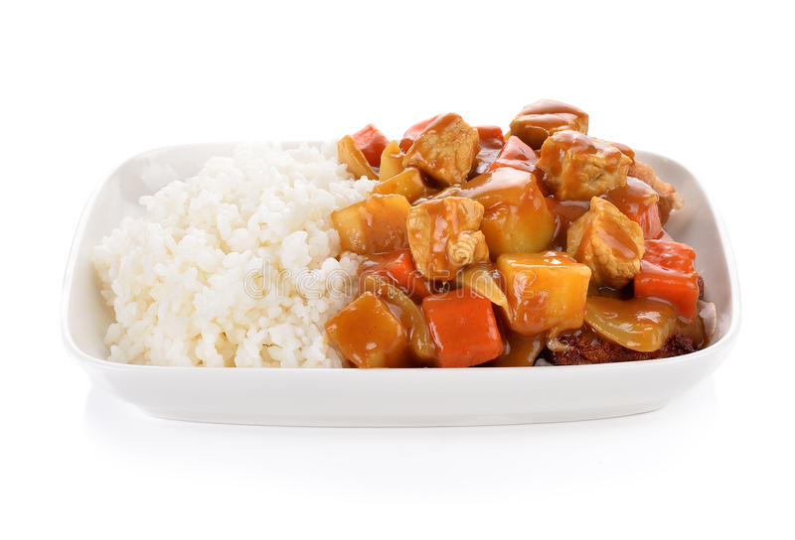
Different types of rice and their use in dishes
Long grain rice
Regular long grain rice is one of the most popular types of rice because it works well with rich and delicate sauces. On cooking the grains separate to give a fluffy effect.
Types include - all purpose, easy cook, brown (or wholegrain), basmati and jasmine.

Slide 13
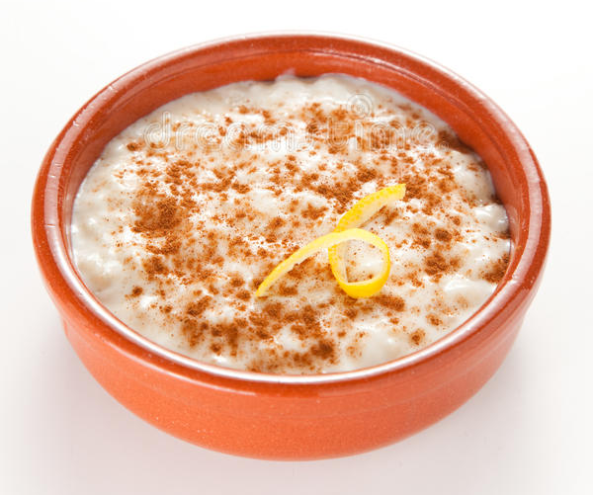
Different types of rice and their use in dishes
Medium grain rice
In Europe, medium grain rice is typically associated with risotto, as it is creamy when cooked. Medium grain rice is also particularly suitable for puddings and other dishes that utilise liquid in the cooking method.
Types include - arborio, carnaroli, roma and ribe.

Slide 14
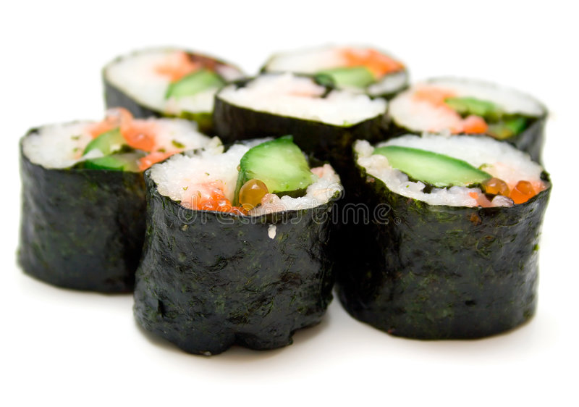
Different types of rice and their use in dishes
Short grain rice
Tends to be almost round and is typically moist when cooked, giving sticky rice, which is perfect for puddings, and is also used in sushi.
Types include – bomba and originario.

Slide 15
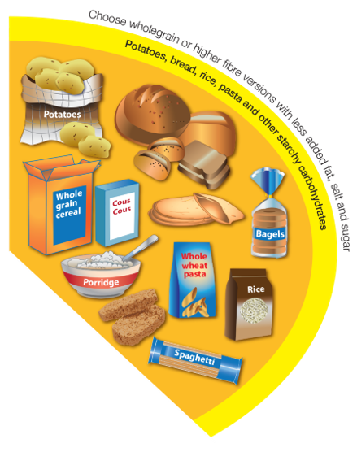
Rice in our diet
The recommendations from the Eatwell Guide is to base meals on starchy carbohydrates.
Around a third of what people eat should be potatoes, bread, rice, pasta and other starchy carbohydrates.
People should be choosing wholegrain versions of starchy carbohydrates where possible, and brown rice is a wholegrain.
Having more wholegrains is a good way to increase fibre intake, which is important for health.
Wholegrains also provide some essential vitamins and minerals that have a wide range of important functions in our body.

Slide 16
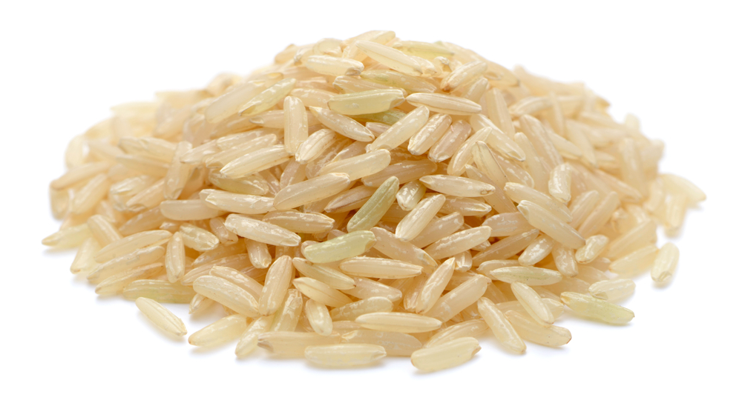
Rice - food safety
Dried rice can be contaminated with Bacillus cereous bacteria, which produces spores. Spores produce toxins which can lead to digestive upset.
Spores are not destroyed by cooking. If left at room temperature, the bacteria could start multiplying. If not eaten straight away, rice should be cooled quickly and stored in a fridge below 5°C, to prevent multiplication.
Reheating will not kill the spores.
FSA Fact checker

Slide 17
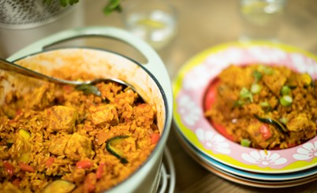
Leftovers using rice
Leftovers should be cooled as quickly as possible within two hours, and then stored in the fridge below 5ºC. Separating the food into smaller containers can help.
When leftovers are reheated they need to be steaming hot. If using a digital probe, food should be reheated to a minimum of 75°C. In Scotland food must be reheated to a core temperature of 82°C.
Leftovers should not be reheated more than once and should be used within 48 hours from when it was made.
Leftover rice dishes should be used within 24 hours from when it was made.

Slide 18
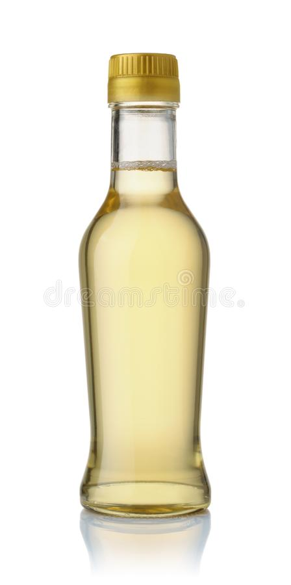
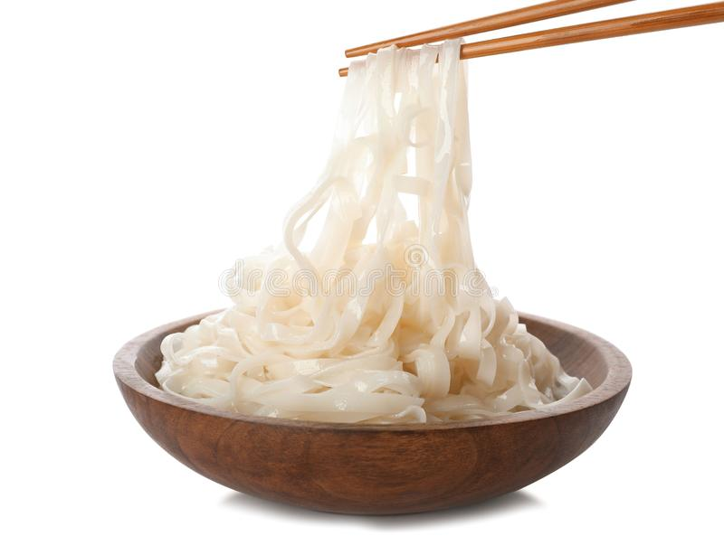
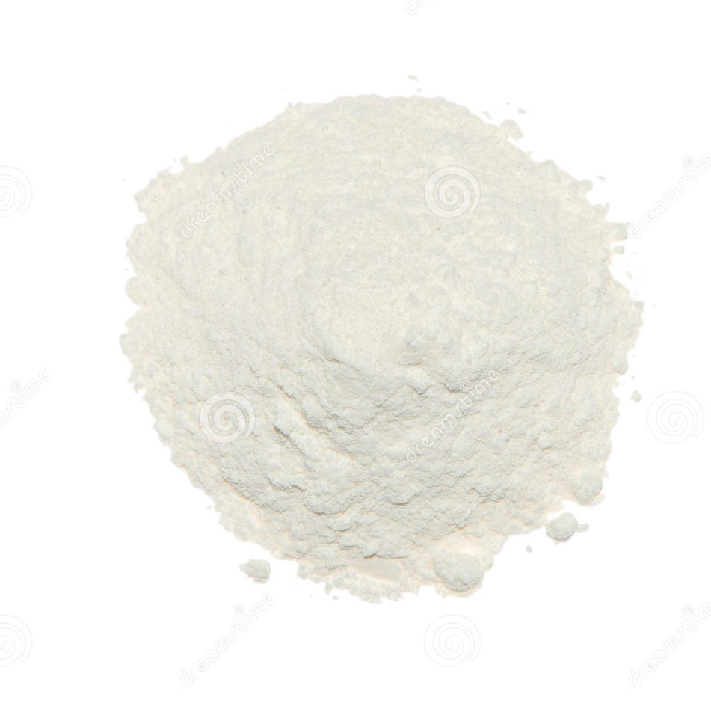
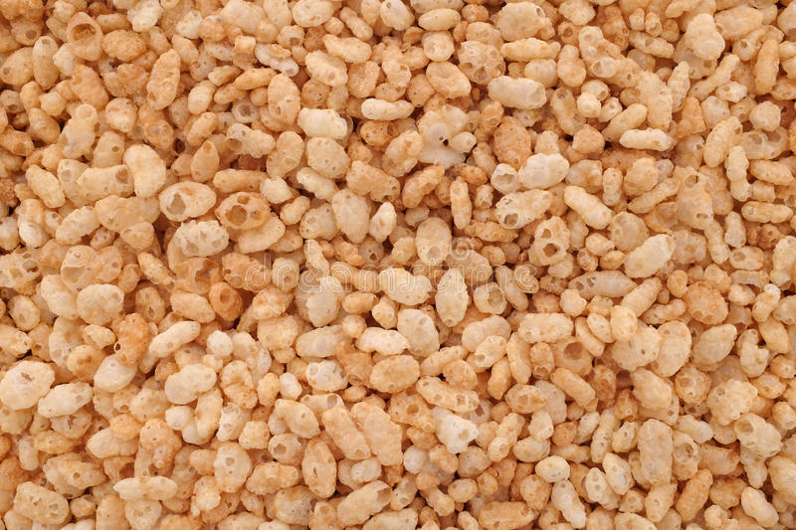
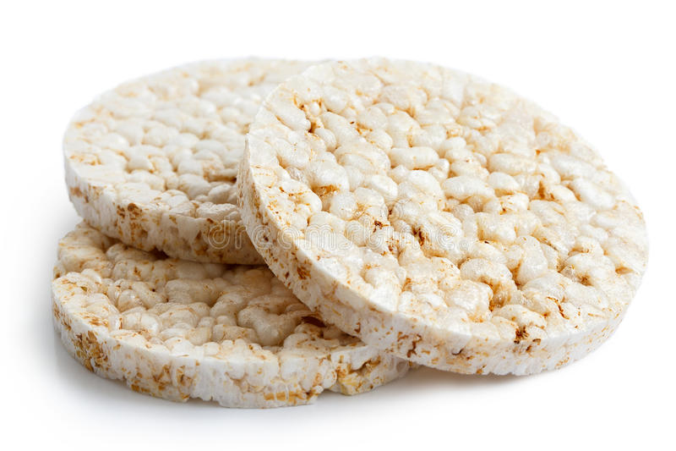
Food and drink made from rice

Slide 19
Rice
For further information, go to:
www.foodafactoflife.org.uk
This resource meets the Guidelines for producers and users of school education resources about food.

