Slide 1
Setting the scene and context: Why might change be needed?
Roy Ballam, British Nutrition Foundation

Slide 2

Why change might be needed?
Societal change, e.g. family structures, working world, time to cook
Diversity in our population
Education opportunity
Health and health inequality
Financial and financial inequality
How we shop, cook and eat
Trends in, and availability of, ingredients, foods, dishes and cuisines
Technological change (cooking and information)
Cooking skills in general adult population
Sustainability - issues and growing concern/interest

Slide 3
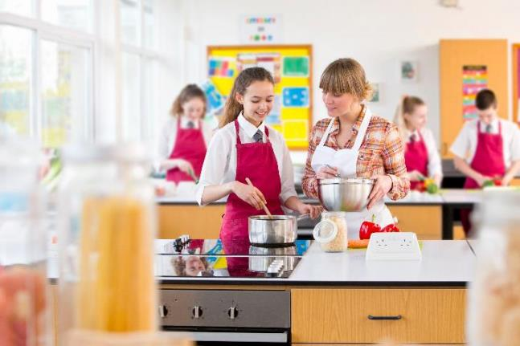
Why worry about food education?
Have we kept up with change? If we went back 20 years, what’s changed?
Food Education Learning Landscape (JOFF, 2017) - reported limited opportunities for pupils to develop cooking and healthy eating skills; food education was not meeting pupil aspirations for their learning; teachers reported they were heavily constrained in their delivery by lack of training, time, budget and facilities; and food education had a low status.
Research undertaken with teachers to review the impact of the removal of A-levels in food indicated that, as a consequence, there is less teaching of food and nutrition overall in the curriculum (from 11 to 16 years); less funding to support the subject; and, the status of food education is in decline (Ballam & Davies, 2021).
Academies and free schools in England do not have to follow the National Curriculum - 50% of primary and secondary schools are academies or free schools (DfE, 2019).2021).

Slide 4
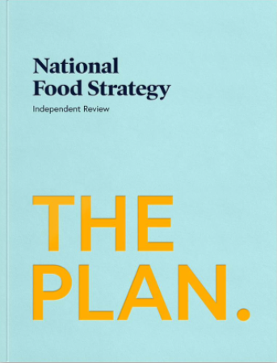
It’s time to take food education seriously
‘It is time to take food education seriously’ states recommendation three in the National Food Strategy (NFS, 2021).
The NFS describes initiatives to support food and nutrition education in schools, including curriculum changes, such as food education for nursery and reinstating a food A-level, inspecting what is taught, providing ingredients and recruiting staff.
The next 2 years will be important in seeing recommendations taken forward and implemented as policy.
If food education is to be taken seriously, it needs funding and championing over decades, separated from changes in government and initiatives that ‘come and go’.
Long-term investment is required – ensuring we have the staff, resources and infrastructure in place.

Slide 5
Why are we doing this?
We want to develop a modern food teaching and learning paradigm,
moving the profession forward from current practice,
which is ‘fit for the future’, and,
in particular, reflects and meets the needs of our culturally diverse society.

Slide 6
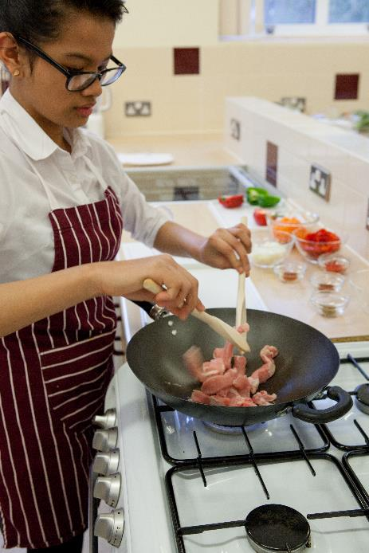
Our 4-step plan
1) What do pupils want? – Understanding and responding to pupil voice.
Conduct a survey with pupils, aged 14-18 years, to find out about their food and cooking experiences, as well as better understand what they would have liked to have been taught.
The outcome for this work is to ascertain possible future content, as well as a baseline for pupils’ food skills after compulsory food education at 14 years of age.

Slide 7

Our 4-step plan
2) What’s modern food teaching? – Understanding the profession and society.
Arrange a consensus building event with experts in the field of food and nutrition education to debate the concepts of future, modern food education. Publish a report.
Undertake a teacher survey.

Slide 8
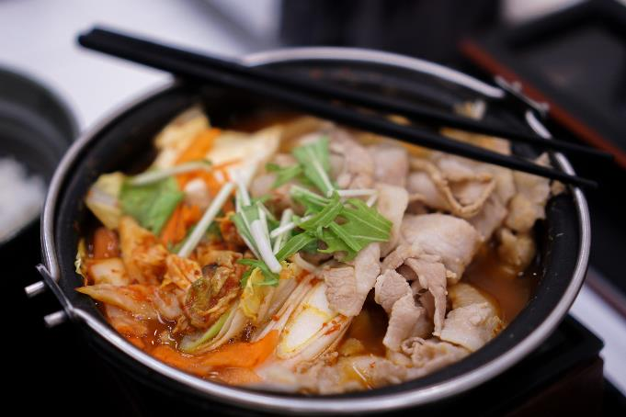
4-step plan
3) What’s cooking? – Ensuring recipe diversity.
Using the outcomes from (1) and (2), develop a range of recipes which reflect modern food teaching and cultural inclusion, ensuring that these can be used to support the curriculum, food skill development and progression.
Highlight and provide recipes which are suitable and practical for schools and their budgets, promote healthier eating, more sustainable, reflect more global cuisine, and encourage dialogue around culture and inclusivity.

Slide 9

4-step plan
4) What future paradigm? – Bringing teachers on the journey.
Taking the learnings from the pupil voice and consensus building event, host teacher training sessions, all set in the context of diversity and inclusivity.
The emphasis will be on using modern food experiences and culture to inform the training, creating a natural link to educating and motivating young people.

Slide 10
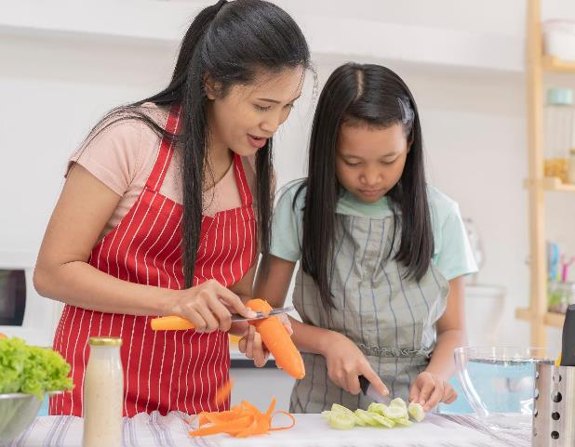
Let’s provide evidence for change …
… set the ‘collective’ agenda for food education. If not us, who?
… say how we want to shape the subject. Content, management, pedagogy, resource, time, teacher recruitment …
… check that ‘food’ reflects modern UK food culture, which is diverse and inclusive of many the different cultures and many traditions within our communities.
… ensure lessons intrinsically teach about health, as well as link to being more sustainable, all while instilling a love of food for all.
… reimagine what food teaching look like in 10–30 years.
… define the skills, knowledge and experience might be required
… understand what young people want and need.
… consider what’s important for the UK (e.g. health, inequality, social mobility, careers, life, enjoyment …)

Slide 11
Thank you, make your voice heard and enjoy the morning

