Slide 1
Teenagers: health status and nutrition knowledge
Ewen Trafford, Nutrition Scientist
2nd October 2021

Slide 2

Importance of nutrition during childhood and adolescence
Needed to support:
rapid growth;
bone development;
muscle development;
cognitive development.
British Nutrition Foundation – Teenagers
Lowe, Morton and Reichelt, 2020
Notes:
There is an acceleration of physical and mental development during the teenage years, leading to increased nutrient requirements
There is also an increased distinction between certain nutrients that boys and girls may need more of as they get older (e.g. boys may require more zinc, selenium and girls more iron)
However, we know that many markers of health status in teenagers are of concern and we also know that the dietary quality of teenagers tends to be poor.

Slide 3
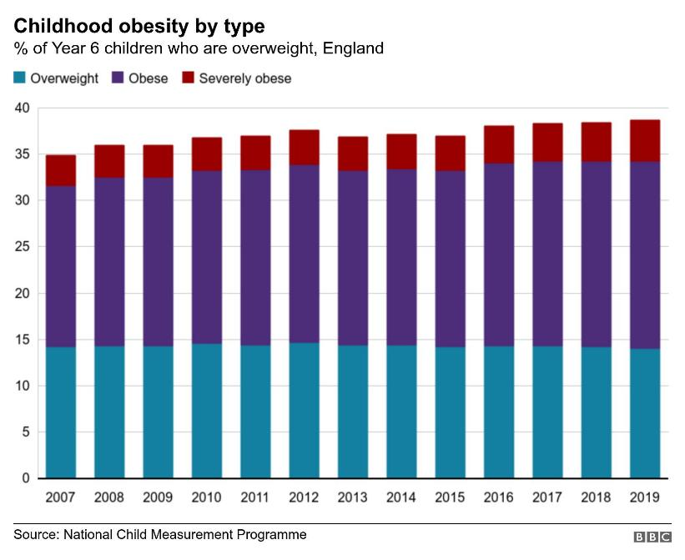
Health status in children and young people
Overweight, Obesity and Physical Activity
1 in 5
obese by year 6
Fewer than 50%
meeting recommended activity guidelines
Statistics on Obesity, Physical Activity and Diet, England, 2020
National Child Measurement Programme
Notes:
1 in 5 by year 6 and this percentage continues to rise as children get older. Between the ages of 13 and 15, 36% of all children in England are overweight or obese. We can also see from this graph that the total overweight, obese and severely obese by age 11 has continued to steadily rise with time.
Guidelines – children and young people (5 to 18) should aim to be physically active for at least 60 minutes per day across the week.
Fewer than 50% of children and young people meet the recommended activity guidelines, compared to 67% of adults. We do know that boys are, on average, a little bit more physically active than girls as well.
When we factor in for deprivation, more deprived children have a much higher rate of obesity and as they get older this gap increases (Children in England by year 6 27.5% obese in most deprived areas vs 11.9% in least deprived) – NCMP 2019/20
Obesity in childhood tracks into adulthood

Slide 4
Health status in children and young people
Government response
Sugary drinks consumed vs free sugar intake
Public Health England
  Sugar reduction
  Salt reduction
  Calorie reduction
Childhood Obesity Plan
Advertising restrictions
Soft Drinks Industry Levy
  Free sugar intake
  Dental health
Notes:
Government has attempted to enact measures to deal with overweight and obesity, plus other health issues such as salt.
Children are an increasing focus of the government’s obesity plan.
For example, rules to introduce a 9pm watershed for foods high in fat, salt and sugar is due to come into force next year
Other legislation includes rules around promotions of HFSS foods in stores.
An example of a broadly successful measure is the SDIL.

Slide 5



Health status in children and young people
Intake of key foods (11-18 year-olds)
12%
4%
2g
getting 5-A-Day
getting enough fibre
avg. oily fish eaten per day
Overall dietary quality in UK adolescents is poor
This suggests that adolescence is a key time to make targeted changes
NDNS: results from years 9 to 11 (2016 to 2017 and 2018 to 2019)
Wimpenny et al., 2018
Notes:
Only 12% getting 5-A-DAY and 4% getting enough fibre.
Both of these are an issue in the adult population too, but worse in teenagers.
Two portions of fish a week, one of which is oily is the general recommendation for oily fish
Children under the age of 16 should avoid eating any shark, swordfish or marlin. This is because the levels of mercury in these fish can affect a child's nervous system.
You can give boys up to 4 portions of oily fish a week, but it is best to give girls no more than 2 portions a week. This is because the low levels of pollutants that oily fish contain can build up in the body and may harm an unborn baby during a future pregnancy.
Research suggests that the overall dietary quality in UK adolescents is poor and not diverse. This is a period of change and therefore it is challenging to intervene but this is an important period for development.

Slide 6
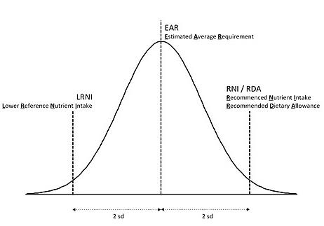
Vitamins and Minerals
During childhood and adolescence, requirements for nutrients are high, due to rapid growth and development.
Reference Nutrient Intakes and Lower Reference Nutrient Intakes are set for vitamins and minerals.
These help to indicate how many people are at risk of deficiency.
Notes:
The EAR is the estimated average requirement for a nutrient in a population, determined by research into that nutrient
The RNI for a nutrient is the level at which 97.5% of a population group will have sufficient status.
The LRNI is the level at which 97.5% of a population group would be deficient
Identifying the LRNI for key nutrients can give an indication of how many teenagers are at high risk of deficiency

Slide 7
Vitamins and minerals (11-18 years)
Vitamin or Mineral | % Boys below LRNI | % Girls below LRNI
Iron | 11% | 49%
Calcium | 14% | 16%
Zinc | 20% | 16%
Iodine | 19% | 28%
Vitamin A | 18% | 18%
Riboflavin (B₂) | 13% | 22%
What about Vitamin D?
NDNS: results from years 9 to 11 (2016 to 2017 and 2018 to 2019)
Notes:
Iron - 49% of girls below LRNI (high iron requirements during this period, particularly due to menstruation, plus lower intakes than boys)
Iron can be found in meat (particularly red meat) but also in green, leafy vegetables. However, the iron in leafy vegetables is less bioavailable
Calcium – important for bone, tissue and dental health
Calcium can be found in dairy products but also green, leafy vegetables such as kale and broccoli (in lower amounts). Many dairy alternatives and juices are also fortified with calcium to boost intake.
Zinc – supports growth and development and the immune system. Zinc is not stored in the body, so regular intake is important.
Zinc can be found primarily in seafood and meat and fortified cereals but in some nuts, seeds and beans at lower levels.
Iodine – Important for proper skeletal development, nervous systems and hormone production
Iodine can be found primarily in dairy, eggs and seafood. Seaweed can have high levels of iodine, however in some species of seaweed this can be dangerously high.
Vitamin A – supports growth and development
Vitamin A can be found in two forms – retinol (from animals) and beta-carotene (from plants). Retinol is more readily available.
Retinol is typically found in meat and in high amounts in liver, but too much retinol can lead to toxicity – so caution should be taken when eating liver.
Beta-carotene is found in high quantities in sweet potato, spinach and carrots – there is far less risk of toxicity with high intakes of beta-carotene
Riboflavin (B2) – Energy production, growth and development
Riboflavin can be found in red meat and dairy but also in lower amounts in nuts and mushrooms. Most cereals are fortified with riboflavin.
Despite the evidence that magnesium, potassium and selenium intakes are below the LRNI in a substantial proportion of the UK population, particularly in older children and adults, the health implications of this are unclear as the DRVs for these minerals are based on limited data. This means that caution should be used when assessing adequacy of intake using the LRNI for these nutrients - just say that intakes also below LRNI in x% for Mg, Se and K but implications (if any) unknown
Bear in mind that these are the percentage below the LRNI, where 97.5% would be deficient. Even if everyone reached the EAR, 50% would still have suboptimal status

Slide 8
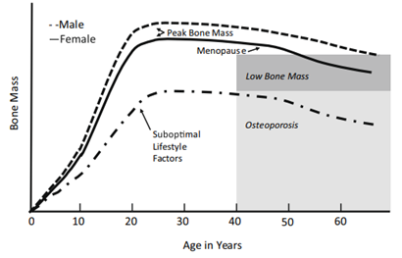


Key consideration – bone mass
Calcium
+
Vitamin D
Weaver et al., 2016
NHS, 2020
Notes:
Vitamin D – no LRNI but median intakes below 20% for both groups. 19% have low blood vitamin D <25nmol/l
Vitamin D is generated by UV light on the skin. In the diet it can be found in oily fish and dairy – mushrooms may be specially treated with UV light to produce it. However, dietary sources alone are typically not enough
We are now all recommended to take vitamin D supplements – the whole population has an issue with this, not just teenagers!
‘Vitamin D helps regulate the amount of calcium and phosphate in the body.
These nutrients are needed to keep bones, teeth and muscles healthy.
A lack of vitamin D can lead to bone deformities such as rickets in children, and bone pain caused by a condition called osteomalacia in adults.’ - NHS
Early accumulation of bone mass important in order that decline not be overly detrimental – suboptimal lifestyle factors (also including other factors than just these 2) increase risk of osteoporosis.
Risk is higher in women – 16% below LRNI for calcium and 19% suboptimal blood vitamin D levels

Slide 9

Eating habits through the teenage years
Less influence from parents, more influence from peers
More independence to make food choices
Easier access to nutrient-poor foods
Propensity to overeat foods high in fat, sugars and salt
Lowe, Morton and Reichelt, 2020
Ragliene and Grønhøj, 2020

Slide 10

A confluence of influences
Peer pressure
Body image
Fad diets
Celebrity ‘influencers’
Weight loss ‘aids’
Skipping meals
Lack of sleep
Other health concerns (e.g. skin)
Lowe, Morton and Reichelt, 2020
Steenson, 2020
Munt et al., 2016

Slide 11
How can we support teenagers in school?

Slide 12

How can we support teenagers?
Inform
Apply
Support
Engage
Notes:
https://academic.oup.com/her/article/21/2/239/671343

Slide 13
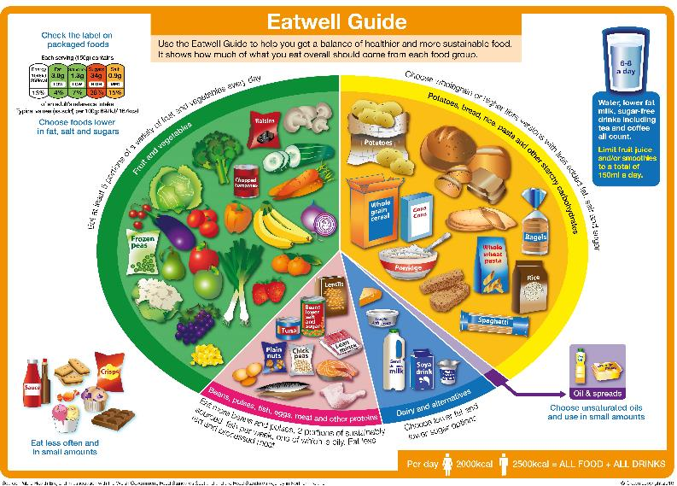
Inform
Cement the basics of food and nutrition
Make sure nutrition knowledge is applicable
Present information in a memorable way
Get feedback from pupils to identify misconceptions
Notes:
Basics of food and nutrition – start with the Eatwell Guide
Nutrition knowledge needs to be applicable – both inside and outside the classroom (see ‘apply’)
Information should be presented in a memorable way to pupils but also from pupils to each other, due to the importance of peer learning
Where possible, learning should be a bidirectional relationship and understanding the gaps in pupils knowledge through receiving feedback is really important

Slide 14

Apply
Apply learning to:
  Practical work
    e.g. healthier and more sustainble cooking
  Life skills
    e.g. independence at University
  Career paths
    food science
    catering
    agriculture
    nutrition
    and more!
  Other subjects
    e.g. chemistry, biology
Notes:
Food and nutrition can be applied in many ways – this can help to keep it in the forefront of pupils minds
Understanding nutrition can link into practical work – pupils may consider whether the dish they are creating is healthy and/or sustainable. They can have an idea about what nutrients are in the food they are making and perhaps those that are not.
Life skills are really important – particularly for students with special needs. Even being able to apply the basic principles of the Eatwell Guide and cook simple meals can be really useful – and we know that people who cook more for themselves are typically healthier. Cooking and eating together with friends/family can also play an important role in social interactions for young people
Pupils should be made aware of the wide array of career opportunities that may be available through studying food
pHood Futures is a project we are a part of with 7 other organisations and organised by the Royal Society of Chemistry. We are identifying schools that we can provide resources and support to around the chemistry of food. The goal is to make chemistry applicable in a real world setting by using food and encouraging uptake of Chemistry post-16.

Slide 15
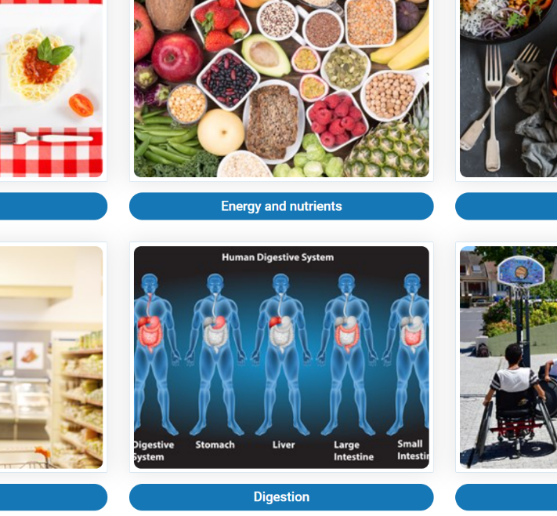
Support
Support learning with a wide range of resources and activities (based on learning need)
Link curriculum and canteen (whole school approach)
Use evidence-based digital resources and media
Help pupils to support each other
  (e.g. group work in practical sessions)
Notes:
Identifying learning needs and supporting those needs with appropriate materials is vitally important. Core competencies!
A whole-school approach can keep food and nutrition on the agenda outside of the classroom, with links to other subjects or to the canteen
Be selective with resources to ensure they are evidence base. We know that teenagers are getting a lot of mixed information, particularly from social media and it’s important to combat misconceptions with accurate information
Using digital media and resources – both teachers and pupils!

Slide 16

Engage
Foster engagement as early as possible (from pre-school)
Engagement relates to both academic and non-academic interactions
Be aware of pupils with negative prior learning experiences
Pupils should ‘own’ their learning, where possible
Wang and Degol, 2014
Notes:
Other opportunities outside the classroom – food across the school day (breakfast clubs, lunchtime, after school activities, rewards etc.) Take every opportunity outside lessons
Engage parents and home situations.

