Slide 1
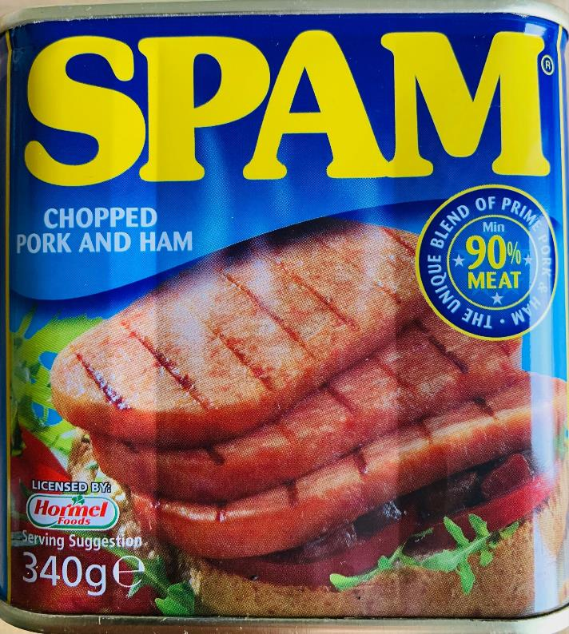
50 years what’s changed?
Jenny Ridgwell

Slide 2
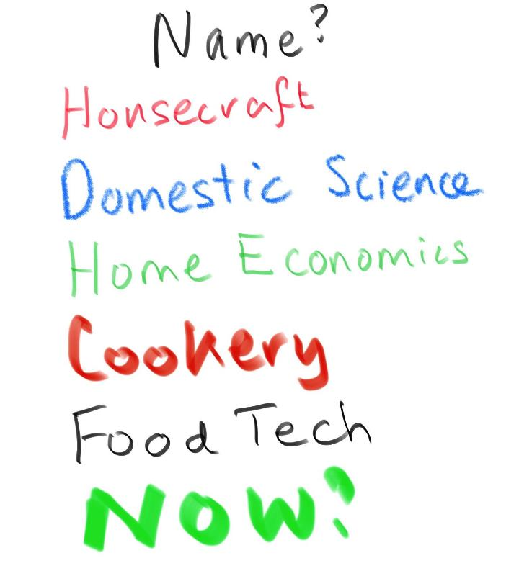

Slide 3
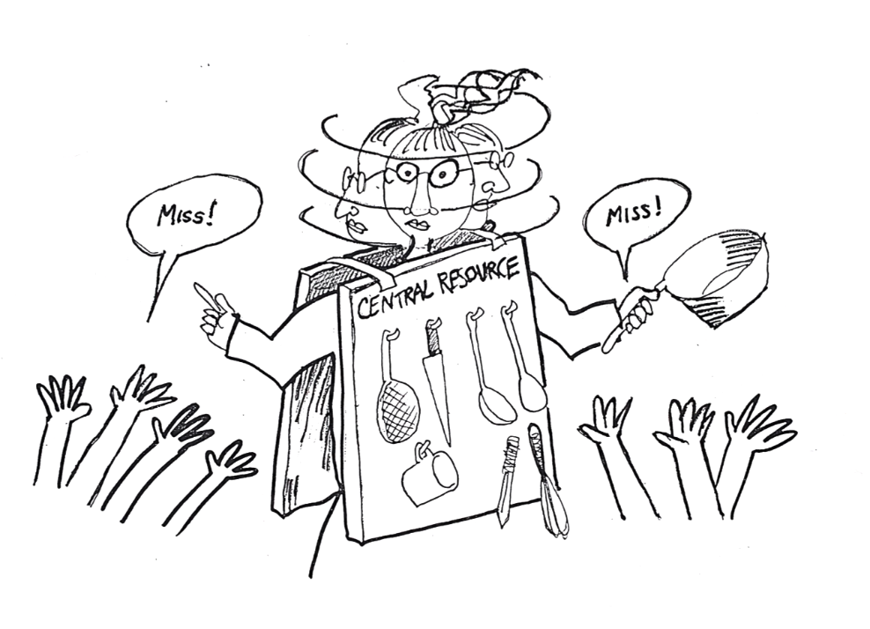
Help!
Other subjects have help.
Do you?
Why not?

Slide 4
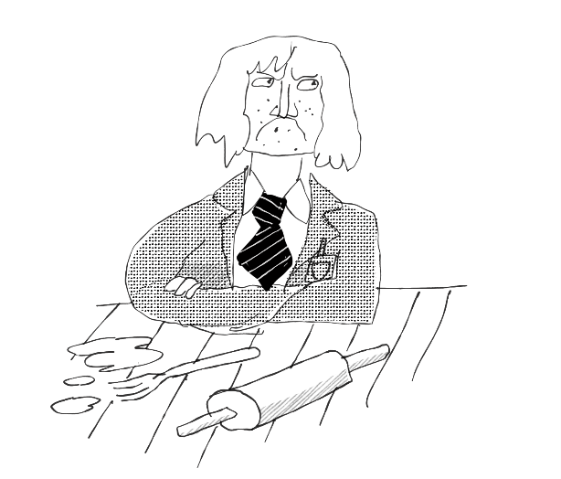
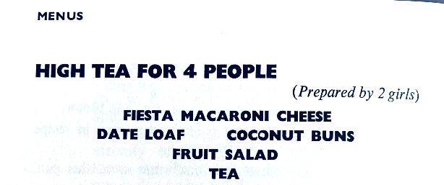
Boys and cooking
Did you know?
Sex Discrimination Act 1975 let boys take lessons
1981 cookery exams 7% male 93% female
2019 GCSE Food entries 34% male 66% female
Exam question 1970s Suggest 2 dinners for a housewife for a) a dinner cooked quickly on her return from shopping b) a dinner which can mainly be left cooking while she is out.
Good Housekeeping’s Cooking is Fun 1970

Slide 5
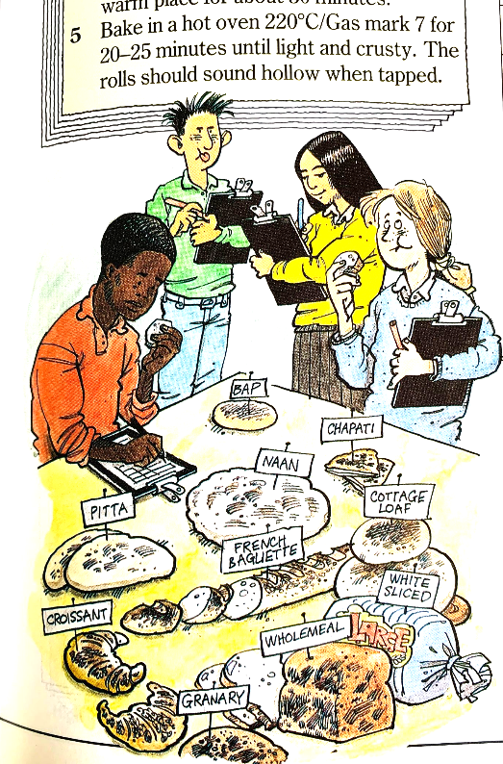
Diversity
Bread tasting from Skills in Home Economics Technology
Ridgwell and Davies 1989
Artwork was briefed to show diversity of cultures and ensure that girls and boys had equal roles.
Exam questions that asked what do you serve with roast lamb were challenged.
Respect and value food from multicultural Britain.
Heinemann artwork 1989

Slide 6
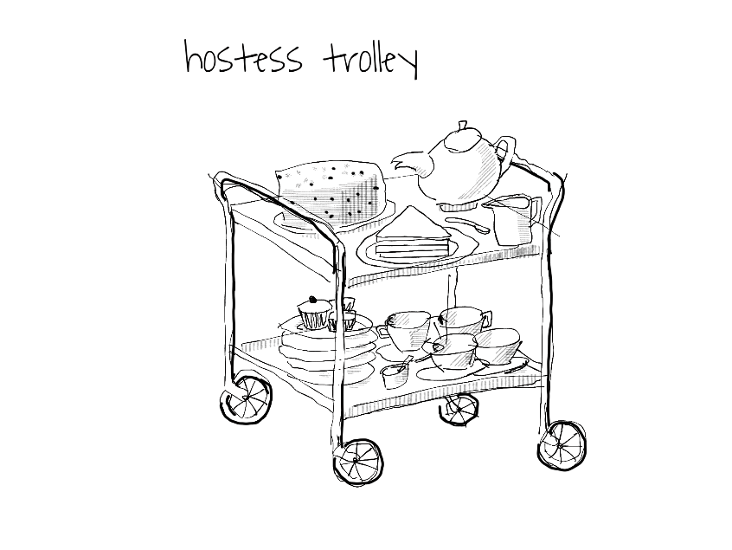
Who pays?
1970 - 1972 ILEA school provided all the ingredients so all students could take part.
From 1972 in different authority paying for ingredients became a challenge.
I made the Governor’s teas. But once headteacher knew me I asked for food allowance to be increased.
And teas were made by school caterers.
Drawings by Dave Smith for I taught them to cook

Slide 7
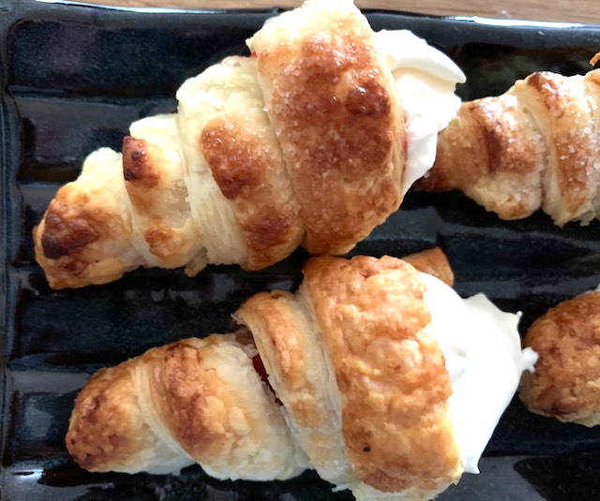
Skills
When did you last make a cream horn?
High fat
High sugar
No waste
Delicious
But why?

Slide 8
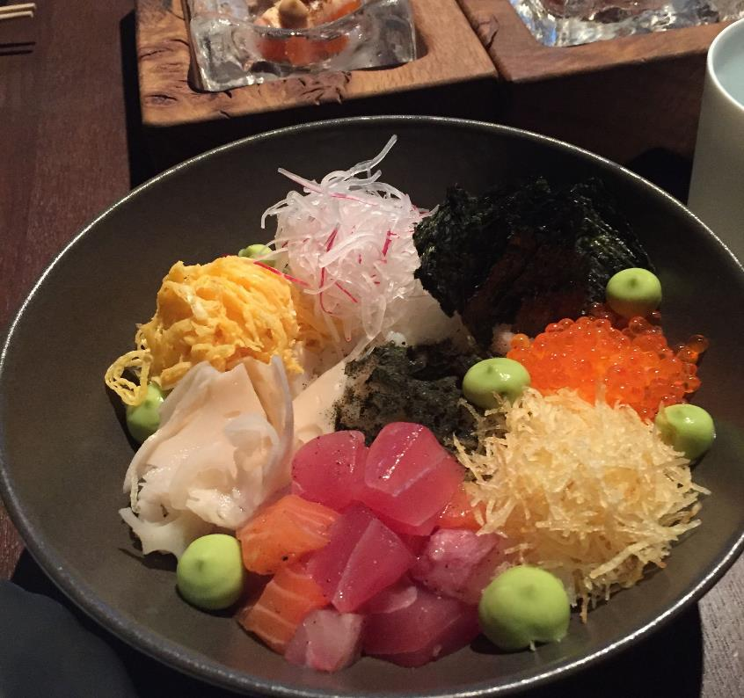
Ideas for now
Grain and pulses,
Street food from around the world,
Mezze
Vegetables and dips
Spanish tapas
Dahl, riata, chapatis and rice
Pasta dishes and sauces
Less meat

Slide 9
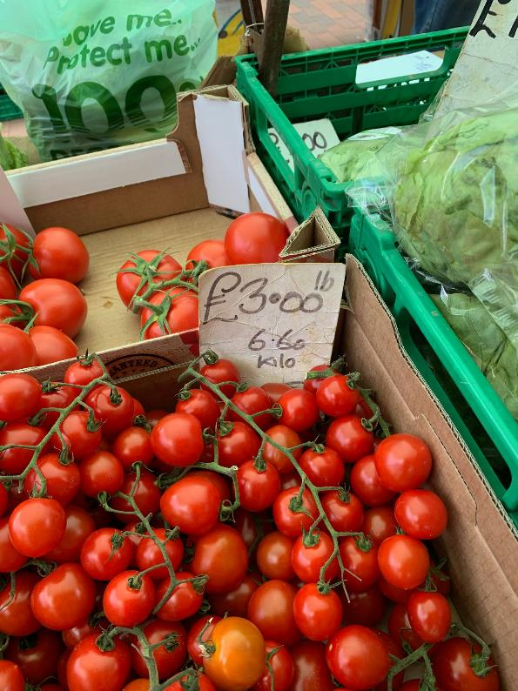
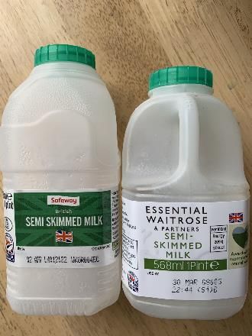
Metrication 1970
That’s 51 years ago and these photos are in 2021
Some things don’t change.

Slide 10
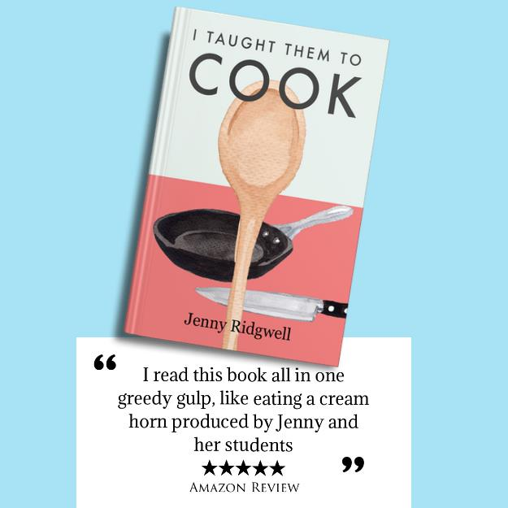
Why does it matter - because things aren’t changing!
Subject name - what is it?
Are students making high fat, high sugar dishes for skills?
Are we valuing multicultural dishes?
Are boys taking GCSE?

