Slide 1
What change is needed?
Teacher and pupil research from across the UK
Frances Meek, Senior Education officer, British Nutrition Foundation
2 October 2021

Slide 2
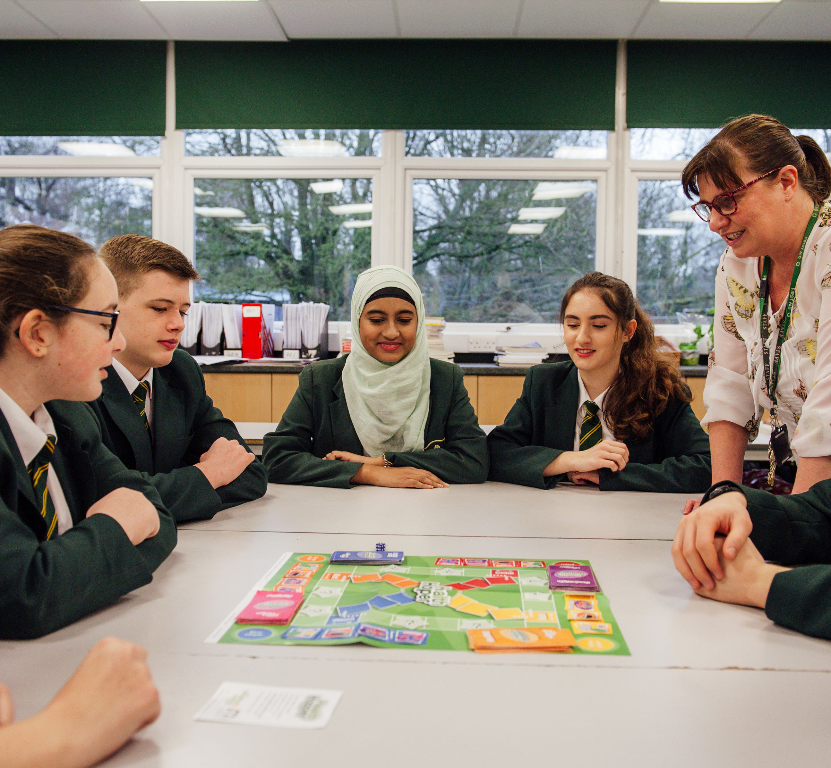
Methodology
The British Nutrition Foundation asked practising teachers, as well as their pupils aged 13-18 years, a few questions to find out about their teaching/learning experiences, as well as consider any potential changes to the subject to ensure its relevance in the future, e.g. subject content, pedagogy, pupil experience.
The surveys were open from 18 August to 24 September 2021

Slide 3
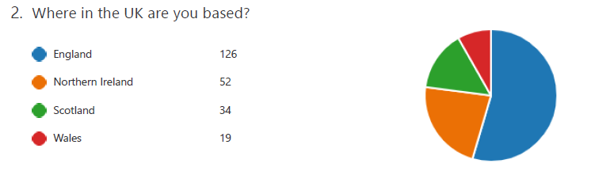
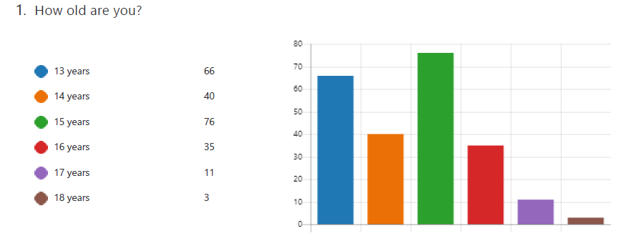
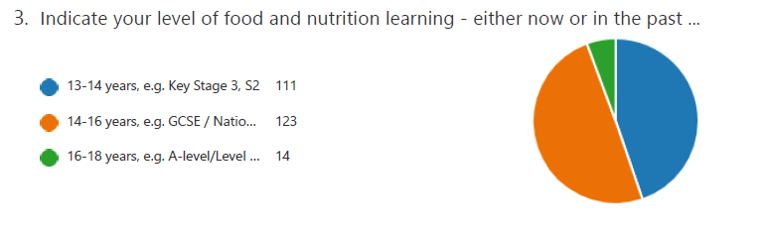
Pupil survey
213 pupils responded

Slide 4
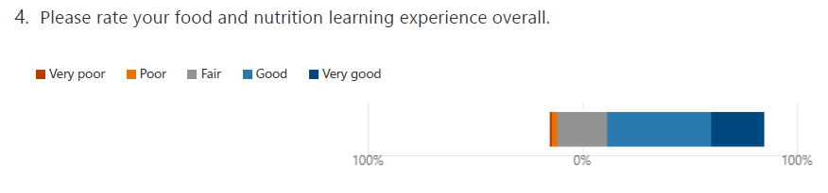
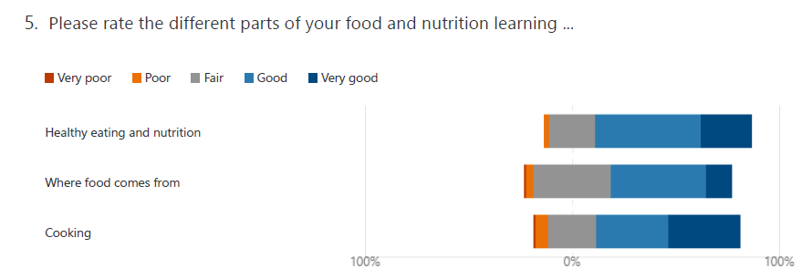
Pupil survey

Slide 5
Q6 Why pupils scored Q4 and 5 the way they did
Notes:
Summary: The majority of responses were positive.
Positive responses mentioned
Enjoyable practicals
High quality teaching
Independent learning
Negative responses mentioned:
Not enough practical work
Issues related to COVID
Not enough information about food provenance
A dislike of theory work/exams

Slide 6
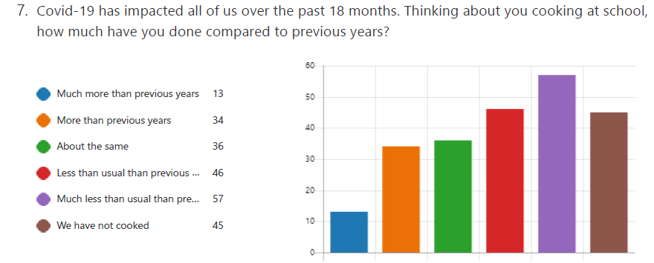
Q 7 The impact of Covid-19
Notes:
Practical lessons over Zoom?
Teachers recording recipe videos and pupils cooking at home
Lessons with key worker children?

Slide 7
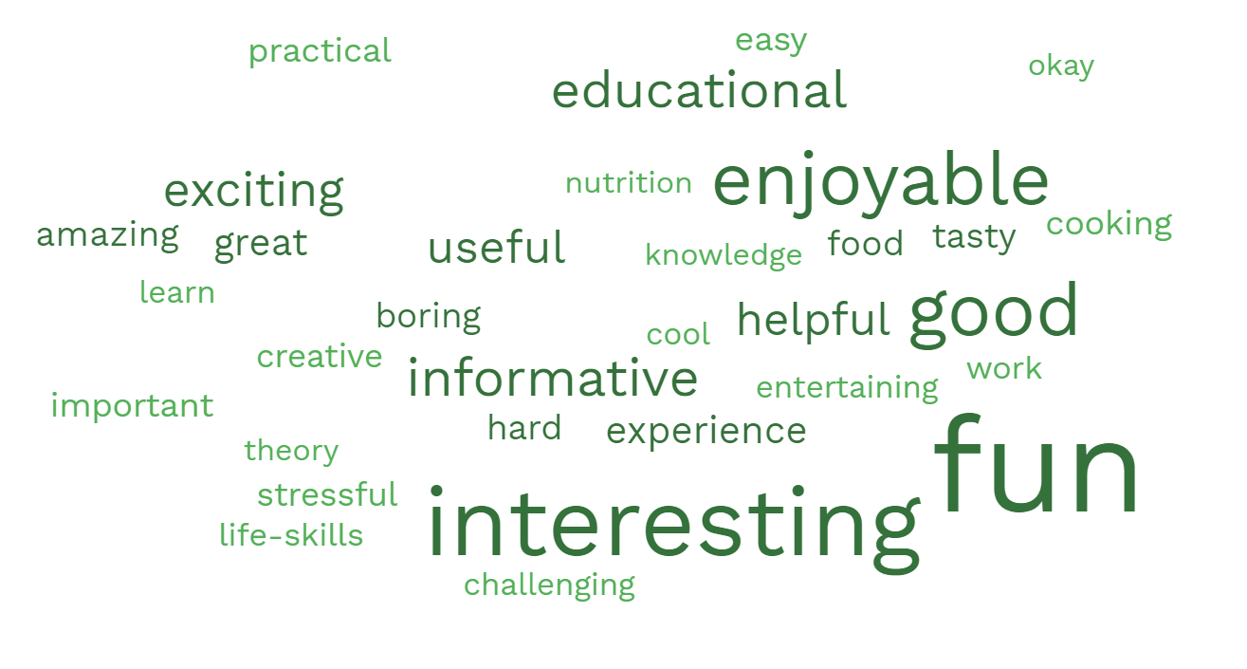
Q8 - Suggest FIVE words that sum-up your food learning experience
Informative, fun, exciting, enjoyable, helpful.
Interesting, essential, practical, enjoyable, informative.
Nutritional, fair, enjoyable, crowded, loud.
Fun 53%!
Notes:
Fun 53.3%
Interesting 36.4%
Educational/Informative 28.6%
Good 23.4%
Useful/Helpful 19.9%
Hard 5.6%

Slide 8
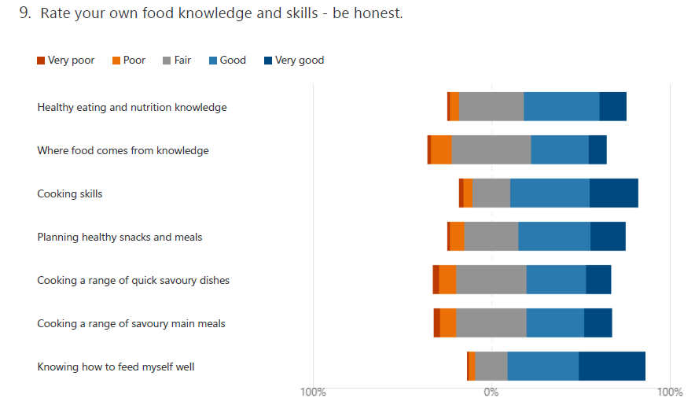
Pupils’ knowledge and skills
Where food comes from – do we need to do more?

Slide 9
Q10 Is there anything you would have liked to be taught?
47% of pupils said no or that they were unsure. Interpretation of this is difficult – it could mean that they are happy with everything they have been taught, or that they had not considered the question. For those that did answer, top themes included additional practical, further baking skills, a wider variety of recipes and more focus on nutrition, food science and provenance.

Slide 10
What have you cooked in school and what would you like to cook in school?
The graph below plots some of the most commonly mentioned types of food. Green indicates where pupils state they have made this type of food and red indicates where they said they would like to make this type of food.
Foods demanded significantly more than they had been made included pasta dishes, Indian dishes, savoury pies, fish and seafood, red meat (steaks), burgers, ice cream and pastry.
Many types of food that were commonly made (e.g. cakes and desserts) were still in high demand – this is often due to the pupils requesting more variety within these categories.

Slide 11
Thinking back, name ONE memorable dish that you cooked at school. What was it? Why was this memorable?
Dishes were memorable to pupils for a variety of reasons.
Enjoying a return to cooking:
“Fajitas, they were the first dish we had cooked post lockdown and it was so nice being able to cook again.”
Trying new things/cultural diversity
“Massaman, because it was Moroccan and I had never made it before.”
Making healthy food and tasty combinations:
“The Mediterranean scones and soup - the soup was full of vegetables which were delicious and the scones contained olives, sundried tomatoes and feta which went so well together.”
Acquiring new skills and feeling pride:
“Cornish pasties – it involved marinating, cooking meat, preparing shortcrust pastry, filling, baking and serving with garnish. The ingredients and skills are still memorable. I would never have believed I could bake tasty and healthy foods when I took my first food lesson.”
Being creative and independent:
“Focaccia. It was memorable as we got to be creative with our designs”
Creating foods suitable for all:
“Focaccia Bread because it was SO yummy and I made it gluten and dairy free for all my family to eat!”
Eating food and engaging with family
“I remember when I made flapjacks, the reason for this is because when I got home I gave some of it to my family to try and they enjoyed it and said it tasted good.”
Generating positive feelings:
“Victoria sponge cake because I've made it with my family and it brought back all the memories I've made with them whilst cooking.”
Being challenged:
“The fishcake was memorable because it was one of the hardest to cook”

Slide 12
Q16 and Q17 – food lessons
For many pupils, what they are asking for reflects a desire for more of what they already value – for example, practical cooking lessons. However, other standout changes include a greater variety of foods available to make (including more culturally diverse dishes), longer lessons in which to cook more complex dishes and a desire for independent choice around the foods and ingredients (a will to take control over their own learning).

Slide 13
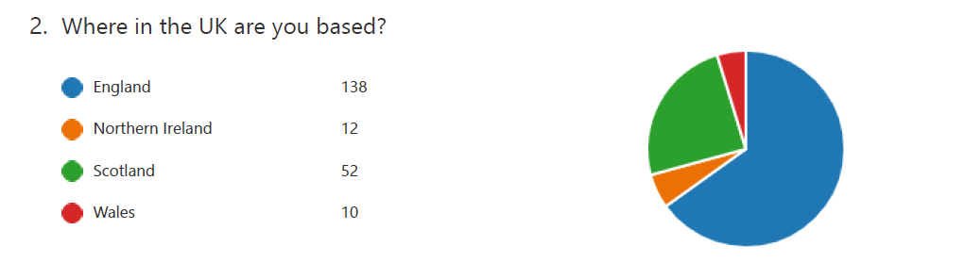
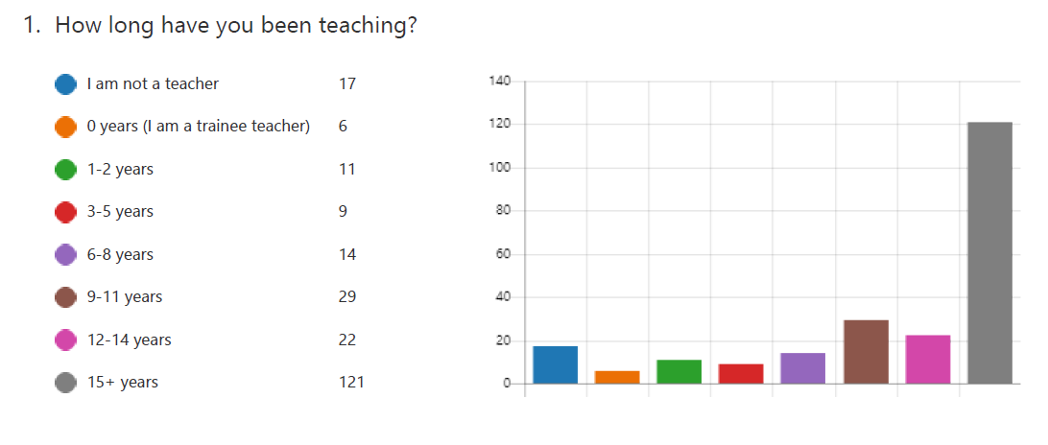
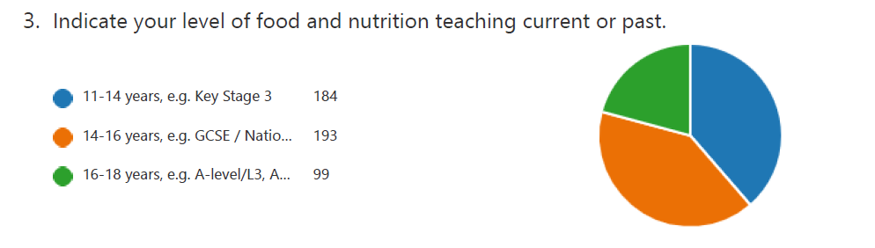
Teacher survey
229 teachers responded
The majority of schools did not have a whole school food policy, which includes food education BUT a significant number of respondents didn’t know ….

Slide 14
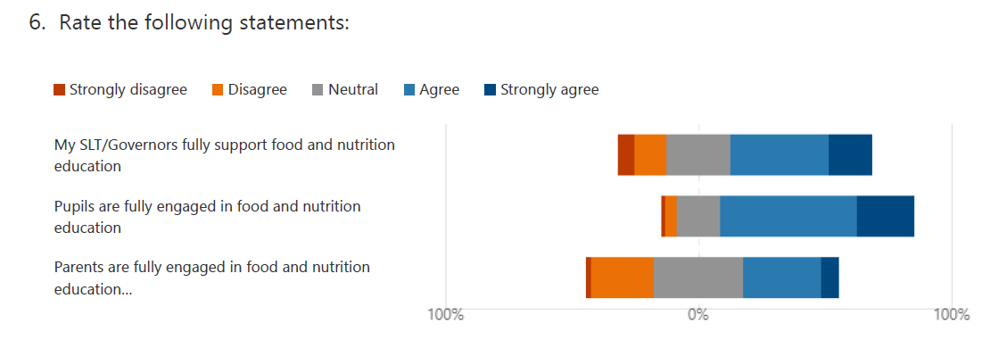
Teachers – liaison, support and engagement
5. The majority of teachers indicated that there was little liaison with other subjects, e.g. RSE/PSHE, health education, PE.

Slide 15
Q11 - If you went to a 'food' lesson in 10 years' time, state FIVE differences you would expect to see
Kitchen technology and equipment:
“More advanced cooking equipment”
“Greater use of video technology for demonstrations to encourage independence”
Sustainability:
“More sustainable ingredients used - probably less meat and dairy and more carbon neutral ingredients”
Food preparation:
“Increased advance level skill preparation”
“Skills being embedded, e.g. making pastry, decorating skills, reflecting the need for catering skills (3rd largest industry!).”
Practical lessons:
“Focus on healthy eating and practical skills rather than food science”
“Emphasis on training for work and jobs / earning potential not health”
Lesson time:
“Longer lesson times to allow for less pressured learning”
Healthy eating:
“Focus on healthy eating and obesity”
“Ensure no food is off limits but instead practise moderation”
Recipes and alternative options:
“More vegetarian and plant-based recipes being used in food preparation”
“Quicker dishes, lower fat dishes, no added sugar dishes, international dishes from regions not seen as frequently today, low cost dishes”
Funding for ingredients:
“Schools providing ingredients paid for by education funding”
Pupil skillset and engagement:
“More students choosing the subject at GCSE for the right reasons, see the link to science and future career prospects.”
“Students still see food lessons as more relaxed/ frivolous than other lessons and see it as an opportunity to just make cakes, this attitude needs to change”
Notes:
How to plan meals on a budget, shopping for food (a lot of people don't know how to do this), longer practical sessions, more healthy meals, pupils have more choice in what they cook.

Slide 16
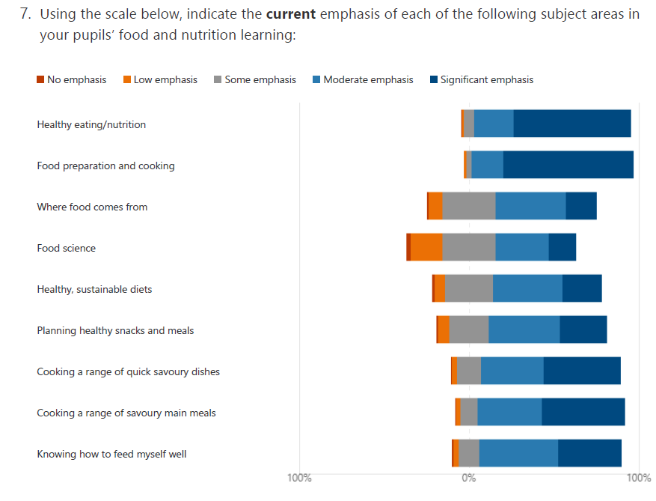

Slide 17
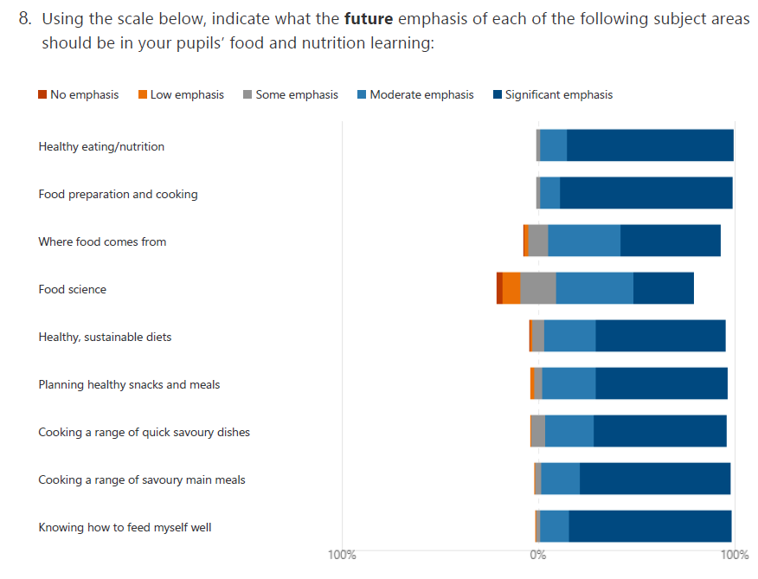

Slide 18
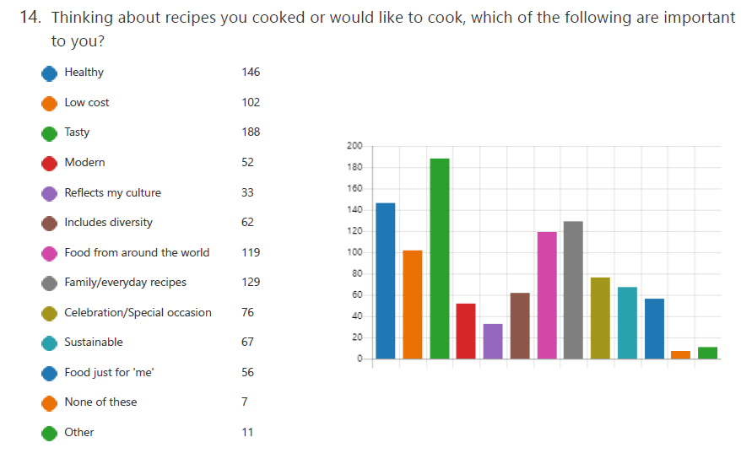
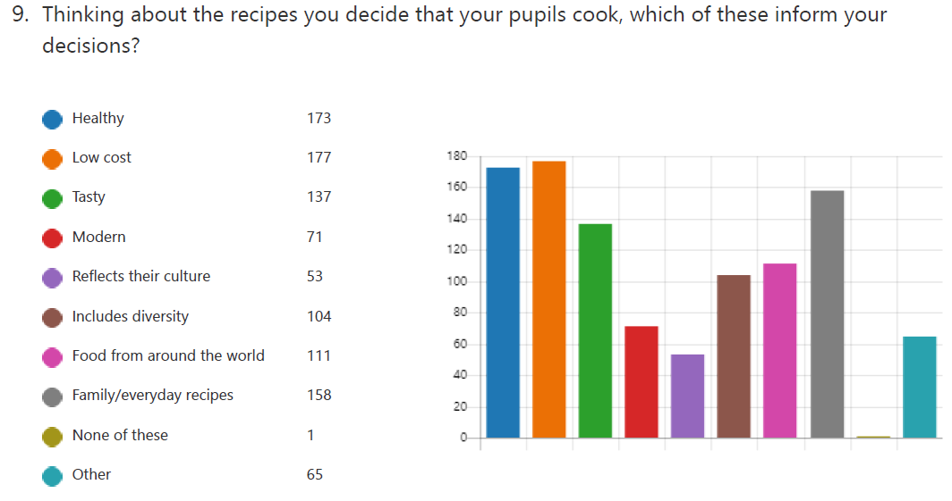
Recipes – what is important?
Pupils
Teachers

Slide 19
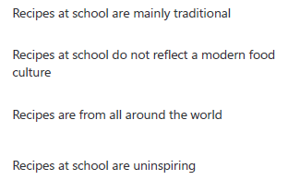
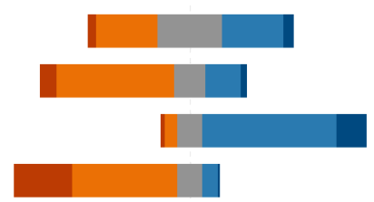
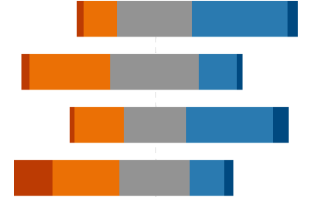
Pupils
Teachers
In the main recipes are mainly traditional, but they also reflect a modern food culture, are from around the world and are inspiring.
Notes:
It’s interesting that teachers currently feel that recipes reflect a modern food culture but in the future teachers expect to see a more diverse range of recipes and options, including more plant-based recipes and culturally diverse recipes.

Slide 20
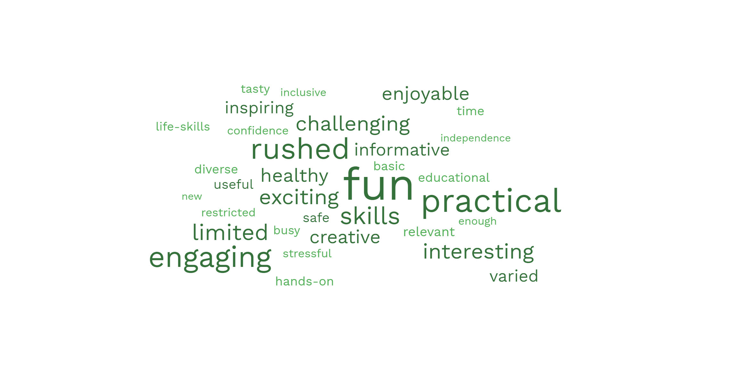
Q14 - Suggest FIVE words that describe your pupils' food learning experience NOW
Same as the pupils
Notes:
Fun 30.7%
Rushed 22.6%
Practical 22.2%
Engaging 19.8%
Skills 18.4%
Educational 15.6%
Challenging 11.8%
More % on excel sheet

Slide 21
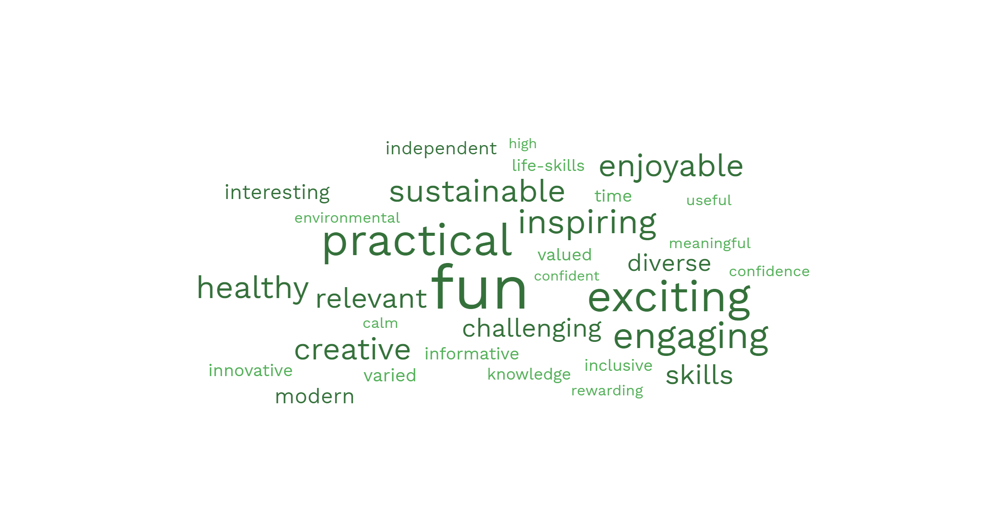
Q15 - Suggest FIVE words that would describe your pupils' food learning experience in the FUTURE
New
Same as now
Notes:
Fun 24.1%
Practical 19.8%
Exciting 17.9%
Creative 17%
Engaging 14.6%
Skills 14.6%
Sustainable 12.7%
Healthy 10.4%
Calm in the future but busy/stressful now
More % on Excel sheet

Slide 22
Q16 - Considering the future, with respect to inclusion, cultural diversity and modernity, what key food skills, knowledge and experiences should be taught?
Notes:
Most common responses related to increasing inclusivity were associated with cultural differences and socioeconomic status. Teachers suggested using different ingredients and recipes from "around the world" to represent different cuisines e.g. Chinese, Indian, and Asian. Linked to this, food provenance/where food comes from was mentioned by some teachers.
Another major focus was on sustainable practises, food choices, and how food consumption impacts the environment. Examples of actions included growing fruit and vegetables, reducing food waste, cooking and eating seasonal and local food, and awareness of your carbon footprint. Many teachers suggested cooking plant-based/vegetarian/vegan meals to improve sustainability and cater for dietary preferences and allergies alongside recipe adaptation e.g. using alternative ingredients.
Cooking skills and food preparation were mentioned including pastry making, bread making, chopping or knife skills, seasoning, cooking from scratch, and batch cooking. Specifically, preparing meals on a budget was often mentioned. Some teachers proposed focusing on food science and nutrition in relation to healthy eating. Safety and hygiene was suggested less often.
Examples:
“Multi cultural recipes, using sustainable ingredients, recipe adaptation, healthy meals on a budget, making food from scratch without using standard components”
“Where food comes from, cultural differences, budgeting and costing, environmental impact”
“All cultures ought to be included. Recipes should be easily adapted for all students to be engaged. Knife skills. Use of small equipment. What constitutes a well balanced, nutritious, affordable dish. Food hygiene. Food provenance.”
“Increased use of food from around the world”
“Food from a range of cultures”

Slide 23
Q17 - In your opinion, what should be kept the same in food lessons in schools?
Pupils – practical lessons were also the top response from pupils, along with not sure and everything!
Notes:
Keeping practical cooking classes was the most common response given by teachers. Related to this, continual development of basic cooking skills, such as knife skills, and preparing meals from scratch were important factors.
Many teachers wanted to continue educating pupils about food science and nutrition with a small selection mentioning Government dietary guidelines including the Eatwell guide.
Practising food safety and hygiene also remained a top priority.
Continuing to incorporate food provenance, the environmental impact of food, and sustainability into teaching was of low priority.
A minority of teachers mentioned keeping class sizes small and ensuring teachers were adequately qualified.
Examples:
“Basic recipes that they can adapt. Good knowledge of ingredients: equipment. Health and safety, hygiene, food safety principles. Skills, understanding cost, portion size, nutrition, where food comes from, environmental issues, organisation skills, time management.”
“Practical cooking skills. Safe storage and preparation. Using ingredients. Budgeting. Eliminating food waste. Food provenance. Sustainable food production.”
“Practical work a priority. Budgeting. Eat well guide. Cultural aspects”

Slide 24
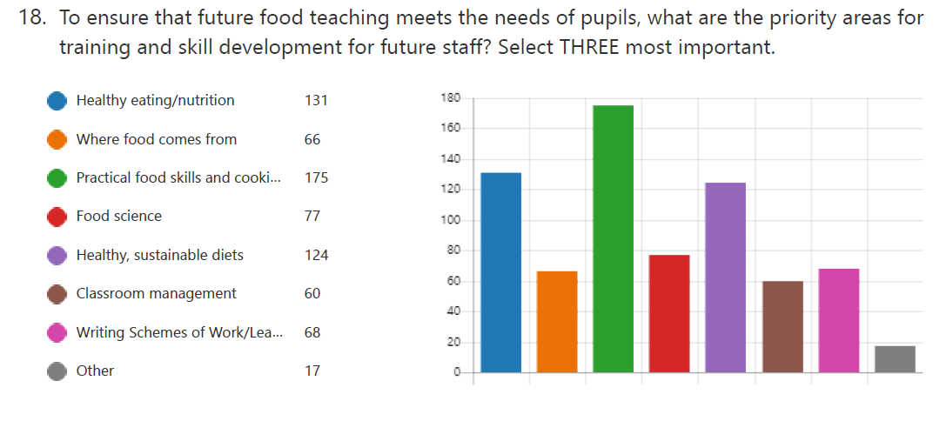
Training and skill development - staff

Slide 25
Q19 - Finally, our goal is for ‘modern food teaching’ for all pupils in secondary schools across the UK, which reflects our changing society, meets the needs of pupils and ensures the future of the subject. What needs to be done to move the subject forward, e.g. pedagogy, facility, subject content, pupil experience?
Teacher training and support:
“The very real shortage of qualified, knowledgeable food teachers is affecting what can be delivered in the classroom and hindering real learning and enjoyment of this subject.
Pedagogy and subject content:
“Changes to curriculum and specifications to meet changes in society and industry”
Funding:
“Investment in rooms and equipment to show the subject is valued”
“Ingredients need to be funded by the government / education dept.”
Whole school approach:
“Whole school approach to food education throughout all key stages”
Pupil experience:
“Enhance the pupil experience with visits and speakers”
Class size and lesson length:
“Smaller class sizes and longer lessons need to be made mandatory”
Importance of food and nutrition:
“Raising profile of this subject to our pupils and SLT particularly curriculum and timetable planners”
Improve facilities and technology:
“Food rooms have to be fit for purpose - preparing and cooking food cannot be taught effectively or safely when facilities and equipment are inadequate”
Notes:
Good Quote:
“The training of well qualified food teachers and the acknowledgement of the importance of this subject on the curriculum needs to be addressed. As a member of SLT and a qualified food teacher who loves her subject - I know first hand the difficulties of recruiting appropriately trained/qualified staff. The very real shortage of qualified, knowledgeable food teachers is affecting what can be delivered in the classroom and hindering real learning and enjoyment of this subject.”

Slide 26
Summary
Key findings - Pupils
229 teachers responded – this potentially represents a large number of schools/classrooms. However, only 213 pupils responded to the pupil survey. This number is smaller than is ideal, as there could be a large number of pupils per classroom, meaning few schools are represented.
Most pupils were younger teenagers, between 13-15 years, with a small number of 16-18 year olds. The majority were from England, with Wales being the least represented area.
Most pupils rated their learning experience as ‘good’ or ‘very good’ and pointed to enjoyable practicals and high-quality teaching as the main reasons for this. Words commonly used to describe their learning experience included: fun, interesting, educational, informative and exciting. When broken down further, more pupils rated ‘where food comes from’ as fair (when compared to nutrition information and cooking). This is reflected in later questions and indicates that at least in some classrooms there could be more focus on provenance.

Slide 27
Summary
Key findings - Pupils
A few pupils scored lower for cooking, this was mainly because of COVID restrictions, that limited opportunities for practical lessons. Over half of pupils said they did less, much less or no cooking at all, due to COVID.
In general, pupils consistently enjoyed and asked for more practical cooking sessions. When asked to rate different skills typically learned from practical cooking sessions, pupils indicated that the areas where some may lack knowledge revolve around food provenance and cooking savoury dishes and main meals. Healthy eating knowledge and basic food skills (e.g. knife skills) were rated more highly.
When asked what pupils would like to be taught in addition to their current materials and lessons, 47% indicated that they either did not require anything additional, or were unsure. Of those that indicated they would like something new, many asked for more practical sessions, a greater focus on baking, a wider variety of recipes and additional nutrition and food science information.
Pupils were asked about foods they typically cooked in schools and those that they would like to cook. Some foods were asked for significantly more than they had been provided. For example, pasta dishes, Indian dishes, savoury pies, seafood, red meat and pastry.

Slide 28
Summary
Key findings - Teachers
When asked whether pupils were engaged in their education, the vast majority of teachers agreed. However, when asked whether parents were fully engaged, a larger proportion disagreed, meaning this may be an important area of focus. Additionally, a small group of teachers felt that they were receiving inadequate support from the SLT in their school, although most did not feel this way.
Teachers were asked what they might expect to see in a food lesson in 10 years time. Answers included: more advanced technology and equipment, an increased focus on sustainable practices, additional funding and support for ingredients and a more diverse range of recipes and options, including more plant-based recipes and culturally diverse recipes.

Slide 29
Summary
Key findings - Teachers
When asked what should remain the same in lessons, teachers largely mentioned practical lessons (in line with pupils desire for additional cooking time), food science education, food preparation and cooking skills and food hygiene and safety.
The top 3 areas that teachers thought were most important to meet the needs of pupils were practical food skills, healthy eating and sustainable diets. Teachers noted the importance of support in their role, whether this be from technicians or from senior leadership within their school. Being able to adopt a whole school approach with support from leadership was considered a key factor in the smooth operation of secondary learning.

Slide 30
Summary
What do pupils and teachers consider most important about a recipe?
Pupils rated taste as the most important aspect of a recipe they cook in school, followed by how healthy it is and whether it is a practical everyday food. They also considered food from around the world to be important for a diverse range of recipes.
Teachers, on the other hand, rated low cost as the most important aspect of a recipe, backing up some concerns around budgets. Teachers also rated whether a recipe is healthy as their second choice – showing an important alignment between themselves and their pupils. Taste was scored highly, but only ranked fourth for teachers.

Slide 31
Next steps
The results will be further analysed.
The pupil survey will remain open. Please encourage your pupils to take part – they don’t need to be currently studying food.

Slide 32
Thank you

