Slide 1
Young people as global citizens through food and nutrition
Suzanne Piscopo
University of Malta
BRITISH NUTRITION FOUNDATION CONFERENCE
What does future, modern food education look like? Have your say.
October 2, 2021

Slide 2
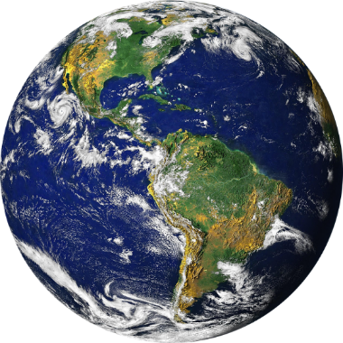
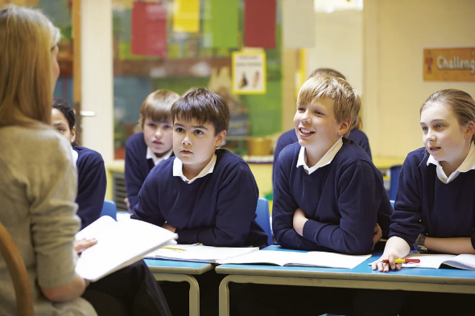
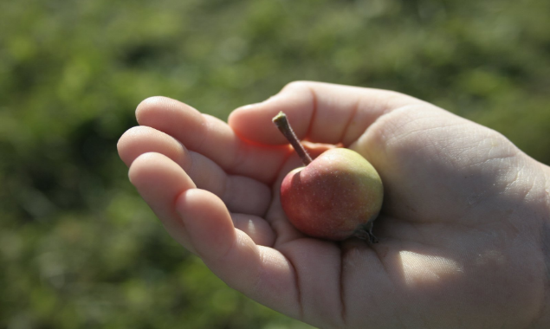
WHY global?
WHY young people?
WHAT and WHY in food and nutrition education?

Slide 3

Adopting a food systems frame of mind
UN Global Food Systems Summit in NY
September 23, 2021
Food systems hold power to ‘realise a vision of a better world’
António Guterres, UN Secretary-General at first UN Food Systems Summit

Slide 4
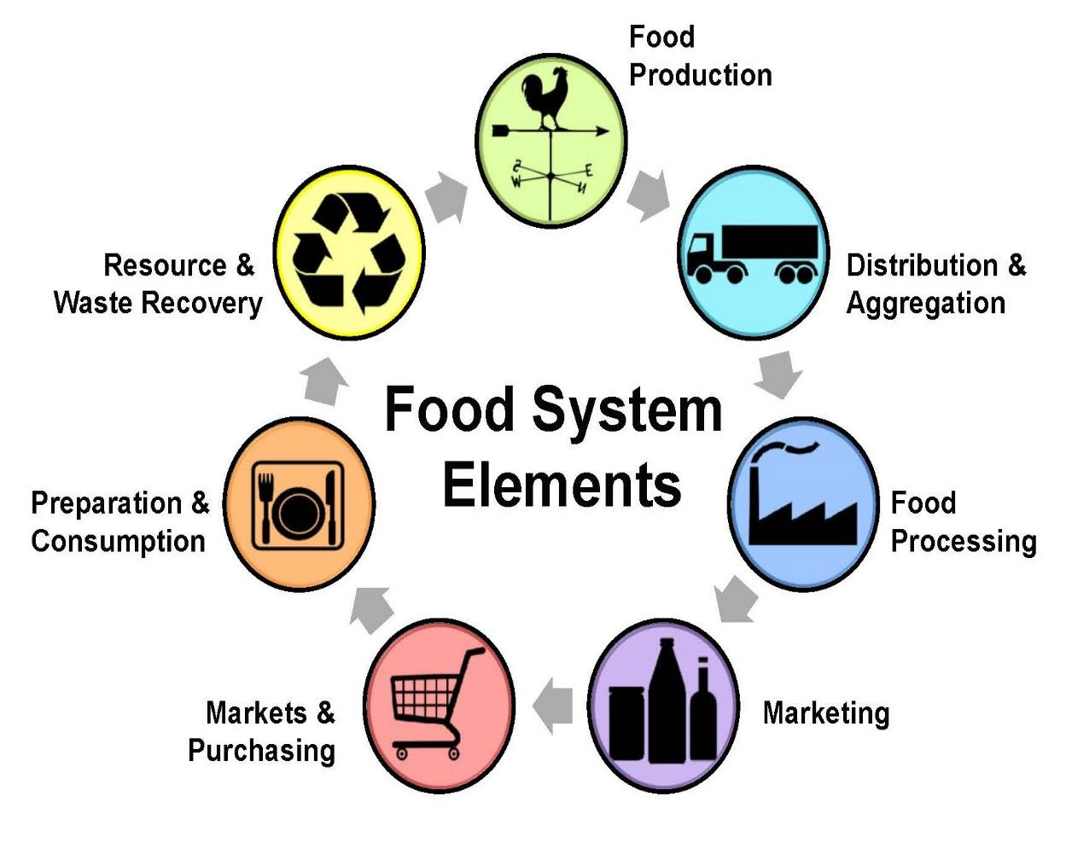
Food systems: More than consumption
Recovering /disposing of food and food packaging
Growing and capturing
Harvesting, storing and transporting
PROCESSES IN THE FOOD SYSTEM
Preparing and consuming
Processing and packaging
Processing
Marketing and distributing
Purchasing
Adapted from Christy Shi, Center for Environmental Farming Systems and from Eames-Sheavly, M.; Hadekel, C.; McGregor Hedstrom, A.; Patchen, A.; Stewart, R.; Wilkins, J. (2011). Discovering Our Food System: Experiential Learning & Action for Youth and Their Communities. Cornel University, Department of Horticulture

Slide 5
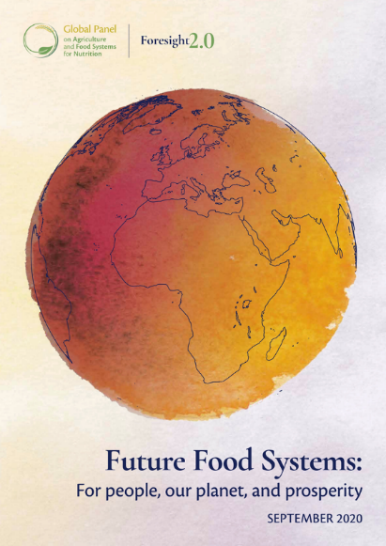
Looking to the future: For people, our planet, and prosperity
FOUR GOALS:
People need to be empowered and encouraged to eat healthy, sustainably produced diets.
Food systems must better support sustainable, healthy diets.
The impacts of food systems on climate, natural resources, and biodiversity must be significantly reduced.
Greater resilience must be built into local and global food systems.
Global Panel on Agriculture and Food Systems for Nutrition. (2020). Foresight 2.0 Report. Future Food Systems: For people, our planet, and prosperity

Slide 6
Looking to the future: Innovations
FOUR CATEGORIES OF INNOVATIONS:
Engaging consumers
Producing sustainably
Getting products to market
Getting organised.
FAO and INRAE. (2020). Enabling sustainable food systems: Innovators’ handbook. Rome. https://doi.org/10.4060/ca9917en

Slide 7
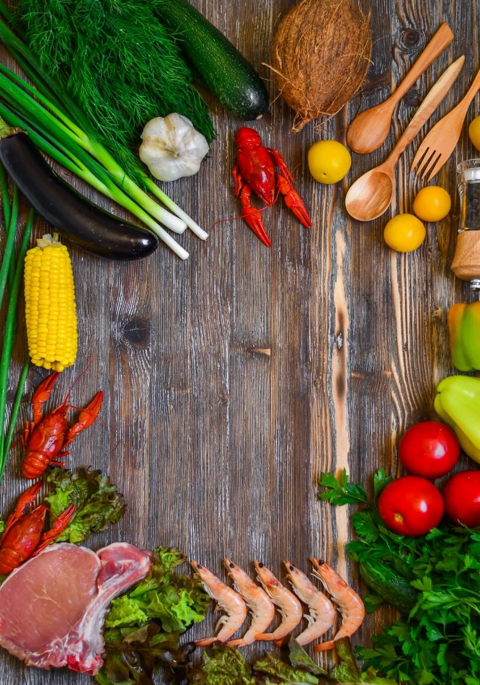

Definition of a healthy diet
A ‘healthy diet’ contains diversity of foods which are safe, and provide levels of energy and key nutrients of all kinds appropriate to age, sex, disease status and physical activity.
The WHO advises people to:
Eat plenty of vegetables, fruit, wholegrains, pulses, nuts and seeds, fish, and some dairy and lean high-quality meats in moderation
Limit intake of processed meats, trans-fats, salt free sugars, sugary snacks and beverages.
Source: : Global Panel. (2020). Foresight 2.0 Report, WHO (2020)
Notes:
Please note, The Global Panel is not promoting or endorsing a single or universal diet for all. It seeks instead to promote policy actions across the entire food system to secure a high-quality diet for everyone.
Slide References:
This report
WHO. Healthy diet [Internet]. 2020 [cited 2020 Apr 29]; Available from: https://www.who.int/news-room/fact-sheets/detail/healthy-diet
While there is no single dietary pattern that delivers ‘good health’ in every society, there is broad agreement on what elements should be included in healthy or high-quality diets They include a diversity of foods which are safe, and provide levels of energy and key nutrients of all kinds appropriate to age, sex, disease status and physical activity (i.e. nutrient-rich). The World Health Organization (WHO) emphasises the importance of starting healthy-eating habits in early life (notably through exclusive breastfeeding). It advises people to eat plenty of fruit, vegetables, wholegrains, pulses, fibre, nuts and seeds, fish, and some dairy and lean high-quality meats in moderation.2 The WHO recommends limiting intake of free sugars, sugary snacks and beverages, processed meats, trans-fats and salt. In this report, the Global Panel is not promoting or endorsing a single or universal diet for all. It seeks instead to promote policy actions across the entire food system to secure a high-quality diet for everyone.

Slide 8
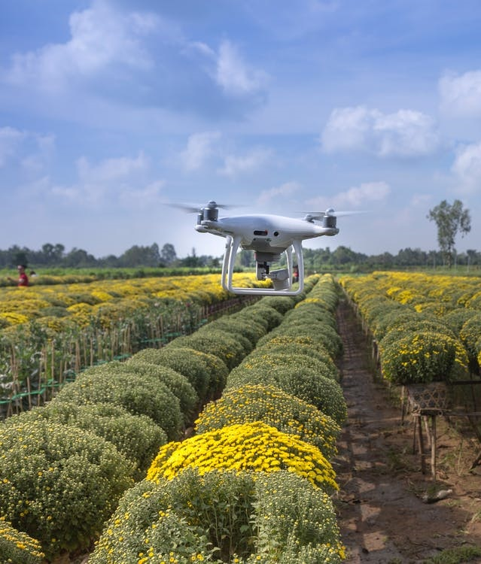
Definition of a Sustainable Food System
The term ‘sustainable food system’ is broadly used if the contribution of a place’s food system (locally produced and imported foods) can be continued without undermining the ability of the natural environment to function in the long term.
The system does not result in:
Biodiversity loss
Soil degradation
Pollution
Climate change
Source: Global Panel. (2020). Foresight 2.0 Report
Notes:
Slide Reference is from this report.
For the purposes of this report, the term ‘sustainable food system’ is broadly used if the contribution of a place’s food system (which delivers locally produced but also imported and marketed foods) can be continued without undermining the ability of the natural environment to function in the long term: that is, the system does not drive biodiversity loss, pollution, soil degradation, or climate change. (For a more detailed and nuanced discussion of ‘sustainability’ in the context of food systems, and how the term is used in this report, see Chapter 3).

Slide 9
What are sustainable, healthy diets?
“Sustainable Healthy Diets are dietary patterns that promote all dimensions of individuals’ health and wellbeing; have low environmental pressure and impact; are accessible, affordable, safe and equitable; and are culturally acceptable.” (p.8)
FAO and WHO. (2019). Sustainable healthy diets – Guiding principles. Rome.

Slide 10
Core Elements of a Transformed Food System
1
2
3
All foods are produced in ways that are sustainable in terms of planetary boundaries
High-quality diets are affordable for everyone
Shifts in dietary patterns are achieved
Ensure nutrient-rich foods are affordable to even the poor
Price distortions towards calorically rich commodities (quantity) to be replaced by nutrient-rich crops (quality)
Food production is consistent with meeting Paris climate goals
Farming is conducted in a way that leaves space for nature, with low impact on land, fresh water, air, or biodiversity
There is a marked shift towards a range of enhanced, culturally relevant choices that favour nutrient-rich foods produced sustainably
Global Panel. (2020). Foresight 2.0 Report

Slide 11
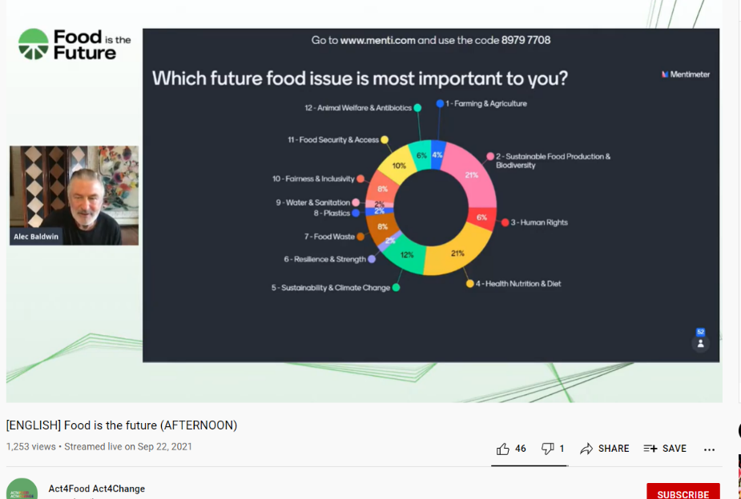
What future food issues are important to young people?
FOOD IS THE FUTURE:
Webinar convened in parallel to the UN Global Food Systems Summit 2021 to hear the voice of youth from around the world
Act4Food Act 4Change
https://youtu.be/F7cceXX3zG8?t=3332

Slide 12
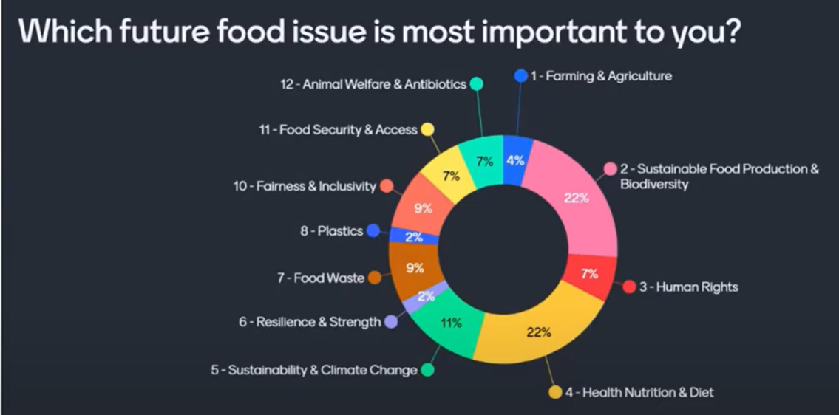
GLOBAL YOUTH
22-9-21

Slide 13
THE TOP 4 THINGS GEN Z WANT FROM THE FOOD SYSTEM:
Better labelling and education
Food labels to have clearer information on the way
food is processed
- For the industry to be more transparent
Clearer advice and information
Where to find credible information on healthy
eating (especially on social media)
Advice on the link between diet and mental health
To be part of the solution
- More support and advice in order to become
active food system changemakers
2,055 adults aged 18-24, UK, France, Germany, Poland and Spain. Online interviews. 30 June – 5 July 2021.
European Institute of Innovation and Technology. (2021). Our food, our food system. What Generation Z wants from a healthy food system

Slide 14

Nurturing informed, responsible, active young people
How shall we enthuse young people to become or to grow as protagonists in transforming the food system to facilitate healthy, sustainable diets?

Slide 15
School-based food and nutrition education (SFNE)
“…the need for a more holistic vision and model for SFNE. The focus needs to go beyond improving individual diets, to acknowledging and addressing many other dimensions of food as integral to human well-being and planetary health.” (p.29)
FAO. (2020). School-based food and nutrition education – A white paper on the current state, principles, challenges and
recommendations for low- and middle-income countries. Rome. https://doi.org/10.4060/cb2064en

Slide 16
SFNE for sustainable development
OUTLOOK:
A transformative vision for SFNE
APPROACH:
Competence based integrated curricula
GOAL:
To produce population groups capable of taking charge of their diet – both for their own health and for the health of others, and of the environment (now and in the future)
FAO. (2020). SFNE White paper, p.15

Slide 17
SFNE promoting global citizens: FOOD SYSTEMS
Students are responsible actors as consumers, producers, processors and policy makers who understand the evolving relationships between food supply and demand, apply critical thinking and are empowered to enact positive changes in their own food system/environment. (FAO, 2020, SFNE White paper)
Biodiversity
Animal welfare
Regenerative agriculture
Sustainable fisheries
Water conservation
Food waste
Climate change
Circular economy

Slide 18
SFNE promoting global citizens SOCIAL JUSTICE
The future generation challenges social disparities and promotes fair and respectful treatment of all those involved in food production, preparation and consumption processes. (FAO, 2020, SFNE White paper)
Food security
Fair compensation to food producers
Quality of life improvement in producers’ communities
Land rights issues
Gender issues and women as food producers
North vs South issues in food supply
Conserving indigenous knowledge and foodways
Advocacy and contribution to democratic policymaking processes

Slide 19
SFNE promoting global citizens FOOD APPRECIATION
Children and their families are invested in, curious about and enjoy daily food-related activities. (FAO, 2020, SFNE White paper)
Food sources
Natural/raw vs ultra-processed food
Connecting with / getting to know the producers of their food
Food from different cultures
Tasting new food
Trying different cooking methods
The therapeutic effect of food/cooking
Credible sources of food/nutrition info
Food labelling
Food choice impact

Slide 20
SFNE promoting global citizens PEDAGOGIES
Action-oriented learning outcomes
Ownership of the programme
Need-based, context-based learning
Experience-based and real-life practice
Observation and discussion
Purposeful interactions with food environments
Involvement of all influential actors
ACTIVE LEARNING for a DIVERSITY OF SKILLS
Adapted from: FAO, 2020, SFNE White paper

Slide 21
SFNE promoting global citizens EMPLOY INNOVATION & CREATIVITY
School and communal kitchen gardens
School and communal cooking classes/demos
Shopping for food together
Cooking for others
Sharing excess food within the community
Preventing food waste through different activities
Bidirectional intergenerational learning
Adapted from: FAO, 2020, SFNE White paper

Slide 22
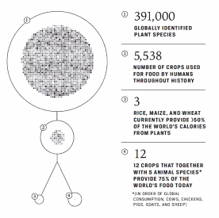
Khoury CK, Bjorkman AD, Dempewolf H, Ramírez-Villegas J, Guarino L, Jarvis A, Rieseberg LH and Struik PC (2014). Increasing homogeneity in global food supplies and the implications for food security. PNAS 111(11): 4001-4006. doi: 10.1073/pnas.1313490111.
SFNE promoting global citizens THE FACTS!!

Slide 23
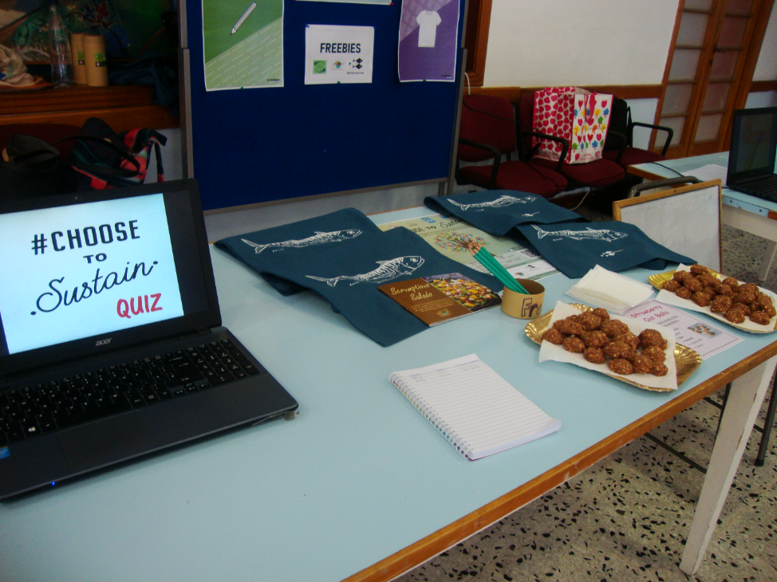
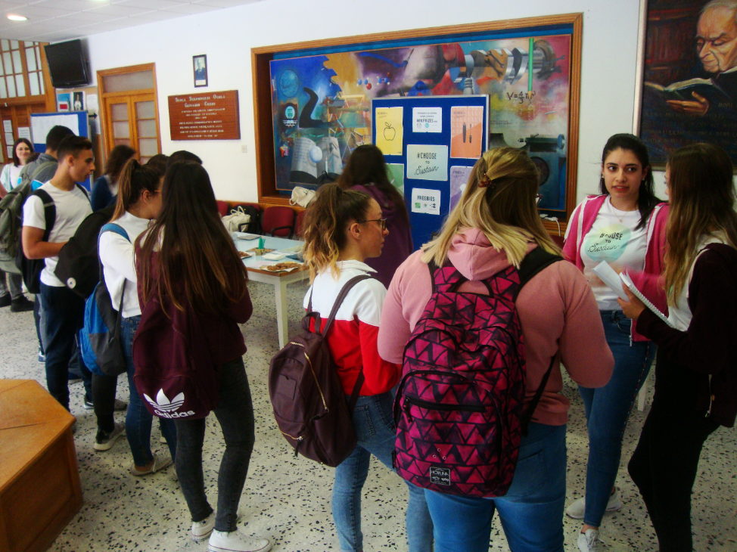
Choose to sustain campaign by youth for peers (Malta)

Slide 24
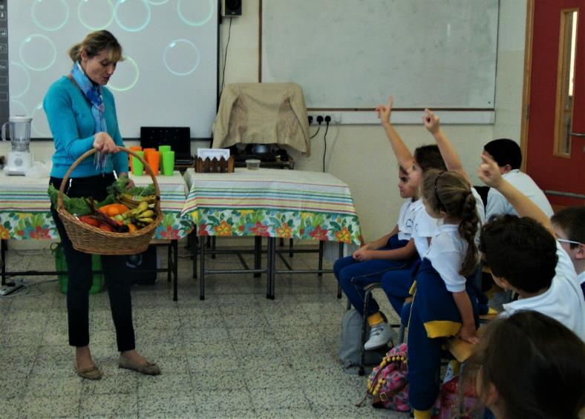
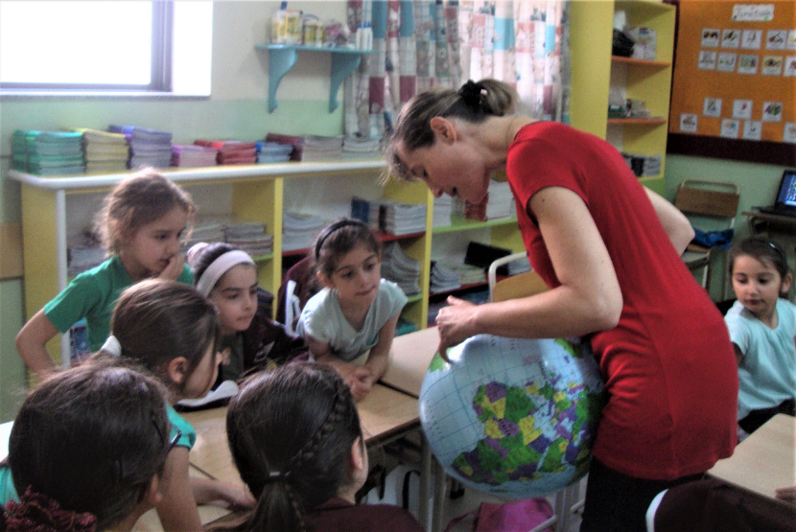
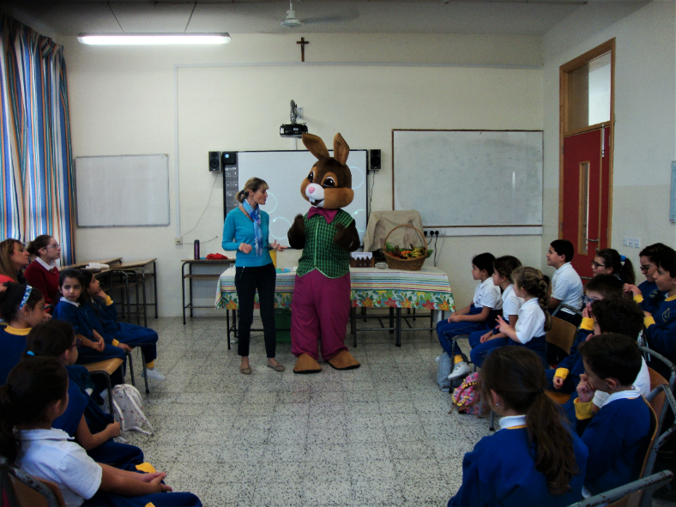
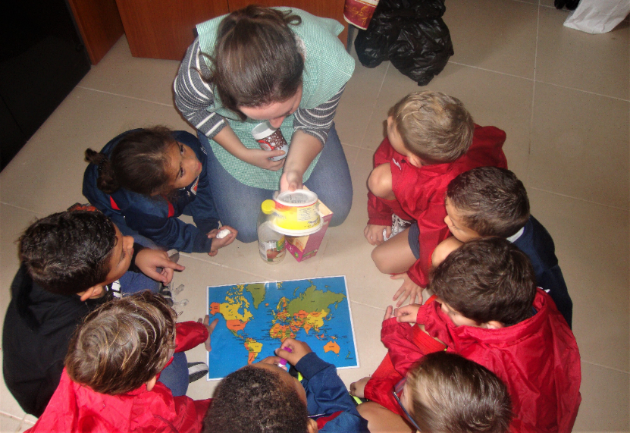
Seasonal food
Local food vs imported foods
Food miles
(Malta)

Slide 25
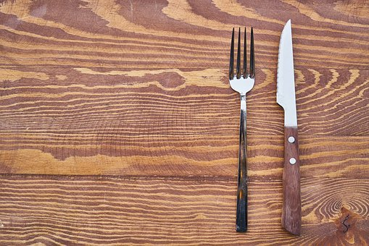
“A locally available least-cost healthy diet based on today’s prices and patterns of consumption is already unaffordable for an estimated three billion people around the world.” (p.120)
Global Panel. (2020). Foresight 2.0 report
Notes:
Quote from this report

Slide 26
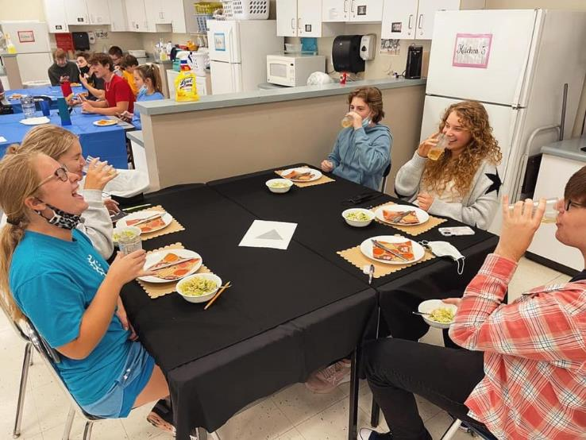
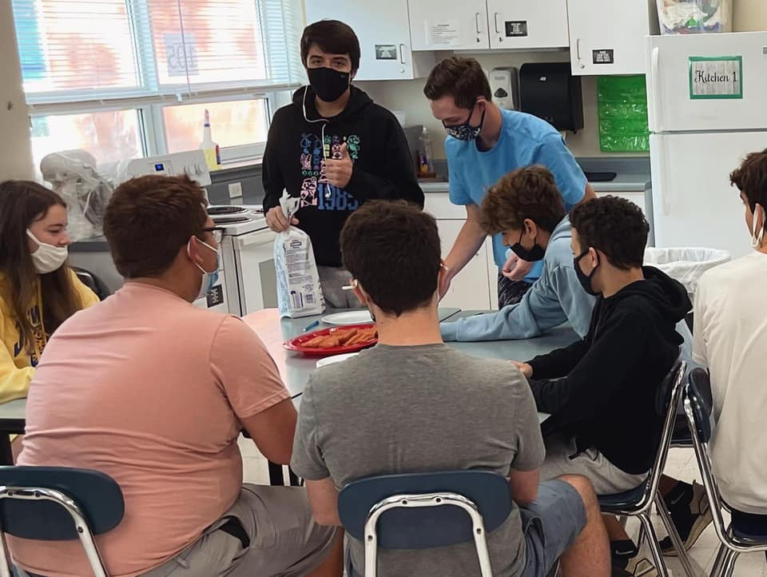
Hunger banquet
Family and Consumer Sciences Teachers FB group post by Marissa Tate
28 September 2021
In my World Foods classes we had a hunger banquet! Students were randomly chosen to be a part of the rich class, the middle class, or the poor class. I gave out tickets to this banquet, and according to the shape that was on their ticket that is where they were supposed to sit. in where they were sitting. The rich class had a table with linen tablecloths and it was all set up real fancy. Students quickly learned that there were some disparities. The middle class had plastic tablecloths and plastic utensils, while the poor had nothing. Originally I planned to have them sit on the floor, but I didn’t want to make them do that. We then started to talk about what classes they were a part of and moved onto the food portion of the lesson.￼The rich class experienced being waited on hand and foot while eating an appetizer, entree, and a dessert! The middle class had to come up to the stove to be served their spaghetti and bread stick. The poor class were given hot dogs with white bread to use as their bun.
This lesson helped shine the light on struggles that hungry people deal with every day. We learned that we are so lucky to have an opportunity to do an exercise like this, and that we do not live everyday in poverty and famine. ￼￼￼￼￼￼
The students really liked this and they were very engaged in it! It was exciting to see how they reacted when everyone got their food. They saw how unfair it was and I could tell it started to register in their minds.
We. Are. So. Blessed!

Slide 27
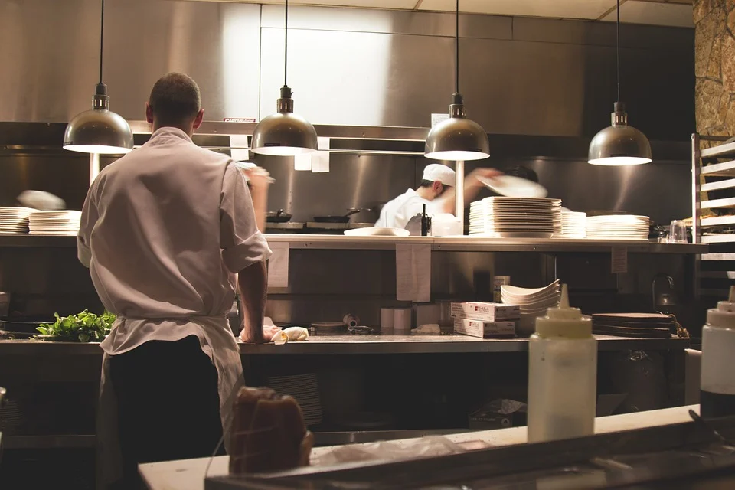
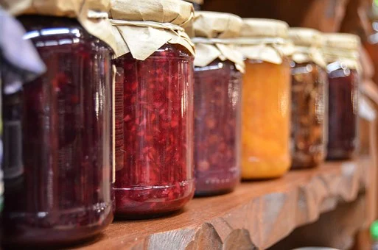
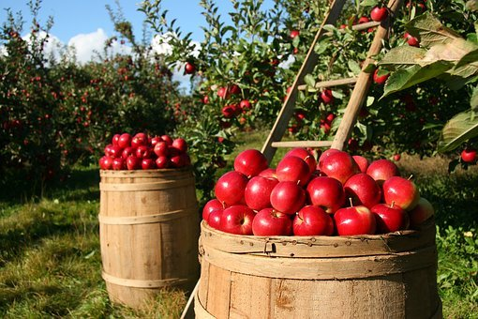
The food sector is the
world’s largest employer, with more than 2 billion people
working in it!
ILOSTAT (2019)
Notes:
Slide Reference: ILOSTAT. Employment by sector. January 2019. 2019.

Slide 28

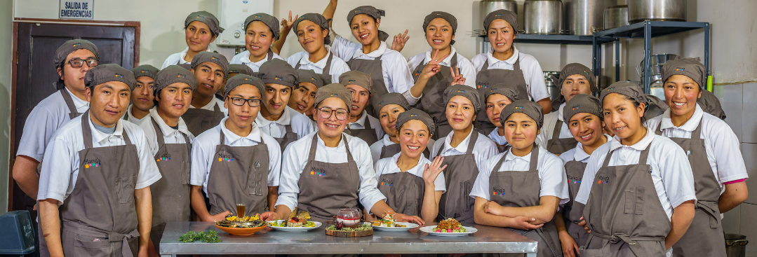
Source: manqa.org
Initiative that empowers at-risk youth through food education in culinary schools and cafeterias.
Seeks to generate life opportunities by training young, low-income Bolivian youths as chefs and culinary entrepreneurs.
Aims to inspire revaluation of local production and promote healthy consumption of food through their trained chefs and through programme graduates who establish successful businesses which bring sustainable income and offer food sourced/produced sustainably.

Slide 29




How the Global Goals are addressed at Manq'a schools
Zero Hunger
Teach the basics of essential nutrition Cafeterias offer affordable food to local communities
Quality Education
Train youth who have limited access to technical skills training.
Decent Work and Economic Growth
Provide the tools for building food start-ups
Support local farmers
Sustainable Consumption and Production
Use only organic and local products, helping to reduce both the freshwater pollution associated with pesticides and the CO2 emissions from long-distance transportation.

Slide 30

Nurturing young people to be global citizens via food and nutrition VALUES ARE KEY!
What do we want young people to give importance to?
What do we want them to care about?
What attitudes and competences can we help them acquire to achieve this through food and nutrition education?
As educators we should work to build on the momentum and change any indifference to action

Slide 31
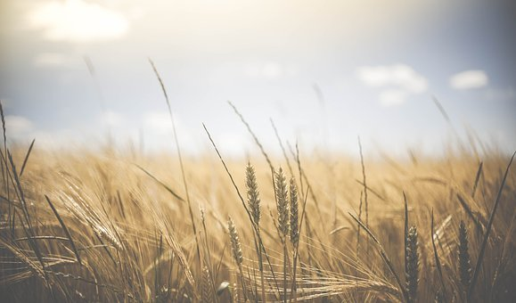
NURTURING YOUNG PEOPLE TO BE GLOBAL CITIZENS VIA FOOD AND NUTRITION
“How awesome is it that we get the opportunity to teach the next generation about something so important!?”
Australian teacher

