Slide 1
Oct 2021
‘Cover picture overlay’ layouts can be used as text only
To add a background picture see next slide. Only recommended for people comfortable with using PowerPoint
Future Fayre – BNF Webinar
David Mulcahy
Food Innovation & Sustainability Director
Sodexo UK, Schools & Universities

Slide 2
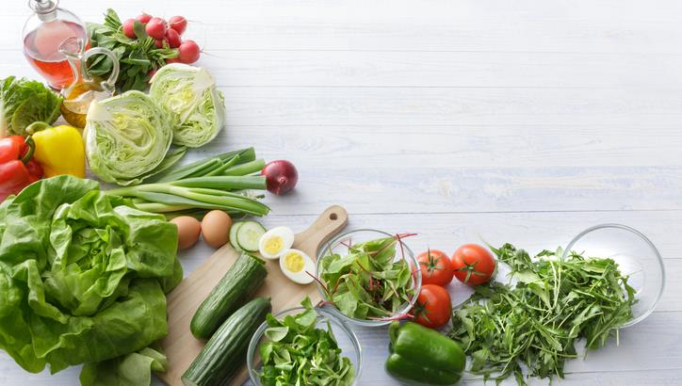
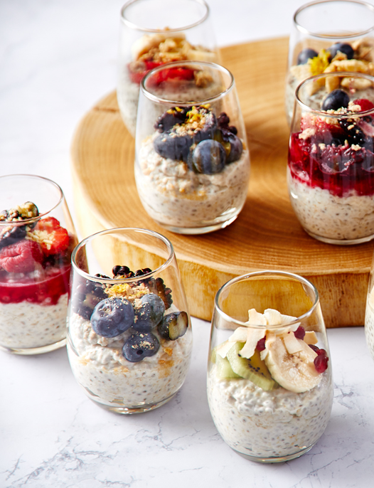
Future Fayre
Creating recipes and dishes to reflect the needs,
experiences and expectations of society
Notes:
Society
Pupils, families, communities and employers

Slide 3
The Times they are a changing’ ………
This pandemic has forced change in unimaginable ways
Personally, professionally and across every part of society
Our ability to adapt, overcome and innovate has been incredible
Technology has moved at breakneck speed as we embrace new ways of working, thinking and responding to our changing world
As a ‘new norm’ settles, we will not return to our old ways
In terms of health & wellbeing our chances of fighting future pandemics are supported by focusing on a sustained healthy eating journey. For our sakes and that of our children.
It’s all about Teamwork…..

Slide 4
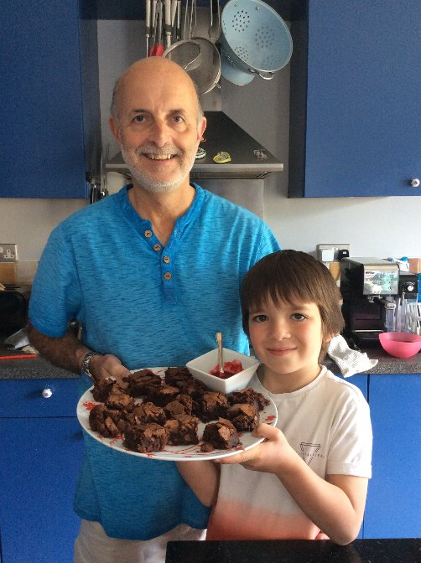

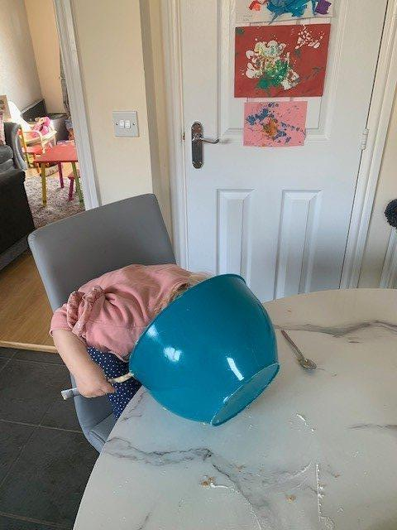

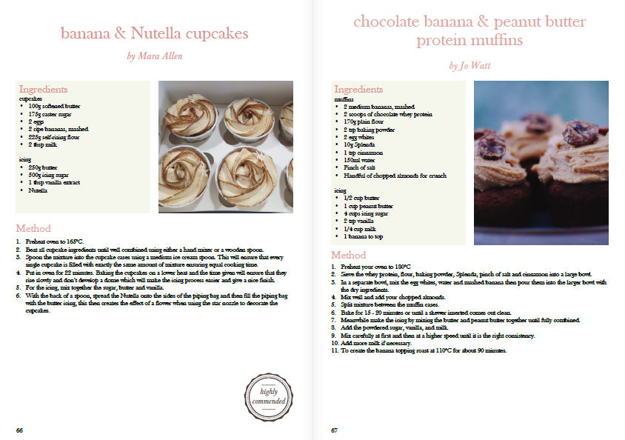
Getting Stuck in…….
The Great Sodexo Bakeoff
Lockdown 2020
Notes:
As an example of this teamwork beginning at home -
Past year – Teamwork started with ensuring we were engaging with our teams
Working on front line / working from home / furloughed / anxious and uncertain

Slide 5
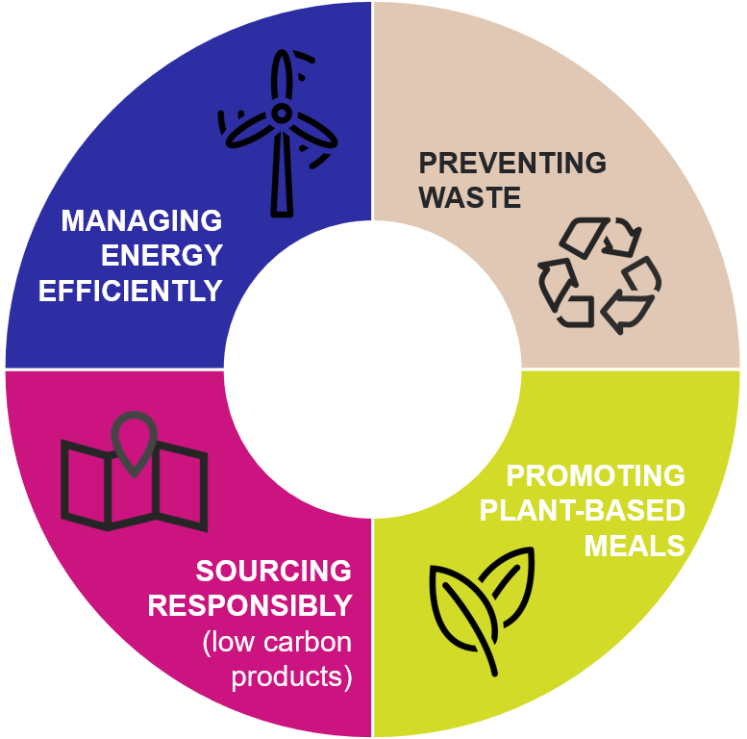



Focus for 2021 and beyond
Preventing Food Waste
Promoting Plant-based Meals
Sourcing Responsibly
Providing innovative energy management solutions
100% of our employees trained on sustainability practices
100% of our customers offered healthy lifestyle options everyday
£200m of our business value to benefit SMEs
34% reduction of carbon emissions
50% food waste reduction by 2030
Social Value Strategy Launched
Notes:
Meanwhile our focus continued to be around ..….
Preventing food waste, promoting plant-based meals, championing responsible sourcing (local, seasonal) and managing energy efficiently.
Supporting the Paris Agreement particularly in reducing food waste/ carbon emissions – and forthcoming COP26
To achieve this we are partnering with a number of organisations including The World Wildlife Fund, The World Resources Institute, Food for Climate League & The Humane Society.
In addition we have reviewed and relaunched our Social Value Strategy to reflect our commitments and focus. (see next slide)

Slide 6
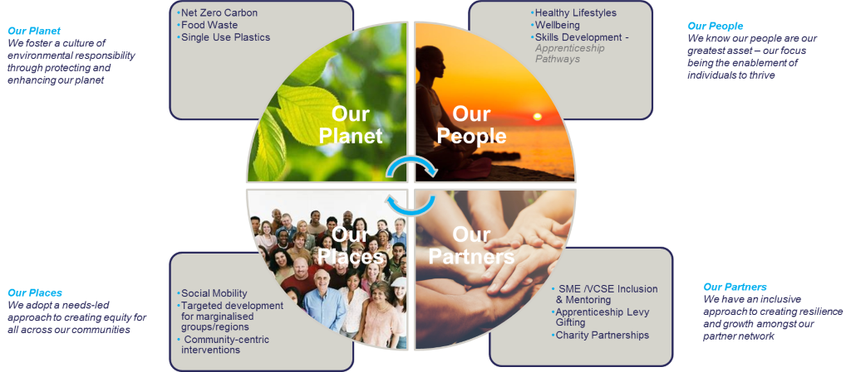
Sodexo social value impact pathways
+ Good
Work
Required Framework
Our Products & Services
Notes:
Our Social Strategy – Its about how we do business and how we make a difference
4 Pillars of SV Strategy (quick mention of each)

Slide 7



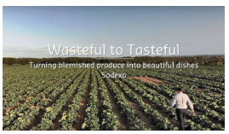

Tackling Food Waste – Supporting Growers Educating students
Notes:
Linking Sustainability to Sustainable Eating – bring to life through using recipes and dishes that reflect eg FoodWaste, buying seasonally and locally.

Slide 8
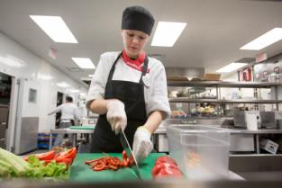
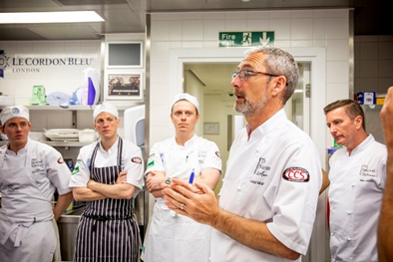

Collaborate for Success
Teaching food skills in the classroom:
Working with caterers and food teams to bring added value to classes
Meet the producer, grower
Guest chef talks – A day in the life of……
Support with designing lessons – Healthy eating dishes
Linking to environmental considerations – Where Food Comes From!
Sustainable eating, reducing carbon footprint
Core skills – explore online options
Career Opportunities through Apprenticeships and professional development
Notes:
Consider some of the resources available to you via onsite catering or local chef community
Chefs love coming into talk to young people
Chefs also generally happy to advise with ideas for recipes and dishes that work well for young people.
Linking environmental messaging to eating - sustainable eating
Some great resources available to support learning plans

Slide 9

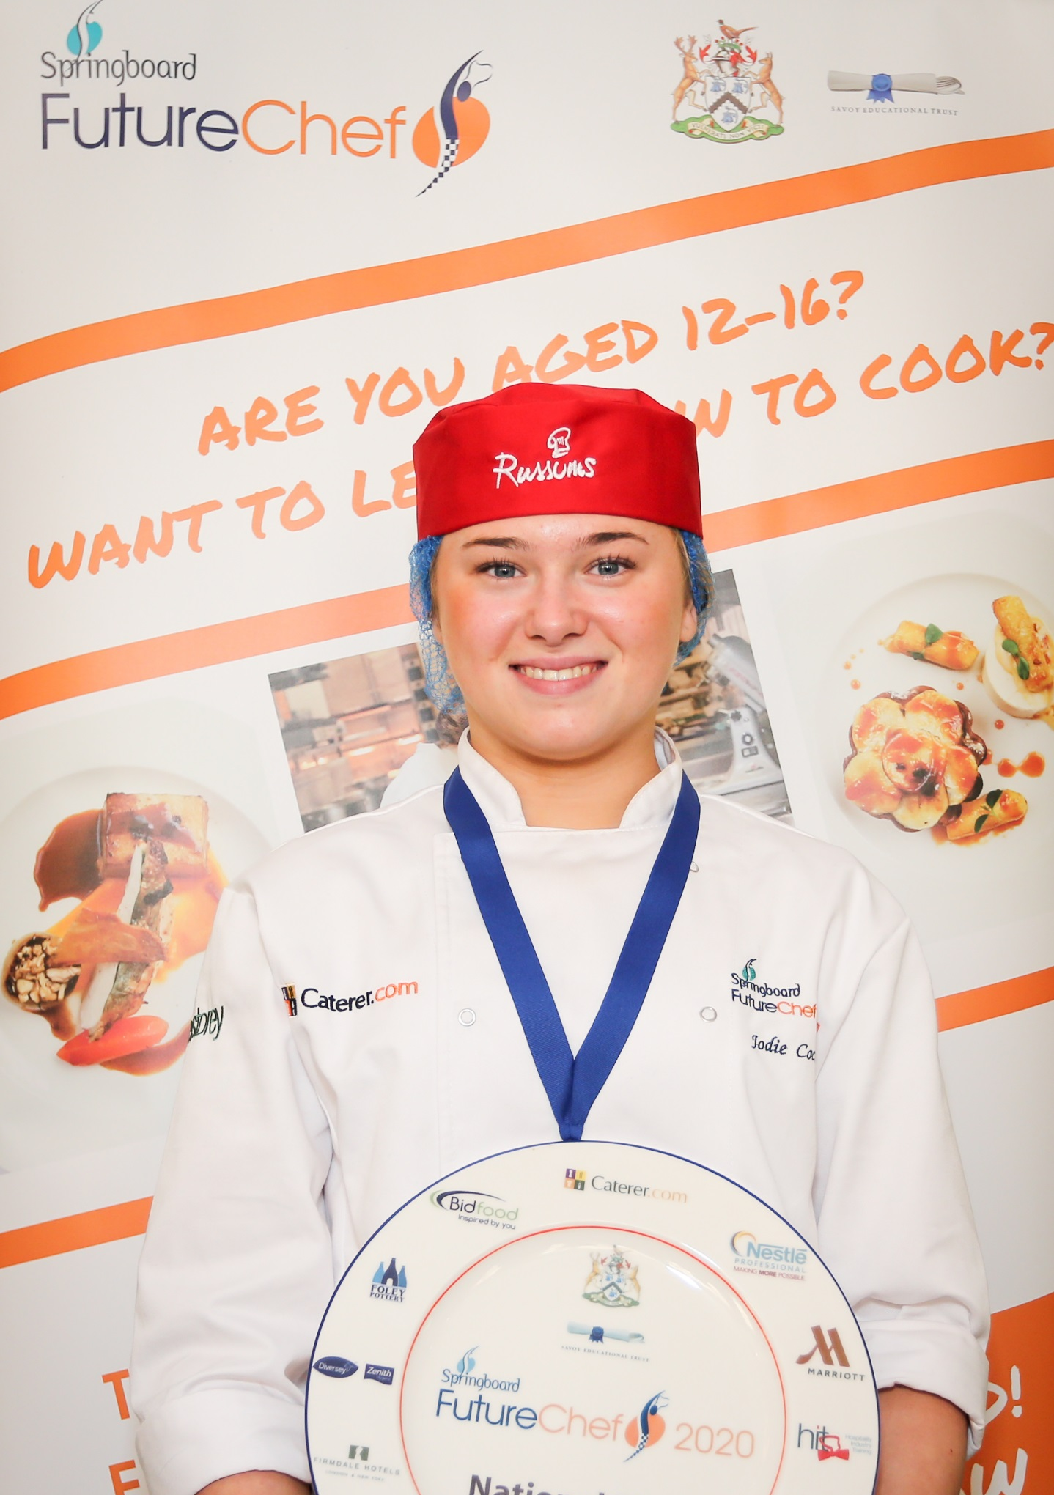
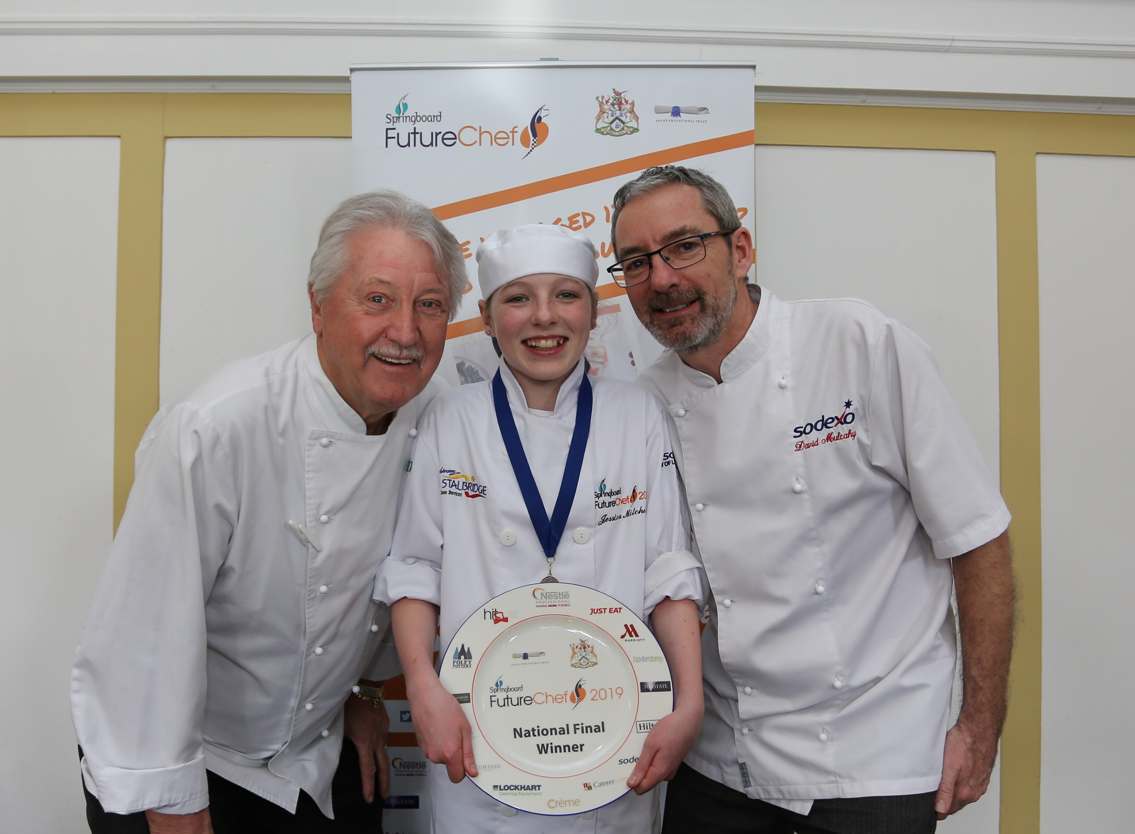
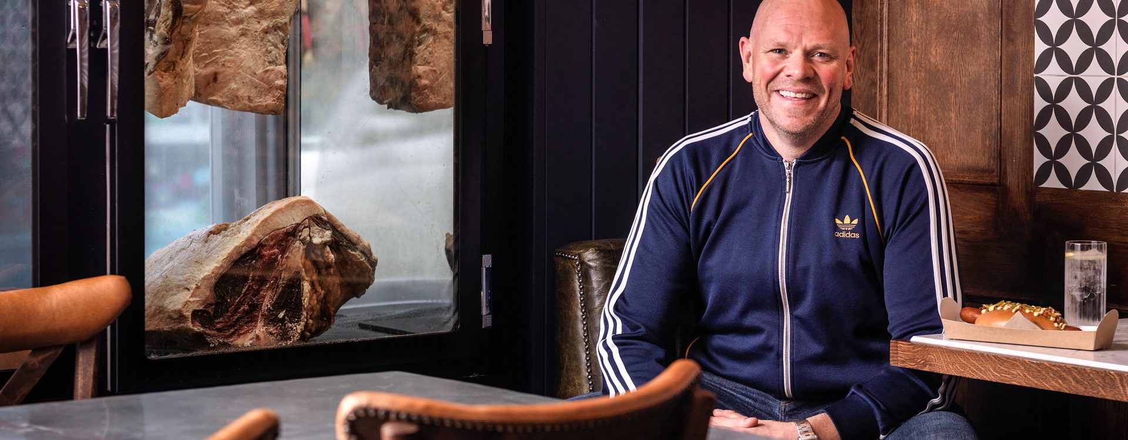
An exciting, engaging gateway to life skills and career paths
Notes:
FutureChef – criteria for competition element evolving to reflect modern trends
Will continue to evolve to include more plant based and alternative underutilised ingredients
Nationally recognised
Fantastic online resources for teachers and students
Inclusive and open to all schools

Slide 10
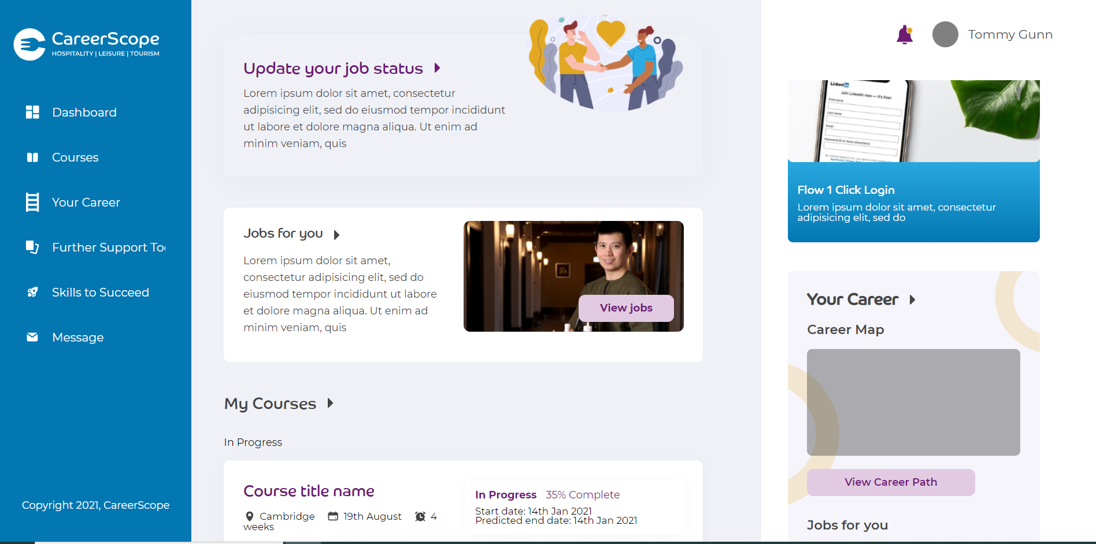
Careerscope Profile
Example of young persons profile that will be created during Culinary Careers Pathway Session – Allowing promotion of opportunities such as apprenticeships and job opportunities and to track students journey from FutureChef into into employment / Education
Notes:
This is a key opportunity – allows students to access vacancies, apply for apprenticeships and engage

Slide 11


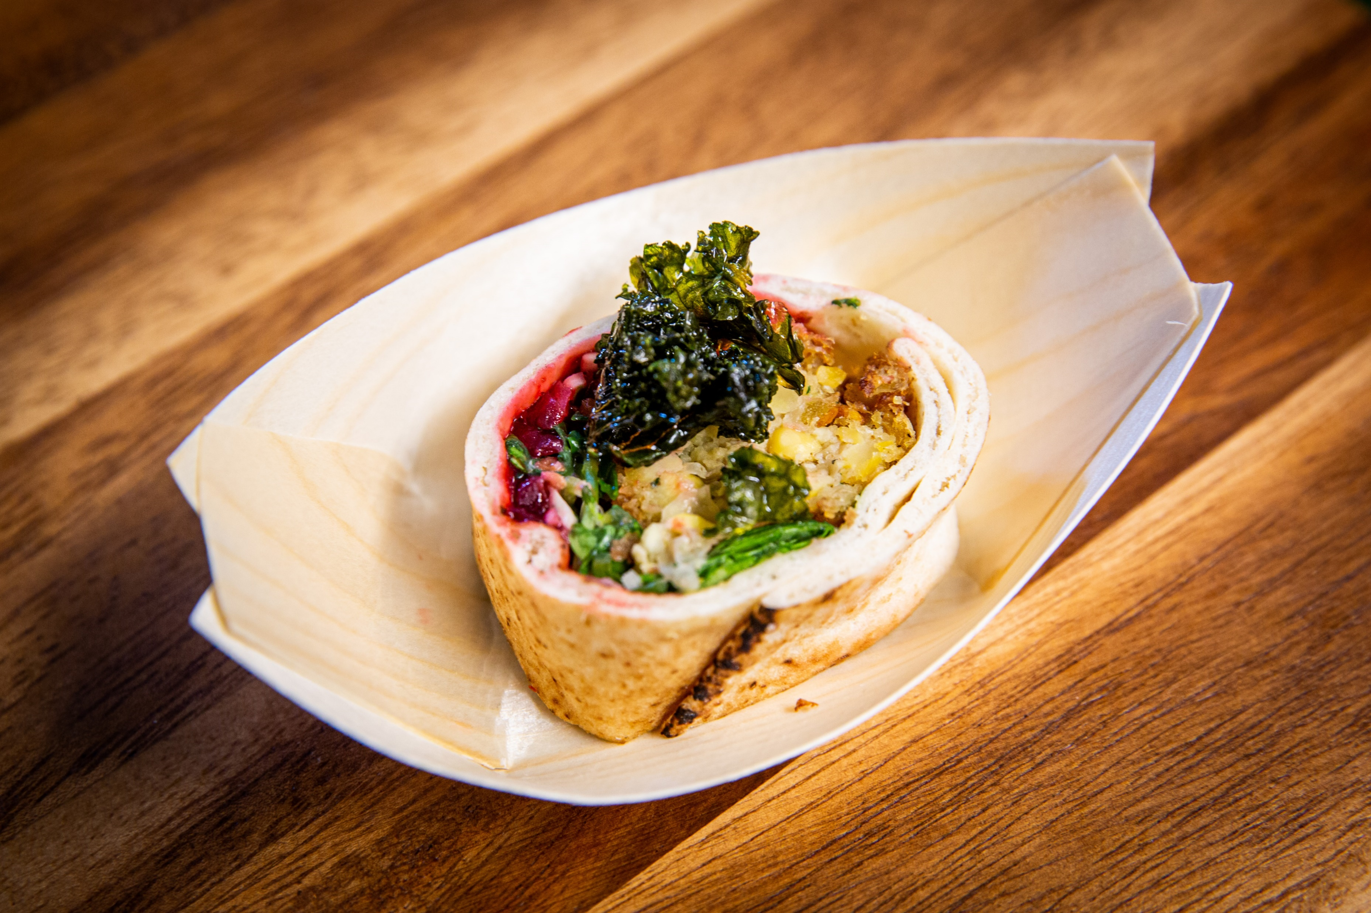

  Example of Initiatives linking experts with a whole school approach –
  Teacher tool kits for the classroom to dishes in the refectories
  Delicious, nutritious, plant-based dishes, students will have the opportunity to learn about the link between the food we eat and climate change.
Notes:
An example of the kind of initiative focusing on amazing plant based dishes that are delicious and good for the planet.
Never before has a generation been more engaged in climate change, and food is at the heart of many environmental issues.

Slide 12
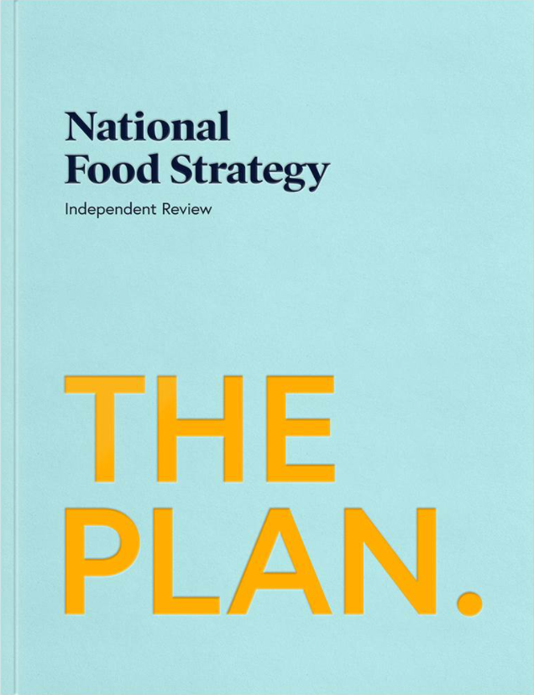
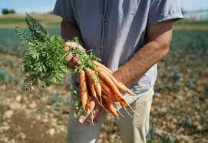
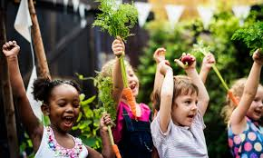
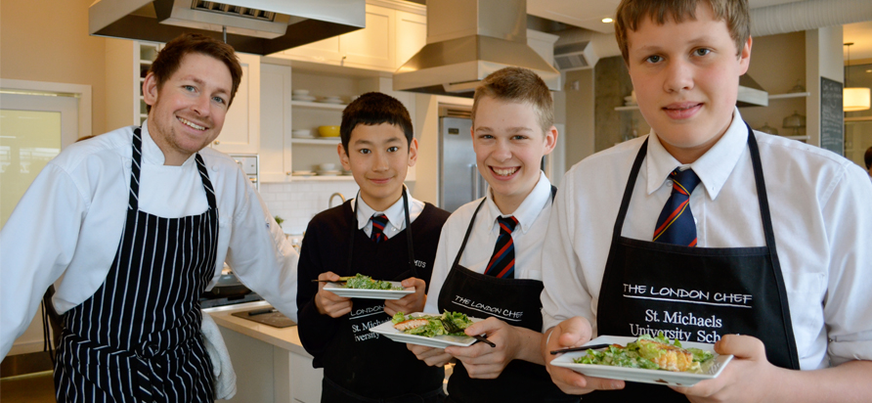
The Dimbleby report is a wake-up call to this country and government to do something about our food system and the epidemic of obesity and ill health destroying our country. We eat more ultra-processed unhealthy food than any other European country and it is getting relatively cheaper and more deadly each year.”
Notes:
It is encouraging that there is a plan in place.
We must now work towards embracing this plan, shaping it to support our goals towards a healthier nation and lobbying where necessary to influence change.
Change in policy, in thinking and in valuing our food and our consumers differently.

Slide 13
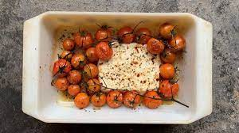

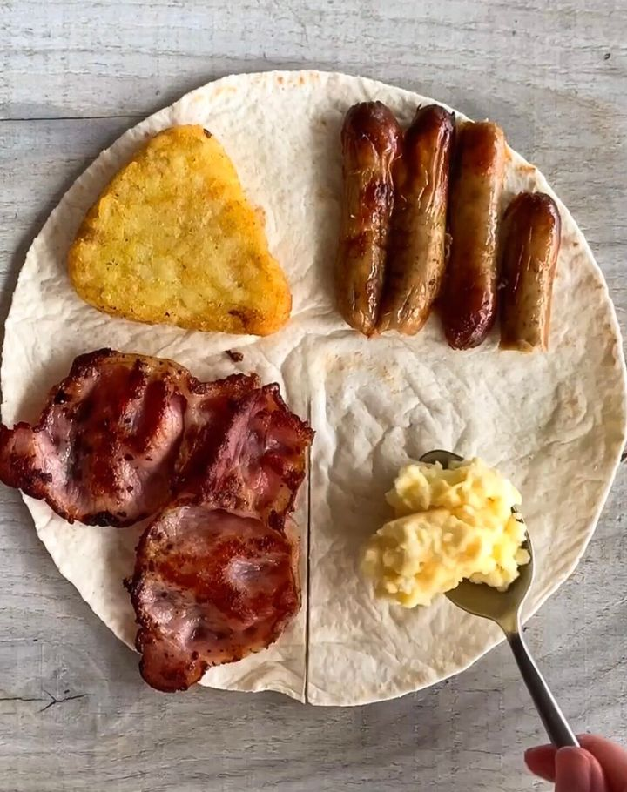
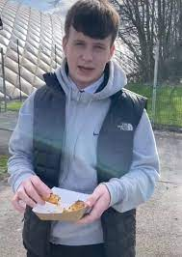
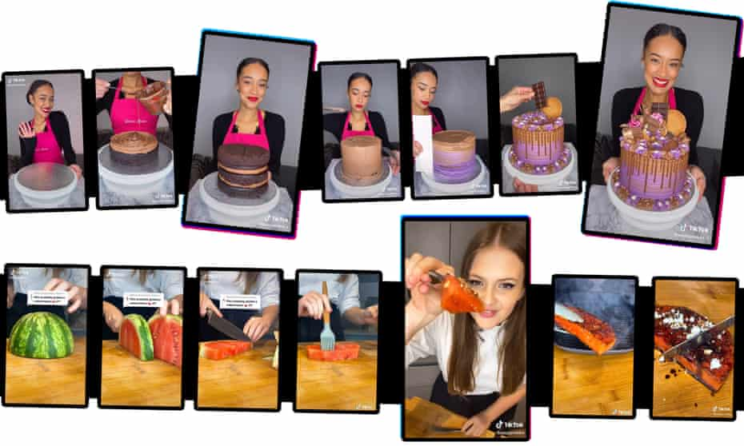
Time to join the Tik Tok Bandwagon?
Easy baked feta pasta – 4.4bn views
The Tortilla Craze 4.4bn views
@poppycooks 1.5M followers
Ollie Ball 1M+ followers
Notes:
The Power of Influencers
Poppy o Toole @poppycooks – made redundant during pandemic as sous chef. Now 1.5 million followers and a book on the way.
Ollie Balls is a Tik Tok Sensation with over 1 Million Followers
These influencers are creating trends, driving trends and even creating their own celebrity cult followings
The #tortillatrend hash tag has hit 4.4bn views
Playing into the strong visual and personal impact of food through social media
Perhaps we can learn from the power of influencers and facilitate this way of communicating and influencing

Slide 14
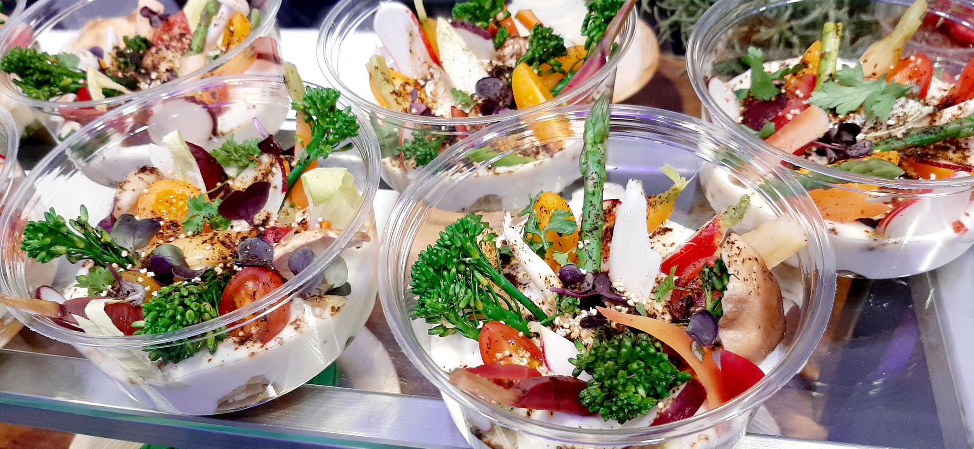
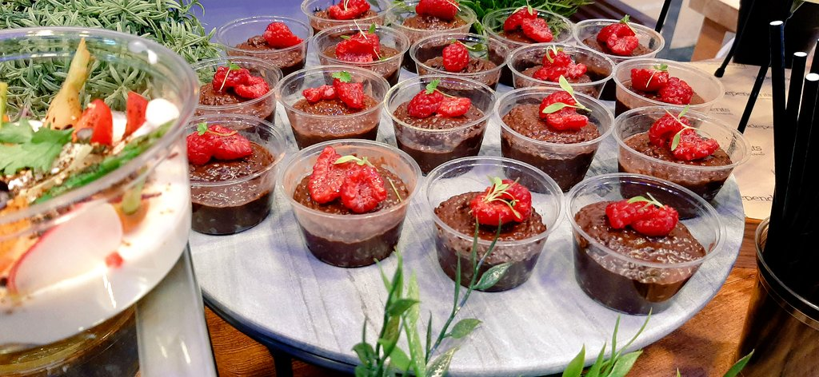
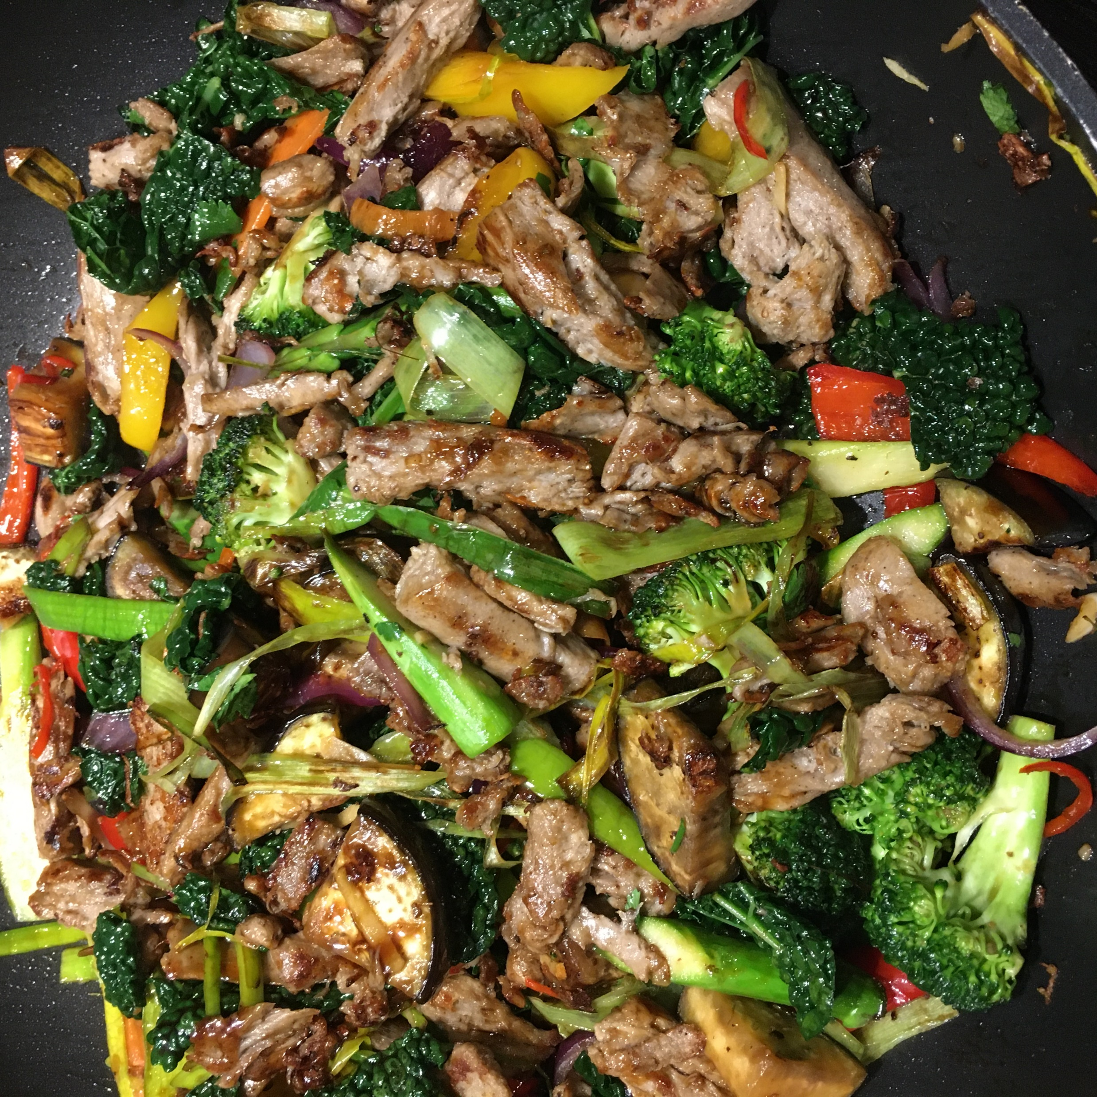
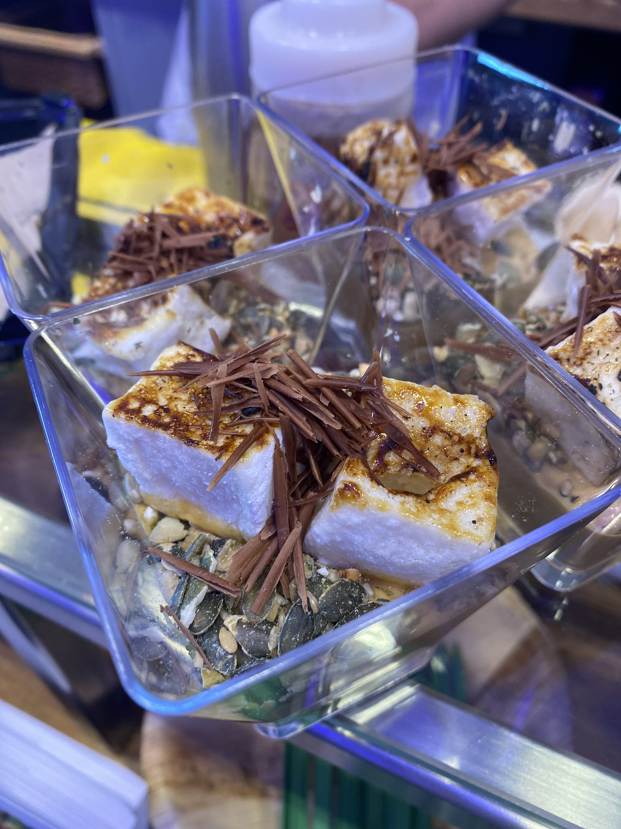
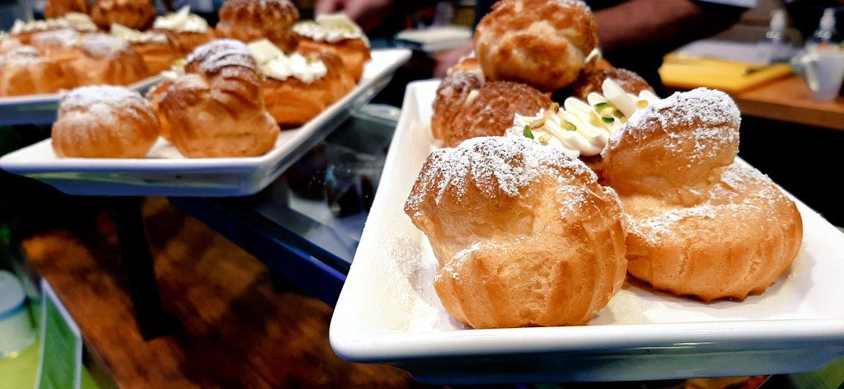
Notes:
A snapshot of some pics from this week

Slide 15
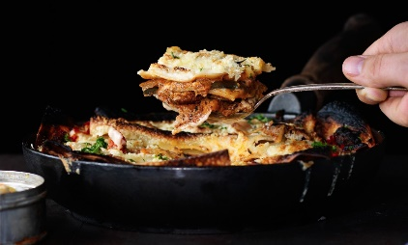
Food for Thought
Consider working with chefs and foodies for ideas on food lessons
Make healthy food cool – no really cool!
Lesson plans – dishes and cooking styles to reflect the diversity and backgrounds of pupils – How about ‘design a dish that sums me up as a person’?
More focus on vegetarian, plant based and whole foods (grains, pulses etc)
Menu language – How recipes and dishes can be more appealing from how they are worded
Adapting meat based recipes to include more pulses and grains
Food costs – understanding how to make food go further

Slide 16
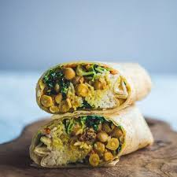
Thanks You Any Questions?

