Slide 1
Progression: Learning intent, practical food skills and recipes
6 October 2021

Slide 2
What will be covered?
Learning intent and progression.
Practical food skill progression.
Recipe complexity – an objective not subjective rating.
Using recipe complexity activities to aid planning.
Learnings from Food – a fact of life.
Resources to support planning and recipe complexity rating.

Slide 3
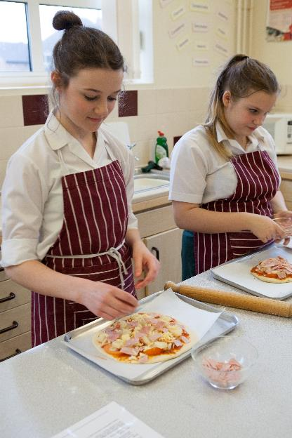
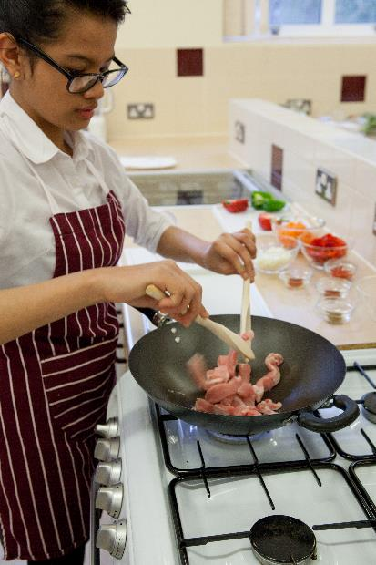
Learning intent and progression
What does the curriculum say? How does it represent progression?
How do you interpret the curriculum into teaching?
What food skills, when and how?
What is food skill progression, isn’t spreading just spreading?
Get a new recipe book … let’s consider our modern world, full of diversity, and think about health too …

Slide 4
Take a step back > From curriculum to classroom
Curriculum >
Key Stage >
Knowledge and skills
Progression
Year >
Prior learning and experiences
Splitting content over years of teaching, ensuring progression
SoW >
Lessons >
Aims for the year and learning outcomes
Effective lessons
Show progress
Differentiation
In the classroom >
Evaluate
Feedback

Slide 5
Cooking and nutrition – top line progression
Key stage 1 Pupils should be taught to: | Key stage 2 Pupils should be taught to: | Key stage 3 Pupils should be taught to:
use the basic principles of a healthy and varied diet to prepare dishes. | understand and apply the basic principles of a healthy and varied diet. | understand and apply the principles of nutrition and health.
 | prepare and cook a variety of predominantly savoury dishes using a range of cooking techniques. | cook a repertoire of predominantly savoury dishes so that they are able to feed themselves and others a healthy and varied diet. become competent in a range of cooking techniques
understand where food comes from. | understand seasonality, and know where and how a variety of ingredients are grown, reared, caught and processed. | understand the source, seasonality and characteristics of a broad range of ingredients.

Slide 6
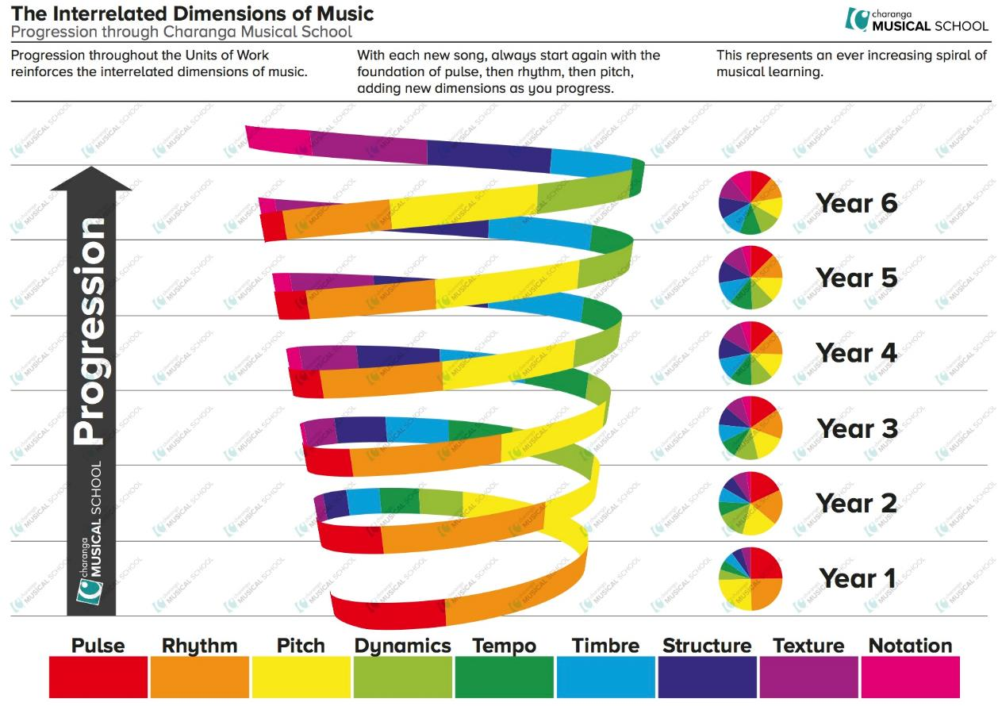
What are the food building blocks?
Healthy eating
Food skills (cooking)
Where food comes from
Food safety
Consumer awareness
Food commodities
Food science
Sensory work
Other?

Slide 7

Haven’t we done this before?
Extend
Key stage 3 Pupils should be taught to:
understand and apply the principles of nutrition and health.
cook a repertoire of predominantly savoury dishes so that they are able to feed themselves and others a healthy and varied diet. become competent in a range of cooking techniques.
understand the source, seasonality and characteristics of a broad range of ingredients.
Year 7
Year 8
Year 9
Year 7
Year 8
Consolidate
Year 9
Year 7
Year 8
Year 9
Introduce

Slide 8
Key concepts: healthy eating
Pupils should be taught to:
use the basic principles of a healthy and varied diet to prepare dishes.
understand and apply the basic principles of a healthy and varied diet.
understand and apply the principles of nutrition and health.
Dietary needs and health (ages and stages, special diets)
Energy and nutrients (source, function and amount)
The Eatwell Guide and 8 top tips for healthy eating
5 A DAY
Food and drinks

Slide 9
Key concepts: cooking
Pupils should be taught to:
use the basic principles of a healthy and varied diet to prepare dishes;
prepare and cook a variety of predominantly savoury dishes using a range of cooking techniques;
cook a repertoire of predominantly savoury dishes so that they are able to feed themselves and others a healthy and varied diet; become competent in a range of cooking techniques.
Food skills - different actions (basic …. extend … practice … become proficient)
Recipe choice to support learning objectives
Equipment (basic … extend … cooker … electrical tools … practice … become proficient)
Accuracy and precision … Safety & hygiene > Complexity > Combination of skills …
Eatwell Guide … Savoury … Variety and cuisines … Creativity … People and diversity

Slide 10




Food skill progression
Acquire
Develop
Secure
Ingredient
Precision
Accuracy

Slide 11
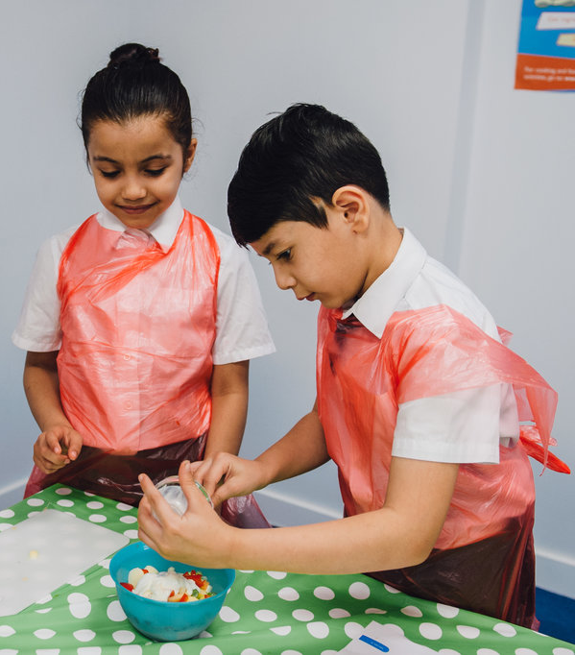
Food skill order?
No established ‘order’ for introducing different food skills at different times/ages
Need to consider that children develop a different times
FFL has some suggested routes (primary progression grid)
Practical food skills chart
Don’t base on recipe name/type – it’s about the food skills and learning (the recipe is the vehicle)
Research has been undertaken around fine/gross motor skills at different ages

Slide 12
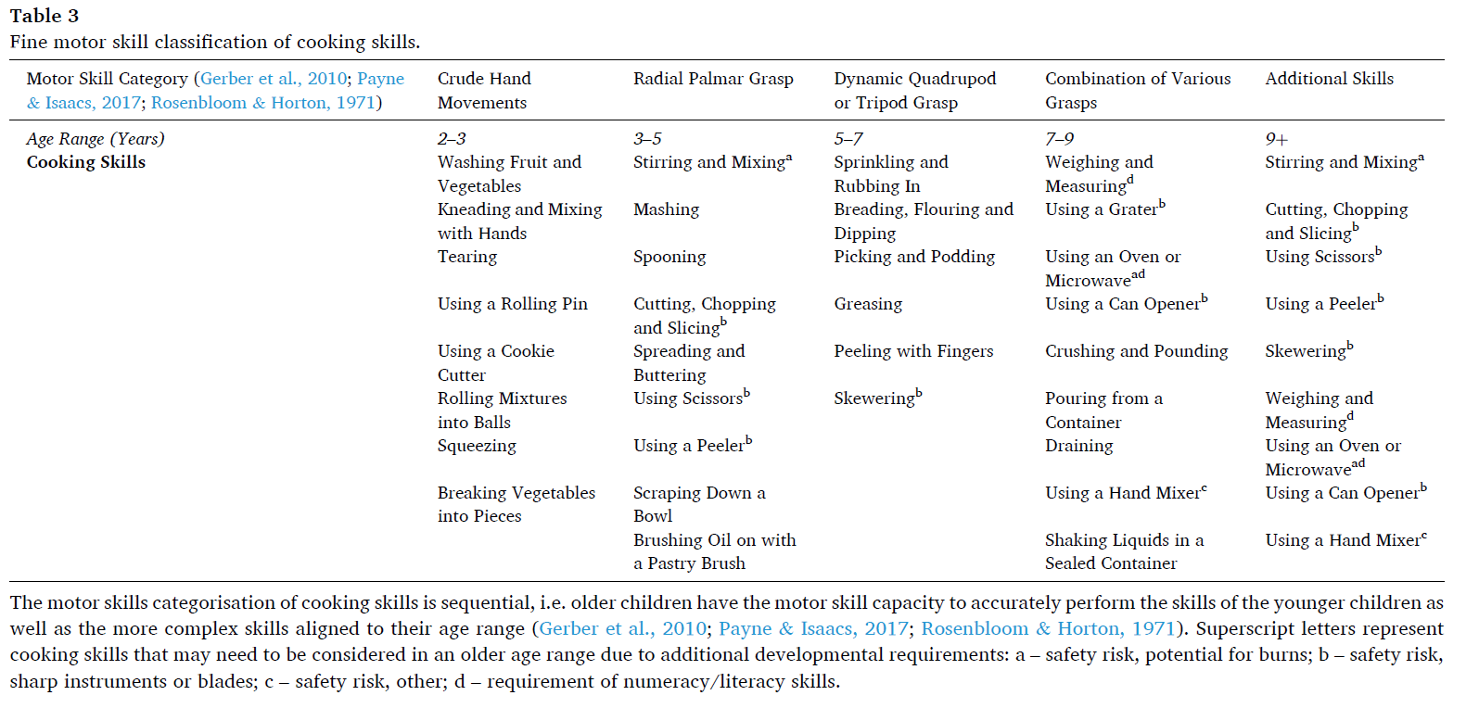
Food skill order?
Guidelines for designing age-appropriate cooking interventions for children: The development of evidence-based cooking skill recommendations for children, using a multidisciplinary approach, Appetite 161, 2021, M Dean et al.

Slide 13
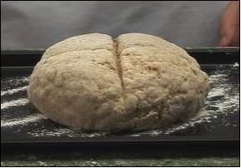
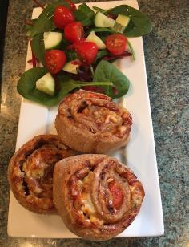
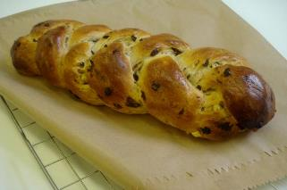
Progression – a traditional example
Soda bread
Weighing & measuring
Mixing
Shaping
Baking
Quick savoury swirls
As before, plus …
Kneading
Knife skills (veg)
Grating
Rolling out
Decorating
Finnish fruit plait
Similar to before, plus
Enriching dough
Using the hob
Adding dried fruit
Mixing in spice
Plaiting / Glazing
Type of food skills
Number of food skills
Related actions
Number of ingredients
Use of equipment
Complexity – not recipe name
Complexity
Complexity
Complexity
+ + + Accuracy and precision over time + + +

Slide 14
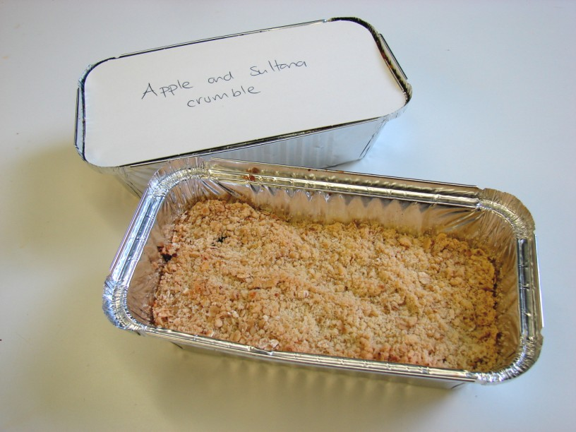
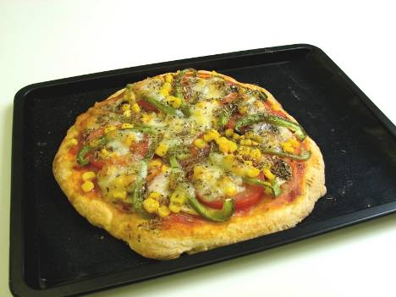
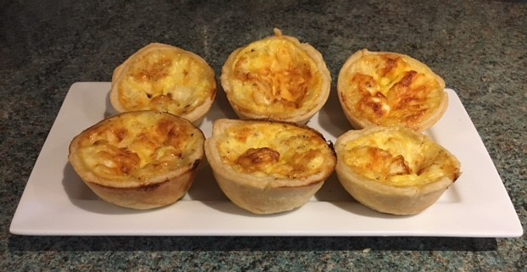
Progression of practical food skills
Fruit crumble
Weighing & measuring
Rubbing-in
Stirring
Layering
Baking
Scone based pizza
Similar to before +
Forming a dough
Shaping
Cutting and chopping
Spreading
Arranging
Baking
?
Mini quiches
Similar to before +
Rolling-out
Cutting-out
Lining a dish/tray
Cutting and chopping
Grating / Mixing
Assembling / Baking
Complexity
Complexity
Complexity
+ + + Accuracy and precision over time + + +

Slide 15
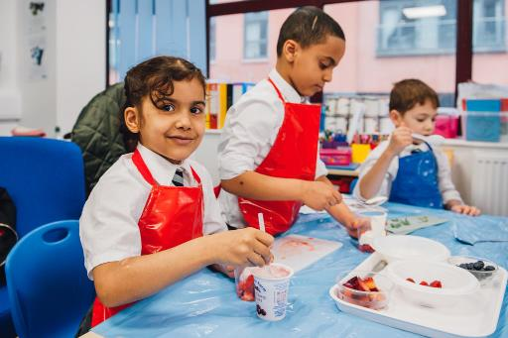
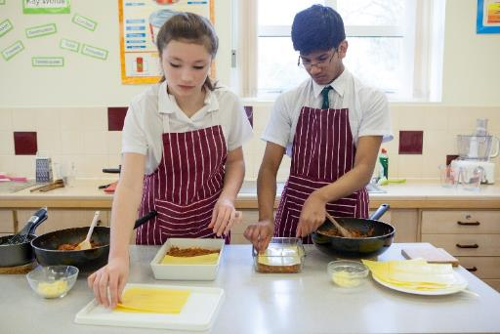
Learning, not recipe name
It’s all about the learning intent, not the ‘recipe name’
We need to embrace diversity and other cultures in our food offer – the world has moved on since the 70’s …
Consider pupil voice in learning
Does ‘high skill’ = ‘high fat, sugar and fat’?
Some traditional recipes are not inherently ‘high skill’ – they may have more individual food skills and use more ingredients – they may be more ‘complex’ (but they are a combination of small ‘actions’)
Secure ‘food skills’ and then these to make more complex dishes with greater accuracy and precision

Slide 16
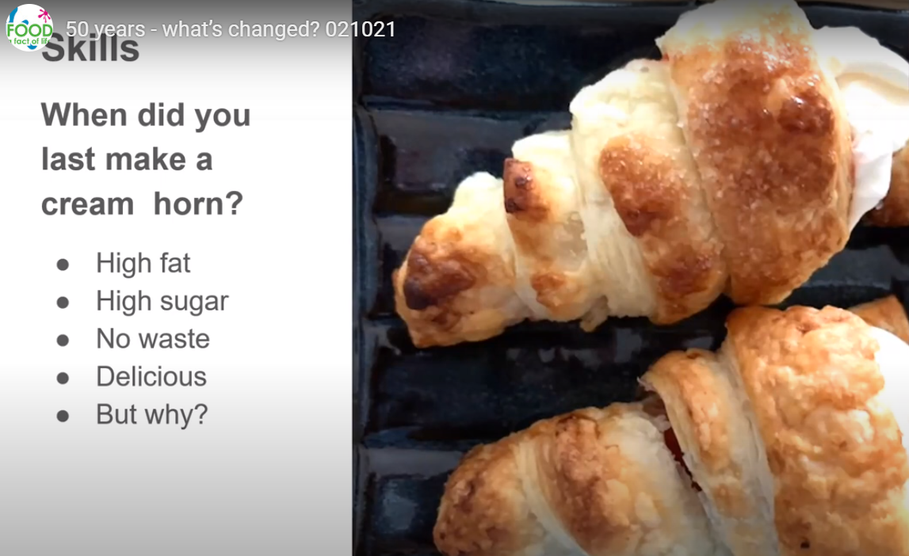
Perspectives …
Louise Davies, Founder Food Teachers Centre
Jenny Ridgwell, author
Video recorded by Jenny Ridgwell for BNF’s Future of food event 2/10/21

Slide 17
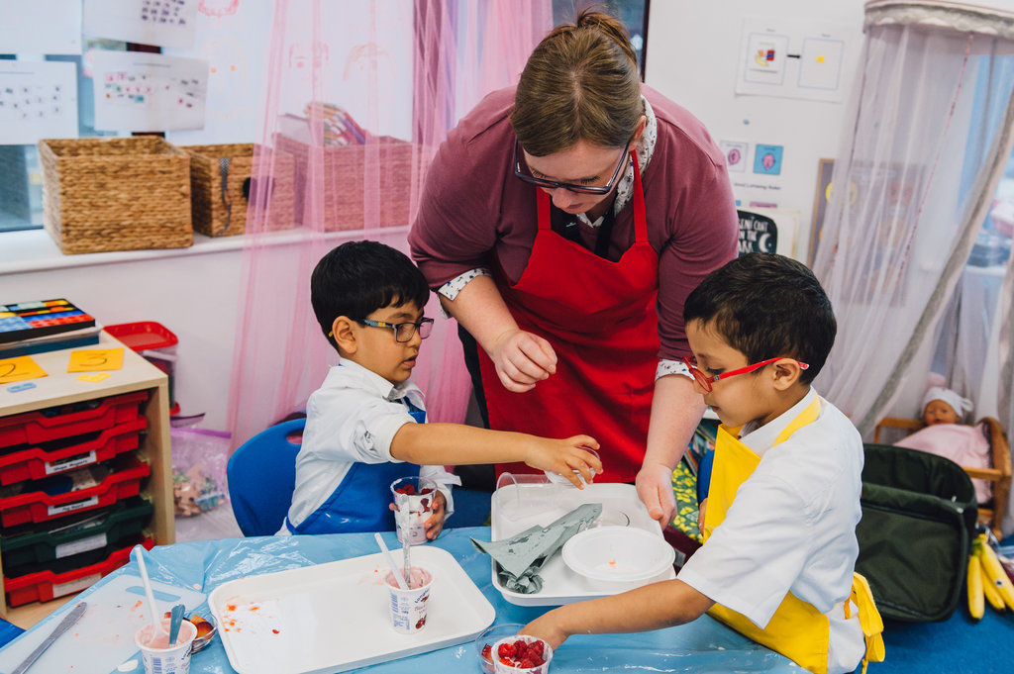
What’s happening on FFL?

Slide 18




Food – a fact of life recipes
Recipes can be searched through a number of filters:
name;
time (up to 30 mins, up to 45 mins, up to 60 mins, 90mins +);
complexity (low, low-medium, medium, medium-high, high);
age, i.e. 3-5, 5-7, 7-11, 11-14, 14-16;
cooking methods: Non-heat, Hob, Grill or Oven;
food commodity (such as vegetable, meat, cereals, potatoes);
food skills, e.g. grate, peel, stir.

Slide 19
Food – a fact of life recipe complexity rating
Why? An ‘objective rating’ rather than a ‘subjective rating’.
What makes a recipe more ‘complex’?
Why is the complexity different/the same with similar dishes?
Is more accuracy and precision required?
Are the practical food skills different?
Are the number of ingredients the same?
It maybe that the recipe is not more complex, but that additional dishes have been added to make it ‘more complex’.

Slide 20
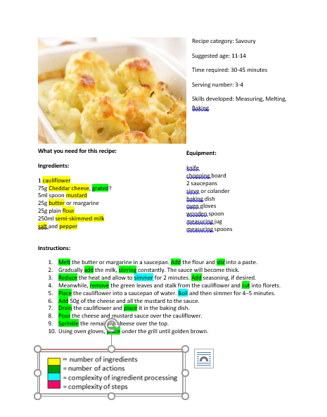
Complexity (objective rating)
Criteria:
Number of ingredients.
Number of actions (verbs/steps).
Complexity of ingredient processing (the fact that a number of steps are required, e.g. divide, shape, debone, fillet, pipe, boil, simmer), including high risk ingredients.
Complexity of steps, e.g. finely cut or a julienne.
Duration of preparation (same as the number of steps).
Cauliflower cheese: low-medium complexity

Slide 21
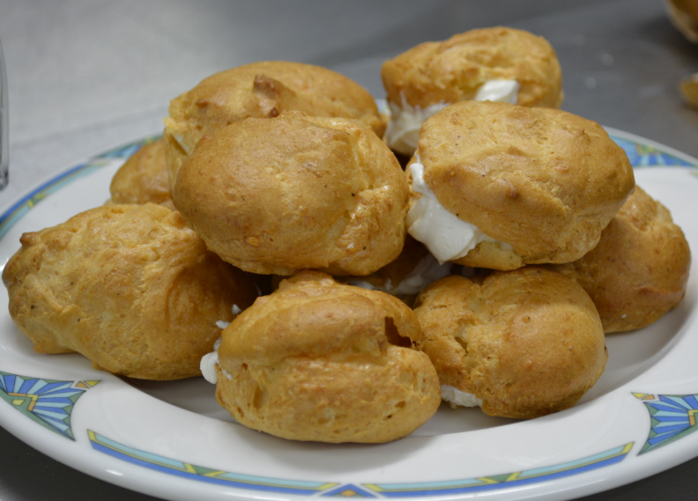
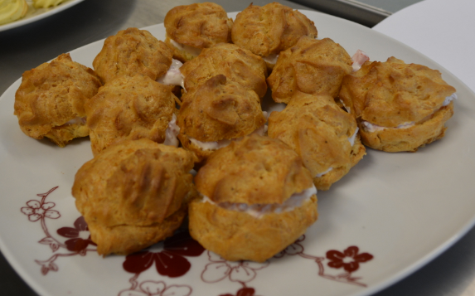
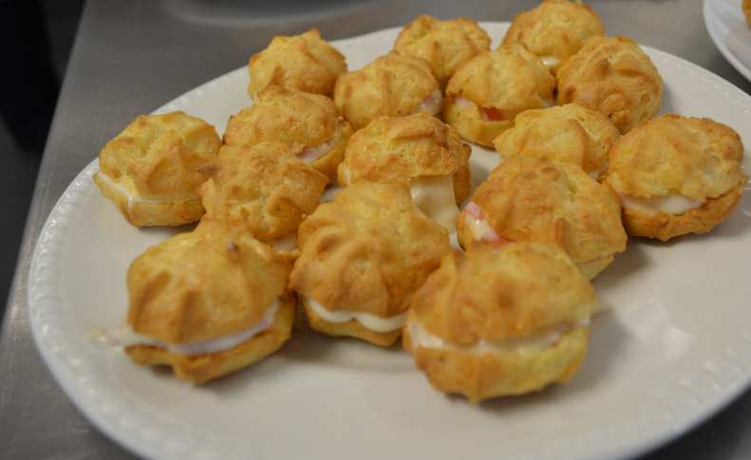
Savoury filled choux buns
Low-medium
Medium
Medium-high
Spooned and filled with cream cheese
Piped and filled with cream cheese, ham and tomato
Piped and filled with a homemade roux sauce, ham and tomato
= number of ingredients 9
= number of actions 14
= complexity of ingredient processing 2
= complexity of steps 0
= number of ingredients 11
= number of actions 20
= complexity of ingredient processing 2
= complexity of steps 1
= number of ingredients 15
= number of actions 33
= complexity of ingredient processing 2
= complexity of steps 1

Slide 22
How complex are the recipes that your pupils make?
A practical activity to get you, your colleagues and pupils thinking objectively:
Working in pairs prepare three similar dishes, e.g. scrambled eggs, omelette, frittata
Identify the learning intent – teacher.
Role model good practice (hygiene, safety, skills) – teacher.
Consider how the recipes could be made in school (age/phase, individually, pairs or in a group) – teacher.
Identify practical food skills used – teacher and pupils.
Discuss key nutrition messages and functions of ingredients – teacher and pupils.
Suggest further developments (stretch and challenge/extend complexity) – teacher and pupils.
Suggest recipe complexity.
Remember: It is not about the recipe title, but what goes into the recipe, e.g. ingredients, skills, processes.
A selection of recipes for this activity can be found here.

Slide 23
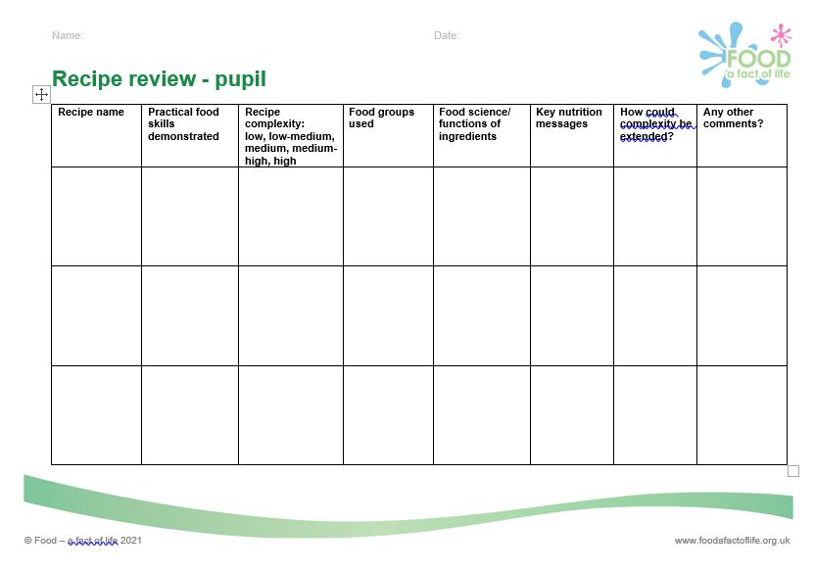
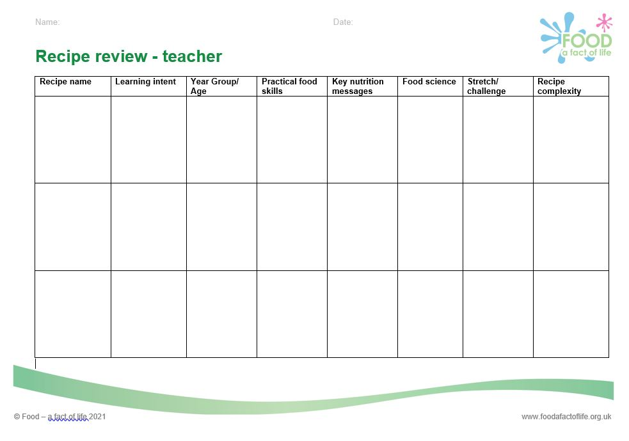
Using complexity rating activities for planning
Use this type of activity:
When planning Schemes of Work and lessons - either make the dishes or use recipes.
With pupils to help them research, plan and trial in preparation for practical examinations.
Recipe review sheets

Slide 24
What we have learnt at Food – a fact of life
Practical food skills and recipe progression workshops – 2020/21
Three recipes made which exemplify key practical food skills and demonstrate progression in complexity.
“I enjoyed the 'progression' aspect, it was very useful to see how one skill can be built on by using more complex recipes and incorporating additional skills. The conversation around differentiation was also very useful. “
“I really enjoyed the recipe progression so you could clearly see how to first introduce a skill and how to further advance the recipe whilst still using the skill. “

Slide 25
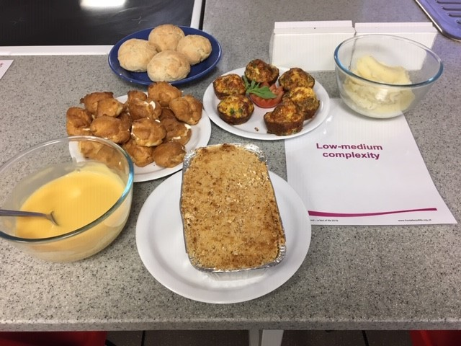
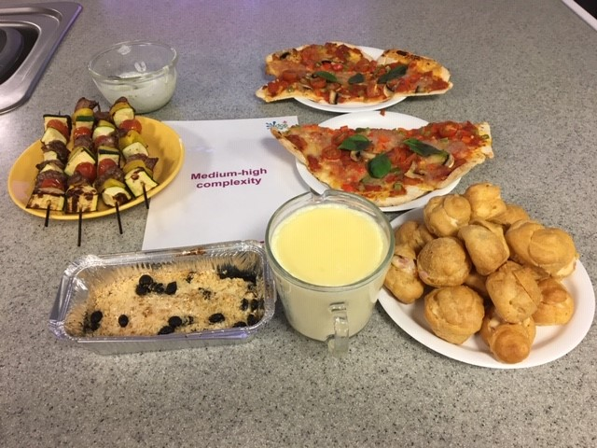
What we have learnt at Food – a fact of life
Rolls, pizza or fruit plait. What’s the learning intent? - 2019
This session focused on understanding the learning intent of a number of recipes. The aim of which was to encourage teachers to more carefully consider why particular recipes are chosen and to ensure that the focus is the learning intent rather than the final outcome.
For example, confidence and competence in temperature control (hob and oven) and shaping, forming and filling through making choux buns rather than the objective/intent to be ‘successfully making choux buns’. The complexity of the different recipes was also highlighted.

Slide 26
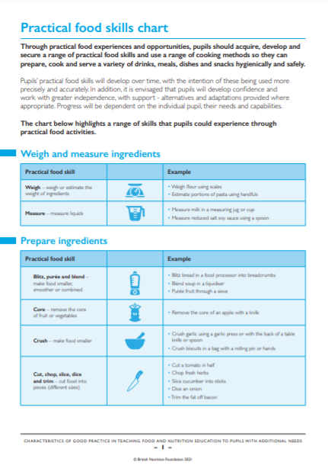
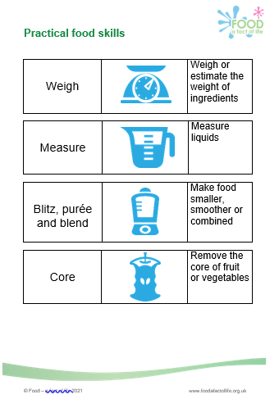
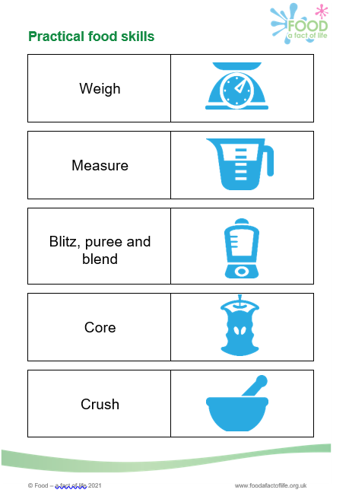
Resources to support planning
Practical food skill with description
Examples of how the practical food skill could be demonstrated
Pupil friendly versions are also available

Slide 27
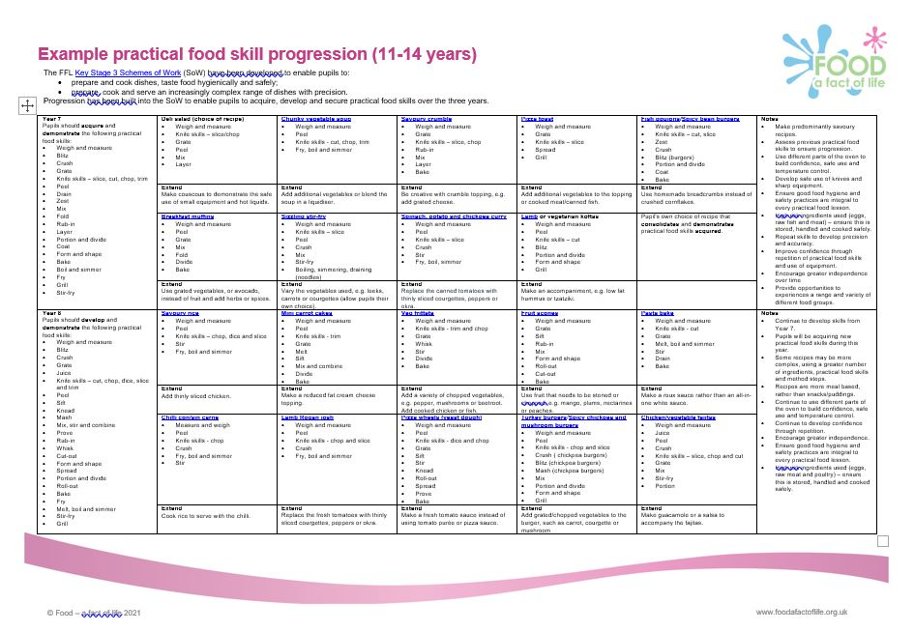
Resources to support planning – 11-14 years
Practical food skills that pupils should acquire, develop and secure
Supporting notes
Suggested recipe with weblink and practical food skills used
Suggestions to extend the complexity of the recipe
Resources to support planning practical food skill progression

Slide 28
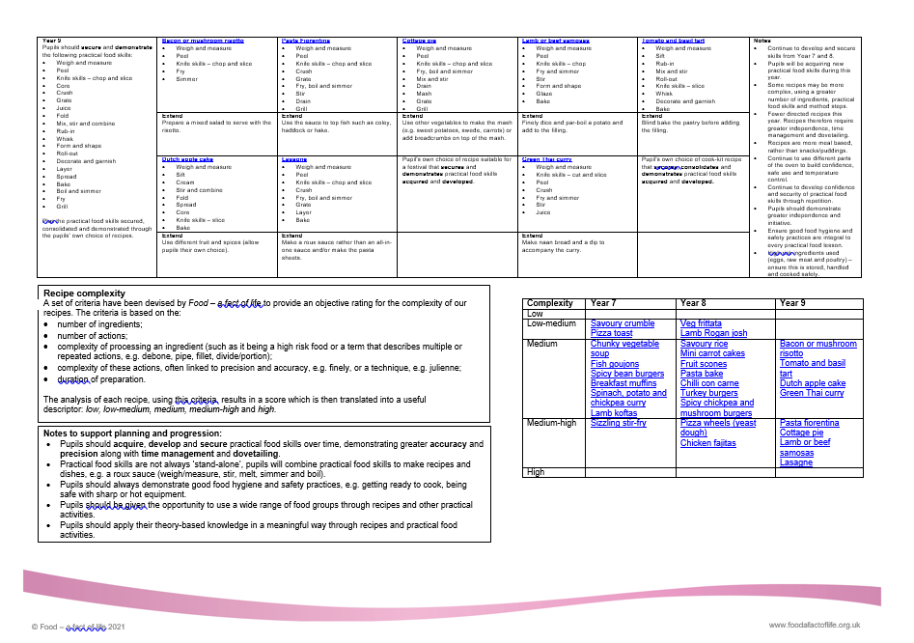
Resources to support planning - 11-14 years
Recipe complexity criteria
Recipe complexity rating for suggested recipes
Notes to support planning and progression

Slide 29
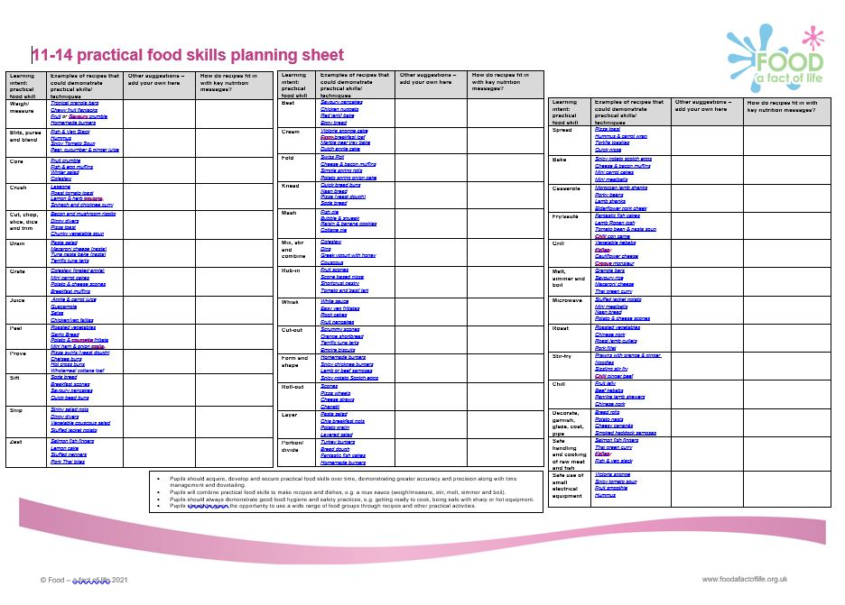
Resources to support planning – 11-14 years
Learning intent: practical food skill
Other suggestions – add your own here
Examples of recipes that could demonstrate practical skills/techniques
How do recipes fit in with key nutrition messages?

Slide 30
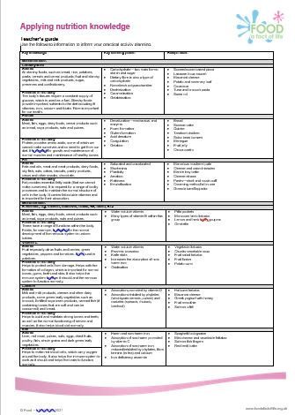
Resources to support planning
Key knowledge
Recipe ideas
Key learning points

Slide 31
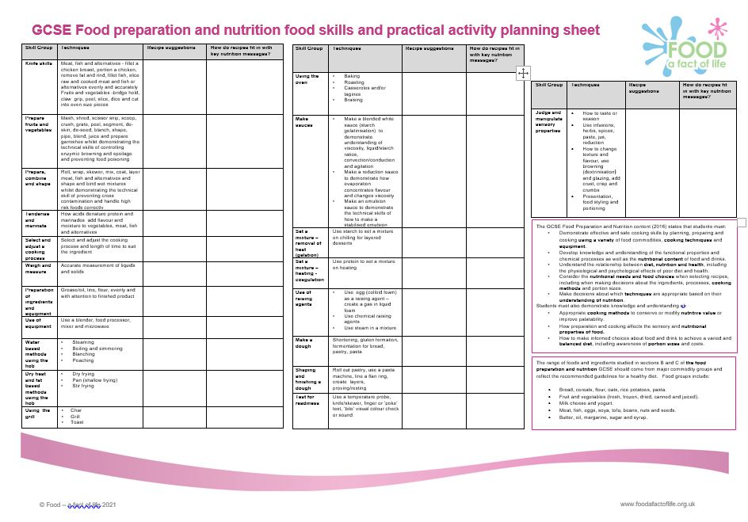
Resources to support planning – GCSE
Skill group
Recipe suggestions
How do recipes fit in with key nutrition messages?
Techniques
Notes from GCSE content

Slide 32
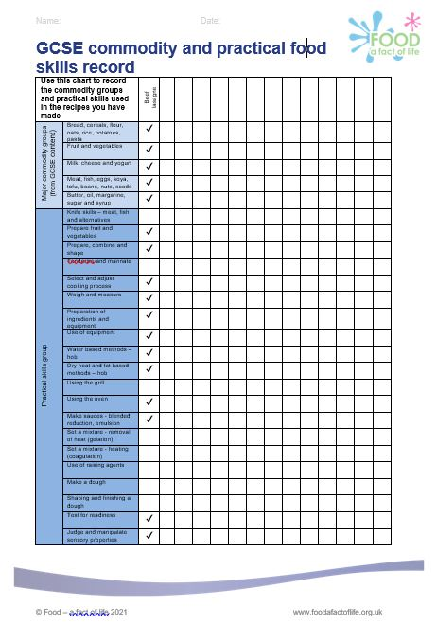
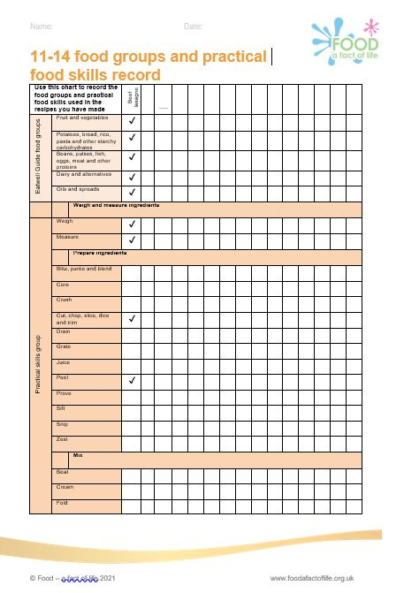
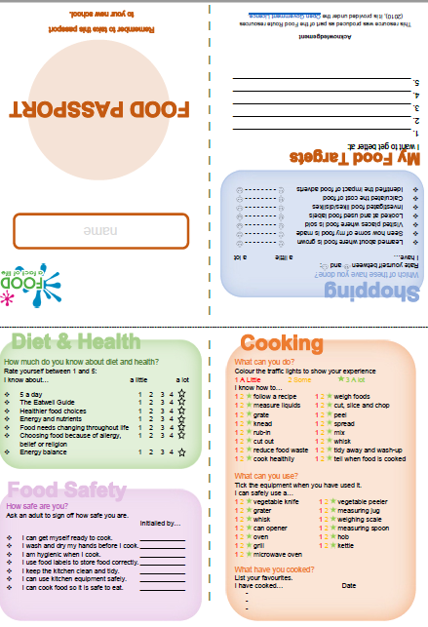
Pupil resources

Slide 33
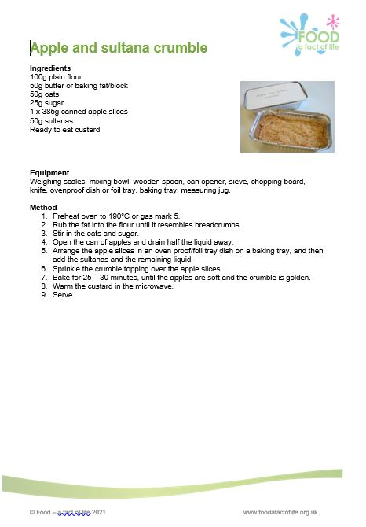
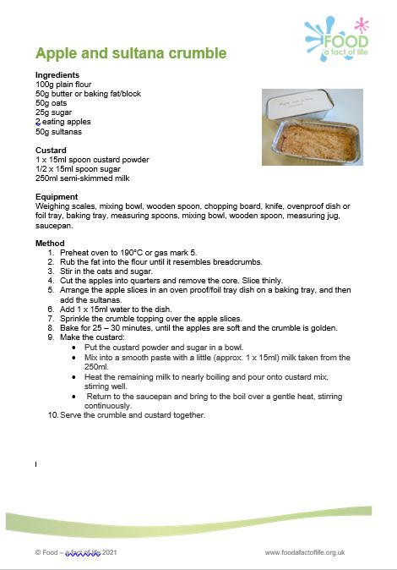
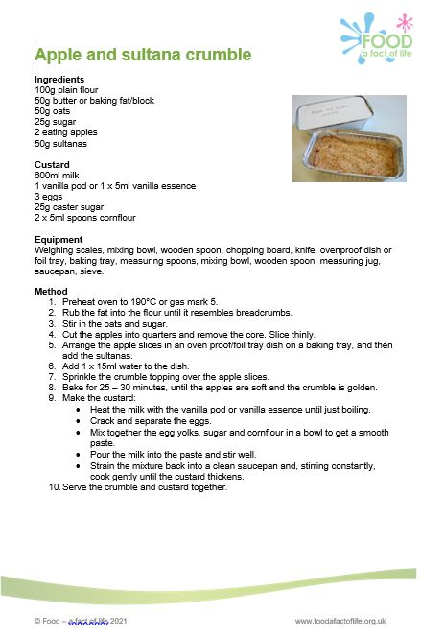

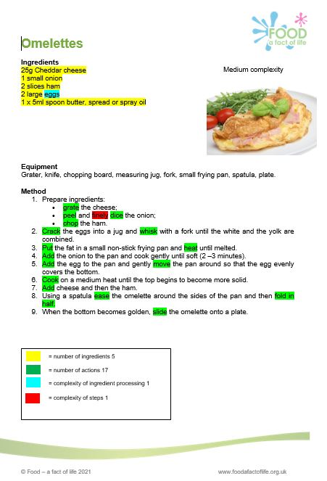
Resources to support complexity rating
Instructions to run a recipe complexity activity and a selection of recipes can be found here.

Slide 34
Further training
To find out more and to book, go to: https://www.foodafactoflife.org.uk/training/
Virtual practical workshops – shorter lessons – 9 October and 4 December at 9am
FFL 30th anniversary conference – Saturday 13 November at 9am
Practical food skills, cooking and food waste – 8 December at 4.30pm
To come in 2022!
Virtual practical workshops: Food science and food skills – practical applications – 15 January and 9 February
Food presentation and styling webinar – 12 January
Careers in food with Tasty Careers webinar – 9 March
More PPD information, support and newsletter sign-up: https://www.foodafactoflife.org.uk/professional-development/

Slide 35
Progression: Learning intent, practical food skills and recipes
For further information, go to:
www.foodafactoflife.org.uk

