Slide 1
New cuisines, new tastes
A Cooking Challenge for 11-14 year olds

Slide 2
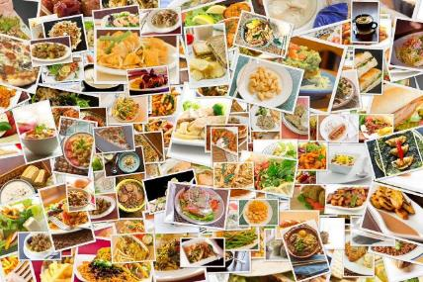
The Challenge
UK food culture is a melting pot of traditions, flavours, ingredients and culinary techniques.
Prepare and cook a dish, or range of dishes, which showcases our modern, diverse food culture.

Slide 3
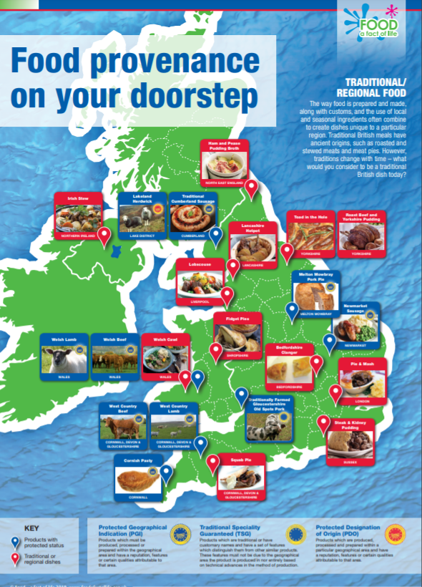
Let’s get started – the Challenge is on!
Name at least five ingredients, food or dishes that you identify as typical of UK cuisine.
Why have you chosen these in particular?
Traditional/regional food around the UK poster

Slide 4
Did you know?
According to a YouGov poll in 2021, the top eight most popular British dishes were:
Dish | Popularity
Chips | 86%
English breakfast | 85%
Roast chicken | 83%
Fish and chips | 83%
Mashed potatoes | 80%
Roast beef | 77%
Beans on toast | 74%
Soup | 74%

Slide 5
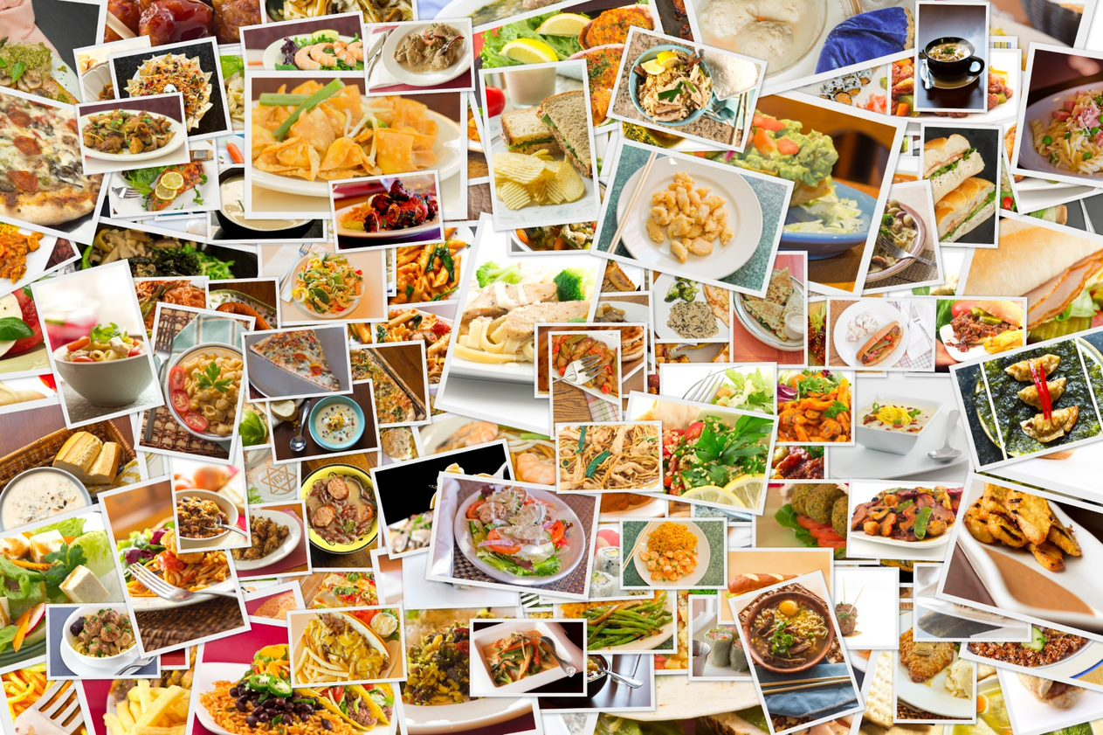
What do you eat at home?
Name a dish or recipe that your family regularly eats at home.
Describe the dish or recipe to the person next to you.

Slide 6
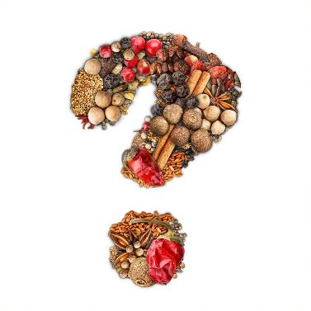
UK food culture
List the factors that have influenced the UK food culture and what we buy, make and eat.
Did you include:
world trade;
immigration;
foreign travel;
developments in technology;
changes in family dynamics.
Was there anything else?

Slide 7
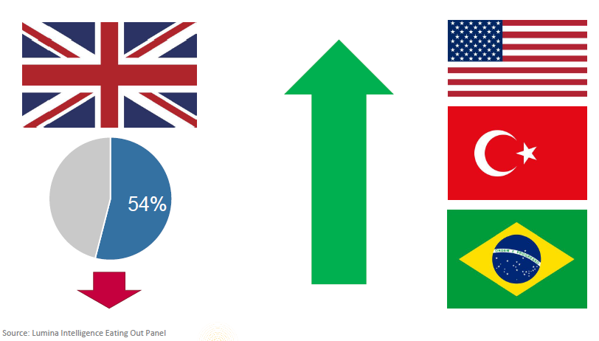
Foods from around the world
British cuisine accounts for over half of the meals eaten out but cuisines from around the world are becoming increasingly popular.
AHDB

Slide 8
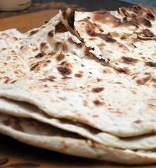
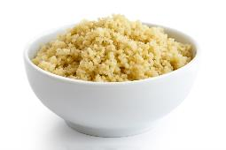
Did you know?
Some food and drink-related traditions are currently recognised by UNESCO and its Representative List of the Intangible Cultural Heritage of Humanity, including:
Lavash, a bread, which plays an important ceremonial role in Armenian weddings, where sheets of the bread are draped over the bride and groom’s shoulders to signal future prosperity.
Mediterranean diet of Spain (and six other countries including Italy, Portugal, Morocco, Croatia, Cyprus, and Greece), concentrating on celebrating the rituals and processes that make this diet an important part of these countries.
Couscous made in Algeria, Mauritania, Morocco and Tunisia and the knowledge associated with how it is produced.
The city of Naples’ trademark technique of making pizza.
Lavash bread
Couscous

Slide 9
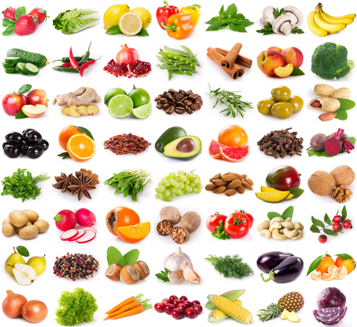
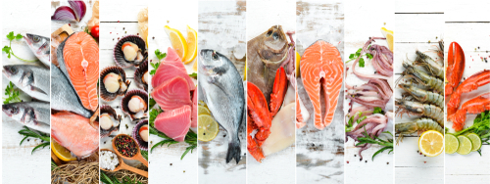
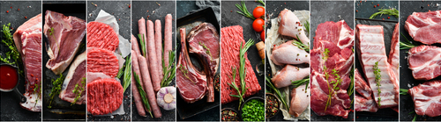
Different ingredients add flavour, colour and texture to food

Slide 10
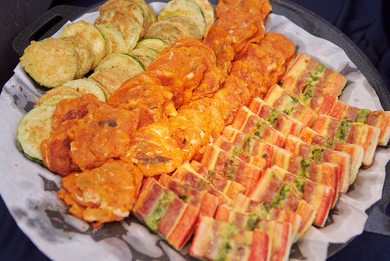
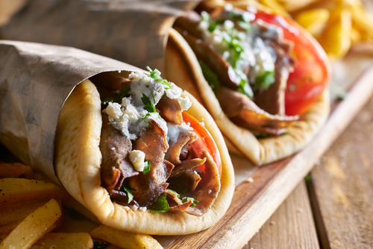
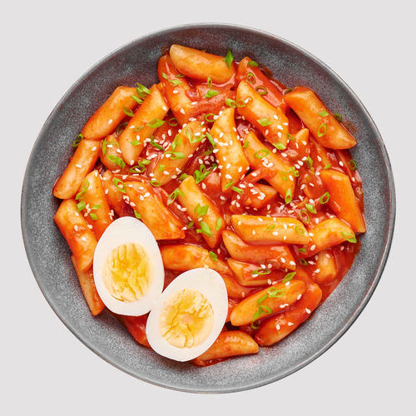
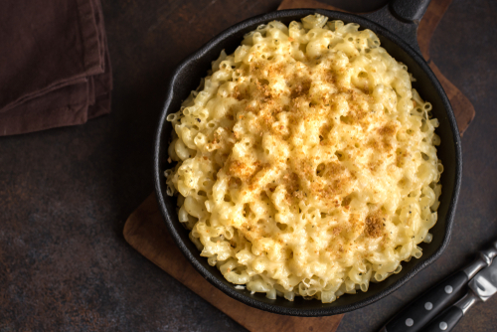
Dishes from around the world to inspire you
Jeon - Korea
Gyros - Greece
Tteokbokki - South Korea
Mac and cheese - America

Slide 11
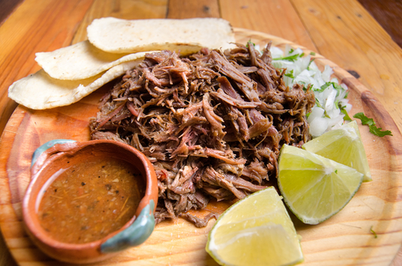
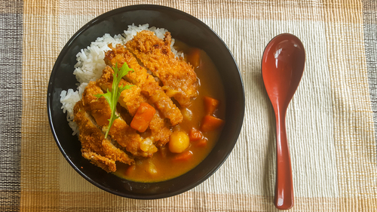
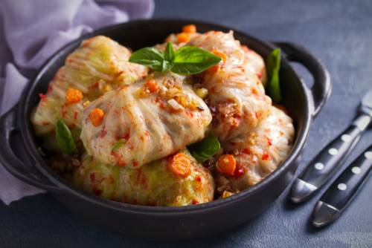
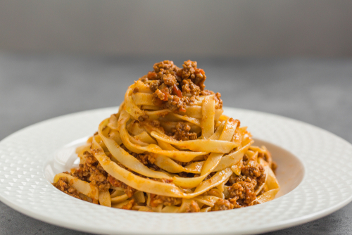
Dishes from around the world to inspire you
Barbacoa - Mexico
Karē - Japan
Sarma - Turkey
Tagliatelle al ragù alla Bolognese - Italy

Slide 12
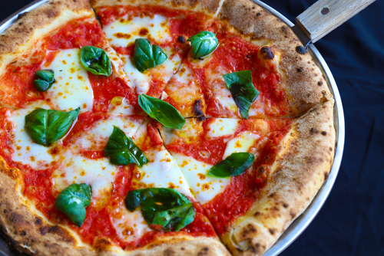
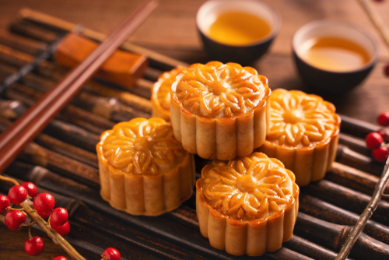
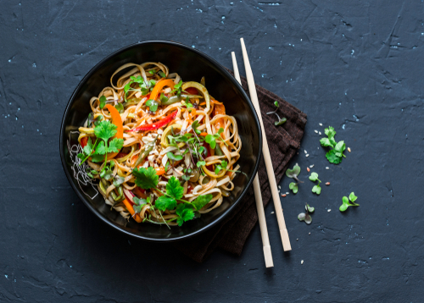
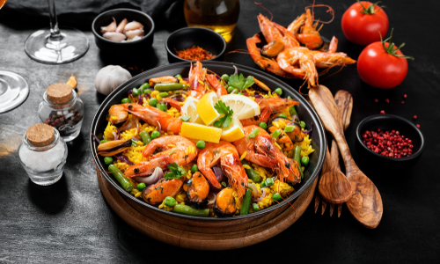
Dishes from around the world to inspire you
Pizza Margherita – Naples, Italy
Mooncake – China
Pad Thai – Thailand
Paella - Spain

Slide 13
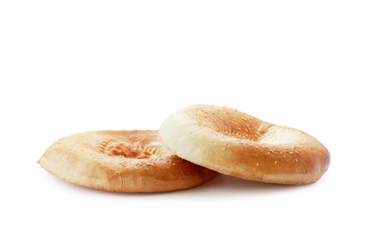
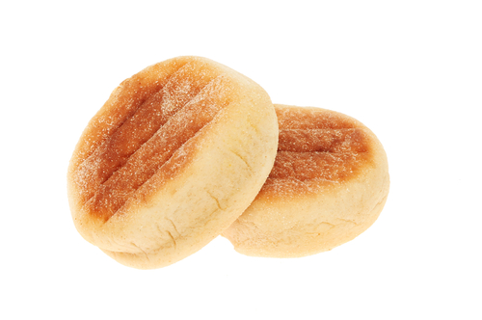
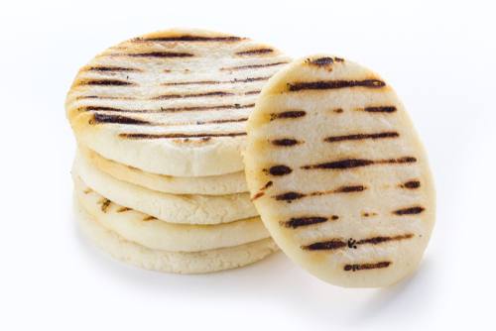
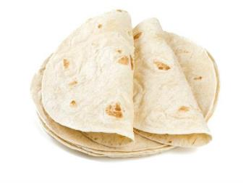
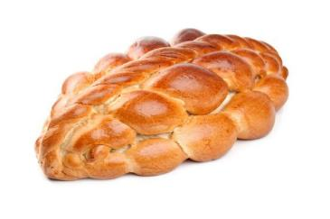
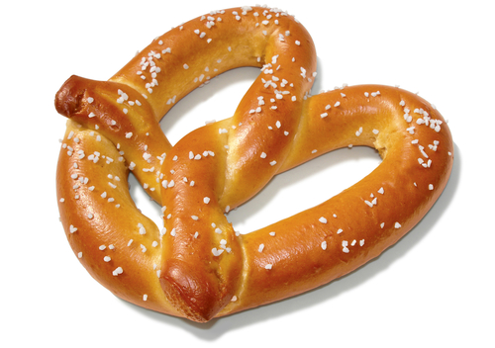
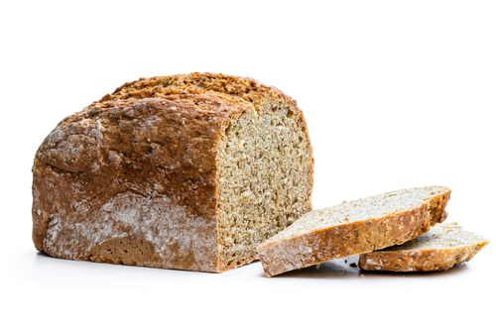
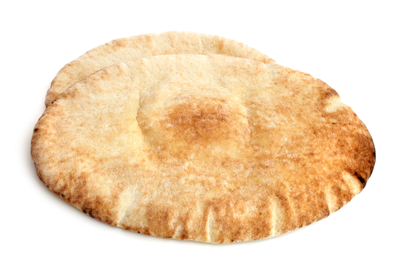
Breads from around the world – how many have you tried?
English muffin - England
Chapatti - India
Obi non - Afghanistan
Arepa - Venezuela and Colombia
Challah - Israel
Pretzel - Germany
Pitta – Middle East
Soda bread – Ireland

Slide 14
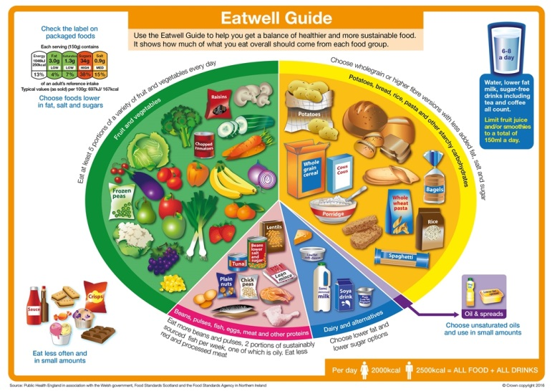
The Eatwell Guide
We should all be following the healthy eating model. In the UK, this is known as the Eatwell Guide.
The Eatwell Guide shows the proportions in which different groups of foods are needed in order to have a well-balanced and healthy diet.
The proportions shown are representative of food eaten over a day or more, not necessarily at each mealtime.

Slide 15
Healthy eating and sustainable diets – applying your knowledge
We should all be choosing a variety of different foods from each food group to help get the wide range of nutrients the body needs to stay healthy.
Following the Eatwell Guide can also be good for the environment/planet, as well as your own health.

Slide 16
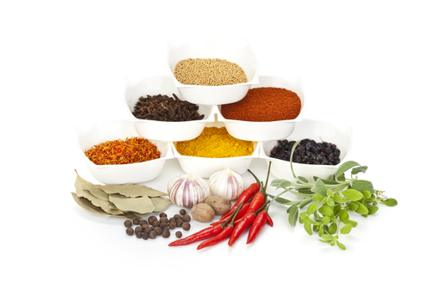
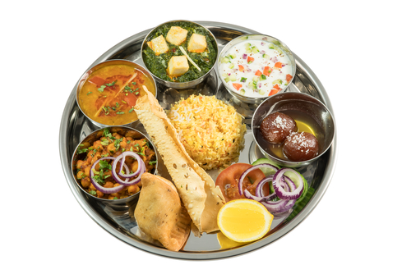
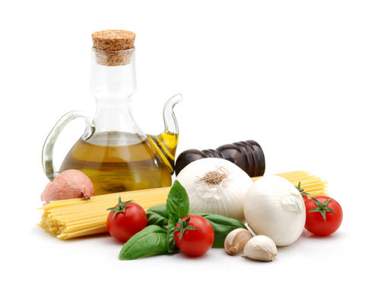
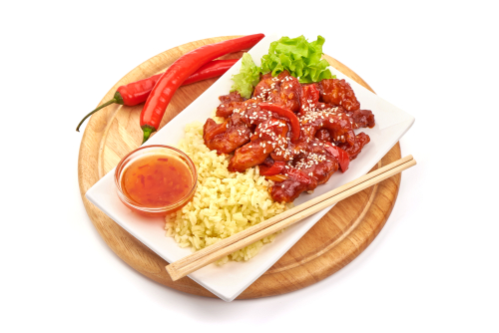
Planning
Consider the cuisine that you are going to showcase.
How will you show the different flavours, ingredients and culinary techniques?
Put together your plan!

Slide 17
The Challenge
UK food culture is a melting pot of traditions, flavours, ingredients and culinary techniques.
Prepare and cook a dish, or range of dishes, which showcases our modern, diverse food culture.
Good luck!

Slide 18
Teachers’ guide

Slide 19
The Food – a fact of life Challenges
The Food – a fact of life Challenge activities have been written to support teachers not following the national curriculum for their specific country or those following a challenge or theme-based approach. However, they could be used in any school across the UK.
The Challenges cover healthy eating, cooking and where food comes from and provide a wide range of activities that teachers can select depending on their pupils’ needs, age and abilities, and the time available.
There are 12 Challenges developed to be used with nursery, primary or secondary pupils.
Each Challenge comprises the Challenge, opportunities for learning and a variety of pupil activities that can be completed individually or in groups. Each Challenge culminates in a final outcome, which could be paper based, such as a report, poster, newspaper article or presentation, a video or interactive activity, or a recipe, menu or dish/range of dishes, depending on the theme of the Challenge.
Optional pupil certificates are available to download and personalise once the Challenge has been achieved.

Slide 20
The 11-14 Cooking Challenge
UK food culture is a melting pot of traditions, flavours, ingredients and culinary techniques.
Prepare and cook a dish, or range of dishes, which showcases our modern, diverse food culture.

Slide 21
Opportunities for learning
By doing this challenge, the opportunities for learning include:
researching food around the world, such as recipes, ingredients and cooking methods;
exploring the different factors of a country’s food culture, such as religion, climate, geography, provenance and history;
applying knowledge of healthy eating and more sustainable diets;
building an appreciation of food from around the world and a repertoire of new food skills;
demonstrating food preparation and cooking techniques through making a range of dishes;
demonstrating the principles of food hygiene and safety.

Slide 22
How can pupils complete the Challenge?
A range of activity suggestions have been provided – you choose those that are most suitable for your pupils and the time that you have available to complete the challenge.
Activities include:
Finding out – activities around researching food across the world and the factors that influence a country’s food culture.
Making and evaluating – activities around applying knowledge of healthy eating and sustainable diets, demonstrating a range of practical food skills and cooking methods, demonstrating the principles of food hygiene and safety, and using your senses to evaluate dishes made.
Bringing it all together – making, photographing and evaluating a dish, or range of dishes, which showcases the UK’s modern, diverse food culture.

Slide 23
Finding out - activities
Pupils, individually or in groups, could:
Investigate the factors affecting food choice. The Factors affecting food choice presentation and worksheet could be used to support.
View the Considerations for cooking savoury meals poster and consider the factors that influence what they cook.
Create a poster to explain the factors affecting food choice, an example can be found here.
View the Selecting ingredients presentation and complete the supporting worksheet.
Explore the cultural diversity of food within the UK and hear about food from around the world through the British Library’s Oral histories of food production and consumption.

Slide 24
Finding out - activities
Pupils, individually or in groups, could:
Choose a region in the UK and research the ingredients, food and recipes distinctive to that area. Create a poster to explain what they have found.
List five countries and name a local dish for each. Find or draw a picture of each dish. The Cook world dishes worksheet could be used to support.
List three of their favourite recipes and research where they are from. Name the country where it originates from and identify three other recipes that also originate from that country.

Slide 25
Finding out - activities
Pupils, individually or in groups, could:
Research one culture or cuisine from around the world and create a PPT presentation or video to share with the rest of the class. Pupils should consider:
the geography and climate of the country that the culture or cuisine originates from and how this may impact on the food grown and dishes made and eaten;
the main food that is grown, reared or caught;
traditional meals and how they are cooked;
how religion may influence the food made and eaten;
festivals and celebrations and food typically made and eaten to mark these occasions.

Slide 26
Finding out - activities
Read through the International food culture and tradition presentation and create a poster showing examples of the cultures and traditions of three of the countries listed.
Use the UK and world food maps, and click and drag the dish into each of the places where the food originates from.
View the Religion and food choices presentation to recognise that food is an important part of religious or cultural observance for many different religions and/or cultures. Pupils could then complete the worksheet and Kahoot quiz.
View the Religion and food traditions around Europe presentation to highlight some of the food and different occasions that are celebrated around Europe.

Slide 27
Finding out - activities
Research one religion and create a menu of three dishes for that religion. Pupils should explain their decisions and then make one of the dishes.
Consider how the weather and climate impacts where and how food is grown, reared or caught and how this has influenced dishes around the world. Pupils could view the Food production, weather and climate presentation to support.

Slide 28
Making and evaluating - activities
Pupils could:
View the Healthier cooking methods presentation to support applying healthy eating messages when making their dish(es).
Make a range of dishes from around the world to acquire, develop and secure practical food skills, and use a range of ingredients and cooking techniques. There is a wide variety of recipes on Food – a fact of life and over 40 suggestions for ‘cooking your way round the world’ can be found here.
Use Gourmet Burger Builder and the Fusion food presentation for inspiration to create an exciting fusion burger which combines ingredients and ideas from different culinary traditions. Pupils could then follow the recipe produced and make their burger, which could be served in a bao bun.

Slide 29
Making and evaluating - activities
Pupils could:
Find a traditional and modern recipe for the same dish and list the reasons why the recipe has changed. An example could be Lamb tagine and Minced lamb tagine. This could include: consideration of dietary advice, healthier eating; wider variety of alternative ingredients available; use of ready-made components; change in lifestyle, e.g. less time for cooking traditional meals; loss of personal food preparation and cooking skills; increased cost of ingredients and personal preference.
Research the origins of starchy carbohydrates, often used to create meals or as an accompaniment, such as couscous, quinoa, bulgur wheat, barley, tapioca or oats and identify traditional meals made with the type of carbohydrate. This worksheet could be used to support this task.

Slide 30
Making and evaluating - activities
Pupils could:
Create an infographic showing the different types of bread that are made and eaten around the world. The Bread traditions around the world presentation could be used to support. Pupils could then make one of the breads shown in the presentation.
Research recipes from around the world and complete a chart identifying ten dishes that they would like to make for their own final dish(es). A range of recipes is available on the Food – a fact of life website. Pupils may also like to look at the recipes on the Simply beef and lamb and Love pork websites for inspiration.
Make one or more of the dishes identified and use the sensory characteristics resources to evaluate them and make decisions for a final dish or range of dishes.

Slide 31
Making and evaluating - activities
Pupils could:
Complete a Time plan for making to ensure that all elements of the dish are completed on time. If more one dish is being made at the same time, pupils can practise the activity of dovetailing by producing a plan for each dish (perhaps in a different colour). They should then cut out each step and then stick them in the order they are required to be done to ensure everything comes together at the right time. Another way to help pupils manage their time is for them to produce a flow map of the recipe they will be making. The Recipe flow map worksheet includes a simple example of a flow map for a mixed salad.
Create a recipe video of one of the dishes made that would be suitable for a recipe website, social media or YouTube channel. Examples of short recipe videos, can be found here.

Slide 32
Bringing it all together
Pupils should:
Prepare and cook, photograph and evaluate a dish, or range of dishes, which showcases the UK’s modern, diverse food culture.

Slide 33
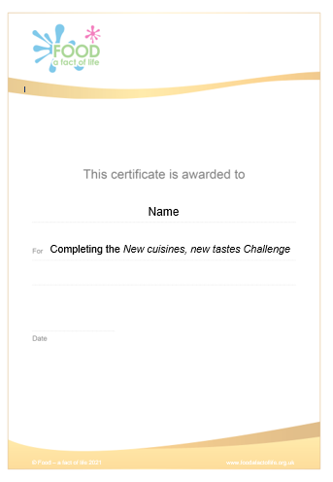
Celebrating success
Optional pupil certificates are available to download and personalise once the Challenge has been achieved.
Why not present the certificates at a celebration assembly or award ceremony?
Downloadable certificate

Slide 34
New cuisines, new tastes
For further information, go to:
www.foodafactoflife.org.uk
This resource meets the Guidelines for producers and users of school education resources about food.

