Slide 1
Be social!
A Healthy eating Challenge for 11-14 year olds

Slide 2
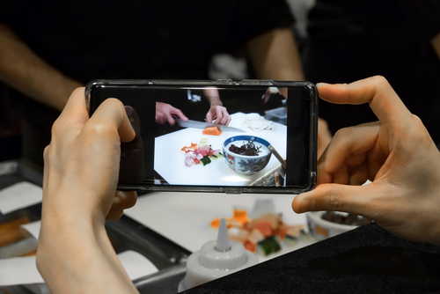
The Challenge
Create a social media campaign to encourage teenagers of your age to make better healthy eating choices.

Slide 3

Let’s get started – the Challenge is on!
Social media is a term which includes many different tools, such as:
Social and professional networking (Facebook, Twitter, LinkedIn);
Media sharing (Instagram, YouTube, Flickr, Pinterest);
Interactive media (Snapchat, TikTok);
Content production (Blogger, Vlogger).
Which of these platforms do you think would be a good choice for sharing the healthy eating choices challenge? Why?

Slide 4
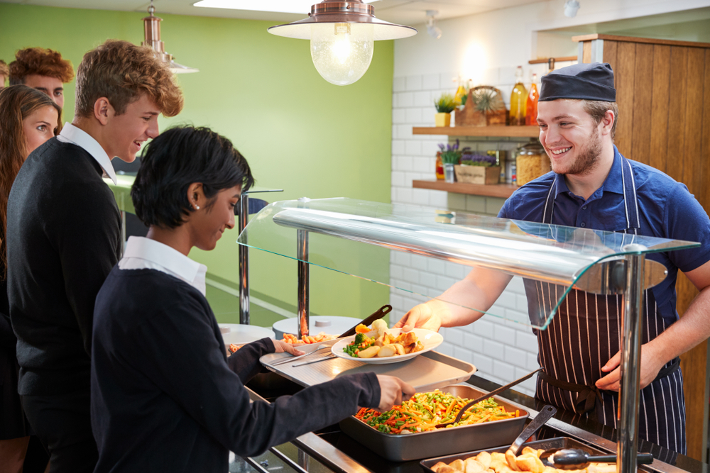
What is healthy eating?
A healthy diet is about getting a balance and variety of foods from the main food groups.
In the UK, our healthy eating model is called the Eatwell Guide.
It also includes information on how much we should drink.

Slide 5
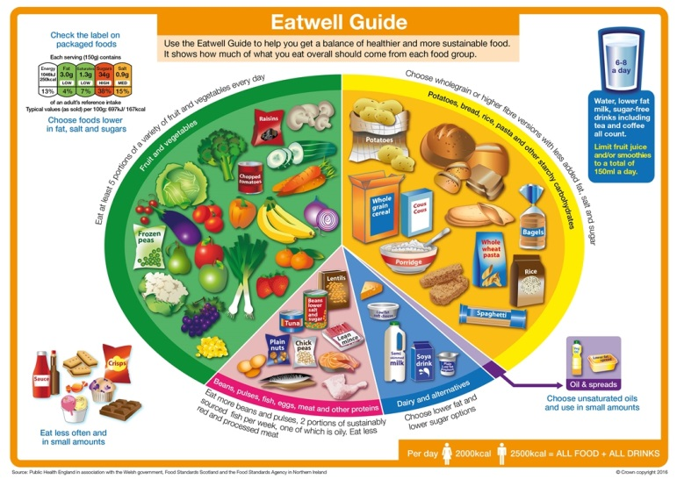
The Eatwell Guide
We should all be following the healthy eating model. In the UK, this is known as the Eatwell Guide.
The Eatwell Guide shows the proportions in which different groups of foods are needed in order to have a well-balanced and healthy diet.
The proportions shown are representative of food eaten over a day or more, not necessarily at each mealtime.

Slide 6
Healthy eating and sustainable diets – applying your knowledge
We should all be choosing a variety of different foods from each food group to help get the wide range of nutrients the body needs to stay healthy.
Following the Eatwell Guide can also be good for the environment/planet, as well as your own health.

Slide 7
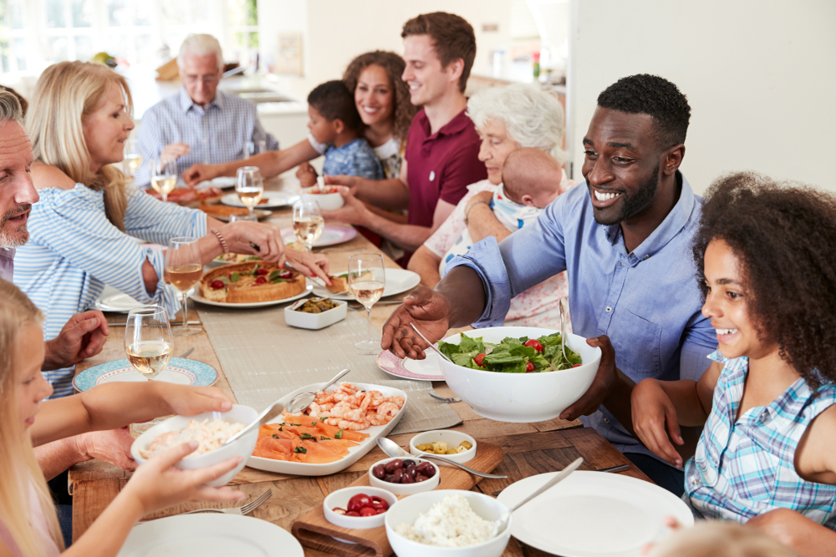
The Eatwell Guide
The Eatwell Guide applies to most people regardless of weight, dietary restrictions/preferences or ethnic origin.
It does not apply to children under two years because they have different nutritional needs.
Children aged two to five years should gradually move to eating the same foods as the rest of their family, in the proportions shown on the Eatwell Guide.
The guide can help you make choices for yourself and others.

Slide 8

What do you know?
Test your knowledge by taking the Eatwell Challenge interactive game.
Your challenge is to put each food in the right place.
You will score one point for each food placed correctly.
Can you get all 20 correct?
Any in the wrong place? Why? Where should they be?
Click on the image above to take the challenge

Slide 9
Eight tips for healthy eating
These eight practical tips cover the basics of healthy eating, and can help you make healthier choices.
Base your meals on starchy carbohydrates
Eat lots of fruit and veg
Eat more fish – including a portion of oily fish
Cut down on saturated fat and sugar
5. Eat less salt
6. Get active and be a healthy weight
7. Don’t get thirsty
8. Don’t skip breakfast

Slide 10


Health status in children and young people
Intake of key foods (11-18 year-olds)
12%
4%
2g
Getting 5-A-Day
Getting enough fibre
Average oily fish eaten per day
Overall the dietary quality in UK adolescents is poor.
The National Diet and Nutrition Survey shows the highest consumption of sugar-sweetened soft drinks is by young people aged 11 to 18 years.
NDNS: results from years 9 to 11 (2016 to 2017 and 2018 to 2019)
Wimpenny et al., 2018

Slide 11
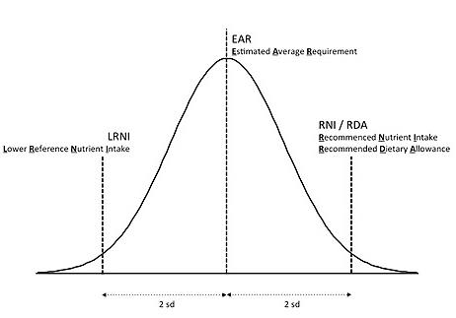
Vitamins and minerals
During childhood and adolescence, requirements for nutrients are high, due to rapid growth and development.
Reference Nutrient Intakes and Lower Reference Nutrient Intakes are set for vitamins and minerals.
These help to indicate how many people are at risk of deficiency.

Slide 12
Vitamins and minerals (11-18 years)
Vitamin or Mineral | % Boys below LRNI | % Girls below LRNI
Iron | 11% | 49%
Calcium | 14% | 16%
Zinc | 20% | 16%
Iodine | 19% | 28%
Vitamin A | 18% | 18%
Riboflavin (B₂) | 13% | 22%
NDNS: results from years 9 to 11 (2016 to 2017 and 2018 to 2019)

Slide 13
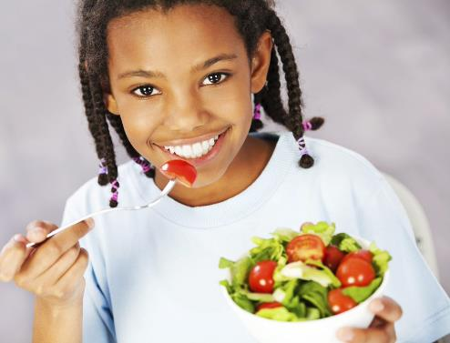
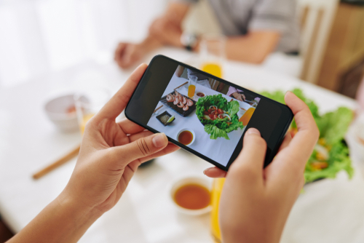
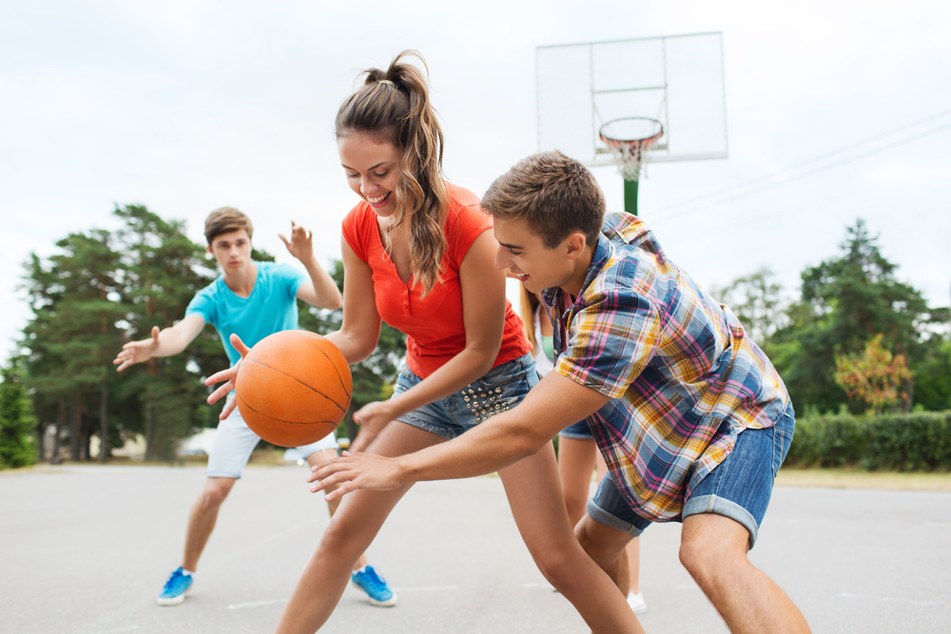
Planning
What are the key messages that you will build into your social media campaign?
Put together your ideas to make a plan!

Slide 14

The Challenge
Create a social media campaign to encourage teenagers of your age to make better healthy eating choices.
Good luck!

Slide 15
Teacher’s guide

Slide 16
The Food – a fact of life Challenges
The Food – a fact of life Challenge activities have been written to support teachers not following the national curriculum for their specific country or those following a challenge or theme-based approach. However, they could be used in any school across the UK.
The Challenges cover healthy eating, cooking and where food comes from and provide a wide range of activities that teachers can select depending on their pupils’ needs, age and abilities, and the time available.
There are 12 Challenges developed to be used with nursery, primary or secondary pupils.
Each Challenge comprises the Challenge, opportunities for learning and a variety of pupil activities that can be completed individually or in groups. Each Challenge culminates in a final outcome, which could be paper based, such as a report, poster, newspaper article or PPT presentation, a video or interactive activity, or a recipe, menu or dish/range of dishes, depending on the theme of the Challenge.
Optional pupil certificates are available to download and personalise once the Challenge has been achieved.

Slide 17
The 11-14 Healthy Eating Challenge
Create a social media campaign to encourage teenagers of your age to make better healthy eating choices.

Slide 18
Opportunities for learning
By undertaking this challenge, the opportunities for learning include:
researching the Eatwell Guide and how it can be applied to make healthy food choices;
investigating the key messages and foods included in each group of the Eatwell Guide;
applying knowledge of healthier and more sustainable diets;
investigating energy and nutrients;
investigating the energy and nutrient provided by different food commodities using a nutritional analysis programme;
exploring the benefits of an active lifestyle.

Slide 19
How can pupils complete the Challenge?
A range of activity suggestions have been provided – you choose the ones that are most suitable for your pupils and the time that you have available to complete the challenge.
Activities include:
Finding out – activities around investigating the Eatwell Guide, applying knowledge of healthy eating to food choice, energy and nutrients, benefits of physical activity.
Making and evaluating – activities around applying knowledge of healthy eating and sustainable diets, demonstrating a range of practical food skills and cooking methods, demonstrating the principles of food hygiene and safety.
Bringing it all together – planning and producing a social media campaign to encourage healthy eating choices.

Slide 20
Finding out - activities
Pupils, individually or in groups, could:
Eatwell Guide
View the Eatwell Guide interactive resource on each section, take notes on the key points for each group and foods which fit into each group.
Complete the Eatwell Guide blank worksheet using a set of the Eatwell Guide food cards. Working in pairs, ask the pupils to sort the cards and place them in the correct food group on the blank Eatwell Guide.
Complete the Eatwell Guide quiz (with a certificate available).
Complete the My Diet worksheet to see how well they are meeting the healthy eating guidelines. Plan any changes that might be needed to meet the guidelines.

Slide 21
Finding out - activities
View the 8 tips for healthy eating presentation and complete the 8 tips for healthy eating worksheet.
Energy and nutrients
View the Nutrients presentation and complete the accompanying worksheets.
Test their knowledge of nutrients using the Nutrients Quiz.
View the Energy presentation and complete the worksheet and Energy requirements quiz.
Use the Energy needs worksheet – estimate the amount of energy each person will need. Play the interactive Energy in, Energy out quiz and test their knowledge of how much energy is provided by different food and how much is used when there are active.

Slide 22
Finding out - activities
Complete an activity in which different nutrients are matched with their roles using the Nutrient Matching cards.
Investigate the dietary needs of teenagers, including health issues related to being overweight/obese and the risks associated low intakes of some vitamins and minerals (vitamin A, iron, calcium, zinc and iodine).

Slide 23
Finding out - activities
Nutritional analysis
Investigate and use the Explore Food nutritional analysis tool. It can be used to by pupils do an analysis of a recipe or a day’s diet. Information on using Explore Food and templates can be found here.
Record a food diary for two days and use Explore Food to calculate the energy and nutrients provided.
Download the nutrients cards. Use these cards as a line up activity (lining up from highest to lowest on different vitamins and minerals). Explore food can be used to create your own nutrients cards to add to the set by typing in 100g of a food and writing down the numbers shown for each nutrient.

Slide 24
Finding out - activities
Physical activity
View the Benefits of physical activity presentation and complete the Benefits of physical activity worksheet.
View the Activity guidelines presentation. Discuss their physical activity with a partner. Do they meet the recommendations for their age/life stage? Ask each pair to suggest one way to increase physical activity in order to meet the recommendations.
Use the Food Route active lifestyles journal for pupils up to 14 years as an extended piece of homework.
Complete the diet and health Food Route journal which looks at energy balance, eating well and nutrients.

Slide 25
Finding out - activities
Social media
Listen to the Making better choices with the Eatwell Guide podcast to further enhance their knowledge of the Eatwell Guide. Challenge the pupils to create their own short video or podcast which could be shared with the school community and parents/carers via your school website.
Investigate and trial suitable methods of capturing images of food for their social media campaign.
Create a recipe video of one of the dishes made that would be suitable for a recipe website, social media or YouTube channel. Examples of short recipe videos, can be found here.

Slide 26
Making and evaluating - activities
Pupils could:
View the Healthier cooking methods presentation to support applying healthy eating messages when making their dish(es).
Create a dish that includes a starchy carbohydrate as a main ingredient. This could be an opportunity to use some wholegrain ingredients that are less familiar to the pupils e.g. starchy vegetables, bulgur wheat, millet, sorghum, quinoa, cornmeal, oats, barley and rye.
Prepare and make a breakfast dish that includes fruit and/or vegetables. Complete a nutritional analysis using Explore Food.
Plan and make a dish (or dishes) that could be used in the campaign to demonstrate how healthier and more sustainable food choices can be made. Photograph or video the recipe. These recipes can be filtered by commodity, complexity, time, skills and cooking method.

Slide 27
Making and evaluating - activities
Investigate a variety of beans and pulses, discuss the benefits of eating them regularly, e.g. they are a cheap, low-fat source of protein, fibre, vitamins and minerals and count towards your 5 A DAY.
Use the Multi-cultural cooking with beans and pulses worksheet to research the use of beans and pulses around the world. Challenge the pupils to make one of the recipes they found during the research task and to carry out a sensory analysis with their peers.
Apply their knowledge by planning and making a dish which would provide at least two portions of fruit and vegetables and use potatoes, bread, rice, pasta and other starchy carbohydrates.

Slide 28
Bringing it all together
Pupils should:
Plan and create a social media campaign to encourage teenagers to make better healthy eating choices.
The campaign should showcase their knowledge of:
The Eatwell Guide applied to making healthy food choices;
energy and nutrients;
activity guidelines;
suitable dish/dishes that demonstrate appropriate choice of ingredients and cooking methods.

Slide 29
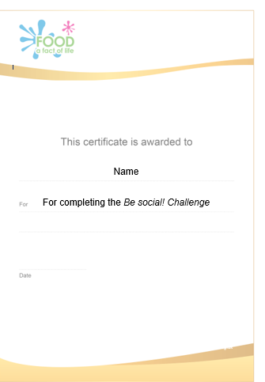
Celebrating success
Optional pupil certificates are available to download and personalise once the Challenge has been achieved.
Why not present the certificates at a celebration assembly or award ceremony?
Downloadable certificate

Slide 30
Be social!
For further information, go to:
www.foodafactoflife.org.uk
This resource meets the Guidelines for producers and users of school education resources about food.

