Slide 1
Twist the dish!

Slide 2
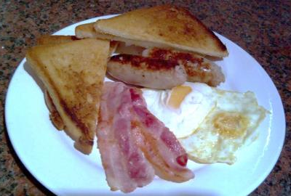
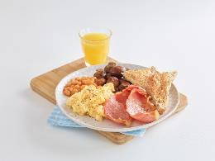
Twist the dish!
Spot the difference!

Slide 3
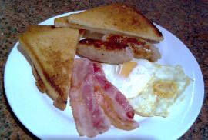

Twist the dish!
Breakfast one
Two sausages
Two streaky bacon rashers
Two fried eggs
Fried bread
Breakfast two
2 grilled lean bacon rashers
Scrambled egg
Grilled mushroom
Baked beans
Wholemeal toast
Small glass of orange juice

Slide 4
Twist the dish!
Consider the impact of the changes in the breakfast on:
Taste and appearance.
Nutritional content.
8 tips for healthy eating.

Slide 5
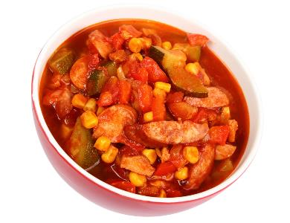
Twist the dish!
Eating healthily does not always mean avoiding certain dishes.
Modifications can be made to dishes to make these healthier.
Healthier dishes can be created by:
choosing lean meat;
changing the cooking method;
adding plenty of fruit and vegetables;
considering portion size;
modifying the recipe for example reducing the fat or type of fat used in a recipe.

Slide 6
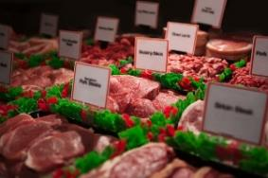
Choose lean meat
Different cuts of meat have different amounts of saturated fat.
It is important to reduce the amount of saturated fat in the diet.
Choose lean cuts of meat where possible.
Trimming away any visible fat before cooking is also a useful strategy to reduce the amount of fat in the dish.

Slide 7
Change the cooking method
Which of the following cooking methods do not require the addition of any fat?
Dry frying, grilling or barbecuing do not require any fat to be added during cooking.
A grill or barbecue allows the fat to drain away during cooking.
Shallow frying Deep frying Stir frying
Dry-frying Grilling or barbecuing Roasting

Slide 8
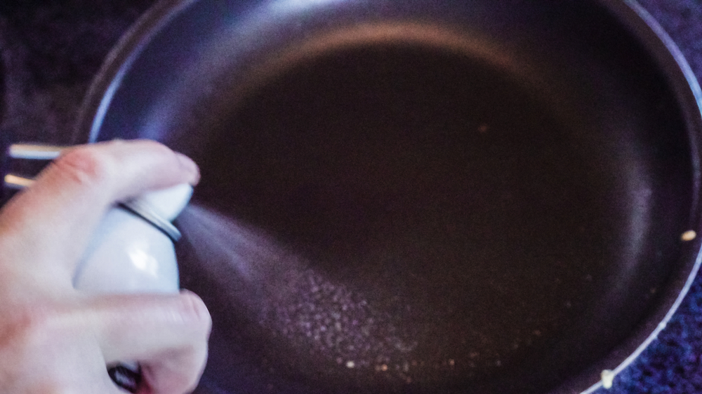
Change the cooking method
When stir-frying or shallow frying, the oil can be measured with a spoon before adding it to the frying pan or wok. Alternatively, use spray oil instead.
Fat can be drained from meals, e.g. if making a casserole, fat can be skimmed from the top; after frying mince the fat can be drained away.

Slide 9

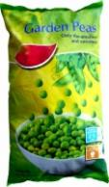
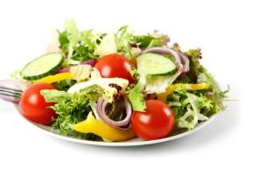


Add plenty of fruit and vegetables
Fruit and vegetables are nutritious. They provide the body with dietary fibre, vitamins A and C, minerals and water or fluid. How can these be incorporated into a meal?
Frozen or canned vegetables are often prepared in smaller sizes and can conveniently be added to many meals. These can create more interest and colour in the dishes.
Steamed vegetables and salads make great sides. Think beyond lettuce when considering salads.
Soups and sauces are easily made with fruit and vegetables.

Slide 10
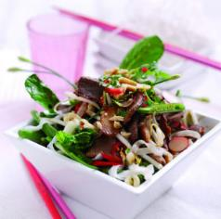
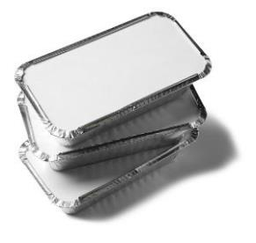
Consider portion size
Enjoying a smaller sized dish will reduce the amount of energy consumed.
Start small, second helpings can always be offered later. Serving dishes on smaller plates helps the meal to look larger than it is.
Large quantities of food make people want to eat more. Serve a sensible portion size of food to eat and set leftovers to one side ready to cool and refrigerate.

Slide 11
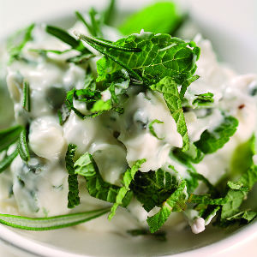
Modify the recipe
Making changes to a recipe can help reduce the fat, salt or sugar provided by the dish.
Rather than adding salt try other herbs and spices to flavour the food – you might be pleasantly surprised.
Switch to low fat options of dairy foods when cooking.
Marinating meat can help add flavour to leaner cuts of meat.

Slide 12
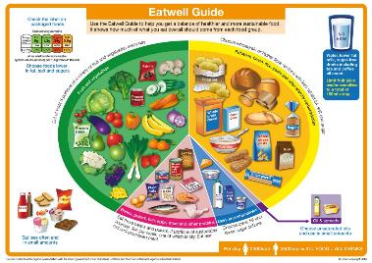
Twist the dish - activity
8 tips for healthy eating
1. Base your meals on starchy foods
2. Eat lots of fruit and veg
3. Eat more fish, including oily fish
4. Cut down on saturated fat and sugar
5. Eat less salt
6. Get active and be a healthy weight.
7. Don’t get thirsty
8. Don’t skip breakfast
In groups, review the dish card you have been assigned.
Re-design the meal to promote the key messages of The Eatwell Guide and 8 tips for healthy eating.

Slide 13
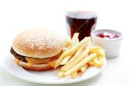
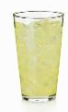
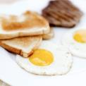
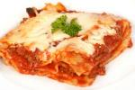

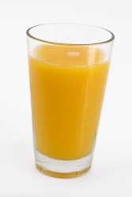
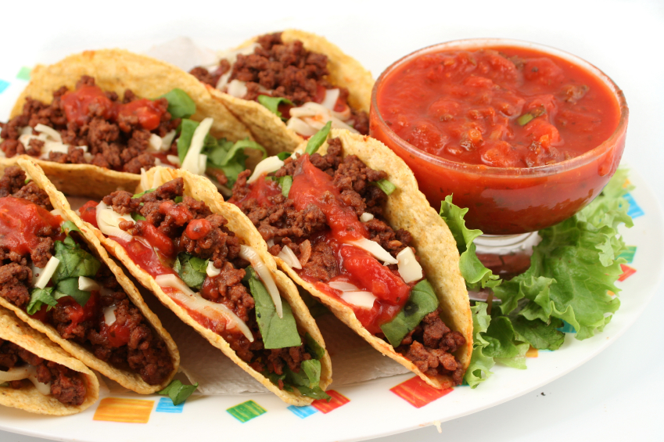

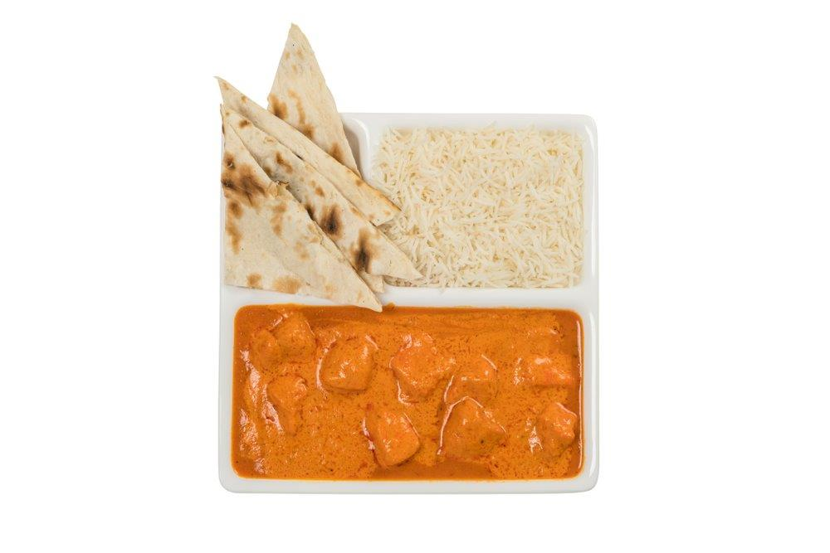

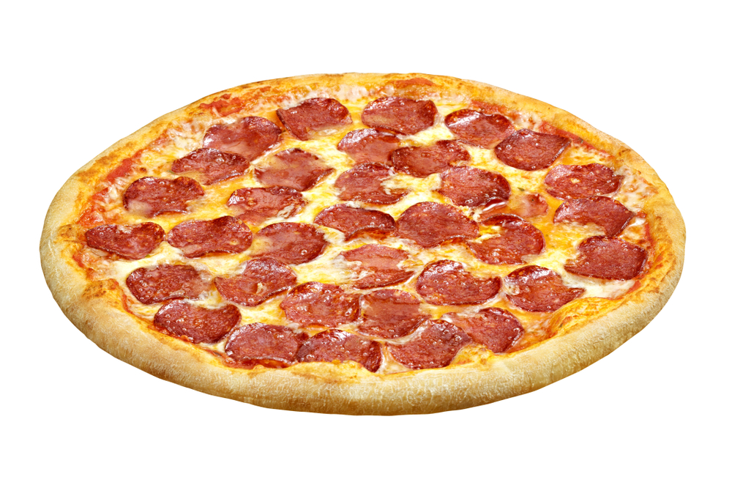
Twist the dish! - dish card feedback
Steak, eggs, toast and tea
Burger, chips and soft-drink
Lasagne and lemonade
Beef tacos and orange juice
Pizza and sports drink
Indian curry and water

Slide 14
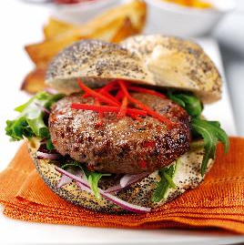
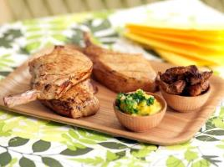
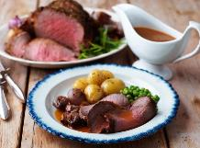
Marvellous meal makeovers – some suggestions
Trim visible fat from meat before cooking
Consider portion sizes
Choose lean meat
Additional tips and tricks:
Base your meals on starchy foods by serving with potato wedges.
Consider portion size 1 lean pork chop is approximately 70g.
Additional tips and tricks:
Go easy on the gravy as it can be high in fat and salt.
A portion size 2 slices of roast beef is approximately 70g.
Additional tips and tricks:
Add finely chopped vegetables to the mince mixture.
Grill or barbecue the burger.

Slide 15
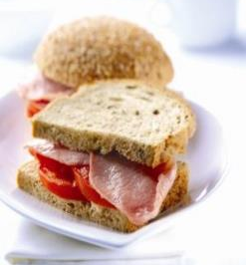
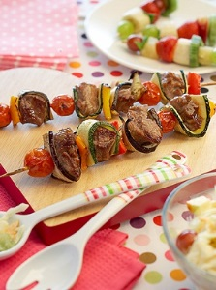
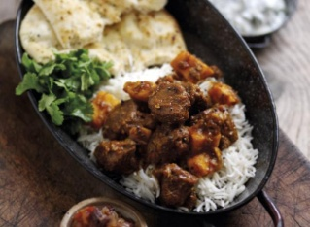
Twist the dish!
Change the
cooking method
Modify the recipe
Add plenty of fruit and vegetables
Additional tips and tricks:
Choose lean back bacon, trimming away any fat before grilling.
Incorporate vegetables into the sandwich such as tomato or mushrooms.
Additional tips and tricks:
Trim any visible fat from the meat before cutting cubes.
Marinate the meat to add extra flavour.
Additional tips and tricks:
Add bean and/or lentils to increase the fibre content.
Choose a tomato based sauce rather than a creamy one.

Slide 16
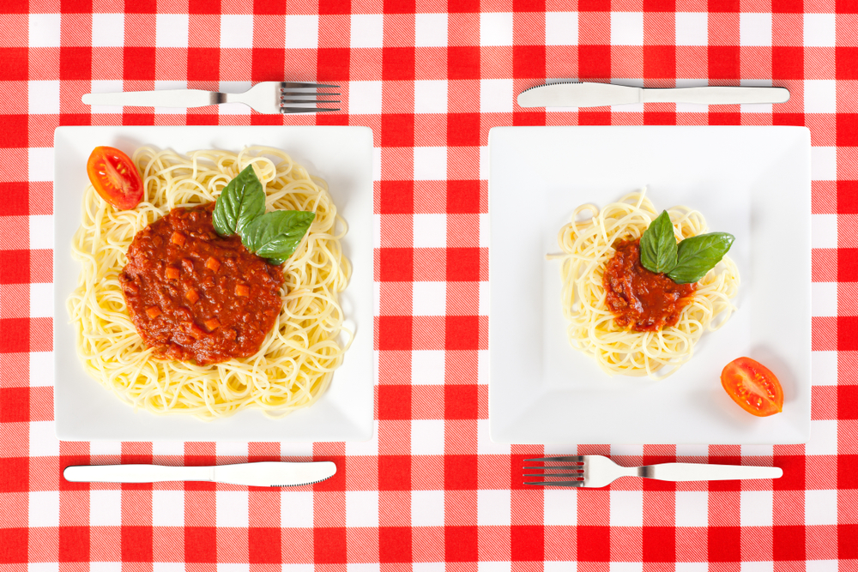
Summary
Choosing to eat healthily does not mean excluding meals from your diet. Simple strategies can help people to enjoy a wide variety of meals within their diet.
These strategies include:
choosing lean meat;
changing the cooking method;
adding plenty of fruit and vegetables;
considering portion size;
modifying the recipe.

Slide 17
Twist the dish!
For further information, go to:
www.foodafactoflife.org.uk
This resource meets the Guidelines for producers and users of school education resources about food.

