Slide 1
Alcohol

Slide 2
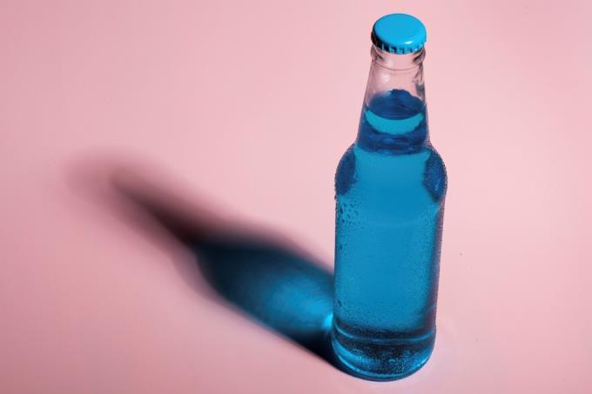
Alcohol
Alcohol is not considered a nutrient but is a source of energy in the diet.
Did you know?
Each gram of pure alcohol provides 7kcal/29kJ of
energy.

Slide 3
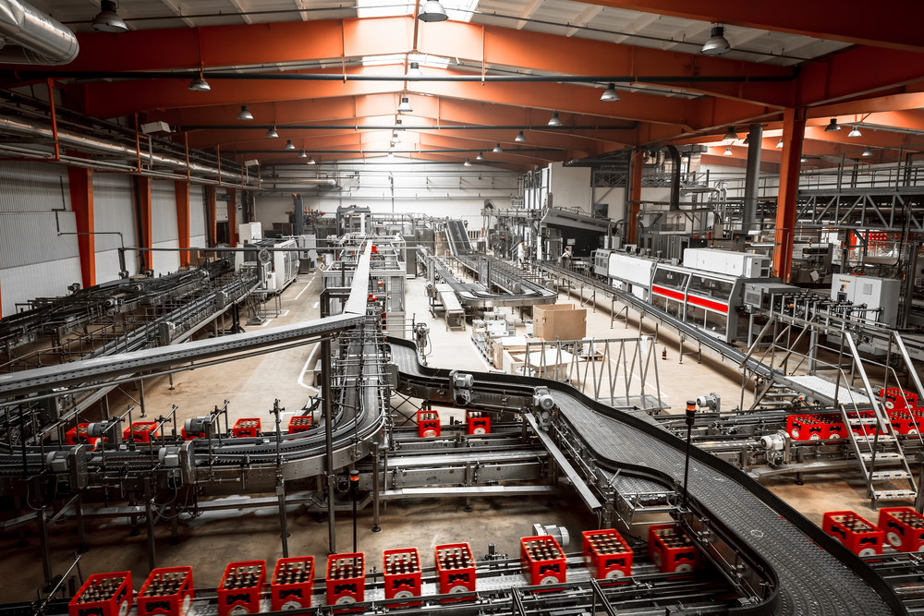
How is alcohol produced?
Alcohol is produced by a process called fermentation.
During fermentation microbes called yeasts grow by
feeding on the sugars (e.g. glucose).
As they grow, the yeasts produce alcohol and carbon
dioxide.
This equation shows what happens:
C₆H₁₂O₆ 2C₂H₅OH + 2CO₂ (+ ENERGY)
Glucose Ethanol Carbon dioxide

Slide 4

Alcoholic drinks
The amount of alcohol in drinks is expressed as a percentage present named as Alcohol by Volume (ABV) and usually varies from 0 - 50%. Spirits such as whisky and vodka have a higher alcohol content than wines or beers. Fruits such as grapes and apples are used to make alcoholic drinks such as wine and cider.
Did you know?
Cereals, e.g. barley and rye, are used to make beer and spirits. Spirits are made through the distillation process.

Slide 5
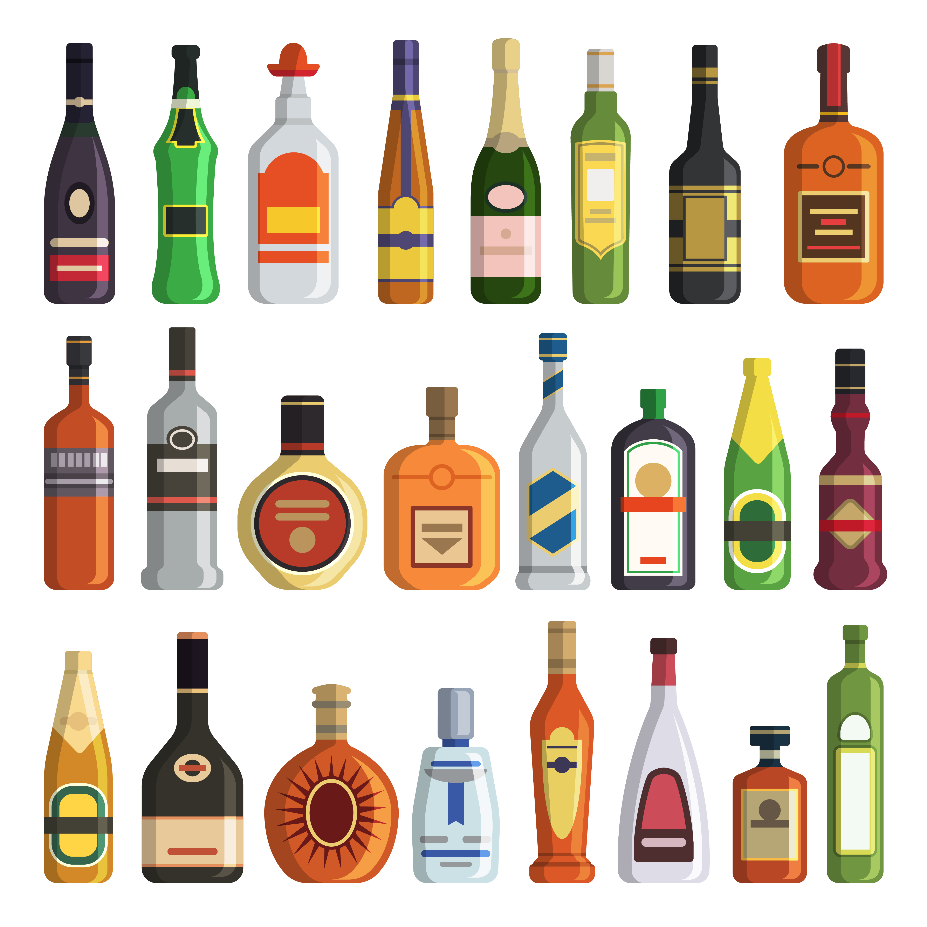
Typical alcohol content of drinks
Drink % alcohol
Spirits 40
Sherry 15-20
Wine 10-15
Strong lager, beer or cider 3-6
Low alcohol lager, beer or cider 1-1.5

Slide 6


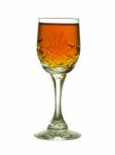
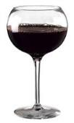
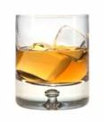
One unit of alcohol
A standard way of measuring the alcohol content in drinks is in units of alcohol.
One unit contains 8 grams or 10ml of pure alcohol (ethanol). For example:
A single pub measure
of spirits.
25ml ~40% alcohol
A glass of sherry or fortified wine
50ml ~20% alcohol
½ glass of table wine
100ml ~10% alcohol
½ pint of regular lager, beer or cider 284 ml ~3.8% alcohol
1 pint of low alcohol beer or cider
568 ml ~2% alcohol

Slide 7
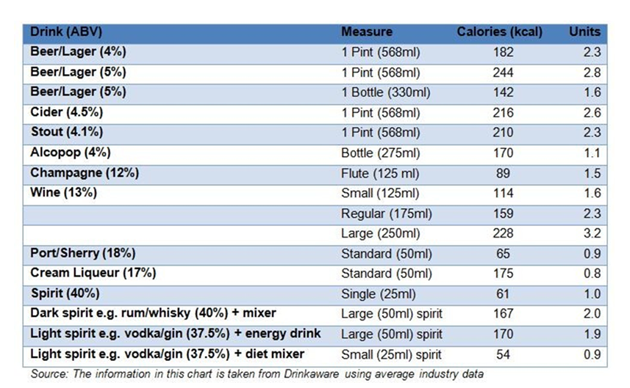
Units and energy within alcohol
You can work out how many units there are in a drink by multiplying the total volume of a drink (in ml) by its ABV (measured as a percentage) and dividing the result by 1,000.

Slide 8
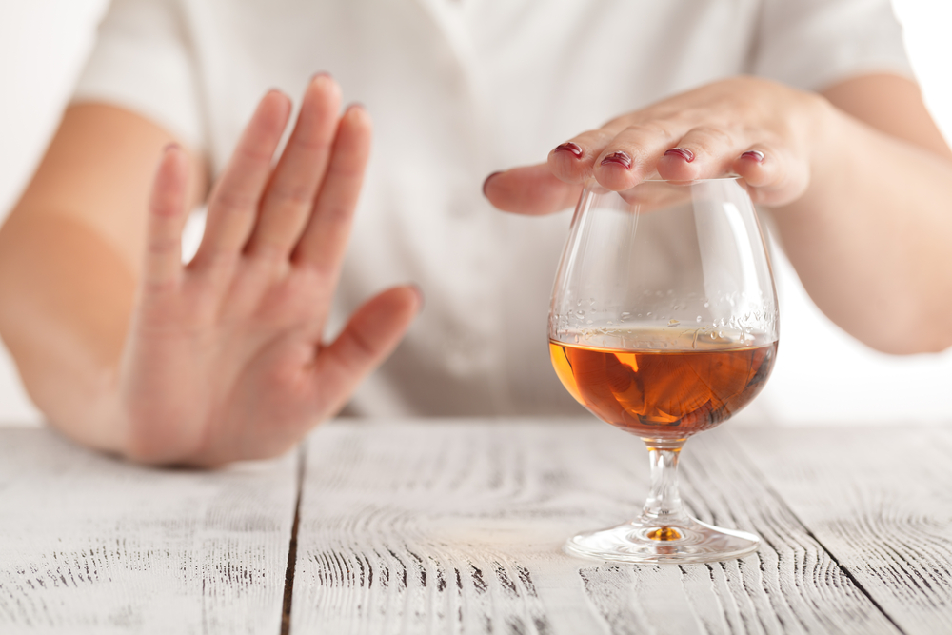
Sensible drinking
The government recommends no more than 14 units of alcohol per week for both men and women.
An additional recommendation is not to ‘save up’ the 14 units for 1 or 2 days, but to spread them over 3 or more days. People who have 1 or 2 heavy drinking sessions each week increase the risk of death from long term illnesses, accidents and injuries.
Alcohol Guidelines UK

Slide 9
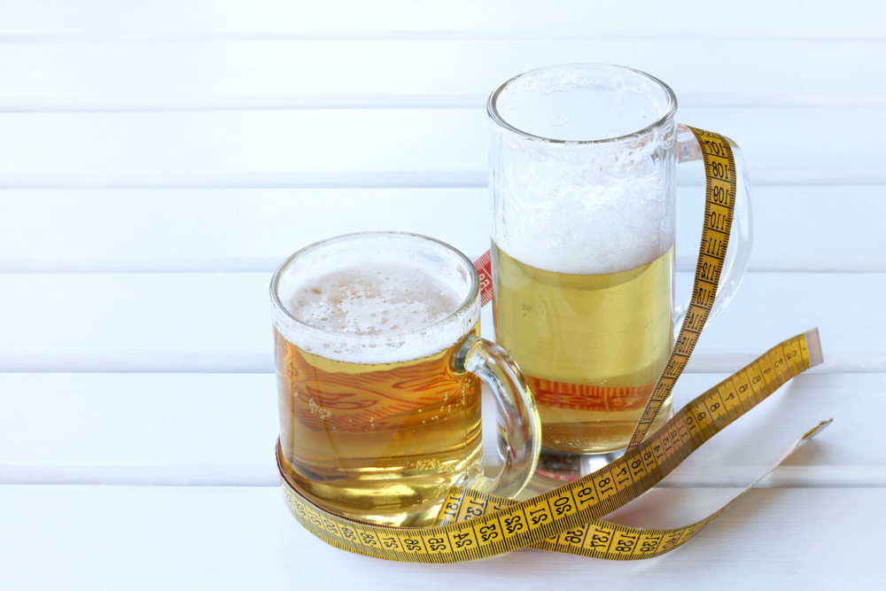
Controlling energy when drinking
As alcohol can be high in energy it is important to try and reduce the amount of calories you consume when drinking. Ways to do this include:
alternating alcohol containing drinks with low calorie soft drinks or water;
making sure you know how much you are actually drinking;
sticking to single measures and use sugar free drinks for mixers;
switching from pints to half pints or bottles and opt for a smaller wine glass;
Avoiding sweet wines or sweet ciders as these will typically have more calories than dry versions.

Slide 10
Drinking in pregnancy
It is best for pregnant women to avoid alcohol completely as it can damage the unborn baby.
The government now advises no level of alcohol is safe to drink in pregnancy, removing the previous advice for pregnant women to limit themselves to no more than 1-2 units of alcohol once or twice per week.
Heavy drinking during pregnancy can lead to foetal alcohol syndrome.
Children with this syndrome may have:
restricted growth;
facial abnormalities;
hearing and vision problems;
problems with the liver, kidneys, heart or other organs;
learning and behavioural disorders.

Slide 11
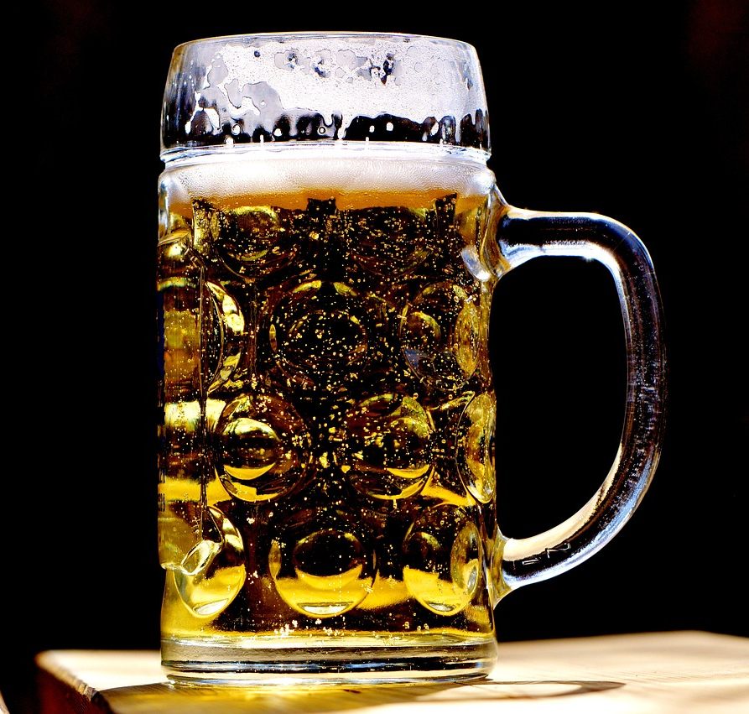
What happens to alcohol in the body?
Alcohol is absorbed from the stomach and the small intestine. This occurs more slowly if alcohol is consumed with food.
Alcohol is soluble in water and carried around the body in the bloodstream.
Alcohol is removed from the blood by the liver. The rate at which this happens depends on age, sex, body weight, liver size and how much alcohol was consumed.

Slide 12
How does alcohol affect the body?
Regularly drinking more than 14 units a week risks damaging your health and can contribute to increased risk of:
cancers of the mouth and throat;
heart disease and stroke;
liver disease;
brain damage;
damage to the nervous system.
Short term:
slower reaction times;
increased risk-taking;
judgement becomes blurred;
poor co-ordination.
This is why it is dangerous to drink alcohol before driving a car.
https://www.nhs.uk/conditions/alcohol-misuse/risks/

Slide 13
Alcohol
For further information, go to:
www.foodafactoflife.org.uk
This resource meets the Guidelines for producers and users of school education resources about food.

