Slide 1
Running practical food lessons and good food hygiene and safety
Claire Theobald, Education Services Manager (primary)
Frances Meek, Education Services Manager (secondary)

Slide 2
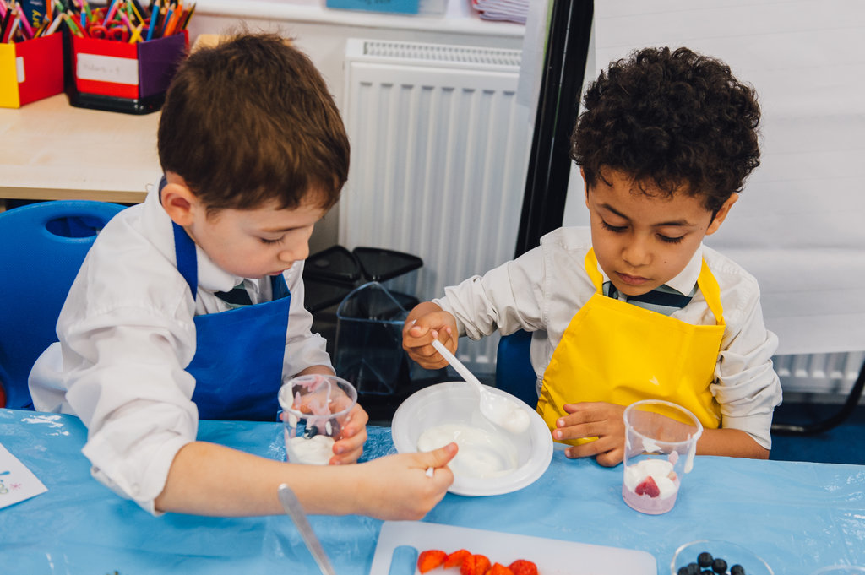
This session will cover:
How to run practical food lessons in the primary school classroom
- learning intentions
- organisation
- routines
How to ensure good food hygiene and safety
- classroom
- equipment and ingredients
- pupils
- adults
Resources to support practical food lessons and food hygiene and safety

Slide 3
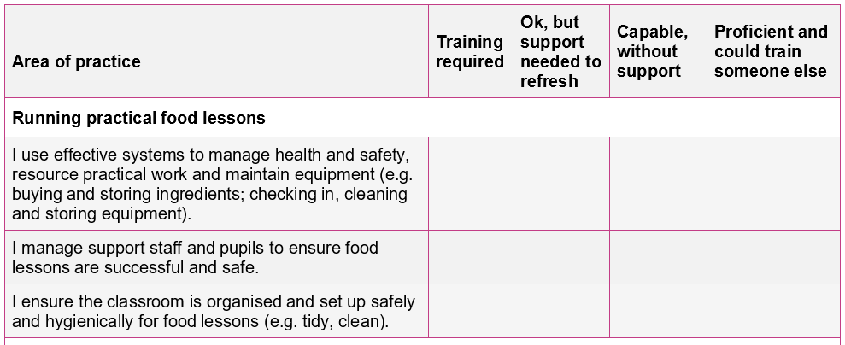

Your audit (completed with registration)
Running practical food lessons

Slide 4
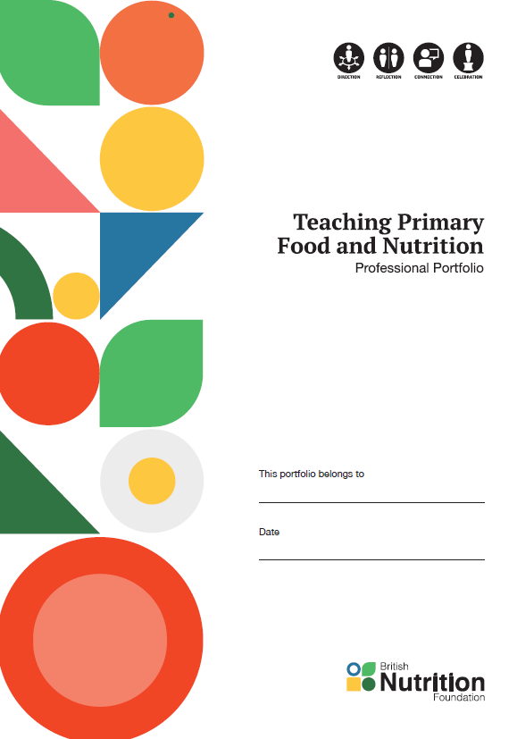
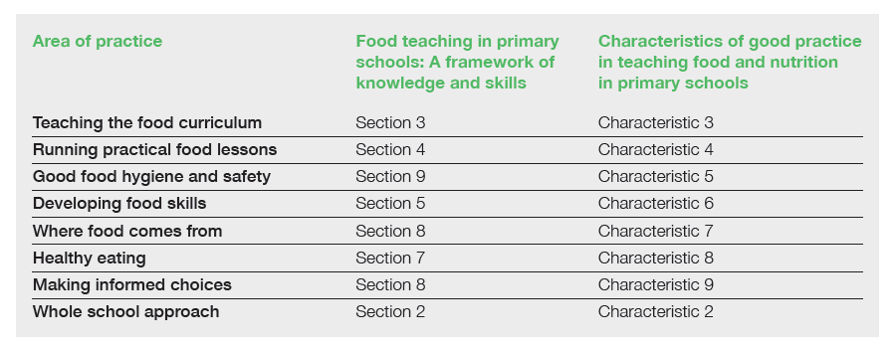
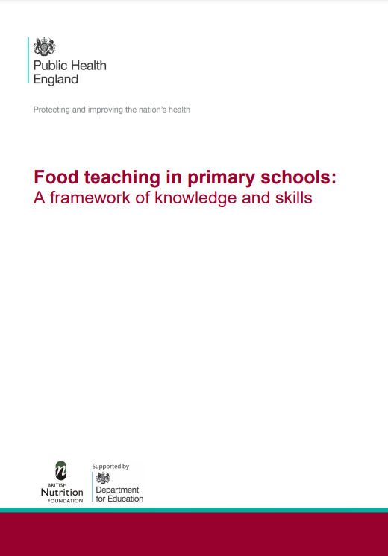

Running practical food lessons
Supporting documents
TPFN booklet, page 5

Slide 5
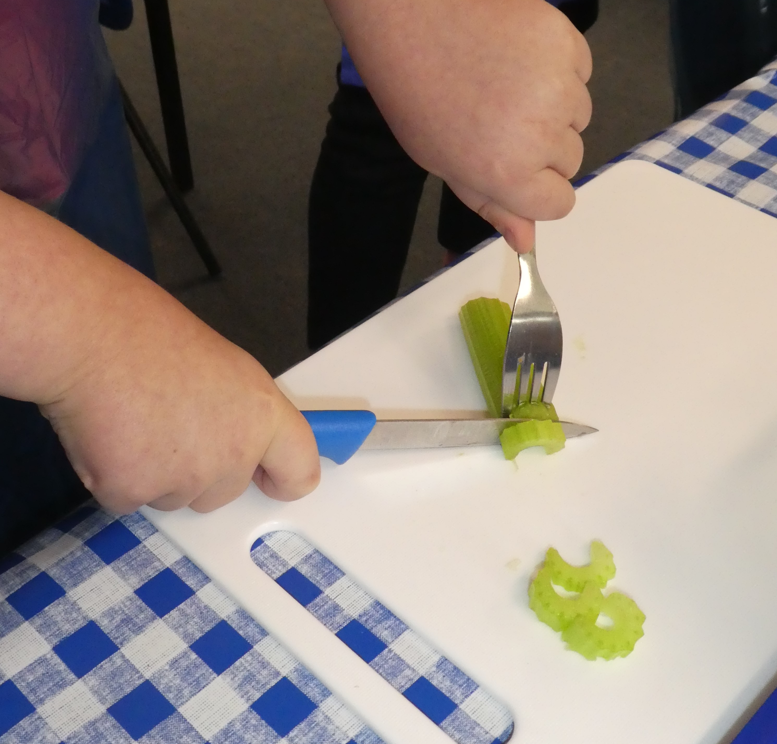
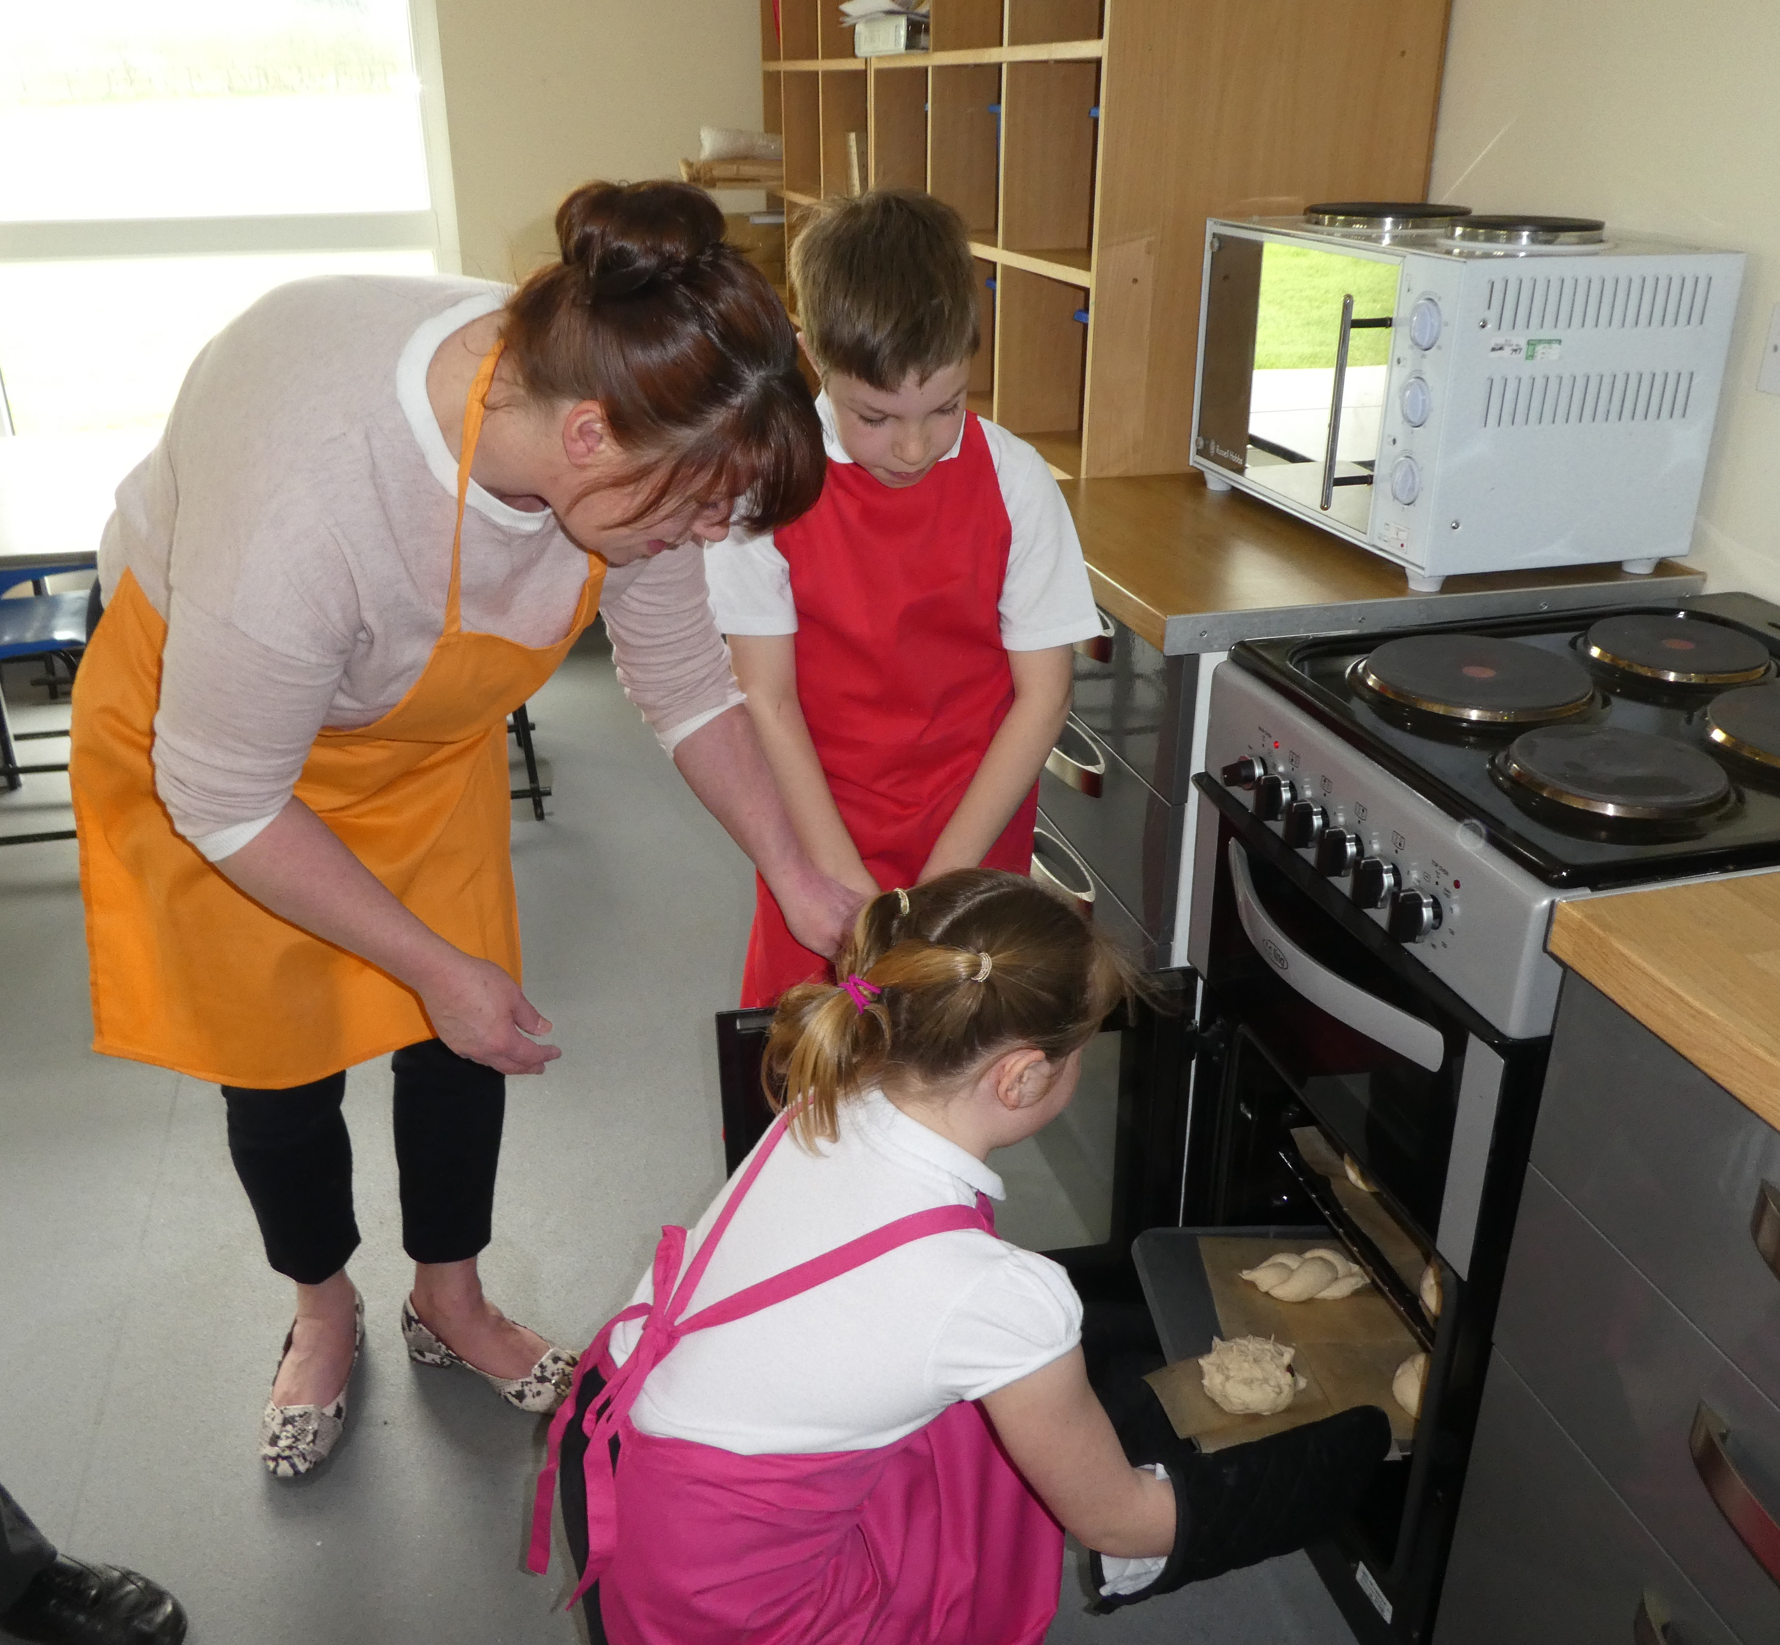
How to run practical food lessons in the primary school classroom
What is your learning intention/objective?
For children to able to:
get themselves ready to cook?
set up the classroom for a food activity?
layer a salad?
use the fork secure safely?
weigh and measure?
using an oven?
wash up?
Remember your focus – you don’t have to do it all in one lesson!

Slide 6
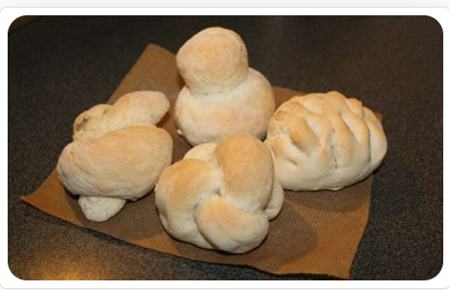
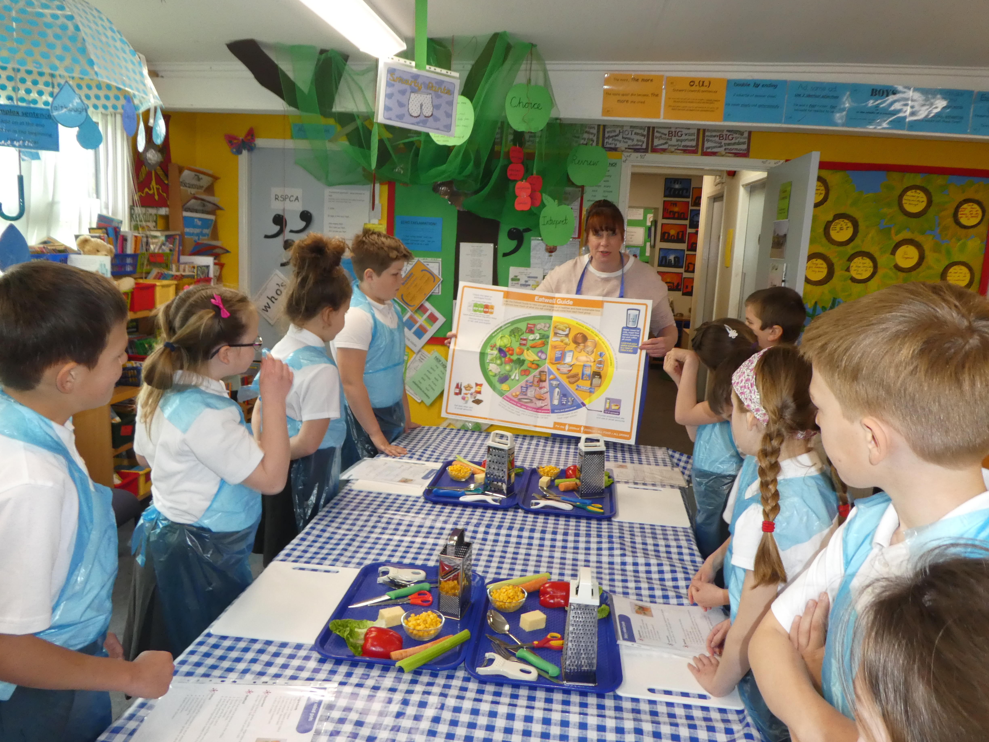
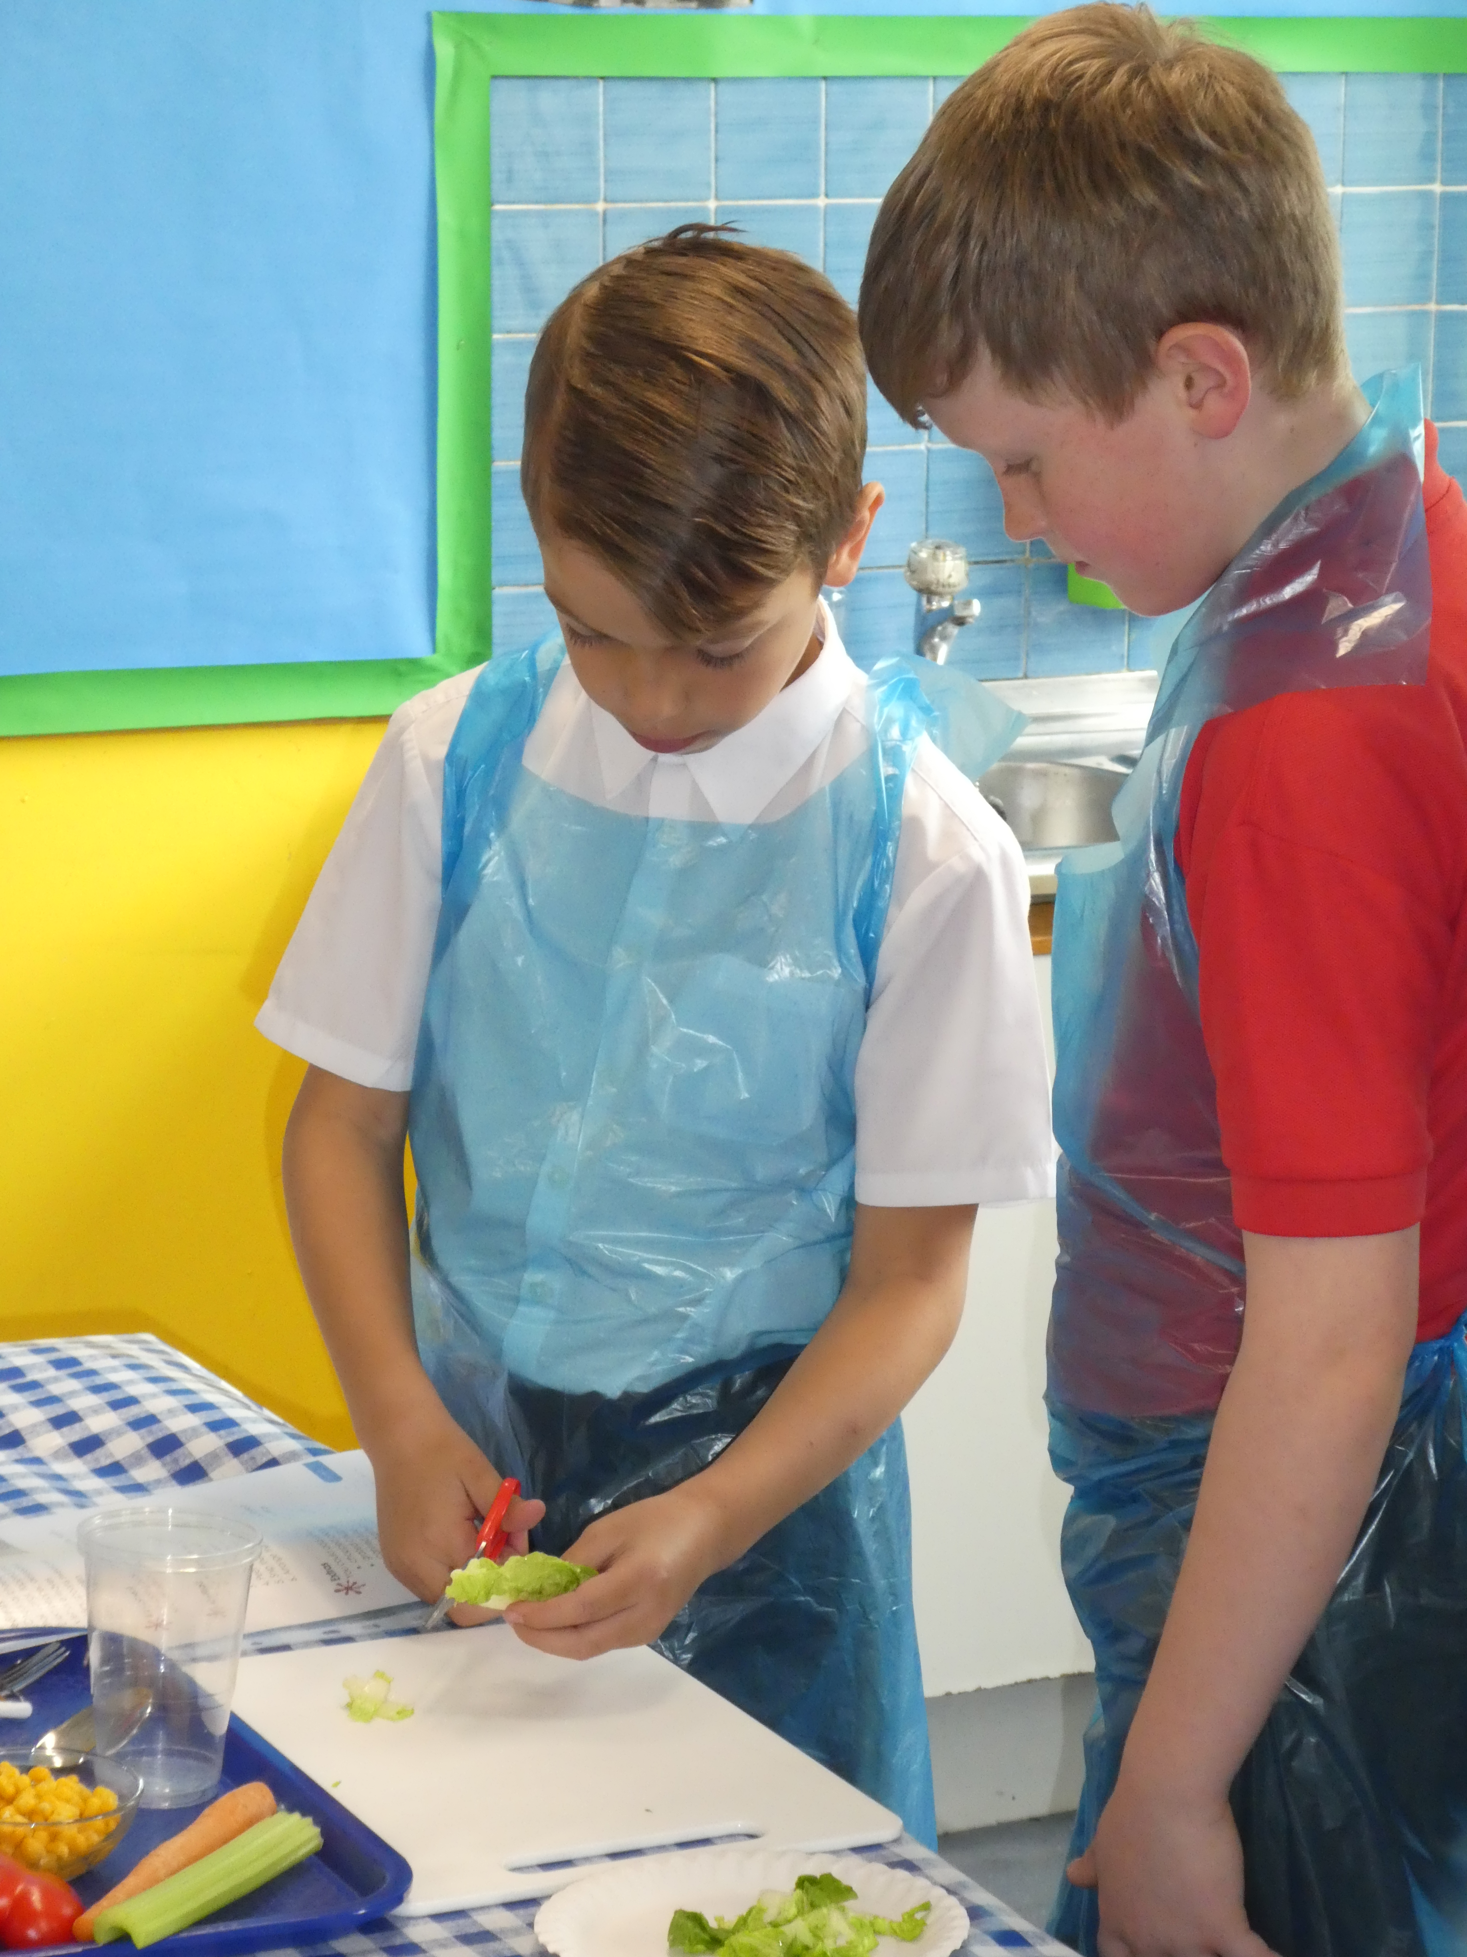
How to run practical food lessons in the primary school classroom
How will you organise the lesson?
Think about:
table/furniture layout?
individual or group work?
ingredients – partly prepared?
equipment – organisation, amount – group work, ‘spotters’?
demonstrating – how, where?
try it at home!
Organisation and preparation is key!

Slide 7
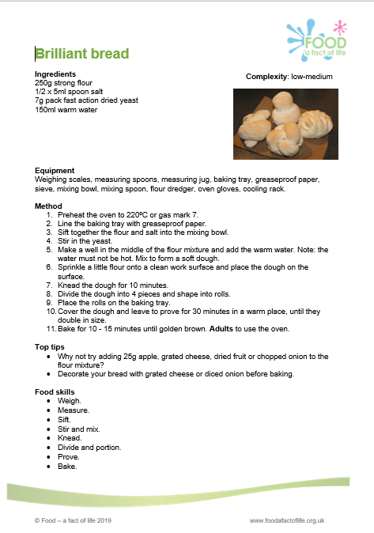
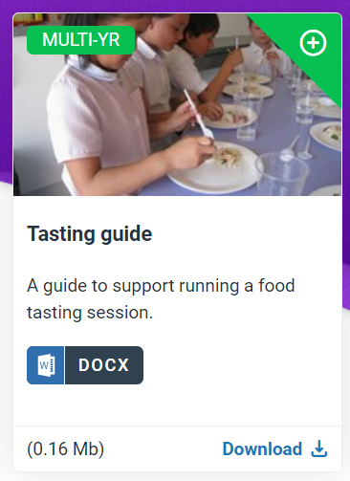
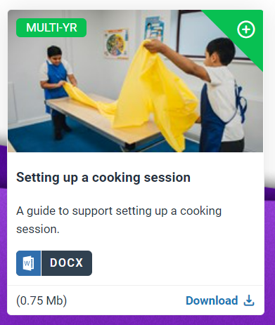
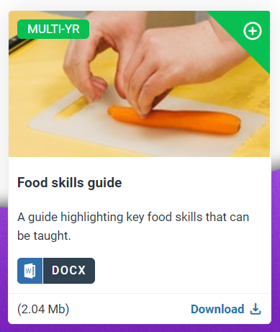
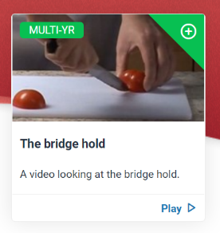
How to run practical food lessons in the primary school classroom
How will you organise the lesson?
Take a look at the guides, recipes and videos to help!

Slide 8
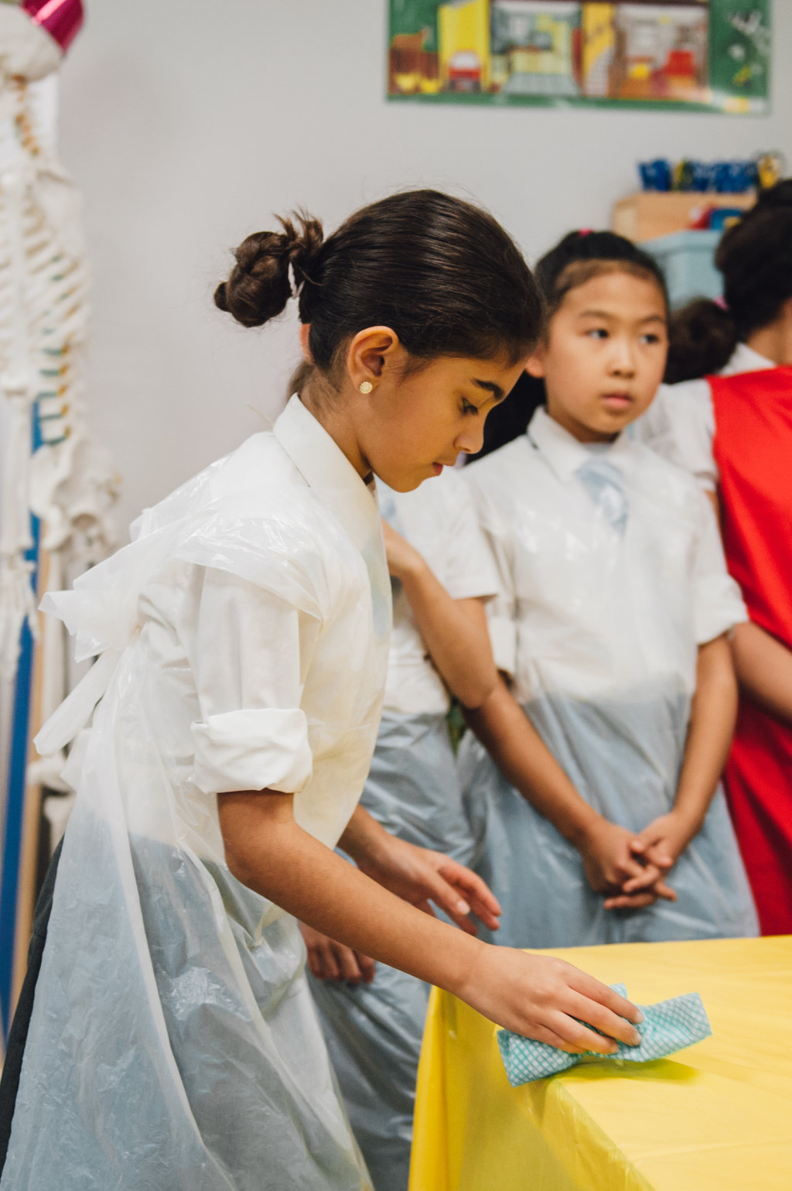
How to run practical food lessons in the primary school classroom
What routines and procedures will you have in place?
For:
getting pupils ready to cook, e.g. handwashing?
setting up, e.g. trays side of the room?
using sharp equipment, e.g. stay at the table?
tidying away, wiping tables, removing aprons?
washing up – where? rota?
food waste?
other adults?
Make sure everyone knows what they need to do!

Slide 9
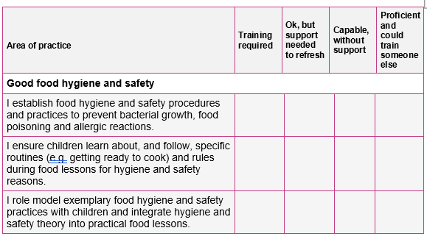
Your audit (completed with registration)
Good food hygiene and safety

Slide 10
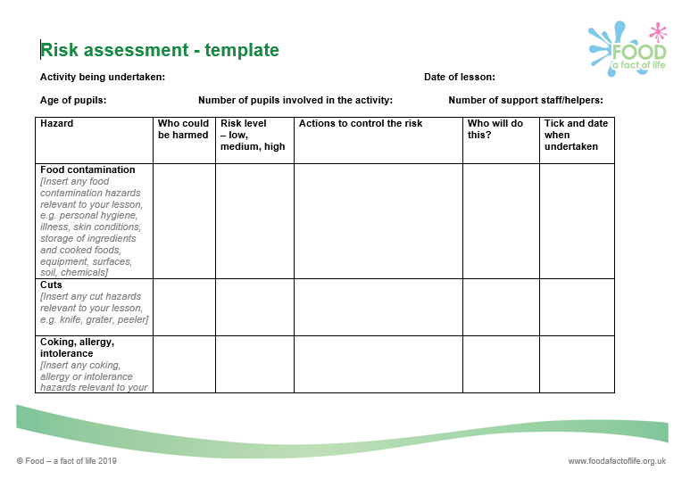
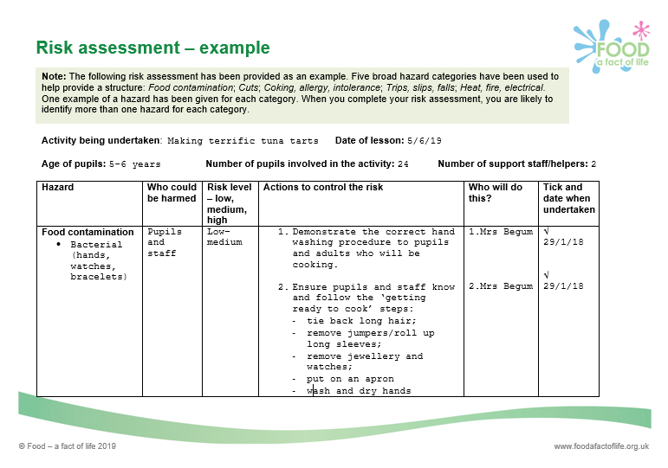
Why is good food hygiene and safety important?
To prevent food poisoning – pupils, parents and staff.
Teacher’s own indemnity.
Considerations:
Do you need a food hygiene and safety award/certificate?
Risk assessments – exemplars available on Food – a fact of life

Slide 11
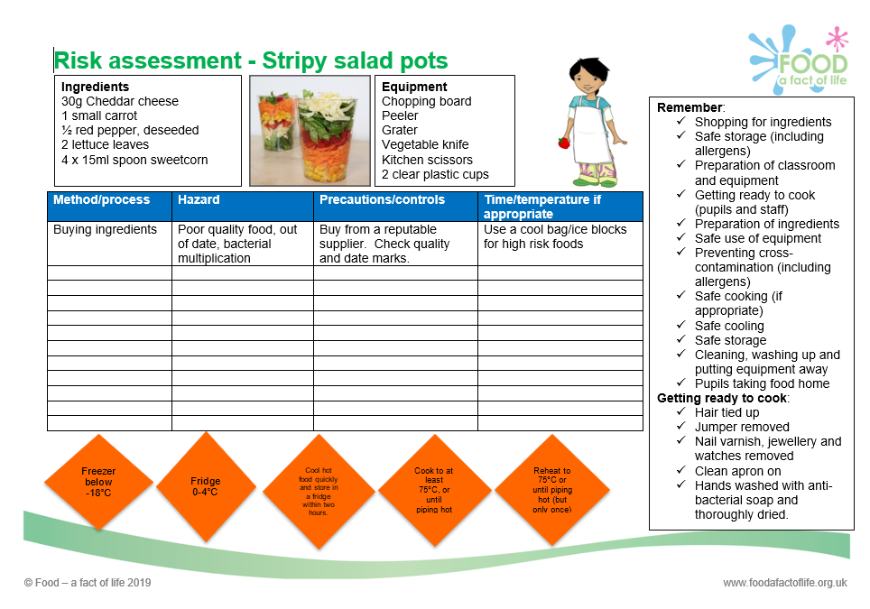
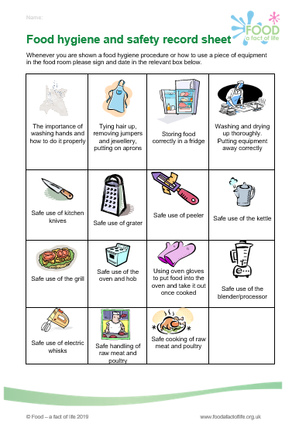
Record sheet
Risk assessment

Slide 12
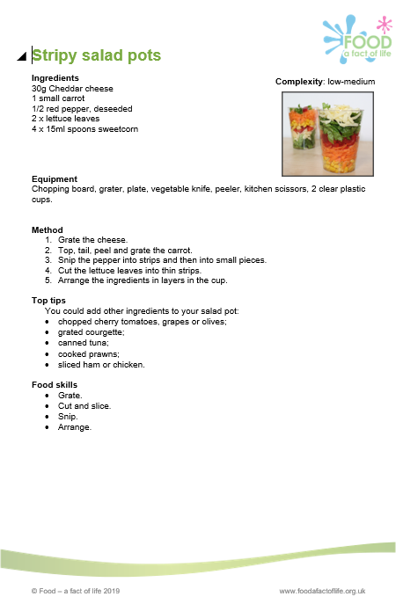
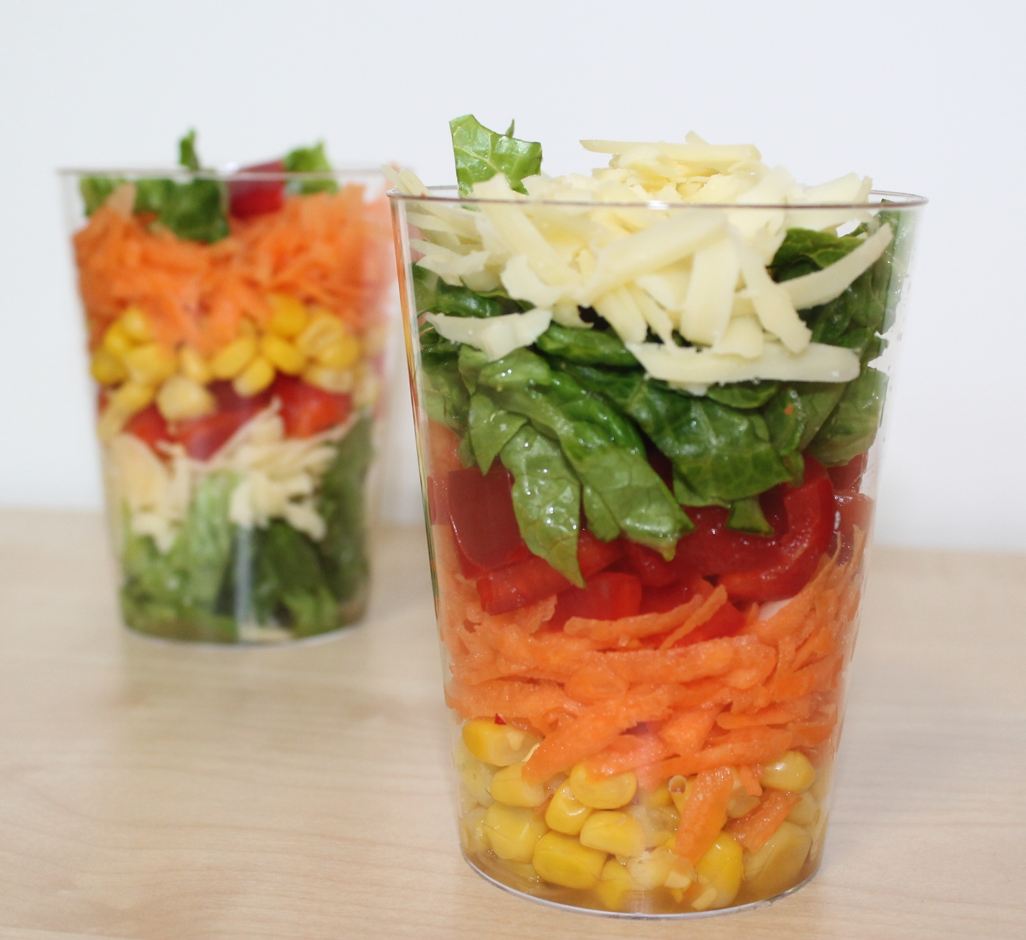
An ingredient check letter has been sent home.
Ingredients checked for allergens (especially packaged foods).
Do you need separate equipment for pupils with allergies or intolerances?
Equipment is appropriate for size of children’s hands.
Equipment is stored safely, that it is in working order, clean and ready to use (count knives and sharp tools out and in).
Ingredients and finished dishes are stored safely.

Slide 13
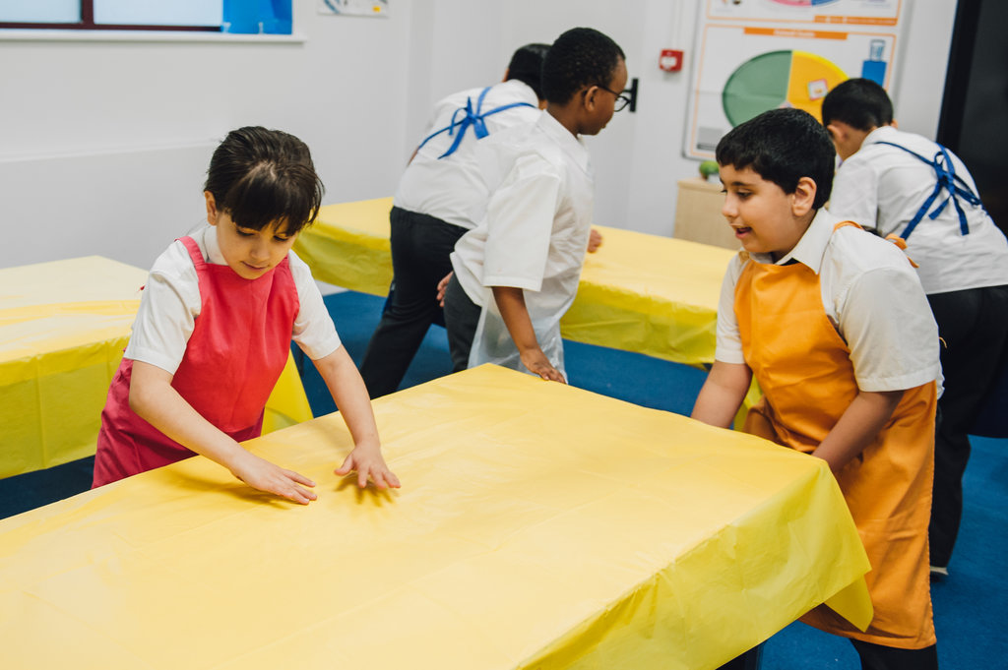
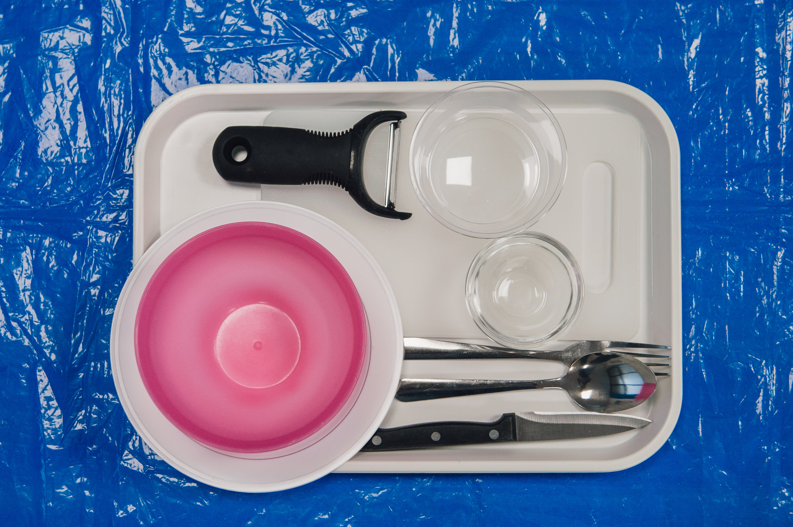
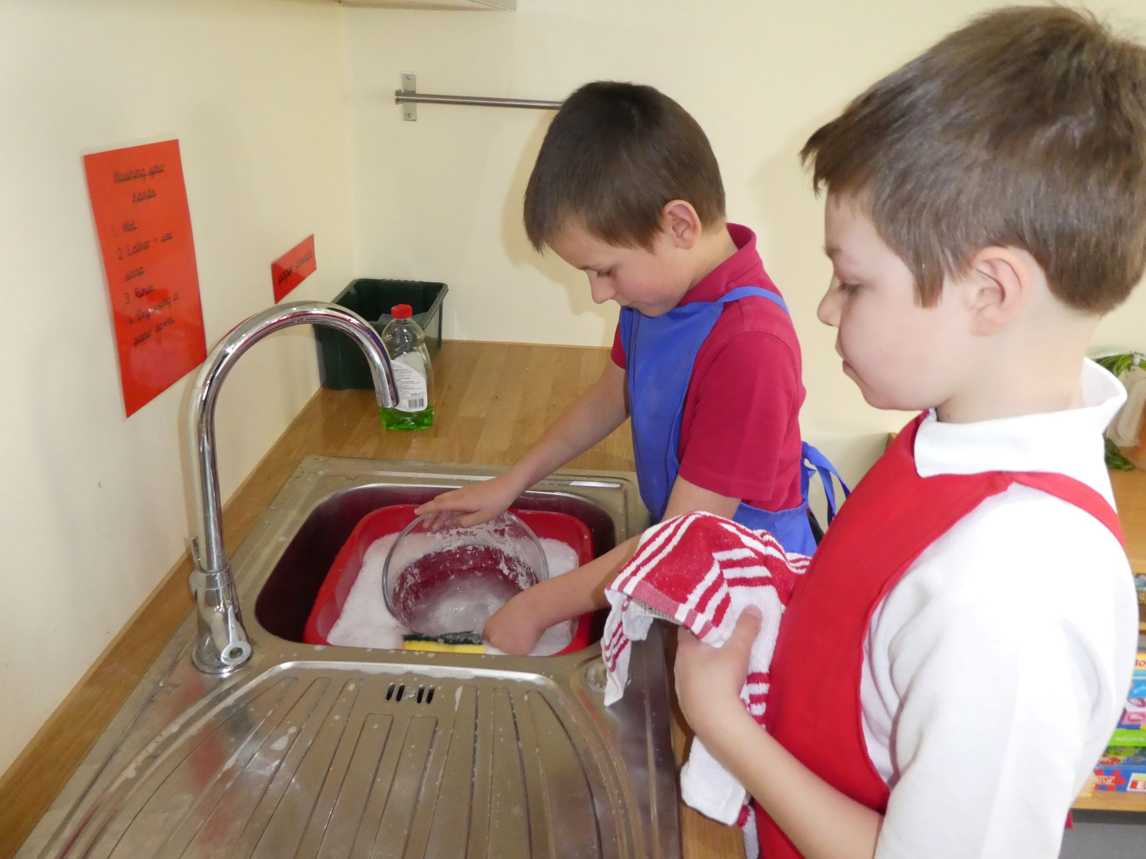
Practicalities of using a primary classroom
Check that:
Classroom furniture is in a safe, practical arrangement.
Cooking surfaces wiped with anti-bacterial spray and covered with clean plastic cloths.
Plenty of bins available for rubbish.

Slide 14
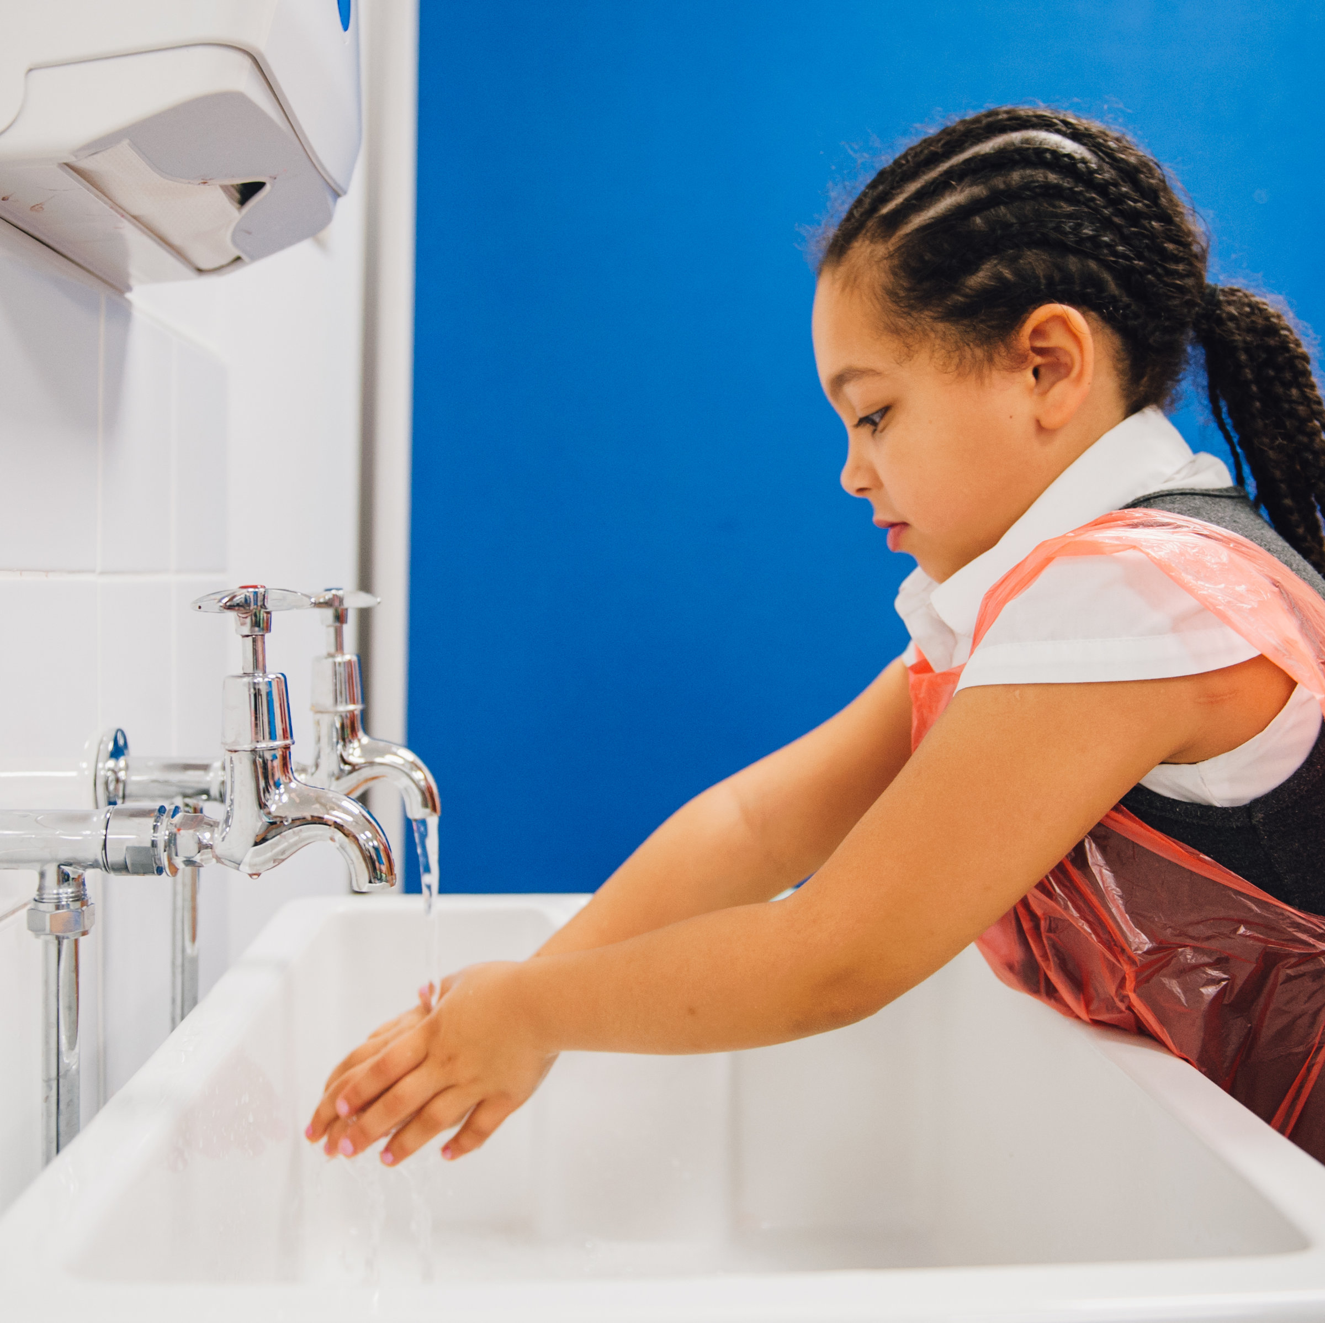
Practicalities of using a primary classroom
Check that:
Children know they must wash their hands again if they blow their nose, cough or sneeze into their hands, touch hair, cuts or spots.
Children know they must remove their apron if they go to the toilet; wash their hands afterwards and then again before starting to cook again.
Children know how to use the equipment safely (following a teacher demonstration).

Slide 15
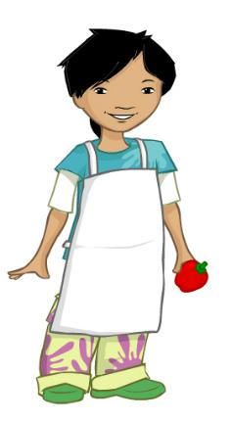
Getting ready to cook
Tie long hair at the back of your head.
Roll up long sleeves.
Remove nail varnish.
Remove jewellery.
Put on an apron.
Wash and dry hands.
All adults must be a role model!

Slide 16
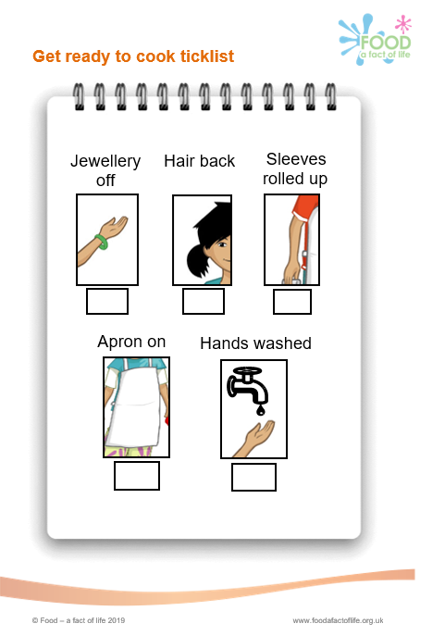
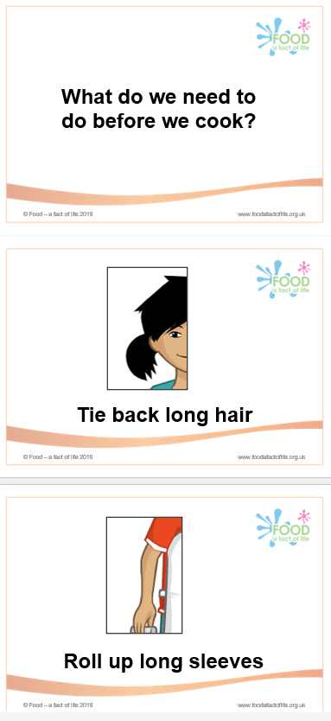
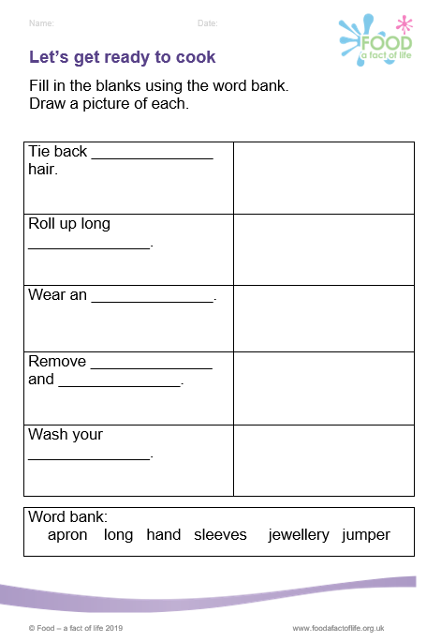
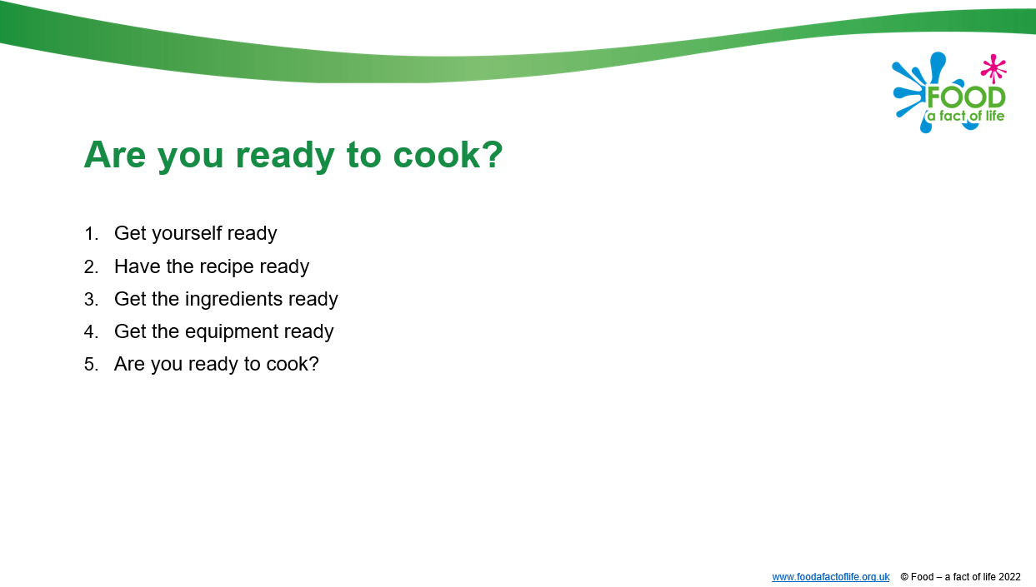
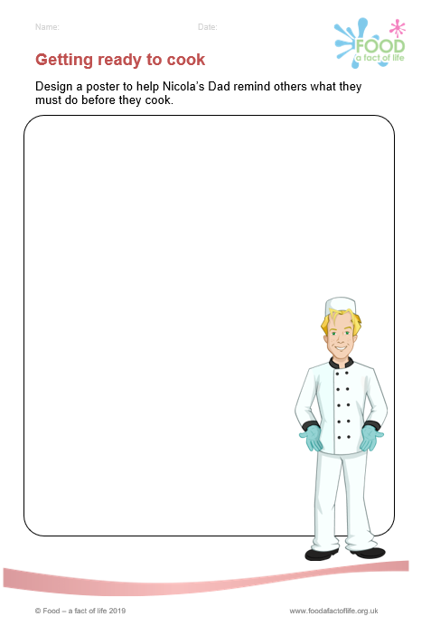
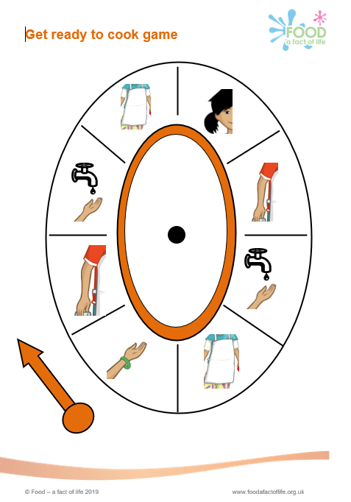
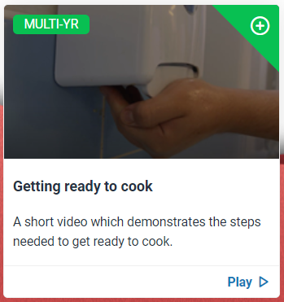
Getting ready to cook
PPT presentation
Video
Getting ready to cook resources

Slide 17
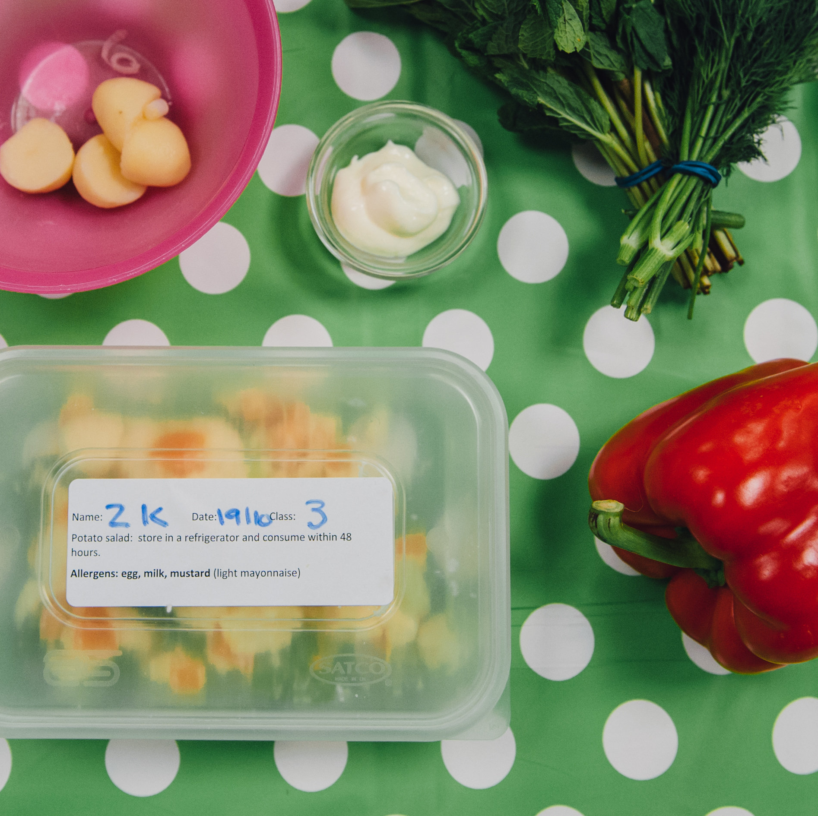
Storage of ingredients and finished dishes
In order to prevent bacterial multiplication and cross-contamination, it is important that safe storage practices are followed:
Store allergenic ingredients, such as flour and nuts, separately in lidded containers. Label with an ‘opened’ or ‘best before’ date.
Store high risk ingredients such as meat, fish and dairy in the fridge below 5°C.
Store raw ingredients below cooked or ready to eat foods in the fridge to prevent cross-contamination.
Decant part used cans into plastic containers with a lid. Label with a ‘use by’ date. Store in the fridge.

Slide 18
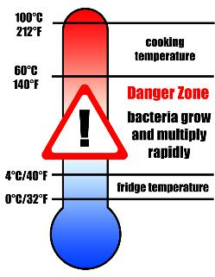
Storage of ingredients and finished dishes
Store all opened jars and bottles in the fridge and label with an ‘opened on’ or ‘use by’ date.
Cool cooked food quickly and store below 5°C within 90 – 120 minutes.
Check and record fridge temperatures regularly.
Clean fridges regularly with hot soapy water and a sanitising spray.

Slide 19
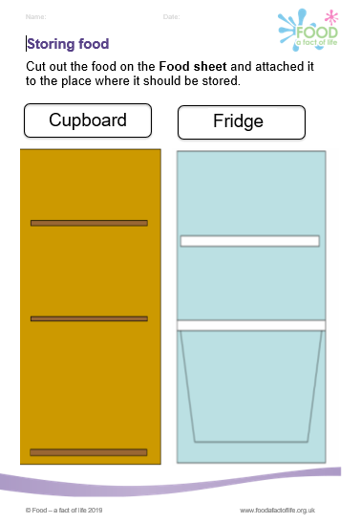
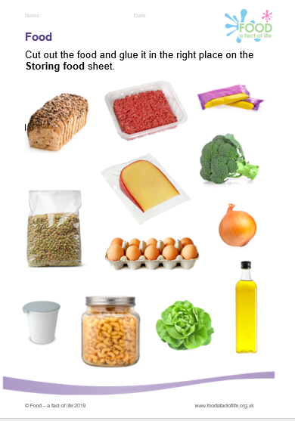
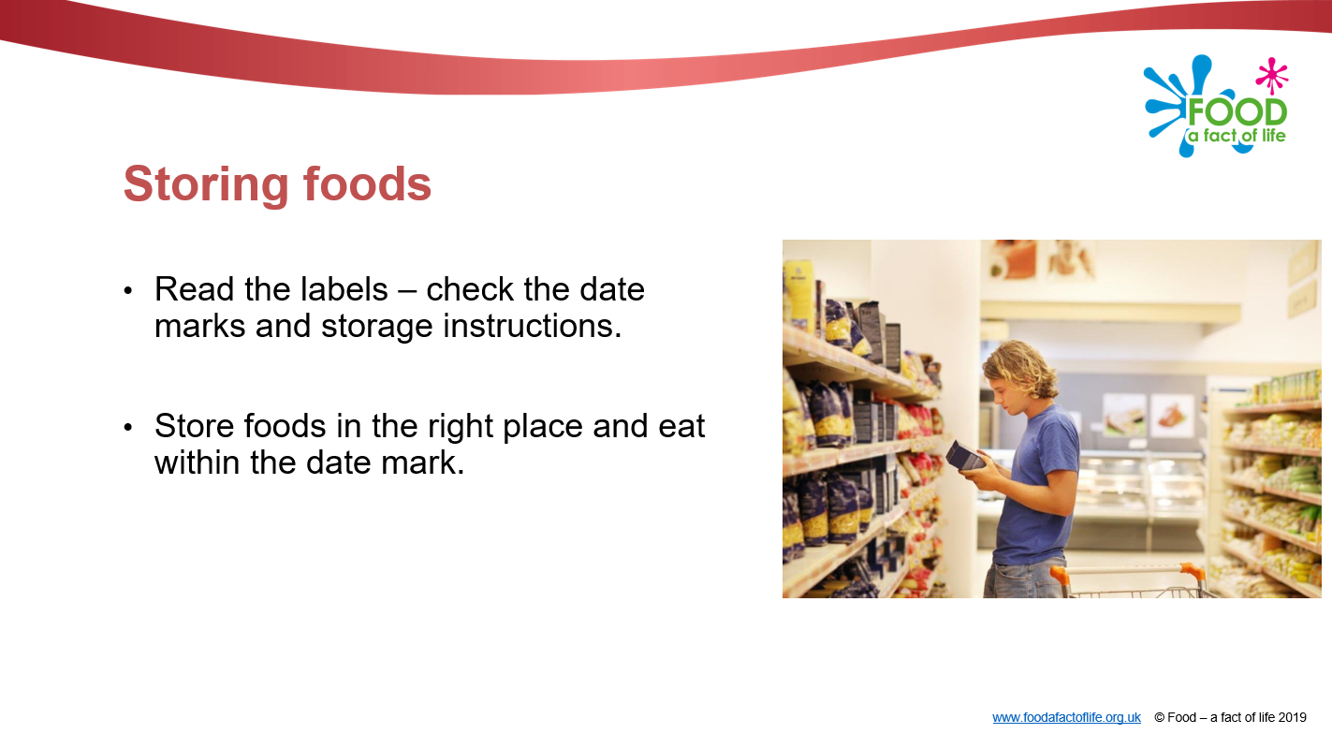
Safe storge – pupil resources
7-11 Food hygiene and safety
5-7 Food hygiene and safety

Slide 20
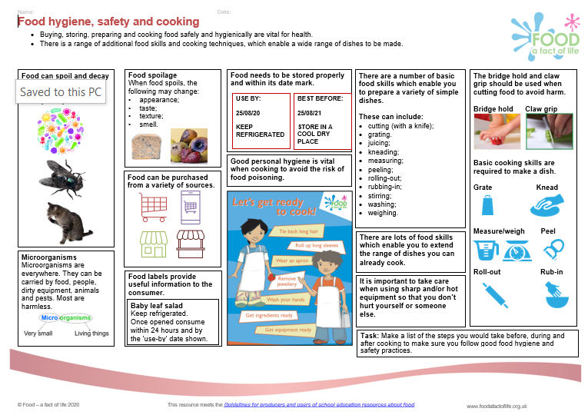
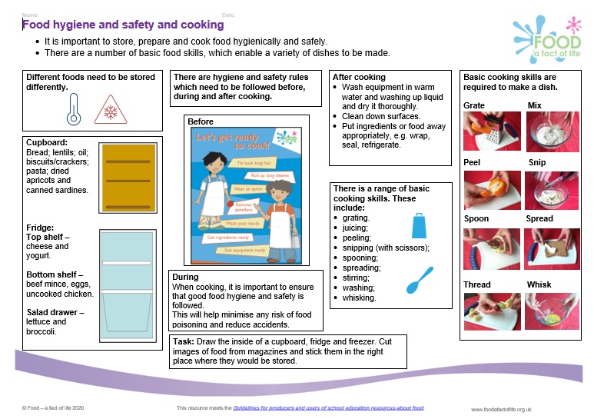
Knowledge organisers
7-11 years
5-7 years

Slide 21
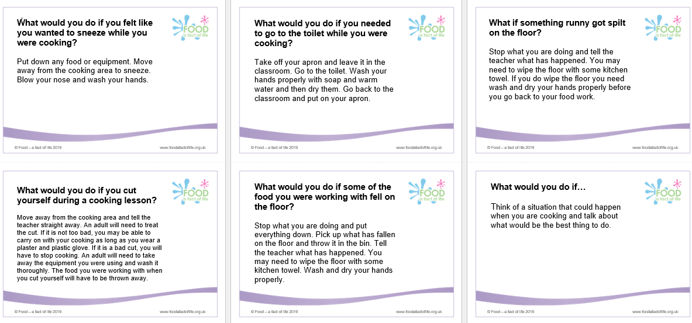
Food hygiene and safety scenarios for pupils
5-7 food hygiene and safety

Slide 22
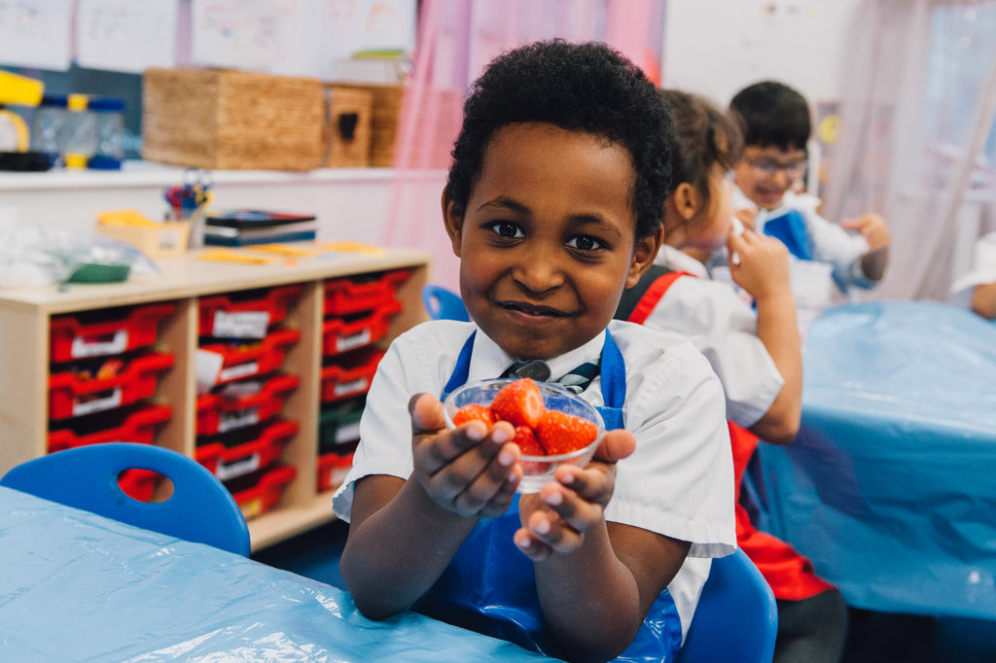
Future training events
Saturday 4 March 2023
Virtual practical workshop – making the most of flour (primary) –
Coming next…diary dates
14 March 2023, 4pm
Workshop (online): Supporting teaching knife skills in primary school
25 April 2023, 4pm
Webinar supporting: Healthy eating
May/June 2023 – Saturday - date TBC
Conference (online)
9 May 2023, 4pm
Webinar supporting: Where food comes from
6 June 2023, 4pm
Webinar supporting: Whole school approach
13 June 2023, 4pm
Workshop (online): Supporting cooking with heat in primary school

Slide 23
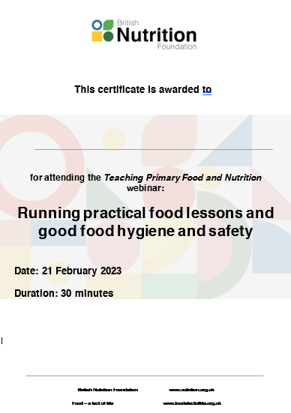
Thank you
Please complete the webinar evaluation. If you are watching a recording of this webinar, you will find a link to the evaluation at the end of the PPT presentation here.
Running practical food lessons and good food hygiene and safety
You will receive a link to the certificate once you have completed the evaluation. Please download the certificate, add your name and print it out for your records.

