Slide 1
Farming food

Slide 2
Farming systems
Agriculture in the UK can be grouped into the following:
Intensive farming – a system of production using large amounts of labour and capital relative to land use (high input/high output). Often used in high value crops e.g., potatoes, peas, carrots.
Extensive farming – a system of production using small amounts of labour and capital in relation to area of land being farmed (low input/lower output). Usually over wide areas of land, e.g., moorland and heathland.
Conventional farming – a system that may include the use of artificial fertilisers and pesticides (to control pests, weeds and diseases), as well as organic manures and natural pesticides; other techniques used may include concentrated animal feeding/rearing operations. Conventional farming includes both intensive and extensive farming approaches.

Slide 3
Farming systems
Organic farming – a system where artificial fertilisers are not allowed to be used, soil fertility is built through crop rotation, and inorganic pesticide use is severely restricted. It is a form of extensive farming.
Free-range farming – a system where animals, for at least part of the day, can roam freely outdoors. This may be done within a conventional or organic farming system.
Regenerative farming – a cropping system and grazing practice that, among other benefits, reverses climate change by rebuilding soil organic matter and restoring degraded soil biodiversity, resulting in both carbon capture and improving the water cycle.

Slide 4
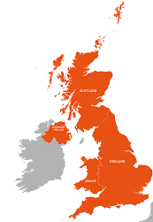
Farming in the UK
Some parts of the United Kingdom have excellent soil for crops, while others are used for cattle, sheep, pigs and poultry.
In the north-west of England, Wales and Scotland, farmers keep cattle and sheep. Sheep can survive the cold winters on the hills and moors.
In the east of England (East Anglia), wheat, barley and vegetables grow in large fields.
Cattle, sheep, pigs and dairy are the largest commodity sectors in Northern Ireland.
In the south-east of England and the lowlands of Scotland, grain, potatoes and sugar beet are grown. Most UK cauliflowers are grown in the south-east.
In the south-west of England, the rich grass is ideal for feeding dairy cows.

Slide 5
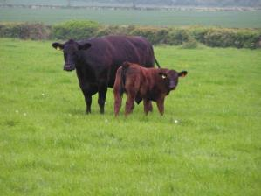
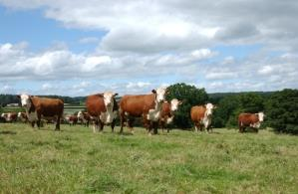
Cattle farming
British beef breeds include:
Hereford;
Galloway;
Beef Shorthorn;
Aberdeen Angus;
South Devon.
Some cattle are dual purpose and are farmed for both dairy and beef production.

Slide 6
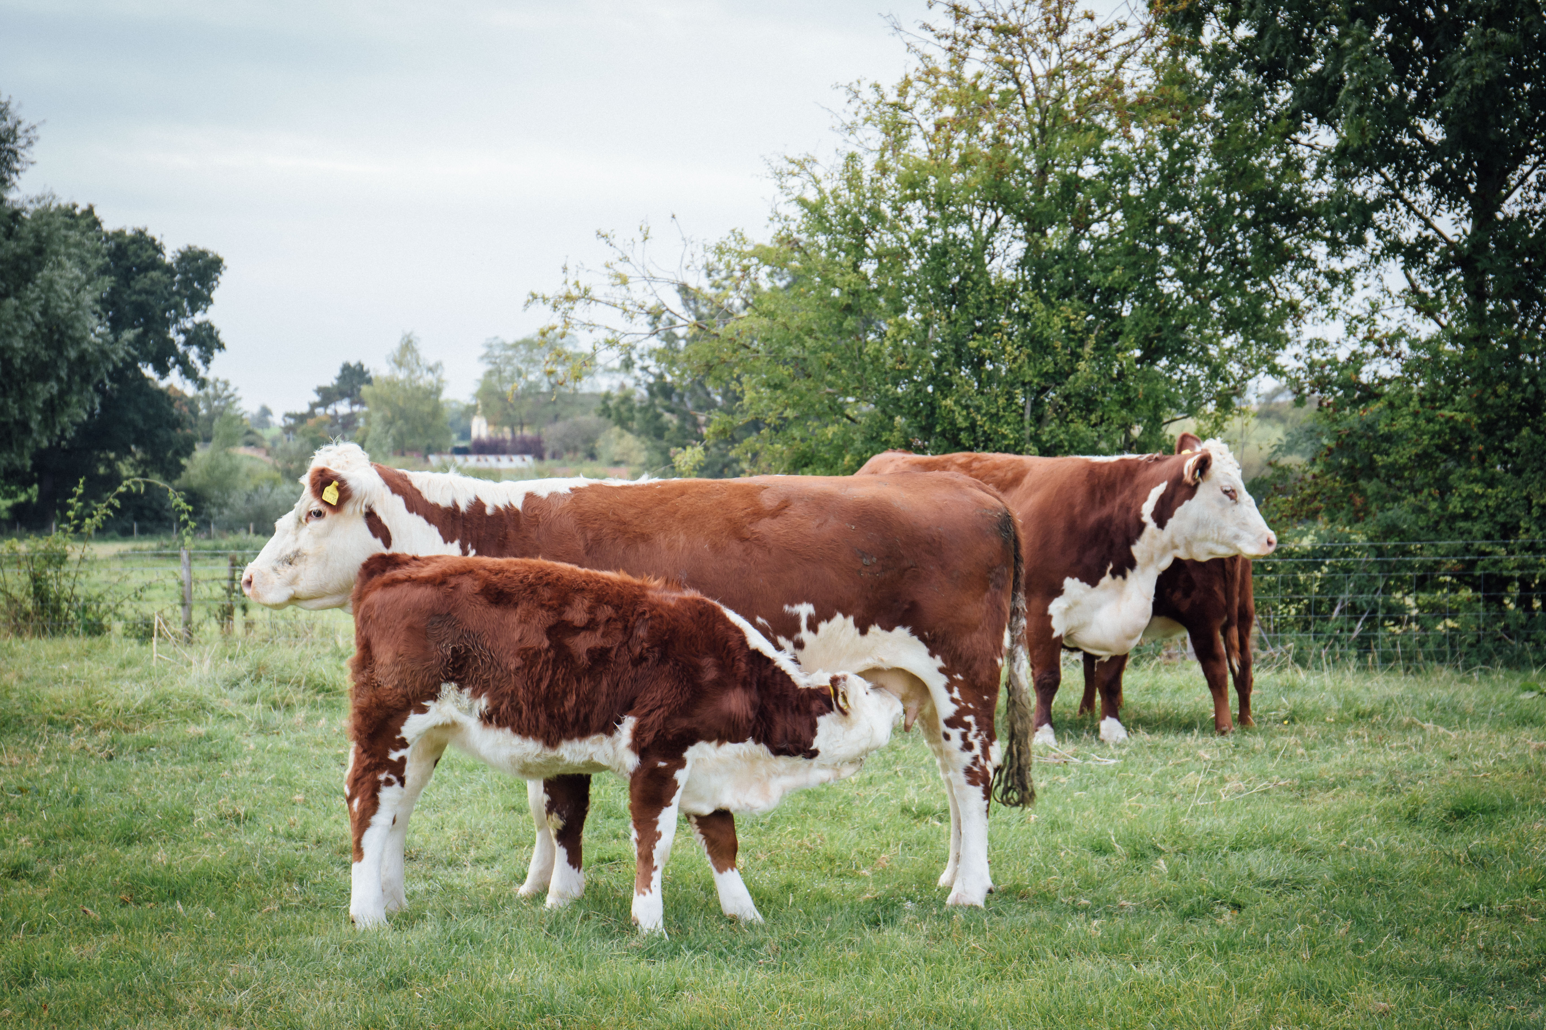
Cattle farming
Calves reared on beef cows remain with their mothers 6-9 months before being weaned.
Dairy calves are separated from their mother shortly after birth.
Milk is the main source of nutrition for young calves.
As they grow older they predominantly have a grass based diet.
Diets will often be supplemented using cereals or pulses to supply energy or protein.

Slide 7
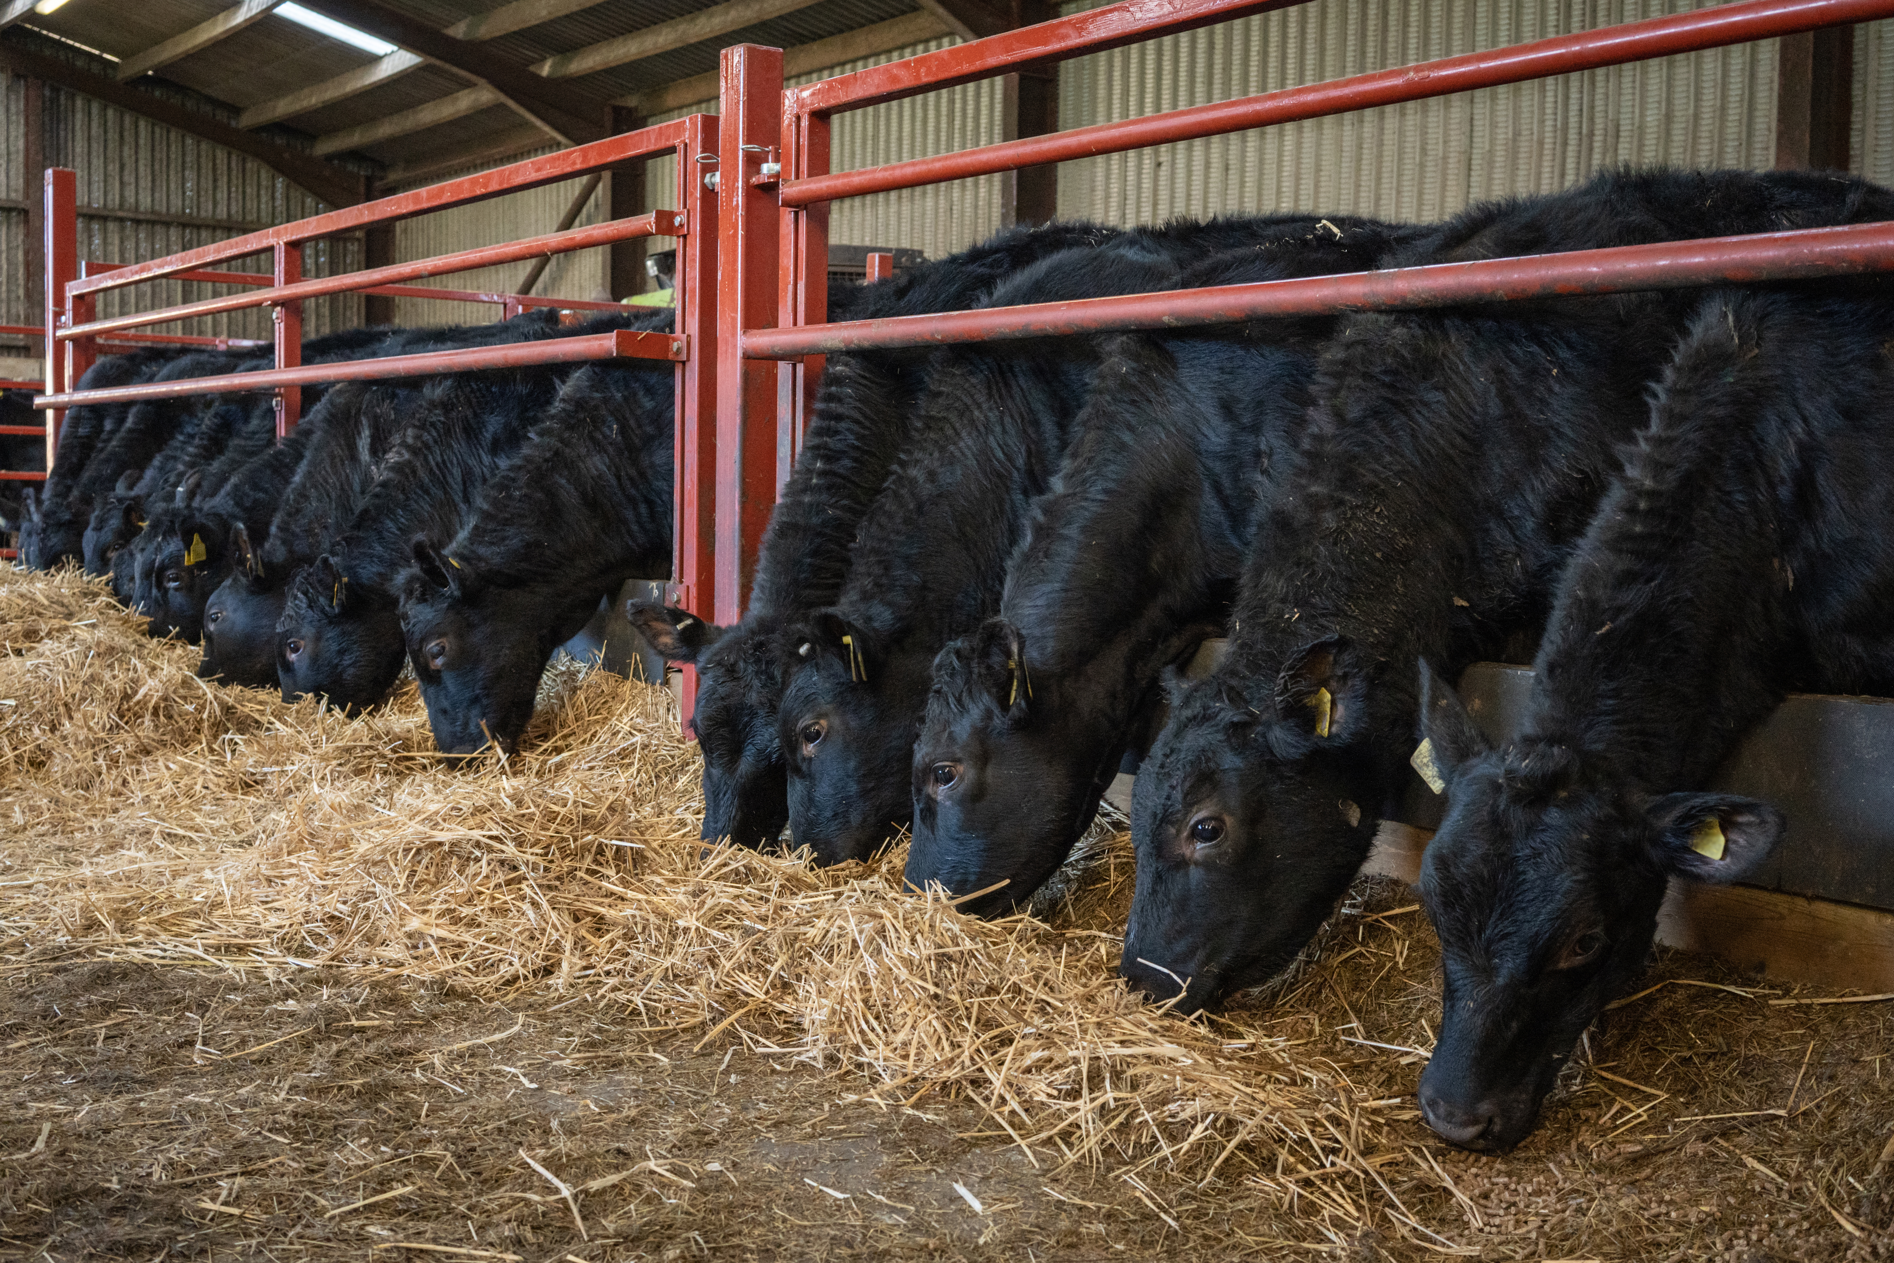
Cattle farming
Most animals spend the summer months in fields grazing and many are housed in large barns in the winter when the grass has stopped growing. Maize silage is also sometimes used as feed.
The diets can be supplemented with other ingredients, for example cereals like barely or protein feeds such as beans.
Cattle diets utilise feed which humans cannot consume, for example by-products of flour manufacture or margarine production.

Slide 8
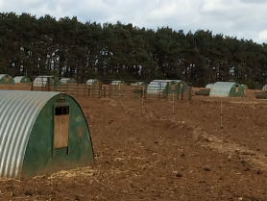
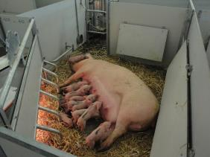
Pig farming
Pigs are generally reared indoors in barns with open sides, natural ventilation and straw or slats which allow drainage of excrement.
Approximately 40% of UK pig production is outside, with huts for shade and protection from the elements. In the summer water is used to create an area for the pigs to wallow and remain cool in the heat. Pigs are like dogs and are not able to sweat to regulate their body temperature.
Once a sow (female pig) has been serviced by the boar (male pig) or artificially inseminated the gestation period will last 3 months, 3 weeks and 3 days. A sow can give birth to two litters a year.

Slide 9
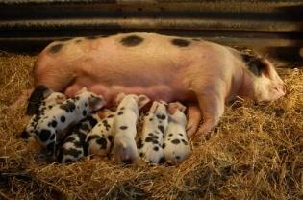
Pig farming
After about 4 weeks, once weaned, the piglets leave the sow to be reared in separate accommodation.
Pigs are normally sent to the abattoir at 6-7 months. The farmer will decide if the sow will be taken to be served by a boar (or more commonly artificially inseminated) or sent to the abattoir (typically after 6 litters).
Adult pigs will feed on cereals such as corn and soya for carbohydrate and protein. Their diet can be supplemented with vitamins and minerals.

Slide 10
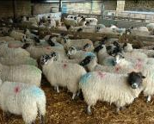
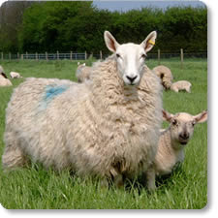
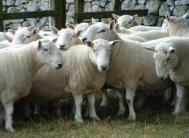
Sheep farming
Three main groups of sheep breeds:
Mountain and Moorland/Upland - these are hardy sheep which can cope with rugged terrain, such as Welsh Mountain and Swaledale;
Longwool - these are originally bred for their wool, but now used in cross breeding, such as Border Leicester and Bluefaced Leicester;
Terminal Sire Breeds - these are compact muscular type of sheep suitable for grassland and less harsh environments, such as Suffolk, Charollais and Texel

Slide 11
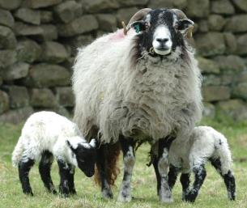
Sheep farming
In late summer, the sheep are prepared for mating. Feed intake is increased just before ovulation - this is called flushing. The sheep need to be healthy and in good physical condition. Mating, or tupping, by rams or artificial insemination occurs during the autumn.
The busiest time of the year for a sheep farmer is during lambing, from January to May. A farmer will plan for lambing to take place when the weather conditions improve and the grass begins to grow.
The lambs are weaned normally between 12 and 16 weeks of age.
Farmers will select some females for breeding based on their physical condition and finish the rest for market.

Slide 12
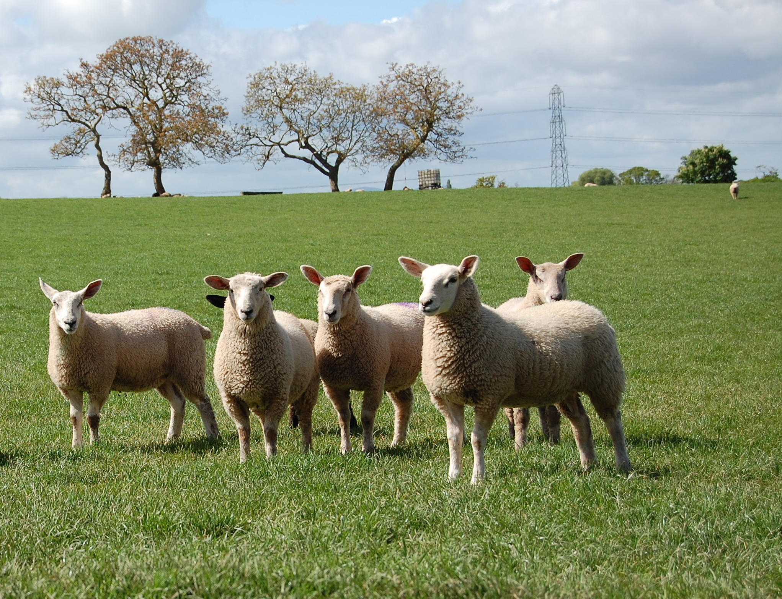
Sheep farming
Sheep enjoy a diet of grass. This diet can be supplemented with hay, silage and root crops, such as turnips, when grass is not readily available.
Shearing takes place when the weather is warm and dry. This does not hurt the sheep. It is effectively a hair cut. Lambs do not need shearing.
Sheep are checked by the shepherd daily, to make sure they are healthy and free from disease.

Slide 13
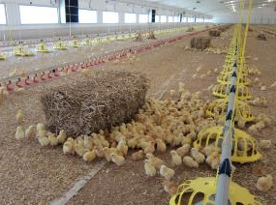
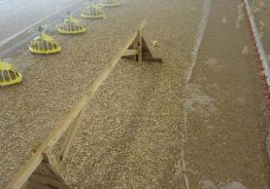
Chicken farming – higher welfare
Chickens reared for meat are called broilers or broiler chickens.
Chickens are born in a hatchery and are then transferred to a rearing farm at one day old.
The chickens are provided with space and dirt to scratch and dust bathe. There are also places for chickens to perch when they are bigger.

Slide 14
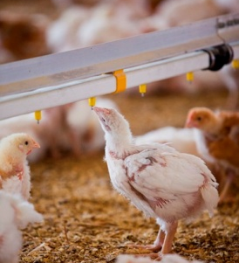
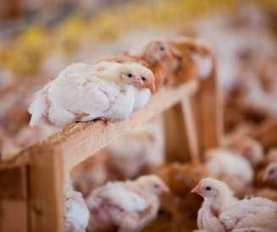
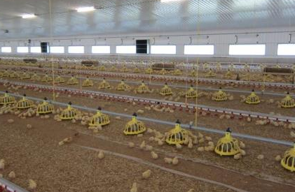
Chicken farming – higher welfare
Their food travels down pipes into feeders and freshwater is always available.

Slide 15
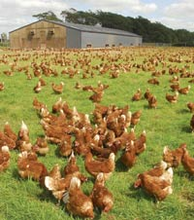
Chicken farming – free range
Chickens have access to the outdoors during the daytime for at least half of their lifetime and the birds used are often slower growing breeds.
Pop-holes allow access to the outside.
At night the hens come inside for protection from predators.

Slide 16
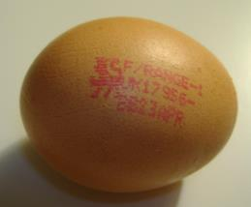
Egg production
In the UK, there are three systems for producing eggs:
  laying cage - across the European Union conventional 'battery' cages have been banned. In the UK, they have been replaced by larger, ‘enriched’ colony cages;
  barn– hens are able to move freely around the barn. The number of hens is limited and they are given space to perch, scratch and dust bathe;
  free-range - hens must have continuous daytime access to runs which are mainly covered with vegetation and there is maximum number of hens in a flock;
  organic - hens producing organic eggs are always free range. In addition, hens must be fed an organically produced diet and ranged on organic land.

Slide 17
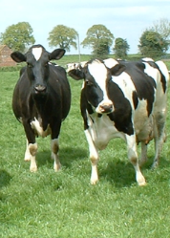
Dairy farming
Cows are reared on dairy farms to produce milk.
Currently, 14.5 billion litres of milk each year are produced on dairy farms in the UK. Around 6.5 billion litres of these are sold for drinking and some goes to the production of dairy products such as cheese or butter.
A dairy cow needs to give birth to a calf in order to produce milk.
Most British dairy cows eat grass during the summer and silage (dried grass or maize) in the winter.

Slide 18
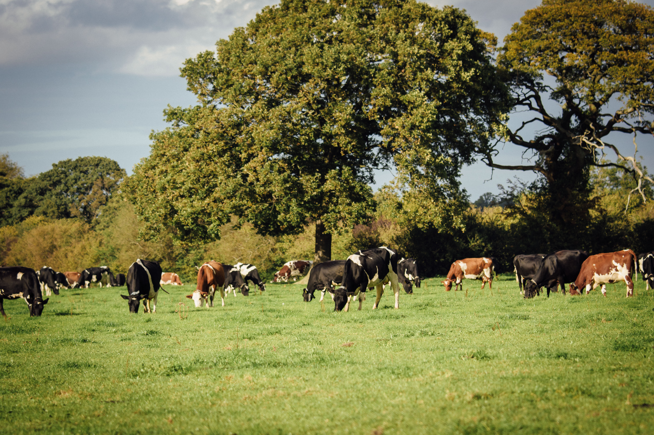
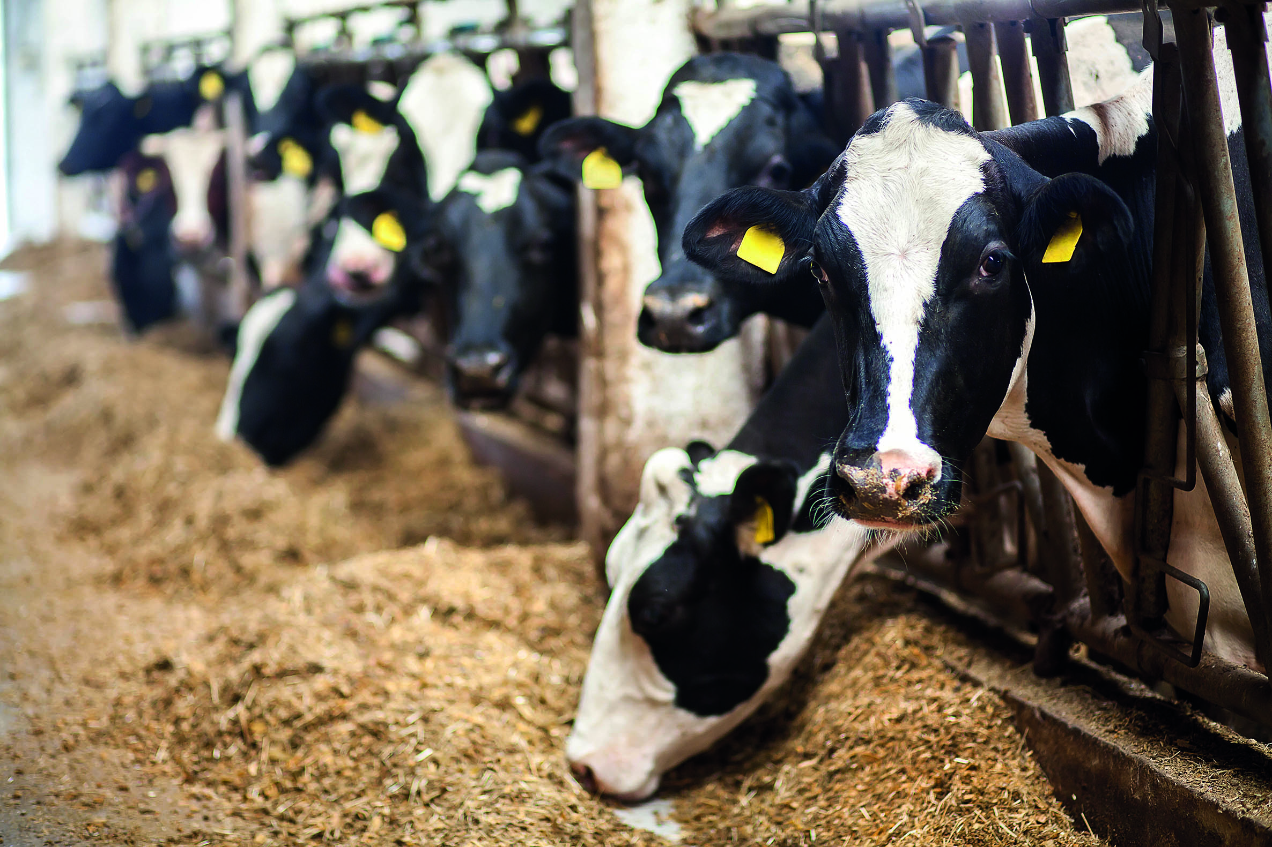
Dairy farming
Dairy cows mostly graze outdoors during the summer, moving from indoor housing. Outside they can easily graze at their own leisure, exercise, get fresh air and natural light.
Most dairy cows are housed during the winter and bad weather.
Sheds are designed to be extremely spacious and airy, allowing the cows to rest, stand and move around freely to exercise and socialise.

Slide 19
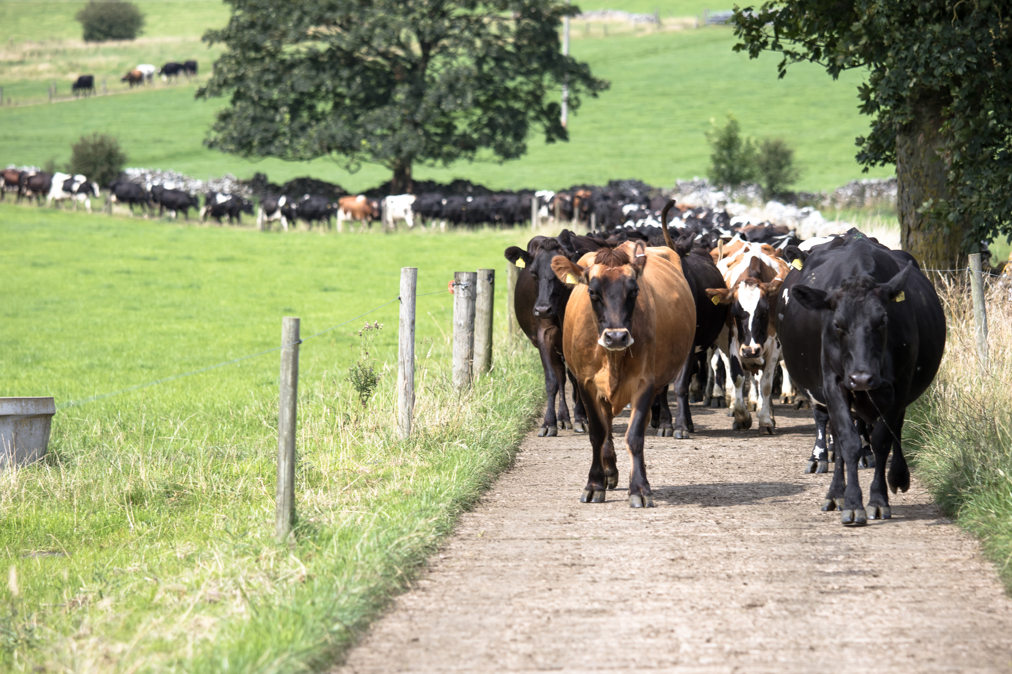
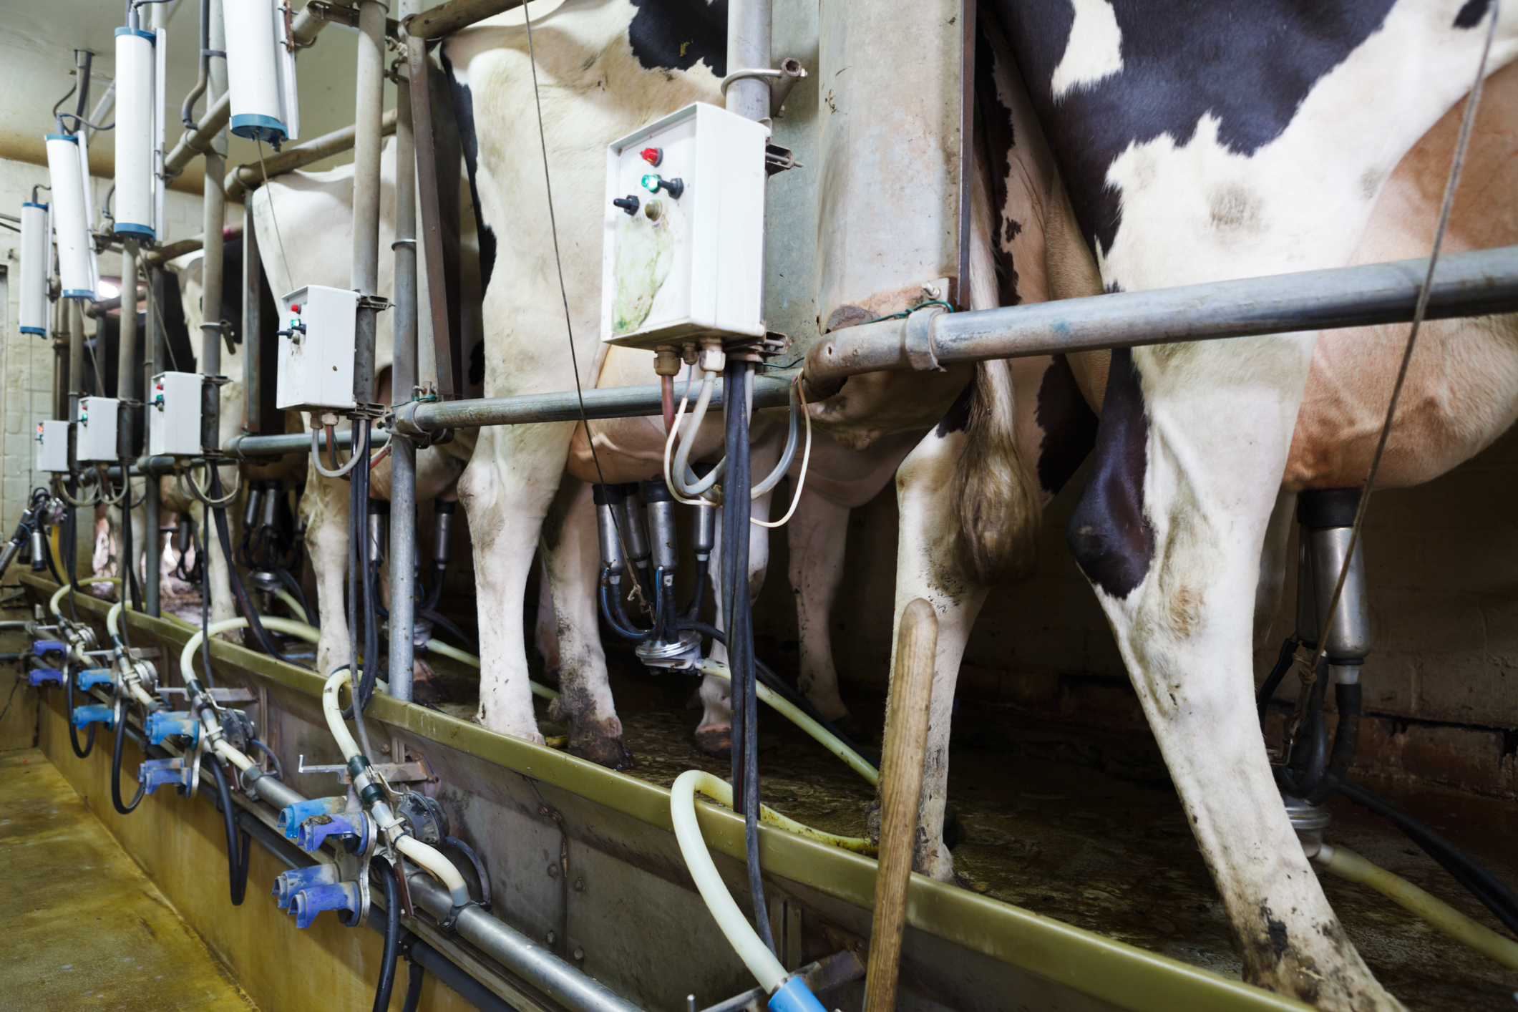
Dairy farming
The cows come in from the fields or the barn into the collecting yard twice a day.
Once the cows have been milked, they are let out of the parlour. The cows are free to move around, sit down, eat and drink.
They are then returned to the field or barn until the next time they are due to be milked.

Slide 20
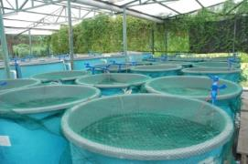
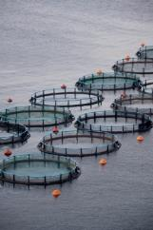
Fish farming
Fish farming is the principle form of aquaculture. Fish are farmed in both fresh water and seawater.
Around the world, fish and shellfish species which are commonly farmed include: salmon, trout, sea bass, turbot, halibut, sea bream, kingfish, barramundi, grouper, prawns and carp.
Atlantic salmon is one of the most commonly farmed fish species in the UK, with farms mainly located in the Scottish highlands.
Farmed fish are bred in special tanks on land, or pens in the sea.

Slide 21
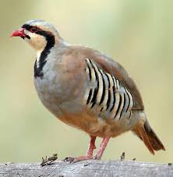
Game farming – game birds
In Britain today there are around 300 game farms, mostly rearing pheasants and partridges.
Eggs are collected daily from April onwards and are hatched in electronic incubators. The chicks are then reared on in purpose-built shelters, where they are provided with food, water, grit and all their other needs.
As they grow, the chicks are given access to outdoor runs where they can get used to the natural environment.
In about August, they are sold to shoots, where gamekeepers will take over their care, releasing them into the countryside.

Slide 22
Farming food
For further information, go to:
www.foodafactoflife.org.uk
This resource meets the Guidelines for producers and users of school education resources about food.

