Slide 1
Enzymic browning

Slide 2
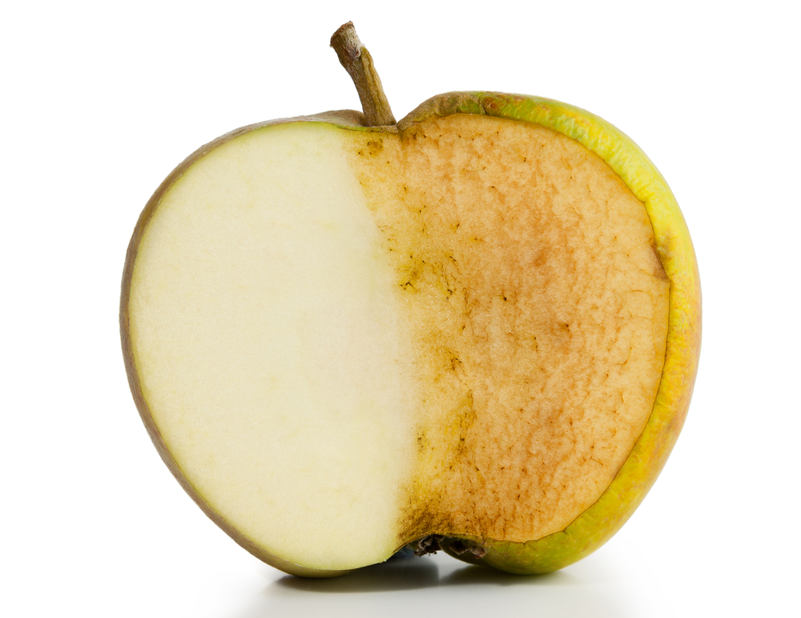
Introduction
Enzymic browning is caused by enzymes.
Enzymes are proteins that catalyse (speed up) reactions.
An easy way to see enzymic browning is to cut an apple in half and leave it for a short time.
You will see that it quickly begins to brown.

Slide 3
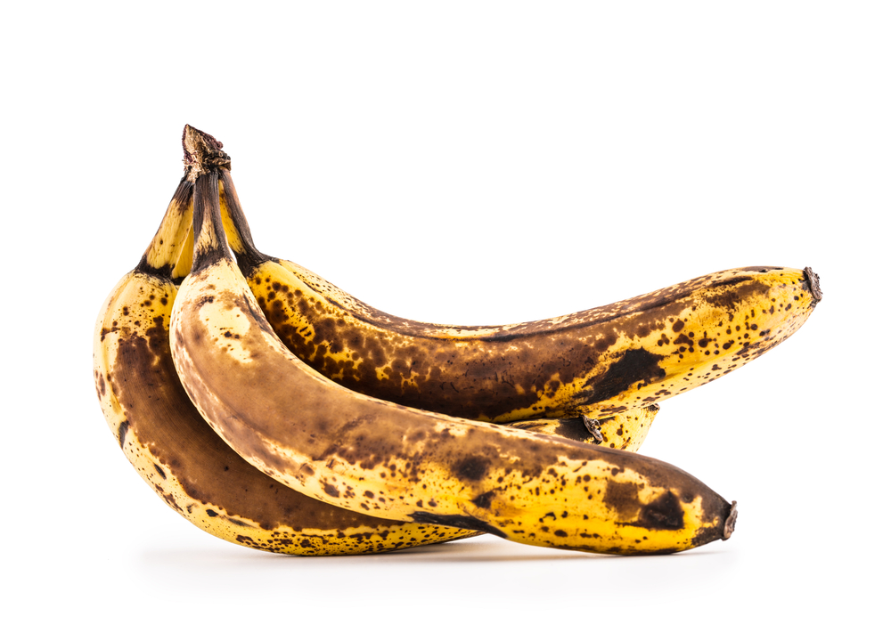
The science of Enzymic browning
The rapid browning of fruit (particularly when cut) is to do with enzymes that are contained within.
For example, when an apple is cut, some of the cells are broken and the enzymes are released.
These enzymes are now exposed to oxygen and other molecules and catalyse a rapid browning reaction.
Whilst browning may make the food look less appealing, it is not dangerous and the food is still edible.

Slide 4
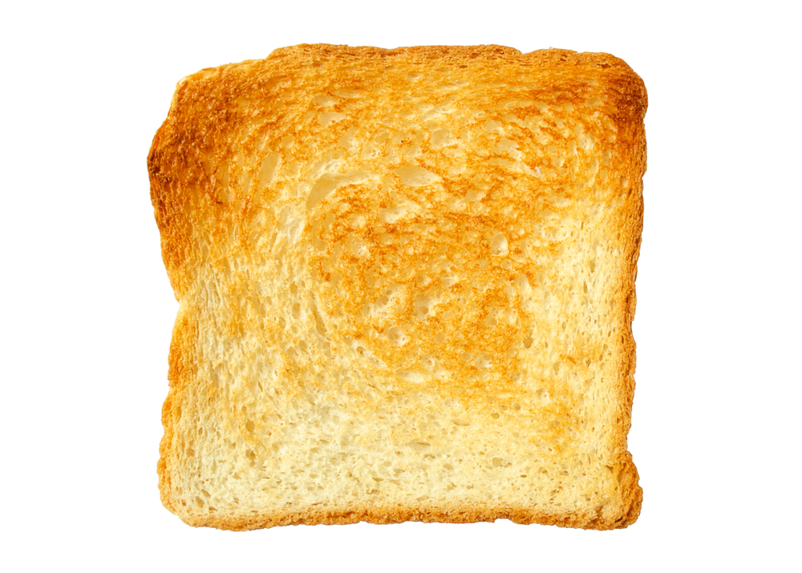
Enzymic browning vs non-enzymic browning
Many types of browning in foods are ‘non-enzymic’. These include:
dextrinisation;
caramelisation;
maillard reaction.
None of the above are catalysed by enzymes. In addition, most non-enzymic browning is desirable.
In most (but not all) cases, enzymic browning is unwanted.

Slide 5
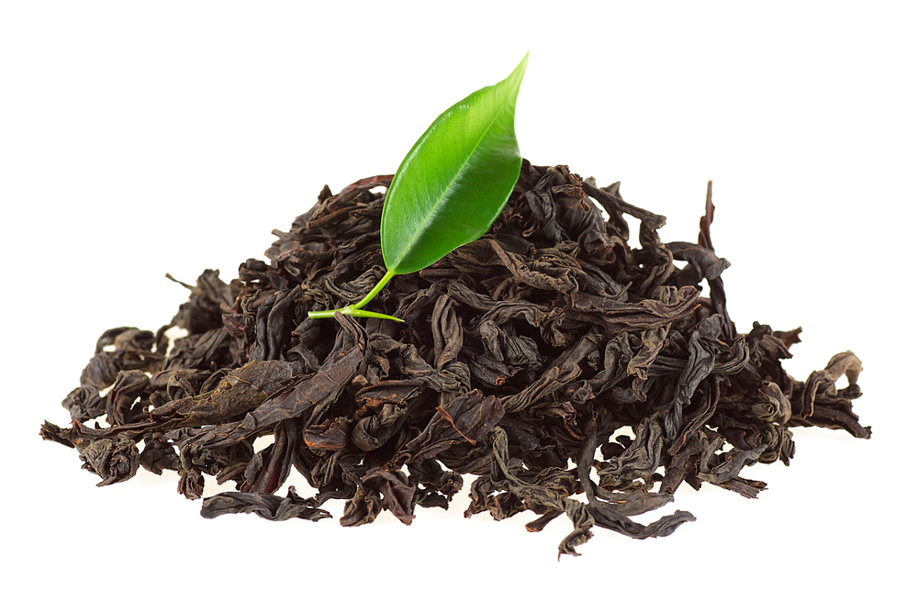
Desirable enzymic browning
Although most enzymic browning is unwanted (e.g. bruised or cut fruit), sometimes it can be useful.
Black tea makes use of enzymic browning to develop its flavours.
Green tea stays green because it is treated after picking to stop the browning reaction from taking place.
Some dried fruits (e.g. prunes and raisins) also use enzymic browning for their colour and flavour.

Slide 6
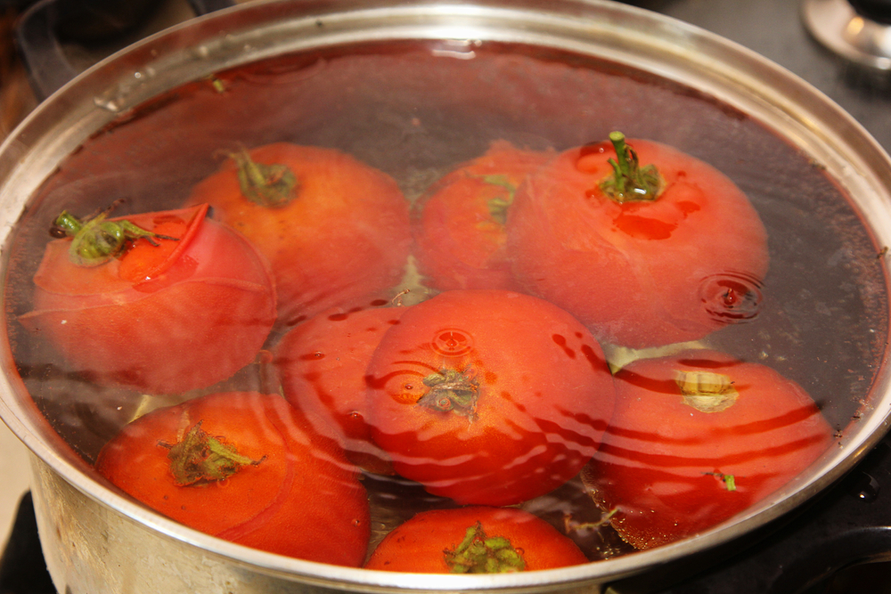
Preventing unwanted browning
Enzymic browning can make food less appealing, meaning it is more likely to be thrown away.
This means that preventing enzymic browning can be important to reduce food waste.
There are several methods that can be used to prevent or reduce unwanted enzymic browning, including:
blanching;
refrigeration or freezing;
acidulation.

Slide 7
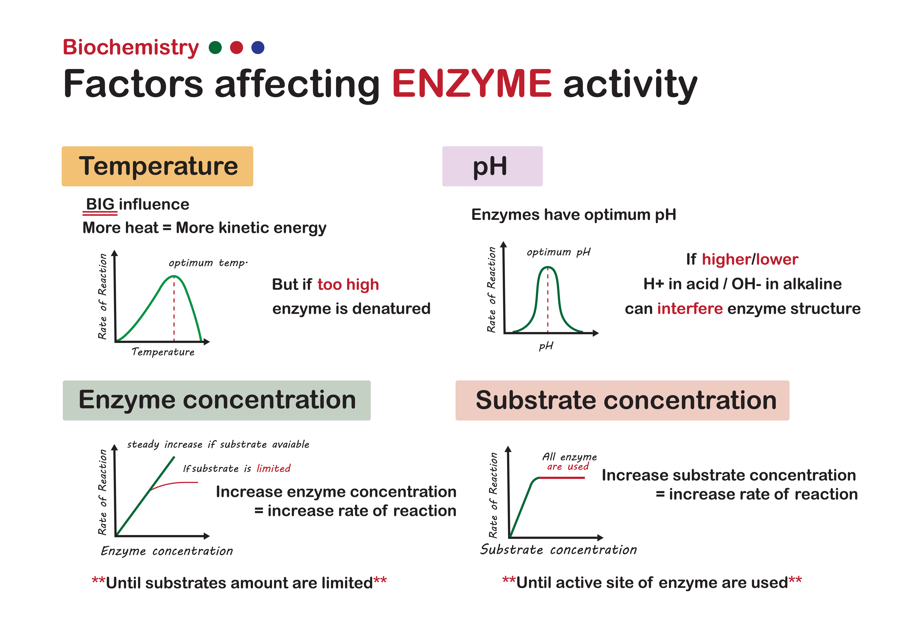
Enzymes, temperature and pH
Enzymes work best at specific temperatures and pH (level of acidity/alkalinity).
Below their optimum temperature, enzymes work more slowly.
Above their optimum temperature, enzymes are denatured and stop working.
Above or below their optimum pH, enzymes can also be interfered with or denatured.

Slide 8
Blanching
Blanching is a technique that involves quickly submerging a fruit or vegetable into boiling water.
The boiling water denatures the enzymes in the fruit or vegetable.
The fruit or vegetable is quickly removed and plunged into cold water to prevent cooking from continuing too far.
Blanching is a useful technique for freezing fruits and vegetables. Without blanching, freezing can cause some cells to rupture and enzymic browning occurs during thawing.
High temperatures during blanching denature the enzymes and prevent the enzymes from functioning correctly

Slide 9
Refrigeration and freezing
Refrigeration and freezing do not destroy enzymes.
However, enzymes typically work less effectively at colder temperatures.
This means that the browning reactions are slower when foods are refrigerated or frozen.
Low temperatures during refrigeration or freezing slows the rate of reaction caused by the enzymes.

Slide 10
Acidulation
Acids (e.g. citric acid from lemon juice) can denature enzymes and prevent or delay a browning reaction.
Other acids, such as acetic acid (vinegar) can be used as preservatives in pickles – this stops pickled vegetables from browning.
Low pH

Slide 11
Key words
Key word | Meaning
acidulation | Making something more acidic.
blanching | The process of treating food with hot water or steam to reduce enzyme activity.
caramelisation | The chemical change of heated sucrose (table sugar) to caramel, which produces flavour and browning. Caramelisation is a type of non-enzymic browning reaction.
catalyse | Cause, or speed up, a reaction.
denaturation | A change in the structure of protein molecules, resulting in their unfolding, e.g., whisking egg white to make meringues.
dextrinisation | The reaction of dry heat on the surface of food which changes starch to dextrin, e.g., toast.

Slide 12
Key words
Key word | Meaning
enzyme | Proteins that regulate chemical reactions, e.g., rennin in cheese production.
Maillard reaction | A type of non-enzymic browning initiated by reducing sugars reacting with amino acids, e.g., sugars and proteins reacting in bread when it is baked.
pH | A measure of acidity or alkalinity of a solution.

Slide 13
Teacher’s guide

Slide 14
Teaching about enzymic browning:
Define enzymes and explain how they can alter reactions
Explain the cause of enzymic browning
Explain the differences between enzymic and non-enzymic browning
Examine why many enzymic browning reactions are undesirable
Note some examples of desirable enzymic browning reactions
Teach about methods of reducing/preventing enzymic browning, including:
  blanching;
  refrigeration and freezing;
  acidulation.

Slide 15
Introduction
Enzymic browning is not normally a desirable kind of browning, as most non-enzymic browning is.
An easy way to see enzymic browning at work is to cut an apple in half and leave it out for a short time.
When the apple is cut, enzymes are exposed to oxygen and other molecules from the now broken cells in the fruit.
This causes a rapid 'browning' reaction. Whilst this may make the food look less appealing, it does not mean it is rendered inedible.

Slide 16
The science of enzymic browning
Enzymic browning is catalysed by an enzyme called polyphenol oxidase (PPO).
The simplified diagram to the right shows the early stages where colourless phenols are converted to brown-coloured quinones.
These quinones then form larger and more complex molecules in further reactions.
OH
OH
O
OH
O
O
Other complex brown polymers
PPO (catalyst)
O
H₂O
PPO (catalyst)
R
R
R
Monophenol
Diphenol
(colourless)
Quinone
(brown pigment)

Slide 17
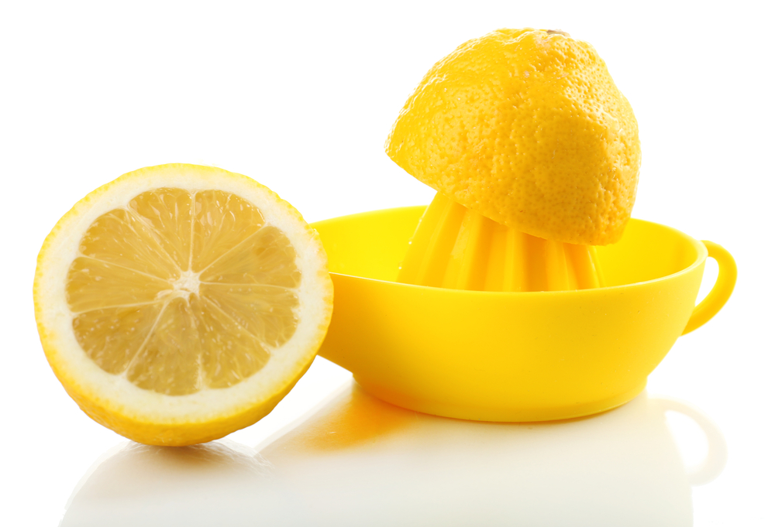
Preventing enzymic browning
Enzymic browning reactions can be reduced (or slowed down) by a variety of methods.
Broadly speaking, these will fall into three categories in the classroom:
  blanching;
  refrigeration and freezing;
  acidulation.

Slide 18
Blanching
Blanching utilises high temperatures to denature the PPO enzymes and prevents it from catalysing oxidation reactions.
Fruit and vegetables are plunged into hot water and then quickly placed into cold water to prevent cooking.
Blanching is a useful procedure before fruit and vegetables are frozen. When frozen, the cells can become damaged and therefore browning occurs upon thawing if PPO has not been denatured.
High temperatures during blanching denature the enzymes and prevent the enzymes from functioning correctly

Slide 19
Refrigeration and freezing
Refrigeration and freezing do not prevent PPO from working, but they do slow down the rate at which it catalyses reactions.
Therefore, this can increase the time taken for browning to occur, allowing food to be used before it becomes unappealing.
However, freezing can damage the cells in fruit and vegetables and lead to more rapid browning after thawing, unless they have been blanched.
Fruit and vegetables with higher water contents to be eaten raw (e.g. lettuce) are not suitable for freezing, as they become damaged by ice crystals during freezing.
Low temperatures during refrigeration or freezing slows the rate of reaction caused by the enzymes.

Slide 20
Acidulation
Acids lower the pH of a food. Acids can denature PPO and prevent it from working as effectively.
A common example used in classroom demonstrations is lemon juice.
Not only does lemon juice lower the pH and slow the browning reaction, it also contains ascorbic acid (vitamin C), which can act as an antioxidant, further slowing the reaction.
Low pH

Slide 21
Desirable enzymic browning
Most enzymic browning is undesirable, as it causes fruit and vegetables to be less appealing (though not dangerous to eat).
However, in some circumstances, enzymic browning can be desirable.
Examples include:
  fermentation of green to black tea;
  development of colour and flavour in some dried fruits, including figs, dates, prunes and raisins.

Slide 22
Enzymic browning - resources
Food – a fact of life resources
Use the Enzymic browning worksheet to demonstrate enzymic browning and discover how it can be prevented or reduced.
Resources around food science can be found here: 11-14 years, 14-16 years
Further information, support and resources around functional characteristics of ingredients can be found here 11-14 and 14-16.
Ingredients - functional characteristics Knowledge Organiser 11-14
External resources
IFST – Fruit and vegetables: enzymic browning
Food and drink federation (FDF) – Enzymic browning (video)
Teachers will need to decide on the level of complexity of the tasks chosen, depending on age, stage and need, and considering progression.

Slide 23

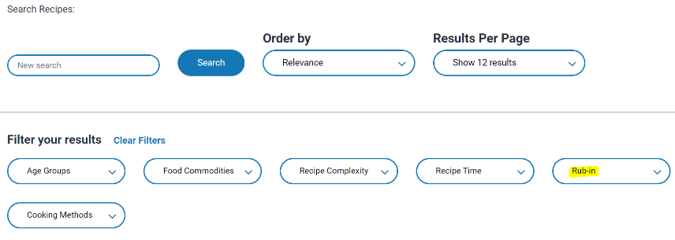
Enzymic browning - recipes
The recipes below can be used to demonstrate enzymic browning, or how it can be prevented:
Fabulous fruit salad (or similar chopped/sliced fruit recipes). Orange juice or lemon juice can be used to reduce browning.
Mini ham and onion rostis – focus on quickly progressing with the recipe to prevent the browning of the raw potato, or use lemon juice or vinegar to slow browning down.
Guacamole – explain how adding the lime juice prevents the guacamole from quickly turning brown. You could make a small amount without lime juice and show the difference in colour.
Go to the recipes section and filter Food Skills for more recipes.

Slide 24
Enzymic browning
For further information, go to:
www.foodafactoflife.org.uk
This food science pack is one of a series of resources produced for the pHood Futures project, supported by the Royal Society of Chemistry.
This resource meets the Guidelines for producers and users of school education resources about food.

