Slide 1
Down on the farm

Slide 2
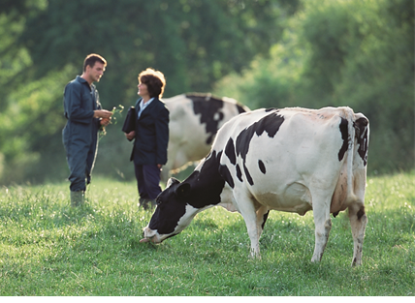
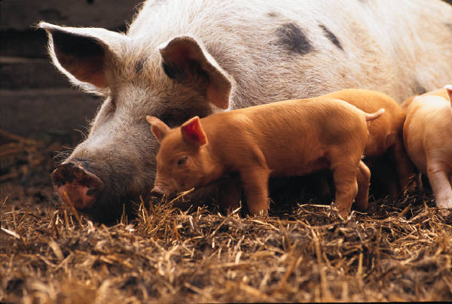
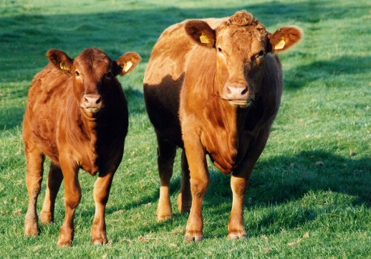
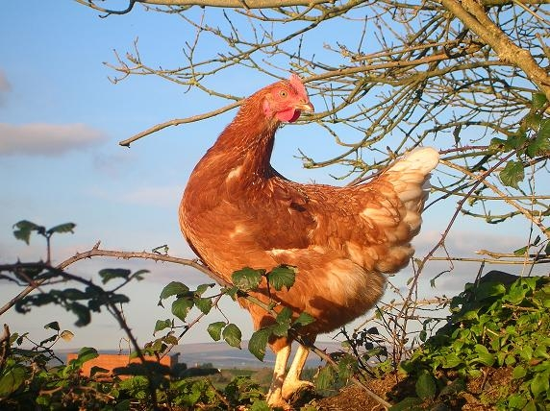
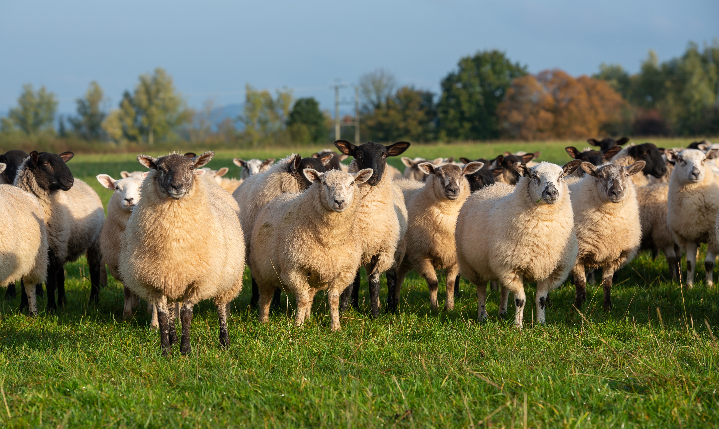
Name these animals
dairy cow
beef cattle
pig
sheep
chicken

Slide 3
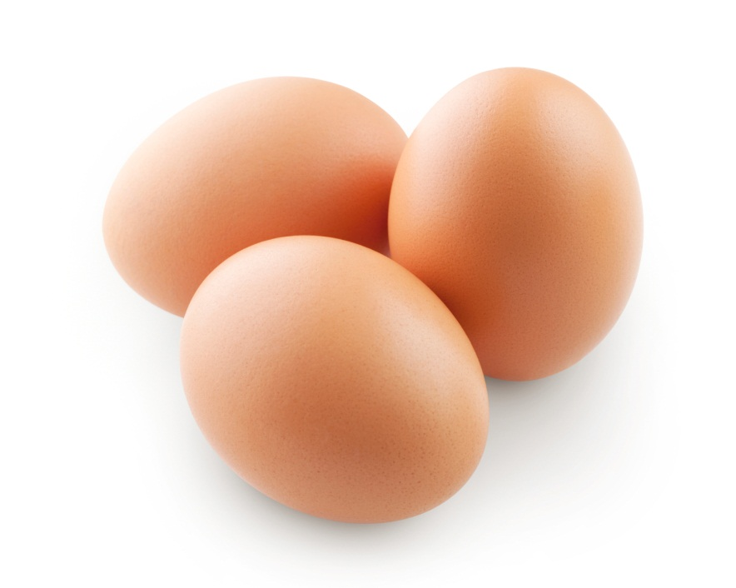
Which animal produces these?
chicken

Slide 4
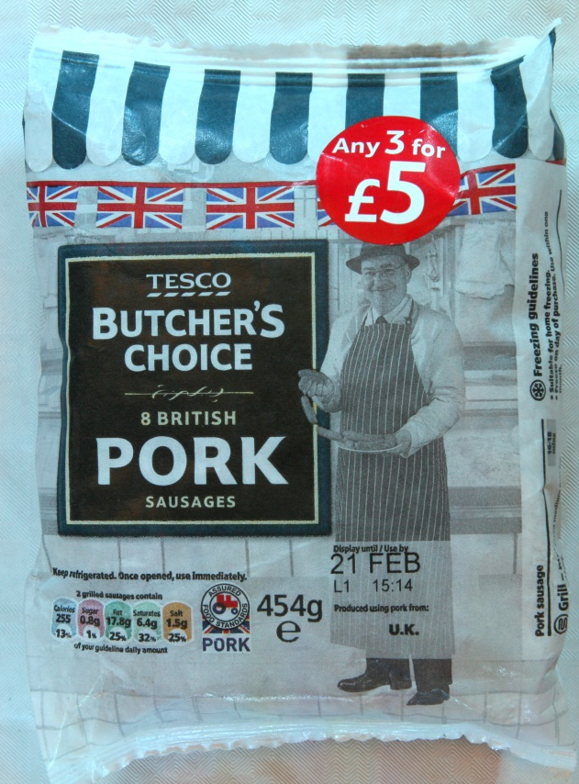
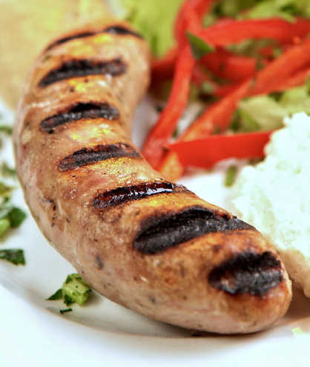
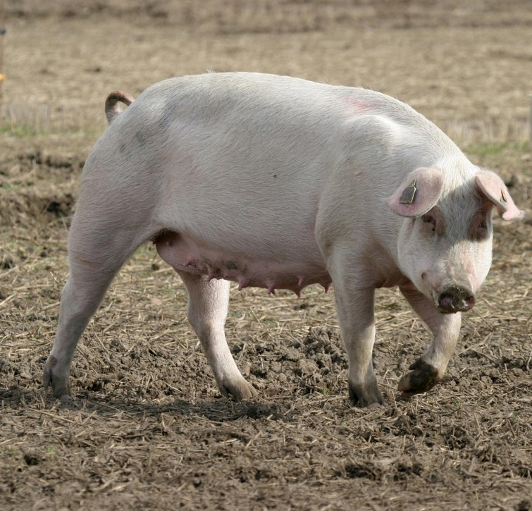
Which animal produces these?
pig

Slide 5
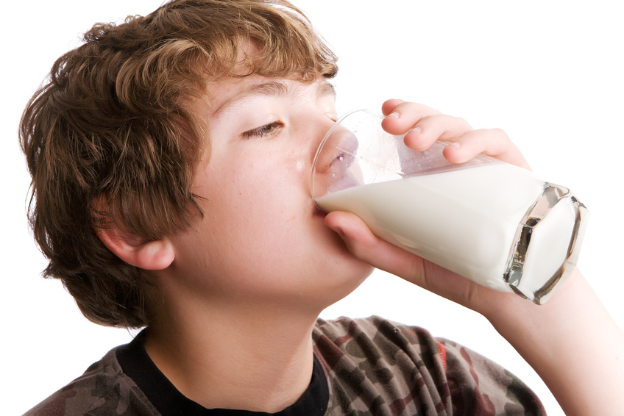
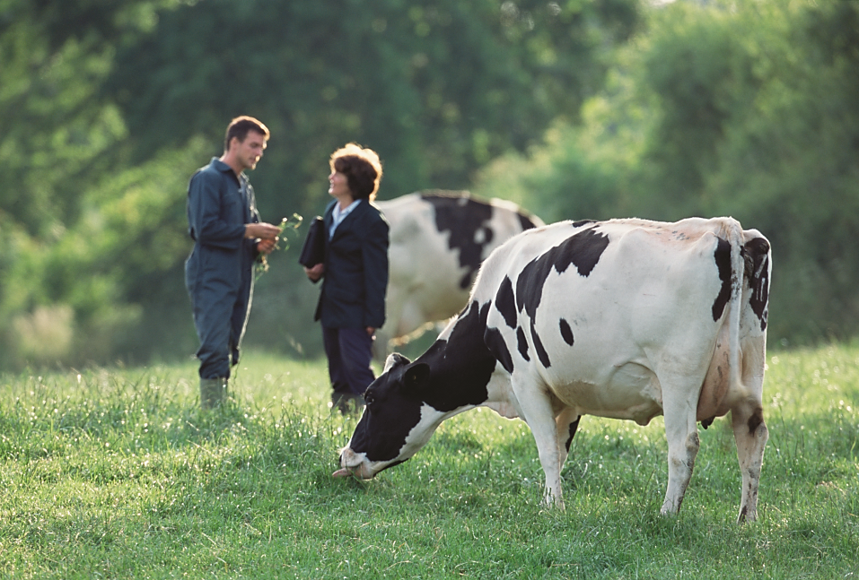
Which animal produces this drink?
dairy cow

Slide 6
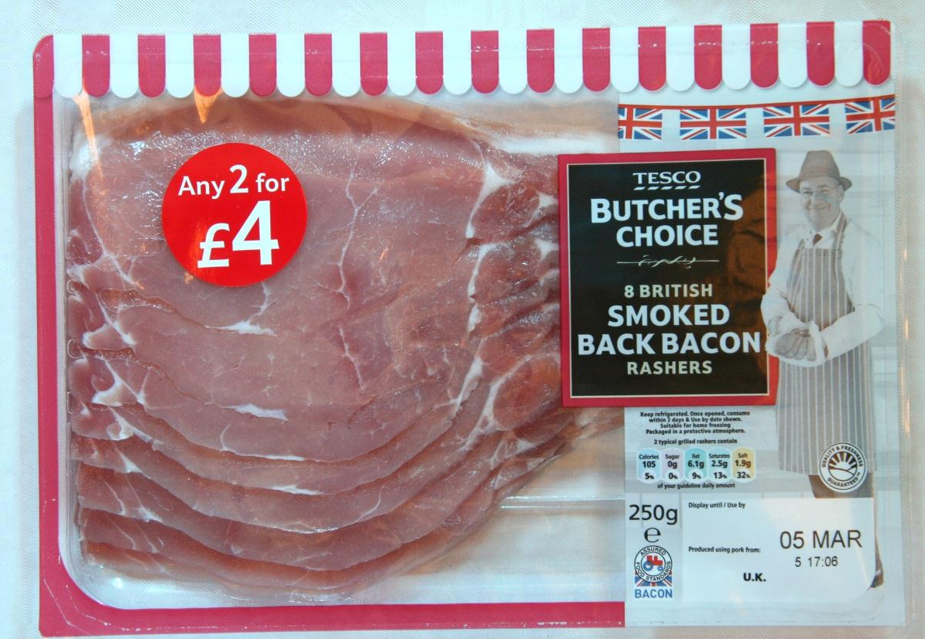
Which animal produces this?
pig

Slide 7
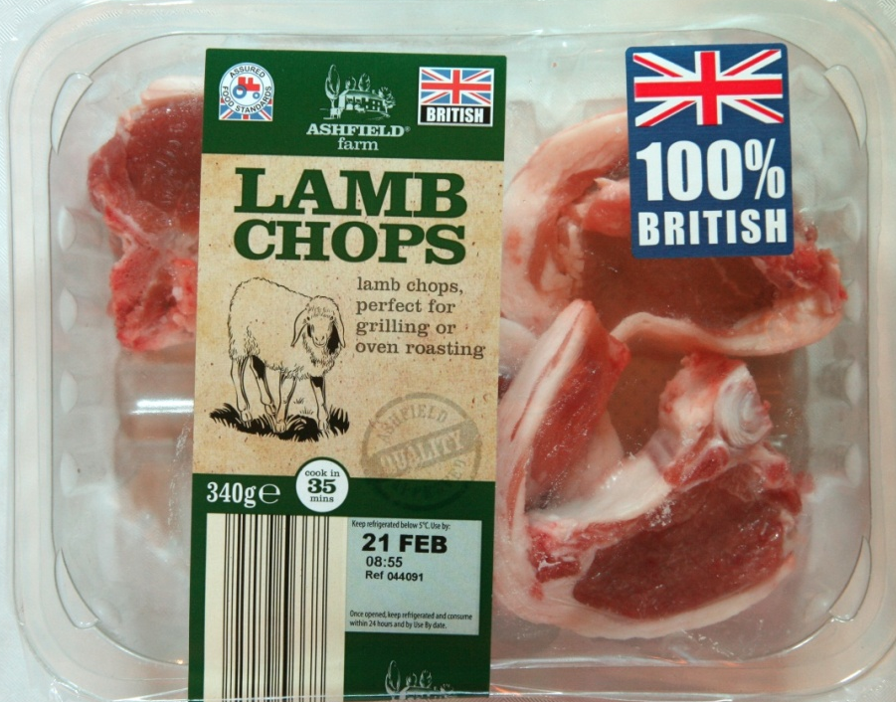
Which animal produces these?
sheep

Slide 8
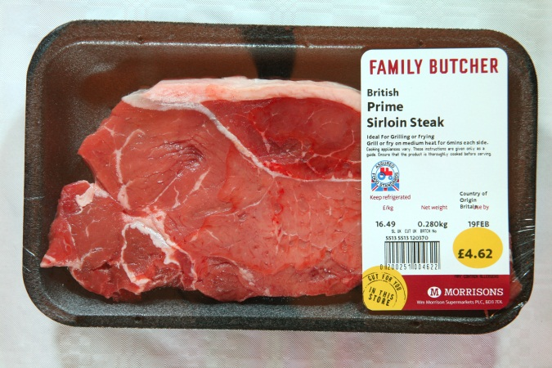
Which animal produces this?
beef cattle

Slide 9
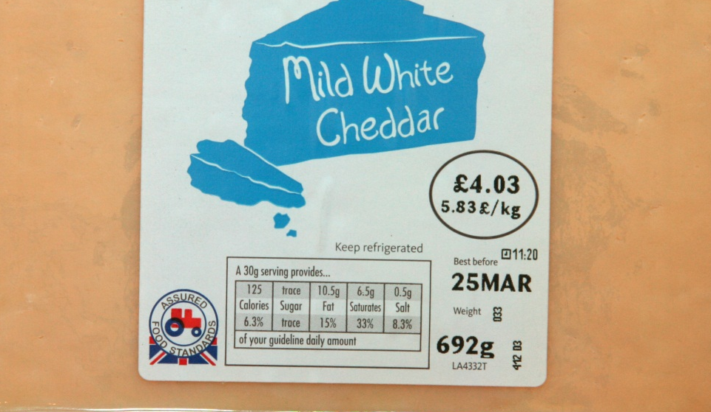
Which animal produces this?
dairy cow

Slide 10


Down on the farm
These animals produce many of the foods we eat.
It is important that we make sure that they have happy lives and have all the things that they need.

Slide 11
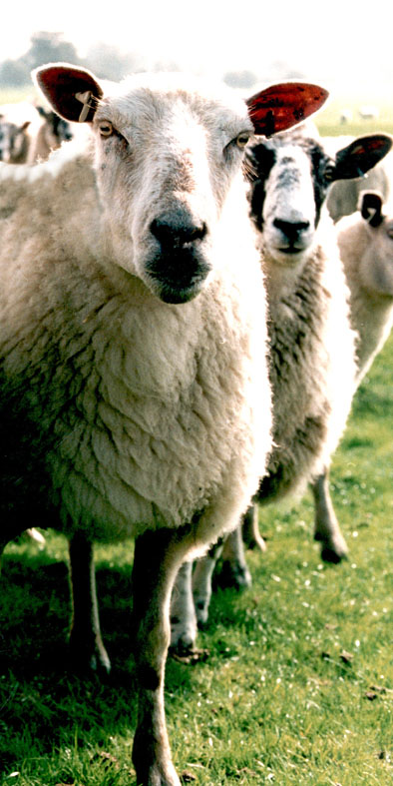
What do you think the animals need?
The right type of food and fresh water.
Somewhere comfortable to rest.
To be treated by a vet if they are ill or injured.

Slide 12
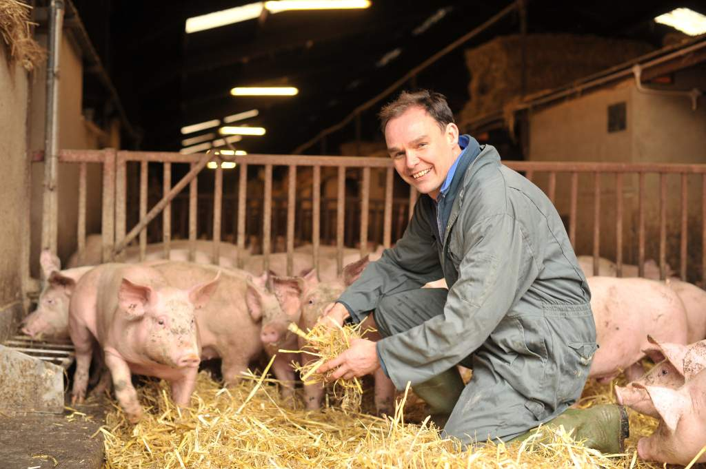
What do you think the animals need?
Company of animals of their own kind, space to move around and to be able to do things they like.
Gentle and caring handling and treatment.

Slide 13


Finding out about our food
Sometimes when we buy food, the label tells us more information about the animal welfare standards and how the food was produced.
Can anyone think of any examples?
These videos show you:
How British milk is turned into Red Tractor assured cheddar cheese
How Red Tractor wheat is put into breakfast cereals

Slide 14

Case study
The Red Tractor tells the shopper that the food meets a set of standards.
There are standards for these foods:
Meat e.g. beef, lamb, pork;
Chicken;
Milk;
Fruit, vegetables and salad;
Crops, e.g. wheat, sugar.

Slide 15
Red Tractor standards
Producers and farmers have to show how they meet the standards.
These include:
how the animals are looked after;
how the farmer protects the countryside;
how they keep the food safe to eat;
keeping records of where the meat comes from.

Slide 16
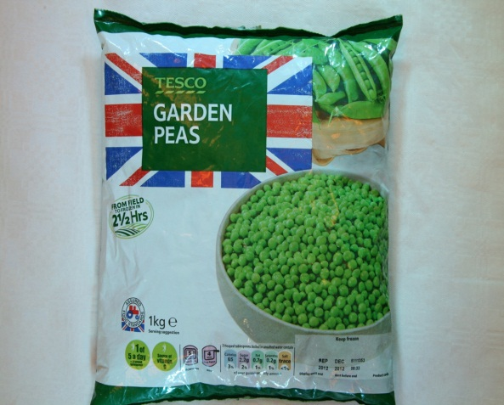
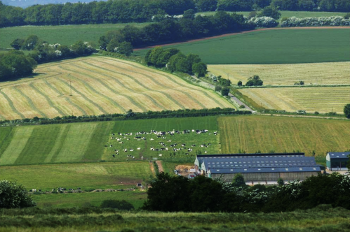
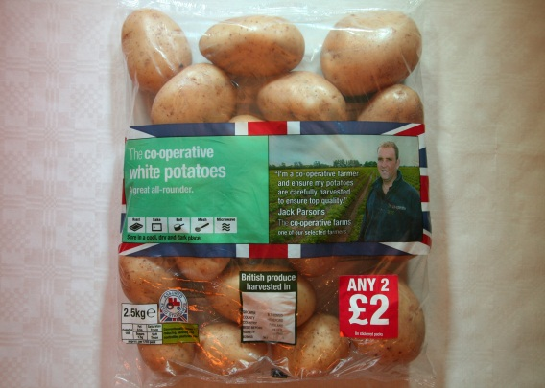
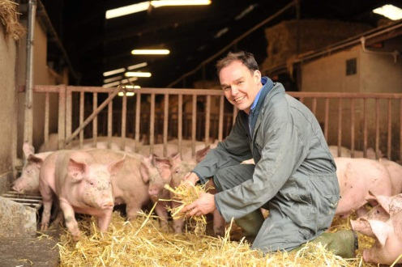
Food labels
Next time you visit a shop that sells food, have a look at the labels and see what they tell you about how the food was produced.

Slide 17
Down on the farm
For further information, go to:
www.foodafactoflife.org.uk
This resource meets the Guidelines for producers and users of school education resources about food.

