Slide 1
Religion and food traditions around Europe

Slide 2
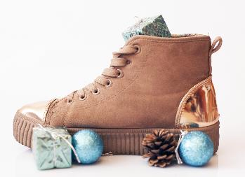
France – Christmas
In some parts of France (North and North East), Christmas begins on the feast day of Saint-Nicolas, December the 6th when Father Christmas (le Père Noël) brings small gifts and sweets for children.
In other parts of the country, children place their shoes by the fire and awake on Christmas day to find them filled with presents from le Père Noël and the tree decorated with fruit, nuts and small toys.

Slide 3
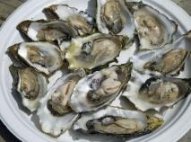
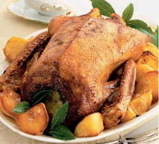
France - Christmas
After Midnight Mass on Christmas Eve people gather for a feast called le réveillon. This usually consists of oysters, snails, seafood, smoked salmon, or caviar as a starter, followed by goose, or some other roasted bird for the main course. Wine and champagne are served as drinks.

Slide 4
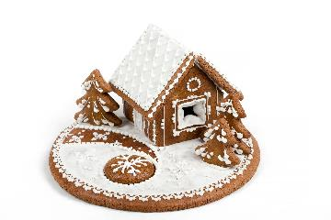
Germany – Christmas
Similar to France, Christmas starts on the night of December 5th – 6th (Nikolaustag - St. Nicholas Day) when children leave their shoes or boots outside the front door. Santa Claus, Nikolaus, visits and fills them with chocolates, oranges and nuts.
Spiced cakes, cookies and gingerbread houses are made. The German Christmas tree pastry, das Christbaumgebäck, is moulded into shapes and baked to make tree decorations.

Slide 5
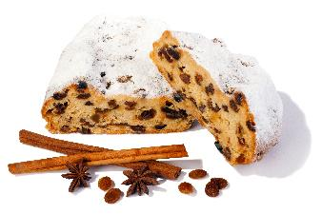
Germany - Christmas
On Christmas Eve, there is an evening feast, generally of carp and potato salad - meat is avoided for religious reasons.
Christmas day dishes include suckling pig or roasted goose, white sausage, macaroni salad, and regional dishes. Sweet foods such as der Christstollen (long loaves of bread with nuts, raisins, lemon and dried fruit), der Lebkuchen (ginger spice cookies) are also eaten.

Slide 6
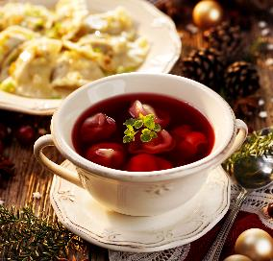
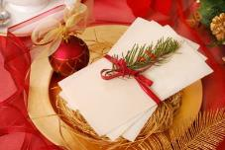
Poland - Christmas
Early on in the day of Wigilia (Christmas Eve), family start preparing the meal. This traditionally consists of 12 meatless dishes, and includes many kinds of fish, beet or mushroom soup, various dishes made from cabbage, mushrooms, or potatoes, pierogi, followed by dried fruit compote and pastries for dessert.
When the first star, gwiazdka, appears in the night sky, the meal can finally begin. A prayer is said first and then there is the ancient Polish Christmas tradition of sharing the Optalek (the Christmas wafer).

Slide 7
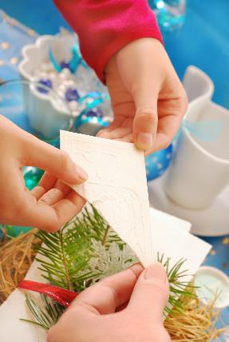
Poland - Christmas
The Oplatek is a thin wafer made of flour and water. The head of the house starts by breaking the wafer and then continues to share with everyone at the Wigilia table. Wishes for peace and prosperity are exchanged as the wafer is shared.

Slide 8
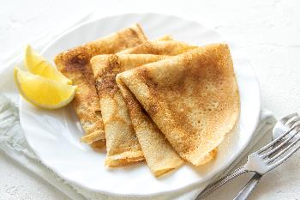
United Kingdom – Shrove Tuesday
Shrove Tuesday is the day preceding Ash Wednesday, the first day of Lent.
In the United Kingdom, it is traditional to eat pancakes on this day.
This is because traditionally, pancakes were made to use up all the eggs, milk and butter before the start of the Lenten fast.

Slide 9
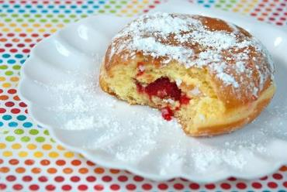
Poland – Fat Thursday
Poland start their festivities almost a week earlier than the UK, on the Thursday prior to Shrove Tuesday.
The most popular tradition in Poland on Fat Thursday is the making and eating pączeks, a filled baked good in a round shape, fried in fat.
There are a wide variety of possible fillings including plum butter, marmalades and whipped cream.

Slide 10

Iceland – Sprengidagur (Bursting Day)
Bursting Day is celebrated on Shrove Tuesday when heavily salted lamb is consumed with a side serving of pea soup.
Traditionally, Icelanders were encouraged to eat to bursting point, during what would be their last proper meal before Lent.

Slide 11
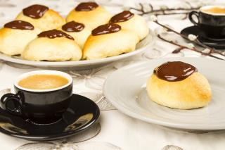
Denmark – Fastelavn
Fastelavn is celebrated on either the Sunday or Monday before Ash Wednesday. Eating Fastelavnsboller which are buns made from pastry dough and decorated with icing, commonly marks the day.
Children beat a barrel which is filled with sweets (similar to a piñata).

Slide 12
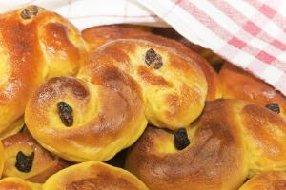
Scandinavia - Saint Lucy’s/Lucia’s Day
Although celebrated in other parts of the world, Saint Lucy’s day is especially celebrated in Scandinavia (e.g. Sweden).
The 13th of December is the feast day of Saint Lucy.
A popular food eaten at Saint Lucy’s day are Lussekatts (St Lucy's day buns) which are buns flavoured with saffron and dotted with raisins which are eaten for breakfast.

Slide 13
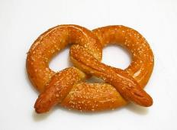
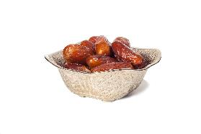
Food traditions
Hot cross buns are traditionally eaten on Good Friday after the Good Friday Liturgy, to break the fast of Christians on that day.
Koulourakia is a pastry dessert served on Easter Day in parts of Greece.
Monks in southern France baked thin strips of dough into the shape of a child's arms folded in prayer, known as a pretzel.
Traditionally dates are eaten at the Iftar meal to break the fast of Ramadan.

Slide 14
Religion and food traditions around Europe
For further information, go to:
www.foodafactoflife.org.uk
This resource meets the Guidelines for producers and users of school education resources about food.

